Slide 1

- an innovative website for everybody to book a meeting room
VISIT: http://D00050904/bookit for a hands-on
Felix Wang (felix.wang@thomsonreuters.com)

Slide 2
Outline
Project Background & Description
Innovation & Highlights
Project Status & Feedbacks
Business Alignment/Annual Benefits/ROI
Wrap Up

Slide 3
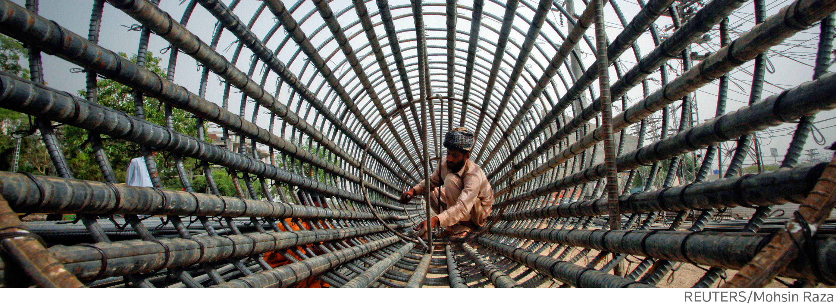
Project Background
The PAIN：There're more than 40+ meeting rooms in our site. To book a meeting room, one needs to go to Outlook, drag them all then look up manually to see which room is available.
The MOTIVATION: Let’s relief this pain. we want to build a web site that can be accessed by everyone with user-friendly UI and cool features to ease and simplify the process.

Slide 4
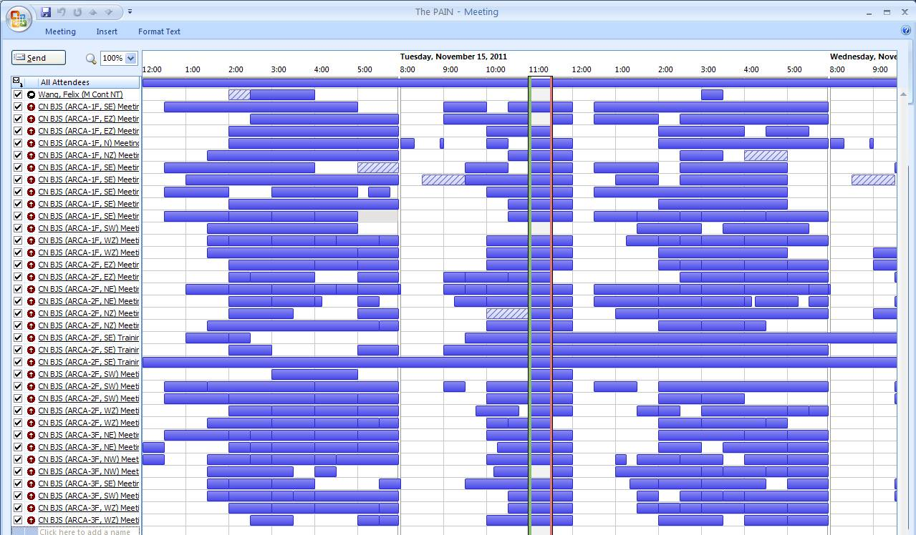
Project Background - PAIN
Drag in all meeting rooms in Outlook then look for free slots manually can be a painful and time-consuming process.
Especially when you want to find a suitable room: is that room near you? Does the capacity of the room meet your attendee number?

Slide 5
Project Description
Book!t is here to relief the pain!
Visit: http://D00050904/bookit (for ARCA)
        http://D00050904/bookit_info (for INFO)
Features
  Regular Search: search for available meeting rooms at given time.
  OneClick Search: immediately list all meeting rooms that will be available in next XX minutes
  Meeting Room Rank: the BIG idea here is that we not only search the rooms but also use algorithm to RANK the search results then show them in an “intelligent” way.

Slide 6

Innovation & Highlights
Innovation @ Design and Usability
Innovation @ Technologies
Innovation @ Idea

Slide 7
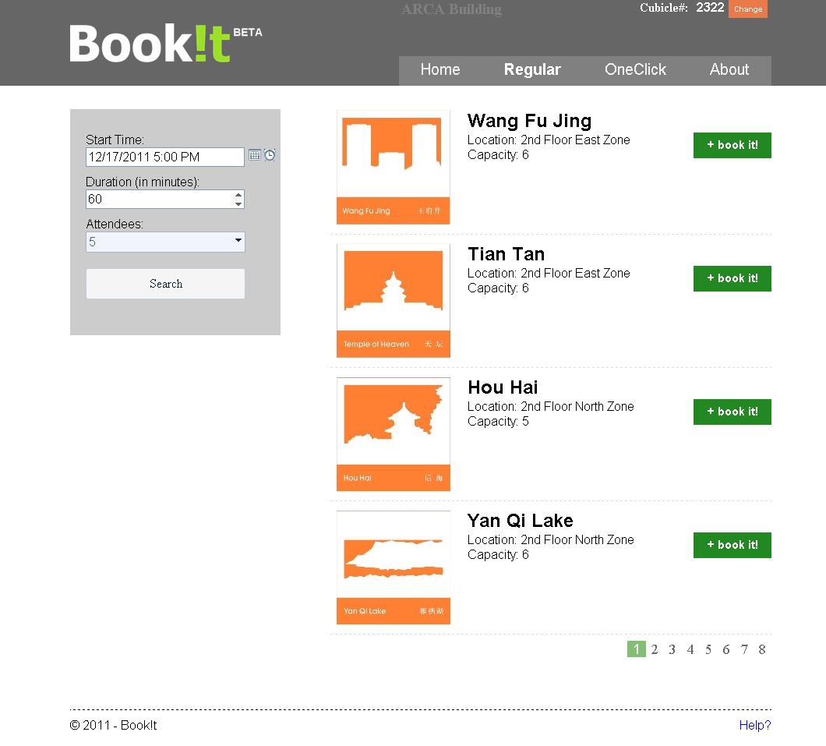
Innovation & Highlights - Design and Usability
Modern UI with high usability/accessibility.

Slide 8




Innovation & Highlights - Technologies
Built by the cutting edge technologies and best practices.

Slide 9
Innovation & Highlights - Idea
Book!t not only searches for meeting rooms, but also ranks them for you.
2 major parameters that Book!t takes into considerations:
    Distances: between YOU and available rooms;
    Differences: between ATTENDEE# and CAPACITY of the room;
  To bring this idea into reality we took great efforts to input all cubicle/cubicle island/gateways/meeting room information (map nodes) and their relationships (map edges) into the database.

Slide 10
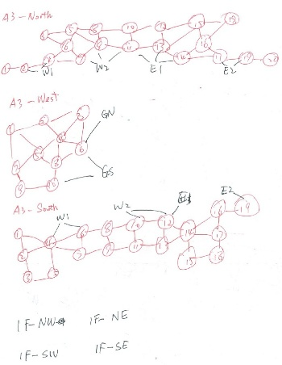
Innovation & Highlights – Idea Cont.
At runtime Book!t builds a GRAPH in memory then traverses it to find a SORTEST DISTANCE between you and meeting rooms, by using classic Dijkstra Shortest Path algorithm.
CAPACITY is also taken into consideration, I created the following formula to calculate the score for each available room:
score = distance + (attendee – capacity)2
Finally all results with scores will be sorted in ascending order (since the less the better).

Slide 11
DEMO

Slide 12
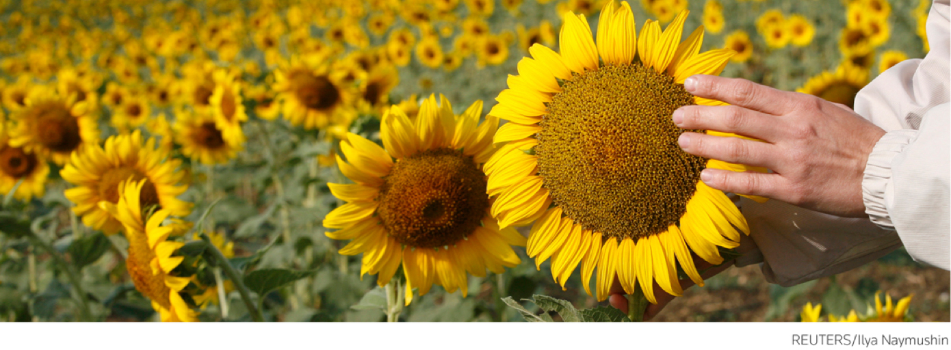
Project Status & Feedbacks
It has been LAUNCHED on one of our workstation since Nov 7th
After the innovation road show, Book!t now has stable 100+ page view on an average working day.
Feedbacks are quite POSITIVE.

Slide 13
Feedbacks from Different Team
"This is absolutely COOL! " - Yuting Li
"It’s Awesome and Pretty Cool ! I love the Meeting Room’s Ranking, especially the Dijkstra algorithm... " - Neil Sun
"That’s very useful, I have booked the rooms for two session successfully using this tools. " -Chunhui Wei
Really cool! I’ve bookmarked it in my browser. – Larry Chen
"...you have all my support as it is absolutely a great site!! :)“ - Long Min

Slide 14
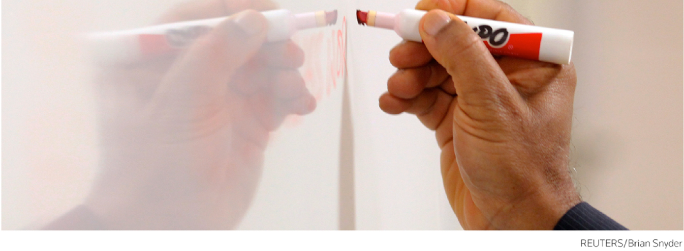
Business Alignment and Benefits
Strategy Alignment
Annual Benefits
3-Year ROI

Slide 15
Business Alignment and Benefits
Business Alignment:
  “…That simpler is better. ..” – Jim Smith
  “…three key threads: grow, simplify and innovate” - Alex Spinelli
Annual Benefits:
    People book all 46 meeting rooms in RTCL through Book!t everyday.
    Every room is booked by 10 different people (every people book for 1hour ) on an average day;
    Book!t saves 3~5 minutes per booking per person;
    Totally saved: 46 * 10 * 4 = 1840 minutes > 3 HEADs
    Alternative (very conservative way):
    In a working day 8% RTCL people use it to book a meeting room;
    Save them 5 minutes each;
    Total saved 1200 * 0.08 * 5 ~ 480 minutes ~ 1 HEAD (very conservative)

Slide 16
Business Alignment and Benefits
  ROI
    Return: Book!t website for RTCL staffs, saved around 1 ~ 3+ heads
    Investment: almost FREE. Book!t is designed and implemented by using our spare/non-working time. In future we may need a server to serve all staffs but still the investment is very small, nearly 0.
    ROI: VERY LARGE. ( > 700% )

Slide 17
Wrap Up
TOP 3 reasons to vote for Book!t:
Born to INNOVATE
  Bear innovation in mind from the beginning;
  Innovation on different aspects: design/technologies/idea
Large ROI / POTENTIAL
  Comes almost FREE. Self-initiated.
  Has POTENTIAL to generate larger benefit, i.e. deploy on other sites;
For EVERYONE!
  Received a lot of positive feedbacks and encouragement from different people of various teams.

Slide 18
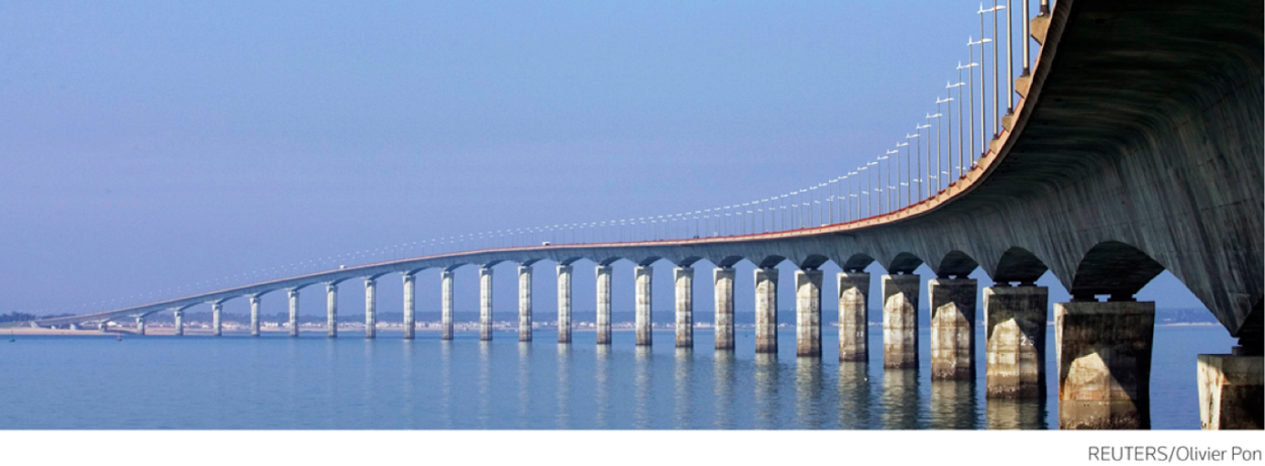
Q & A

Slide 19
Misc Fun Facts
Book!t = “just BOOK IT!” as well as “BOOK + KIT”
In our DB ARCA has 1169 cubicles (grouped into 185 cubicle islands)
The longest path from a cubicle to a meeting room in ARCA is (3001~3006) to Yang Guifei (distance = 41.5 units where 0.5 unit = distance between 2 directly adjacent islands). (calculated result)

Slide 20

Future Dev Plan & How YOU can support it
Future Plan:
“Who occupied the room” feature
Need YOUR Support:
We would like to have a SERVER to deploy Book!t for all RTCL staffs. Our workstation runs out of resources when traffic is high.

