Slide 1
Computer Architecture Tutorial 2
LOGOS LAB
2016/03/29

Slide 2
Outline
Project 1 – Issues
Submission Problem
Demo time
Project 2 – Pipeline
Concept
Input & Output
Submission

Slide 3
Project 1 – Issues

Slide 4
Submission Valid Format
103062541_01.tar.gz
103062541_01
simulator
Testcase
Tar on this directory

Slide 5
Re-Testing
Some performance issues
Change server to test(same env.)
Modified Tutorial: +”s” is fixed
Increase valid test cases
Several scores are changed

Slide 6
Makeup Principle
Misunderstand test_script’s using method.
Qualified:
Passing test_script.py but
Fail to pass TA’ s script
Diff result is the same, but didn’t get any score (all zero)
Time:
Tue 1:30~3:30 p.m.
Wed 3:30~5:30 p.m.
Method:
Using ilms package to run test_script.py

Slide 7
Second Submission
Postpone to 4/4
Submission format same as the first one

Slide 8
Demo time
Date: 4/7(Thur.) & 4/8(Fri.)
Place: General Building II(綜二) 737、738
Time: 15 mins

Slide 9
Project 2 - Pipeline

Slide 10
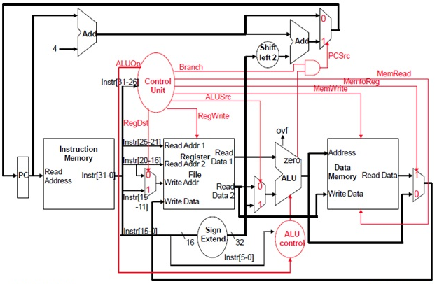
Single Cycle Data Path
Low design complexity
Poor throughput

Slide 11
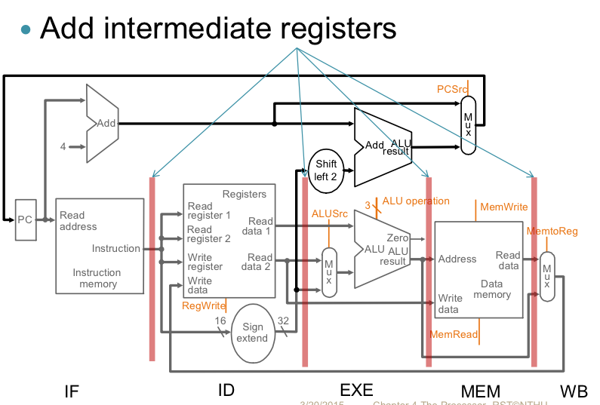
Pipeline
IF/ID
ID/EX
EX/DM
DM/WB
Higher design complexity
High throughput

Slide 12
Pipeline 5 Stages
Independent of instruction type
Dependent of instruction type
EX
ALU
DM
Access data memory
WB
Write value to Register File
IF
instruction fetch
PC+4
ID
Read Register File
Sign extension
Control unit decode
Hazard detect, Branch/Jump detect, Branch

Slide 13

Resolving Pipeline Hazards
Data hazard
Stall
Forwarding ( appendix C-2 )
EX/DM to ID
EX/DM to EX
Control hazard
Flush

Slide 14
Forwarding Paths
EX/DM to ID
EX/DM to EX
x
IF/ID
ID/EX
EX/DM
DM/WB

Slide 15
Input & Output
Input: same as project 1
Output:
snapshot.rpt
Contents of registers
whether instruction is completely executed
Instruction representation executing in pipeline stage
whether to be stalled in next cycle
whether forwarding in this cycle
error_dump.rpt
Appendix D ( be careful about error order )

Slide 16
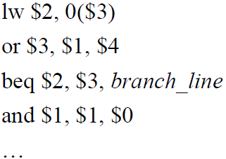

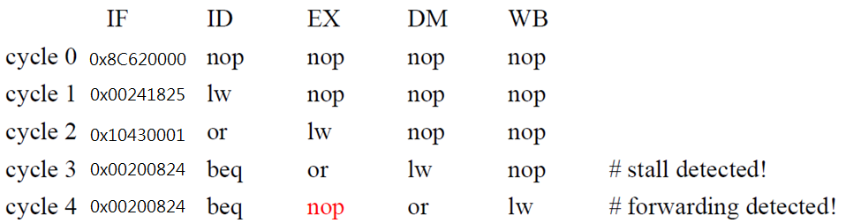
Snapshot: Stall
Data hazard

Slide 17

Snapshot: Forwarding
Data hazard
EX/DM

Slide 18
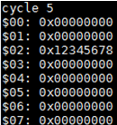
Snapshot: Register contents

Slide 19
Test Case Design
Your test case need to include:
One control hazard
One data hazard resolved by inserting NOPs
One data hazard cleared by forwarding
Number of NOPs and forwarding path is unlimited.
< 500,000 cycles
(Valid rule is same as Project 1)

Slide 20
Implementation
Initialization: The pipeline is initialized with NOPs in all stages
Terminates: after five “halt”, otherwise invalid

Slide 21
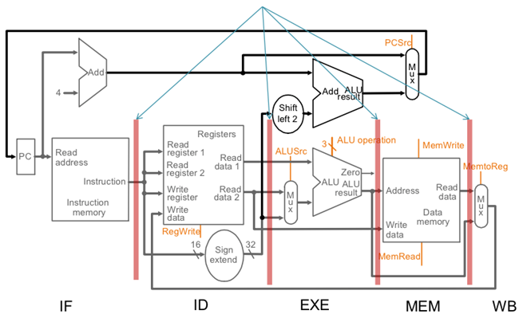
Implementation
Simulation Order (highly recommended)
WB ➔ DM ➔ EX ➔ ID ➔ IF
IF/ID
ID/EX
EX/DM
DM/WB
add $3, $1, $4
lw $1, 0($2)

Slide 22
Modules
C files
Header files
main.c
simulate.c
instruction.c
regfile.c
memory.c
pipereg.c
piperpt.c
hazard.c
arithmetic.h
simulate.h
instruction.h
regfile.h
memory.h
pipereg.h
piperpt.h
hazard.h

Slide 23
Submission
Grading policy is same as project 1
1st Submission: 2016/ 4/ 30
2nd Submission: 2016/ 5/ 07
New self test and submission process will be announced next Thursday.

Slide 24


