Slide 1
Project 2 Submission
胡宇康

Slide 2
Project 2 Submission Format
Folder Structure
- pipeline
simulator
testcase
Tar on this folder
and submit it to iLMS
Others are same as project1

Slide 3
test_script_v2.py
Linux command-like, -h = help
Env. Linux ubuntu
Execute location:
- dir
- Test_script_v2.py
- pipeline
- simulator
- testcase
Under same directory
with pipeline

Slide 4
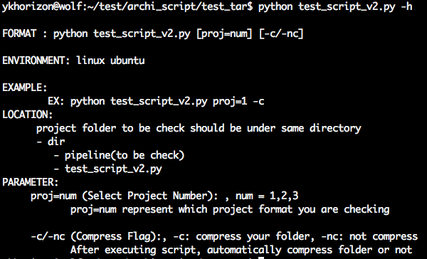
Manual

Slide 5
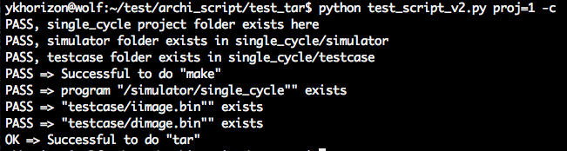
Successful Result

