Slide 1
数据库课程设计
——图书管理系统
小组成员：史金明 苟云帆 王广胜

Slide 2
一、成员分工
项目组长：史金明
程序设计：苟云帆
单元测试：王广胜
小组成员分工明确：
前期，共同商讨并完成数据库的设计、实现，负责人绘制E-R图并制定开发计划、分配开发任务；
中期，分别负责一定的PO类和DAO类的开发工作，由程序设计人员负责协调各方开发工作；
后期，各成员分别开发一定的Junit测试类，并由测试人员进行集中测试，形成测试报告；
最后，所有小组成员进行开发总结，反思项目开发过程中的问题，撰写课设报告。
在整个项目开发过程中，小组成员积极参与，都在此过程中有所收获。

Slide 3
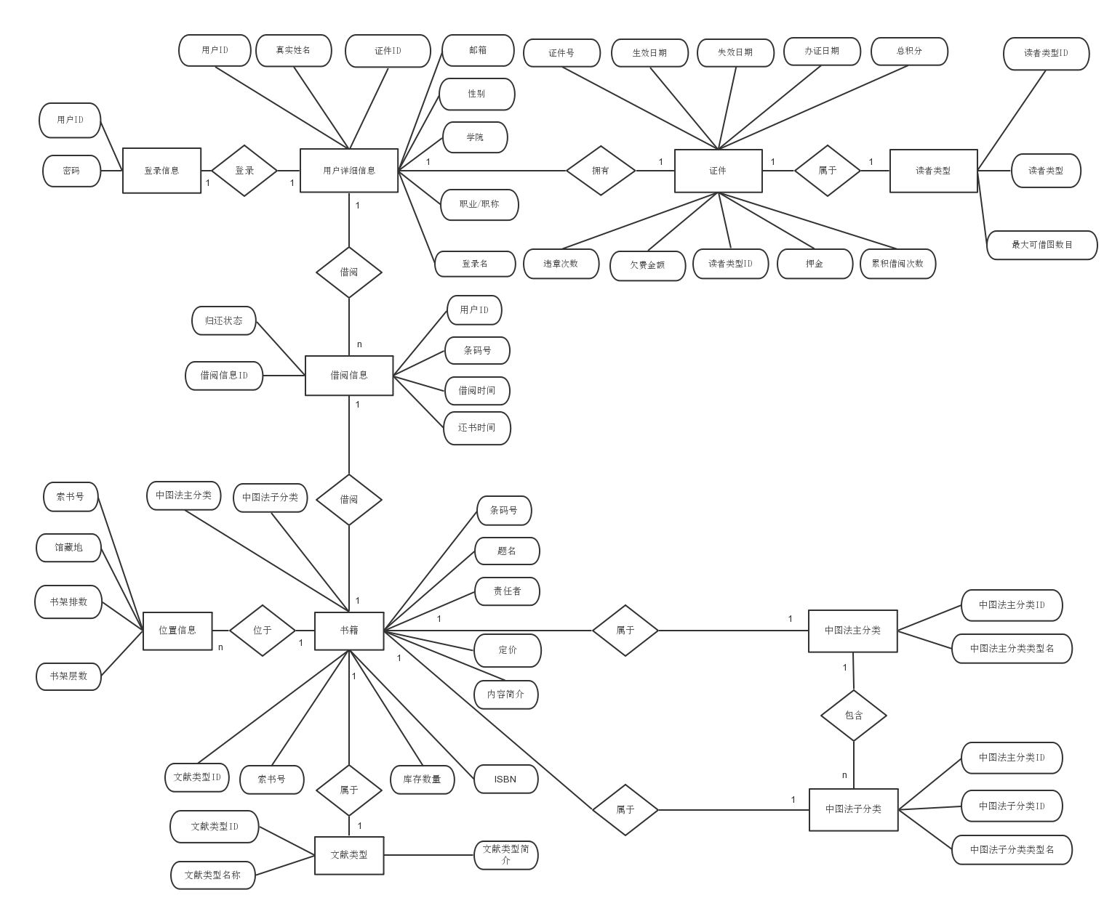
二、数据库设计与实现
1. 用户登录表
2. 用户详细信息表
3. 用户类型表
4. 证件表
5. 文献类型表
6. 中图法分类表1
7. 中图法分类表2
8. 图书表
9. 借阅关系表
10.藏书位置表
在数据库设计工作中，小组成员仔细分析项目需求，对数据存储和使用方式进行深入讨论。
为了使用方便，将用户登录信息与详细信息分离，建立证件表对应不同用户类型，并分配与类型相适应的借阅权限。
在图书分类方面，使用文献类型分类伐和中国图书馆分类法两种方式进行，使书籍查询方式更为多元。

Slide 4
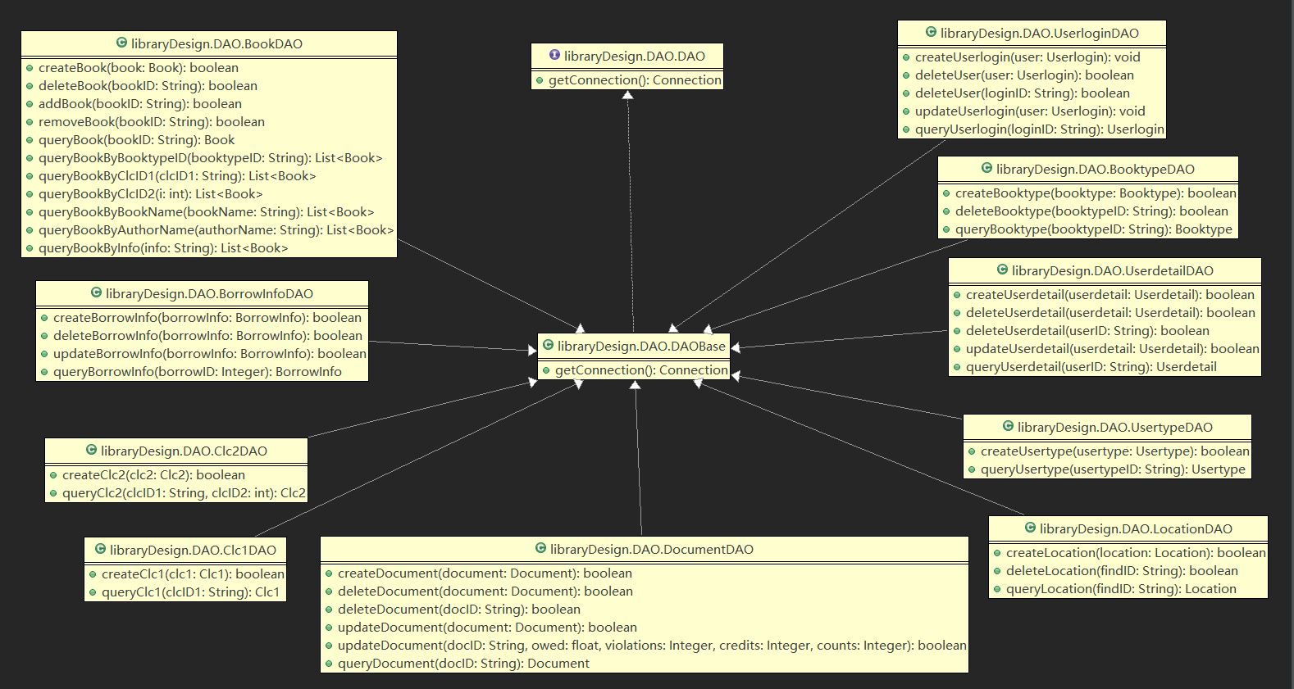
三、DAO类设计与实现
1.定义了一个DAO接口，有一个getConnection()方法需要实现。
2.定义DAOBase类，通过c3p0连接池连接SQL server 2012数据库，实现了上述DAO接口中的getConnection()方法。
3.所有DAO类均继承DAOBase类，拥有getConnection()方法。
４.针对每个DAO类的实际使用功能，设计适合的增删改查方法，并根据使用需求增加合适的方法（例如，可以对图书名、图书内容、作者等关键字进行模糊查询）。

Slide 5
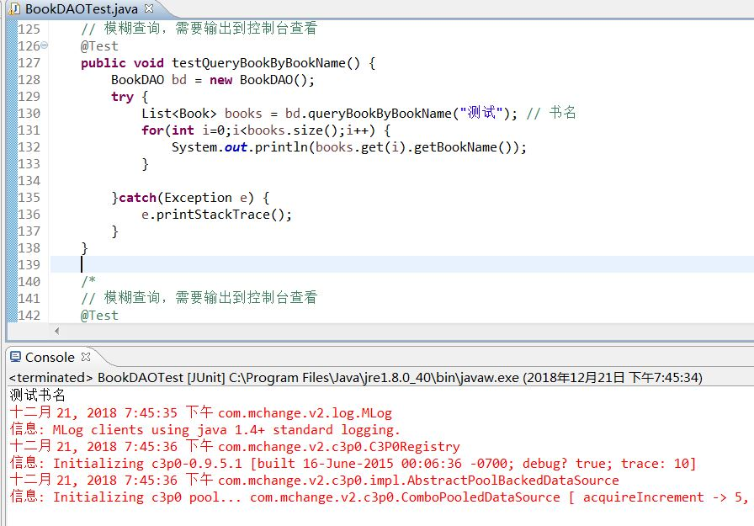
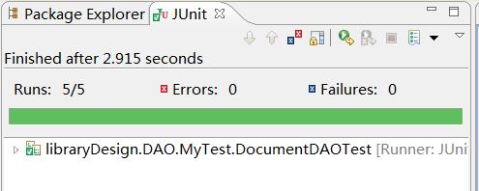
四、JUnit单元测试
1.针对每个DAO类生成JUnit Test Case类，针对其中的每个方法编写对应的测试方法。
2.按照恰当的顺序进行每个方法的测试，测试内容覆盖外键约束、必要的边界条件、例外情况等。
3.利用JUnit自动生成测试报告。
4.经过调试修改，所有DAO类中的方法均通过JUnit测试。

Slide 6
五、开发过程与问题解决
1.数据库设计时，在数据库应方便用户使用还是符合第三范式方面产生了争议，结合实际使用情况，把用户类的信息分为用户登录信息、用户详细信息、证件信息和用户类型信息。
2. 对图书分类管理产生争议，经讨论，根据文献分类法、中国图书馆分类法两种分类方法进行图书的分类，查询方式更多元。
3.最初进行测试的时候，需要人工判断，后采用Junit单元测试，通过assertEquals()，assertTrue()等方法进行自动判断。
4.小组成员最初配置的开发环境不一致，导致乱码等问题，其后统一了开发环境，并对GitHub的分支进行管理。
周二，确定选题，分析项目需求并完成数据库设计，绘制E-R图，制定开发计划，分配开发任务，配置开发环境。开发工作正式开始。使用Github仓库对开发工作进行管理。
周四，编写完成大部分DAO类，配置测试环境，开始进行部分测试工作。根据实际编程工作和测试工作中遇到的问题，对原有设计进行了部分调整。
01
02
03
04
周三，实现数据库并填充适当的测试数据。进行PO类和DAO类设计实现，编写增删改查方法。维护一个DAO说明文件，记录每个DAO类及其中的方法，实现的功能以及待测试方法和测试结果。
周五，完成所有DAO开发工作，进行Junit单元测试，调试代码，通过所有测试。进行小组开发总结，反思开发过程中遇到的问题以及解决方法。撰写测试报告、开发总结等文档，制作答辩PPT等。

Slide 7
选题背景 - Background
Building Your Friendships
Making friends after college is hard, but meaningful friendships make a big difference on almost every aspect of your life for decades to come.
Brand College Degree
Not everyone graduates with one of the best-paying degrees. If yours is among those with the worst return on your money, not all hope is lost.
Maintaining Friendships
So make an effort to stay in touch with the friends closest to you now and make new friends even as you get busy with work.

Slide 8
价值意义 - Value
Value 04
Know How to Brand Your “Useless” College Degree
Keep Maintaining Your Friendships
Value 03
Value 02
Figure Out If Grad School Is Worth It
Work on Gaining Additional Skills
Value 01

Slide 9
方法工具
Research Method
Not everyone graduates with one of the best paying degrees. If yours is among those with the worst return on your money, not all hope is lost. During your job search, even a “useless” degree can be shown as valuable..

Slide 10
理论依据 - Theory
Theory 01
Theory 02
Theory 03
Millions of college students will be released from their college careers.
It’s such a promising time. Here are 9 ways to make the most.
If you’re graduating college and still don’t know what to do next, school is an option.
Figure out which degrees are worth the debt and find out if graduate school might be worth it for you.
Making friends after college is hard, but friendships make a big difference on almost every aspect of your life.
So make an effort to stay in touch with the friends closest to you now and make new friends even as you get busy.

Slide 11
研究假设 - Hypothesis
01 Building Your Friendships
Making friends is hard, but meaningful friendships make a big difference on almost every aspect of your life for decades to come. So make an effort to stay in touch with the friends closest to you now and make new friends even as you get busy.
02 Start Cooking for Real
Given the tiny kitchens most college students deal with and perhaps too much prior assistance from Mom &Dad restaurant, cooking isn’t a skill universal to college grads.

Slide 12
研究方法 - Methods
If you’re graduating college and still don’t know what to do next, graduate school is an option.
Method & Tool 01
Not everyone graduates with one of the best-paying degrees. If yours is among those with the worst return on your money, not all hope is lost. During your job search, even a “useless” degree can be shown as valuable.
Method & Tool 02
Figure out which graduate degrees are worth the debt and find out if graduate might be worth it for you.
Figure Out If Grad School Is Worth It

Slide 13
研究过程
Research Procedure
Given the tiny kitchens most college students deal with and perhaps too much prior assistance from Mom &Dad restaurant, cooking isn’t a skill universal to college grads. Pick up some essential kitchen skills, learn how to make basic meals.

Slide 14
研究方案Planning
✗
Think Beyond Work
✓
School Is Worth It
Go see the world, even on a budget or for free. Go on dates. Keep up your own creative side projects. Challenge yourself to see the world in new ways.
Figure out which graduate degrees are worth the debt and find out if graduate school might be worth it for you.
✓
Get Money in Order
✗
Cooking for Real
Maybe you have student loans and other debt to deal with, no more support from your parents, and income that you budget.
Given the tiny kitchens most college students deal with and perhaps too much prior cooking isn’t a skill universal to grads.

Slide 15
实施步骤 - Procedure
Go see the world, even on a budget or for free. Go on dates. Keep up your own creative side projects. Challenge yourself to see the world in new ways.
You might have held jobs in college, but once you’ve got your diploma in hand, it’s time to completely dive into the work you want to do.
01
02
03
04
05
Your career might be your main focus as you leave college, but remember that work isn’t everything either (you don’t want to burn out).
Yes, take the commencement speech to heart. Life is like a video game, so spend your time and energy in the most important areas.

Slide 16
关键要素 - Elements
Keep Building and Maintaining Your Friendships
01
TEXT
02
TEXT
Making friends after college is hard, but meaningful friendships make a difference on almost every aspect of your life for decades to come.
So make an effort to stay in touch with the friends closest to you now and make new friends even as you get busy with work.
03
TEXT

Slide 17
问题探讨
Problem Exploration
If you’re graduating college and still don’t know what to do next, graduate school is an option. Figure out which graduate degrees are worth the debt and find out if graduate school might be worth it for you.

Slide 18
主要问题 - Problems
Go on dates. Keep up your own creative side projects. Challenge yourself to see the world in new ways.
Figure out which graduate degrees are worth the debt and find out if graduate school might be worth it.
Maybe you have student loans and other debt to deal with, no support from your parents, and income that you budget.
Given the tiny kitchens most college students deal with and perhaps too much prior cooking isn’t an universal skill.

Slide 19
观点讨论 - Discussion
You might have held jobs in college, but once you’ve got your diploma in hand.
Go see the world, even on a budget or for free. Go on dates. Keep up your own creative side projects. Challenge yourself to see the world in new ways.
Yes, take the commencement speech to heart. Life is like a video game, so spend your time and energy in the most important areas.
Your career might be your main focus as you leave college, but remember that work isn’t everything either (you don’t want to burn out).

Slide 20
讨论结果 - Results
Failure Reason
Suggestions
If you’re graduating college and still don’t know what to do next, school is an option.
Figure out which degrees are worth the debt and find out if graduate school might be worth it for you.
Millions of college students will be released from their college careers.
Making friends after college is hard, but friendships make a big difference on almost every aspect of your life.
So make an effort to stay in touch with the friends closest to you now and make new friends even as you get busy.
It’s such a promising time. Here are 9 ways to make the most.

Slide 21
研究结论
Research Conclusion
You can become more hirable by developing additional skills, whether it’s a new language, HTML, or any other skill valued in the workplace. It could not only broaden your job and career options, learning new skills can boost your brain and make you happier. Never stop learning.

Slide 22
数据分析 - Analysis
Data Analysis 01
Making friends after college is hard, but meaningful friendships make a big difference on almost every aspect of your life for decades to come.
Data Analysis 02
So make an effort to stay in touch with the friends closest to you now and make new friends even as you get busy with work.

Slide 23
假设检验 - Testing
School Is Worth It
Figure out which graduate degrees are worth the debt and find out if graduate school might be worth it for you.
Think Beyond Work
Go see the world, even on a budget or for free. Go on dates. Keep up your own creative side projects. Challenge yourself to see the world in new ways.
Get Money in Order
Maybe you have student loans and other debt to deal with, no more support from your parents, and income that you budget.

Slide 24
结论建议 - Result
这是份简约实用的论文答辩模板
This is a Simple and Practical Template for Thesis Defense

Slide 25
敬请指导
Question & Answer

Slide 26
Bye
THANKS

Slide 27
封面字体：粗宋简体
正文中文：幼圆
正文英文：Segoe UI Light
模板颜色：R0-G112-B192

