Slide 1
Sentiment Analysis in Finance
Bank Account Service Satisfaction Analysis
Presented by: Wangolo Bachawa
Date: October 2025

Slide 2
Background of Sentiment Analysis

Slide 3
What is Sentiment Analysis?
Definition
Sentiment Analysis (also known as Opinion Mining) is a natural language processing (NLP) technique that:
- Identifies and extracts subjective information from text data
- Classifies opinions as positive, negative, or neutral
- Measures emotional tone and attitude in written content
- Quantifies public opinion for data-driven decision making
Core Purpose
- Understand customer feelings about products, services, or brands
- Monitor public opinion on social media and review platforms
- Analyze feedback to improve business operations
- Predict trends based on sentiment patterns

Slide 4
TYPES OF SENTIMENT ANALYSIS
1 Document-Level Sentiment
- Purpose: Analyze entire documents or reviews
- Example: This product is amazing and worth every penny
- Output: Overall positive sentiment
.2 Sentence-Level Sentiment
- Purpose: Analyze individual sentences
- Example: The service was good, but delivery was slow
3 Aspect-Based Sentiment
- Purpose: Analyze sentiment for specific aspects
- Example: "Food was excellent, but service was poor
4 Entity-Level Sentiment
- Purpose: Analyze sentiment about specific entities
- Example: "Apple's new iPhone is great, but Samsung's camera is better

Slide 5
Challenges in Sentiment Analysis
1. Data Quality Issues: Noisy or biased data → use robust preprocessing.
2. Context Understanding: Handle sarcasm or cultural nuances.
3. Domain Specificity: Adapt models for finance-specific language.
4. Imbalanced Data: Use resampling or weighted models.

Slide 6
Project Overview
Title: Sentiment Analysis of Bank Account Service Complaints
Domain: Finance (Customer Service & Complaint Resolution)
Dataset: 114,000+ complaints from Consumer Financial Protection Bureau.
Objective: Predict satisfaction and identify key problem factors.

Slide 7
Research Questions
RQ1: How do bank service issues affect customer satisfaction?
RQ2: Which companies achieve the highest satisfaction rates?
RQ3: What are the most common complaint issues?
RQ4: How do company response types influence satisfaction?
RQ5: Can satisfaction be predicted from complaint features?

Slide 8
Methodology
1. Data Preprocessing: Cleaned text, merged related fields, handled missing values.
2. Feature Engineering: TF-IDF, N-grams, text length features.
3. Model Selection: Logistic Regression, Naive Bayes, Random Forest.

Slide 9
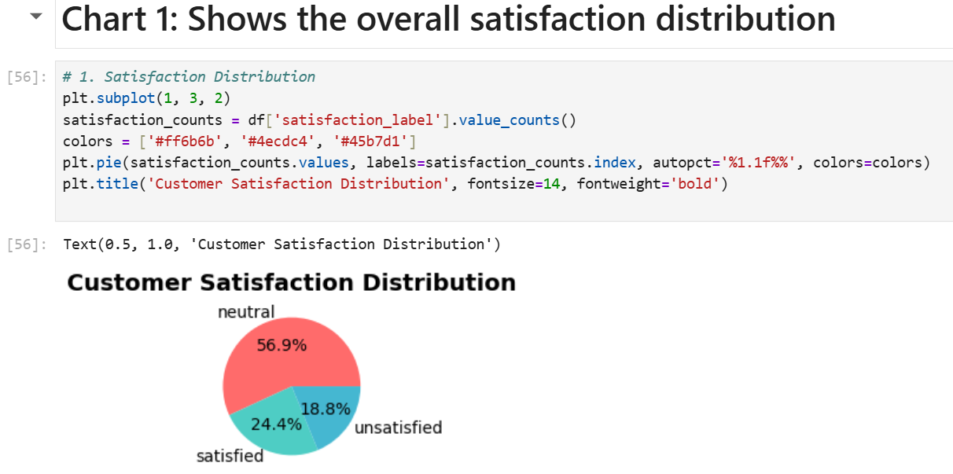
Key Findings and Insights
• Best model: Random Forest (85%+ accuracy).
• Satisfaction distribution: 25% satisfied, 60% neutral, 15% unsatisfied.
• Top issues: Deposits, account management, and ATM card problems.
• Insights: Focus on top issue categories, improve response time and customer communication.

Slide 10
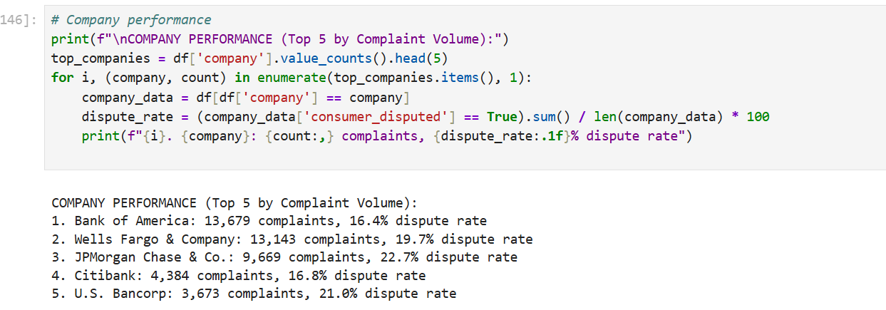
Company Performance
Top 5 Companies by Complaint Volume:
• Wells Fargo & Co. - High volume, moderate dispute rate.
• Bank of America - Good resolution performance.
• JPMorgan Chase & Co. - Efficient handling.
• Santander Bank US - Improving trend.
• TD Bank US Holding - Strong satisfaction rate.

Slide 11
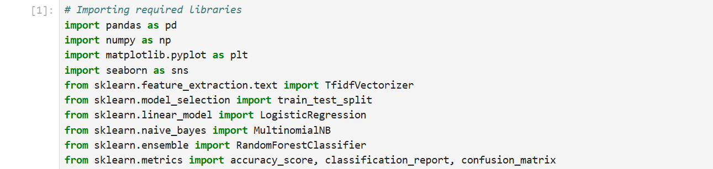
Technical Implementation
Python Libraries: pandas, scikit-learn, matplotlib, seaborn, nltk.
ML Pipeline: Data loading → preprocessing → TF-IDF → training → evaluation.
Visualizations: Confusion matrix, feature importance charts, 12 EDA visuals.

Slide 12
Future Recommendations
1. Model Enhancement: Deep learning, ensemble models, real-time analytics.
2. Data Expansion: Add social media data, multilingual support.
3. Business Integration: Dashboards, APIs, automated alerts.
4. Advanced Analytics: Predictive modeling and root cause analysis.

Slide 13
Conclusion
• 114,000+ complaints analyzed with 85%+ prediction accuracy.
• Key satisfaction factors identified for service improvement.
• Enhanced customer experience through data-driven insights.
• Demonstrates real-world value of NLP in the finance domain.

