Slide 1
BT2102 Group Assignment 3
Airline Delay and Utilization Analysis
Group 16
Chen Siyi A0194556R
Liu Yan A0194511J
Wang Pei A0194486M
Xu Fangzhou A0194552Y
Zuo Xinyue A0194561Y

Slide 2
Q1
Show the overall flight profile based on the available data, where the population is classified into the 4 groups (see Table 1). Verify whether the initial estimate in Table 1 is correct.
Verify data distribution with initial estimate

Slide 3

Q1: Overall Flight Profile
The initial estimate in Table 1 is not completely accurate.
Conclusion: Beta Airlines has a higher on-time rate when compared to Alpha Airlines

Slide 4
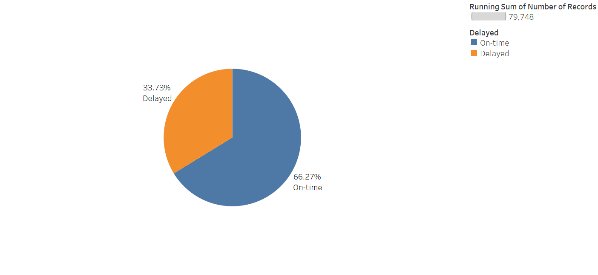
Q1 (1): Overall Flight Profile for Alpha Airlines

Slide 5
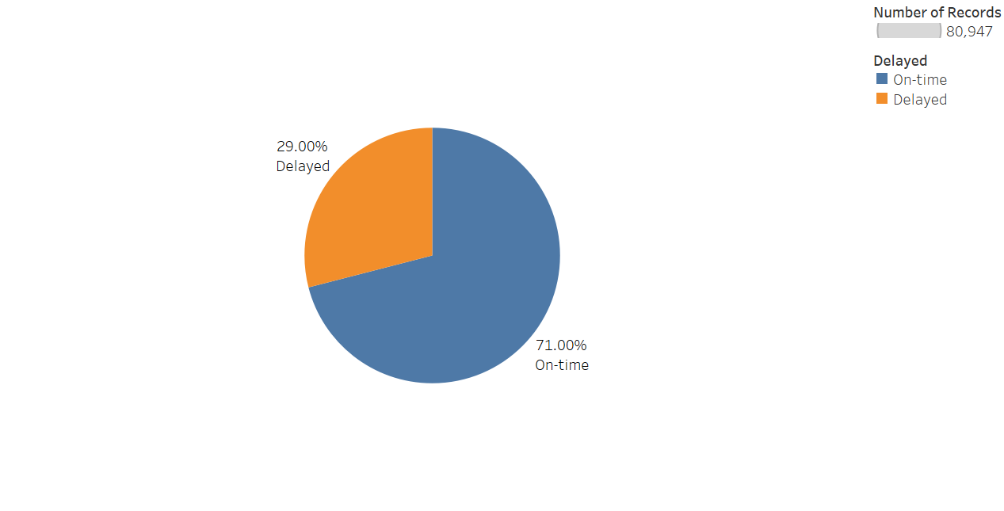
Q1 (2): Overall Flight Profile for Beta Airlines

Slide 6
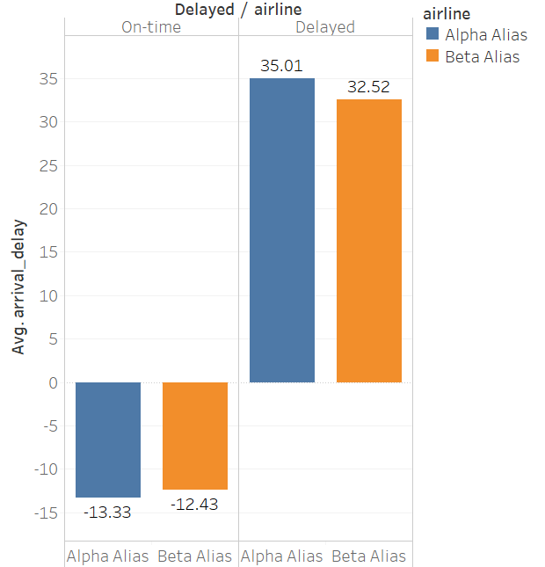
Additional graphs for Q1
Average delay time in minutes for two airlines

Slide 7
Q2
Show with illustrations how the average delay time of all delayed flights vary with the day of the week (Monday, Tuesday, etc.) for Alpha airlines. Compare the results with Beta airlines on the same illustration.

Slide 8
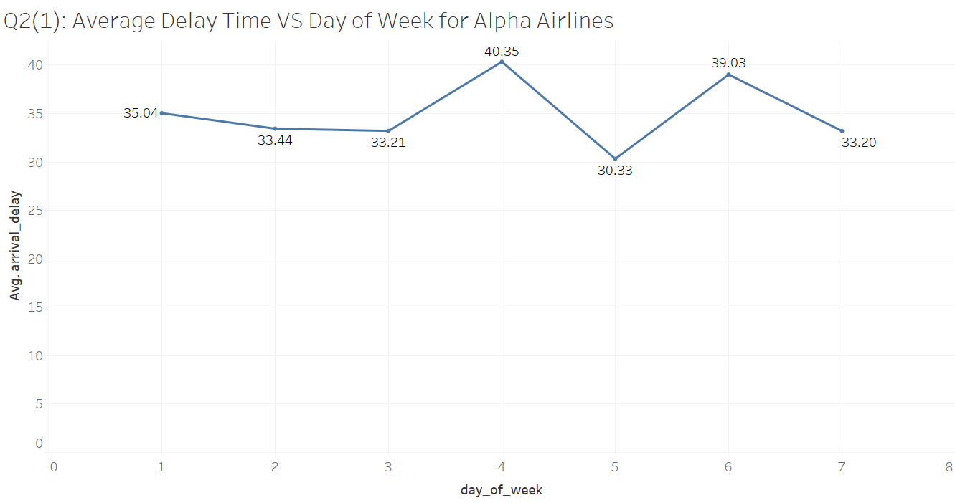
Alpha Airlines have more severe delay on Thursday and Saturday. Average delay time for every day across the week for Alpha Airlines all exceeds 30 minutes.

Slide 9
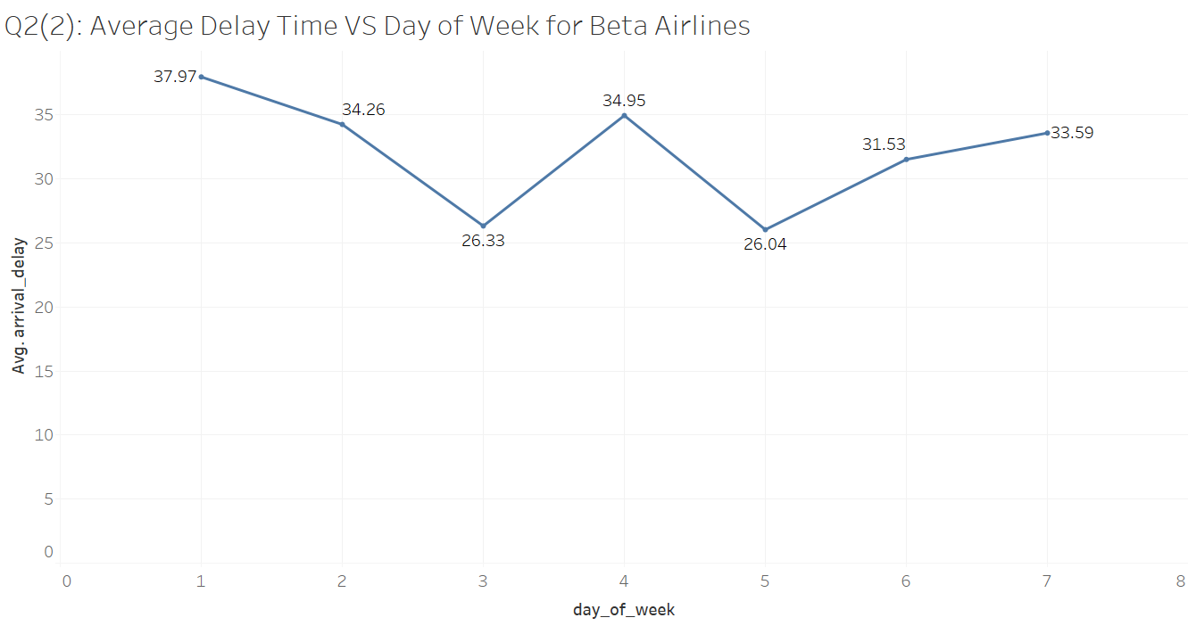
Beta Airlines have more severe delay on Monday, Tuesday and Thursday. Average delay time for Wednesday and Friday for Beta Airlines is smaller than 30 minutes.

Slide 10
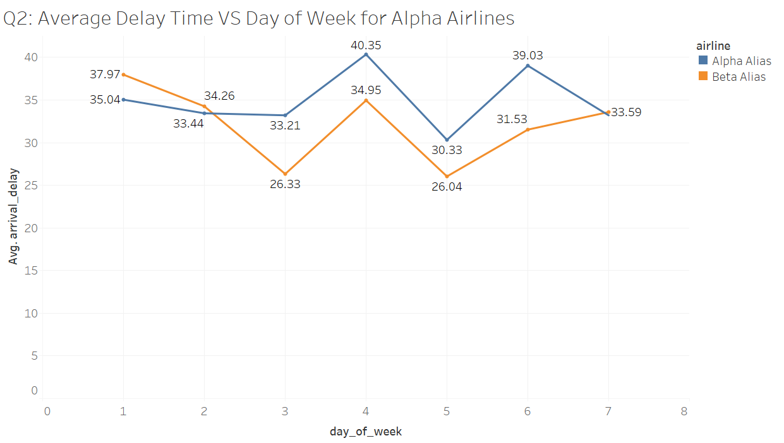
Conclusion: The average delayed time across the week for Alpha Airlines is higher than that for Beta Airlines.
Thursday is of highest average delayed time for Alpha Airlines, while Monday is the highest for Beta Airlines.
There are both a decreasing-increasing-decreasing- increasing trend in the average delayed time across the week.

Slide 11
Q3
Compare the air time fluctuations between the two airlines with regard to following airports:
Origin | Destination
ORD | ATL
SLC | DFW
JFK | MCO
MCO | JFK
JFK | MIA

Slide 12
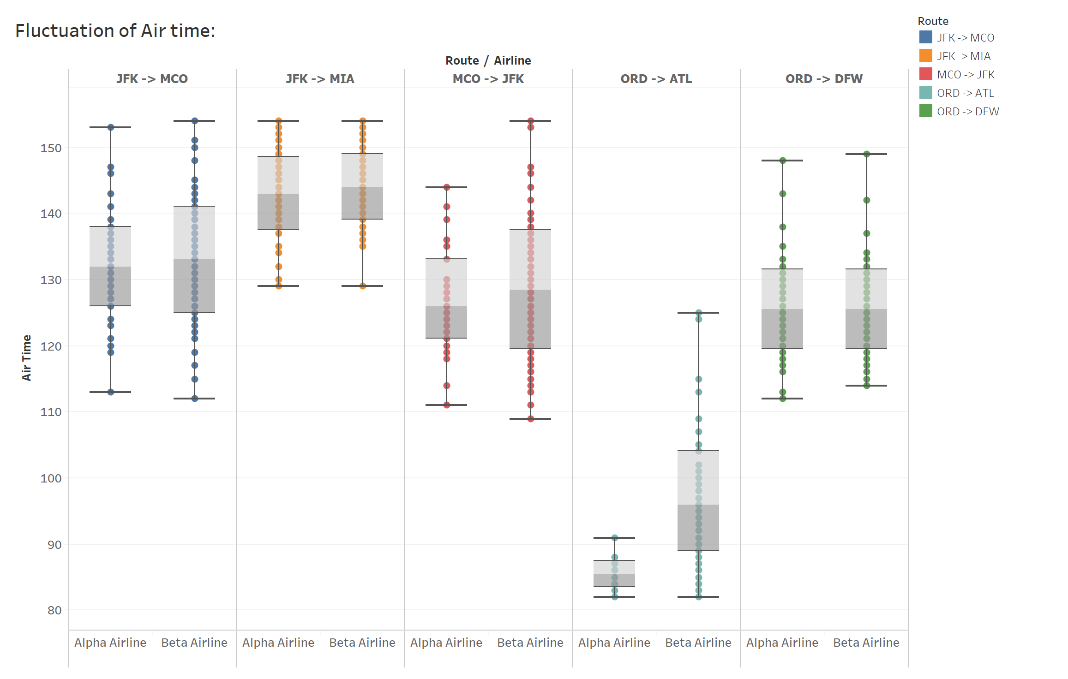
Q3.1: Airtime fluctuation between airports
As shown in the diagram, flight airtime has high fluctuation between the 5 routes: it displays variant mean and dispersion across routes.

Slide 13
Q3.2: Comparing between airlines
Comparing airtime fluctuation of Alpha and Beta airline, we found that they have similar distribution of airtime across 5 routes.
However, compared to Alpha airline, Beta airline has larger dispersion of airtime on MCO -> JFK and ORD -> ATL routes, and furthermore, larger mean airtime on ORD -> ATL.

Slide 14
Q4
Identify the top 20 most utilized aircrafts for Alpha Airlines. An aircraft with highest airtime for the month is considered as most utilized i.e. the aircraft is idling a lesser time on the ground. Make illustrations to compare the results with Beta Airlines.
For Alpha Airlines, identify which origin and destination airports are the most common airports where these aircrafts operate.

Slide 15
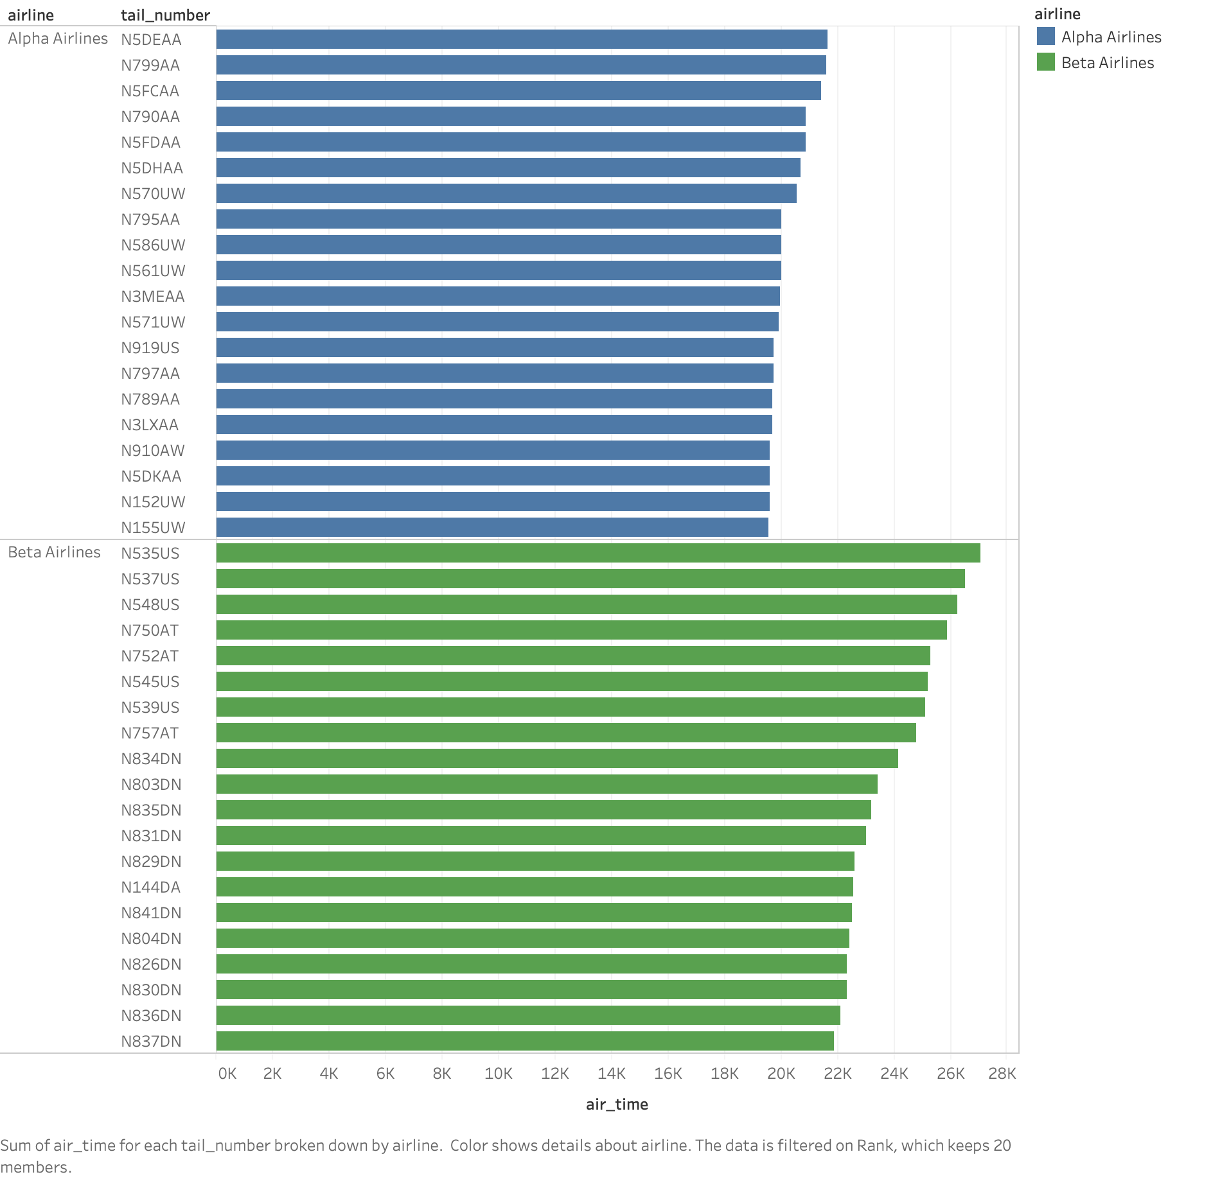
Q4.1: The top 20 most utilized aircrafts for Alpha Airlines and Beta Airlines
The top 20 most utilized aircrafts for Alpha Airlines have less airtime than the top 20 most utilized aircrafts for Beta Airlines.

Slide 16
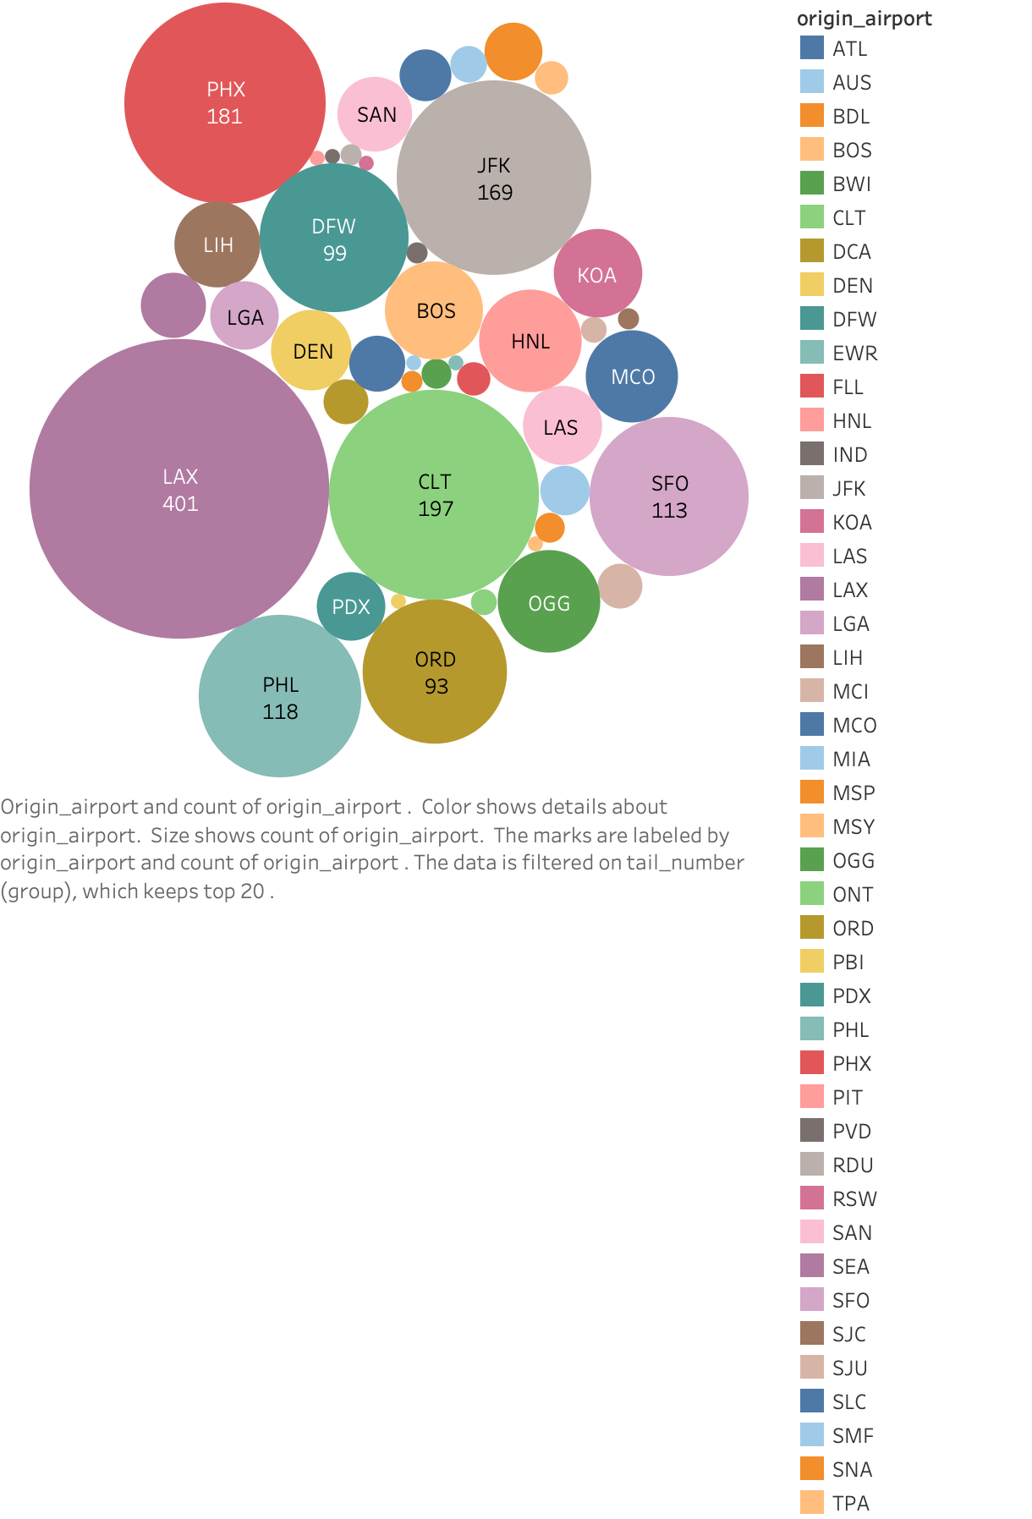
Q4.2: For Alpha Airlines, the most common origin airport where these most utilized aircrafts operate
For the top 20 most utilized aircrafts in Alpha Airlines, LAX is the most common origin airports where these aircrafts operate.

Slide 17
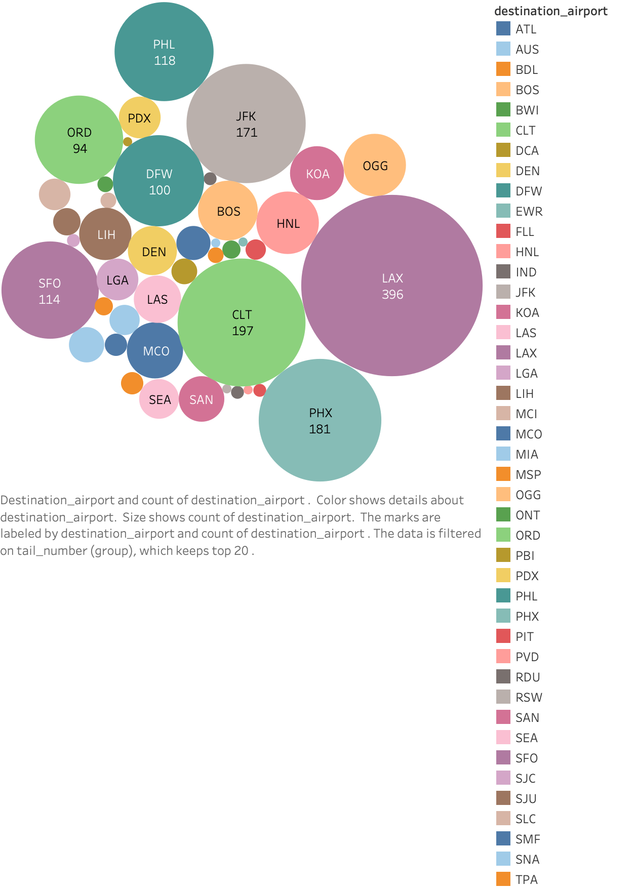
Q4.2: For Alpha Airlines, the most common destination airport where these most utilized aircrafts operate
For the top 20 most utilized aircrafts in Alpha Airlines, LAX is also the most common destination airports where these aircrafts operate.

Slide 18
Q5
Similarly, identify the top 10 most underutilized aircrafts for Alpha Airlines. Make illustrations to compare the results with Beta Airlines.

Slide 19
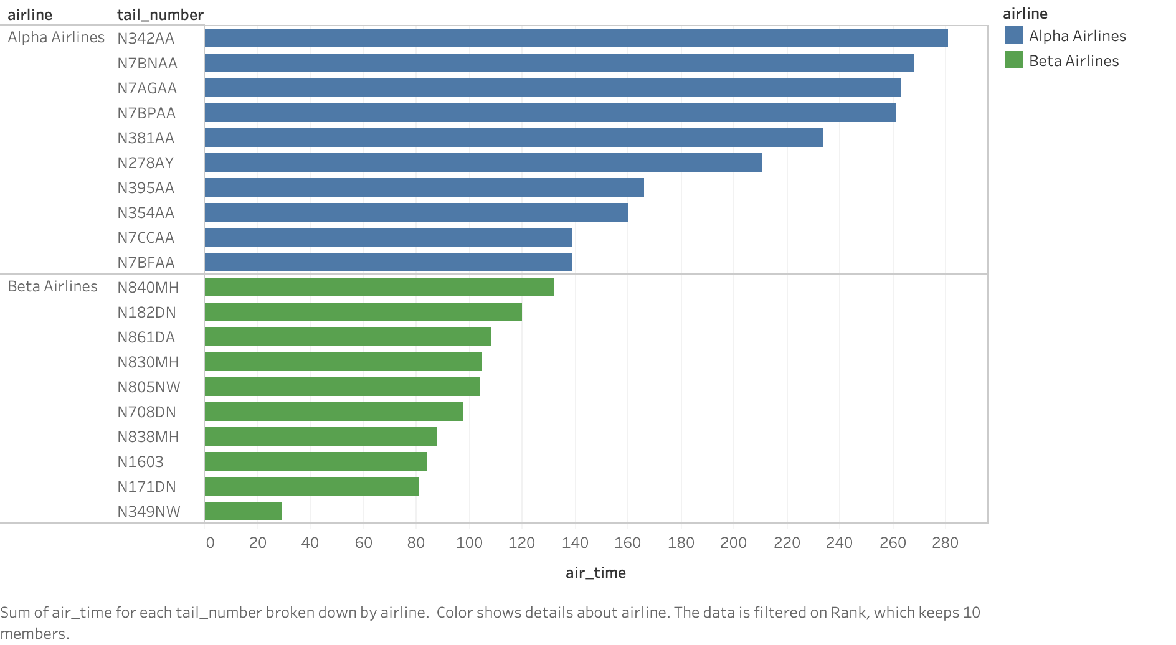
Q5: The top 10 most underutilized aircrafts for Alpha Airlines and Beta Airlines
The top 10 most underutilized aircrafts for Alpha Airlines have more airtime than the top 10 most underutilized aircrafts for Beta Airlines.

Slide 20
Q6
Use suitable illustrations to demonstrate whether the amount of departure delay, amount of taxi out time and departure time of the day has an impact on the arrival delay for Alpha Airlines. Compare the results with Beta Airlines.
Amount of departure delay vs arrival delay
Amount of taxi out time vs arrival delay
Departure time of the day vs arrival delay

Slide 21
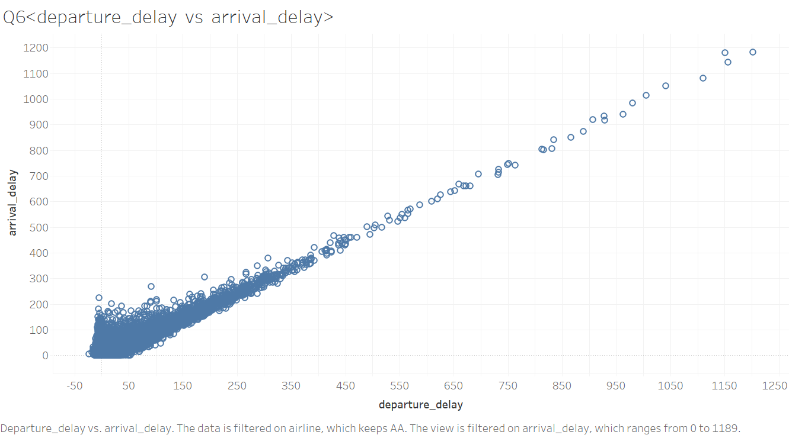
Amount of departure delay -- arrival delay, of Alpha airline
Overall, amount of departure delay has a positive linear relationship with the time of arrival delay, especially when the departure delay is in [300, 1800] period. But arrival delay seems not fully dependent on the departure delay, as when departure delay is less than 150 minutes arrival delay varies a little bit.

Slide 22
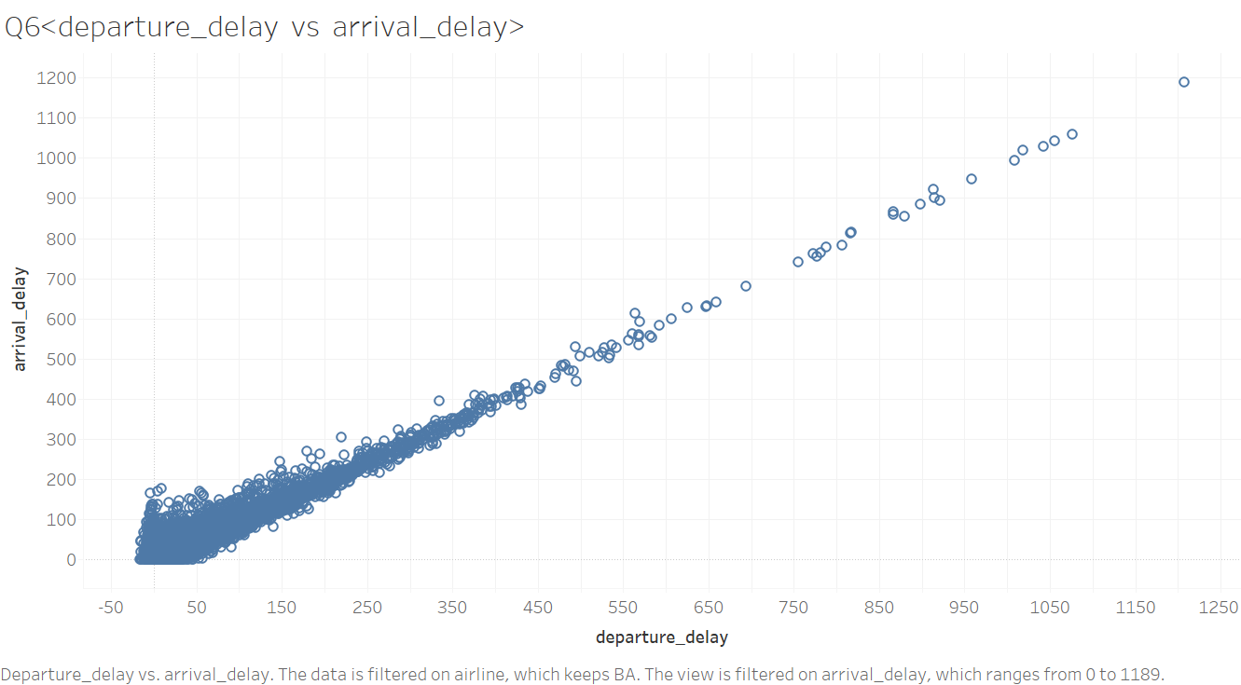
Amount of departure delay -- arrival delay, of Beta airline
Overall, amount of departure delay has a positive linear relationship with the time of arrival delay, especially when the departure delay is in [300, 1250] period. But arrival delay seems not fully dependent on the departure delay, as when departure delay is less than 150 minutes arrival delay varies a little bit.

Slide 23
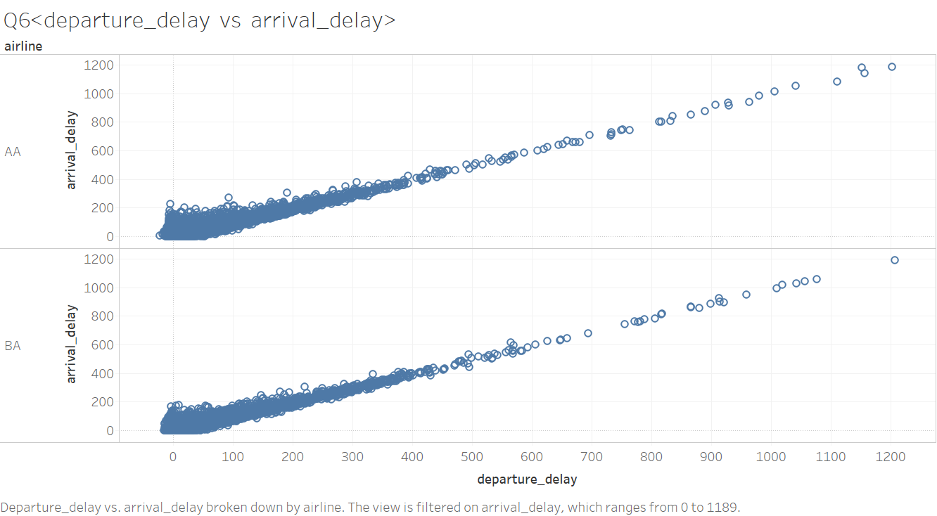
Put AA and BA together
Departure delay vs arrival delay
Differences: Beta airline does not have departure delay of [1300, 1900] minutes. This shows that Beta airline does not have long departure delay.
Similarity: Two plots are both close to positive linear relation

Slide 24
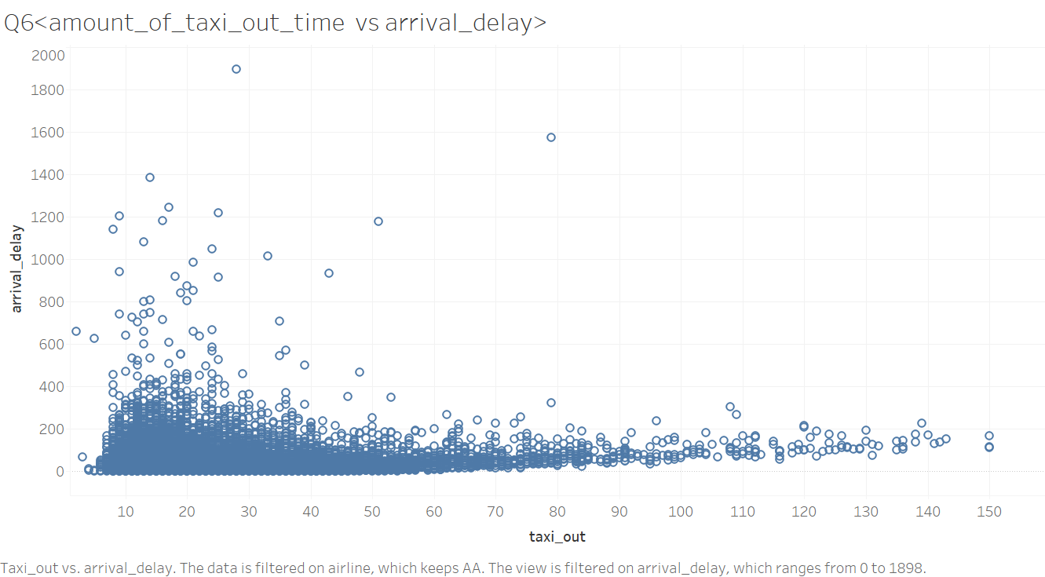
Amount of taxi out time -- arrival delay, of Alpha airline
Since the arrival delay varies a lot when taxi out time is small and there is not much variation of arrival delay as taxi out time varies, there is no obvious relationship between arrival delay and taxi out time.

Slide 25
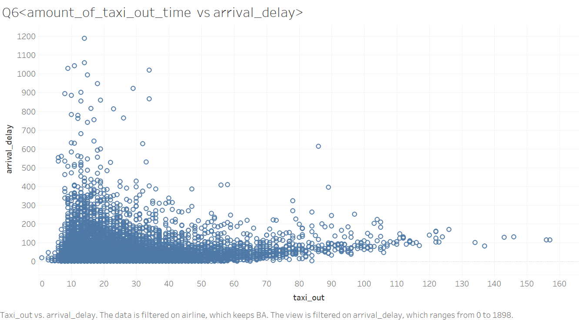
Amount of taxi out time -- arrival delay, of Beta airline
Since the arrival delay varies a lot when taxi out time is small and there is not much variation of arrival delay as taxi out time varies, there is no obvious relationship between arrival delay and taxi out time.

Slide 26
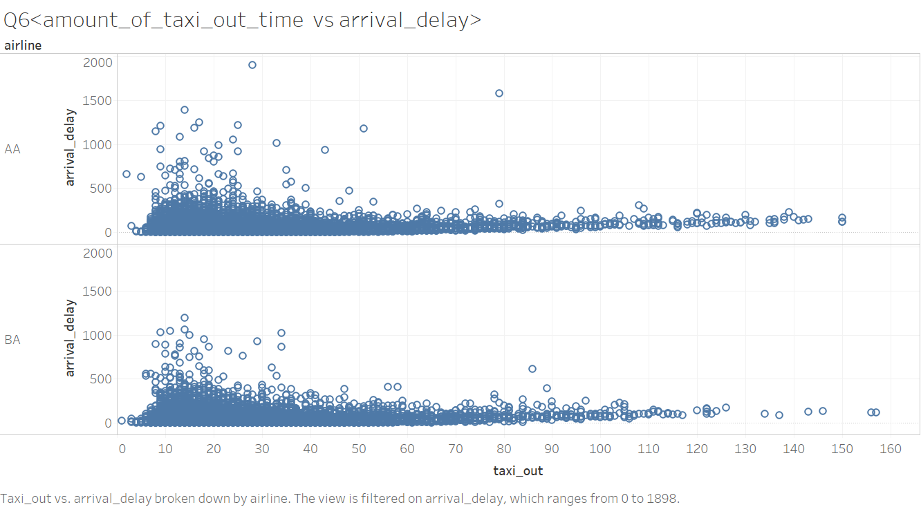
Put them together (AA and BA together)
Taxi out time vs arrival delay
Alpha airline has higher arrival delay with compared to Beta airline when taxi out time is between 0 to 40.

Slide 27
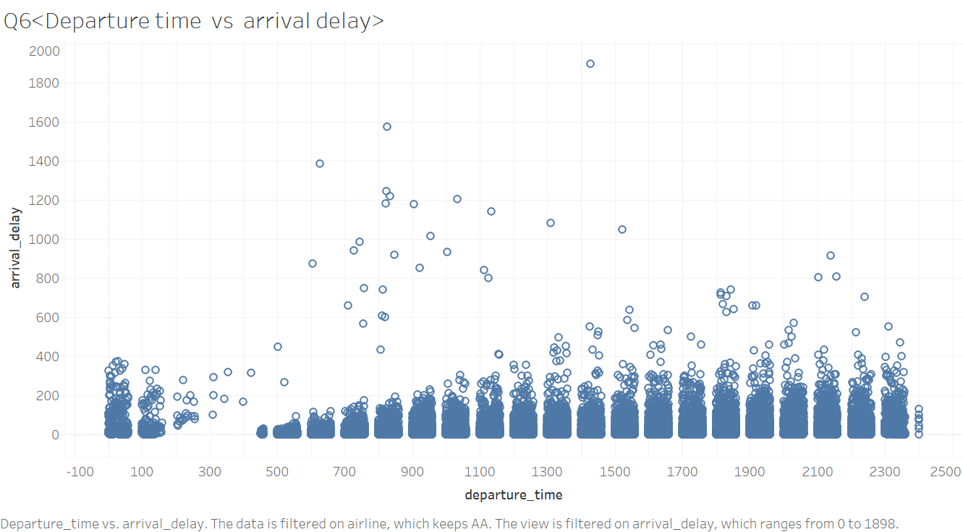
Departure time of the day vs arrival delay, of Alpha Airline
Flights with departure time between 5am to 7am do not have many long arrival delay. The arrival delay of all flights with other departure time do not have much differences.

Slide 28
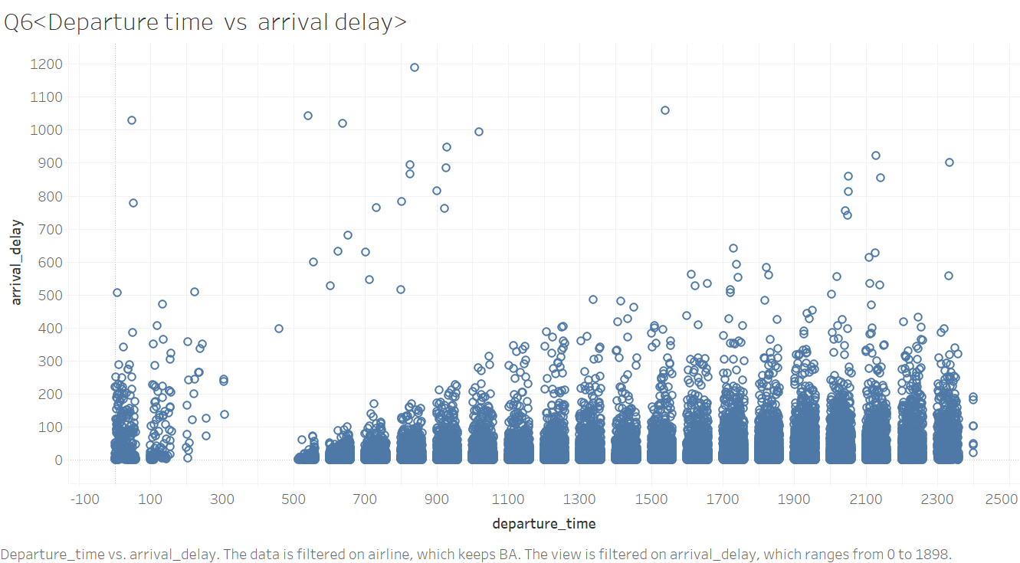
Departure time of the day vs arrival delay, of Beta airline
Flights with departure time between 5am to 7am do not have many long arrival delay. The arrival delay of all flights with other departure time do not have much differences.

Slide 29
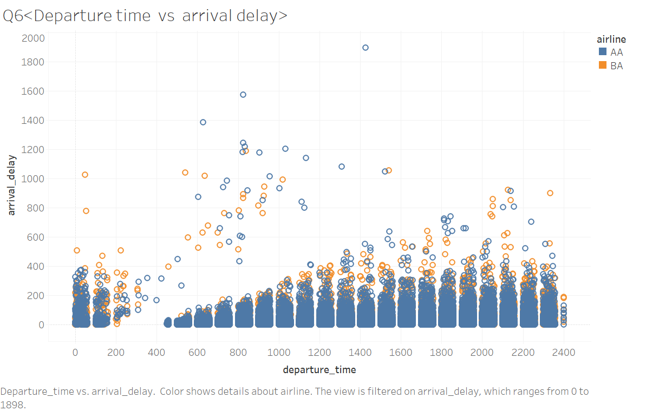
Put them together (AA and BA together)
Departure time of the day vs arrival delay
By comparison, both airlines’ flights with departure time between 5am to 7am do not have many long arrival delay. And the arrival delay of flights with other departure time do not have much difference.
There is no obvious difference between the two airlines.

Slide 30
In conclusion,
We see that there is obvious relationship between departure delay and arrival delay. Big departure delay is more likely to contribute a big arrival delay.
However, the relationship between arrival delay and taxi out time, the relationship between arrival delay and departure time of the day is not so clear from the graph. Hence, we conclude that arrival delay and taxi out time is more likely to have no relationship as well as arrival delay and the departure time of the day.

Slide 31
Q7
Use suitable illustrations to demonstrate the cause of significant and severe delays for Alpha Airlines. Compare with Beta Airlines.

Slide 32
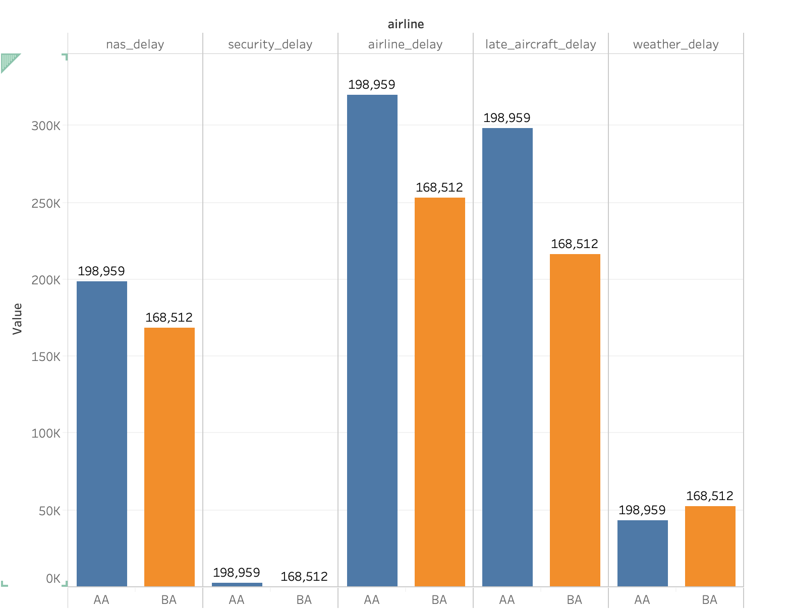
Q7: Cause of Significant and Severe Delays
Q7
The three main causes of significant and severe delays are airline delay, late aircraft delay, and national air system delay.

Slide 33
Q8
To understand reasons for aircraft delays, what figures would you like to show to the airline executives from the information provided from the data?

Slide 34
Q8: Alpha Alias have longer delay than Beta Alias on average (refer to Q2)

Slide 35
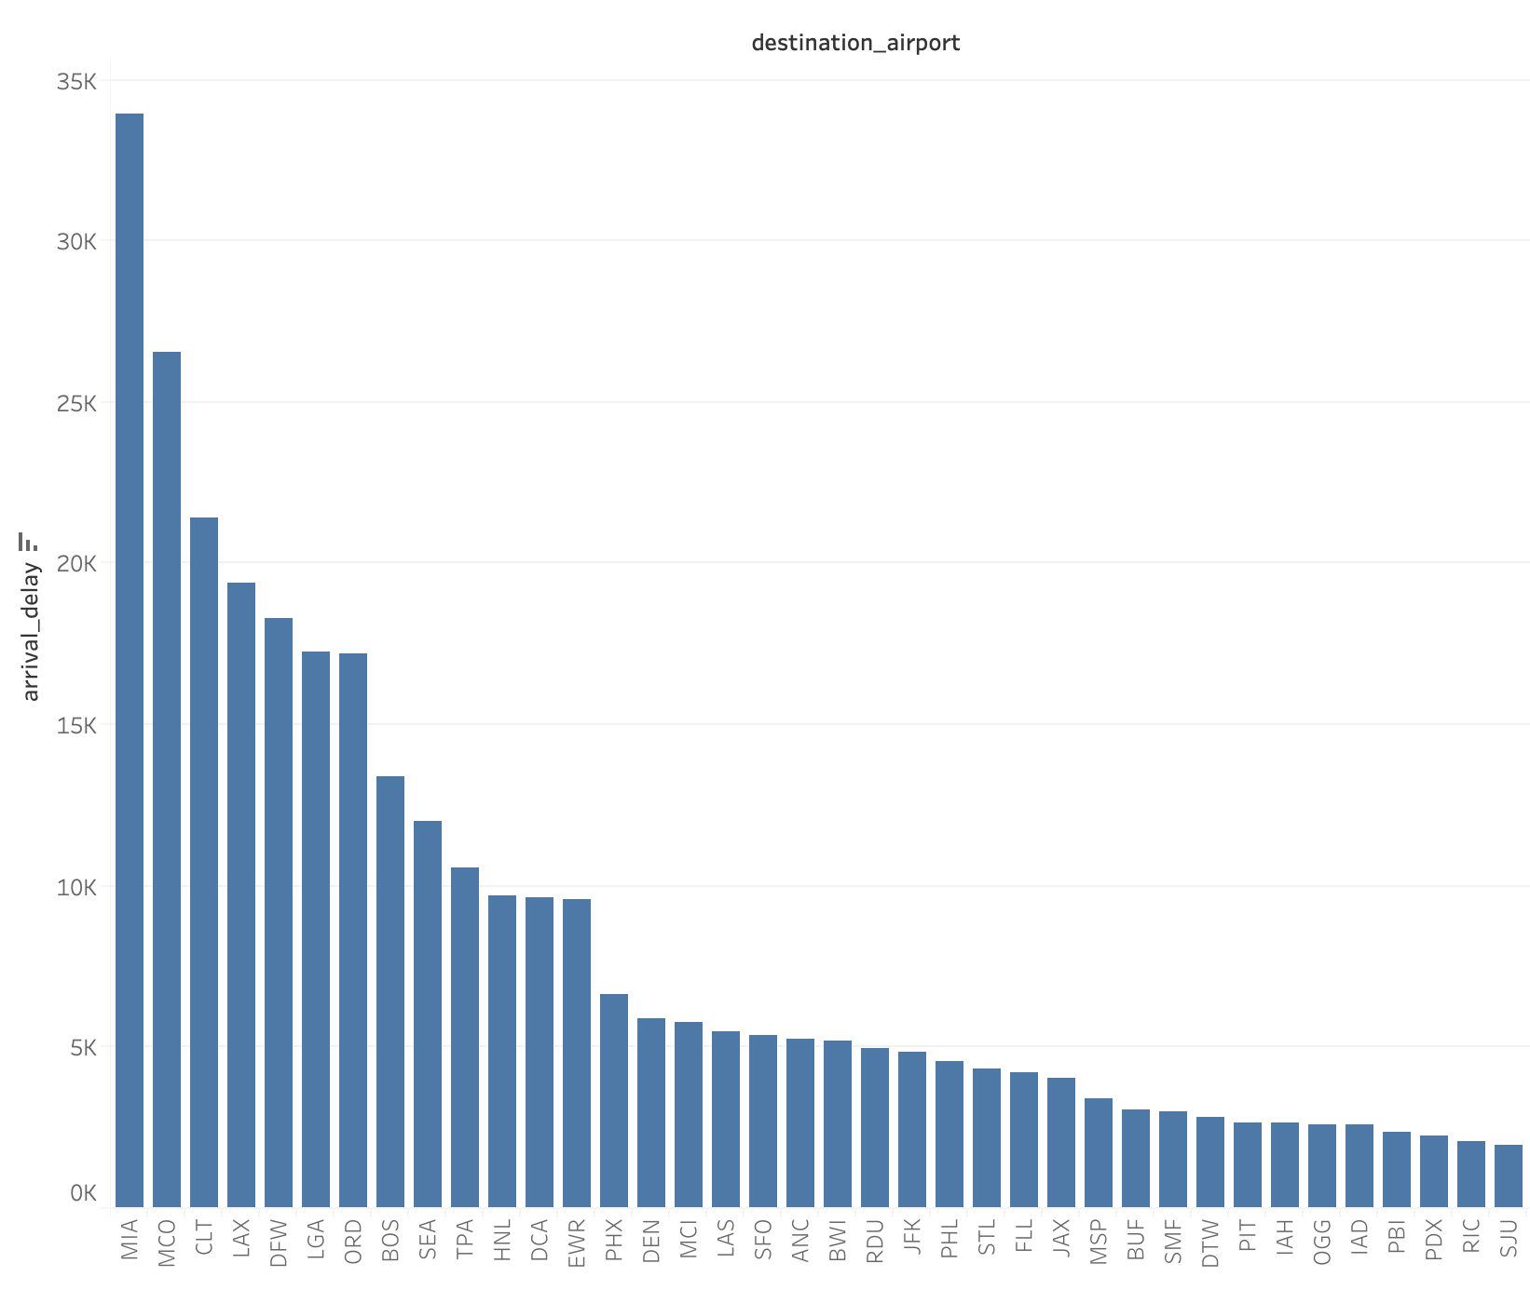
Q8: The Location of the Destination_Airport has Impacts on the Aircraft Delays
Q8
Assumption: since there is no data about the causes of minor delay, we assume that the location of the origin and destination airport may affect the aircraft delays.
MIA, MCO, CLT, LAX, DFW are five destination airports with longest delay.

Slide 36
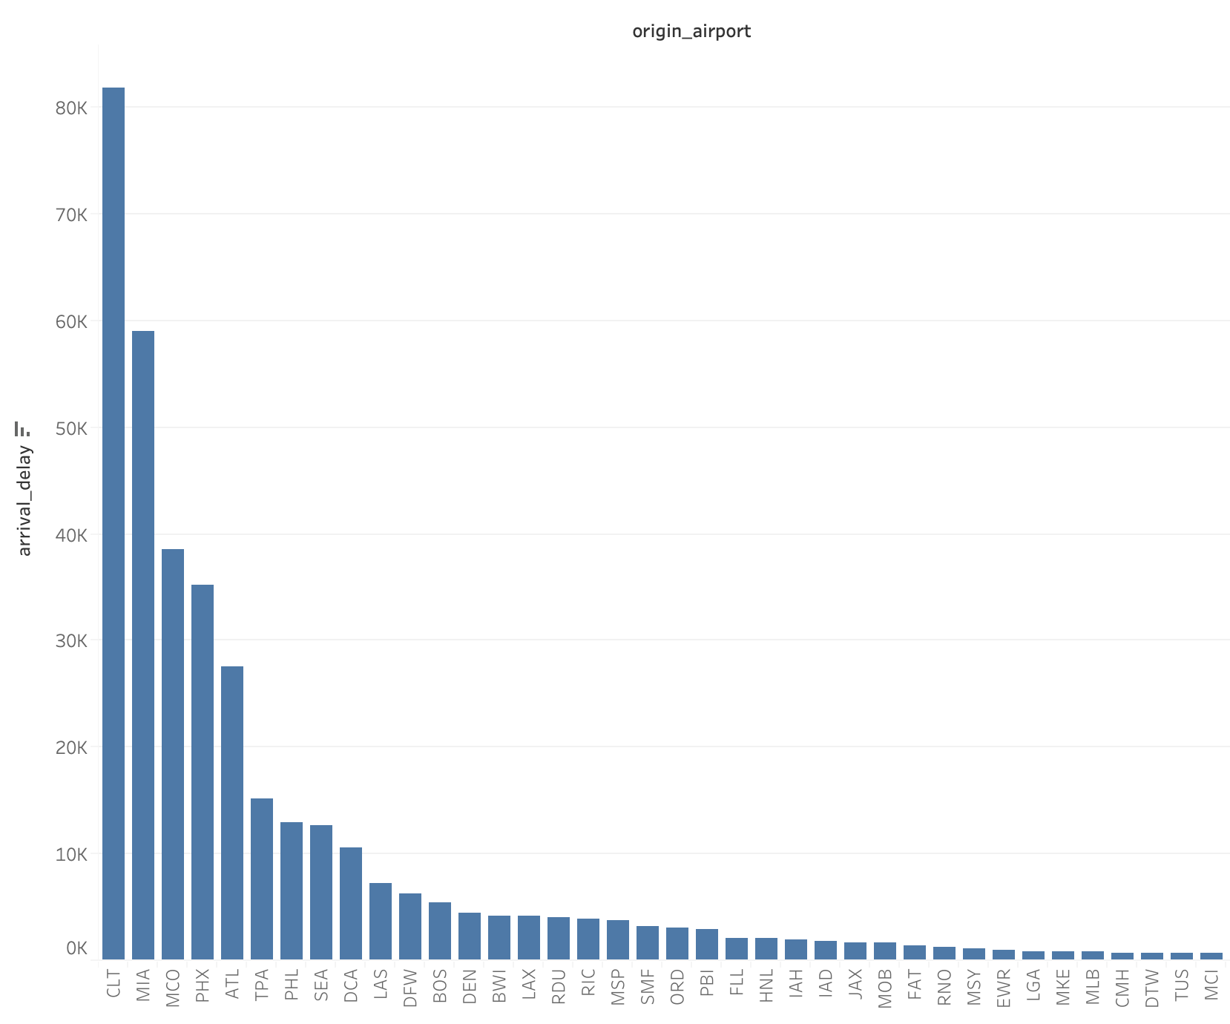
The Location of the Origin_Airport has Impacts on the Aircraft Delays
Q8
CLT, MIA, MCO, PHX, ALT are five origin airports with longest delay.
Note: CLT, MIA, MCO (marked red) have longest delay as both origin and destination airports.

