Slide 1
How Well Are Regular Expressions Tested
in the Wild?
Peipei Wang Kathryn T. Stolee
North Carolina State University
pwang7@ncsu.edu, ktstolee@ncsu.edu
Notes:
Introduce myself, from NCSU, advisor
Recall the ReDoS paper on Tuesday, DOS security vulnerabilities in regex
How do you make sure your regex is correct? The universal solution is software testing

Slide 2
Motivation
L1: if(Pattern.matches("-d|--data",str)) {
L2: System.out.println("YES");
...
L4: } else {
L5: System.out.println("NO");
...
}
str
L1
“-d”
“xd”
L2
L5
Branch coverage is insufficient to describe regex structure
Notes:
In our study we introduced graph-based coverage criteria for regular expressions because we believe Current code coverage is not sufficient for regular expression testing.
Here is one example. This regular expression accepts two strings: -d and --data
Think of its code branch coverage, we only need one input “-d” to cover the true branch and some non-matching input “xd” to cover the false branch.
But another valid input for this code snippet, which is “--data,” is not required to be covered to satisfy branch coverage of the code.
Obviously, the current code coverage metrics have ignored the internal structure of the regular expression.

Slide 3
Motivation
L1: if(Pattern.matches("-d|--data",str)) {
L2: System.out.println("YES");
...
L4: } else {
L5: System.out.println("NO");
...
}
str
L1
“-d”
“xd”
L2
L5
Matching
1
“d”
“-”
3
“-”
“data”
"-d|--data"
0
2
not “-”
Non-matching
e
Notes:
We suggest that regular expressions deserve more attention in testing.
So we propose to use a graph, specifically a DFA, to represent the regular expression structure. Then the coverage of regular expression can be clearly shown on the visited nodes and edges of the graph.
For example, in this graph, represent matching state, “-d” and “--data” are matching strings;
non-matching state anything that doesn’t start with a dash, traverses the edge from zero to e, representing a non-matching state. This is a simplification of the actual DFA as several edges to the error state are missing, but it’s useful for illustration.

Slide 4
Motivation
L1: if(Pattern.matches("-d|--data",str)) {
L2: System.out.println("YES");
...
L4: } else {
L5: System.out.println("NO");
...
}
str
L1
“-d”
“xd”
L2
L5
1
“d”
“-”
3
“-”
“data”
"-d|--data"
0
2
not “-”
e
Notes:
For the given inputs earlier, the following nodes and edges are covered, and highlighted in blue.
In this case, the uncovered path in graph is highlighted in blue.
Node 2 and edges from 1 to 2, and from 2 to 3, remain uncovered.
While branch coverage was achieved on the control flow graph, the regular expression’s DFA reveals that there is uncovered behavior.
It means that there is a string “--data” is not covered in testing the regex.
In this way, the graphical representation can provide finer-grained testing coverage for regex.

Slide 5
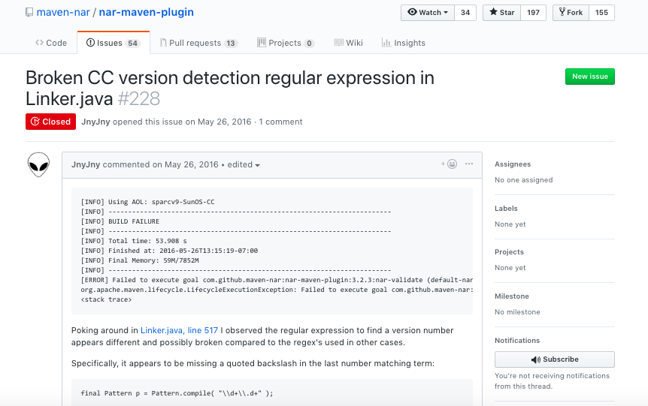


Why Structural Coverage Makes Sense
final Pattern p = Pattern.compile( "\\d+\\.d+" );
final Pattern p = Pattern.compile( "\\d+\\.\\d+" );
Notes:
Why this makes sense by using graph to measure regex coverage? Represent the structure of regex
Here we use a bug report from a Maven plugin in which a regular expression is the source/root cause of the bug.
We use this example to show that structural coverage can unveil/reveal regex mistakes.
In this bug report, the regex is used to match the version of linker. The version consists of a major version and a minor version, separated by a “dot” symbol. \d+ means integers
So the intended regex starts with an integer, then “dot”, and followed with another integer; the faulty regex forgets the escape character and instead looks for the letter ‘d’.
While the developer writes the regex, he or she forgets the backslashes for the last d/

Slide 6
Why Structural Coverage Makes Sense
0
not “0”-“9”
e
“0”-“9”
not “0”-“9”, not “.”
not “d”
[0-256]
1
“.”
2
4
not “d”
“0”-“9”
“d”
3
“d”
not “d”
5
DFA for regular expression: “\\d+\\.d+”
“d”
Structural coverage could detect potential faults
Notes:
This DFA represents the faulty regex in the bug report.
It was generated by the RE2 tool. When matching a string to a regex, RE2 appends the byte [256] to mark the end of the string.
Back to the example, covering the edge from nodes 2 to 3 could reveal the fault.
If an input is ended with the character “d” after “dot” sign, it is expected to reach the error state, but instead it ends in a matching state; this is because after visiting node 3, the ending byte 256 leads us to the matching state in node 4.
This is just one example of a bug report, but it shows the potential of using structural coverage metrics on regular expressions to bring potential issues to the developer’s attention early.

Slide 7
What We Need to Know
How well are regular expressions tested? (RQ1)
Do existing tools increase regular expression coverage? (RQ2)
Notes:
We suggest that regular expressions deserve more attention in testing. Thus, we are interested in two research questions:
First one is the current situation of regular expression testing; and the second one is that “can we utilize some existing regular expression tools to improve regular expression testing”

Slide 8
Measuring Regular Expression Coverage
Regex: “\d+” input set S: {“123”, “1a”}a
Full-Match DFA
e
not “0”-“9”
0
[0-256]
 | S
Node Coverage | 100% (5/5) | 80% (4/5) | 80% (4/5)
Edge Coverage | 86% (6/7) | 57% (4/7) | 43% (3/7)
“0”-“9”
1
3
not “0”-“9”
“0”-“9”
not “0”-“9”
2
256 marks the end of string
“0”-“9”
Notes:
Before getting into our research questions, first we need to introduce the graph-based coverage criteria.
We use DFAs generated by RE2 to represent the structure of regular expressions. RE2 is a fast regular expression engine developed by Google, and it is similar to those used in PCRE.
Those DFAs are full-match DFA and only accept when the entire string matches the regular expression. For example, if the regex is “\d+”, then string “123” is matching string, but string “1a” is a non-matching string.
Full Match DFAs use 256 as the marker to identify the end of the string. That’s why you see some 256 on graphs of this slides.
We use the percentage of visited nodes and edges as the testing coverage of a regular expression. Edge-pair is another criteria but we are not going to talk about it in this slides.
We use “\d+” and these two inputs as a running example to show how to calculate Node and Edge Coverage. In this table, NC means Node coverage and EC mean Edge Coverage

Slide 9
Measuring Regular Expression Coverage
Regex: “\d+” input set S: {“123”, “1a”}a
e
not “0”-“9”
0
[0-256]
“1”
3
 | S
Node Coverage | 100% (5/5) | 80% (4/5) | 80% (4/5)
Edge Coverage | 86% (6/7) | 57% (4/7) | 43% (3/7)
1
not “0”-“9”
“2”
[256]
2
“3”
Notes:
Here is the DFA for this regex. It consists of 5 nodes and 7 edges.
For the matching input “123”, the visited nodes and edges are highlighted in blue color. There are 4 visited nodes and 4 visited edges. So the node coverage is 80% and edge coverage is 57%

Slide 10
Measuring Regular Expression Coverage
Regex: “\d+” input set S: {“123”, “1a”}a
e
not “0”-“9”
0
[256]
“1”
3
 | S
Node Coverage | 100% (5/5) | 80% (4/5) | 80% (4/5)
Edge Coverage | 86% (6/7) | 57% (4/7) | 43% (3/7)
1
“a”
“0”-“9”
not “0”-“9”
2
“0”-“9”
Notes:
For the non-matching input “1a”, the visited nodes and edges are highlighted in red color.
There are 4 visited nodes and 3 visited edges. So the node coverage is still 80% but the edge coverage is 43%

Slide 11
Measuring Regular Expression Coverage
Regex: “\d+” input set S: {“123”, “1a”}a
e
not “0”-“9”
0
[256]
“1”
3
 | S
Node Coverage | 100% (5/5) | 80% (4/5) | 80% (4/5)
Edge Coverage | 86% (6/7) | 57% (4/7) | 43% (3/7)
1
“a”
“2”
[256]
2
Visited by both “123” and “1a”
“3”
Notes:
Considering both matching and non-matching inputs, all five nodes are visited, so the node coverage becomes 100%.
Six out the seven edges are covered, so the edge coverage is 86%

Slide 12
Measuring Regular Expression Coverage
Regex: “\d+” input set S: {“123”, “1a”}a
Uncovered
e
not “0”-“9”
0
[256]
“1”
3
 | S
Node Coverage | 100% (5/5) | 80% (4/5) | 80% (4/5)
Edge Coverage | 86% (6/7) | 57% (4/7) | 43% (3/7)
1
“a”
“2”
[256]
2
“3”
Notes:
You must notice that the edge coverage is not 100%. The edge from Node 0 to Node Error is not covered.
This uncovered edge implies that these two inputs are not sufficient to test “\d+” and more inputs are needed for better testing.

Slide 13
What We Need to Know
How well are regular expressions tested? (RQ1)
Do existing tools increase regular expression coverage? (RQ2)
Notes:
Get back to our research questions.
In order to know how well regexes are tested, we need to collect the regular expressions and their testing inputs in some real projects

Slide 14
Implementation of Data Collection
...
11 private static Pattern segmentRegex = Pattern.compile("((:\\w+)|\\*)");
...
33 private Pattern compileRoutePattern(String route) {
34 String routeWithoutFirstSlash = route.substring(1);
35 List<String> segments = new ArrayList<String>();
36 for (String segment : routeWithoutFirstSlash.split("/")) {
37 Matcher match = segmentRegex.matcher(segment);
38 if (match.matches()) {
...
53 }
Call site
Project name:
mikko-apo/KiRouter.java
File name: SinatraRouteParser.java
Line number: line 38
Notes:
In the source code, we looked for the places where regular expression matching happens, which is also called “call sites”.
First thing we did is searching in the source code for call sites of matching functions
In this example, the call site is on Line 38, so we logged the project name, the file name, and the line number of this call site.
However, in this example the regular expression and input string for matching is not directly available in source code.
The regex variable segmentRegex is defined in a different place. The input variable segment is derived from the function parameter route.

Slide 15
Implementation of Data Collection
Maven Test Process
Source code
JVM
String.matches(String regex)
“\d+”
Call site
Pattern.matches(String regex, CharSequence input)
Test cases
“123”
Regex: “\d+”
Input: “123”
Matcher.matches()
Dynamic Instrumentation
Notes:
Therefore, we designed a process to get regexes and inputs during test execution.
In a Java Maven project, the testing process will engage both the source code and test cases. It will also pass both the regex and input into JVM.
We dynamically instrumented these three matching functions in JVM and modified their bytecode, so it can record not only the call site, but also the regex and input.

Slide 16
RQ1: How Well Are Regex Tested
Artifacts
RepoReaper: curated GitHub projects
5,691 Java Maven projects ( test code ratio > 0, call sites in code > 0 )
1,225 Java Maven projects ( call sites in JVM )
Notes:
For our artifacts in RQ1. we started with projects curated in RepoReaper and selected Java Maven projects based on their test code ratio and the number of call sites in their source code.
Then we ran mvn test and use instrumentation to log the regex and inputs.
In total we picked up 1200 projects which have regex and inputs during testing

Slide 17
RQ1: How Well Are Regex Tested
Most regular expression call sites (83%) are not tested
18,426 call sites in source code (String.matches, Pattern.matches, Matcher.matches)
3,093 (16.8%) are executed by the test suites.
Notes:
Our first import finding in RQ1 is that 83% regular expression call sites are not tested.
In the 1200 projects, we found 18,000 call sites in their source code, but only around 17% of them are executed during testing.

Slide 18
RQ1: How Well Are Regex Tested
A majority of regular expressions are tested with exclusively matching or exclusively non-matching inputs.
 | Only matching inputs | Only non-matching inputs | &non-m | total
# regex | 6,029 | 4,941 | 4,126 | 15,096
% regex | 39.9% | 32.7% | 21.3% | 100%
Notes:
Our next important finding in RQ1 is that the majority of tested regular expressions have either only matching inputs or only non-matching inputs.
In our experiment, we logged 15,000 regexes,
about 33% have only non-matching input, 40% have only matching inputs.
Only 20% regex testing have both matching and non-matching inputs.

Slide 19
What We Need to Know
How well are regular expressions tested? (RQ1)
Do existing tools increase regular expression coverage? (RQ2)
Notes:
Now we know that regular expressions are not tested enough.
But what we still do not know is that RQ2: ------repeat the question ----Not rephrase the question
Our next question is how we can improve regular expression testing, can we utilize the existing regular expression tools to improve testing.

Slide 20




RQ2: Can REX Increase Coverage
REX is a Microsoft research tool generating strings for regex through constraint solver
Developers
REX
Small test input size
matching and non-matching strings
Large test input size
matching strings
Notes:
To answer this question, we compared the coverage from two different types of testing strings. One type of testing strings are developer-provided inputs; the other type are tool-generated inputs.
(compare the coverage achieved by developers and the coverage achieved by REX)
In our experiment, we chose Rex to generate strings for regular expressions.
REX is a research tool published by Microsoft. It converts regular expressions into constraints and generates strings by solving constraints.
Therefore, all strings generated by Rex is matching inputs

Slide 21
RQ2: Can REX Increase Coverage
Regex: “\d{2,5}”
Developers
REX
“12”
“a”
“123”
“1a”
“589”
“99”
“47”
“456”
Higher Coverage
Notes:
\d{2,5} ----8 nodes, 12 edges
Developer: 6 nodes, 7 edges
Rex: 5 nodes, 5 edges
We use this example to illustrate the comparison between developer-provided inputs and rex-generated inputs
This regex is used to match 2-5 digits.
The developer-provided inputs consist of four strings: two matching and two non-matching inputs
We use REX to generate same number of input strings, that is four matching strings.
In this case, developer-provided inputs produce higher coverage for the regex.

Slide 22
RQ2: Can REX Increase Coverage
Regex: “\d{2,5}”
Developers
REX
“12”
“a”
“123”
“1a”
“32” | “481” | “14” | “9991” | “96835”
“68” | “492” | “28” | “968” | “88929”
“01” | “88” | “82” | “519” | “89”
“86” | “52” | “02” | “8887” | “96298”
Same/similar Coverage
Notes:
\d{2,5} ----7 nodes, 12 edges
Developer: 6 nodes, 7 edges
Rex: 7 nodes, 9 edges
When we increase the rex-generated string size from 4 to 20, the coverage of regex using 20 generated strings is higher than using 4 developer-provided strings.

Slide 23
RQ2: Can REX Increase Coverage
Regex: “\d{2,5}”
Developers
REX
“12”
“a”
“123”
“1a”
“32” | “481” | “14” | “9991” | “96835”
“68” | “492” | “28” | “968” | “88929”
“01” | “88” | “82” | “519” | “89”
“86” | “52” | “02” | “8887” | “96298”
Higher Coverage
Notes:
\d{2,5} ----7 nodes, 12 edges
Developer: 6 nodes, 7 edges
Rex: 7 nodes, 9 edges
When we increase the rex-generated string size from 4 to 20, the coverage of regex using 20 generated strings is higher than using 4 developer-provided strings.

Slide 24
RQ2: Can REX Increase Coverage
Artifacts
7,926 regular expressions (REX supports 78% of the dataset from RQ1)
REX generated inputs 1X, 5X, and 10X the size of the developer-provided input sets
Average coverage based on 5/10 runs of REX
Notes:
In RQ2, we use REX to generate string inputs for the regular expressions.
Because some regular expression features are not supported by rex, we can only generate strings for about 8,000 regexes.
For these regexes, the input size can be same as the developer-provided input size, 5 times as the developer-provided size, or 10 times as the developer-provided size.
We run several times for each regex and each input size, and use the average coverage to compare with the coverage from developer-provided strings.

Slide 25
RQ2: Can REX Increase Coverage
REX does nearly as well as developers with only matching inputs
 | Node Coverage | Edge Coverage
Developer inputs | 73.27% | 36.35%
Developer matching inputs | 70.41% | 33.79%
REX 1X matching inputs | 69.29% | 33.57%
REX 5X matching inputs | 71.69% | 36.42%
REX 10X matching inputs | 72.01% | 36.87%
Notes:
Our finding in RQ2 is that Rex does nearly as well as developers with only matching inputs.
By nearly, we mean that with the same number of inputs, developers make a little bit higher testing coverage.
However, if we only look at the matching inputs, Rex works better given a larger input set size

Slide 26
Future Work
Auto-generated test strings
Mutation to generate non-matching strings
Beyond structural coverage
Fault classification through bug reports
Relationship between coverage and faults
Notes:
In the future, we can look into automatic tools of generating regex testing strings.
Instead of generating only matching string, we can consider using mutation to generate non-matching strings.
And besides the structural coverage introduced in this work, we are interested in different types of regular expression faults.
Some regex faults can be revealed in our graph-based coverage metrics, some cannot.
So we are also interested in the relationship between coverage and faults.

Slide 27
Key Takeaways
Graph-based coverage metrics for regexes
Regular expressions are un-tested, or under-tested
Non-matching testing inputs
String generation tools for regexes
Thanks
Peipei Wang (pwang7@ncsu.edu)
Notes:
Take away:
1. We introduced a graph-based coverage metrics to measure the testing coverage of regular expression used in the source code.
2. Our finding indicates that regular expression testing deserve more attention because of the small percentage of regexes been tested.
We suggest using both matching and non-matching inputs for testing them. And if possible, tools which can automatically generate testing inputs for regular expressions can be involved to help establish a better input set.
With this, I will end the talk.
Thanks for listening.
Feel free to send me emails if you have any questions or interested in our work.
(need to confirm: it is the duty of session chair to say “I am happy to take you questions” )

Slide 28
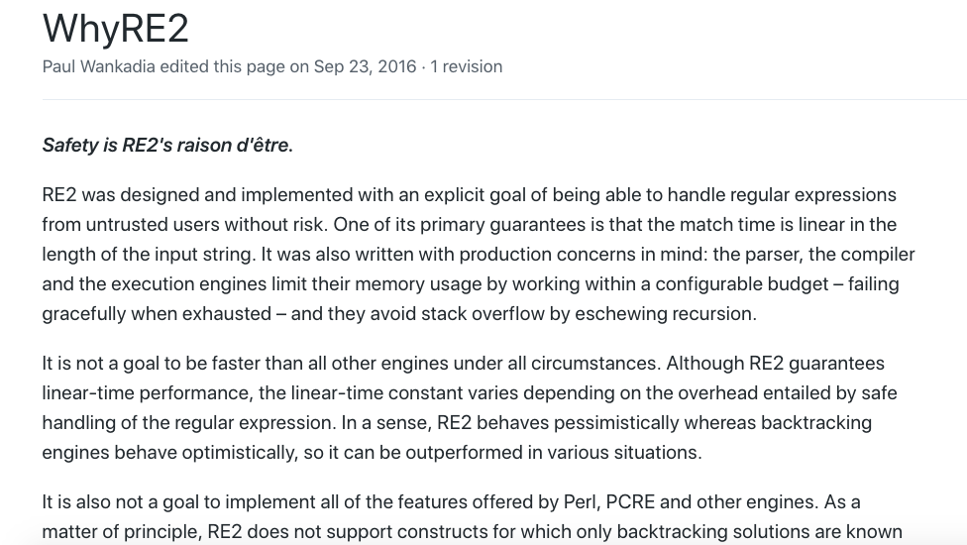
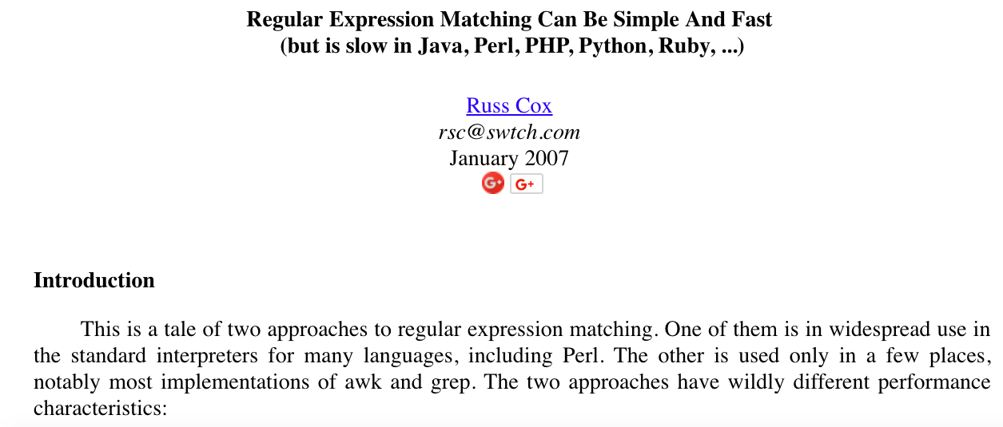
Backup

Slide 29
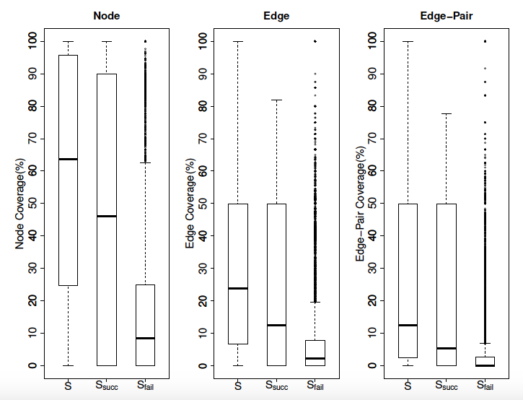
RQ1: Test Coverage in GitHub
Notes:
Most of the regular expressions are not tested thoroughly since the mean values of coverage are low, especially for edge and edge-pair coverage.
Although the coverages on failed matchings are relatively small, they contribute to a high overall test coverage.
Failed matching tests are a necessary part of testing regular expressions

Slide 30
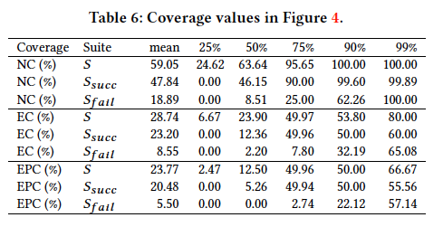
Backup

Slide 31
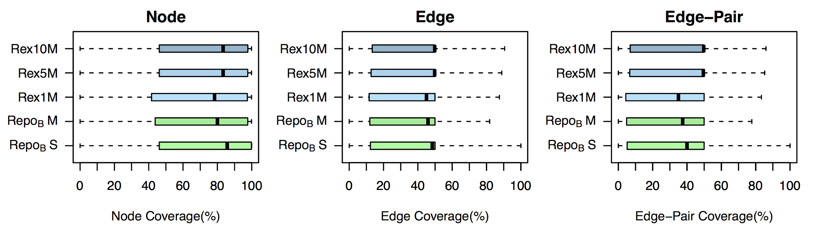
RQ2: Test Coverage by Rex
Notes:
Repo B M significantly outperforms Rex1M with α = 0.0001.
However, as test suite size is strongly correlated with coverage [19], as soon as the Rex test set is amplified to 5x and 10x the size,
the coverage of Rex outperforms the developer coverage.
with test inputs sets of the same size, Repo B S outperforms Rex1M.
However, this comparison is unfair since Rex does not generate non-matching strings.
That said, as soon as the Rex dataset is amplified as in Rex5M and Rex10M, there is no clear winner compared to all test inputs from the repository.

Slide 32
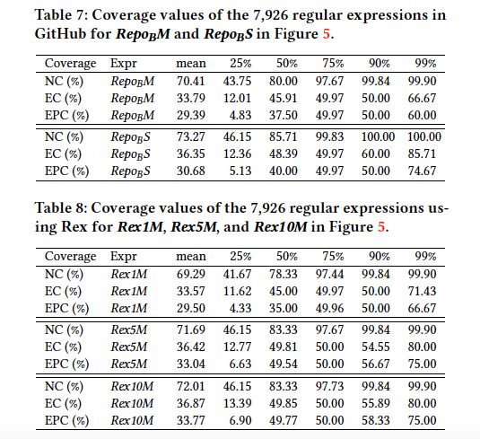
Backup

Slide 33
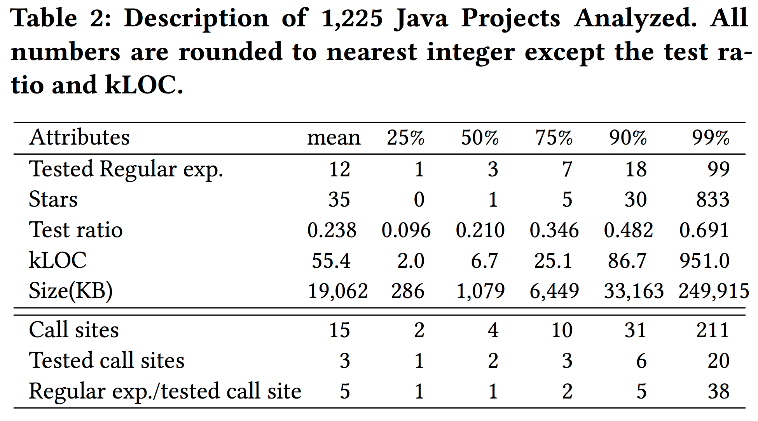
Backup

Slide 34
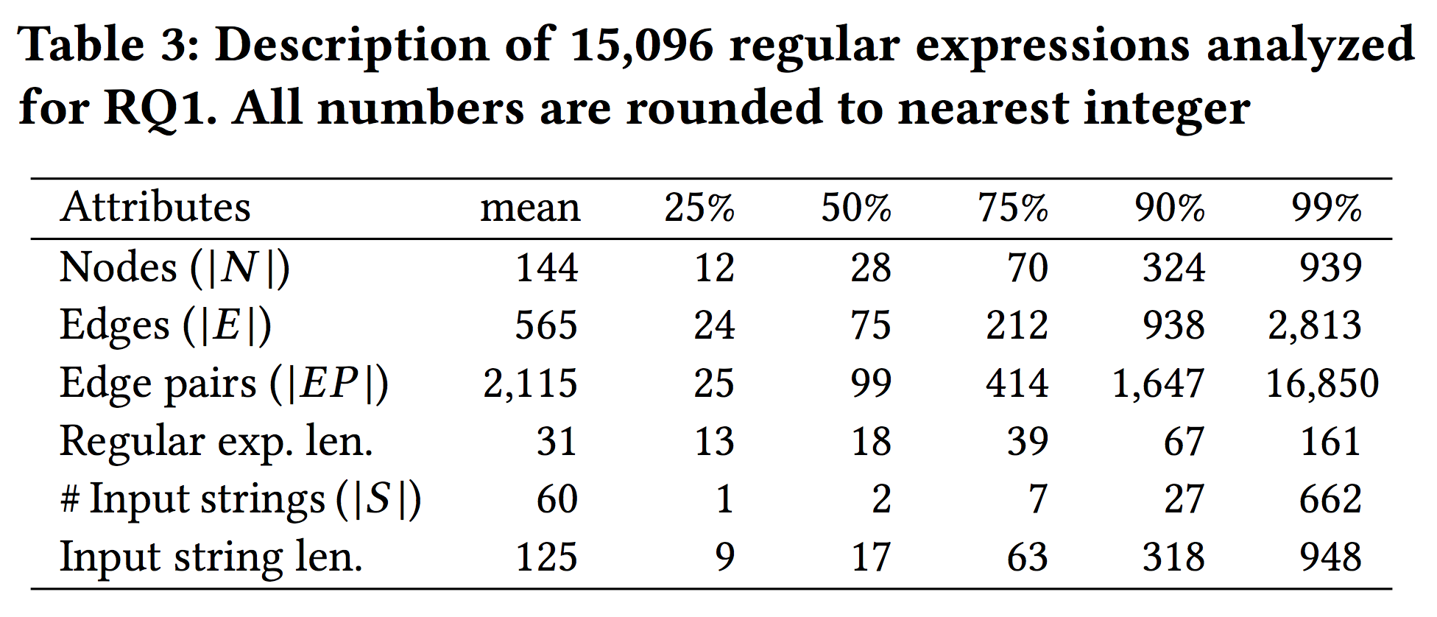
Backup

Slide 35
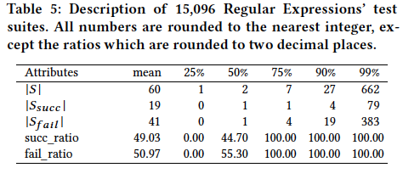
Backup

Slide 36
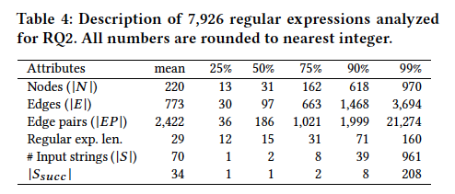
Backup

Slide 37
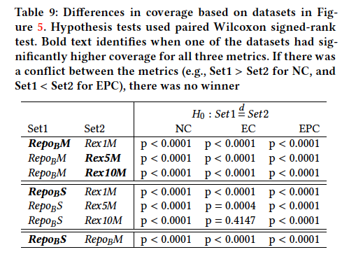
Backup

