Slide 1
Analyses of Regular Expression Usage
in Software Development
Peipei Wang
pwang7@ncsu.edu
Committee:
Kathryn T. Stolee
Gregg Rothermel
Christopher Parnin
Bradley Reaves
Jamie Jennings
June 17, 2021
Notes:
Good afternoon, thank you all for coming to my defense.
Today I am going to tell you something about regular expression.
It is the summary of my dissertation titled as “Analyses of Regular Expression Usage in Software Development”
For my committee members, feel free to interrupt me in the middle if you have any questions.
Also, Dr. Stolee, can you remind me when audience raise hand or type their questions in chat box?
(click)

Slide 2



Example of Regular Expression (Regex)
^\w+@[a-zA-Z_]+?\.[a-zA-Z]{2,3}$
[a-zA-Z0-9_]
joe@gmail.com
smith@baidu.com
pwang7@ncsu.edu
joe@web.info
smith@163.com
atif@unimelb.edu.au
Restrictive
Notes:
So, What is regular expression?
A regular expression or regex is a language describing the shared pattern of a set of strings. The string set can be limited or unlimited.
(click) The characters in the text box is a regex for email address. It consists of four parts: username, AT, and two domain names, separated by dot.
The username (click) are made from letters, digits, and underscores. Since dot is a wildcard character matching any character, backslash is added to annotate that it is a literal dot, not a regex metacharacter.
The first domain name has to be from alphabet characters or underscore. The second domain name must have 2 or 3 alphabet characters.
Some strings match this regex (click), the others not. (click)
In the examples of non-matching strings, the domain name either has a length larger than 3, or contain digits, or it has more than two domain names.
All the three strings shown on the right side are actually valid email addresses. So we think this regex is too restrictive. We have to find another one better than this example. (click)

Slide 3
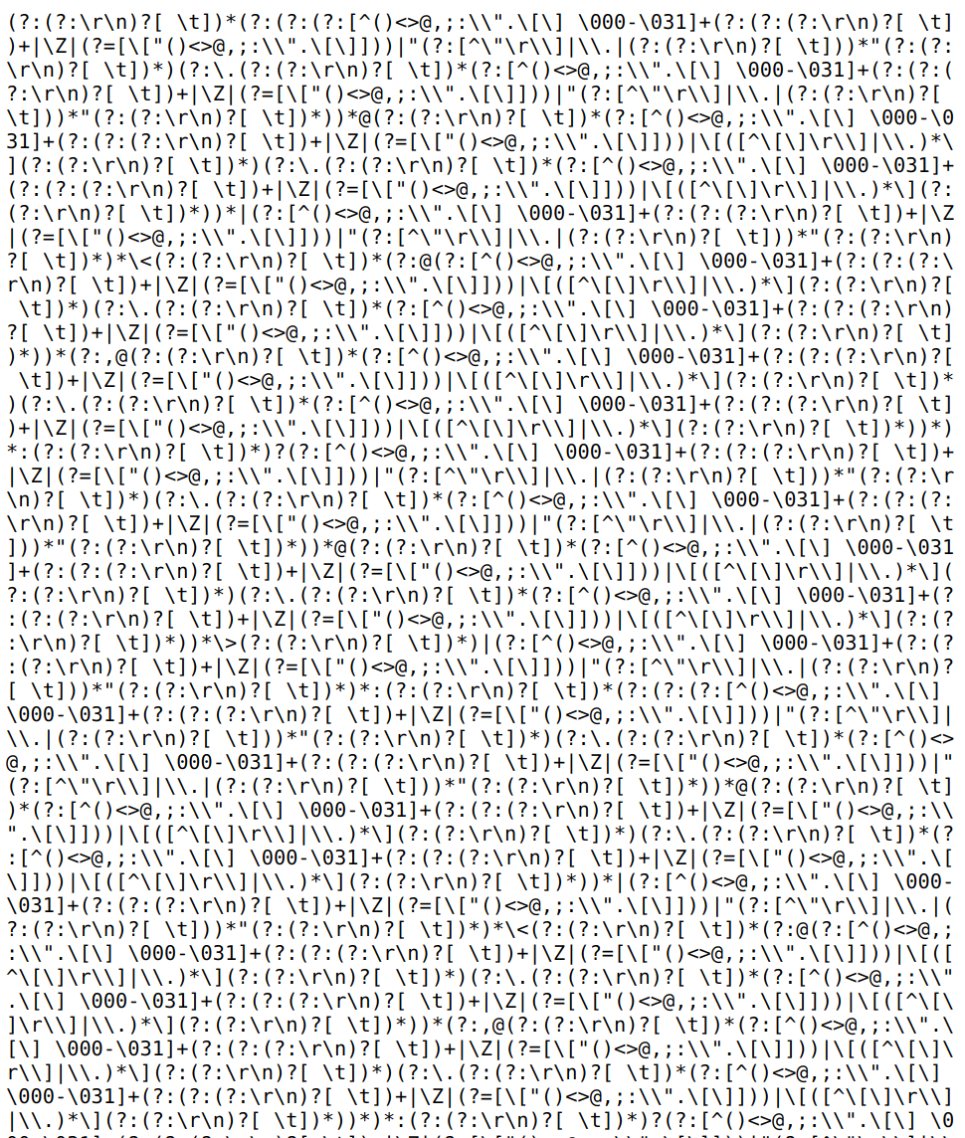
Example of Regular Expression (Regex)
Mail::RFC822
Notes:
Then how about this one? This is a regex defined according to the RFC grammar.
To fully cover the grammar described in RFC, the regex is extremely long and complicated. I believe no one in this zoom meeting can actually read it.
So sometimes, developers have to make a tradeoff between the correctness and readability of the regex.
https://www.ex-parrot.com/pdw/Mail-RFC822-Address.html

Slide 4
Why Regex in Software Development?
EVERYWHERE
Regular expressions matter
Search, replace, validation, extraction
Web search, database query
Compiler lexical analysis
Network access control, intrusion detection
Pattern matching in DNA sequences
42% of Python projects use regex
[Chapman, ISSTA 2016]
Notes:
Regular expression is a very useful tool for data processing, such as search data, replace/extract strings, or validate inputs.
It is used commonly in today’s web search and database query engines.
In compiler, it can identify the tokens and variables.
In bioinformatics, it can be used in DNA sequence pattern matching or sequence alignment.
It can also be used for network access control and intrusion detection.
So the first reason motivating us to study regex in software development is that regex is commonly used. In a paper published in ISSTA 2016, it is said that 42% of the python projects have used regex module.
Register, or create an account on one website, you need phone number, email address, password, … SSN credit
The lexical analyzer needs to scan and identify only a finite set of valid string/token/lexeme that belong to the language in hand. It searches for the pattern defined by the language rules.
Bio-informatics - A classical algorithm for the pairwise sequence alignment is the Smith Waterman algorithm which uses dynamic programming.

Slide 5
Why Regex in Software Development?
Regexes are hard
Read
Compose
Reuse
Search
Validate
Document
Master
Some people, when confronted with a problem, think
“I know, I'll use regular expressions.” Now they have two problems.
[Chapman, ISSTA 2016; Chapman, ASE 2017; Davis, FSE 2018; Staicu Security 2018; Davis ASE 2019; Michael, ASE 2019]
Notes:
The 2nd reason to study regex in software development is that regexes are hard.
Several studies have found that regex is not just hard to read and compose, it is also hard to reuse, hard to search, and validate.
For example, regex is hard to reuse because regex engine implementations are inconsistent across programming languages. There are semantic and performance differences in different regex implementations.
Regex is also hard to master because most developers are not aware of the security risks when using regexes, and do not know how to deal these risks effectively.
Though most regexes compile across language boundaries, 15% exhibit semantic differences across languages and 10% exhibit performance differences across languages.

Slide 6
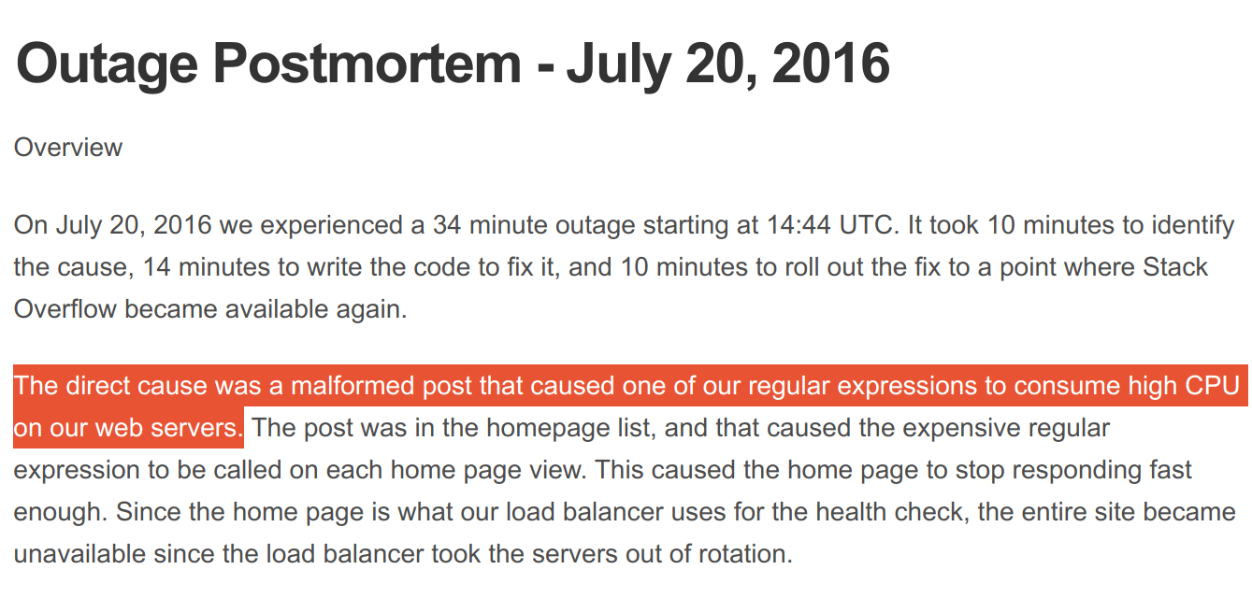
Notes:
Regular expression is the culprit for the 30 minutes outage if StackOverflow in 2016. This type of regex security risk is prevalent in libraries and web servers.
The prevalence of ReDOS has been demonstrated in javascript and python modules (Davis FSE 2018) and JavaScript-based Web Servers(Staicu USENIX Security Symposium 2018)

Slide 7
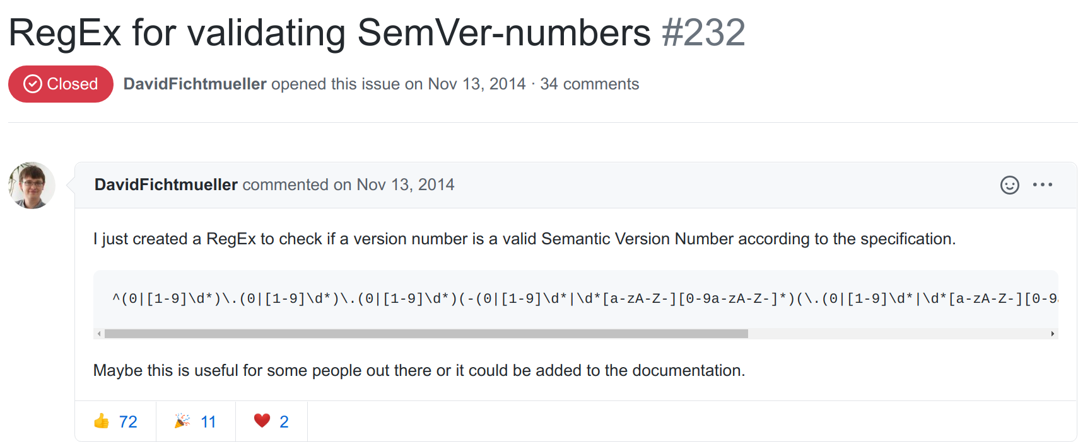
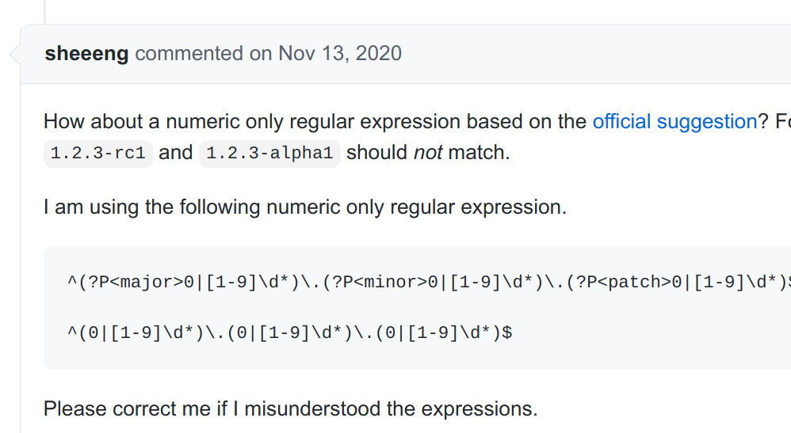
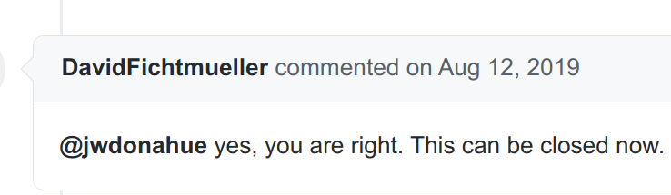
Notes:
Here is another example showing that regexes are hard to use.
This is a GitHub issue. Someone proposed a regex to valid Semantic Version Number in Nov, 2014. This issue didn’t close until August 2019. It takes almost 5 years for developers to reach an agreement.
The reported number comments per issue is only 10 on average. Median is 0. But this regex issue takes 34 comments. Even after the issue was closed, the discussion goes on and people continue add their comments.
https://github.com/semver/semver/issues/232
5 years 34 comments,
Comments average: 10, median: 0 [MSR 2015 A Data Set for Social Diversity Studies of GitHub Teams]
Issue resolution latency varies from 2 days to 55 days. (mean varies from 16 to 231 days) [2018 APSEC Multi-discussing Across Issues in GitHub: A Preliminary Study]
the number of comments is the best single predictor of the latency; [MSR 2015 Wait For It:]
A the discussion of this problem hadn’t ended yet. People continue posting their comments. The latest one was posted 7 months ago.

Slide 8
Regexes are hard but necessary!
Developers make mistakes!
How to help them?
Wait!!
Notes:
People use regex for good reasons. Regular expression is very concise. Concise means less code and flexibility. So regexes are hard but necessary.
Because of the difficulty, developers make mistakes in using regexes.
So how to help developers and prevent them from making mistakes?
But wait!! Before coming up with any solutions, we have to first define the problem. Up to now, we don’t know what mistakes or problems developers make and deal with yet.

Slide 9
Thesis Statement
Regular expressions in open source software have low test coverage, are modified infrequently, are overly restrictive, and contribute to software bugs.
Notes:
To get an overall picture of regex problems, we study the regex usage in open source projects.
Our findings about regex usage is that “regex have low test coverage, are modified infrequently, overly restrictive, and contribute to software bugs”.

Slide 10
Outline
Developers do not often change regex test code (51%)
2
Regular Expression Testing
1
Regular Expression Bugs
[FSE 2018]
3
[MSR 2020]
Regular Expression Evolution
Regex semantics become obsolete as software evolves
[SANER 2019]
Notes:
This work consists of three pieces. We will start with the study on regex bugs. (click)
In the regex bug study we found developers do not often change regex test code, bringing in the study of regex testing as the second piece of work.
Also originated from the regex bug study, (click) we observe that regex semantics become obsolete as software evolves, so the study of regex evolution is brought in as the third piece of my dissertation.

Slide 11
Contributions: Regular Expression Bugs
Identify root causes and manifestations of 356 regex bugs
Regex bug
Code changes fixing the bug
Regex Bug Taxonomy
Pull Request
Notes:
In the regex bug study, we chose GitHub pull requests as our study object because pull requests usually contain not only the regex bug description, but also the resolution, the code changes fixing the bug.
The first contribution of regex bug study is the Identification of root causes and manifestations of 356 regex bugs in pull requests.
Based on this, we build a taxonomy of regex bugs.

Slide 12
Contributions: Regular Expression Bugs
Regex bug
Code changes fixing the bug
Analysis of bug fix complexity
Ten Fix patterns
Pull Request
Notes:
We also studied the complexity of bug fix and identified common fix patterns.
Due to the time limitation, this part of contributions will not be covered in this presentation.

Slide 13
Contributions: Regular Expression Bugs
Regex bug
Code changes fixing the bug
Test code changes
W/O test code changes
Pull Request
Notes:
A convention in bug fixing is that developers also change tests so that they can test whether the fix actually fix the bug or not.
So we did another analysis on pull request test code changes
https://reactjs.org/docs/how-to-contribute.html

Slide 14




Search title and description:
“regular expression”
-- or --
“regex”
Filter by language:
Java
JavaScript
Python
Filter by PR status:
merged
Identify regex bugs:
Change to regex or regex API
350
PRs
356 bugs
Automatic
Manual
Notes:
For data collection, we selected regex-related pull requests from Apache, Mozilla, Facebook and Google GitHub repositories.
For a pull request to be regex-related, it must have keywords “regular expression” or “regex” in the title and description.
We choose only repos whose primary language is Java, JavaScript, or Python, the top 3 most popular languages on GitHub.
The pull requests also need to be already merged because merged ones not only shows developers’ interest to solve the problem but also provides accepted patch to fix the problem.
Finally, for regex-related pull requests, there is at least one code changes to a regex or a regex API.
With this selection criteria we ended up with 350 regex-related PRs and 356 regex bugs. There are 6 pull requests fixing more than one regex problem.
The first few steps are automatic, but identifying regex-related pull requests are manual.

Slide 15
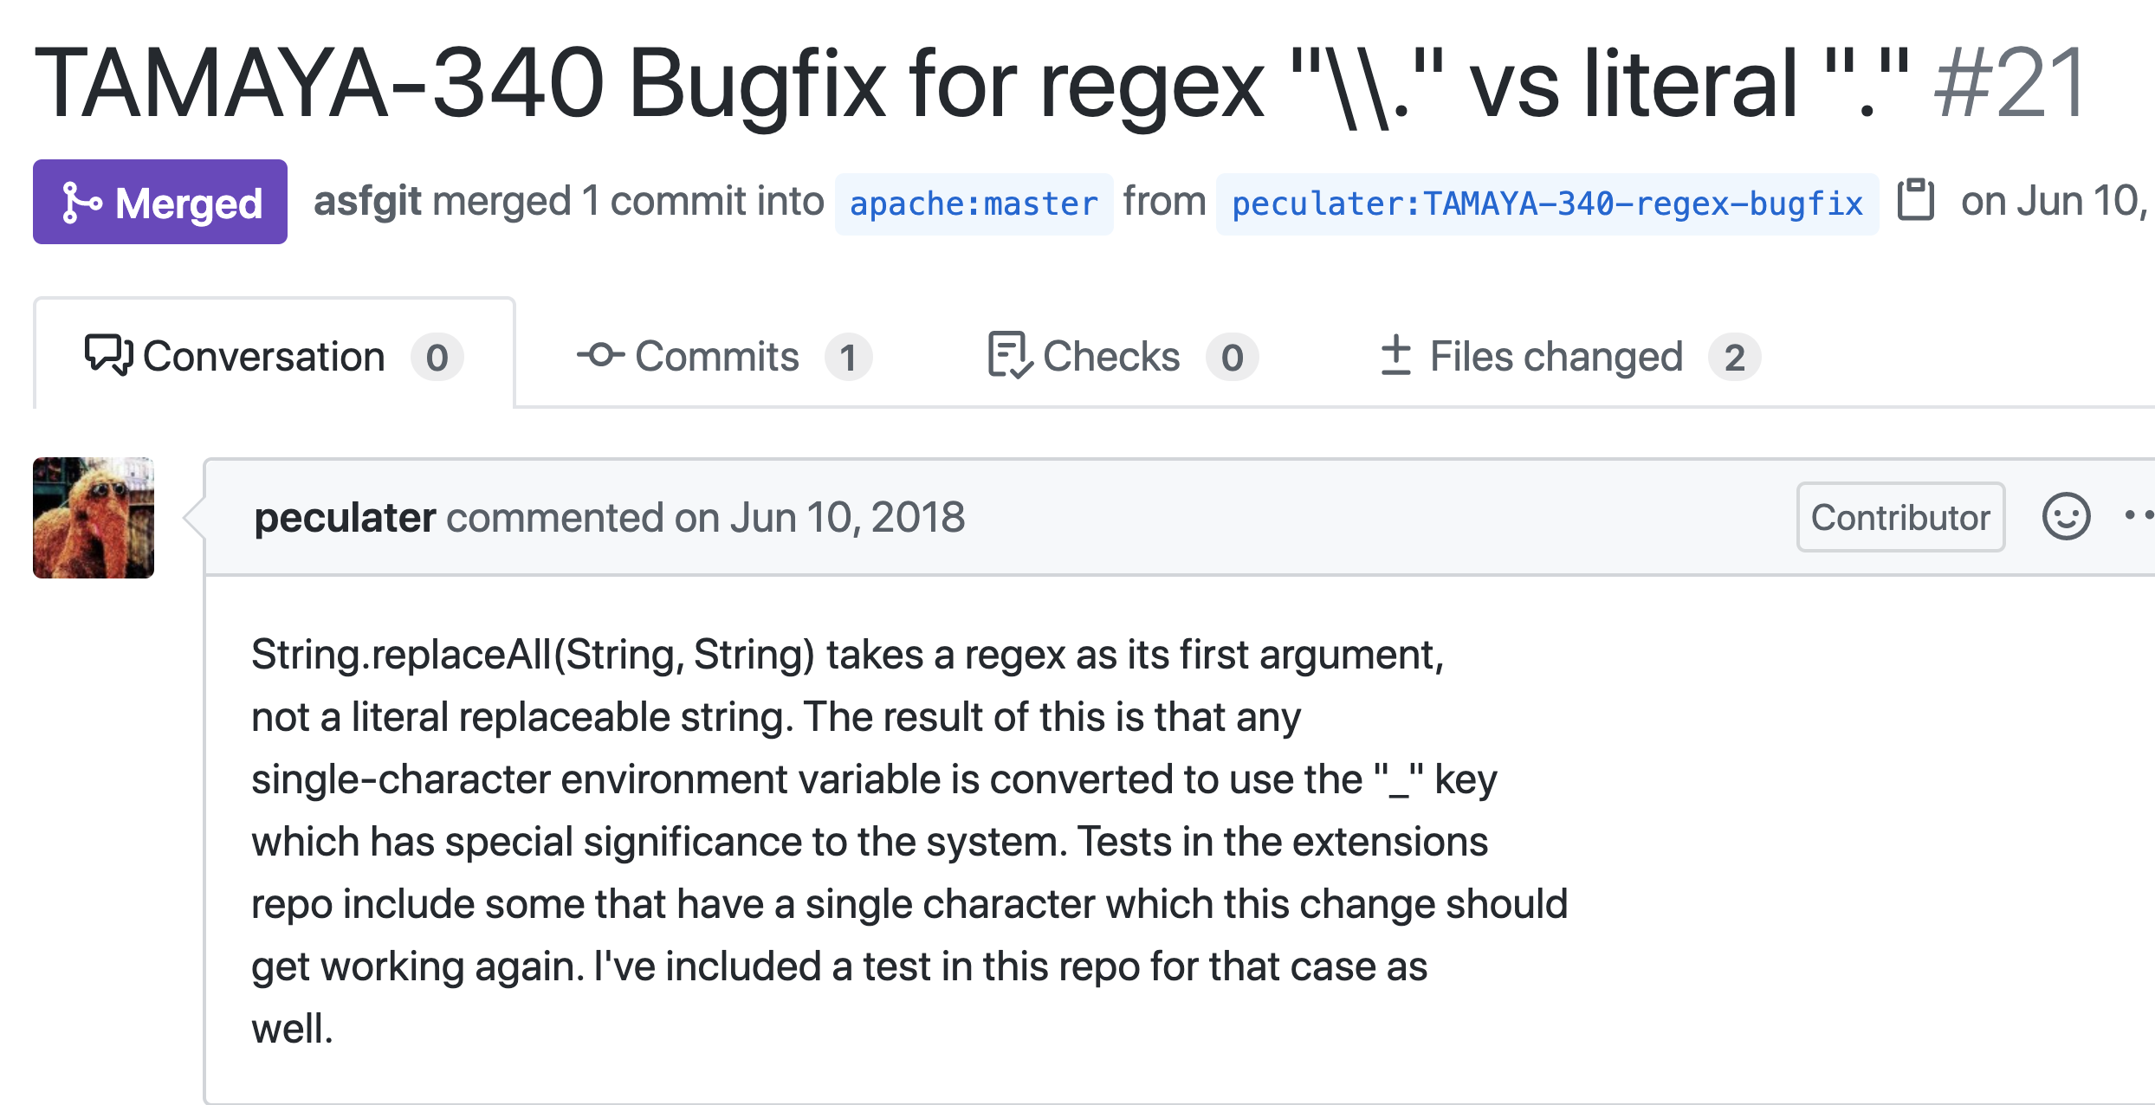
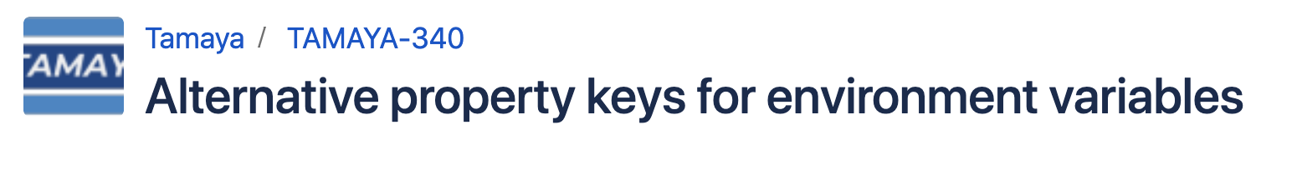
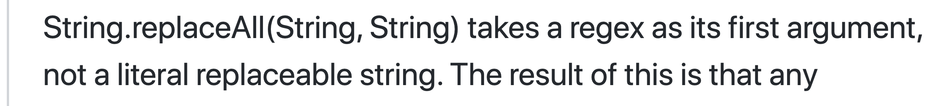
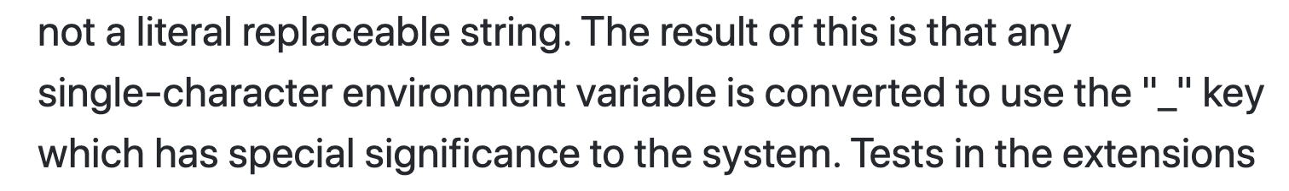
Notes:
To identify the root cause and manifestation, we check the title and description to understand what happened.
In this example, regex is complained (click) because if you pass the literal dot to the replaceAll function, it would be treated as the wildcard dot in regex. As a result (click), all single characters are converted.
If the pull request contains an external JIRA bug report(click), we also read the bug report to get more information.
https://github.com/apache/incubator-tamaya/pull/21

Slide 16
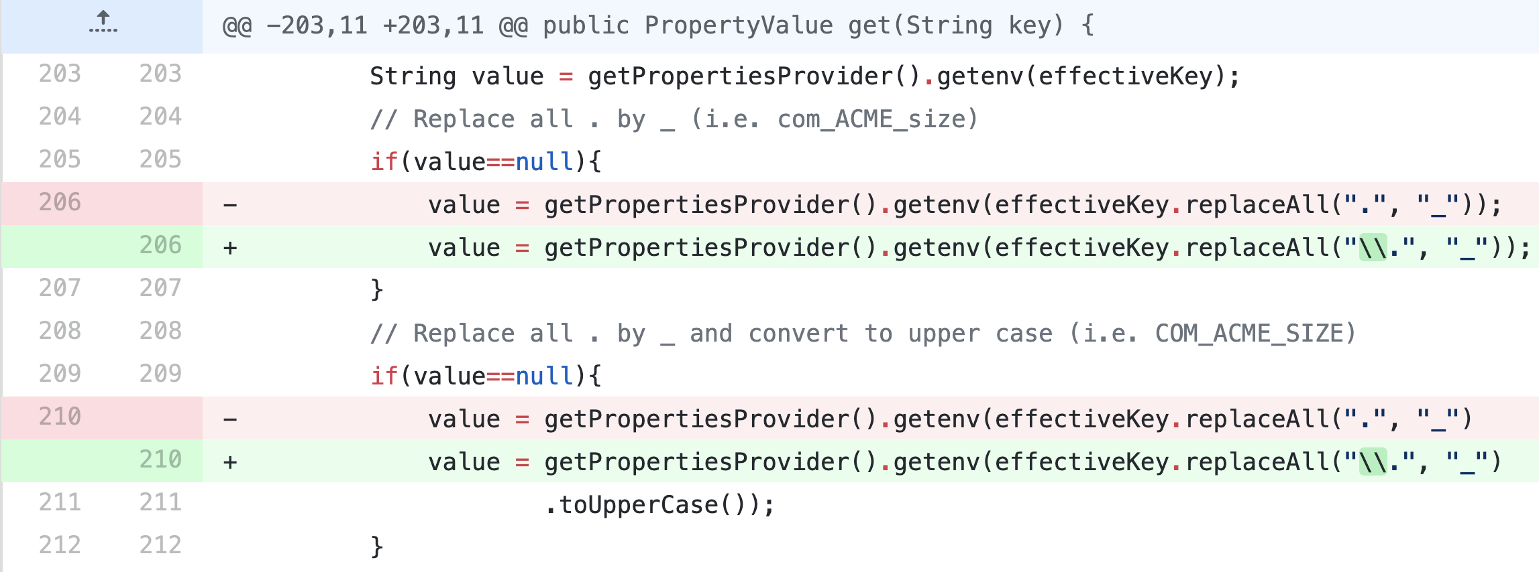
Notes:
We also look at the code changes in the pull request. (click).
In this example, the fix is pretty easy, Just add two backslashes before the dot, and it will tell the regex parser that here is a literal dot and not a wildcard.

Slide 17
Incorrect Semantics
Compile Error
Regular Expression Itself
Design/Code Smells
Incorrect Computation
Root Causes
Regex API
Manifestations
Design/Code Smells
New Feature
Other Code
Bad Smells
Other
Notes:
With this approach, three root causes emerged. (click)
Each root cause manifested in two or three different ways. (click)
(click) “Other Code” is used to describe bugs where regex or regex API changes are contained in the PR but they are not the root cause of the bug. This is because we did not exclude pull requests for feature requests in the data collection. Pull requests can be used for both feature requests and bug fixes, but it is hard to distinguish them automatically.
(click) Note that each group has a bad smell as its manifestation. A bad smell can be either a code smell or a design smell. They refer to code that has correct semantics but is flawed in another way, such as poor maintainability, performance, or readability. Duplicated code, long method, or spaghetti code are the well-known smells you might have already heard of.
In the next few slides, I will give two examples to illustrate the different type of regex bugs.
So we treat all pull requests for bug fixing during artifact collection and distinguish the ones for new feature during classifying the root causes and manifestations.
We used open card sorting with two raters to identify categories of root causes and manifestations.
The root cause is the location in the
source code wherein the problem lies. The manifestation is the impact of the bug on the code.

Slide 18
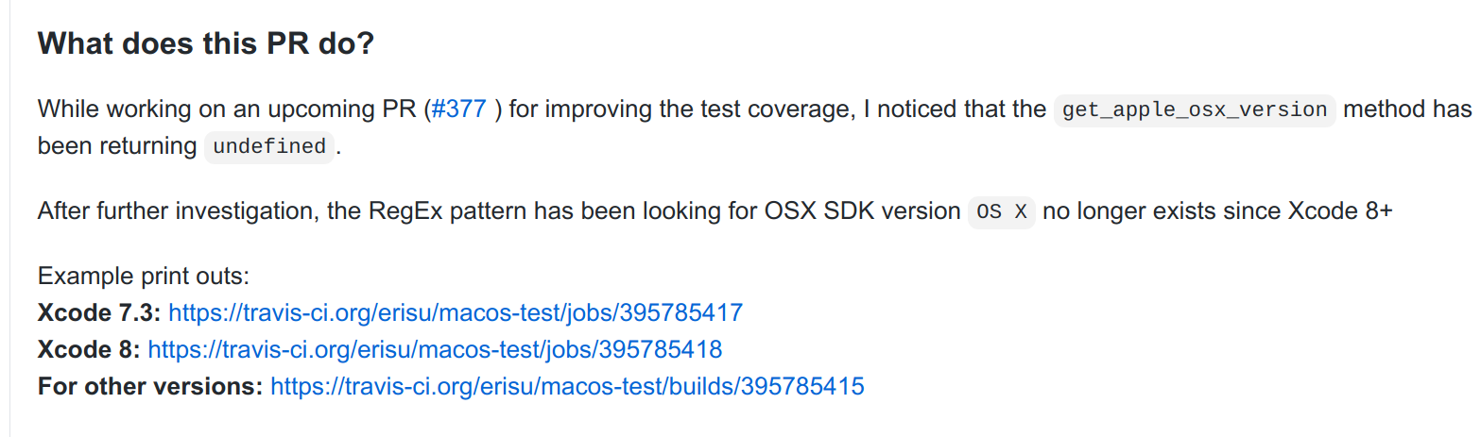

After further investigation, the RegEx pattern has been looking for OSX SDK version OS X no longer exists since Xcode 8+.
Incorrect Semantics
Regular Expression
Regexes need to evolve with the target content
Notes:
This is the example of incorrect regex semantics. From the description (click) we can see that regex could not get the correct version number because the input string has changed since Xcode version eight.
To fix the bug (click), regex has to be changed in order to match the new data type.
This example shows(click) that regex can become obsolete and needs to evolve with the content
https://github.com/apache/incubator-tamaya/pull/21
https://github.com/mozilla/feedthefox/pull/43

Slide 19
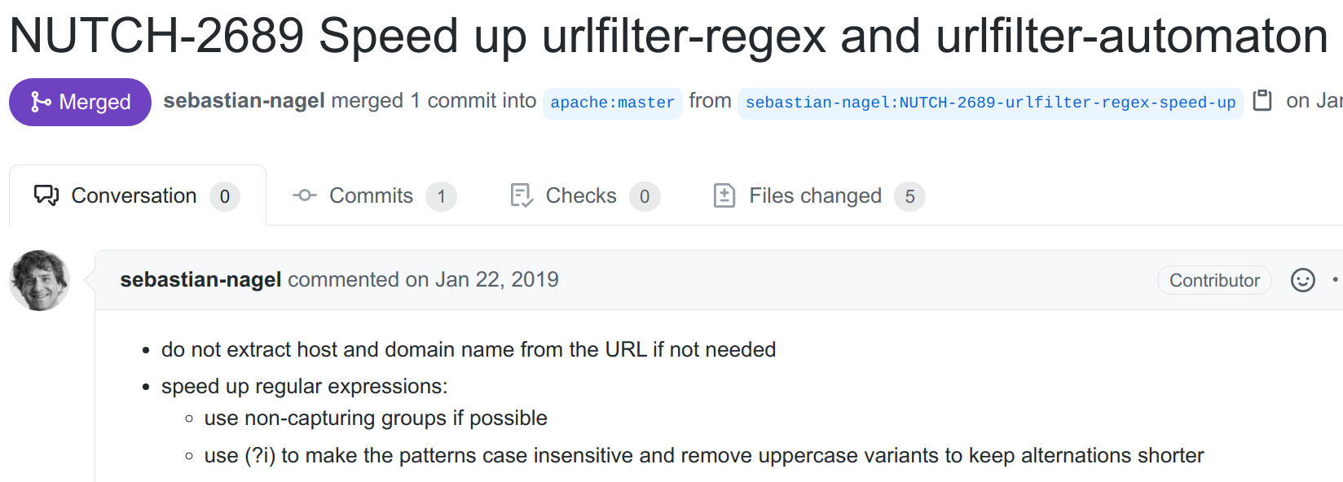
Regular Expression
Design/Code Smells
Code Smells
speed up regular expressions:
use non-capturing groups if possible
use (?i) to make the patterns case insensitive and remove uppercase variants to keep alternations shorter
Performance issues
Notes:
This example is about regex code smells. Specifically it is a code smell related to regex performance.
(click) In order to optimize regex execution, capturing groups are changed to non-capturing groups. And capitalized letters are removed and flag is used to indicate that regex is case-insensitive.
However, the effectiveness of tuning regex features is still unknown yet, we have an ongoing work to measure the regex optimization improvement.
Here is another example. The problem in this PR is the performance because most of the succeeded test logs are sent for error parser with a regex. So the root cause is Regex API. Since the problem lies in how to write the code, it is a code smell. Specifically, it is a type of code smell of unnecessary computation.
The fix for this type of performance problem is to filter out the logs which do not need the regex parsing. In the domain of network intrusion detection, it is called string-based pre-filtering.
Also with the two examples about performance issues, we realize that Regex performance is about more than regex complexity.
Prior work on theoretical regexes performance and ReDoS [45, 168, 175, 200] have been focuses on the complexity of executing a regular expression, such as linear or super-linear, or (Cyclomatic Complexity
) ---number of wildcard, the level of nested repetitions. But In the PRs we studied, developers demonstrated an interest in optimizing regex execution by refactoring the surrounding code (e.g., adding conditional checking,or by fine tuning the features in the regular expression representation such as changing capturing groups to non-capturing groups in the previous slide.
https://github.com/google/ExoPlayer/pull/3185
https://github.com/apache/nutch/pull/432
https://github.com/apache/accumulo/pull/628
https://github.com/mozilla/treeherder/pull/61

Slide 20
Distribution of Regex Bugs
Root Cause | Manifestation | Count (%) in Manifestation | Count (%) in Root Cause
Regex | Incorrect Semantics | 165 (75.7%) | 218 (61.2%)
 | Compile Error | 8 (3.6%)
 | Bad Smells | 45 (20.6%)
Regex API | Incorrect Computation | 6 (22.2%) | 33 (9.3%)
 | Bad Smells | 27 (81.8%)
Other Code | New Feature | 59 (56.2%) | 105 (29.5%)
 | Bad Smells | 19 (18.1%)
 | Other Failures | 27 (25.7%)
Notes:
Regarding the distribution of regex bugs, we can see from the table that (click) 60% of them are caused by the regex itself. Another 9% are caused by regex APi, and 30% of them are other code, not caused by regex or regex API.
In the perspective of manifestation, the largest category (click) is incorrect semantics taking 76% of the bugs caused by regex, or (click) 46% of the studied regex bugs.

Slide 21
Distribution of Regex Bugs
Incorrect Semantics (165/356 Bugs, 46%)
Rejecting valid strings | 102 (61.8%)
Accepting invalid strings | 36 (21.8%)
Both of the above | 17 (10.3%)
Others | 10 ( 6.1%)
Regexes tend to be too restrictive.
Notes:
If we look at incorrect semantics loser, the most common bug of incorrect semantics is rejecting valid strings. Its percentage is almost three times as common as accepting invalid strings, indicating that (click) developers tend to write overly-restrictive regexes.

Slide 22
Distribution of Regex Bugs
Root Cause | Manifestation | Count (%) in Manifestation | Count (%) in Root Cause
Regex | Incorrect Semantics | 165 (75.7%) | 218 (61.2%)
 | Compile Error | 8 (3.6%)
 | Bad Smells | 45 (20.6%)
Regex API | Incorrect Computation | 6 (22.2%) | 33 (9.3%)
 | Bad Smells | 27 (81.8%)
Other Code | New Feature | 59 (56.2%) | 105 (29.5%)
 | Bad Smells | 19 (18.1%)
 | Other Failures | 27 (25.7%)
Regexes need to be tested!
Notes:
Note that in the distribution of bugs, compile errors occur in eight of the PRs. Although this type of bug is not common, it is worthy to point it out because regexes exist in the code base even though they do not compile.
The existence of regex compile errors implies that regexes are not tested otherwise compile error will break the test execution and cause test failures. (click) So definitely regexes need to be tested. And it would better to test regexes earlier before they are introduced into the code base.

Slide 23
Regex Bug Fix W/O Test Code Changes
Total | Without Test Code Changes | With Test Code Changes
 |  | Addition | Edit | Removal
356 | 182 (51.1%) | 131 (75.3%) | 59 (33.9%) | 19 (10.9%)
 |  | 174 (48.9%)
# bug fixes without test changes (GitHub commits)
4/795 (0.5%) in BugsJS
[Gyimesi, ICST 2018]
741/12,355 (6%) in BEARS
[Madeiral, SANER 2019]
Test changes is uncommon in regex bugs
Notes:
As an extension of regex bugs, we checked the number of bugs where test code changes are contained in the bug fix.
It turns out that over 50% regex bugs are resolved without changes to the test cases.
(click)
In the dimension of GitHub commits, the reported percentages are below 6%.
In other words, (click) test changes not common in regex bugs, making us worry if regular expression testing is not common as well.
BUGSJS: A Benchmark of JavaScript Bugs
BEARS: An Extensible Java Bug Benchmark for Automatic Program Repair Studies

Slide 24
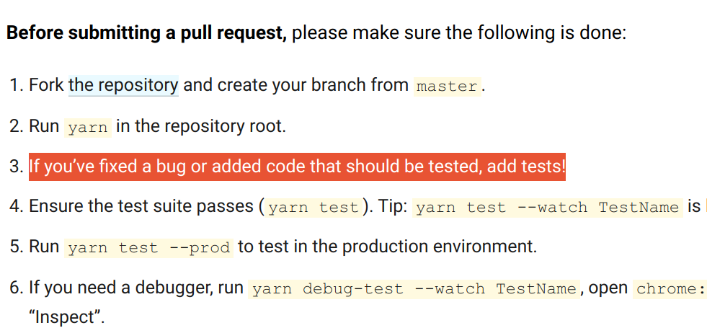
Regex Bug Fix W/O Test Code Changes
Total | Without Test Code Changes | With Test Code Changes
 |  | Addition | Edit | Removal
356 | 182 (51.1%) | 131 (75.3%) | 59 (33.9%) | 19 (10.9%)
 |  | 174 (48.9%)
Notes:
The dominant type of test code changes in regex-related pull requests is test case addition (75%).
Which is somewhat expected. If you check the developers guide on how to contribute, you can see (click) they always suggest add tests.

Slide 25
Regex Bug Fix W/O Test Code Changes
Root Cause | Manifestation | Test Code Addition | Test Code Edit | Test Code Removal | Combined
Regex | Incorrect Semantics | 53 | 32 | 10 | 79/165 (47.9%)
 | Compile Error | 0 | 0 | 0 | 0/8 (0.0%)
 | Bad Smells | 10 | 7 | 2 | 16/45 (35.6%)
Regex API | Incorrect Computation | 2 | 2 | 0 | 4/6 (66.7%)
 | Bad Smells | 6 | 1 | 1 | 7/27 (25.9%)
Notes:
Combining the regex bugs with test code changes, we can see that the overall percentage of test case change for incorrect semantics is 48%, which is even less than the average.
Also, there is no test code change for fixing regex compile errors, consistent with our speculation that those regexes are not tested.

Slide 26
Summary: Regular Expression Bugs
Regex can become obsolete and needs to evolve
Regexes tend to be restrictive and cause incorrect semantics
Developers do not often change regex test code
Notes:
To summarize the study of regex bugs, we found regex bugs have multiple root causes and manifestation, including incorrect semantics, compile error, incorrect API usage, and bad smells.
Also, we realize that “Write once and read forever” is a bad practice in regex usage, because as software evolves, regular expression can become obsolete and cause regex bugs.
We also find evidence to support regexes tend to be restrictive.
Most importantly, we find that developers do not often change regex test code in bug fix. In the next study will be focusing on regex testing, (click) to measure how well regex are tested.

Slide 27
Outline
Developers do not often change regex test code (51%)
2
Regular Expression Testing
1
Regular Expression Bugs
[FSE 2018]
3
[MSR 2020]
Regular Expression Evolution
Regex semantics become obsolete as software evolves
[SANER 2019]

Slide 28
Regex Testing Artifacts
RepoReaper: curated GitHub projects
5,691 Java Maven projects ( test code ratio > 0, call sites in code > 0 )
1,225 Java Maven projects
Notes:
In regex testing, we also use Github projects. But this time we choose curated projects and select only Java Maven projects. In total we picked up 1200 projects based on two criteria. One is that the project must have test code. The other is that the project must have regex call site.

Slide 29
Regex Call Site
...
11 private static Pattern segmentRegex = Pattern.compile("((:\\w+)|\\*)");
...
33 private Pattern compileRoutePattern(String route) {
34 String routeWithoutFirstSlash = route.substring(1);
35 List<String> segments = new ArrayList<String>();
36 for (String segment : routeWithoutFirstSlash.split("/")) {
37 Matcher match = segmentRegex.matcher(segment);
38 if (match.matches()) {
...
53 }
Call site
Project name: mikko-apo/KiRouter.java
File name: SinatraRouteParser.java
Line number: line 38
Notes:
Regex call site is the place where regular expression matching happens.
In this example, there are four lines related to the regex. (click)
The object match in Line 38 is created in Line 37, but the regex and the input string are defined in different places.
Since we only care about the matching invocation, only line 38 is the valid call site. (click) So we logged the project name, the file name, and the line number of this call site.

Slide 30
How Many Regexes are Tested
18,426 call sites in source code (String.matches, Pattern.matches, Matcher.matches)
# call sites per project (median: 4, mean: 15)
3,093 (16.8%) are executed by the test suites.
Most regular expression call sites (83%) are not tested
Notes:
To answer how many regexes are tested, we calculate how many call sites are reached in maven tests.
Overall, there are 18 thousand call sites about the three regex matching methods in Java API.
But only around 17% of them are executed in maven tests. (click) The majority of the regex call sites are not tested.
Call site is the statement coverage of regex matching.
But regex can be passed as variables and in each call site there could be multiple regex being executed.
So call sites do not actually measure how many regex tested. We need other coverage metrics to describe it.

Slide 31
Regex Testing Coverage
L1: if(Pattern.matches("-d|--d",str)) {
L2: System.out.println("YES");
...
L4: } else {
L5: System.out.println("NO");
...
}
str
L1
“-d”
“xd”
L2
L5
Code coverages are insufficient to describe regex structure
Notes:
Then how about branch coverage?
In this example the regex accepts two inputs “-d” and “--d”.
Bt to have a 100% branch coverage, we only need one input “-d” to cover the true branch and some non-matching input “xd” to cover the false branch.
But “--d” is not covered. (click)
So current code coverage metrics have ignored the internal structure of the regular expression.
We have come up with graph-based coverages for measuring regex coverage.

Slide 32
Regex Testing Coverage
L1: if(Pattern.matches("-d|--d",str)) {
L2: System.out.println("YES");
...
L4: } else {
L5: System.out.println("NO");
...
}
Matching
1
“d”
“-”
3
“-”
“d”
"-d|--d"
0
not “d”
2
not “d”
not “-”
Non-matching
e
Notes:
In graph-based coverages, we use an automata or DFA to represent the regular expression structure. (click) In this DFA, the node with double circles (click) represents the matching state and the node e in grey color (click) represents the non-matching state.
With this DFA, the regex coverage can be clearly shown on the visited nodes and edges of the graph.

Slide 33


Regex Testing Coverage
str
 | Total
Node Coverage | 80% (4/5) | 60% (3/5) | 40% (2/5)
Edge Coverage | 43% (3/7) | 29% (2/7) | 14% (1/7)
Matching input
Non-matching input
L1
“-d”
“xd”
L2
L5
1
“d”
“-”
Uncovered
3
“-”
“data”
"-d|--data"
0
not “d”
2
not “d”
not “-”
e
Notes:
If we use the same test input: (click) “-d” as matching string, “xd” as non-matching string, the visited nodes and edges looks like this on the graph. (click)
Blue circle and blue edge are the ones visited by matching string, Red circle and red edge are the ones visited by non-matching string. Purple is the node visited by both strings.
Regarding this example, the graph has 5 nodes and 7 edges.
The matching string covers 3 nodes and 2 edges, Similarly, the non-matching string covers 2 nodes and 1 edge. In total, test inputs cover 4 nodes and 3 edges.
So the total node coverage is 80%, and the total edge coverage is 43%.
Since both node and edge coverages are not 100%, we can spot on the graph that (click) node 2 and other 4 edges are not covered by the tests.
In this way, the graphical representation provides finer-grained testing coverages for regex.

Slide 34
How Well Are Regex Tested
 | Only matching inputs | Only non-matching inputs | & | total
# regex | 6,029 | 4,941 | 4,126 | 15,096
% regex | 39.9% | 32.7% | 27.3% | 100%
A majority of regular expressions are tested with only matching or non-matching inputs
Notes:
In total, we measured test coverage for 15 thousand regexes. But (click) the majority of them are tested with only matching or non-matching inputs. 40% of them are tested with only matching inputs and 33% are tested with only non-matching inputs. Only 27% of tested regexes are tested with both input types.

Slide 35
How Well Are Regex Tested
 | Regex length | # Test string inputs | Node Coverage | Edge Coverage
Mean | 31 | 60 | 59.05% | 28.74%
25% | 12 | 1 | 24.62% | 6.67%
Median | 18 | 2 | 63.64% | 23.90%
75% | 39 | 7 | 95.65% | 49.97%
Regex test coverages are low
Notes:
Regarding the size of test inputs, 75% of the regex have at most 7 test strings.
The average node coverage is below 60%. The edge coverage is even lower. 75% of the tested regex have a edge coverage below 50%.
So (click) regex test coverages are low. It is might because the test input size is small, and the test inputs mainly include one type of strings.

Slide 36
Summary: Regular Expression Testing
Regular expressions are un-tested or under-tested
The majority of regular expressions are tested with only matching or non-matching inputs
Notes:
The take-away from the study of regex testing is that regular expression testing deserve more attention because regex are un-tested or under-tested.
They are un-tested because 83% of regex call sites are not executed.
Another take-away from this study is that regex are tested mainly with either matching inputs or non-matching inputs.
We suggest using both matching and non-matching inputs for testing them. And if possible, tools should be used to help developers establish a better input set.

Slide 37
Outline
Developers do not often change regex test code (51%)
2
Regular Expression Testing
1
Regular Expression Bugs
[FSE 2018]
3
[MSR 2020]
Regular Expression Evolution
Regex semantics become obsolete as software evolves
[SANER 2019]
Notes:
Following the finding in bug study that regex semantics become obsolete as software evolves, the regex evolution will focus on the semantic changes of regex over time.

Slide 38
Regex Evolution
Collect regex changing history in GitHub
latest
v0
v1
v2
v3
v4
v5
v6
Len: 3
Edits: 2
Regular Expression Edit Chain
r1
r2
r3
path/to/file_regex.java
13: String regex = function_par
14: Pattern test = Pattern.compile(regex);
path/to/file_regex.java
14: Pattern test = Pattern.compile( “\d{3}-\d{3}” );
Notes:
To get regex changes over time, we search in the GitHub commit history to find that which commit version contain regexes.
For each project we start with (click) latest version where a literal regex is used in the source code. So from V6 (click) we trace back to V4, V2 and V0. All these code versions contain the regex in the same location.
For V0, although there is a regex compiled on line 14(click), we exclude it in the regex change history (click) because the regex is a variable, not a literal string.
(click) So we are left with 3 regular expressions, r1, r2, and r3.
(click) They form a regex edit chain with 2 regex edits and have a length of 3 (click).

Slide 39
Regex Evolution Artifacts
Commit histories: “git log -L <start>,<end>:<file>”
3,962 edit chains with 4,224 regexes
Notes:
We use “git log” to trace back the changes of a regex at a specific file location.
The result is about 39 thousand edit chains.

Slide 40
Regex Edit Frequency
 | Edit Frequency ( # edit chains)
 | No edits (len = 1) | Have one edit (len = 2) | Have edits (len >2)
GitHub | 3,775 (95.3%) | 137 (3.5%) | 50 (1.3%)
Regexes are not frequently modified
Notes:
Among those edit chains, 95% of them have a length of one, which means there is no regex edit on these regex locations.
(click) So regexes are not frequently modified. Only 187 edit chains have a length more than one.

Slide 41
Regex Semantic Changes
Disjoint
Overlap
Equivalent
r1
r2
r1
r1
r2
== r2
Expansion
Reduction
r1
r2
r1
r2
Notes:
There are five types of regex semantic changes. Regex semantics can have overlap, can be equivalent or disjoint. Also the regex semantics can expand or shrink after the regex edit.
We use r1 to refer regex before the semantic changes, and r2 to refer regex after the semantic change.

Slide 42
How to Measure Semantic Changes
Semantic reduction
Regex for matching string of integers
r1: [0-9]+ r2: [0-9]|[1-9][0-9]*
“1a”
“02”
“123”
r2
Matching strings for r1: 500
Matching strings for r1: 1000
r1
1000 strings
Matching strings for r2: 500
Matching strings for r2: 940
Notes:
Suppose there is a edit on the regex matching string of integers.
We can illustrate the semantic change in this graph. “1a” is always rejected by both r1 and r2. “123” is always accepted by both r1 and r2. “02” is a matching string in r1, but it becomes a non-matching input in r2.
To identify the type of semantic changes automatically, (click) we generate 500 matching strings for r1, and 500 matching strings for r2. (click) together there are 1000 strings.
We then calculate (click) how many of these 1000 strings are matching strings in r1 and r2.
Since r1 matches all 1000 strings but r2 only 940, the type of semantic change in this example is (click) semantic reduction.

Slide 43
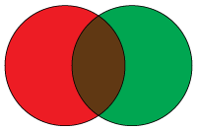
How to Measure Semantic Changes
Regex for integers
r1: [0-9]+ r2: [0-9]|[1-9][0-9]*
r1
r2
Matching strings for r1: 500
Matching strings for r1: 1000
Removal | Inter- section | Addition
6% (60/1000) | 94% (940/1000) | 0% (0/940)
1000 strings
Matching strings for r2: 500
Matching strings for r2: 940
Notes:
We also need to measure the degree of semantic changes. They are the areas of different colors in the circles.
(click) The intersection of semantics is the percentage of strings accepted by both regexes.
(click) The removal is the percentage of strings accepted in r1 but rejected in r2. In this example, the rejected strings are 60, so the degree of semantic removal is 6%.
(click) The addition is the percentage of strings rejected in r1 but accepted in r2. In the example of semantic reduction, it is 0.

Slide 44
Regex Semantic Changes
 | Disjoint | Overlap | Equivalent | Reduction | Expansion
GitHub | 44 (21%) | 17 (8%) | 22 (11%) | 20 (10%) | 106 (51%)
Regexes are overly restrictive
Notes:
Our result shows that 51% of regex changes is regex semantic expansion, another evidence (click) to show that regexes are overly restrictive.

Slide 45
Regex Semantic Changes
 | Disjoint | Overlap | Equivalent | Reduction | Expansion
GitHub | 44 (21%) | 17 (8%) | 22 (11%) | 20 (10%) | 106 (51%)
70% of regular expression edits in GitHub are related to semantic correctness
Notes:
Regex overlap, reduction, and expansion mainly deal with semantic correctness. So together there are about 70% of regex edits are related to semantic correctness.

Slide 46
Regex Semantic Changes
 | Disjoint | Overlap | Equivalent | Reduction | Expansion
GitHub | 44 (21%) | 17 (8%) | 22 (11%) | 20 (10%) | 106 (51%)
Software requirement
Performance, Security
Notes:
For the other two types, equivalent semantic changes (click) are usually because of regex refactoring for performance or security purposes.
Disjoint changes (click) are related to software evolution where the software requirement or data input changes.

Slide 47
Regex Semantic Changes
 | Intersection |  | Addition |  | Removal
 | Mean | Median | Mean | Median | Mean | Median
GitHub | 57% | 70% | 39% | 26% | 28% | 0%
Regexes are partially correct
Notes:
As we mentioned earlier, intersection, addition, removal are the metrics to measure the degree of semantic changes.
The average value of the regex semantic intersection in an edit is 57%, meaning that on average more than half of the matching strings are retained after the regex edit. But the median is 70%, indicating that for 50% of regex changes, at most 70% of the matching strings will be retained after the regex edit. Changing 30% of the matching input strings is a big deal, it is telling us that (click) regex in the source code are partially correct.

Slide 48
Summary: Regular Expression Evolution
Regular expressions are rarely changed (5% changed)
Why regular expression evolves
Restrictive regexes (50%), semantic correctness (70%)
Performance, security, software evolution, etc (disjoint, equivalent)
Notes:
To summary the regex evolution study, we do think that “Write once, read never” is a common problem in regex usage because only 5% of regexes have been changed in GitHub projects.
Second, for the 5% of changed regex, we found that regex evolves for different reasons. Half of them are done because the original regexes are too restrictive. About 70% of them are related to semantic correctness, For the others the reasons are usually software changes, performance concerns, and security concerns.
Partially correct -----compromise between what to match/ offer
Regular expressions are partially correct

Slide 49
Thesis Statement Revisit
Regular expressions in open source software have low test coverage, are modified infrequently, are overly restrictive, and contribute to software bugs.
Notes:
To revisit regex usage, we found regex are modified infrequently and are overly restrictive in the study of regex evolution. In the study of regex testing, we found that most regexes are not tested. For the tested ones, they have a low test coverage. These issues in regex usage contribute to regex-related software bugs. In the regex bug study we also found similar evidence of these issues.

Slide 50
Future Work
Education
When to (not) use regular expression
Correct Regex Practice on writing, testing, documentation
IDE
Immediate feedback
Persuade developer to use
Default optimization in regex engines/libraries
Regex performance optimization [Hyperscan NSDI 2019]
ReDoS-safe regex engine [JEP draft: Predictable regex performance]
Notes:
After showing all these regex issues, the first thing I want to say is that don’t blame developers. Regex is hard and not well-supported in software development. So developers are not fully responsible for all these faults.
Now let’s go back to our original question of how to help developers. In the study we found sometimes regex is introduced as a better solution, sometimes, regex is removed and other alternative solutions are used instead. So in the education area, maybe we should teach students ont just the basics of regex syntax is necessary but also educate students when to use and when not to use regex. Also we can educate students the correct way to use regex. How to compose and validate the regex, how to test them, and even how to document them so that others can understand the purpose of using it.
To help developers, there are already some regex tools, but these tools are independent from the software development. So maybe we can build these tools in the IDE. With the immediate feedback from IDE, developers can spot the regex compile errors and more willing to test their regex correctness. Only having the tool is not enough, we also need to persuade developers to use it. The nudge theory may help
One more thing we learned in the study is that developers care about regex performance. Instead of pushing developers to detect the security risks and make the optimization manually, why can’t we build the auto-optimization in the regex library. These are actually progressing work. Hyperscan is a regex library which has already merge the optimization. Also the openJDK community is having a proposal to build a ReDoS-safe regex engine.
There are a lot of work can be done for regex. Some I have proposed previously such as regex mutation, fix regex bugs, and regex synthesis. As we can see, developers use it but not frequently enough for them to take a very serious attitude, to know all aspects of it. If I only use it once a year, why should I know how it is implemented, using DFA or NFA, or when it could cause security issues? I may be using a simple regex and this knowledge may never be used.

Slide 51
Publication List
“Demystifying Regular Expression Bugs: A comprehensive study on regular expression bug causes, fixes, and testing”. Peipei Wang, Chris Brown, Jamie Jennings, Kathryn T. Stolee, Empirical Software Engineering (EMSE) 2021. (under minor revision).
“An Empirical Study on Regular Expression Bugs”, Peipei Wang, Chris Brown, Jamie A. Jennings, Kathryn T. Stolee, International Conference on Mining Software Repositories (MSR), 2020.
“Exploring Regular Expression Evolution”, Peipei Wang, Gina R. Bai, Kathryn T. Stolee, IEEE International Conference on Software Analysis, Evolution and Reengineering (SANER), 2019.
“How well are regular expressions tested in the wild?”, Peipei Wang, Kathryn T. Stolee, Symposium on the Foundations of Software Engineering (FSE), 2018.
“DScope: Detecting Real-World Data Corruption Hang Bugs in Cloud Server Systems”, Ting Dai, Jingzhu He, Xiaohui Gu, Shan Lu, and Peipei Wang, ACM Symposium on Cloud Computing (SOCC), 2018.
Notes:
Here is the list of publications since I came to ncsu. My dissertation is based on the first 4 publications.

Slide 52
Publication List (cont.)
“Hytrace: A Hybrid Approach to Performance Bug Diagnosis in Production Cloud Infrastructures”, Ting Dai, Daniel Dean, Peipei Wang, Xiaohui Gu, Shan Lu, IEEE Transactions on Parallel and Distributed Systems (TPDS), 2018.
“Exploring Regular Expression Comprehension”, Carl Chapman, Peipei Wang, and Kathryn T. Stolee, International Conference on Automated Software Engineering (ASE), 2017.
“Hytrace: A Hybrid Approach to Performance Bug Diagnosis in Production Cloud Infrastructures”, Ting Dai, Daniel Dean, Peipei Wang, Xiaohui Gu, Shan Lu, Proc. of ACM Symposium on Cloud Computing (SOCC), poster session, Santa Clara, CA, September, 2017.
“A Systematic Study of Security Isolation”, Rui Shu, Peipei Wang, Sigmund A. Gorski III, Benjamin Andow, Adwait Nadkarni, Luke Deshotels, Jason Gionta, William Enck and Xiaohui Gu, ACM Computing Surveys(CSUR), 2016.
“RDE: Replay DEbuggging for Diagnosing Production Site Failures”, Peipei Wang, Hiep Nguyen, Xiaohui Gu, Shan Lu, Proc of IEEE International Symposium on Reliable Distributed Systems (SRDS), Budapest, Hungary, Sep. 26-29th, 2016.
Notes:
Here are a few more papers when I worked on security, and cloud systems before 2017.

Slide 53
Publication List (cont.)
“PerfCompass: Online Performance Anomaly Fault Localization and Inference in infrastructure-as-a-Service Clouds”, Daniel J. Dean, Hiep Nguygen, Peipei Wang, Xiaohui Gu, Anca Sailer, Andrzej Kochut, IEEE Transactions on Parallel and Distributed Systems (TPDS), 2015.
“Automatic Server Hang Bug Diagnosis: Feasible Reality or Pipe Dream”, Daniel J. Dean, Peipei Wang, Xiaohui Gu, William Enck, Guoliang Jin Proc. of IEEE International Conference on Autonomic Computing(ICAC), 2015. (short paper)
“Understanding Real World Data Corruption Bugs in Cloud Systems”, Peipei Wang, Daniel J. Dean, Xiaohui Gu, Proc. of IEEE International Conference on Cloud Engineering (IC2E), 2015.
“PerfCompass: Toward Runtime Performance Anomaly Fault Localization for Infrastructure-as-a-Service Clouds”, Daniel J. Dean, Hiep Nguyen, Peipei Wang, and Xiaohui Gu, Proc. of USENIX Workshop on Hot Topics in Cloud Computing (HotCloud), 2014.

Slide 54

Thanks
Thanks
Dr. Kathryn Stolee
Committee members
SE-lab
Notes:
Before the end of the talk, I would like to thank all the people who have helped me in the past, especially my advisor xxx, my committee, all labmates in the software engineering lab. And my cat Sarabi for giving me a lot of joy during the pandemic.

