Slide 1
Understanding Real World Data Corruptions in Cloud Systems
Peipei Wang, Daniel Dean, Xiaohui Gu
North Carolina State University
Notes:
Hi everyone, My name is Peipei, Today, I am going to present you my paper on :*****

Slide 2
About Me
Received my B.S. in Software Engineering and M.S. in Computer Science from Xi’an Jiaotong University, China.
Java EE5 Application Server Synchroweb (Patent)
Research of software aging and rejuvenation under network environment (Thesis)
Java instrumentation tool, patterns of method execution time
Entered the PhD program in May, 2013
Working under the guidance of Dr. Xiaohui (Helen) Gu
Part of the Distributed Systems Research Group on Autonomy, Resilience, Collaboration, and Energy (DANCE)

Slide 3
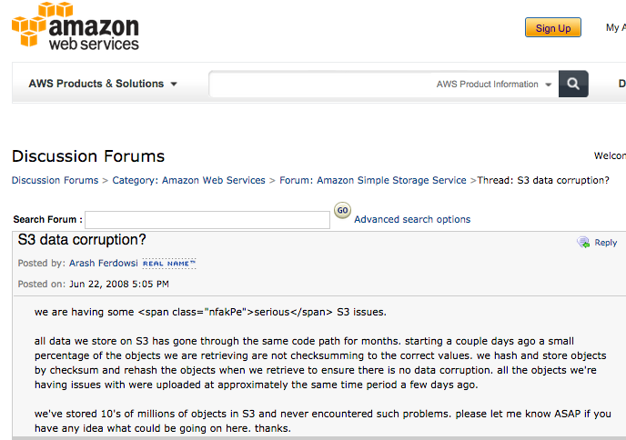
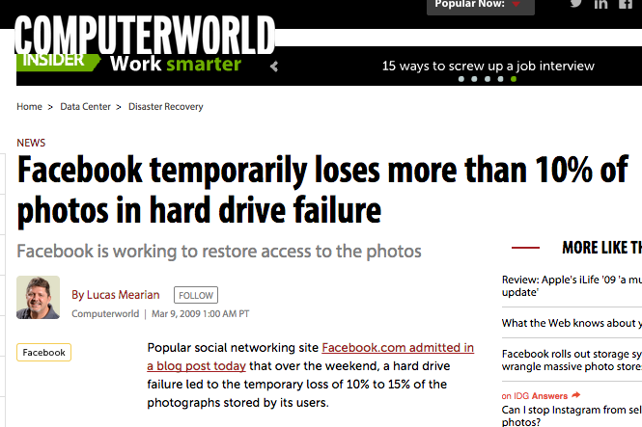
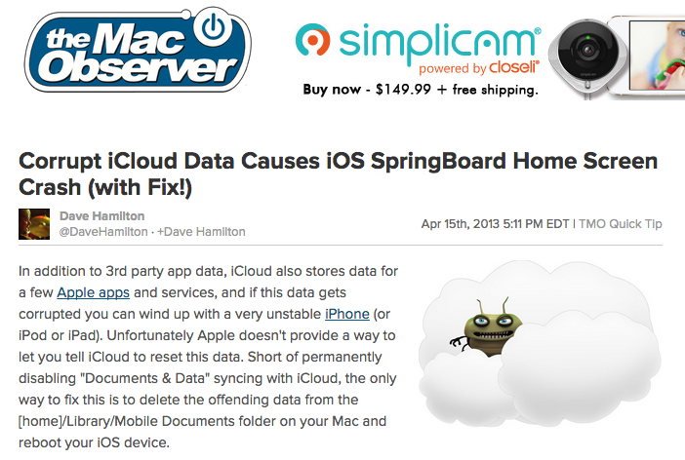
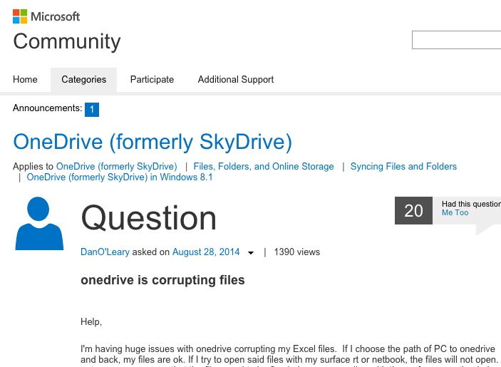
Motivation
Notes:
That’s first look at several real data corruption events in recently years
Facebook temporarily loses more than 10% of photos in hard drive failure
When most people think their data stored in cloud is safe, actually it is not the case.
While people think if data corruption happens, it must be because of hardware problems. But it could also because of software problems
It is important to understand some of the causes of data corruption

Slide 4
HDFS Background
1.HDFS write operation
Client
Memory
Data
NameNode
Data
3.Return three block locations
2.Log this operation, log block location
Disk
HDFS System Files
Memory
Memory
Memory
Block size
Checksum
Timestamp
Version
DataNode A
DataNode B
DataNode C
Disk
Disk
Disk
Block
Block
Block
Block
Block
Block metadata
Block metadata
Block metadata
Notes:
Data corruption can happen at any level of storage and with any type of media, Data corruption can happen anywhere within a storage environment. Data can be corrupted simply by migrating it to a different platform.
Media: bit rot, controller failures, deduplication metadata, tape failures
Metadata corruption----hardware-induced, software glitches,

Slide 5

HDFS Background
1.HDFS write operation
Client
Memory
Data
NameNode
3.Return three block locations
2.Log this operation, log block location
Disk
HDFS System Files
Memory
Memory
Memory
Block size
Checksum
Timestamp
Version
DataNode A
DataNode B
DataNode C
Disk
Disk
Disk
Block
Block
Block
Block metadata
Block metadata
Block metadata
Notes:
Errors occurred in logging----HDFS system File
Pipeline, network--------Block
Changes or update Block, without updating block metadata------metadata file
race condition---block metadata---which one is correct

Slide 6
Methodology
Randomly sampled 138 Hadoop bug incidents that are related to data corruption
All incidents are resolved bug incidents
Manually studied each bug report (e.g., bug descriptions, patches)
System Name | System file corruption | Metadata corruption | Block corruption | Misreported corruption
Hadoop 1.x | 15 | 11 | 46 | 4
Hadoop 2.x (YARN) | 1 | 0 | 7 | 0
HDFS 1.x | 17 | 7 | 23 | 7
HDFS 2.x | 8 | 0 | 22 | 10
Notes:
Covered both 1.x and 2.x version of Hadoop
HDFS is more likely related to data corruption than other Hadoop components

Slide 7
Outline
State of the art
Research goals
Data corruption impact
Data corruption detection
Data corruption causes
Data corruption handling
Key findings
Ongoing work
Conclusion
Notes:
Don’t need to read all points

Slide 8
State of the Art
Data corruption studies
DRAM errors [Schroeder et al. ASPLOS`12]
Latent sector errors [Schroeder et al. FAST`10]
Data corruption in storage stack [Bairavasundaram et al. FAST`08]
Issues
Focused on hardware-induced data corruption problems

Slide 9
State of the Art
Data corruption detection frameworks
Disk corruption on DBMS [ Subramanian et al. ICDE`10]
Subsystems of storage stack [Yang et al. OSDI`06]
ZFS File System [Zhang et al. ICDE`10]
Issues
Reactive approaches(e.g., corruption injection)
Stand-alone systems (e.g., file system)
Notes:
Reactive approaches, for stand-alone systems (e.g., file system)

Slide 10
State of the Art
Bug characteristic studies
Concurrency bugs [Lu et al. ASPLOS`08]
Performance bugs [Jin et al. PLDI`12]
Misconfiguration bugs [Xu et al. SOSP`13]
Incorrect error handling [Yuan et al. OSDI`14]
Cloud bugs [Gunawi et al. SOCC`14]
Issues
Not focus on data corruption
Notes:
Don’t need to read all points

Slide 11
Outline
State of the art
Research goals
Data corruption impact
Data corruption detection
Data corruption causes
Data corruption handling
Key findings
Ongoing work
Conclusion
Notes:
Don’t need to read all points

Slide 12
Research Goals
Understand real-world software-induced data corruptions
What impact can data corruption have on the application and system?
How is data corruption detected?
What are the causes of the data corruption?
What problems can occur while attempting to handle data corruption?
Notes:
Don’t need to read all points

Slide 13
Outline
State of the art
Research goals
Data corruption impact
Data corruption detection
Data corruption causes
Data corruption handling
Key findings
Ongoing work
Conclusion
Notes:
Don’t need to read all points

Slide 14
Data Corruption Impact on System
Integrity
Block
Metadata
Availability
Hadoop failures
MapReduce job failures
Performance
System file
Time delay
Decreased throughput

Slide 15
Data Corruption Impact Examples
HDFS-3277: fsimage load failure
HDFS-2798:
Thread cannot complete file operation
Block
Appending
Block
Scanner
Memory
NameNode
Matched
File system state
Disk
Disk
fsimage
Block
Block
Block metadata
Hadoop failures
Job failures
Time delay
Unmatched
Notes:
An fsimage file contains the complete state of the file system at a point in time

Slide 16
Data Corruption Detection
Existing data detection schemes are insufficient
Notes:
Discuss what each type of detection means
42%: misreported
21%: silent
12%: misreported
25%: correct

Slide 17


Data Corruption Detection Example
HDFS-1483:
silent data corruption
DataNode A
Block location on DataNode A
Block location on DataNode A/B/C
DataNode B
getBlockLocations()
DataNode C
NameNode
Client does not know block corruption
Corrupted block
Uncorrupted block
Notes:
Discuss what each type of detection means

Slide 18
Data Corruption Detection Example
HDFS-1524:
Misreported data corruption
Memory
4 bytes of compression related information unread
Compressed
fsimage
NameNode
Disk
Compressed
fsimage
Compressed
fsimage
Notes:
HDFS-1524 load failure because of uncomplete fsimage file

Slide 19
Outline
State of the art
Research goals
Data corruption impact
Data corruption detection
Data corruption causes
Data corruption handling
Key findings
Ongoing work
Conclusion
Notes:
Don’t need to read all points

Slide 20
Data Corruption Causes
Cause | Number of incidents
Improper runtime checking | 25
Race condition | 26
Inconsistent state | 16
Improper network failure handling | 5
Improper node crash handling | 10
Incorrect name/value | 5
Lib/command errors | 4
Compression-related errors | 4
Incorrect data movement | 2
Notes:
Discuss what each type of detection means
42%: misreported
21%: silent
12%: misreported
25%: correct

Slide 21
Data Corruption Causes Example
HDFS-3626:
Improper runtime check given invalid file path
Command with invalid path:
hadoop fs –put filename hdfs://localhost:8020//temp/filename
Mkdir
(path=/)
Mkdir
(path=//temp)
Add block
Set timestamp
Update block
…
Illegal operation
Hadoop failed to load edits.log
Edits.log
Notes:
Explain what this command is used for

Slide 22
Data Corruption Causes Example
HADOOP-3069:
Improper network failure handling
Void getFileServer
(outstream,…)
try{
…
outstream.write(buf,0,num);
…
}finally{
outstream.close();
…
}
try{
…
TransferFsImage.getFileServer(response.getOutputStream().nn.getFsImageName());
…
}catch(IOException e)
…
Response.sendError(…);
}
SecondaryNameNode
NameNode
Notes:
Error message cannot send out, Namenode will never know the file is corrupted

Slide 23
Existing Data Corruption Handling Schemes
Data corruption handling
Data recovery
Data replication
Data deletion
Simple re-execution
Notes:
Discuss what each type of detection means
42%: misreported
21%: silent
12%: misreported
25%: correct

Slide 24
Problems in Data Corruption Handling Schemes
HDFS-4799:
Incorrect data deletion
reboot
DataNode D
DataNode A
DataNode E
DataNode B
DataNode F
DataNode C
NameNode
Notes:
Discuss what each type of detection means
42%: misreported
21%: silent
12%: misreported
25%: correct

Slide 25
Outline
State of the art
Research goals
Data corruption impact
Data corruption detection
Data corruption causes
Data corruption handling
Key findings
Ongoing work
Conclusion
Notes:
Don’t need to read all points

Slide 26
Key Findings
The impact of data corruption is not limited to data integrity
Existing data corruption detection schemes are quite insufficient
There are various causes of data corruption
Existing data corruption handling mechanisms make frequent mistakes
Notes:
Don’t need to read all points

Slide 27
Ongoing Work
Data corruption detection schemes
Trace data-related operations
Find similar operations
Anomaly detection over the operation logs
Frequency
Order
Advantages: proactive
Weakness: cannot detect system file corruption
Notes:
Don’t need to read all points

Slide 28
Ongoing Work
HDFS-3626 bug detection
Command: ./hadoop fs -copyFromLocal ~/hadoop-2.0.0-alpha/README.txt hdfs://localhost:8020/
Operations: OP_ADD--->OP_SET_GENSTAMP(genstamp=1002)--->OP_UPDATE_BLOCKS--->OP_CLOSE--->OP_RENAME_OLD
--->OP_SET_GENSTAMP(genstamp=1003)
…
Command: cat /usr/share/dict/words |./hadoop fs -put - hdfs://localhost:8020//temp/bugfile
Operations: OP_MKDIR(path=/)--->OP_MKDIR(path=//temp)--->OP_ADD--->OP_SET_GENSTAMP(genstamp=1006)--->OP_UPDATE_BLOCKS --->OP_CLOSE--->OP_RENAME_OLD

Slide 29
Ongoing Work
Data corruption bug localization
Explore the execution path to generate the data
Comparison between two functionally equivalent execution paths
One has data corruption, the other does not have
Find the key difference that determines the data corruption
Notes:
Don’t need to read all points

Slide 30
Ongoing Work
Explore the execution path to generate the data
Insight:
In-situ Online Service Failure Path Inference in Production Computing Infrastructures
Use environment data, runtime outputs, and logs to reduce the failure path search scope and to guide exploration of correct failure path
Notes:
Don’t need to read all points

Slide 31
Ongoing Work
Comparison between two functionally equivalent execution paths
Memcached: Distributed key-value caching system with two protocols
ASCII protocol: classic, simple
Binary protocol: faster, more effective
Notes:
Don’t need to read all points

Slide 32
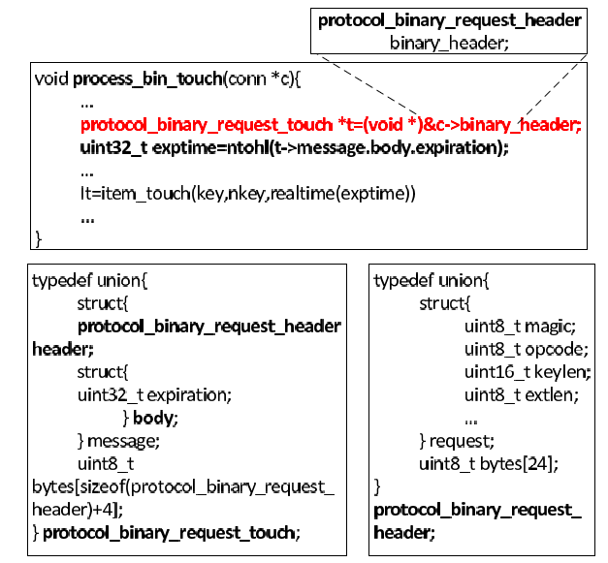
Ongoing Work
ASCII VS Binary
Notes:
Don’t need to read all points

Slide 33
Ongoing Work
Find the key difference that determines the data corruption
Observation: Functionally equivalent executions finally invoke same functions
Notes:
Don’t need to read all points

Slide 34
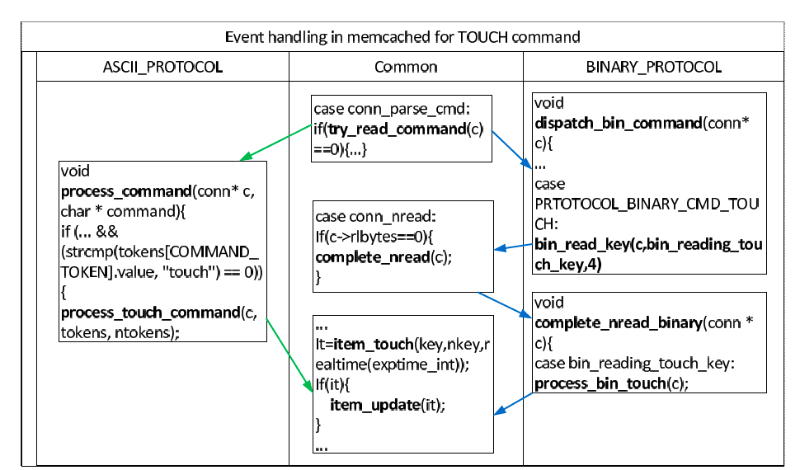
Ongoing Work
Same functions: item_touch(), item_update
Notes:
Don’t need to read all points

Slide 35
Conclusion
Characteristic study of 138 real world data corruption incidents
Software-induced data corruptions are prevalent
Data corruption detection schemes need to be improved
Replication cannot completely solve data corruption problems
Data corruption handling schemes may introduce other issues (e.g., mistaken block deletion, resource hogging)
Notes:
Don’t need to read all points

Slide 36
Thank you!
36

