Slide 1
Metrology Design
Project Name:J510
Part Number & Rev：160-06631-01
Vendor：MAGSOUND
Date：2025/12/02

Slide 2
MTD | J510-Content-160-06631-01
Cover sheet | Page 1
Content | Page 2
history List | Page 3
Measurement Equipment Details | Page 4-9
Measurement Fixture List | Page 10
Bom List | Page 11
Details for Each Measurement | Page 12-22

Slide 3
MTD | J510- revision history List 160-06631-01
APNs | Rev | Update | Description of Revision
160-06631 | 01 | 2025/10/28 | Initial Release, Fliped Poles And Shifted Unmagnetized Region By 1.7mm

Slide 4
MTD | J510 Measurement Equipment Details-Keyence
Name: | KEYENCE
Manufacturer: | KEYENCE
Model: | IM7010
Image pickup device: | 1#6.6 mega pixel monochrome CMOS
Display: | 10.4# LCD monitor
Light receiving lens: | Double telecentric lens
Field of view: | Wide-field measurement mode Φ100x200mm
 | High-precision measurement mode Φ25x125mm
Minimum display unit: | 0.1μm
Repetition Accuracy: | Wide-field measurement mode: | W/0 Stage Movement: ±1μm
 |  | With Stage Movement: ±2μm
 | High-precision measurement mode: | W/0 Stage Movement: ±0.5μm
 |  | With Stage Movement: ±1.5μm
Measurement Accuracy: | Wide-field measurement mode: | W/0 Stage Movement: ±5μm
 |  | With Stage Movement: ±(7+0.01L)μm
 | High-precision measurement mode: | W/0 Stage Movement: ±2μm
 |  | With Stage Movement: ±(4+0.01L)μm

Slide 5
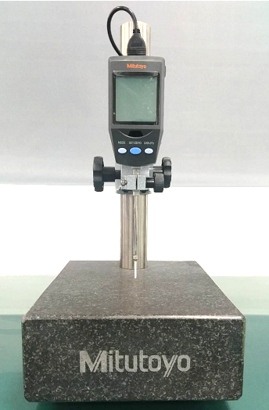
MTD | J510 Measurement Equipment Details
Name: | Height Gage
Manufacturer: | Mitutoyo
Model: | 543-563DC
Range: | 0-50mm
Accuracy: | 0.001mm

Slide 6
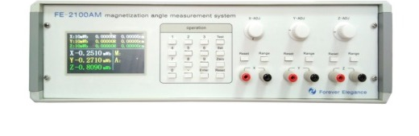
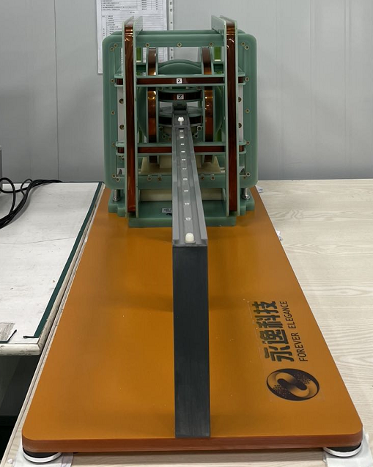
MTD | J510 Measurement Equipment Details-(3D Axis) Fluxmeter
Name: | (3D Axis) Fluxmeter
Manufacturer: | HuNan YongYi TechnologyCo.,Ltd / HNYY
Model: | Fluxmeter Model：FE-2100AM Coil Model：FE-3HM100
Range: | Mono Magnetic moment 0.1-499.9 μWb*cm
Accuracy: | ±0.5%

Slide 7
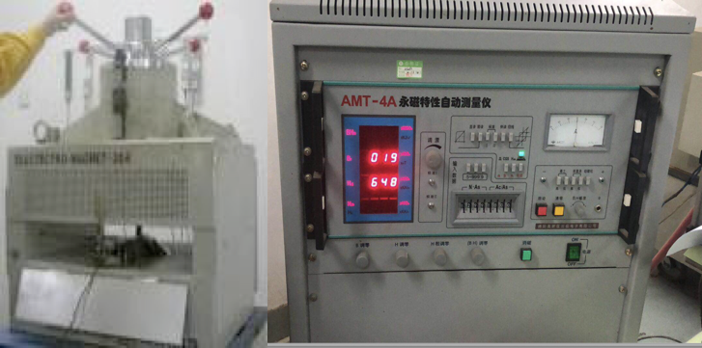
MTD | J510 Measurement Equipment Details-Mono Magnetic permanent tester
Name: | Mono Magnetic permanent tester
Manufacturer: | Sheep
Model: | AMT-4A
Range: | Min:10*10*10mm
Accuracy: | NA

Slide 8
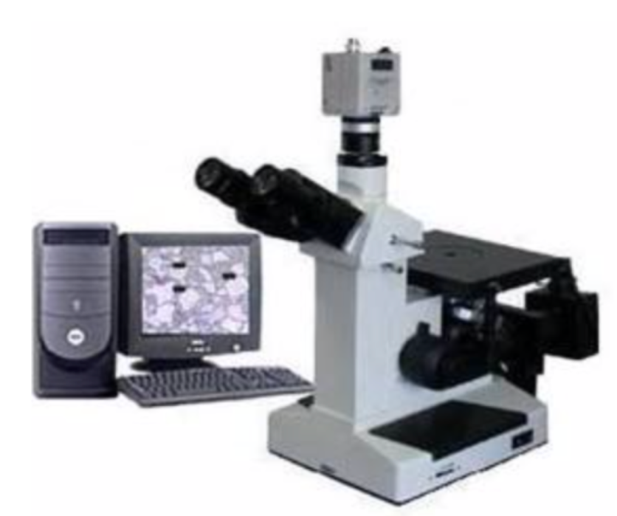
MTD | J510 Measurement Equipment Details-Metallographic Microscope
Name: | Metallographic Microscope
Manufacturer: | Shanghai Optical Instrument Factory
Model: | 4XC-MS
Resolution: | 0.01μm
Magnification: | Zoom | 600X
 | Pixel | 20 million
Illumination System: | Halogen lamp 20W/6V

Slide 9
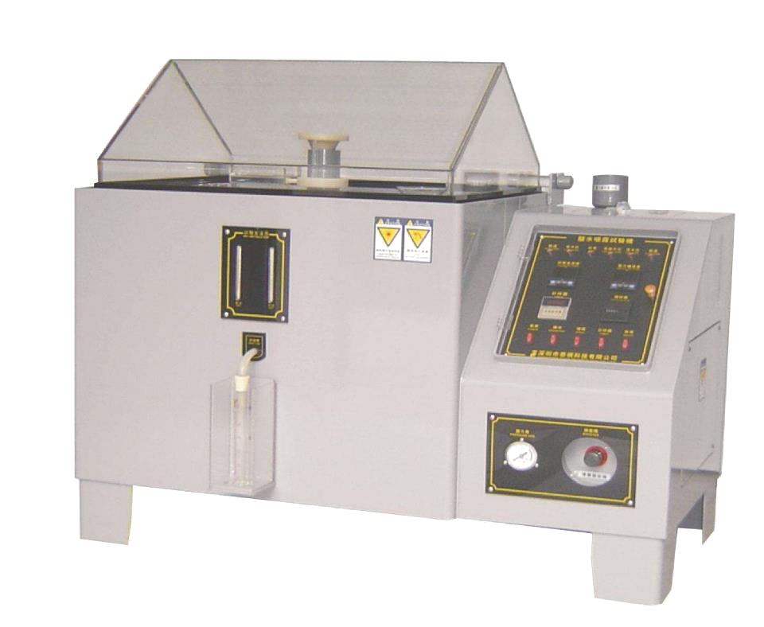
MTD | J510 Measurement Equipment Details-SST Tester
Name: | SST Tester
Manufacturer: | Ningbo Yuanming
Model: | YM-90
Tester Container: | 900*600*500mm
Spray quantity | 1.0-2.0ml/h
Salt water volume | 25L

Slide 10
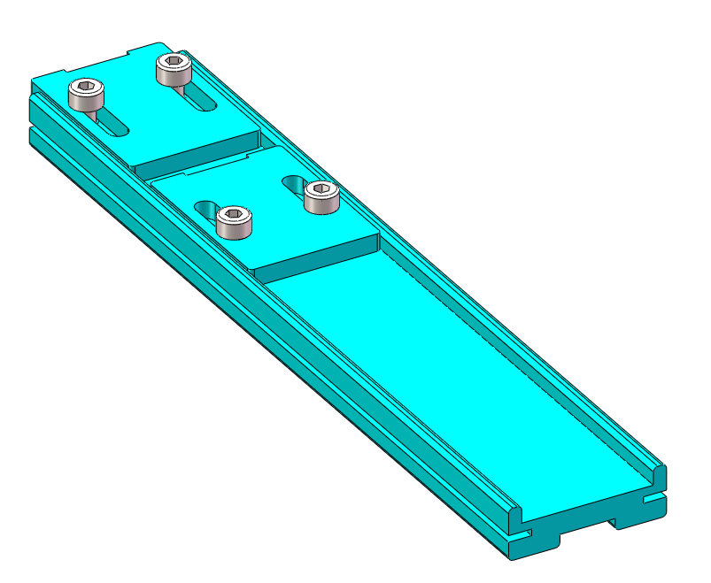
MTD | J510 Measurement Fixture List
Fixture No | Size | Material | Pic | Remark
J-J510-1# | 189*36*12 | Electric board |  | /

Slide 11
MTD | J510 Metrology Details-Mono Magnet 160-06631-01
FAI | SPC | Specification | Description | FAI/CPK Method | FAI/CPK Fixture | In-Process Method | In-Process Fixture | Location | Cross check by
1 | A | 3*2.00±0.10 | Thickness | HG | No | HG | No | P1A3 | Guo Teng
2 | B | 3*2.85±0.10 | Width | Keyence | No | Keyence | No | P1A2 | Guo Teng
4 | D | 2*30.96°±3.00° | Angle | Keyence | No | Keyence | No | P1B2 | Guo Teng
5 | E | 20.00°±7.0° | Mono Magnetic Orientation | Three-dimensional coil tester | No | Three-dimensional coil tester | No | P1B2 | Guo Teng
7 | G | 14.20±0.10 | Length | Keyence | No | Keyence | No | P1C1 | Guo Teng
10 | J | 9.72±0.68 μWb*cm | Mono Magnetic Orientation | Three-dimensional coil tester | No | Three-dimensional coil tester | No | P1B4 | Guo Teng
11 | K | See Table | Flux density | JQS | Yes | JQS | Yes | P1B3 | Guo Teng
12 | L | 4.50±0.10 | Magnetized Region | JQS | Yes | JQS | Yes | P2A4 | Guo Teng
13 | M | 8.50±0.10 | Magnetized Region | JQS | Yes | JQS | Yes | P2A3 | Guo Teng
14 | / | 1.20±0.10 | Unmagnetized Region | JQS | Yes | JQS | Yes | P2A3 | Guo Teng
15 | O | 2*0.77±0.10 | Distance | Keyence | No | Keyence | No | P1B3 | Guo Teng
/ | / | Br:13.2~13.8KGs Hcj:20 KOe minimum BHmax:342~366 KJ/M³ | Br/Hcj/BHmax | Permanent Mono Magnetometer | Yes | Permanent Mono Magnetometer | Yes | P1B4 | Guo Teng
/ | / | Layer 1：2~5 μm | Base nickle | Metallographic microscope | No | Metallographic microscope | No | P1B4 | Guo Teng
/ | / | Layer 2：2~5 μm | Copper | Metallographic microscope | No | Metallographic microscope | No | P1B4 | Guo Teng
/ | / | Layer 3&4：3~9 μm | Bright nickle | Metallographic microscope | No | Metallographic microscope | No | P1B4 | Guo Teng
/ | / | 7~19μm | Total Thickness | Metallographic microscope | No | Metallographic microscope | No | P1B4 | Guo Teng
/ | / | 24HR | SST | SST Tester | Yes | SST Tester | Yes | P1A4 | Guo Teng

Slide 12
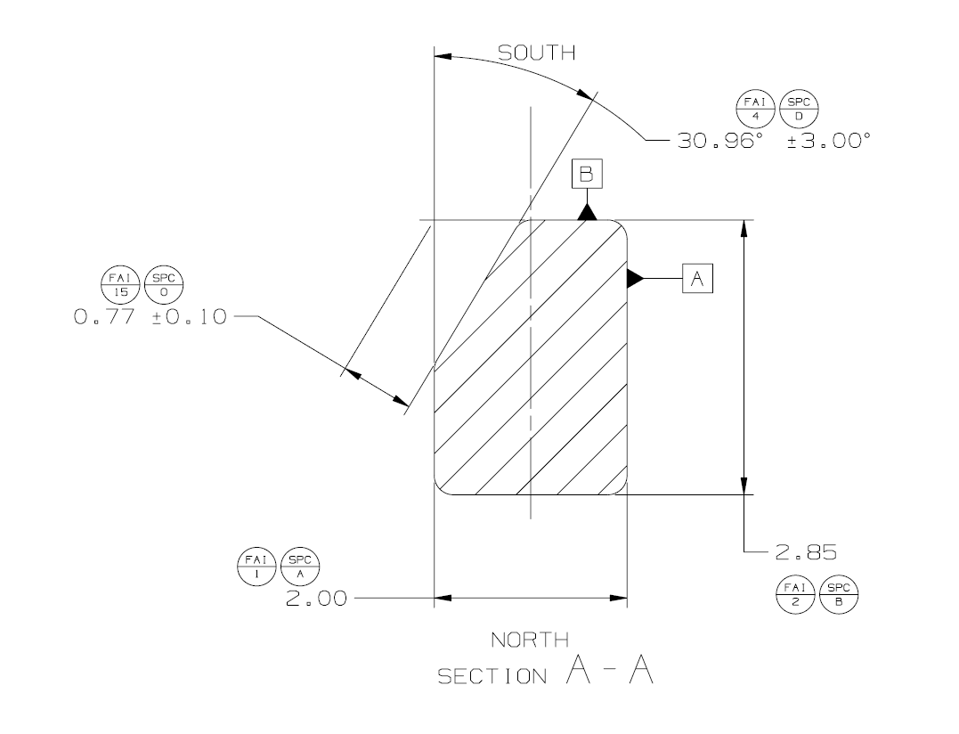
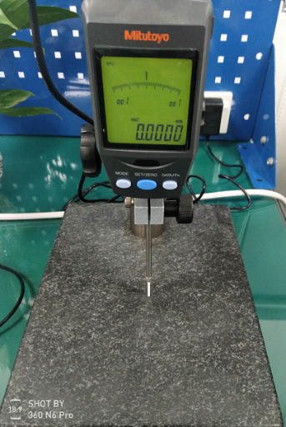
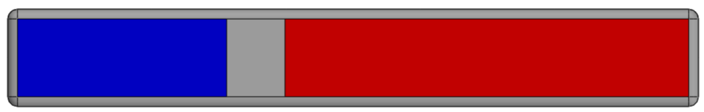
MTD | J510 Metrology Details-Mono Magnet 160-06631-01
Mono Magnet Thickness: FAI 1 /SPC A :3*2.00±0.10
CPK | In-process
1. Measurement Method ：HG 2. Fixture ：/ 3. Measurement status ：Free 4. Measurement procedure： 1.将产品如下图平放大理石平台上;(PIC 1) 2.将高度规测针在大理石平台上A1点归零（PIC 2）； 3.在每个magnet上面中心位置由左至右测量三个点P1~P3（PIC 2），记录数据为FAI1-1~FAI1-3. Place the product flat on the marble platform as shown in the following picture; (PIC 1) 2. Zero the height gauge probe at point A1 on the marble platform (PIC 2); 3. Measure three points P1 to P3 from left to right at the center position of each magnet (PIC 2), and record the data as FAI1-1 to FAI1-3. | 1. Measurement Method ：HG 2. Fixture ：/ 3. Measurement status ：Free 4. Measurement procedure ：Same as the CPK
Measure three points from left to right on the magnet surface
Probe Dia.=Ø2.0mm
Step 1
P1
P2
P3
A1
0.0
Working Platform
Pic1
PIC 2

Slide 13
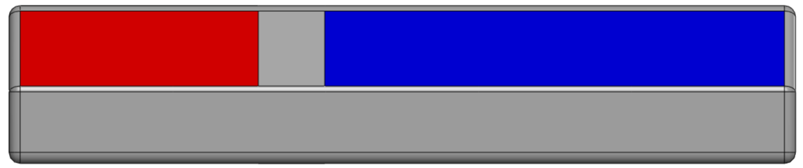
MTD | J510 Metrology Details-Mono Magnet 160-06631-01
Mono Magnet Width: FAI 2 /SPC B :3*2.85±0.10
CPK | In-process
1. Measurement method ：Keyence 2. Fixture ：/ 3. Measurement status ：Free 4. Measurement procedure： 1. 将磁钢大平面朝下摆放在测试平台上，如下图; 2. 选择“线”功能，自动选取直线L1~L4； (边缘避开0.5*0.5mm，线L2~L4线段长度为2.0mm); 3. 选择“线-线距离”功能，分别输出L1/L2，L1/L3,L1/L4在Y方向距离即为FAI2-1/FAI2-2/FAI2-3. 1. Place the large flat surface of the magnet steel downward on the testing platform, as shown in the figure below. 2. Select "line" function to automatically select line L1~L4; (The edge is avoided by 0.5*0.5mm, and the length of line L2~L4 is 2.0mm); 3. Select the "line-to-line distance" function to output the distance of L1/L2,L1/ L3,L1/L4 in the Y direction respectively, which is FAI2-1/FAI2-2/FAI2-3. | 1. Measurement method ：Keyence 2. Fixture ：/ 3. Measurement status ：Free 4. Measurement procedure ：same as the FAI/CPK
X-center
0.5mm
2.0mm
2.0mm
0.5mm
2.0mm
L2
L3
L4
FAI2-1
FAI2-2
FAI2-3
L1
0.5mm
0.5mm

Slide 14
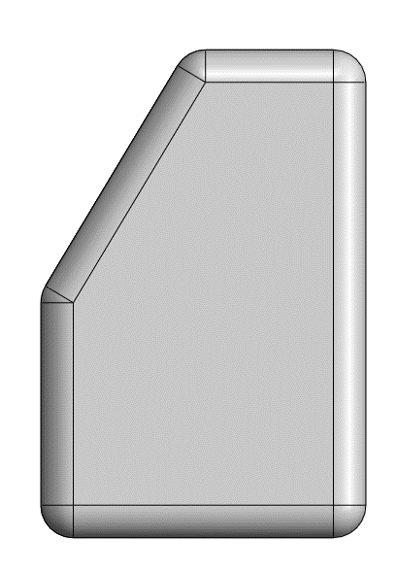
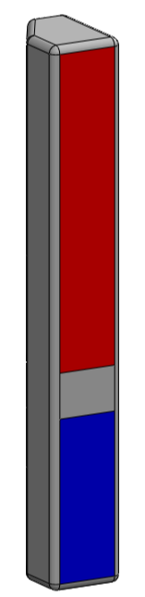
MTD | J510 Metrology Details-Mono Magnet 160-06631-01
Mono Magnet Angle: FAI 4 /SPC D :2*30.96°±3.00°
CPK | In-process
1. Measurement method ：Keyence 2. Fixture ：/ 3. Measurement status ：Free 4. Measurement procedure： 1. 将磁钢立面摆放在测试平台上，如下图; 2. 选择“线”功能，自动选取直线L5/L6； (边缘避开0.5*0.5mm); 3. 选择“角度”功能，输出L5/L6的角度即为FAI4-1,使用同样的测量方式测量Bottom面得到FAI4-2. 1. Place the magnetic steel surface on the test platform as shown in the figure below; 2. Select the "line" function to automatically select the line L5/L6; (Edge avoid 0.5*0.5mm); 3. Select the "Angle" function and output the Angle of L5/L6 as FAI4-1. Use the same measurement method to measure the Bottom surface to get FAI4-2. | 1. Measurement method ：Keyence 2. Fixture ：/ 3. Measurement status ：Free 4. Measurement procedure ：same as the FAI/CPK
0.5mm
TOP surface
FAI4
30.96°
L6
0.5mm
0.5mm
L5
Bottom surface
0.5mm

Slide 15
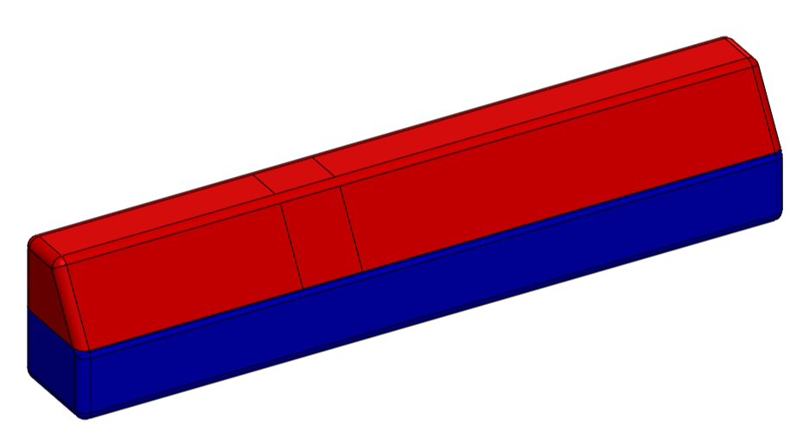
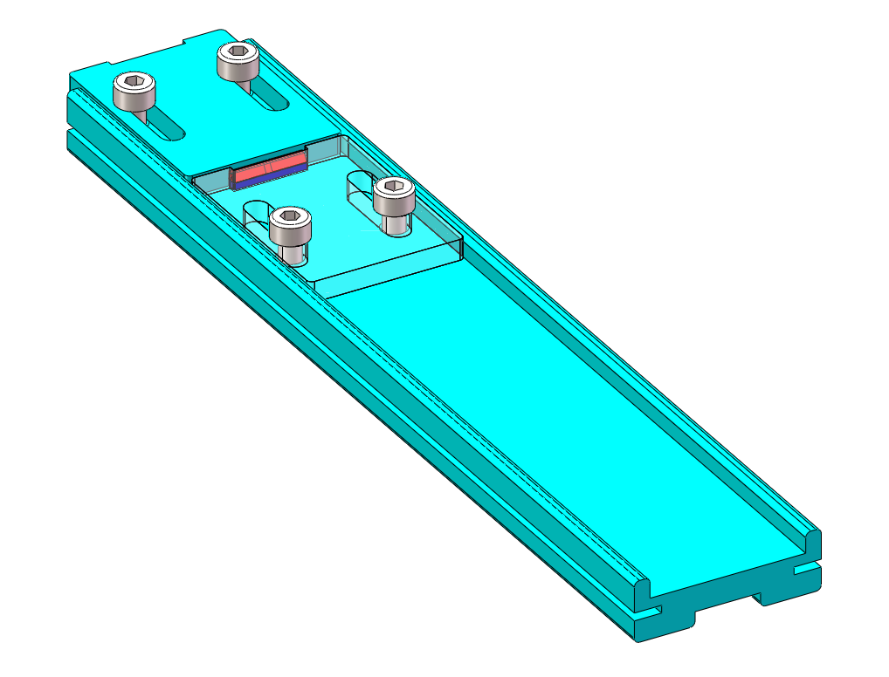
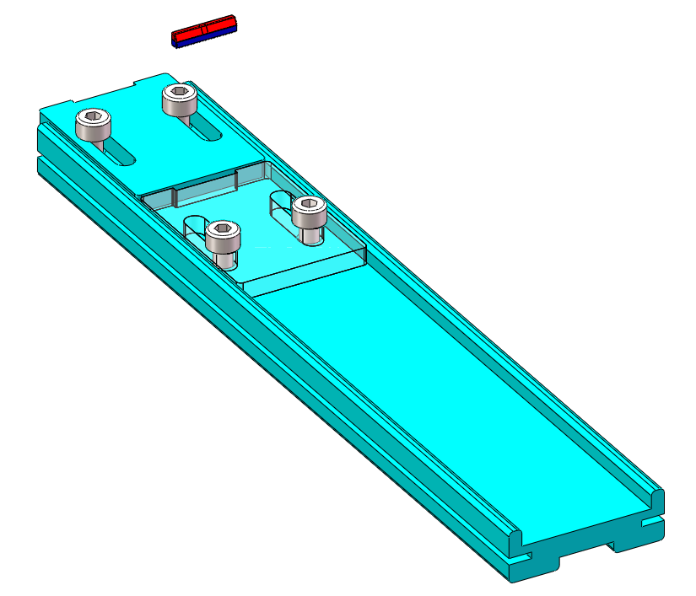
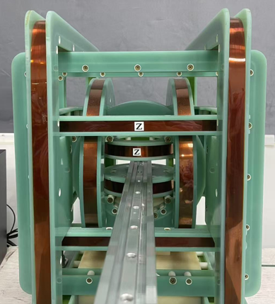
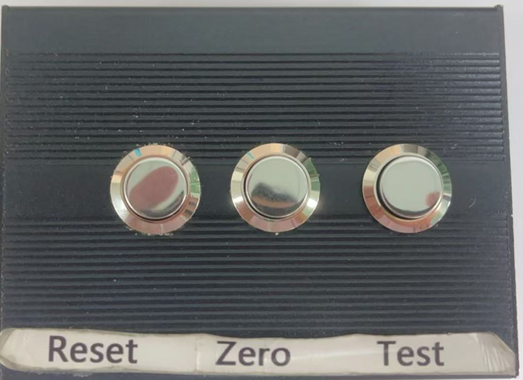
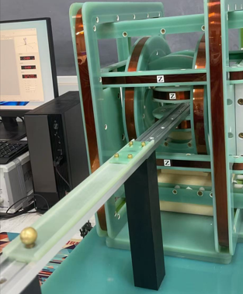
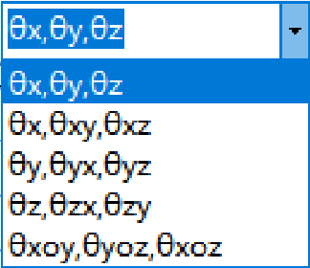
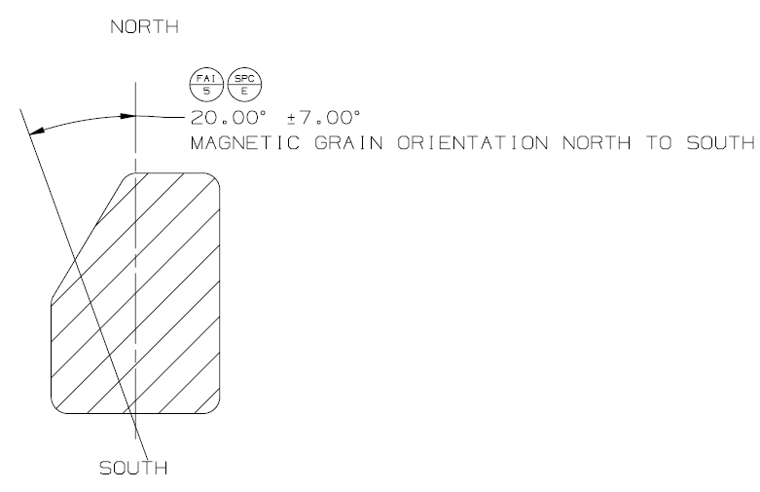
MTD | J510 Metrology Details-Mono Magnet 160-06631-01
Magnetic Orientation: FAI5/SPC E:20.00°±7°
CPK | In-process
1. Measurement Method ：Three-dimensional coil tester 2. Fixture ：J-J510-1# 3. Measurement status ：Free 4. Measurement procedure： 1.将无磁产品按磁化方向进行饱和充磁； 2.如图1,将磁钢按照所示方向放在测量夹具中(夹具需要按照“磁铁取向为竖直方向”设计),测试时保持N极朝上； 3. 如图2，将夹具平放在线圈测试平台上后，按"Reset"键;等待2秒再按“Zero"键清零，准备测试;然后稳定地把治具从亥姆霍兹线圈中抽出,逃逸距离>600mm，再按"Test"键获取数据 4. 如图3,选择“θz"角度显示方式,系统自动计算出Z轴夹角θz; 重点事项:至少2.5米内不可有电子设备,磁性材料,金属等物体移动. Saturate and magnetize the non-magnetic product in the direction of magnetization; 2. As shown in Figure 1, place the magnetic steel in the measuring fixture in the indicated direction (the fixture needs to be designed with the magnet orientation in the vertical direction), and keep the N pole facing upwards during the test. 3. As shown in Figure 2, after placing the fixture flat on the coil test platform, press the "Reset" key; Wait for 2 seconds and then press the "Zero" key to reset and get ready for the test. Then steadily withdraw the fixture from the Helmholtz coil with an escape distance greater than 600mm, and press the "Test" key to obtain the data. 4. As shown in Figure 3, select "θz" Angle display mode, the system automatically calculates the Angle θz of z-axis; 4. As shown in Figure 3, select "θz" Angle display mode, the system automatically calculates the Angle θz of z-axis; Important matters: No electronic equipment, magnetic materials, metal and other objects can be moved within at least 2.5 meters. | 1. Measurement Method ：Three-dimensional coil tester 2. Fixture ：J-J510-1# 3. Measurement status ：Free 4. Measurement procedure ：Same as the CPK
Pic 1
N极朝上：N pole up
Y
Z
X
Y尺寸
Z尺寸
X尺寸
Z方向充磁Apns摆放图示
(充成单极测试,X尺寸对齐X轴,Y尺寸对齐Y轴,N极朝Z+方向)
Y
Y+
Y
Y+
X+
X
X+
X-
X
X-
Y-
Y-
Pic 2
中间间隔2s
1.按 Reset 按钮
2.按 zero 按钮
Escape
distance ≥ 600mm
3.拉出产品后;按 Test 按钮
Step 1
Step 2
Step 3
Step 4
Pic 3

Slide 16
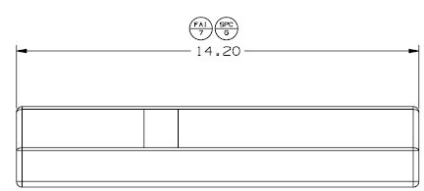
MTD | J510 Metrology Details-Mono Magnet 160-06631-01
Mono Magnet Length: FAI 7/SPC G : 14.20±0.10
CPK | In-process
1. Measurement Method ：Keyence 2. Fixture ：/ 3. Measurement status ：Free 4. Measurement procedure： 1. 将磁钢大平面朝下摆放在测试平台上，如下图; 2. 选择“线”功能，自动选取直线L7/L8； (边缘避开0.5*0.5mm) 选择“线-线距离”功能，输出L7/L8在X方向的最大距离即FAI7. 1. Place the large flat surface of the magnet steel downward on the testing platform, as shown in the figure below. 2. Select the "line" function to automatically select the line L7/L8; (Edge avoid 0.5*0.5mm) 3. Select the "line-to-line distance" function to output the maximum distance of L7/L8 in the X direction, which is FAI7. | 1. Measurement Method ：Keyence 2. Fixture ：/ 3. Measurement status ：Free 4. Measurement procedure ：Same as the FAI/CPK
0.5mm
0.5mm
L8
L7
0.5mm
0.5mm
FAI7

Slide 17
MTD | J510 Metrology Details-Mono Magnet 160-06631-01
MAGNET MOMENT :FAI 10/SPC J :9.72±0.68 uWb.cm
FAI | In-process
1. Measurement Method ：Three-dimensional coil tester 2. Fixture ：J-J510-1# 3. Measurement status ：Constrained 4. Measurement procedure： 1.将无磁产品按磁化方向进行饱和充磁； 2.如图1,将磁钢按照所示方向放在测量夹具中(夹具需要按照“磁铁取向为竖直方向”设计),测试时保持N极朝上； 3. 如图2，将夹具平放在线圈测试平台上后，按"Reset"键;等待2秒再按“Zero"键清零，准备测试;然后稳定地把治具从亥姆霍兹线圈中抽出,逃逸距离>600mm，再按"Test"键获取数据; 4. 如图3,系统自动计算出磁矩MM值-单位uWb*cm. 1. Saturate and magnetize non-magnetic products according to the magnetization direction; 2. As shown in Figure 1, place the magnetic steel in the measuring fixture according to the direction shown (the fixture should be designed according to the "magnet orientation is vertical"), and keep the N pole facing up during the test; 3. As shown in Figure 2, press the "Reset" button after placing the fixture flat on the coil test platform; Wait 2 seconds and then press "Zero" to reset to zero, ready to test; Then steadily pull the fixture out of the Helmholtz coil, escape distance >600mm, and press the "Test" key to obtain data; 4. As shown in Figure 3, the system automatically calculates the magnetic moment MM value - unit uWb*cm. | 1. Measurement Method ：Three-dimensional coil tester 2. Fixture ：J-J510-1# 3. Measurement status ：Constrained 4. Measurement procedure ：Same as the FAI/CPK
Pic 1
N极朝上：N pole up
Y
Z
X
Y尺寸
Z尺寸
X尺寸
Z方向充磁Apns摆放图示
(充成单极测试,X尺寸对齐X轴,Y尺寸对齐Y轴,N极朝Z+方向)
Y
Y+
Y
Y+
X+
X
X+
X-
X
X-
Y-
Y-
Pic 2
中间间隔2s
1.按 Reset 按钮
2.按 zero 按钮
Escape
distance ≥ 600mm
3.拉出产品后;按 Test 按钮
Step 1
Step 2
Step 3
Step 4
Pic 3
记录MM值

Slide 18

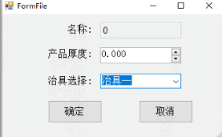
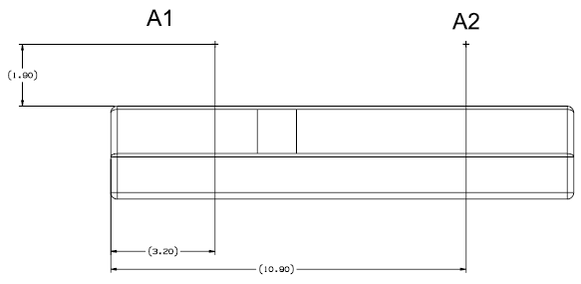
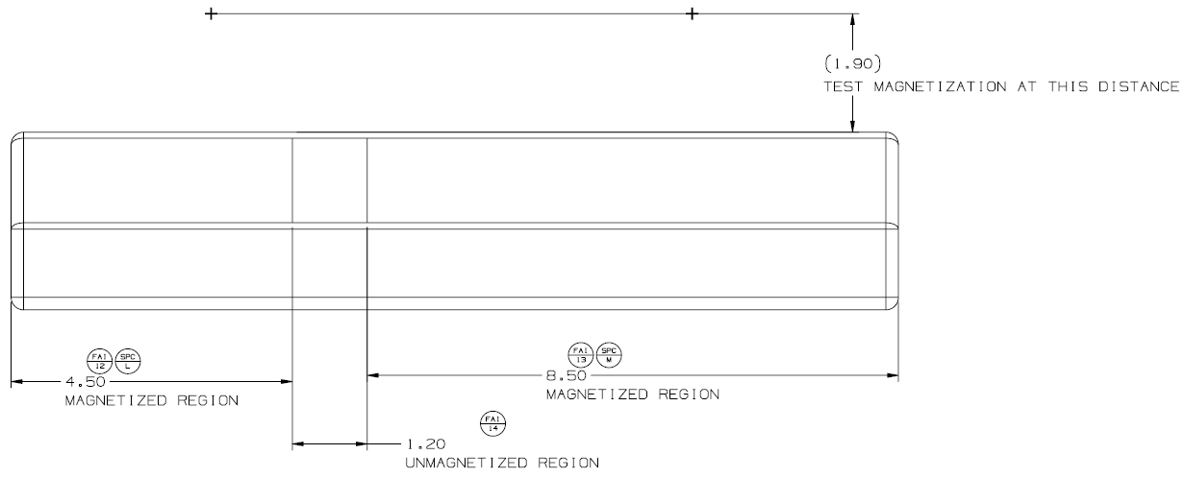
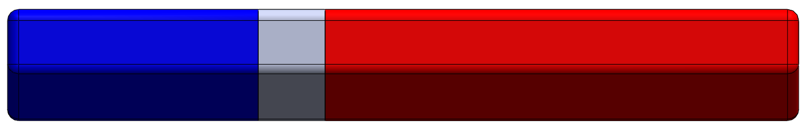
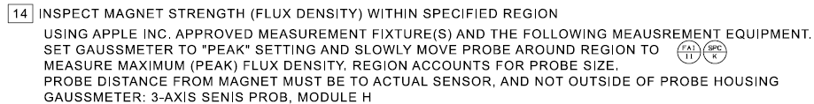
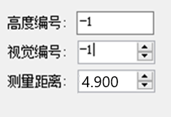
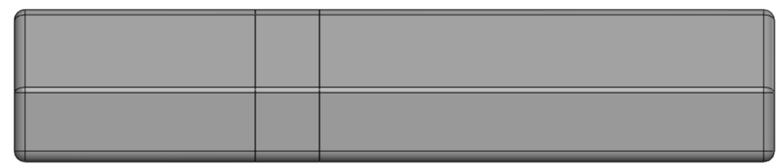
MTD | J510 Metrology Details-Mono Magnet 160-06631-01
Flux Density Test: FAI 11~FAI 14/SPC K~M: See Table
CPK | In-process
1 . Measurement Method ：MagScanner 2. Fixture ：/ 3. Measurement status ：Free 4. Measurement procedure： | 1 . Measurement Method ：MagScanner 2. Fixture ：/ 3. Measurement status ：Free 4. Measurement procedure ：Same as the CPK
零件放置方法： S极面朝左，产品直接对准“L”，不需要固定装置或吸盘 Part placement method: S pole facing to the left , Product is directly aligned with the "L" without the need for fixtures or suction | Key Parameter: 1.Test distance: 4.75mm | Drawing:
扫描路径和编程: 扫描路径 L1：起始点：(3.20,6)，结束点：(3.20,-12)；输出最大 BZ_A1 值； 扫描路径 L2：起始点：(10.90,6)，结束点：(10.90,-12)；输出最大 BZ_A2 值； 扫描路径 L3：起始点：(-6,0.9)，结束点：(24,0.9)；输出最大 Bxy 值，即当 BZ 为 0 时的位置，以及 P1/P2 的位置； 关键信息：传感器以工件表面作为 Z0 点向上移动 4.75 毫米. Scan path and programing:S Scan path L1: Start :(3.20,6), End :(3.20,-12); Output Max BZ_A1; Scan path L2: Start :(10.90,6), End :(10.90,-12); Output Max BZ_A2; Scan path L3: Start :(-6,0.9), End :(24,0.9); Output Max Bxy, the position when BZ=0, the positions of P1/P2; Key information: The sensor moves upward by 4.75mm with the tooling surface as the Z0 point.
测试结果保存： 数据格式：“Time+d”.csv，一扫描一csv数据； ﻿保存数据 Test result saving: Data format: "Time+d".csv, one scan oath one CSV data; ﻿Save the data
Y
X
“L”-Fixture
“N”-X-axis scanning position
“S”-X-axis scanning position
4.75
L1
Sensor
L3
Z
Max Bxy
Test distance of the three scanning paths L1 to L3(4.75mm)
0,0
X
A1_Peak
Threshold
P2_TBD
Y
Scan line L1
Threshold
-TBD
Threshold
TBD
Scan line L2
BZ=0
L2
Threshold
P1_TBD
A2_Peak
Dead zone Position Datum
A1
A2
Scan line L3
Y=0.9
P1
P2
X
0.0
X=3.20
BZ=0
X=10.90
 | Output | Threshold | B added
L1 | A1 | / | TBD
L2 | A2 | / | TBD
L3 | P1 Position | -320 | /
 | Bz=0 position | 0 | /
 | P2 Position | 320 | /
 | Max Bxy | / | TBD

Slide 19
MTD | J510 Metrology Details-Mono Magnet 160-06631-01
Mono Magnet Distance: FAI 15 /SPC O :2*0.77±0.10
CPK | In-process
1. Measurement method ：Keyence 2. Fixture ：/ 3. Measurement status ：Free 4. Measurement procedure： 1. 将磁钢立面摆放在测试平台上，如下图; 2. 选择“线”功能，自动选取直线L5/L6/L9； (边缘避开0.5*0.5mm); 3. 选择“交点”功能，构造L5/L9的交点P1, 4. 选择“点线距离”功能，输出点P1与线L6的XY距离即为FAI15-1,使用同样的测量方式测量Bottom面得到FAI15-2. 1. Place the magnetic steel surface on the test platform as shown in the figure below; 2. Select the "line" function to automatically select the line L5/L6/L9; (Edge avoid 0.5*0.5mm); 3. Select the "intersection point" function to construct the intersection point P1 of L5/L9, 4. Select the "point-line distance" function, and the output XY distance between point P1 and line L6 is FAI15-1. Use the same measurement method to measure the Bottom surface to get FAI15-2. | 1. Measurement method ：Keyence 2. Fixture ：/ 3. Measurement status ：Free 4. Measurement procedure ：same as the FAI/CPK
P1
0.5mm
L9
0.5mm
0.5mm
TOP surface
FAI15
L6
0.5mm
0.5mm
L5
Bottom surface
0.5mm

Slide 20
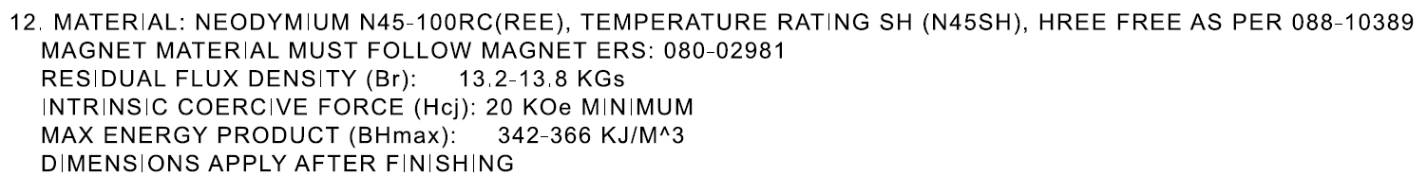
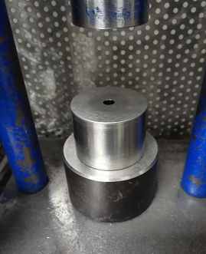
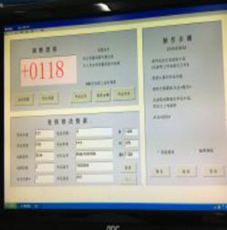
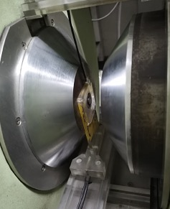

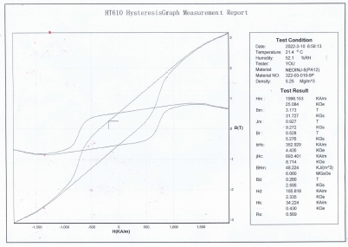
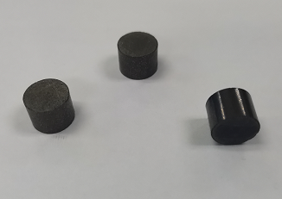
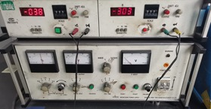
MTD | J510 Metrology Details-Mono Magnet 160-06631-01
MATERIAL PROPERTIES:*:(Br): 13.2-13.8 kGs; (Hcj):20 KOe Min；(BH) Max: 342-366 KJ/M^3
/ | In-process
1. Measurement Method ：Magnetic permanent tester 2. Fixture ：/ 3. Measurement status ：Free 4. Measurement procedure ： 1.使用模具准备规格为Φ10mm*7mm的样柱(Pic1&Pic2); 2.根据测试样柱的规格在程式中输入测试面直径10mm（Pic3） 3.将样柱放平在线圈上，再放置电磁铁的正中间，线圈两角调至平行后，压紧样柱（Pic4） 4.点击操作界面“启动”键，设备自动开始测试（Pic5） 5.输出磁性曲线，记录Br，Hcj , Hcb, BH max值（Pic6） 1. Prepare sample columns (Pic1&Pic2) with specifications Φ10mm*7mm using the mold; 2. According to the specifications of the test sample column, enter the test surface diameter 10mm (Pic3) in the program. 3. Place the sample column flat on the coil, and then place the electromagnet in the middle. After the two angles of the coil are adjusted to parallel, press the sample column (Pic4) firmly. 4. Click the "Start" button on the operation interface, and the device will automatically start the test (Pic5) 5. Output magnetic curve, record Br, Hcj, Hcb, BH max value (Pic6) | 1. Measurement Method ：Magnetic permanent tester 2. Fixture ：/ 3. Measurement status ：Free 4. Measurement procedure ：Same as the
PIC 1 column mold
PIC 2 Φ10mm*7mm samples
PIC 3 Set column sample size into program
PIC 5 Start test
PIC 6 Record the value of Br, Hcb, Hcj, BH max.

Slide 21

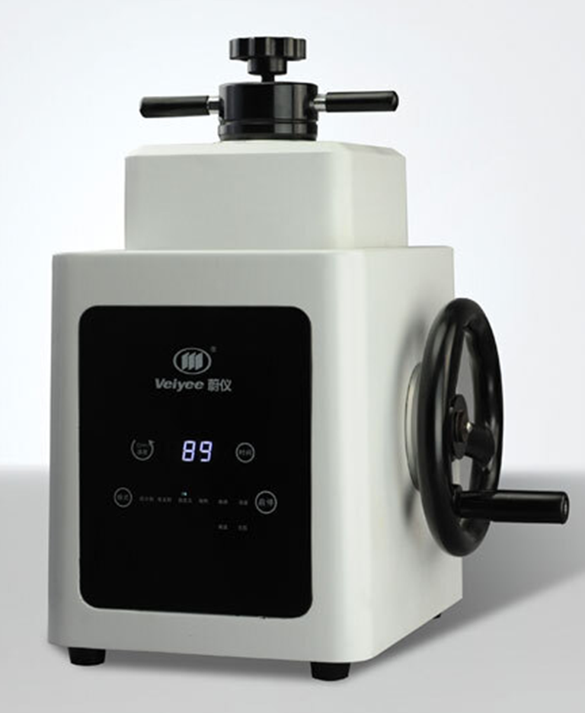
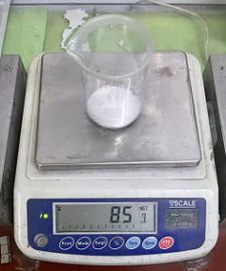
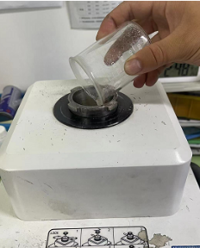
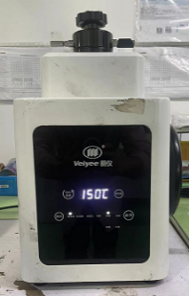
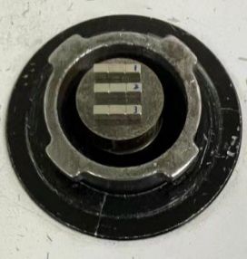
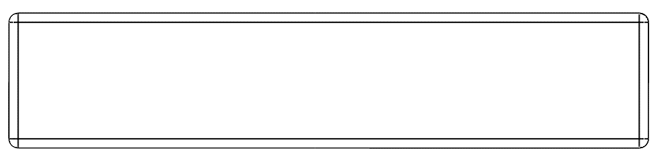


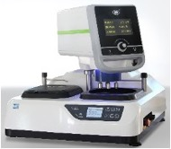
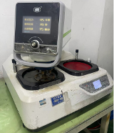
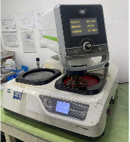


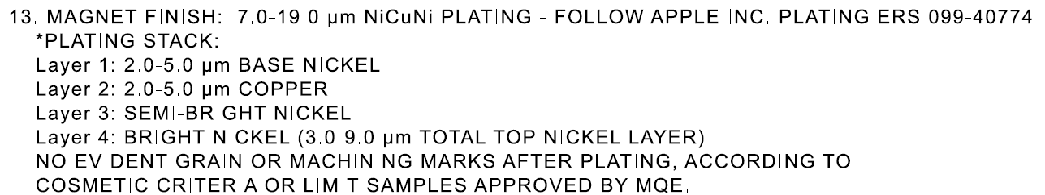
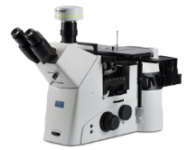
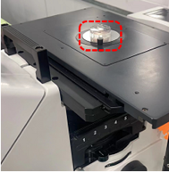
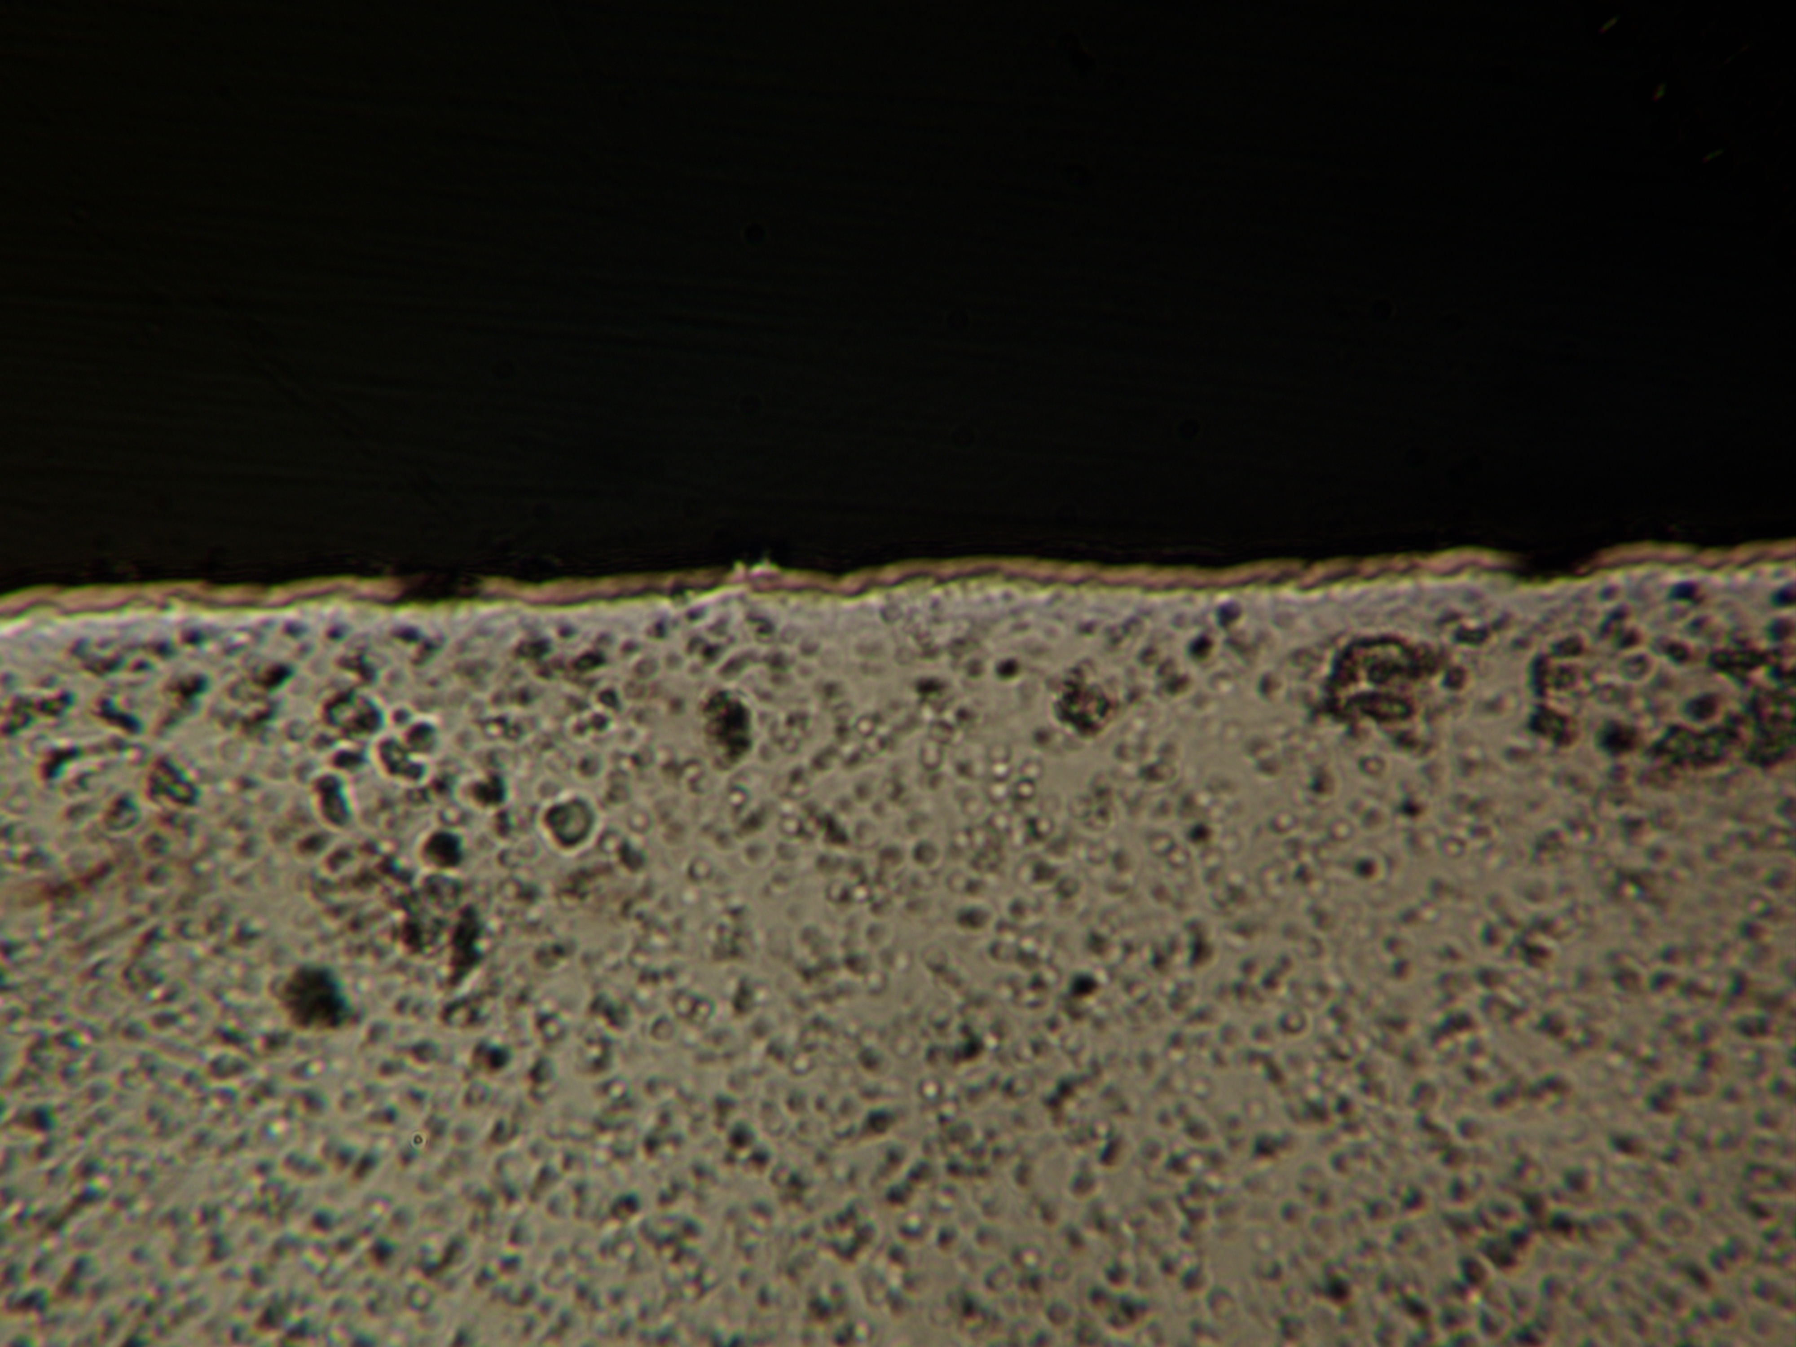

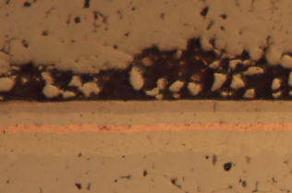
MTD | J510 Metrology Details-Mono Magnet 160-06631-01
Plating Thickness :layer1: 2~5μm layer2: 2~5μm layer3&4: 3~9μm Total thickness : 7~19μm
FAI | In-process
1. Measurement Method ：Metallographic Microscope 2. Fixture ：/ 3. Measurement status ：Free 4. Measurement procedure: 1.制作镶样块：按Step1~Step4作业;（Pic1） 2.磨抛：按Step5~Step7作业;（Pic2）； 3.测量：按Step8~Step10作业;（Pic3） 4.根据磨拋将样件从Y0开始向上磨拋产品1/2处1.425mm位置测量P1~P3，先调试金相显微镜100X，查找P1凹坑区域，再将显微镜放大至500x,分别每层每个位置测试3个数据，记录3个数据的平均值;总厚度=layer1+layer2+layer3+layer4(同样的方式测量P2与P3位置的镀层厚度). 1. Make the insert block: work according to Step1~Step4; (Pic1) 2. Grinding and polishing: work according to Step5~Step7; (Pic2); 3. Measurement: Work according to Step8~Step10; (Pic3) 4. According to grinding and polishing, measure P1-P3 at the 1.425mm position of 1/2 of the product from Y0. Firstly, adjust the metallographic microscope 100X, find the P1 pit area, and then enlarge the microscope to 500x, test 3 data at each position of each layer, and record the average of 3 data; Total thickness =layer1+layer2+layer3+layer4(same way to measure the coating thickness at P2 and P3). | 1. Measurement Method ：Metallographic Microscope 2. Fixture ：/ 3. Measurement status ：Free 4. Measurement procedure ：Same as the FAI
制作镶样块 Pic1
Y
L3
X=-13.7
L2
X=-7.10
L1
X=-0.5
(0.0)
X
镶嵌机
Step1. 将准备好的3pcs产品，先按图纸镭雕3条线L1~L3；
将产品通过方形磁钢固定,放在仪器上
Step2. 准备85镶嵌粉
Step3. 将镶嵌粉加入镶嵌机
Step4. 镶嵌机设置150℃、
30min制作样块
Y
Y
Y=1.425mm
P1
P2
P3
(0.0)
X
(0.0)
X
抛光机
Step 5.磨拋方向，从Y0方向向上磨，磨拋掉产品的1/2处1.425mm位置测量P1~P3
Step6. 粗磨：磨盘转速 500转/分、 压头转速 75转/分/压力45N， 依次使用240-1000-2400砂纸磨抛，磨抛量1.425mm
Step7. 抛光：磨盘转速 500转/分、
压头转速 75转/分/压力45N
使用抛光布，抛光
Test points
P1
1＇
2＇
3＇
4 Layer bright Ni
P2
3.82μm
3.76μm
3.82μm
3Layer semi-bright Ni
2.86μm
2.85μm
2.69μm
Position of the radium carving point
2.23μm
2.31μm
2.29μm
2 Layer Cu
P2
4.47μm
4.36μm
4.52μm
1 Layer Ni
100X
500X
1st Test points
Total Thickness:=1 layer +2 layer +3 layer+4 layer
金相测量仪
Step8. 将磨抛好的样块，放置测量平台
Step9. 放大100X确定测试位置
步骤10.根据磨拋将样件从Y0开始向上磨拋产品1/2处1.425mm位置测量P1~P3，先调试金相显微镜100X，查找P1凹坑区域，再将显微镜放大至500x,分别每层每个位置测试3个数据，记录3个数据的平均值;总厚度=layer1+layer2+layer3+layer4(同样的方式测量P2与P3位置的镀层厚度).

Slide 22




MTD | J510 Metrology Details-Mono Magnet 160-06631-01
SST: 24h
FAI | In-process
1. Measurement Method ：SST Tester 2. Fixture ：Yes 3. Measurement status ：Free 4. Measurement procedure ： a. 设备点检(图1)和溶液制备:5%氯化钠+95%去离子水,将氯化钠溶液放入溶液桶中,PH试纸测试PH值标准6.5-7.2。 b. 测试条件：在35°C下设置试验室，在47°C下设置饱和空气桶，压力0.1MPa(图2)。 c. 产品垂直放置：确保样品表面无划痕、气泡、铁锈等异常，将产品32片/批垂直放置(图3)在板上夹具1(材料橡胶磁铁、塑料袋真空包装），然后每两片产品之间保持20毫米的间距(图4) d. 橡胶磁板放置(图4): 将装有样品的背板倾斜到三脚架上夹具2,底板与垂直方向的夹角为15°-30°,符合ASTM B117-11标准。 e. 判定:试验后取出样品,用纯水冲洗2次,每次至少10秒，然后用吹风机微风吹干；检查表面有无剥落、气泡、锈迹等(图5)。 a. Check of equipment (PIC 1) and solution preparation: 5%NaCl+95% deionized water (DI water), Measuring PH value with PH pen, PH 6.5-7.2 is OK;Put salt solution into the NaCl solution barrel. Put DI water into the saturated air barrel; b. Test Condition:Set up test chamber35°C and saturated air barrel at 47°C,Pressure 0.1MPa (PIC 2). c. Make sure the surface of samples J-X3812-06 abJ-X3812-06rmalities, such as scratch, bubble and rust etc，Put Magnet 32 pieces/Batch , firstly each Magnet is placed vertically (PIC 3) on the plate-Fixture 1 ( material rubber magnet, Vacuum Packaging of Plastic Bags and paper) and keep 20mm space between each part (PIC 4) d. Then lean backplane loaded(PIC4) with samples on the tripod-Fixture 2The angle between the backplane and the vertical direction is 15°-30° from ASTM B117-11. e. Judgement: Take the samples out after salt spray test,Rinse 2 times with pure water for at least 10 seconds each time and then dry with a light breeze from a hair dryer;Check whether there are peeling, bubbles, rust and etc. on the surface (PIC 5). | 1. Measurement Method ：SST Tester 2. Fixture ：Yes 3. Measurement status ：Free 4. Measurement procedure ： Same as the FAI
表面无断裂，剥落，气泡等OK
20MM
表面断裂，剥落，气泡等NG
PIC 5： Judgement

