Slide 1
Metrology Design
测试项目 - DEMO-001

Slide 2
MTD | TEST-001 Content 200-00001-00 (Demo)
Cover sheet | Page 1
Content | Page 2
history List | Page 3
Measurement Equipment Details | Page 4-9
Measurement Fixture List | Page 10
Bom List | Page 11
Details for Each Measurement | Page 12-22

Slide 3
MTD | J510- revision history List 160-06631-01
A01 | 2026-01-14 | 初始版本 | AI
A02 | 2026-01-15 | 添加测试数据 | Claude
A03 | 2026-01-16 | 更新规格 | User

Slide 4
MTD | J510 Measurement Equipment Details-Keyence
设备名称 | 三坐标测量机
型号 | CMM-2000
精度 | ±0.001mm

Slide 5
MTD | J510 Measurement Equipment Details-Keyence
设备名称 | 影像测量仪
型号 | VMS-3020
精度 | ±0.005mm

Slide 6
MTD | J510 Measurement Equipment Details-Keyence
设备名称 | 磁通计
型号 | MF-5000
精度 | ±1%

Slide 7
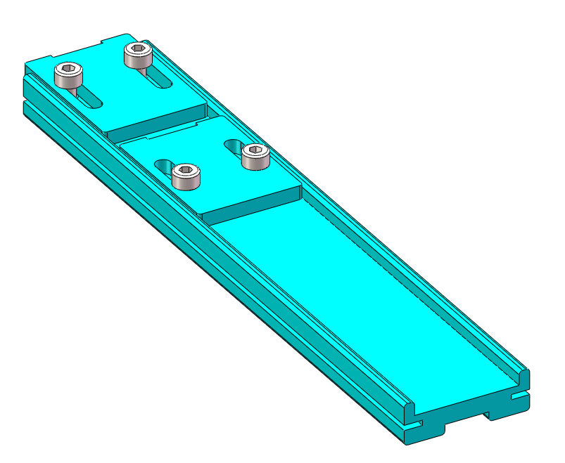
MTD | J510 Measurement Fixture List
1 | 底座夹具 | FIX-001 | 1 | Remark
2 | 定位夹具 | FIX-002 |  | /

Slide 8
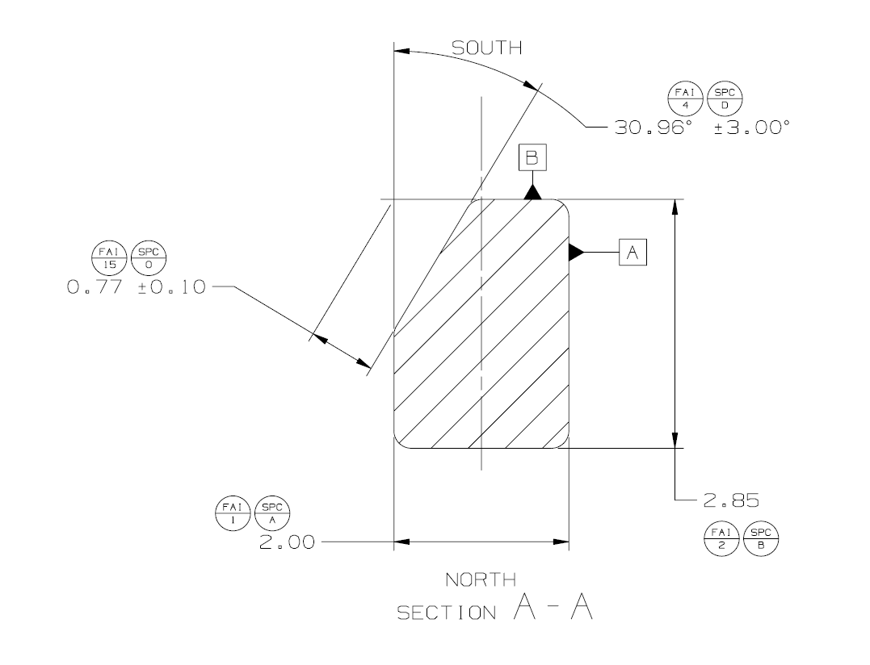
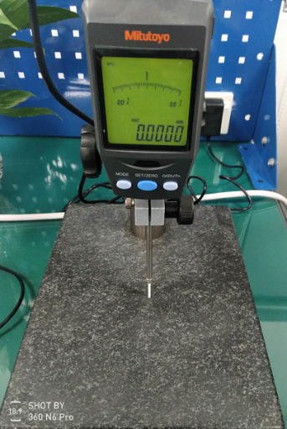
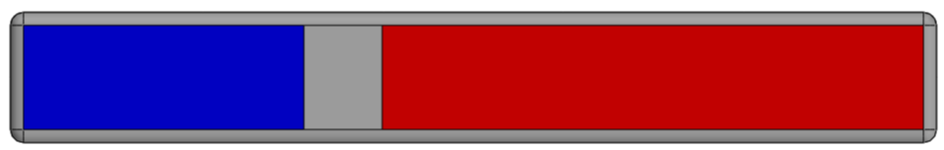
MTD | J510 Metrology Details-Mono Magnet 160-06631-01
Mono Magnet Thickness: FAI 1 /SPC A :3*2.00±0.10
CPK | In-process
1. Measurement Method ：HG 2. Fixture ：/ 3. Measurement status ：Free 4. Measurement procedure： 1.将产品如下图平放大理石平台上;(PIC 1) 2.将高度规测针在大理石平台上A1点归零（PIC 2）； 3.在每个magnet上面中心位置由左至右测量三个点P1~P3（PIC 2），记录数据为FAI1-1~FAI1-3. Place the product flat on the marble platform as shown in the following picture; (PIC 1) 2. Zero the height gauge probe at point A1 on the marble platform (PIC 2); 3. Measure three points P1 to P3 from left to right at the center position of each magnet (PIC 2), and record the data as FAI1-1 to FAI1-3. | 1. Measurement Method ：HG 2. Fixture ：/ 3. Measurement status ：Free 4. Measurement procedure ：Same as the CPK
Measure three points from left to right on the magnet surface
Probe Dia.=Ø2.0mm
Step 1
P1
P2
P3
A1
0.0
Working Platform
Pic1
FAI-001: 尺寸测试

Slide 9
MTD | J510 Metrology Details-Mono Magnet 160-06631-01
Mono Magnet Thickness: FAI 1 /SPC A :3*2.00±0.10
CPK | In-process
1. Measurement Method ：HG 2. Fixture ：/ 3. Measurement status ：Free 4. Measurement procedure： 1.将产品如下图平放大理石平台上;(PIC 1) 2.将高度规测针在大理石平台上A1点归零（PIC 2）； 3.在每个magnet上面中心位置由左至右测量三个点P1~P3（PIC 2），记录数据为FAI1-1~FAI1-3. Place the product flat on the marble platform as shown in the following picture; (PIC 1) 2. Zero the height gauge probe at point A1 on the marble platform (PIC 2); 3. Measure three points P1 to P3 from left to right at the center position of each magnet (PIC 2), and record the data as FAI1-1 to FAI1-3. | 1. Measurement Method ：HG 2. Fixture ：/ 3. Measurement status ：Free 4. Measurement procedure ：Same as the CPK
Measure three points from left to right on the magnet surface
Probe Dia.=Ø2.0mm
Step 1
P1
P2
P3
A1
0.0
Working Platform
Pic1
FAI-002: 磁性测试

