Slide 1
B747 RAMP Drawing Review_HRE FREE Magnet
160-06025-91
160-06026-90
160-06027-90
160-06028-91
160-06029-90
Magsound
2025/11/17

Slide 2
B747 RAMP | DWG Review | HRE FREE M1 Magnet_160-06025-91
No. | Page | FAI/SPC | Description | DWG Spec | Proposal | PD Disposition
1 | 1 | FAI 24 | POR: ≥19 kOe HRE FREE: ≥17 kOe Due to the decrease in Hcj specifications,HRE FREE 72hr 85°C/85%RH MM decay can’t meet ＜5% | ＜5% | Option 1: keep current spec MM decay <5%, but change the test condition from 85c/85% to 65c/90% Option 2: keep current test condition 85c/85% unchanged, but relieve MM decay spec from <5% to <10%

Slide 3
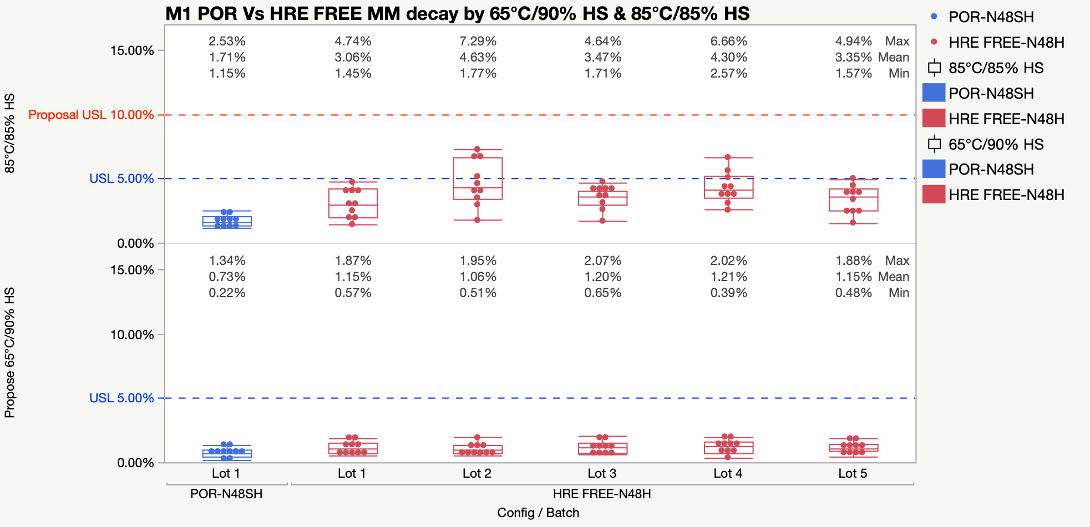
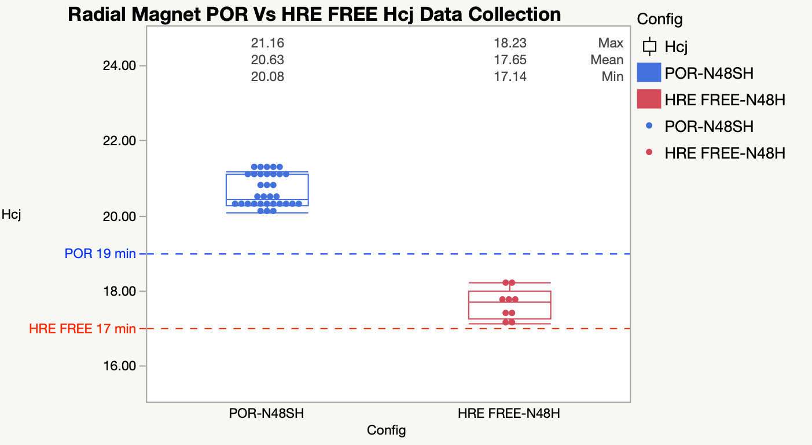
DWG Review | HRE FREE M1 Magnet Callout/Definition
PD
Dimension | FAI 24
Page | 1
Issue Description | Due to the decrease in Hcj specifications,HRE FREE 72hr 85°C/85%RH MM decay can’t meet ＜5%
Proposal | Option 1: keep current spec MM decay <5%, but change the test condition from 85c/85% to 65c/90% Option 2: keep current test condition 85c/85% unchanged, but relieve MM decay spec from <5% to <10%
2D Drawing | Legacy Best Practice | Proposal
Due to HRE FREE dowm grade, Hcj reduced from POR>19 to HRE FREE>17,HS is tested under strict requirement of 85 ℃/85%. After collecting more data, found HRE FREE 72hr 85°C/85%RH MM decay OOS. | / | Option 1: keep current spec MM decay <5%, but change the test condition from 85c/85% to 65c/90% Option 2: keep current test condition 85c/85% unchanged, but relieve MM decay spec from <5% to <10%

Slide 4
B747 RAMP | DWG Review | HRE FREE M2 Magnet_160-06026-90
No. | Page | FAI/SPC | Description | DWG Spec | Proposal | PD Disposition
1 | 1 | FAI 24 | POR: ≥19 kOe HRE FREE: ≥17 kOe Due to the decrease in Hcj specifications,HRE FREE 72hr 85°C/85%RH MM decay can’t meet ＜5% | ＜5% | Option 1: keep current spec MM decay <5%, but change the test condition from 85c/85% to 65c/90% Option 2: keep current test condition 85c/85% unchanged, but relieve MM decay spec from <5% to <10%

Slide 5

DWG Review | HRE FREE M2 Magnet Callout/Definition
PD
Dimension | FAI 24
Page | 1
Issue Description | Due to the decrease in Hcj specifications,HRE FREE 72hr 85°C/85%RH MM decay can’t meet ＜5%
Proposal | Option 1: keep current spec MM decay <5%, but change the test condition from 85c/85% to 65c/90% Option 2: keep current test condition 85c/85% unchanged, but relieve MM decay spec from <5% to <10%
2D Drawing | Legacy Best Practice | Proposal
Due to HRE FREE dowm grade, Hcj reduced from POR>19 to HRE FREE>17,HS is tested under strict requirement of 85 ℃/85%. After collecting more data, found HRE FREE 72hr 85°C/85%RH MM decay OOS. | / | Option 1: keep current spec MM decay <5%, but change the test condition from 85c/85% to 65c/90% Option 2: keep current test condition 85c/85% unchanged, but relieve MM decay spec from <5% to <10%

Slide 6
B747 RAMP | DWG Review | HRE FREE M3 Magnet_160-06027-90
No. | Page | FAI/SPC | Description | DWG Spec | Proposal | PD Disposition
1 | 1 | FAI 24 | POR: ≥19 kOe HRE FREE: ≥17 kOe Due to the decrease in Hcj specifications,HRE FREE 72hr 85°C/85%RH MM decay approaching the upper limit of 5% | ＜5% | Option 1: keep current spec MM decay <5%, but change the test condition from 85c/85% to 65c/90% Option 2: keep current test condition 85c/85% unchanged, but relieve MM decay spec from <5% to <10%

Slide 7
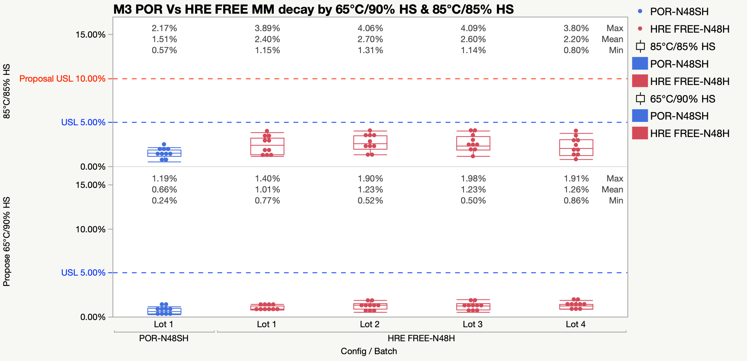
DWG Review | HRE FREE M3 Magnet Callout/Definition
PD
Dimension | FAI 24
Page | 1
Issue Description | Due to the decrease in Hcj specifications,HRE FREE 72hr 85°C/85%RH MM decay approaching the upper limit of 5%
Proposal | Option 1: keep current spec MM decay <5%, but change the test condition from 85c/85% to 65c/90% Option 2: keep current test condition 85c/85% unchanged, but relieve MM decay spec from <5% to <10%
2D Drawing | Legacy Best Practice | Proposal
Due to HRE FREE dowm grade, Hcj reduced from POR>19 to HRE FREE>17,HS is tested under strict requirement of 85 ℃/85%. After collecting more data, found HRE FREE 72hr 85°C/85%RH MM decay approaching the upper limit of 5%. | / | Option 1: keep current spec MM decay <5%, but change the test condition from 85c/85% to 65c/90% Option 2: keep current test condition 85c/85% unchanged, but relieve MM decay spec from <5% to <10%

Slide 8
B747 RAMP | DWG Review | HRE FREE M4 Magnet_160-06028-91
No. | Page | FAI/SPC | Description | DWG Spec | Proposal | PD Disposition
1 | 1 | FAI 24 | POR: ≥19 kOe HRE FREE: ≥17 kOe Due to the decrease in Hcj specifications,HRE FREE 72hr 85°C/85%RH MM decay approaching the upper limit of 5% | ＜5% | Option 1: keep current spec MM decay <5%, but change the test condition from 85c/85% to 65c/90% Option 2: keep current test condition 85c/85% unchanged, but relieve MM decay spec from <5% to <10%

Slide 9
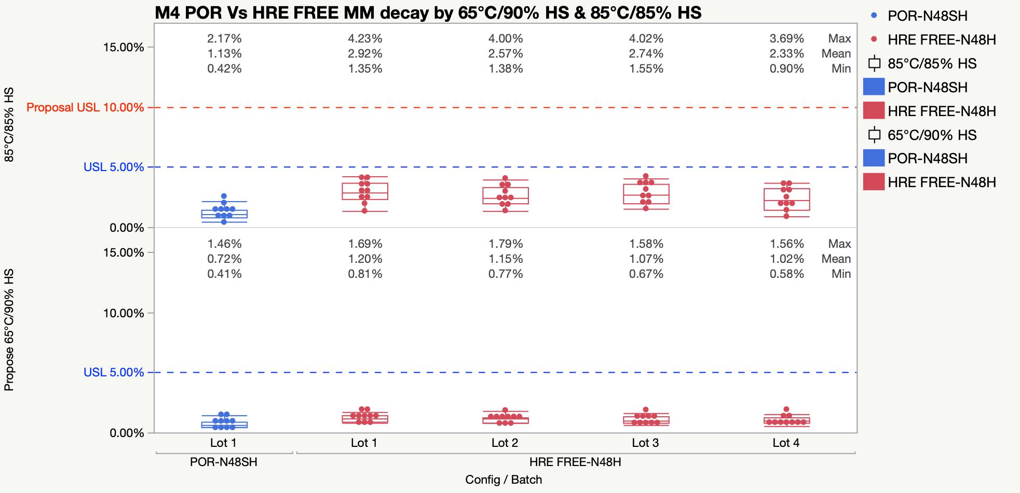
DWG Review | HRE FREE M4 Magnet Callout/Definition
PD
Dimension | FAI 24
Page | 1
Issue Description | Due to the decrease in Hcj specifications,HRE FREE 72hr 85°C/85%RH MM decay approaching the upper limit of 5%
Proposal | Option 1: keep current spec MM decay <5%, but change the test condition from 85c/85% to 65c/90% Option 2: keep current test condition 85c/85% unchanged, but relieve MM decay spec from <5% to <10%
2D Drawing | Legacy Best Practice | Proposal
Due to HRE FREE dowm grade, Hcj reduced from POR>19 to HRE FREE>17,HS is tested under strict requirement of 85 ℃/85%. After collecting more data, found HRE FREE 72hr 85°C/85%RH MM decay approaching the upper limit of 5%. | / | Option 1: keep current spec MM decay <5%, but change the test condition from 85c/85% to 65c/90% Option 2: keep current test condition 85c/85% unchanged, but relieve MM decay spec from <5% to <10%

Slide 10
B747 RAMP | DWG Review | HRE FREE WP Magnet_160-06029-90
No. | Page | FAI/SPC | Description | DWG Spec | Proposal | PD Disposition
1 | 1 | / | POR: ≥20 kOe HRE FREE: ≥17 kOe Due to the decrease in Hcj specifications,HRE FREE 72hr 85°C/85%RH MM decay can’t meet ＜5% | ＜5% | Option 1: keep current spec MM decay <5%, but change the test condition from 85c/85% to 65c/90% Option 2: keep current test condition 85c/85% unchanged, but relieve MM decay spec from <5% to <10%

Slide 11
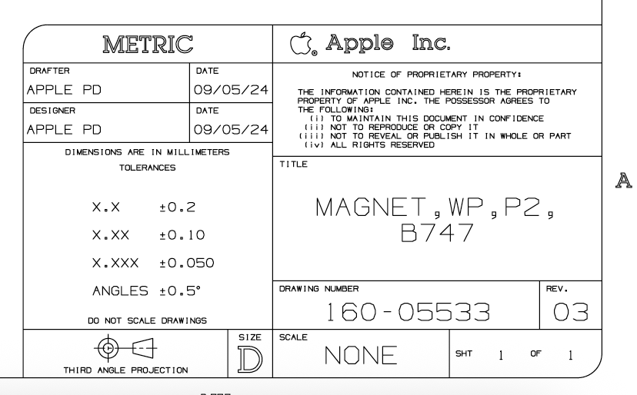
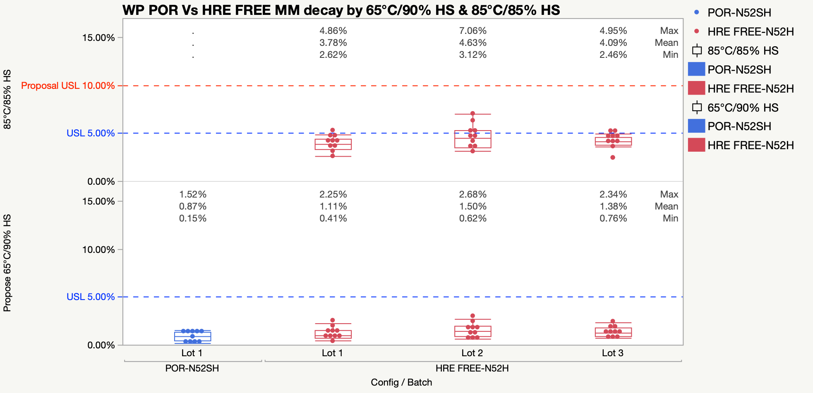
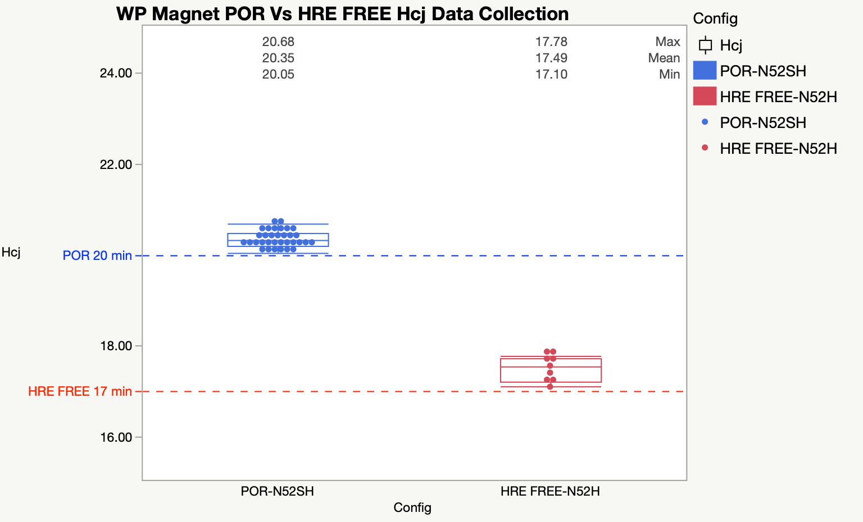
DWG Review | HRE FREE WP Magnet Callout/Definition
PD
Dimension | /
Page | 1
Issue Description | Due to the decrease in Hcj specifications,HRE FREE 72hr 85°C/85%RH MM decay can’t meet ＜5%
Proposal | Option 1: keep current spec MM decay <5%, but change the test condition from 85c/85% to 65c/90% Option 2: keep current test condition 85c/85% unchanged, but relieve MM decay spec from <5% to <10%
2D Drawing | Legacy Best Practice | Proposal
Due to HRE FREE dowm grade, Hcj reduced from POR>20 to HRE FREE>17,HS is tested under strict requirement of 85 ℃/85%. After collecting more data, found HRE FREE 72hr 85°C/85%RH MM decay OOS. |  | Option 1: keep current spec MM decay <5%, but change the test condition from 85c/85% to 65c/90% Option 2: keep current test condition 85c/85% unchanged, but relieve MM decay spec from <5% to <10%

