Slide 1




RDC Year-2019 August MBR ——奥维世纪研发中心
By Harold.Duan
2019.08
AVATECH.COM.CN

Slide 2

Agenda
1
Summary
2
Mission
3
Actionsteps

Slide 3
Summary of August 2019

Slide 4
Mission important
Framework
Front-end
Back-end
Middleware
Standardization
Naming
API
Documents
Implement
Demo
Deploying
Debugging

Slide 5





(Data/App)HubPlatform-Architecture
Stock Management
Scene
Material
Service
Inventory Receipt
Service
Service
Units
Virtualization
Containers
Hardware
Platform
Inventory Issue
Service
Business
Scenes
…
…
Docker A
Docker B
Docker X
…
AWS
Ali Cloud
X Cloud
…

Slide 6







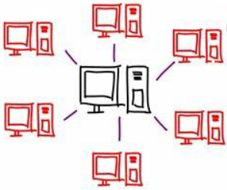



(Data/App)HubPlatform-Principle
REST API
Cross-platform
Heterogeneous
Micro Service
Distributed Storage
Distributed Computing
Docker
Live
Flexible
Cloud
High-reliability
High-scalability

Slide 7
(Data/App)HubPlatform-Actionsteps
Explore
3-6 Month
码上用，EDI-SBO Standard Services
Prepare
3 Month
码上用，EDI-SBO Standard Services
Implement
6 Month
More functions improving
Data Hub Platform
SAP Business One
S4 HANA
3rd Party System
SAP ByD
App Hub Platform
码上用
App A
3rd Party App
App X
HubPlatfrom

Slide 8
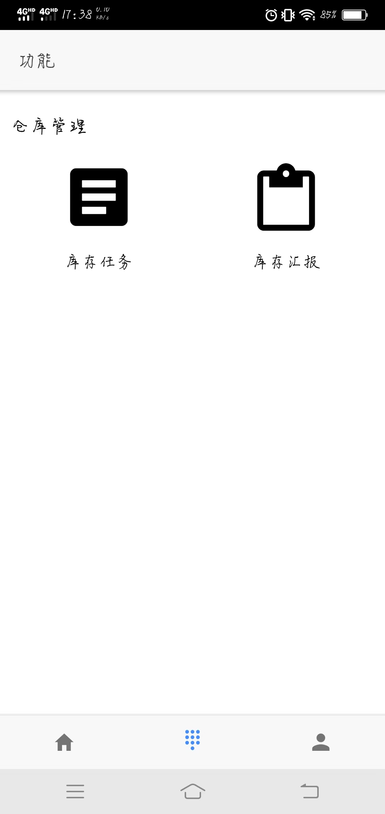
(Data/App)HubPlatform-Firststep-码上用
Business
Scenes
Purchase Stockin
Scene
Purchase Stockout
Scene
Business X
Scene
Service
Unit
Purchase Receipt
Service Unit
Purchase Receipt
Service Unit
Business X
Service Unit
Middleware
Middle API Func
Datacore
System
SAP Business One
S4 HANA
SAP ByD
3rd Party System

Slide 9
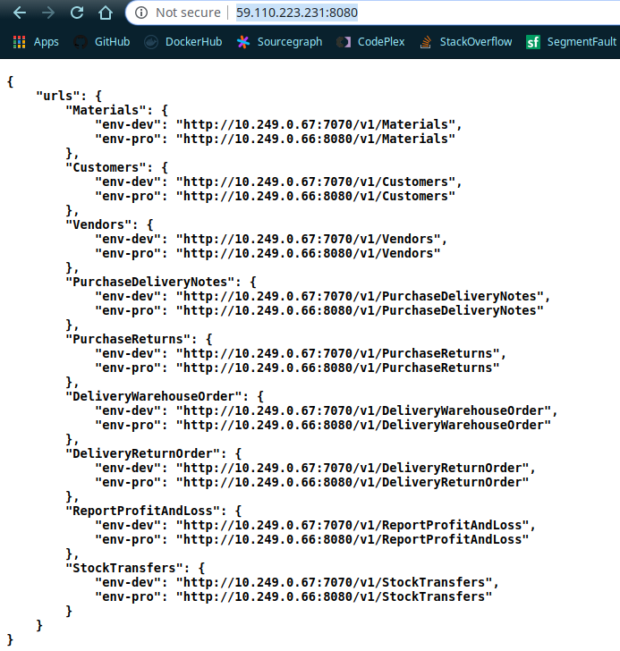
(Data/App)HubPlatform-Firststep-DataHub
Business Scenes
(3rd Party System)
Master Data Add
Scene
Purchase Order Add
Scene
Business X
Scene
Middleware
Middle API Func
Service
Unit
Master Data Add
Service Unit
Purchase Order Add
Service Unit
Business X
Service Unit
Datacore
System
SAP Business One
S4 HANA
SAP ByD

Slide 10



Actionsteps Next
Aaton
Pancy
Harold
Pancy
Aaton
Aaton
Presentation
Application
Framework

Slide 11

谢谢 THANKS !
北京奥维奥科技有限公司
中国北京市朝阳区望京西路48号金隅国际A座201室
Room201, Tower A, Jinyu International Mansion,
No.48 Wangjingxi Rd.Chaoyang District, Beijing 100102, China

