Slide 1
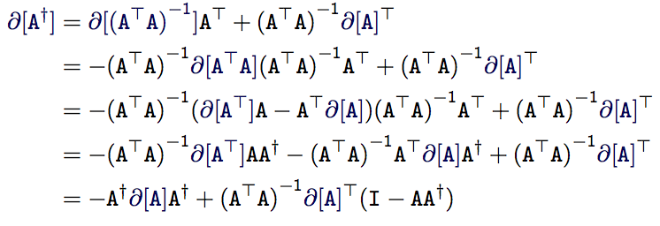
From “Proof by Latex” To “Proof by Ltac”
Peng (Perry) Wang
Host: Georges Gonthier

Slide 2
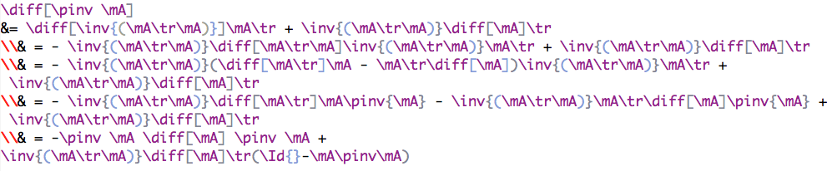
Proof by Latex

Slide 3

Proof by Latex
copy, paste, rewrite
+
Notes:
Here is a question. Can you find a typo here?

Slide 4
A Machine-checked Proof

Slide 5
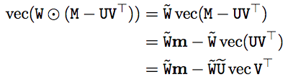
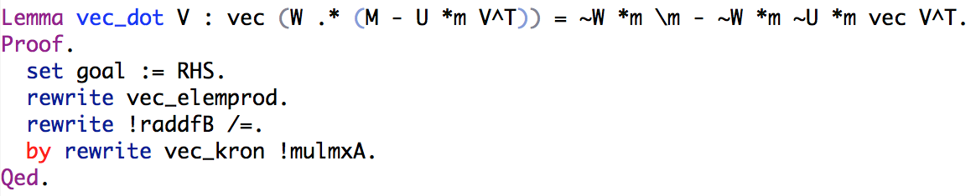
A Machine-checked Proof

Slide 6
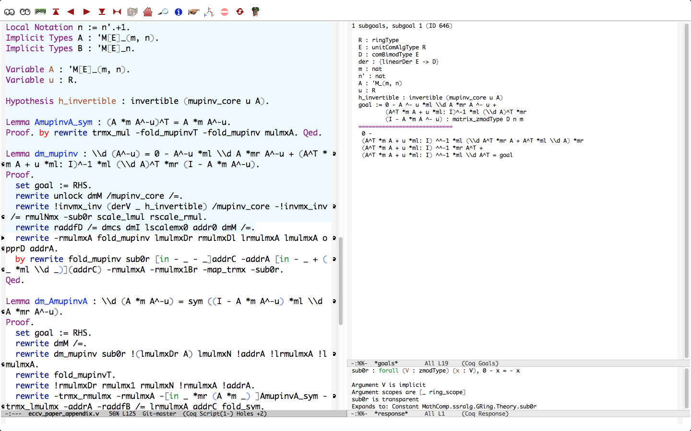
Coq – An Interactive Proof Assistant
Premises
Proofs
Current subgoal

Slide 7
Demo
Notes:
move forward
move backward
query about
exploring mode (dummy RHS)

Slide 8





“Eye check”
Generate?
Notes:
“Eye check”.
What if we can directly generate the paper?

Slide 9
Annotated Coq Proof → Latex

Slide 10
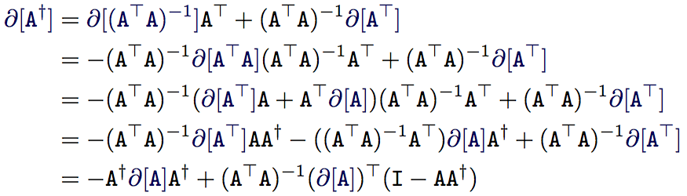
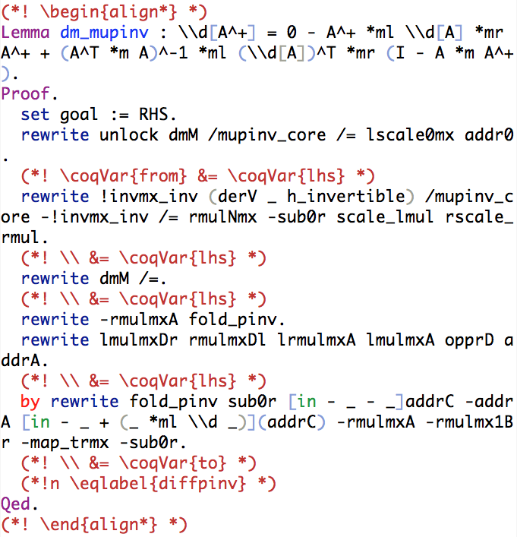
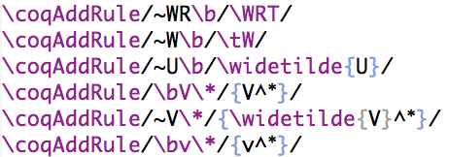
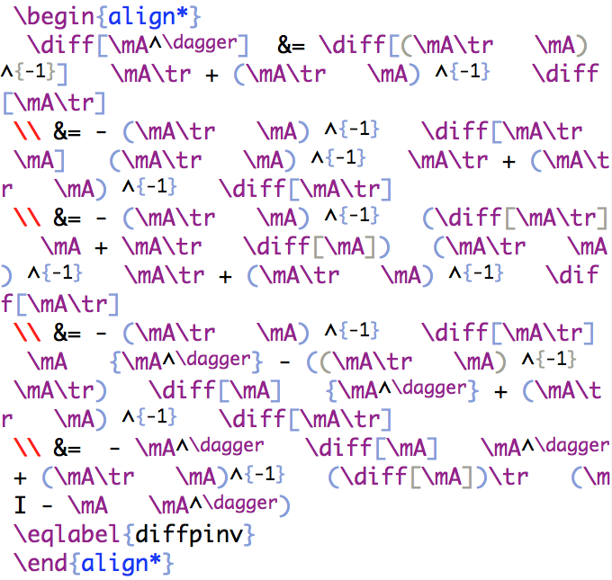
[
]

Slide 13


Typo list
-μ
+
+

Slide 14
The Technical Stuff

Slide 15
The Coq2Latex tools
a.tex
\begin{coq_example}
COQ CODE …
\end{coq_example}
a1.tex
\begin{coq_output}
COQ CODE +
RESPONSE …
\end{coq_output}
RunCoq.exe
a2.tex
\begin{align}
Latex …
\end{align}
PostCoq.exe

Slide 16
For Slow Coq Proofs
a.v
COQ CODE
a.txt
COQ CODE + RESPONSE
RunCoq.exe
a1.tex
\begin{align}
Latex …
\end{align}
PostCoq.exe
a.tex
\coqOutput{a.txt}
Notes:
All things that needs fine tuning (e.g. regex rules) should be in a.tex

Slide 17
Coq Formalization
Notes:
Things would have been easy if we already had everything and could just start proving equations.
They were not, but there is a good foundation we could build upon.

Slide 18
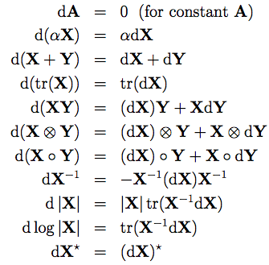
1. Matrix Differentiation

Slide 19
Differentiation Operator for a_{ij}
Defining property:
Corollaries:
a.
b.
If R is unital:
c.
If d is additive:
d.
If R is an algebra (i.e. can be scaled by a constant) and d is scalable:
e.
f.
(linear= additive + scalable)

Slide 20
Jacobian Matrix
“flatten” a column vector of row vectors into a matrix
The “read-off” lemma:

Slide 21
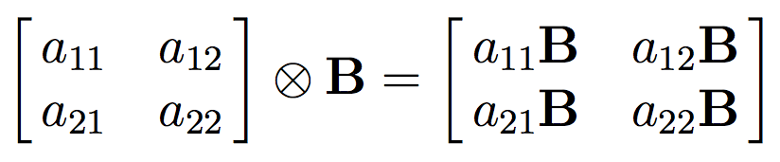
2. Kronecker Product
The characteristic property:
We can define (construct) a matrix from a property in this form
column-wise
vectorization

Slide 22
Define Kronecker Product
lin_mx (defined in SSReflect)
Notes:
How lin_mx is defined?
In 10 lines of Coq code!
See SSReflect’s documentation.

Slide 23
Conclusions
Tools to translate Coq proof into latex
Coq formalization of matrix differentiation
Proof by Latex
Learn Coq!
Proof by Ltac
Notes:
But before that

Slide 24
Thanks!

Slide 25
Coq Formalization
Base on SSReflect
Matrix Differentiation
Jacobian Matrix
Kronecker Product

Slide 26
Define Differentiation Operator
Defining property:
Corollaries:
a.
b.
If R is unital:
c.
If d is additive:
d.
If R is an algebra (i.e. can be scaled by a constant) and d is scalable:
e.
f.
(linear= additive + scalable)

Slide 27
Define Kronecker Product
The characteristic property:
We can actually define (construct) a matrix from such a characteristic property
column-wise
vectorization

Slide 28
SSReflect
Notes:
The name is not quite informative.
SSReflect is about a lot of things, all things that the author thinks are good stuff but can’t persuade the Coq developer to put into the trunk!
Most relevant to us:

Slide 29
SSReflect
An abstract algebra hierarchy
A matrix library
A good “rewrite” tactic (compared to the one Coq provides)

Slide 30
The Abstract Algebra Hierarchy
Z-module
Ring
ComRing
UnitRing
L-module
L-algebra
Algebra
ComUnitRing
Field
UnitAlgebra

Slide 31
The Matrix Library
‘M[R]_(m,n): type of m × n matrix whose
elements have type R
A *m B : multiplication
A^T : transpose
A^^-1 : inverse
A i j : element A(i,j)
\det A : determinant

Slide 32
But there are things missing …

Slide 33


Matrix Differentiation
In optimization we often need to calculate the Jacobian matrix:
Gauss-Newton method:
Levenberg method:
Notes:
A little background

Slide 34
Many flavors for deriving Jacobian matrix, such as:
But now many practitioners agree upon the “differentiation operator approach”:

Slide 35
Differentiation Operator
Assuming there is a “differentiation operator” d for matrix elements a_{ij}
Then we can define a differentiation operator for the whole matrix:
In Coq: \\d := map_mx \d

Slide 36
The “read-off” lemma
Hopefully, we can prove this lemma:
the “read-off” lemma, because as soon as we reach a canonical form dv = Adx, we can “read off” v’s Jacobian matrix

Slide 37
Why is this approach good?
A lot of nice properties about this matrix differentiation operator:
Notes:
From Minka’s note.

Slide 38
What’s a differentiation operator for a_{ij}?
Conventional definition:
real numbers → limits → derivatives → differentiation operator
An abstract algebra approach to define an operator:
“type” signature of the operator
defining properties (axioms)
“type”: algebraic structure (group, ring, field, etc)
Notes:
Our first formalization job is to prove these properties. But wait

Slide 39
Differentiation Operator
Differentiation operator d
1. “type” signature: R → R, where R is a ring
2. defining property:
Corollaries:
a.
b.
If R is unital:
c.
If d is additive:
d.
If R is an algebra (i.e. can be scaled by a constant) and d is scalable:
e.
f.
(linear= additive + scalable)

Slide 40
All went well, until …

Slide 41
Jacobian?
How to
define Jacobian matrix?
prove the “read-off” lemma?
The “type” signature is too restrictive:
R → R
same?
Notes:
We spent some time on this but then realized that we couldn’t.
The problem here is.
We are assuming here that the domain and co-domain of the operator are the same

Slide 42
OK for single variable functions
instance: derivation
For multi variable functions, no instance
a typical attempt:

Slide 43
Revise
Revised “type” signature:
d : R → D
D is a R-R-bimodule
For example, R^{n} is a R-R-bimodule
well defined

Slide 44
Jacobian matrix can’t be defined on this abstract setting, but can be defined on one of its instantiation:
“flatten” a column vector of row vectors into a matrix

Slide 45
The “read-off” lemma
is trivial to prove:
assuming J(x) = I, where x is the free variables of F_{n}

Slide 46
The Kronecker Product
The characteristic property:
We can actually define (construct) a matrix from such a characteristic property
column-wise
vectorization

Slide 47
Define Kronecker Product
lin_mx (defined in SSReflect)
Notes:
How lin_mx is defined?
In 10 lines of Coq code!
See SSReflect’s documentation.

