Slide 1
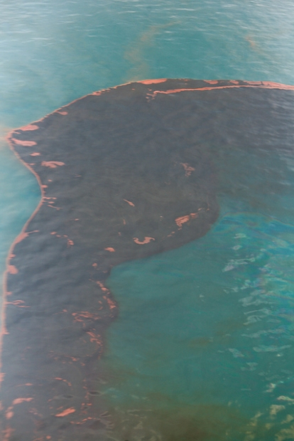

Oil Spill in Mexican Gulf
Oil Spill Modeling in Columbia River
- Based on SELFE Model -
Dr. Yun Jung at CMOP, OHSU

Slide 2
1. Introduction
1.1 Background of the Study
This study is motivated by the vulnerability of river system against oil spill accident due to ship traffic.
The lesson obtained from major oil spill accidents is to be prepared in advance.
1.2 Objective of the Study
Development of a sophisticated river oil spill model
Requisites to oil spill model
- accurate prediction for movement and fate of oil released on the water.
- simple and quick implementation with data acquisition when required
1.3 Why SELFE?
Good representation of shoreline.
Wetting & drying algorithm, more realistic modeling is possible.
Providing with good input data for oil spill model.

Slide 3
2. Brief Description of Oil Spill Model
2.1 Lagrangian Particle Tracking
In oil spill model, spilled oil is represented as a group of particles and each particle is tracked independently, which is called “Lagrangian particle tracking”.
The movement of each particle is governed by advection and diffusion processes, which is based on advection-diffusion equation.
1) Advection Term
water velocity
wind velocity
rising velocity due to buoyancy
virtual velocity by the gradient of diffusion coefficient
wind induced wave velocity – not included yet
2) Diffusion Term
random turbulent velocity

Slide 4



2. Brief Description of Oil Spill Model
2.2 Random Displacement Model
The RDM is basically similar to random walk model, but it works more accurately
in heterogeneous media(different turbulent diffusion coefficient in space).
1) Representation of Particle Movement in RDM
Where U ,V & W are x, y & z components of water velocity, respectively.
n is current time step, n+1 is next time step, * denotes n+½ time step.
Δt is time step interval. R is uniform random number [-1 1].

Slide 5




2. Brief Description of Oil Spill Model
are turbulent diffusion coefficients in x, y, z direction, respectively.
are wind dragging speeds in x, y direction. Where
is dragging coefficient, normally 0.03.
is rising velocity due to buoyancy, which is calculated from following empirical
equation.
Where, g is the acceleration of gravity coefficient, is oil droplet diameter,
are density of oil and water, respectively.
2) Weathering Processes
There are many weathering processes, such as evaporation, dispersion, emulsification, dissolution, bio-degradation, etc., but in this study, evaporation process is only considered because it is major process.

Slide 6
2. Brief Description of Oil Spill Model
3) Boundary Treatment
At land boundary : It is assumed that 80% of particles are stranded when they get on shore, but remaining 20% particles will still move with reflecting to shoreline. Also, if drying land is rewetted, stranded particles will start to move again. We can put this stranded percentage arbitrarily as based on shoreline type.
At open boundary : It is assumed that particles which crossed the open boundary don’t come back to computational region. Thus, modeling region must be sufficiently large as compared to the interest area.

Slide 7

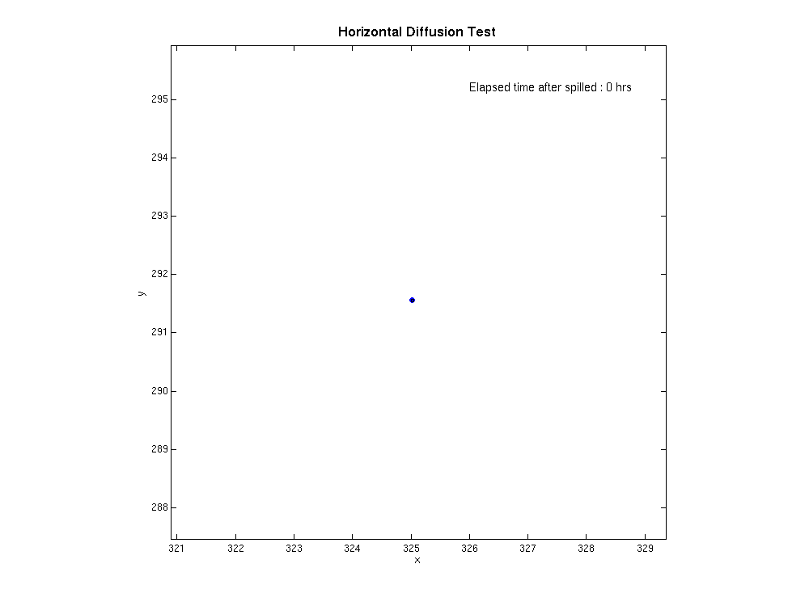
3. Model Application and Results
3.1 Simple Test of Model
1) Horizontal Diffusion Test
Switched off advection term and 1,000 particles are released at same time.
Black circle in picture represents 3 times standard deviation( ) limit.
It means that 99.7% of total particles should be located in circle statistically.

Slide 8
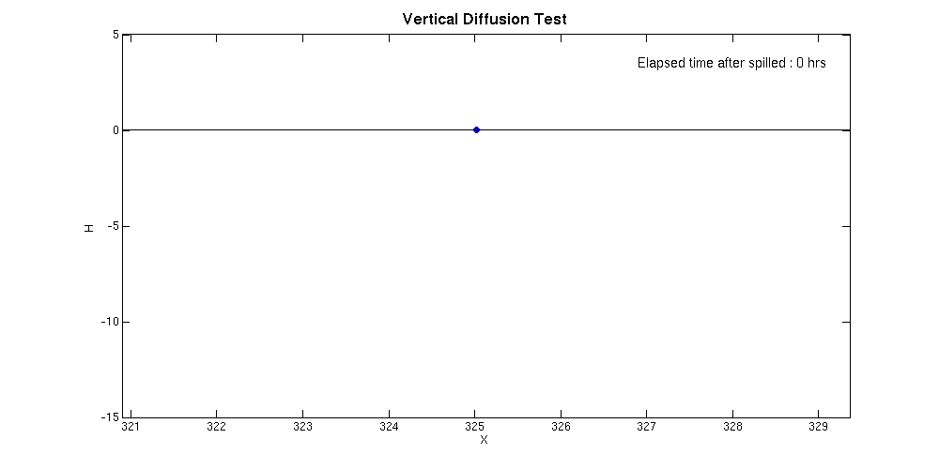
3. Model Application and Results
2) Vertical Diffusion Test
Switched off advection term and 1000 particles are released at same time.
With rising velocity (green particles in picture)
Without rising velocity (red particles in picture)

Slide 9
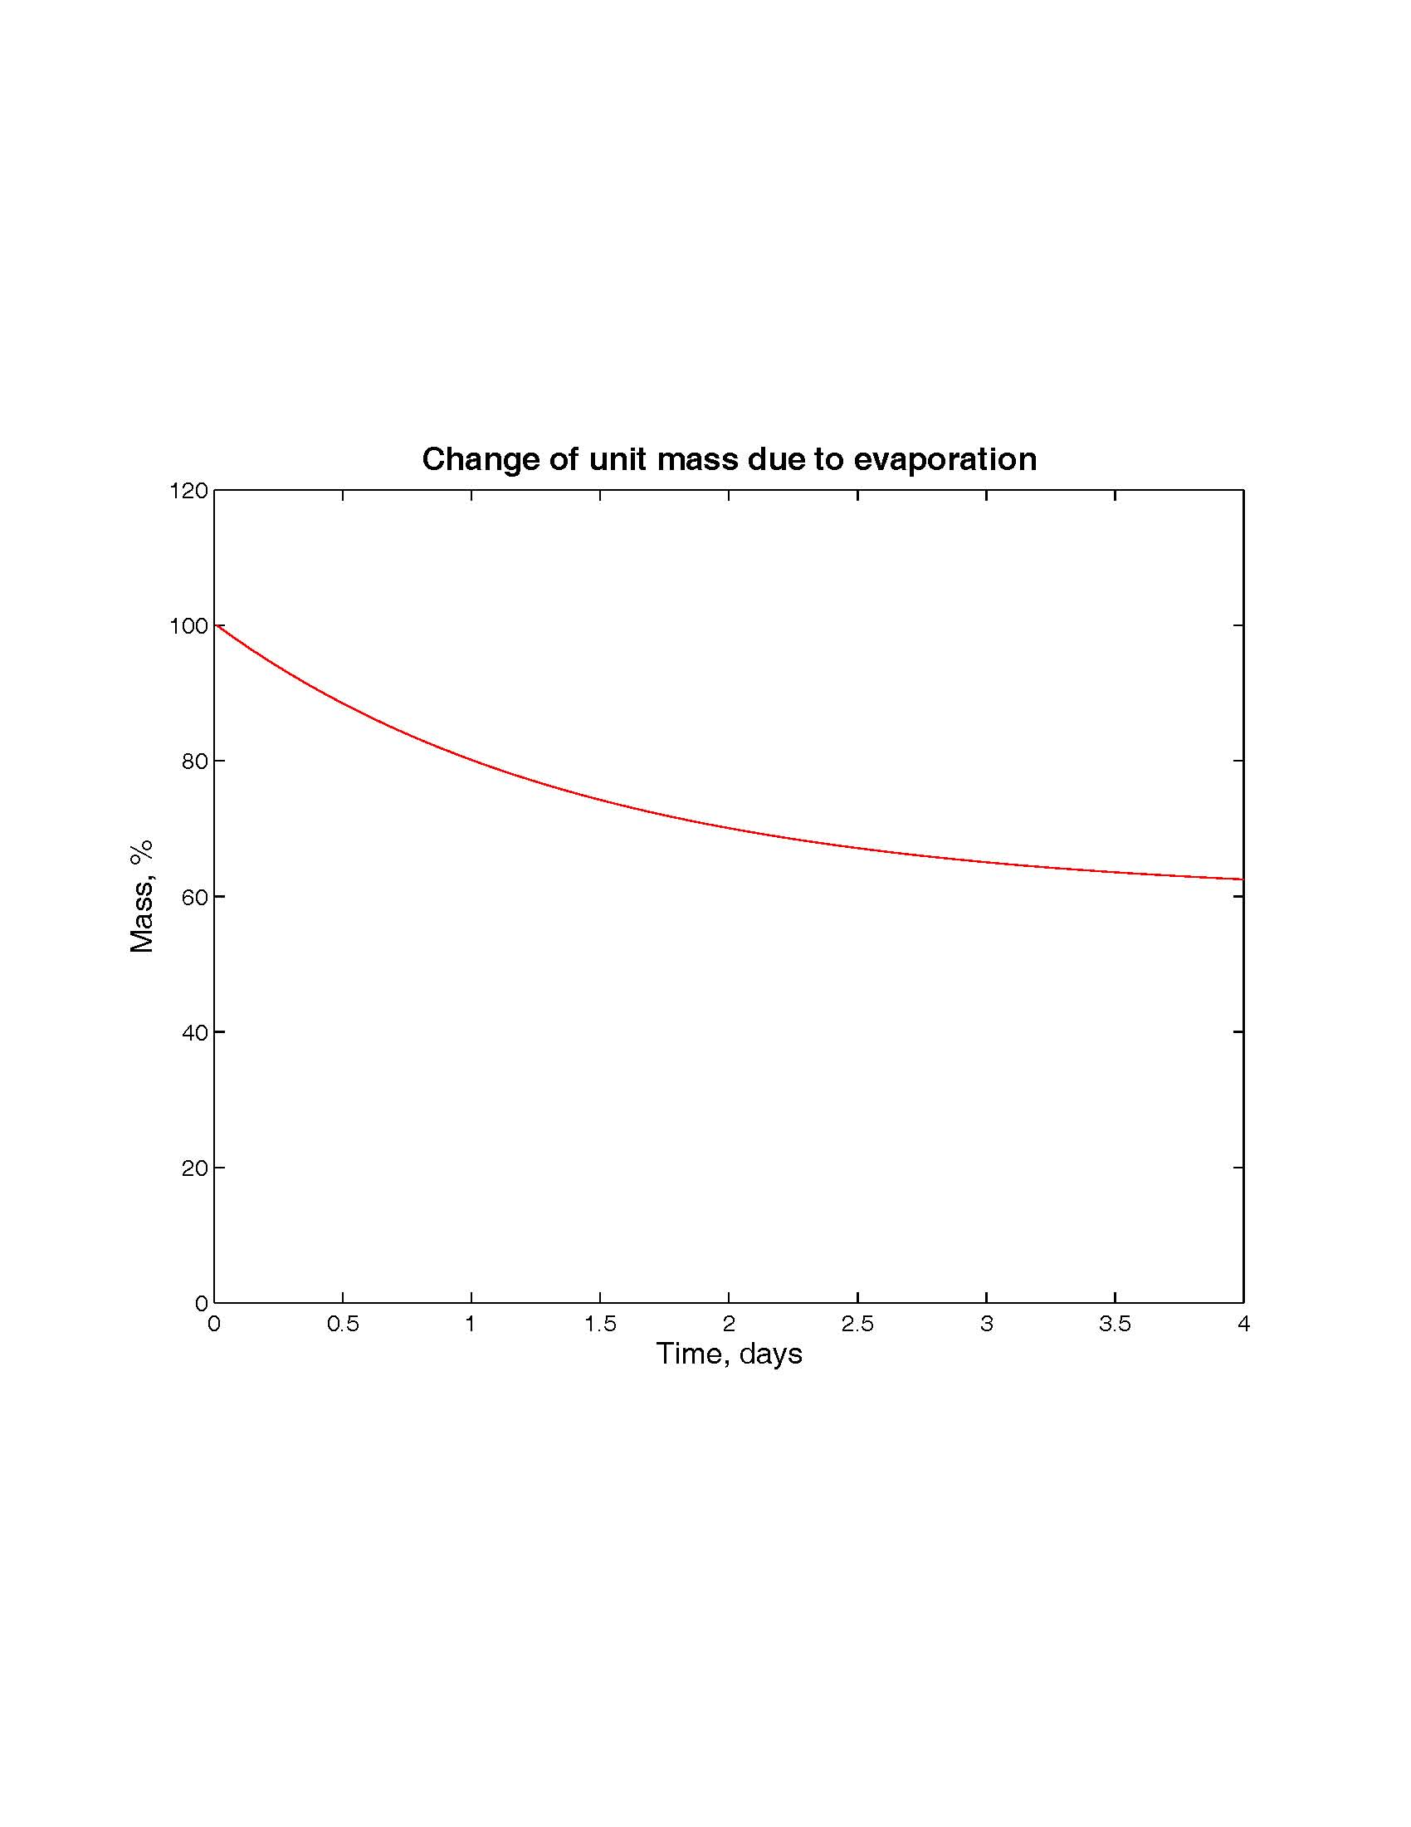

3. Model Application and Results
3.2 Model Application
1) Model Set Up
At three different parts of Columbia river estuary, particles are released for 24 hours with 10 particles in every 15 minutes
Turbulent diffusion coefficients : The vertical coefficient is taken from SELFE output, but the horizontal coefficient is set to constant value, 5.0
Evaporation is progressed as below graph.
The unit mass is reduced exponentially by evaporation from 100% to 60% with time.
Half-life time is set to 1.5 days.

Slide 10
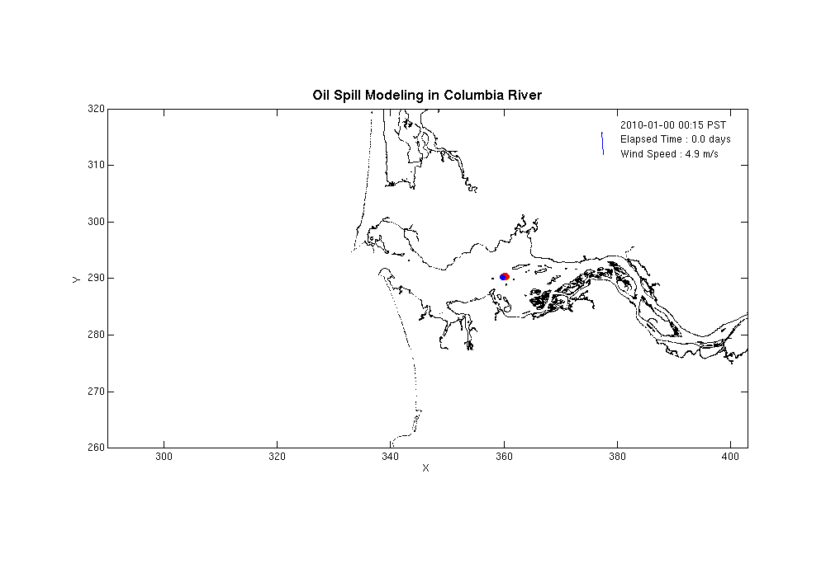
3. Model Application and Results
2) Modeling Case 1
Particles are released at middle part of Columbia river estuary.
Model was run for 4 days with and without wind, respectively.

Slide 11
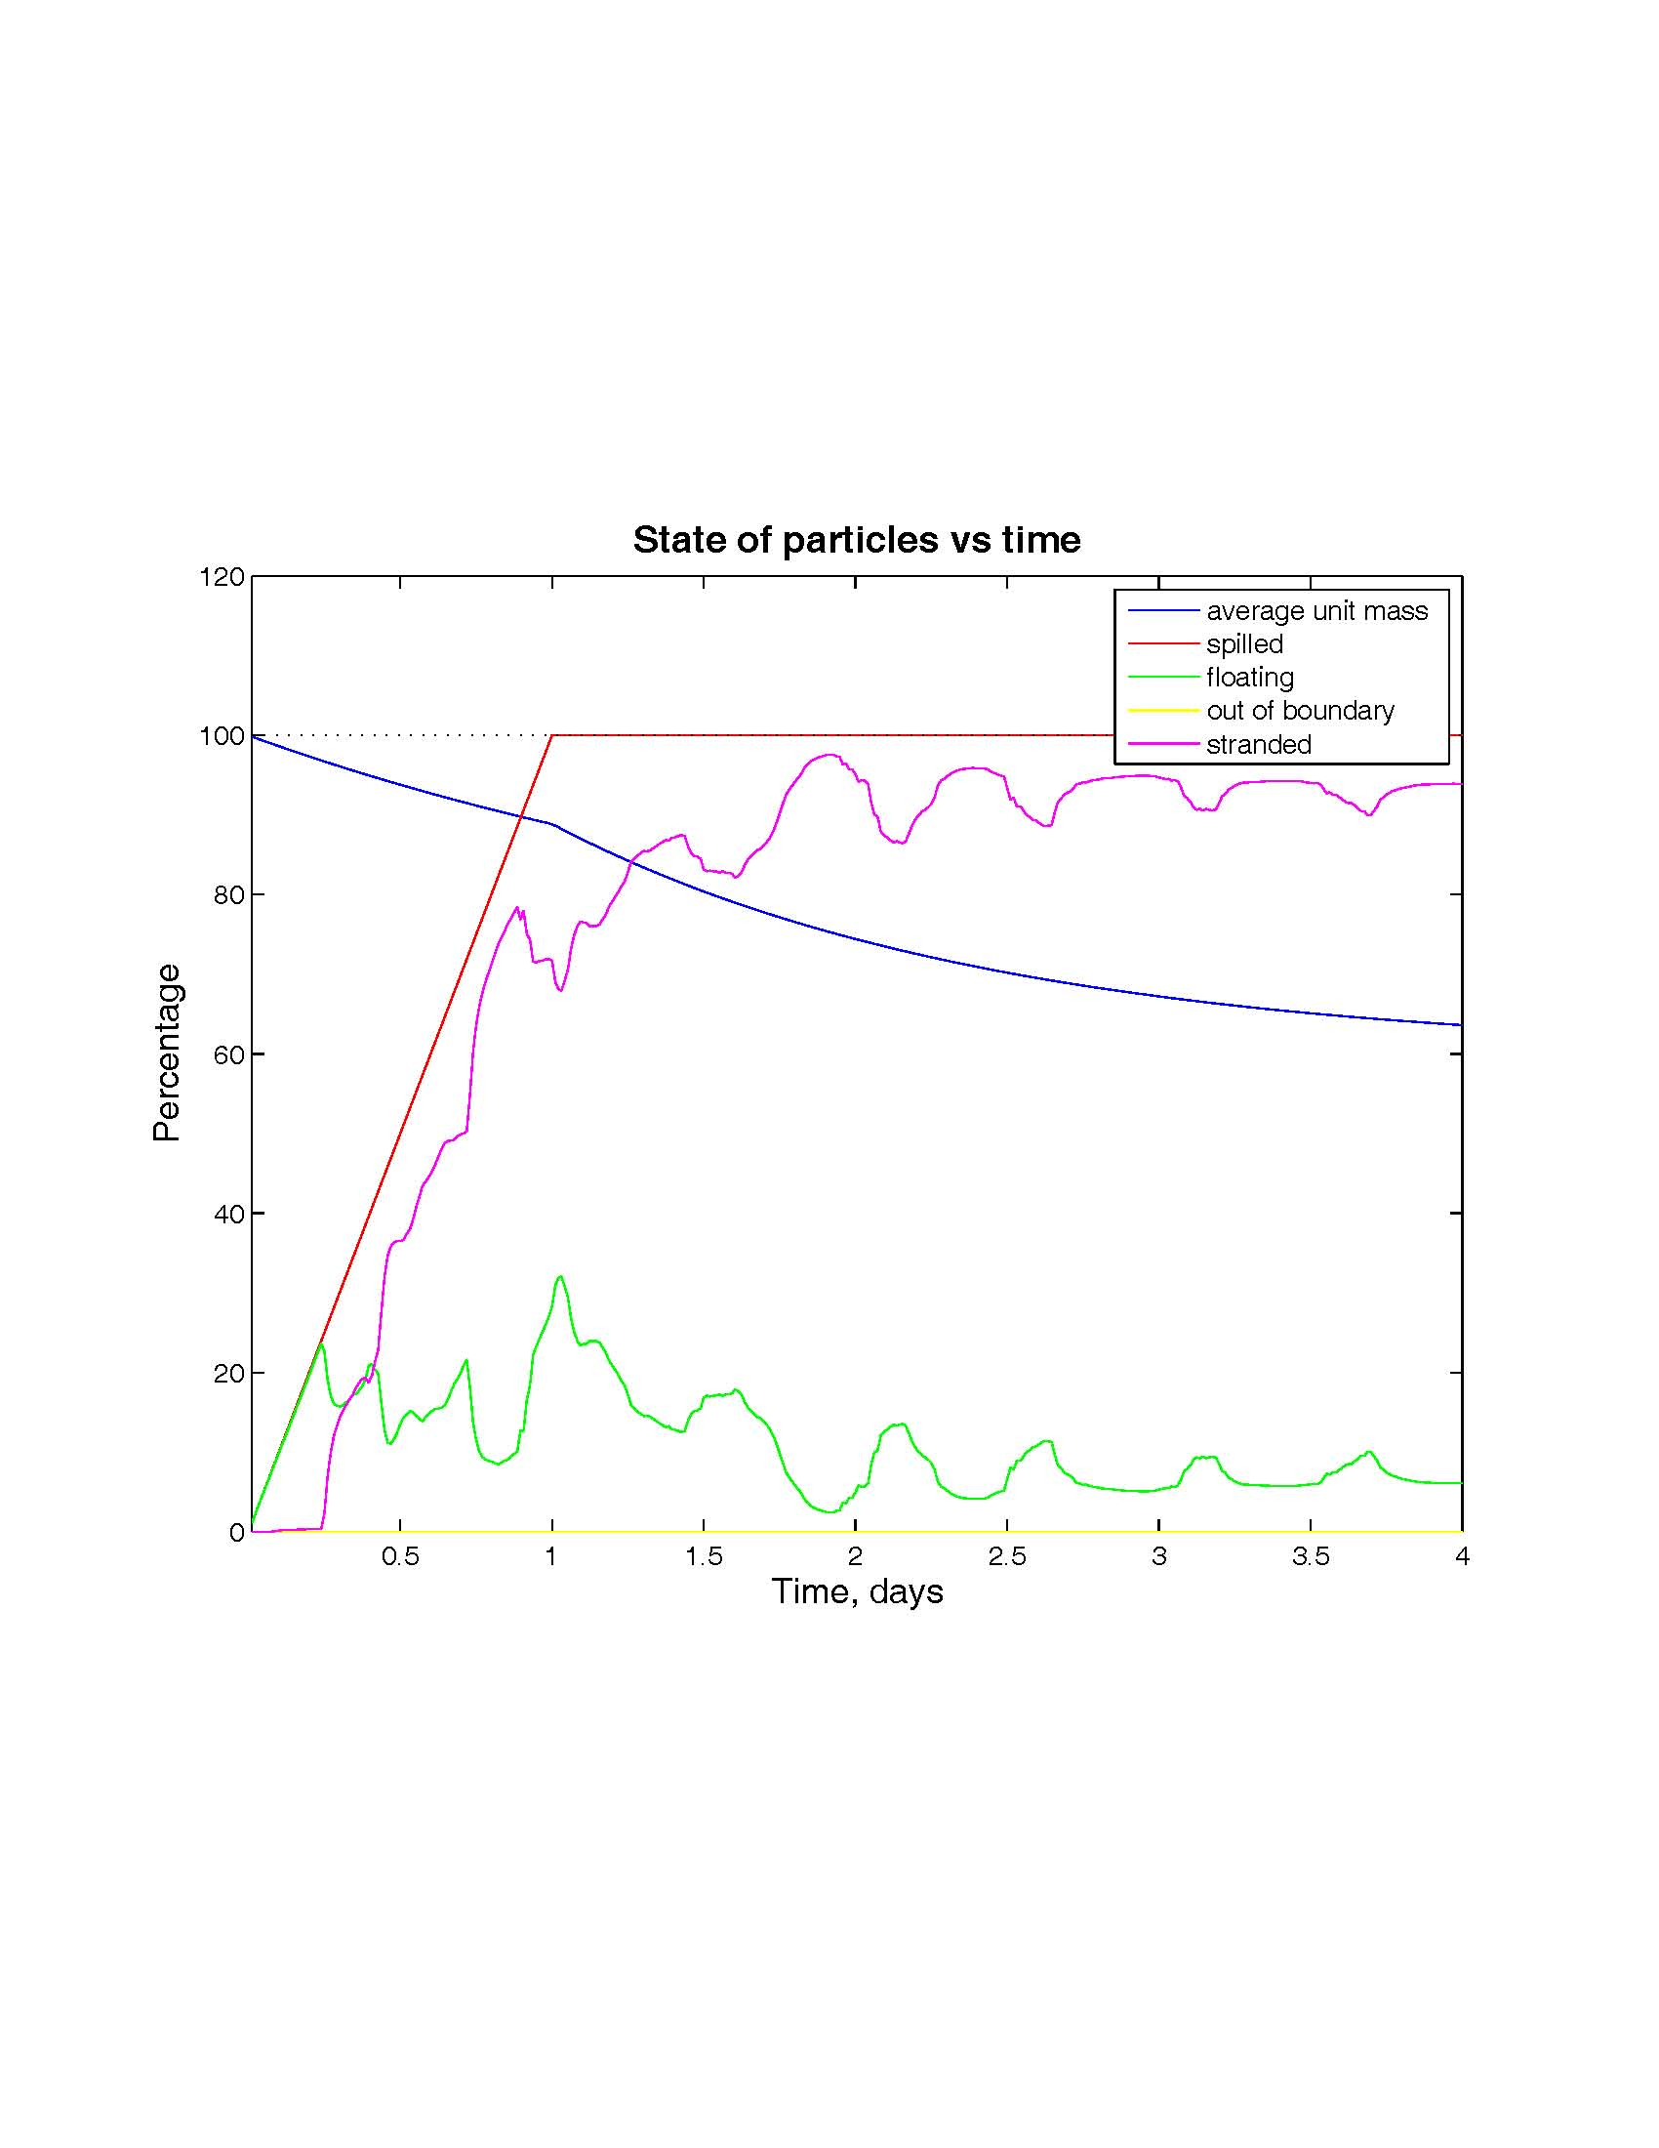
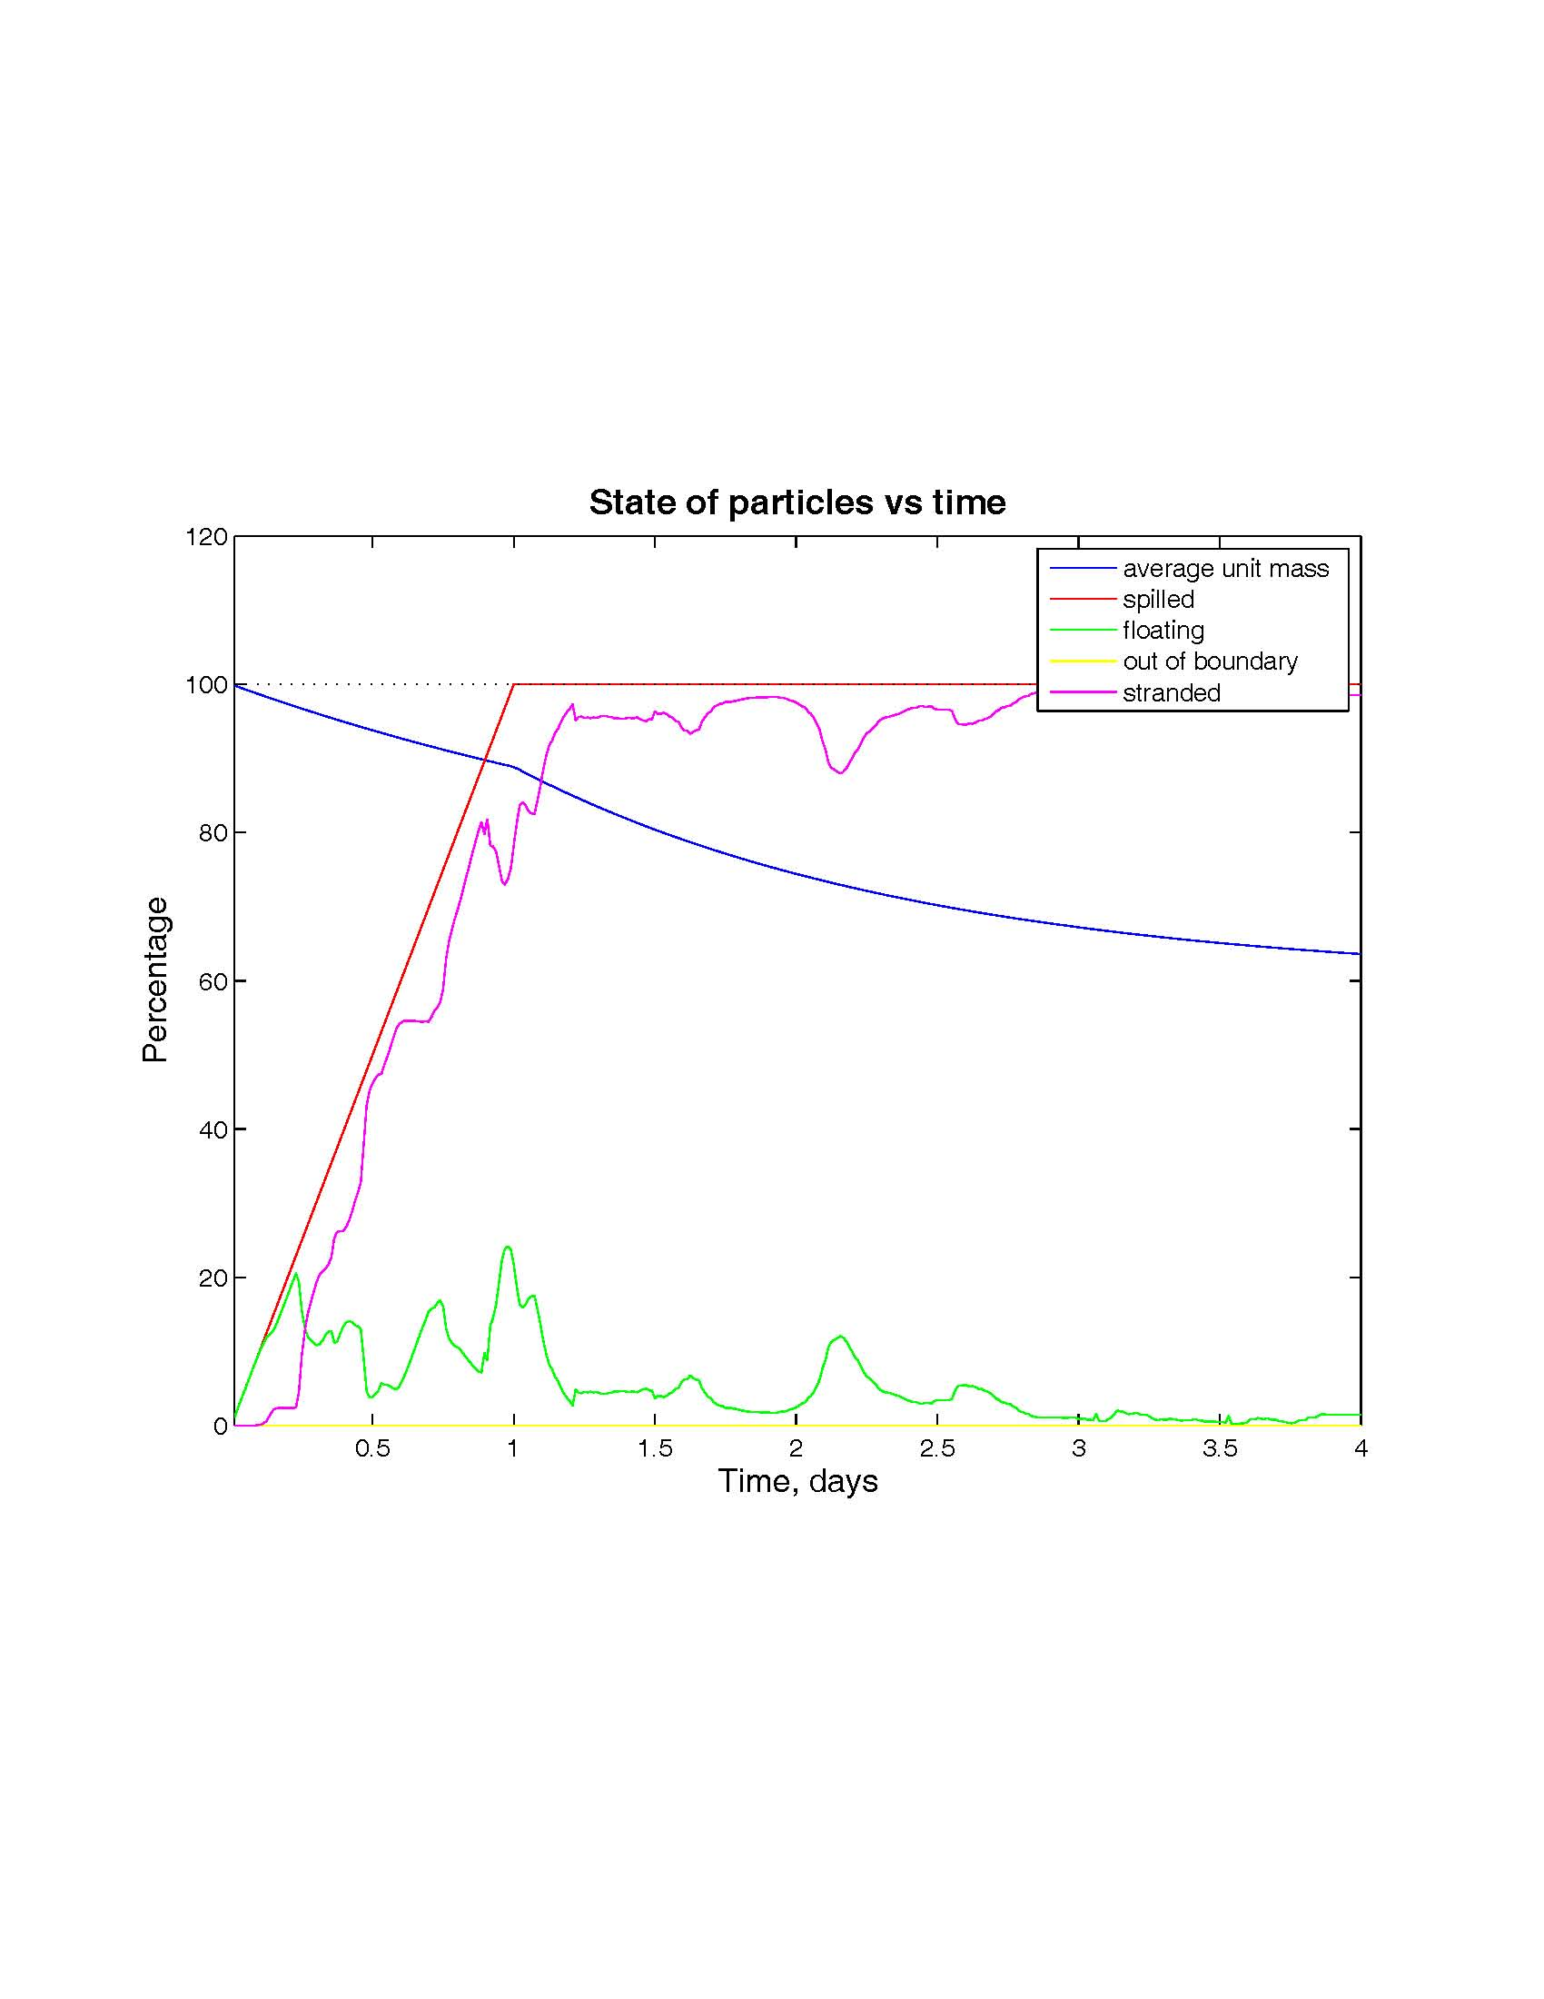
3. Model Application and Results
2) Modeling Case 1
The change of particle state with time
The wind makes the particles stranded more on shore.
without wind with wind

Slide 12
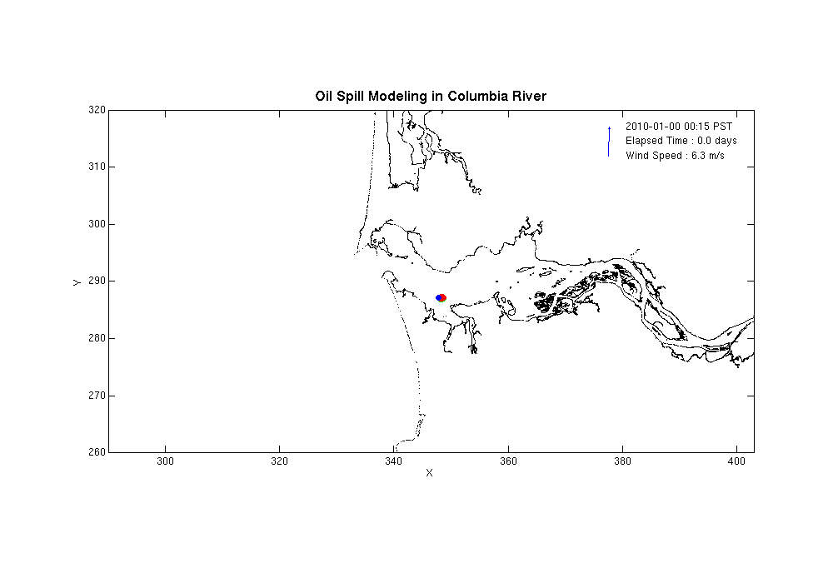
3. Model Application and Results
3) Modeling Case 2
Particles are released at middle part of Columbia river estuary.
Model was run for 3 days with and without wind.

Slide 13
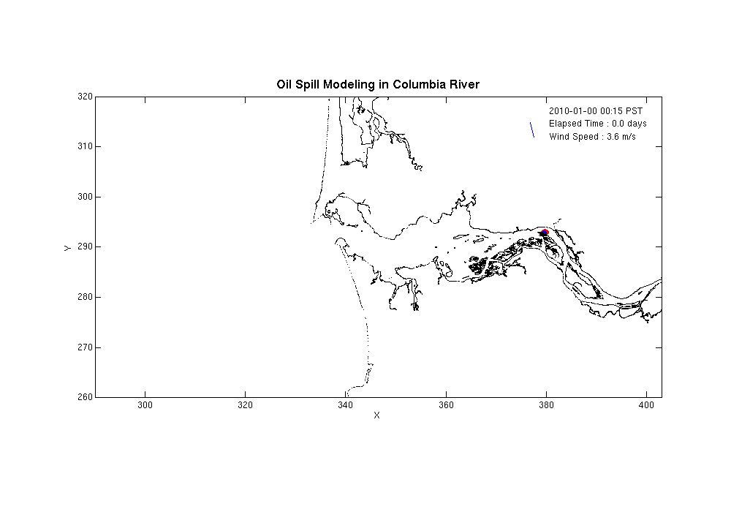
3. Model Application and Results
4) Modeling Case 3
Particles are released at upper part of Columbia river estuary.
Model was run for 5 days with and without wind.

Slide 14
4. Conclusion Remarks
The study of oil spill modeling in Columbia river seems to be successful, but model still needs to be verified with observational data.
If SELFE output is provided, oil spill modeling can be done anytime within few minutes. But the accuracy of SELFE output affects to modeling results inevitably.
The oil spill modeling study in Columbia river estuary shows that wind plays an important role in moving the spilled oil. Thus accurate wind data is requisite to get good results of modeling.
For the further works,
- It is necessary to run oil spill model with realistic horizontal diffusion coefficients and to check the results.
- Weathering processes except evaporation are to be considered.
Thanks for your attention !

