Slide 1

Bottom-up Approach
V2G-Sim Model Architecture
Includes libraries of models of varying complexity & computing time
Core objective: a platform to develop and test any user-defined charge/discharge control approach and co-simulate with complementary models (e.g. distribution, transmission, market, etc.)
V2G-Sim models the driving and charging of many individual vehicles to temporally and spatially predict how vehicles can benefit the electricity grid and how the grid
affects vehicles
e⁻
$
Notes:
Detailed information on V2G-Sim:
v2gsim.lbl.gov
The Vehicle-to-Grid Simulator (V2G-Sim) provides systematic quantitative methods to address the uncertainties and barriers facing vehicle-grid integration (VGI). In the real world, each person drives a different vehicle, in different ways, with different trip distances, at different times. Predicting the adequacy of plug-in electric vehicles (PEVs) for the needs of drivers, and accurately predicting the impacts and opportunities to the electricity grid from increased PEV deployment requires models that can consider these differences at the individual vehicle level.
V2G-Sim models the driving and charging behavior of individual PEVs to generate temporally- and spatially-resolved predictions of grid impacts and opportunities from increased plug-in electric vehicle (PEV) deployment. V2G-Sim provides bottom up modeling from
individual vehicle dynamics all the way up to aggregate grid impacts and opportunities, as shown in Figure 1. Any managed charging or discharging control approach can be modeled to predict the impacts on individual vehicles, or at any grid scale. Battery degradation from driving or vehicle-grid services can be modeled with battery degradation models integrated into V2G-Sim. The model is scalable to simulate impacts and opportunities for any number of vehicles (from 1 to 1 million or more PEVs).

Slide 2
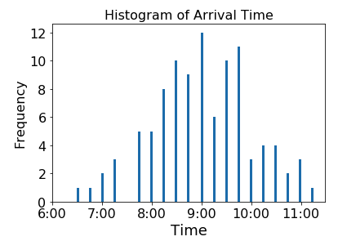
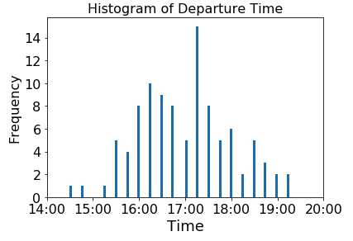
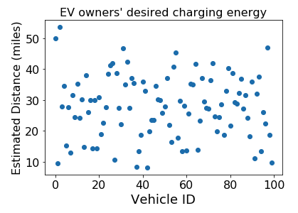
Case study: Energy cost saving + demand charge mitigation
Real-world commercial building load (6/1/2016 – 6/30/2016)
100 EV data from CEC-LBNL Alameda County EV charging demonstration project^{[1]}
100 EVSE, maximum charging power 6.6kW
PG&E E-19 tariff（Medium general demand-metered TOU service) ^{[2]}
Building manager aims to minimize monthly electricity bill (energy cost + demand charges) , without compromising energy demand from EV owners
1. https://vehicle-grid.lbl.gov/project/smart-charging-plug-vehicles-and-driver
2. https://www.pge.com/tariffs/tm2/pdf/ELEC_SCHEDS_E-19.pdf

Slide 3
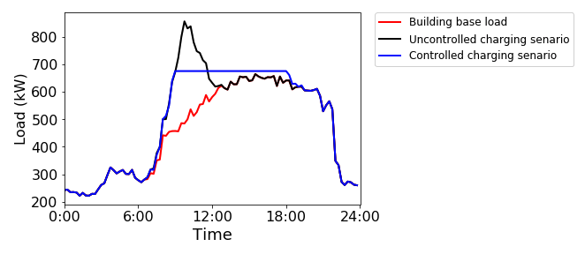
Simulation Results:
Load profiles on the peak day
Table 1. Monthly electricity bills in different scenarios
Scenarios | Energy charge | Demand charge | total
Base load | 37409.4 | 28376.5 | 65785.9
Uncontrolled charging | 40166.8 | 36926.6 | 77093.4
Controlled charging | 40372.1 | 29015.8 | 69387.9
1. Lambert, Fred (31 October 2016). "Tesla Powerwall 2 has no competition – comparison with LG Resu and SonnenBatterie". Electrek. Retrieved 1 November 2016.

Slide 4
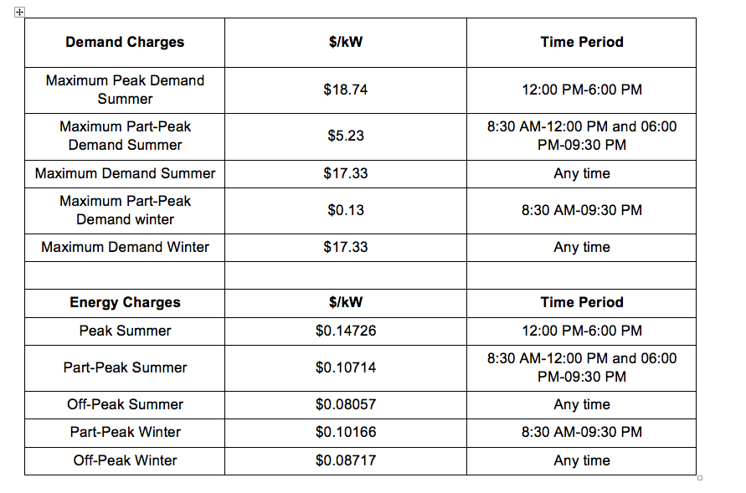
E-19

