Slide 1
ClassLoader In Cloud Architecture Group| Stack & Cloud
Jun 08, 2012

Slide 2
Agenda
ClassLoader overview
Class Loader Hierarchy
Dynamical Class Loading
ClassLoader in Tomcat
Class Loader Hierarchy
Servlet loading
ClassLoader in Cloud
Class Loader configuration
Issue && solution

Slide 3
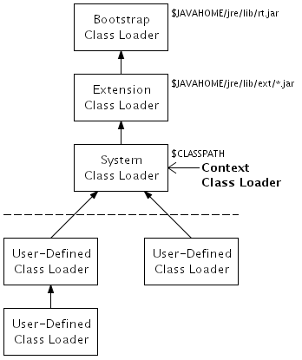
ClassLoader Overview -- Class Loader Hierarchy
Notes:
Class Loader hierarchy
Each class loader (except the bootstrap class loader) has a parent class loader
Class loaders created automatically by the JVM
Bootstrap class loader: Core classes
Extension class loader: Installed extension classes
System class loader: Classes on the class path
User-defined class loaders created by the program
The system class loader is the parent class loader by default
Another parent class loader can be specified explicitly
Each thread has an associated context class loader
Default context class loader is the system class loader
A different context class loader can be specified by calling Thread.setContextClassLoader()
Obtain a thread's context class loader by calling Thread.getContextClassLoader()
Delegation model
When asked to load a class, a class loader first asks its parent to load the class
If the parent succeeds, the class loader returns the class from the parent
If the parent fails, the class loader attempts to load the class itself
This recurses up the hierarchy — thus, the class loader hierarchy is searched from the top back down to the starting point
Which class loader is used?
You can explicitly load a class into a class loader by calling the class loader's loadClass() method
If a class needs to be loaded and a classloader is not explicitly specified -- e.g., a new statement is executed -- the class is loaded into the same class loader that loaded the class that contains the code that is executing

Slide 4
ClassLoader Overview – Dynamical Class Loading
System ClassLoader ClassLoader.getSystemClassLoader()
Current class ClassLoader Class.forName(String className)
Class.getResource(String name)
Current thread context ClassLoader Thread.currentThread().getContextClassLoader()

Slide 5
ClassLoader Overview – Context Class Loader
Q: When should I use thread.getContextClassLoader()?
A: The classloading delegation model doesn’t work
API (Application Programming Interface)
VS
SPI (Service Provider Interface)
E.g. JDBC/JNDI/JAXB

Slide 6
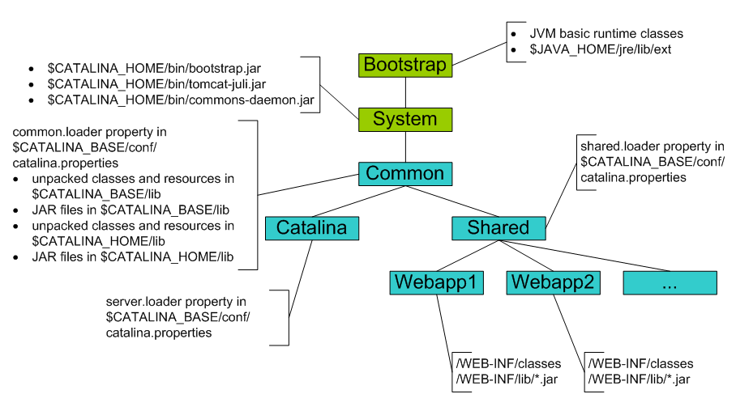
ClassLoader In Tomcat -- Class Loader Hierarchy
Notes:
org.apache.catalina.startup.Bootstrap

Slide 7
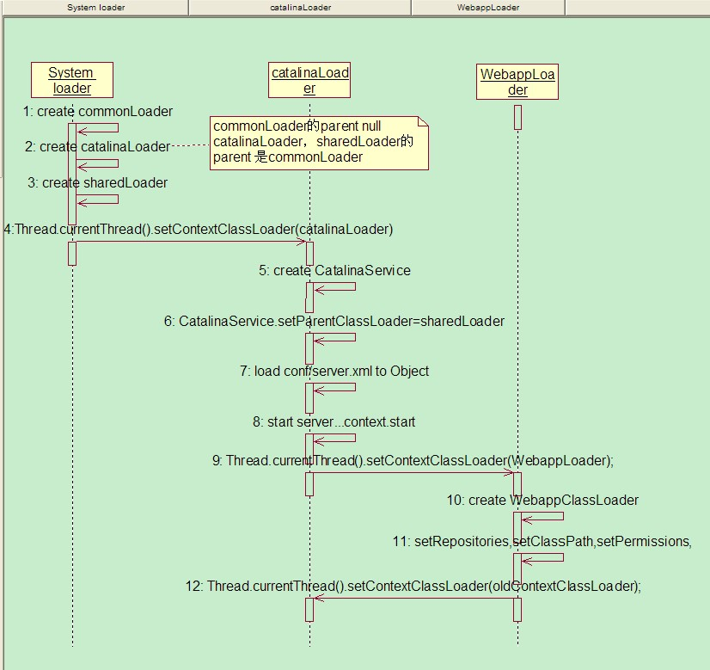
ClassLoader In Tomcat – ClassLoader&&WebappLoader
Notes:
org.apache.catalina.startup.Bootstrap

Slide 8
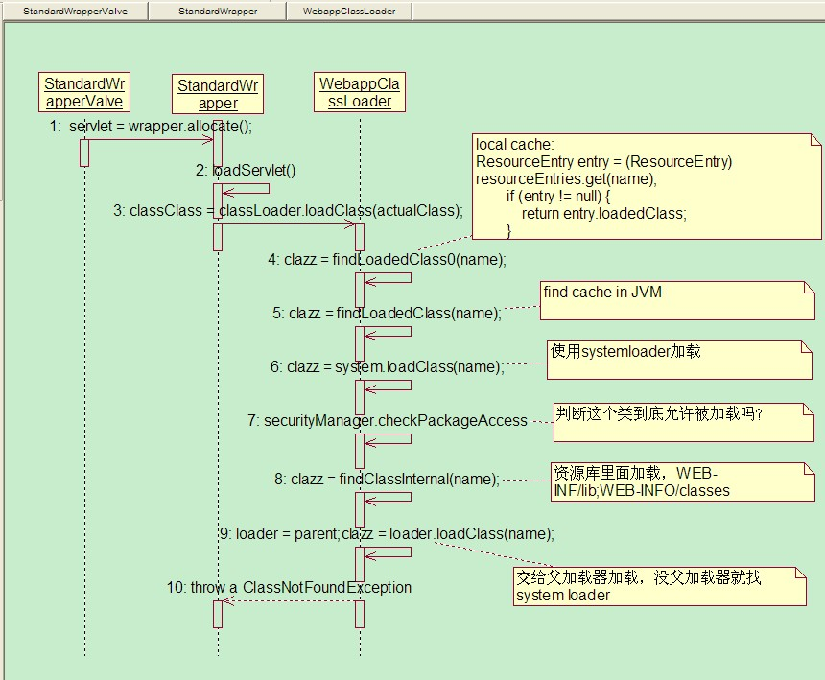
ClassLoader In Tomcat – Load Servlet Class

Slide 9
ClassLoader In Cloud
shared.loader=
${catalina.home}/webapps/cashpro/WEB-INF/lib/*.jar,
${catalina.home}/webapps/cashpro/WEB-INF/classes/,
${catalina.home}/osa_lib,
${catalina.home}/osa_lib/*.jar

Slide 10
ClassLoader In Cloud – Different ClassLoader
<servlet>
<servlet-name>QuartzInitializer</servlet-name>
<display-name>Quartz Initializer Servlet</display-name>
<servlet-class>
com.ssc.cashpro.quartz.CashproJobStarter
</servlet-class>
<load-on-startup>3</load-on-startup>
<init-param>
<param-name>shutdown-on-unload</param-name>
<param-value>true</param-value>
</init-param>
<init-param>
<param-name>start-scheduler-on-load</param-name>
<param-value>true</param-value>
</init-param>
</servlet>
<servlet id="XMLServlet">
<servlet-name>XMLServlet</servlet-name>
<display-name>XML Servlet</display-name>
<description>XML Adapter servlet with both request and response in XML</description>
<servlet-class>com.ssc.faw.controller.XMLServlet</servlet-class>
<load-on-startup>2</load-on-startup>
</servlet>
Webapp ClassLoader
Shared ClassLoader

Slide 11
ClassLoader In Cloud -- Issue
“Incorrect” value for static variable in servlet class
java.lang.ClassCastException: ABC cannot be cast to ABC
Notes:
11

Slide 12
ClassLoader In Cloud -- Solution
put osa_framework.jar under WEB-INF/lib/
Notes:
Caveat: if osa_framework makes use of third party lib which uses context class loader, we may also put that thirdparty lib under web-inf/lib

Slide 13


