Slide 1
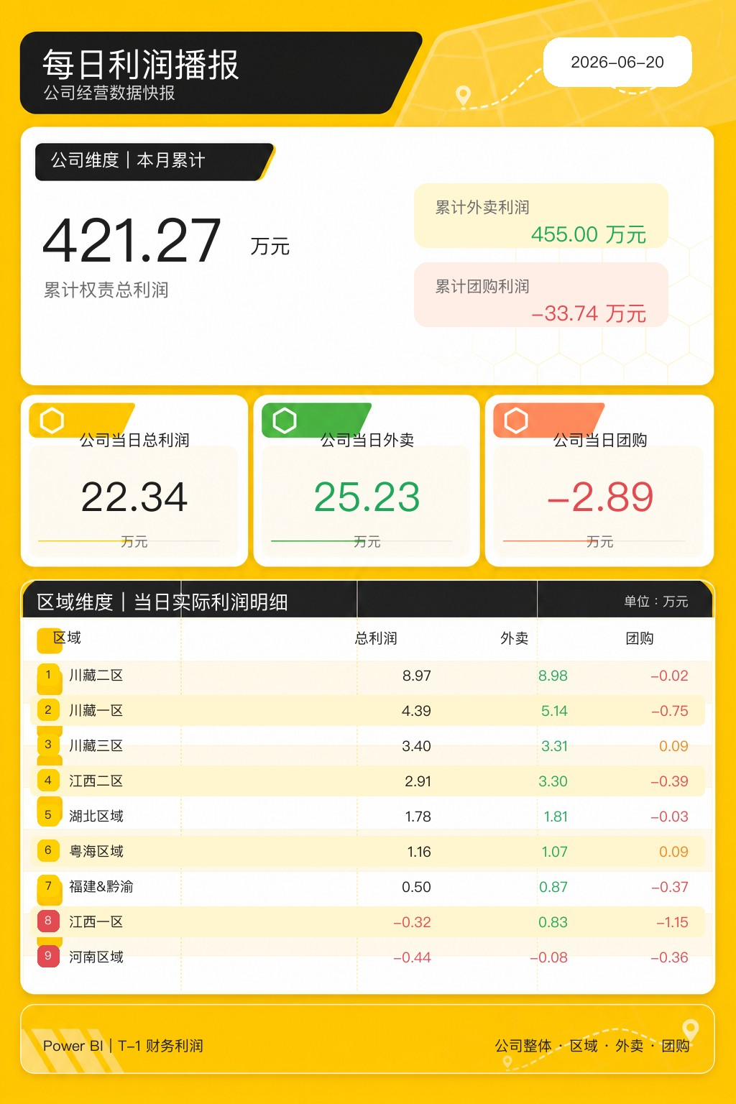
{{DATE}}
累计外卖利润
{{MONTH_TOTAL}} 万元
{{MONTH_DELIVERY}} 万元
累计团购利润
{{MONTH_GROUP}} 万元
{{DAILY_TOTAL}}
{{DAILY_DELIVERY}}
{{DAILY_GROUP}}
万元
万元
万元
1
{{R1_NAME}}
{{R1_TOTAL}}
{{R1_DELIVERY}}
{{R1_GROUP}}
2
{{R2_NAME}}
{{R2_TOTAL}}
{{R2_DELIVERY}}
{{R2_GROUP}}
3
{{R3_NAME}}
{{R3_TOTAL}}
{{R3_DELIVERY}}
{{R3_GROUP}}
4
{{R4_NAME}}
{{R4_TOTAL}}
{{R4_DELIVERY}}
{{R4_GROUP}}
5
{{R5_NAME}}
{{R5_TOTAL}}
{{R5_DELIVERY}}
{{R5_GROUP}}
6
{{R6_NAME}}
{{R6_TOTAL}}
{{R6_DELIVERY}}
{{R6_GROUP}}
7
{{R7_NAME}}
{{R7_TOTAL}}
{{R7_DELIVERY}}
{{R7_GROUP}}
8
{{R8_NAME}}
{{R8_TOTAL}}
{{R8_DELIVERY}}
{{R8_GROUP}}
9
{{R9_NAME}}
{{R9_TOTAL}}
{{R9_DELIVERY}}
{{R9_GROUP}}

