Slide 1


分享
WEB PACK 介绍
*********************************************************************************************************************************************************************************
*********************************************************************************************************************************************************************************
汇报人：王强

Slide 2
1
什么是Webpack？
目录
2
为什么要使用Webpack
S
3
怎么使用Webpack
4
升级Webpack

Slide 3
什么是Webpack？
js
webpack 是一个现代 JavaScript 应用程序的静态模块打包器。当 webpack 处理应用程序时，它会递归地构建一个依赖关系图(dependency graph)，其中包含应用程序需要的每个模块，然后将所有这些模块打包成一个或多个 bundle
WebPack可以看做是模块打包机：它做的事情是，分析你的项目结构，递归处理你执行脚本的依赖，生成一个依赖关系图，然后将依赖的模块输出处理（后续的工作是它提供的API扩展工具完成的）类似开发工具explise或者vscode
js
css
webpack
css
scss
image
image

Slide 4
什么是Webpack？
webpack的主要功能包含：
模块关系依赖图
按需加载
高阶函数 前一个函数的执行结果作为后一个函数的执行参数（参照reduce和reduceRight）

Slide 5
为什么要使用Webpack
前端发展业务发展
（对打包工具要求不同）
前段跨平台开发（同一份代码，不同环境运行，这就要求打包工具提供依赖图，方便扩展插件）
前后端分离（但是还是web项目，只是运行的客户端不同，只需要进行代码优化）
前后端一起混合开发（基本上都是PC段运行，服务器性能好，不需要打包优化）

Slide 6
为什么要使用Webpack
打包工具对比
根据NodeJs和ES6的模块化关键字require、import、export生成代码的关系依赖图返回，并提供一套完善的API方便其他用户对其进行处理
Webpack
根据requireJs的require和define模块化关键字的依赖关系而自动对代码进行合并和混淆
R.JS
根据requireJs的require和define模块化关键字的依赖关系而自动对代码进行合并和混淆
Glup
代码优化工具，根据制定的配置文件利用nodeJs对文件进行复制、合并、混淆
Grunt

Slide 7
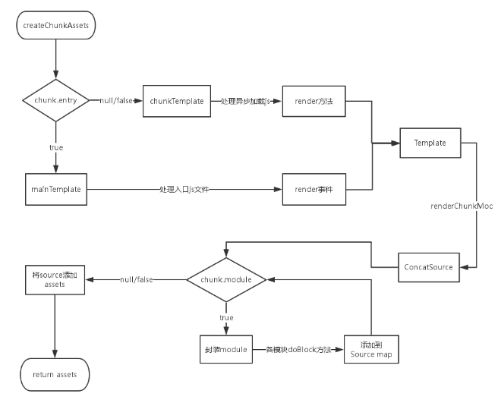
怎么使用Webpack

Slide 8
此处添加标题
CLICK TO ADD CAPTION TEXT
请替换文字内容
1
Please replace text, click add relevant headline, modify the text content, also can copy your content to this directly.。
请替换文字内容
2
请替换文字内容
80%
60%
请替换文字内容
请替换文字内容
Please replace text, click add relevant headline, modify the text content, also can copy your content to this directly.
Please replace text, click add relevant headline, modify the text content, also can copy your content to this directly.
3
请替换文字内容
93%
55%
4
请替换文字内容
请替换文字内容
请替换文字内容
Please replace text, click add relevant headline, modify the text content, also can copy your content to this directly.
Please replace text, click add relevant headline, modify the text content, also can copy your content to this directly.

Slide 9

02
CHAPTER
此处添加标题
添加相关标题文字
添加相关标题文字
添加相关标题文字
添加相关标题文字

Slide 10




此处添加标题
CLICK TO ADD CAPTION TEXT
请替换文字内容
请替换文字内容
Please replace text, click add relevant headline, modify the text content, also can copy your content to this directly.
Please replace text, click add relevant headline, modify the text content, also can copy your content to this directly.
54%
68%
72%
90%
请替换文字内容
请替换文字内容
请替换文字内容
请替换文字内容
请替换文字内容
请替换文字内容
Please replace text, click add relevant headline, modify the text content, also can copy your content to this directly.
Please replace text, click add relevant headline, modify the text content, also can copy your content to this directly.

Slide 11
此处添加标题
CLICK TO ADD CAPTION TEXT
请替换文字内容
请替换文字内容
Please replace text, click add relevant headline, modify the text content, also can copy your content to this directly.
Please replace text, click add relevant headline, modify the text content, also can copy your content to this directly.
请替换文字内容
请替换文字内容
Please replace text, click add relevant headline, modify the text content, also can copy your content to this directly.
Please replace text, click add relevant headline, modify the text content, also can copy your content to this directly.

Slide 12
此处添加标题
CLICK TO ADD CAPTION TEXT
请替换文字内容
请替换文字内容
Please replace text, click add relevant headline, modify the text content, also can copy your content to this directly.
Please replace text, click add relevant headline, modify the text content, also can copy your content to this directly.
请替换文字内容
请替换文字内容
Please replace text, click add relevant headline, modify the text content, also can copy your content to this directly.
Please replace text, click add relevant headline, modify the text content, also can copy your content to this directly.

Slide 13
此处添加标题
CLICK TO ADD CAPTION TEXT
请替换文字内容
请替换文字内容
请替换文字内容
请替换文字内容
请替换文字内容
请替换文字内容
请替换文字内容
请替换文字内容
请替换文字内容
请替换文字内容
请替换文字内容
请替换文字内容
Please replace text, click add relevant headline, modify the text content, also can copy your content to this directly.
Please replace text, click add relevant headline, modify the text content, also can copy your content to this directly.
Please replace text, click add relevant headline, modify the text content, also can copy your content to this directly.

Slide 14
03
CHAPTER
此处添加标题
添加相关标题文字
添加相关标题文字
添加相关标题文字
添加相关标题文字

Slide 15
此处添加标题
CLICK TO ADD CAPTION TEXT
请替换文字内容
请替换文字内容
请替换文字内容
Please replace text, click add relevant headline, modify the text content, also can copy your content to this directly.。
Please replace text, click add relevant headline, modify the text content, also can copy your content to this directly.。
Please replace text, click add relevant headline, modify the text content, also can copy your content to this directly.。
2013
2014
2015
10%
20%
30%
40%
50%
60%
70%
80%
90%

Slide 16
此处添加标题
CLICK TO ADD CAPTION TEXT
请替换文字内容
Please replace text, click add relevant headline, modify the text content, also can copy your content to this directly.。
80%
60%
文字内容
文字内容
Please replace text, click add relevant headline, modify the text content, also can copy your content to this directly.
Please replace text, click add relevant headline, modify the text content, also can copy your content to this directly.
93%
55%
文字内容
文字内容
Please replace text, click add relevant headline, modify the text content, also can copy your content to this directly.
Please replace text, click add relevant headline, modify the text content, also can copy your content to this directly.

Slide 17
此处添加标题
CLICK TO ADD CAPTION TEXT
01
请替换文字内容
Please replace text, click add relevant headline, modify the text content, also can copy your content to this directly.
请替换文字内容
Please replace text, click add relevant headline, modify the text content, also can copy your content to this directly.。
02
请替换文字内容
Please replace text, click add relevant headline, modify the text content, also can copy your content to this directly.
1.234K
03
请替换文字内容
Male Users
Please replace text, click add relevant headline, modify the text content, also can copy your content to this directly.
1.234K
Female Users

Slide 18
此处添加标题
CLICK TO ADD CAPTION TEXT
请替换文字内容
请替换文字内容
Please replace text, click add relevant headline, modify the text content, also can copy your content to this directly.
Please replace text, click add relevant headline, modify the text content, also can copy your content to this directly.
请替换文字内容
请替换文字内容
Please replace text, click add relevant headline, modify the text content, also can copy your content to this directly.
Please replace text, click add relevant headline, modify the text content, also can copy your content to this directly.
请替换文字内容
请替换文字内容
Please replace text, click add relevant headline, modify the text content, also can copy your content to this directly.
Please replace text, click add relevant headline, modify the text content, also can copy your content to this directly.

Slide 19
04
CHAPTER
此处添加标题
添加相关标题文字
添加相关标题文字
添加相关标题文字
添加相关标题文字

Slide 20
此处添加标题
CLICK TO ADD CAPTION TEXT
请替换文字内容
请替换文字内容
01
02
Please replace text, click add relevant headline, modify the text content, also can copy your content to this directly.
Please replace text, click add relevant headline, modify the text content, also can copy your content to this directly.
请替换文字内容
请替换文字内容
03
04
Please replace text, click add relevant headline, modify the text content, also can copy your content to this directly.
Please replace text, click add relevant headline, modify the text content, also can copy your content to this directly.

Slide 21
此处添加标题
CLICK TO ADD CAPTION TEXT
请替换文字内容
Please replace text, click add relevant headline, modify the text content, also can copy your content to this directly.Please replace text, click add relevant headline, modify the text content, also can copy your content to this directly.
请替换文字内容
请替换文字内容
Please replace text, click add relevant headline, modify the text content, also can copy your content to this directly.
Please replace text, click add relevant headline, modify the text content, also can copy your content to this directly.
请替换文字内容
请替换文字内容
Please replace text, click add relevant headline, modify the text content, also can copy your content to this directly.
Please replace text, click add relevant headline, modify the text content, also can copy your content to this directly.

Slide 22
此处添加标题
CLICK TO ADD CAPTION TEXT
2015
2015
2015
2014
2014
2014
2013
2013
2013
2012
2012
2012
0
50
100
150
200
0
50
100
150
200
0
50
100
150
200
请替换文字内容
请替换文字内容
请替换文字内容
Please replace text, click add relevant headline, modify the text content, also can copy your content to this directly.
Please replace text, click add relevant headline, modify the text content, also can copy your content to this directly.
Please replace text, click add relevant headline, modify the text content, also can copy your content to this directly.

Slide 23
2017
THANK YOU
感谢聆听，批评指导

Slide 24

更多精品PPT资源尽在—PPT宝藏！
www.PPTBZ.com
Notes:
模板来自于 http://www.ypppt.com

