Slide 1
Flying Flamingos
WANG Qian Wen
LIU Su Yun

Slide 2
Overall structures
Flamingos with animation effects
Fireball heading to flamingos
Environment: sky, ocean, island
Camera movement and light setting
Keyboard control
Conclusion

Slide 3
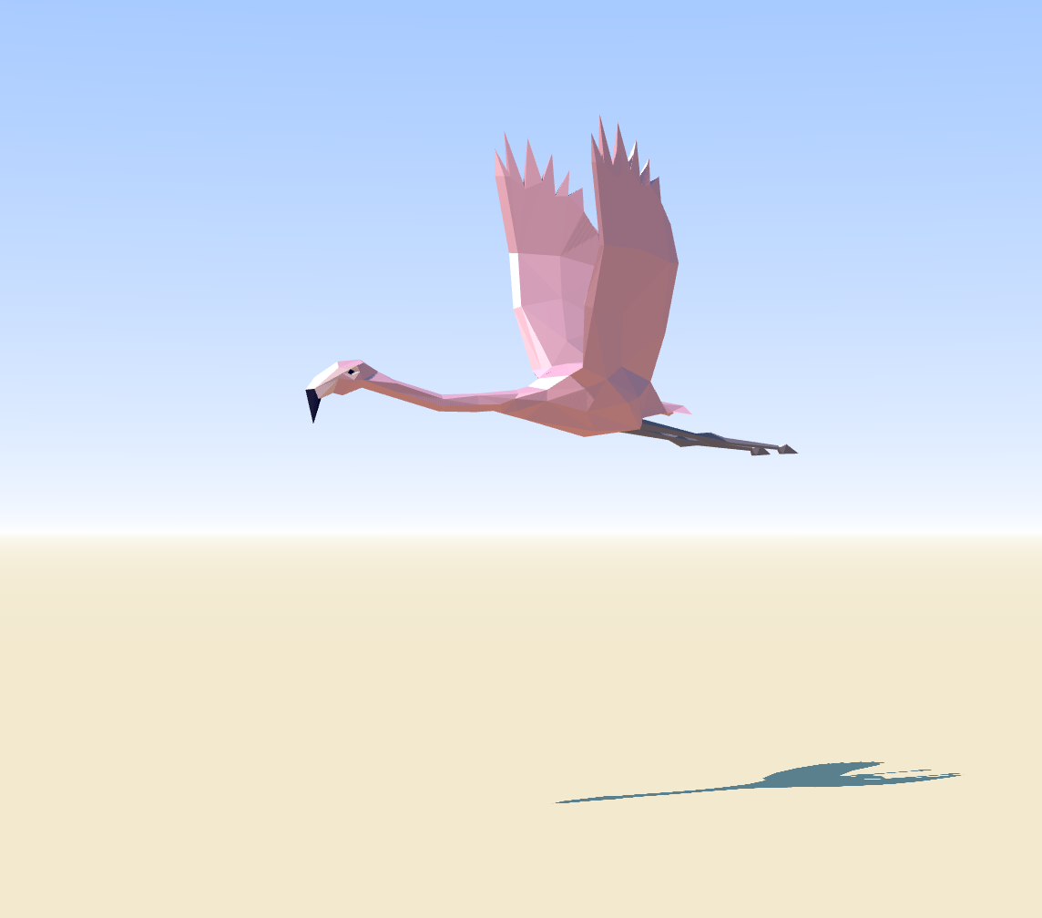
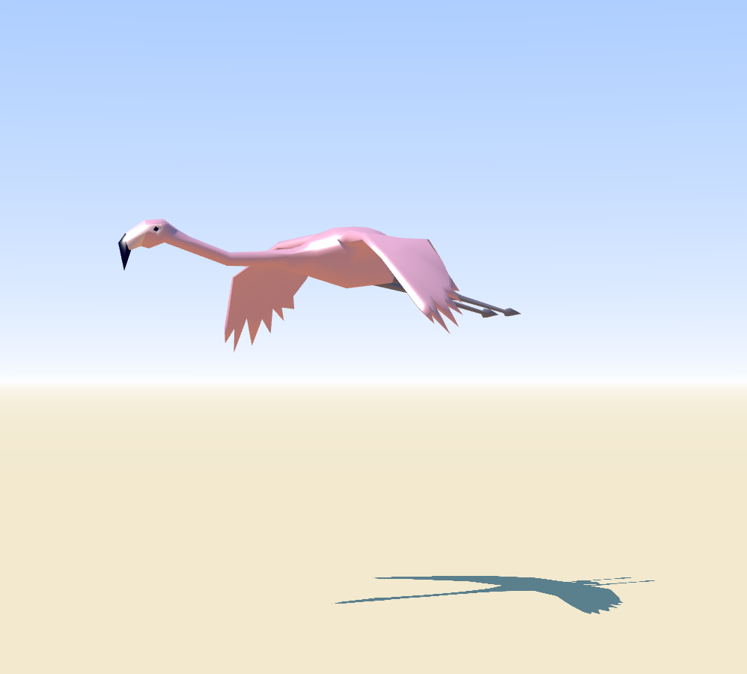

Flamingos
Geometry (flamingo.js)
Vertices and faces
morph targets for animation: 14 status during its flying
(https://threejs.org/examples/#webgl_lights_hemisphere)
Compute its vertex normal

Slide 4
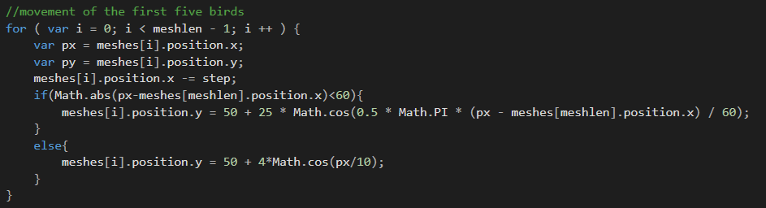
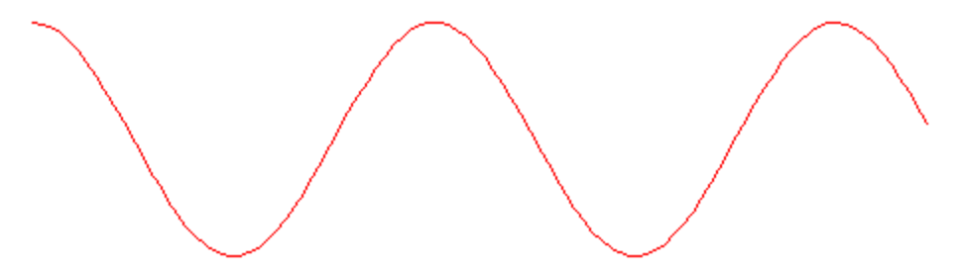
Flamingos
Mesh manipulation
Translation (realistic)
Normal flying
Avoid the fireball

Slide 5

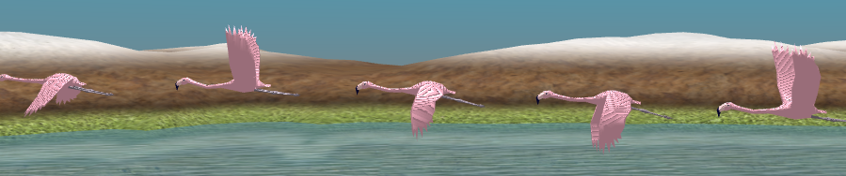
Flamingos
Mesh manipulation
Animation (flamingo.js):

Slide 6
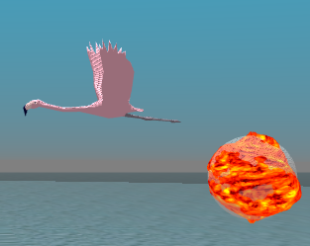
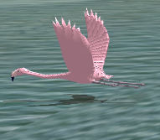
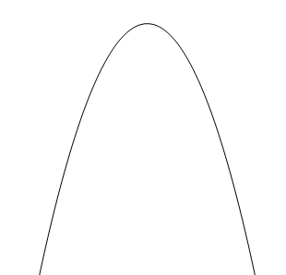
Flamingos
Mesh manipulation
Animation (fast_flamingo.js):

Slide 7
Flamingos
Mesh manipulation
Animation:
var vertices = [];
for ( var v = 0; v < geometry2.vertices.length; v ++ ) {vertices.push( geometry2.vertices[ v ].clone() );
vertices[ vertices.length - 1 ].x *= 2;
vertices[ vertices.length - 1 ].x *= 10*Math.abs(i-2.5);
vertices[ vertices.length - 1 ].z *= 2;
geometry2.morphTargets.push( { name: "target" + i, vertices: vertices } );
var mixer = new THREE.AnimationMixer( mesh );
var clip =THREE.AnimationClip.CreateFromMorphTargetSequence( 'gallop', geometry2.morphTargets, 3 ); mixer.clipAction( clip ).setDuration( 0.8+0.2*Math.random() ).play();

Slide 8
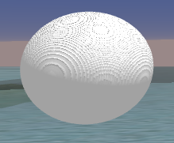
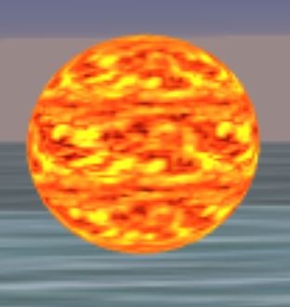
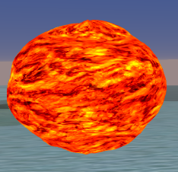
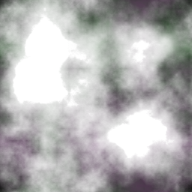
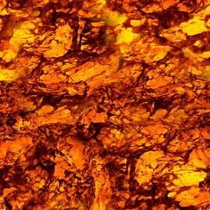
Fireball
Bump texture: change position along normal in vertex shader
Blending texture: change fragment color (offset) in fragment shader

Slide 9
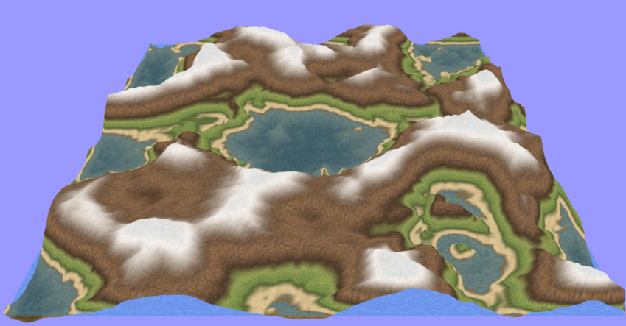
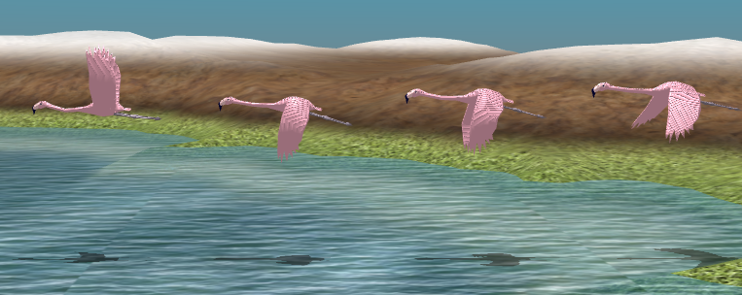
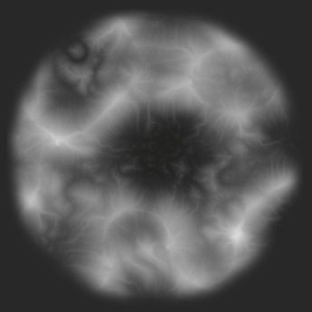
Environment
Sky dome: double-side sphere
Ocean and island (height map)
(https://stemkoski.github.io/Three.js/Shader-Heightmap-Textures.html)
Ocean
Plane one
Receive the shadow
Bump
Plane two
Simulate the terrain

Slide 10
Camera and light
Camera: move with the same speed as the birds
Light setting
Ambient Light : white with increasing density
Direct light: density increases gradually to certain value

Slide 11
User Interaction
Keyboard
0: stop or continue any movement;
1: move along positive x (right);
2: move along negative x (left, by default);
3: move along positive y (down);
4: move along negative y (up);
5: move along positive z (farther);
6: move along negative z (nearer);

Slide 12
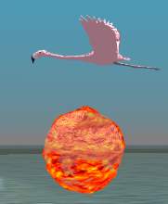

Conclusion
Complete scenario
Problems
Shadowing of the bumping fireball
Amination of water

