Slide 1
毕设阶段讨论14
20180426

Slide 2
集中平台的路由存储
集中平台针对每台边界路由器分别存储
Adj-RIB-In
Private-Loc-RIB
Adj-RIB-Out
集中平台存储
Public-Loc-RIB

Slide 3
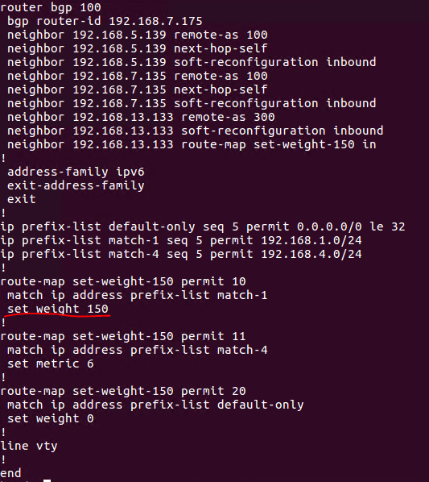
集中平台的策略管理
传统的配置管理
neighbor ip.addr distribute-list [] in/out
ip access-list [] permit/deny {}
neighbor ip.addr prefix-list [] in/out
ip prefix-list [] permit/deny {}
neighbor ip.addr filter-list [] in/out
ip as-path access-list [] permit/deny {}
neighbor ip.addr route-map [] in/out
Route-map [] match-set permit/deny {}

Slide 4
集中平台的策略管理
分析
每台边界路由器上的策略配置，是针对其周围的eBGP邻居设定的

