Slide 1
毕设阶段讨论6
20180304

Slide 2
目录
编译运行ebgp
打开179端口的监听
使用ebgp的输出函数，输出信息
查看Debug模式下的ebgp信息
归纳模块

Slide 3
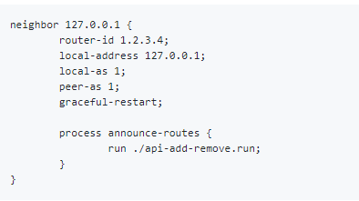
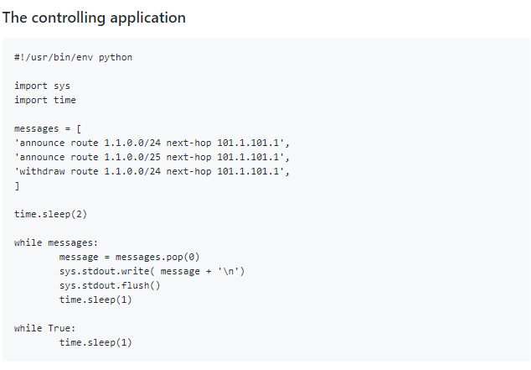
配置文件

Slide 4
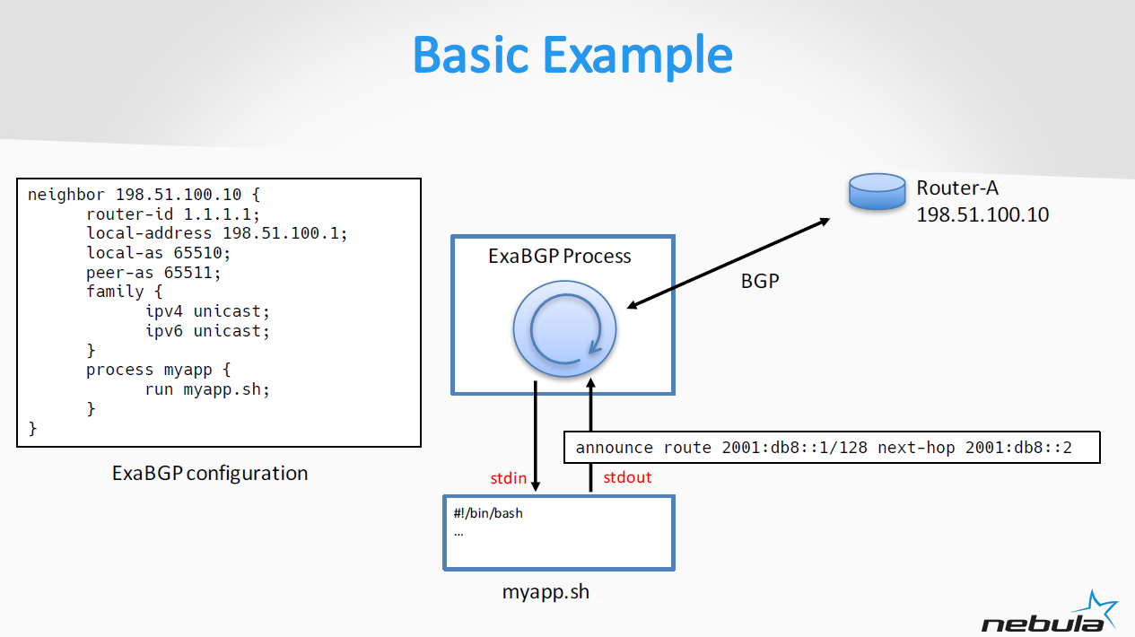
Exabgp例子
Notes:
每一个sh: cli_in，cli_out

Slide 5
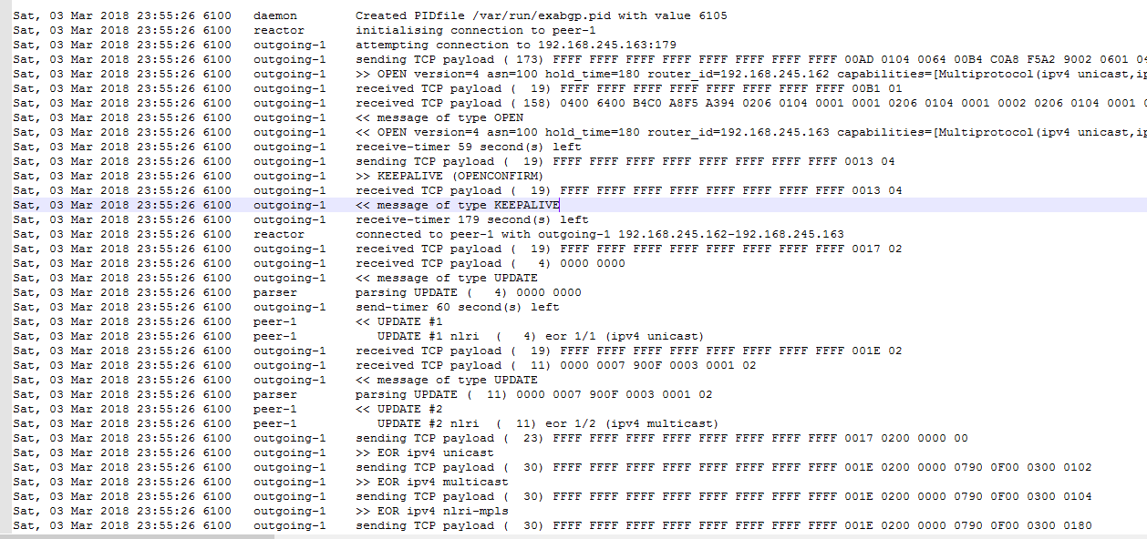
Debug模式下的输出

Slide 6
熟悉相关函数
def main #bgp.py 308
def run
def savepid #daemon.py print(create pid)
def run #peer.py print(initialising connection)
def __init__ #outgoing.py print(attempting connection to )
def writer #connection.py print(sending TCP payload)
def __str__ #message\open\__init__.py print(open mesg)
def read_message #protocol.py print(message of type)
def unpack_message #mesg\update\__init__.py print(parsing UPDATE)
def __main #peer.py print(<< UPDATE #)
def __reader #connection.py print(received TCP payload)
def extensive #eor.py print(>> EOR ipv4 unicast)
def announce_route withdraw_route #announce.py

Slide 7
代码调用流程
__main__.py
run_exabgp()
Main() #bgp.py
Build peer
run each configuration in its own process
Run() #bgp.py
Protocol.py #Send message
Announce/withdraw route

Slide 8
exabgp
no fib manipulation
没有策略部署、路由计算、路由表存储
Main loop/reactor
每一个peer：python 协程、TCP连接
Message
Open
Update
Notification、keepalive、refresh

