Slide 1
Master thesis
Text mining and data analytics for analysis of slug formation in offshore oil/gas pipelines
Ran Wang
S111503
August 2016

Slide 2
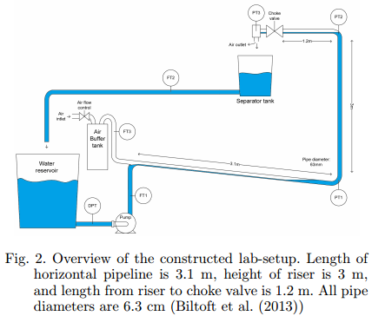
Original Problem
Expecting to find the correlation between slug formation/occurrence and
system maintenance report,
so as to avoid the risk and keep safe production.

Slide 3
Similar works
Big Data Risk Assessment (BDRA) - Van Gulijk, et al. 2015
Done- Railway signal information and textbased reports of railway safety near misses have been analyzed to extract safety information.
Ongoing research- combining various data sources to uncover obscured trends that cannot be identified by considering each source individually.

Slide 4
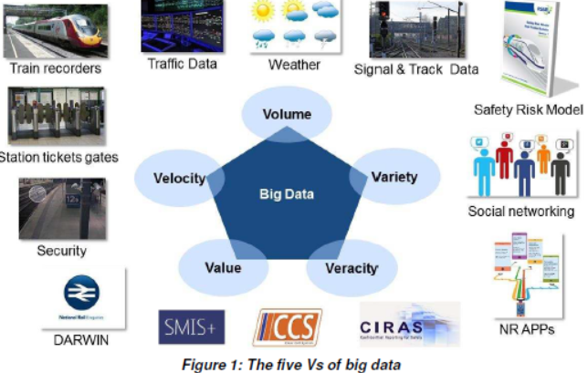
Similar works

Slide 5
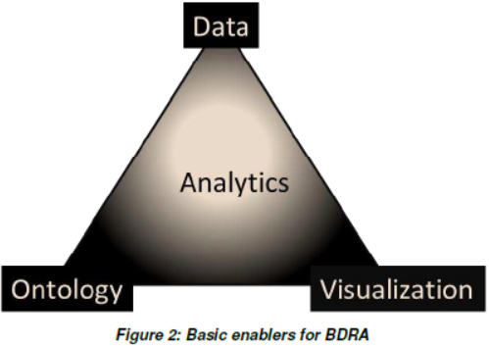
Similar works
Enablers of a BDRA system:
Data: various data sources
Ontology: classification of entities
Visualization: support knowledge elicitation
Analytics: software and data processing

Slide 6
Project problem
Due to confidentiality issues, Mæske cannot leak the data, which in turn underlines the need to cluster the unstructured texts by using text mining techniques.
Therefore, the main problem becomes to:
How to cluster the unstructured text data with high semantic sensibility while identifying
the most suitable dimension reduction and clustering method?

Slide 7
Pipeline of data process
Raw text- PDF
NLP- Remove symbols, stop-words; Stemming.
Data split- training, validating, testing.
Plain text- txt
Vectorization- tf-idf
Feature Extraction- PCA, LSI, NMF
Clustering- K-means, Ward hierarchical
Estimate the Optimal Number of Clusters- NbClust
Evaluation- RI, NMI. Select the optimal model.
Prediction on new coming data.
Topic

Slide 8

Data source
Two corpora:
Reason: observe the change of clusters as the number
of topics and corpus size increase.

Slide 9
Data pre-processing
Convert PDF to txt.
Remove non-word symbols.
Remove non-English word and stop-words.
Perform stemming.

Slide 10
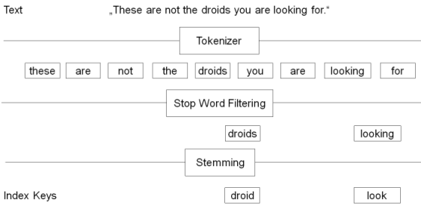
Data pre-processing

Slide 11
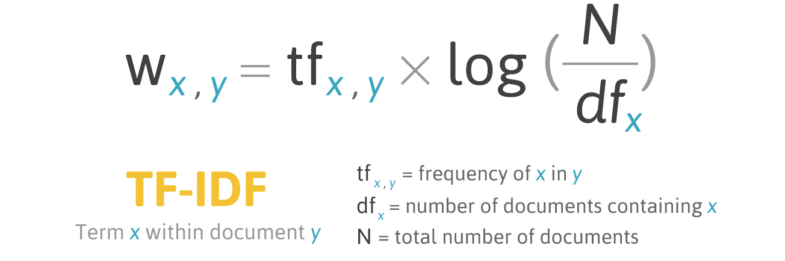
Vectorization

Slide 12
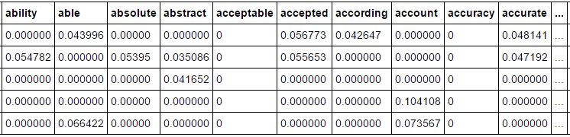
Vectorization

Slide 13
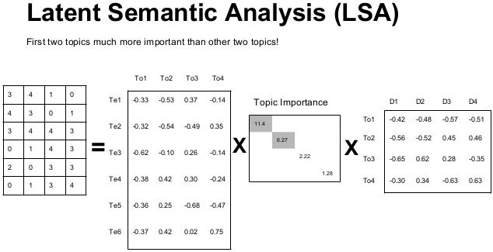
Dimension reduction

Slide 14
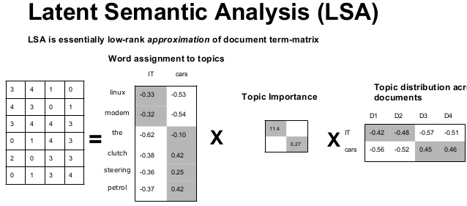

Dimension reduction

Slide 15
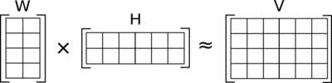
Dimension reduction
Nonnegative matrix factorization

Slide 16

Clustering- Kmeans
The algorithm is the minimum of sum of squares of Euclidean distance within each cluster.
Randomly assigning K data points as centroids, follows by an iterative process:
For each centroid assigned, identify the data points that are closer to it.
Update the centroids for each new formed cluster.
Converges to a local minimum when the mean vectors become stable.

Slide 17
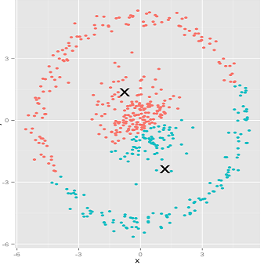
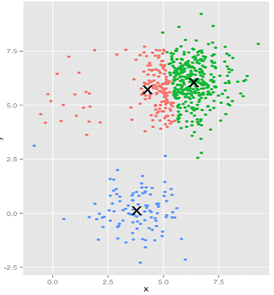
Clustering- K-means
Assumptions:
Datapoints in each cluster are roughly spherically distributed.
Each cluster have roughly same size of datapoints.
Violation could fail k-means clustering.

Slide 18
Ward Hierarchical clustering
Agglomeratively merging clusters, while the criterion for selecting pairs of clusters to merge at each step is determined by the minimum value of the objective function below

Slide 19
Optimal Number of Clusters (ONC)
.
.
Gap statistics:
Developed by Stanford researchers Tibshirani, Walther and Hastie 2001.
A way to standardize the comparison of log Wk with a null reference distribution of the data.
The ONC is the value for which log Wk falls the farthest below this reference curve.
E*n{log Wk} is obtained by the average of many times copies of log Wk, each of which is generated with a Monte Carlo sample from the uniform distribution.
Monte Carlo replicates exhibit a standard deviation sd(k) accounting for simulation error:
The ONC is the smallest K such that:

Slide 20
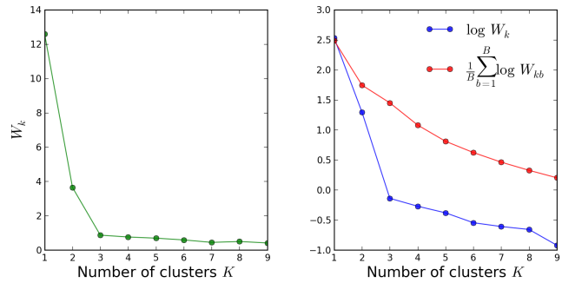
Optimal Number of Clusters (ONC)

Slide 21
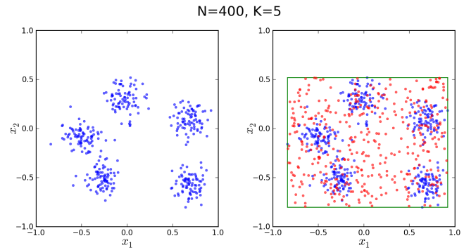
Optimal Number of Clusters (ONC)

Slide 22

Optimal Number of Clusters (ONC)
Silhouette:
A method of validation of consistency within clusters of data,
depends on the comparison of cluster's tightness and dispersion:
Where -1 <= s(i) <= 1, and
a(i) is the average distance of ith data with all other data within the same cluster,
b(i) is the average distance of ith data with all other data within the nearest cluster.

Slide 23
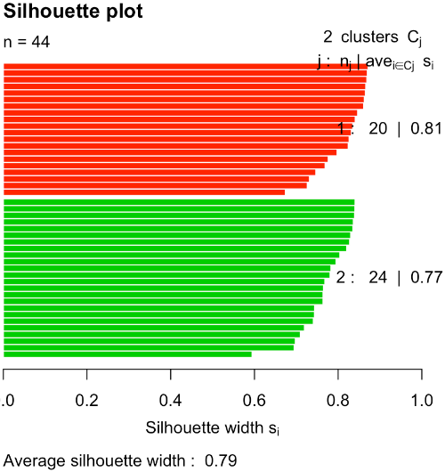
Optimal Number of Clusters (ONC)
Silhouette:

Slide 24
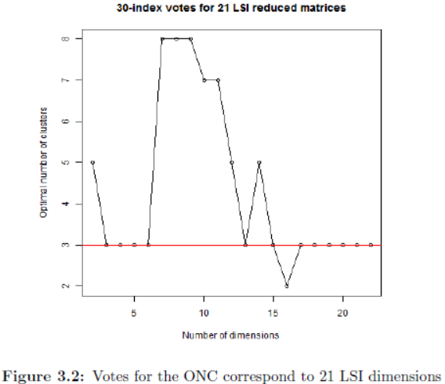
Experiment- ONC- gap
By using R package NbClust,
the 30 indexes votes for ONC is 3.

Slide 25
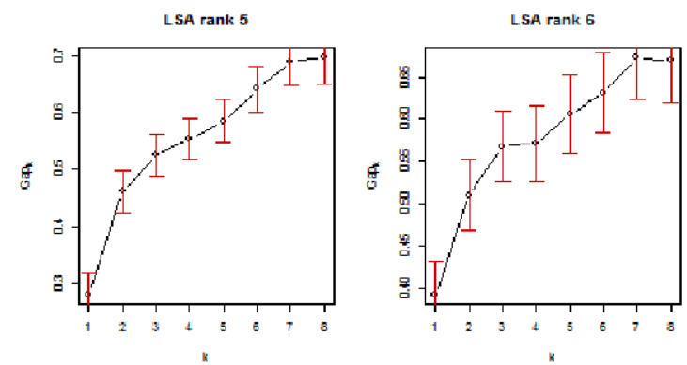
Experiment- ONC- gap
Perform gap statistic at 10 dimensions (2-11), only dimension 5 and 6 exhibit ONC=3,
The rest dimensions show ONC=2.

Slide 26
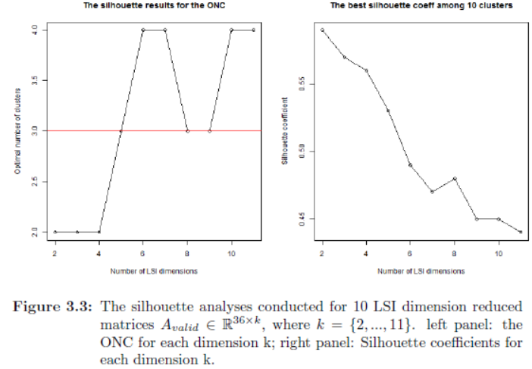
Experiment- ONC- silhouette

Slide 27
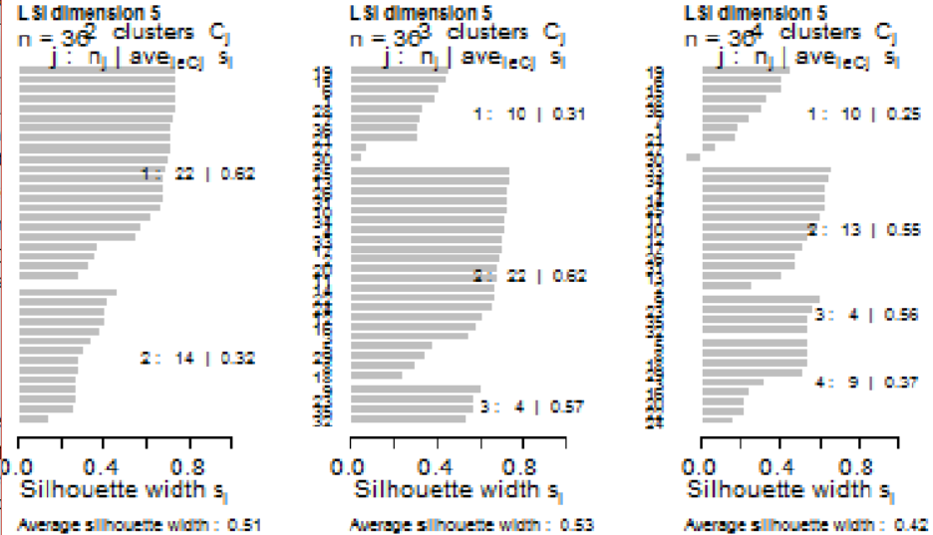
Experiment- ONC- silhouette

Slide 28

Clustering evaluation metrics
Rand index: a similarity measure between two clusterings, penalizes both false positive and false negative. (0~1)
Adjusted Rand Index: adjusted for the chance grouping of elements.
ARI = (RI - Expected_RI) / ((RI) - Expected_RI)

Slide 29





Clustering evaluation metrics
Mutual Information: quantifies the "amount of information" obtained about one random variable, through the other random variable.
Normalized Mutual Information: account for chance.

Slide 30
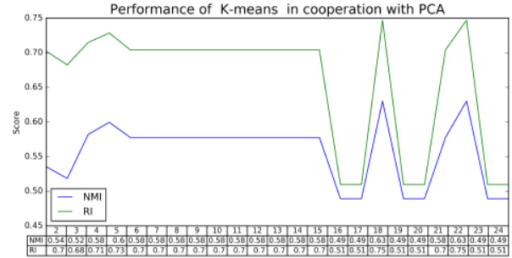
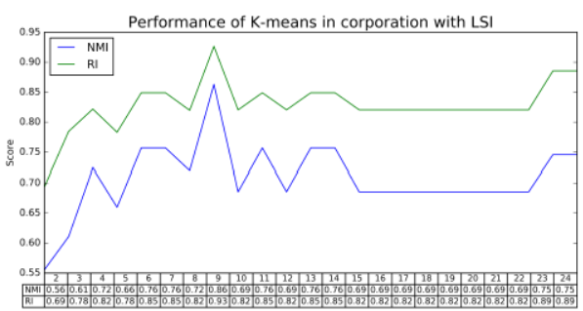
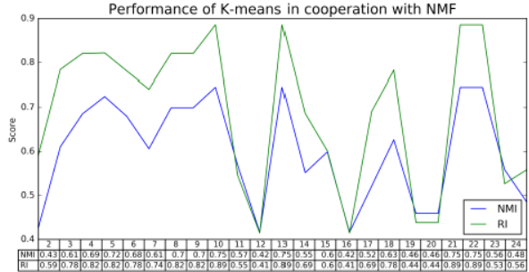
Corpus I- Experiment- K-means clustering

Slide 31
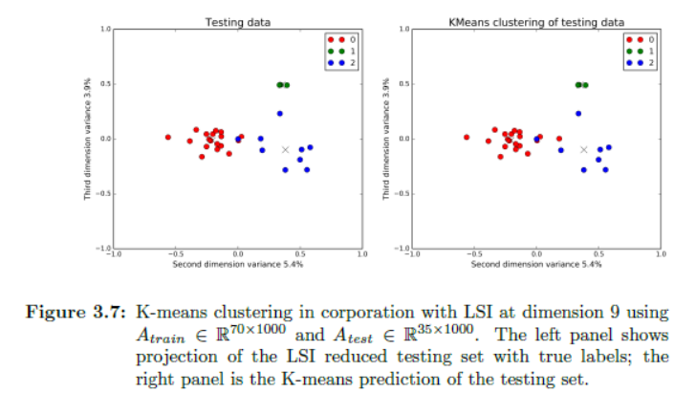
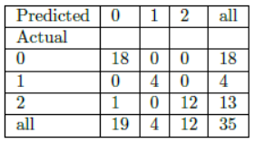
Corpus I- Experiment- K-means clustering

Slide 32
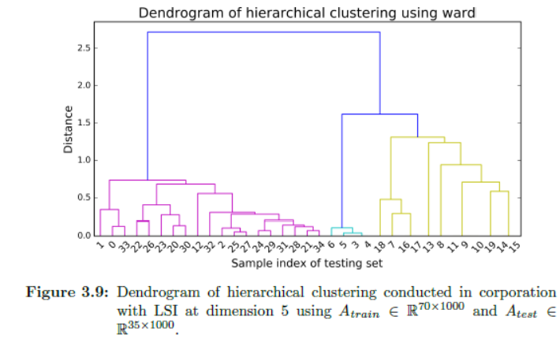
Corpus I- Experiment- Ward hierarchical clustering
Cophenetic correlation
0.89

Slide 33
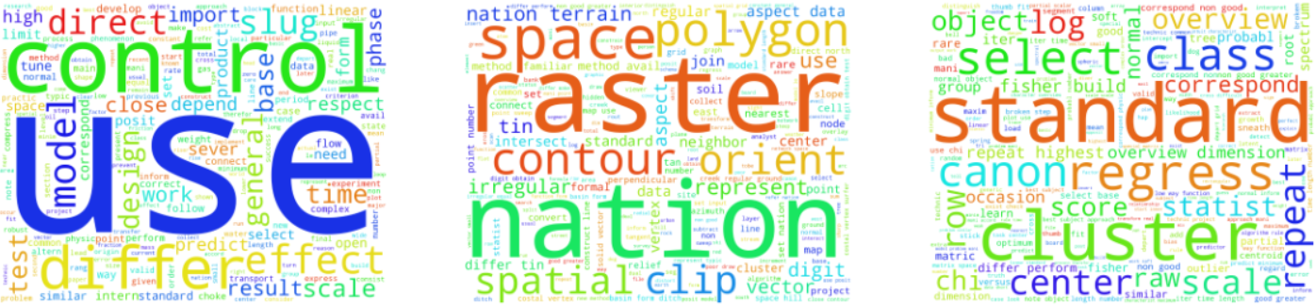
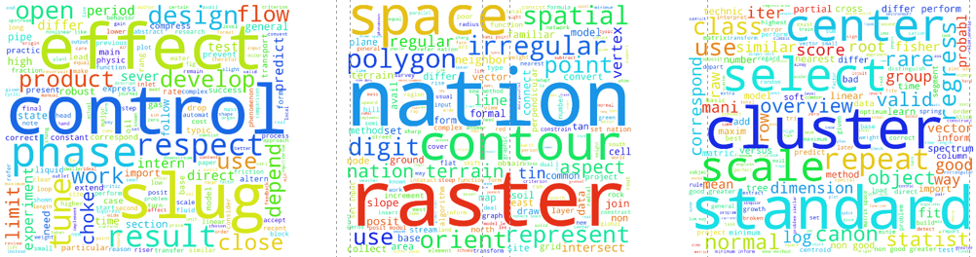
Corpus I- Experiment- topics
LSI:
NMF:

Slide 34
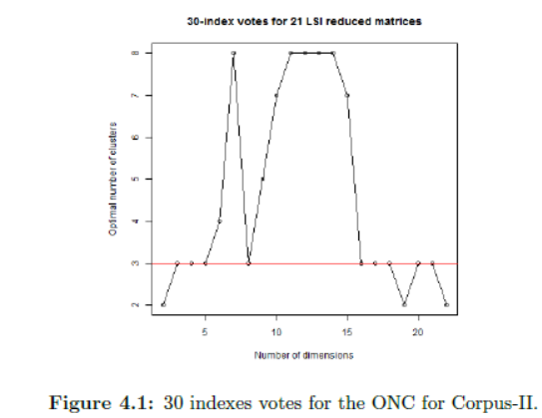
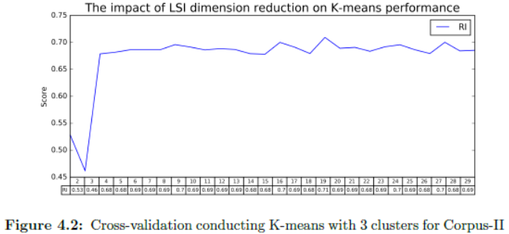
Corpus II- Experiment- K-means clustering

Slide 35
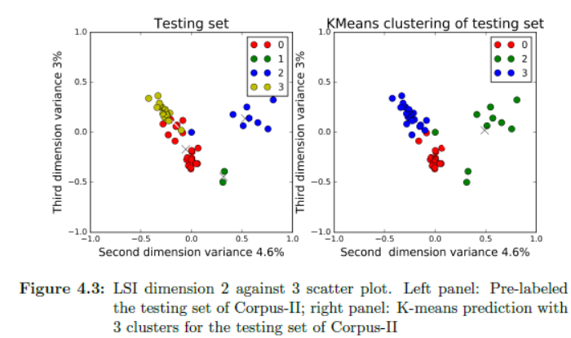
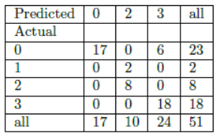
Corpus II- Experiment- K-means clustering

Slide 36
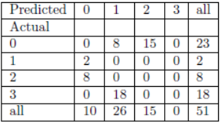
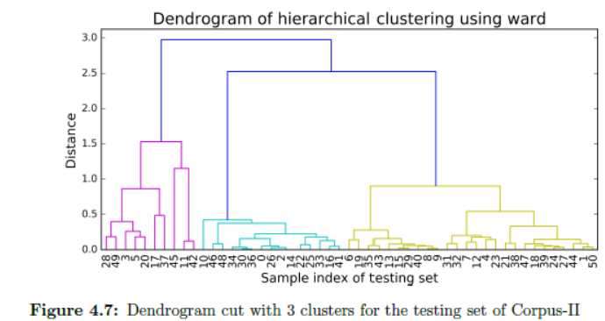
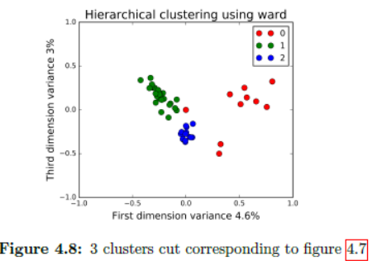
Corpus II- Experiment- K-means clustering
Cophenetic correlation = 0.84

Slide 37
Discussion
Dimension reduction is crucial to extract semantic meanings and to determine the quality of clustering.
For type I data split (0.5,0.25,0.25), LSI outperforms NMF and PCA in terms of the ARI and NMI. But this interpretation could be more secure if cross-validation is used.
K-means and Ward give the same clustering for Corpus I, with one GIS miss-clustered to Slug.
In Corpus II, Ward has two more (in total 8) Slug points miss-clustered to OWT than K-means does (in total 6). So K-means outperforms Ward.

Slide 38
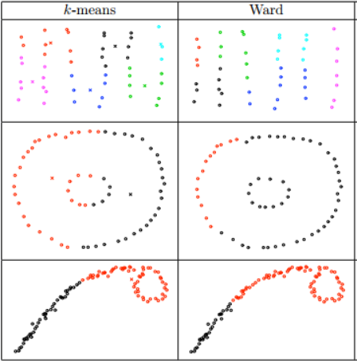
Conclusion
No clustering method is good for all, it depends on the data. So learning and transforming the data is expected before performing clustering.
If using K-means, check if the data violates the assumptions.
Finding the right ONC is complicated, which entails taking a broad perspective to estimate it.

Slide 39
Future expectations
Test with more various types of clustering method, such as spectral clustering, Gaussian Mixed Modeling.
Use distributed system to handle big quantity of data, like Hadoop and Spark.
Integrate the piecewise functions to a single application, which process the raw PDF and yields topics and clusters.

Slide 40
Thank you!

