Slide 1


Device Management Protocols
Protocoles de gestion des appareils
Gerätezugangsprotokolle
Industrial Automation
Automation Industrielle
Industrielle Automation
Named
Program
Variable
Named
Invocation
Variable List
Domain
. The device itself is
Types
a VMD object
Operator
Transaction
File
Station
Journal
Semaphore
Event
Event
Condition
Event
Enrolment
Action
4.
4.2
MMS - Manufacturing Message Specifications
Prof. Dr. H. Kirrmann
ABB Research Center, Baden, Switzerland

Slide 2
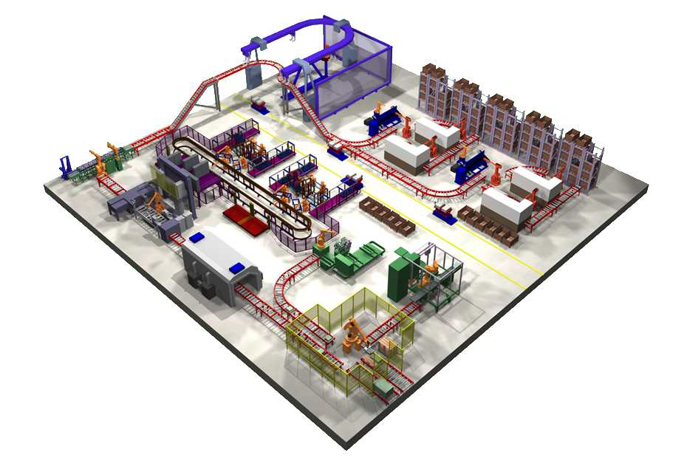
MMS Application domain
controller
cell

Slide 3
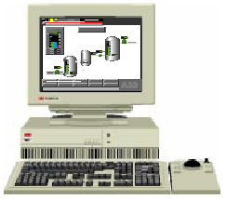
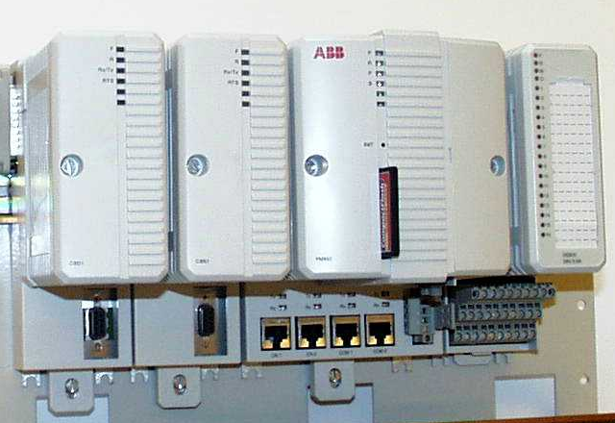


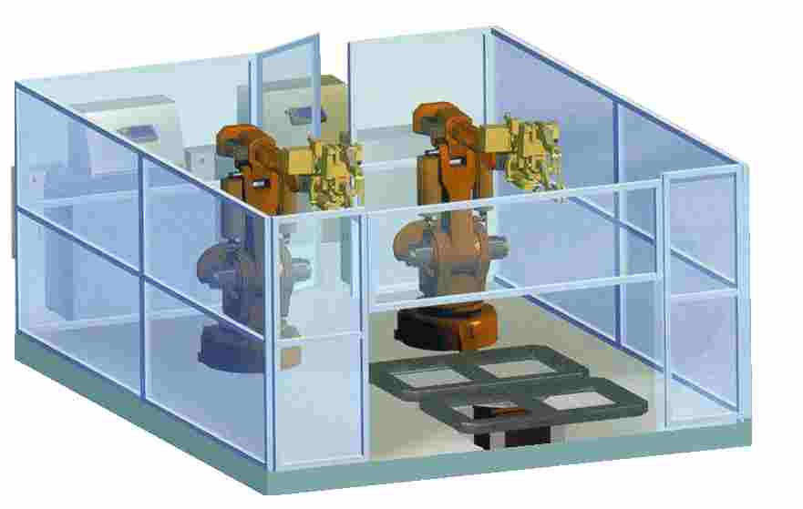


Interaction between Operator Workplace and field equipment
SCADA (client)
(any technology)
request message
response message
network
(any)
controller (server)
(any technology)
represents automation objects,
i.e. a collection of PLC¹ variables
manufacturing devices
represent pieces of equipment
MMS: we want to access all controllers, regardless of the manufacturer, in the same way.
1: PLC= Programmable Logic Controller

Slide 4
The basic MMS idea: read a variable
client
(any technology)
request
read
variable name
response
value
status
network
(any)
server
I / O devices
basic MMS idea: read and write equipment variables using standard messages.

Slide 5
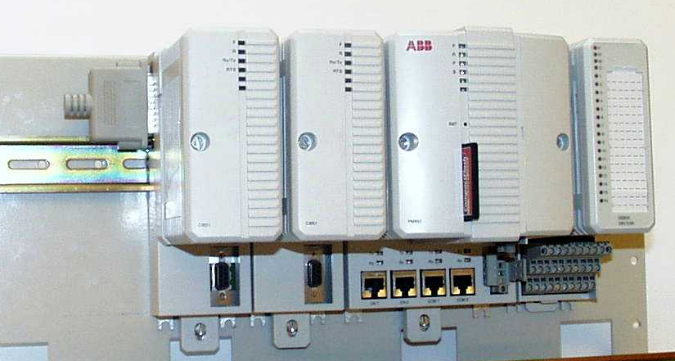
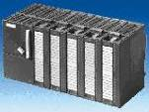
Application: MMS for OPC
operator
(client)
historian
client
other clients
OPC uses MMS for variable access, (events)
OPC will be detailed in
chapter 4.3
OPCserver
MMS client
MMS accesses PLC
Variables
TCP/IP
Ethernet
Ethernet
AC800
Ethernet
S7
Ethernet
TSX
TCP/IP
TCP/IP
TCP/IP
MMS
server
MMS
server
MMS
client
MMS
server
MMS
client
PLC variables
PLC variables
PLC variables
intention: any PLC should be accessed that way (MMS as universal server)

Slide 6
MMS - Manufacturing Message Specification history
Developed 1980 (!) for the MAP project (General Motor’s flexible manufacturing initiative)
Originally unluckily tied to the OSI communication stack and Token Bus (IEEE 802.4)
Reputed for being heavy, complicated and costly due to poor implementations.
Boeing adopted MMS as TOPs (MMS on Ethernet) - a wise step.
Adopted by the automobile industry, aerospace industry, and PLC manufacturers:
Siemens, Schneider, Daimler, ABB.
Standardized since 1990 as:
[1] ISO/IEC 9506-1 (2003): Industrial Automation systems -
Manufacturing Message Specification -
Part 1: Service Definition
[2] ISO/IEC 9506-2 (2003): Industrial Automation systems -
Manufacturing Message Specification -
Part 2: Protocol Specification

Slide 7
MMS - Concept
MMS (Manufacturing Message Specifications) defines:
• A set of standard objects which must exist in every conformant device, on which
operations can be executed (examples: read and write local variables, signal events...)
• A set of standard messages exchanged between a client and a server station
for the purpose of controlling these objects
• A set of encoding rules for these messages (how values and parameters are mapped to bits and bytes when transmitted)
• A set of protocols (rules for exchanging messages between devices)
MMS does not specify application-specific operations (e.g. change motor speed).
This is covered by application-specific, “companion standards”
(e.g. flexible manufacturing, drives, remote meter reading, ...)

Slide 8
MMS - Communication model
MMS does not specify the application interface
MMS specifies a set
of messages which
allow an MMS client
to control an MMS
server
device
device
(e.g. SCADA)
(e.g. PC)
MMS specifies the class of objects that an MMS server is expected to hold
MMS
client
MMS
server
remote
request
response
procedure
(command)
(reply)
call interface
communication
stack
MMS specifies how messages are encoded for transmission
communication
stack
switch
network
router

Slide 9
MMS mapping to communication
MMS is not by itself a communication protocol, it defines messages that have
to be transported by an unspecified network

Slide 10
MMS - Underlying Communication Principles
MMS is in principle independent from the communication stack.
MMS only requires that two types of communication services exist:
MMS Client
MMS Server
network
Request
Indication
1)
Remote Procedure Call
(Call paired with Reply,
synchronous, unicast)
processing
Confirmation
Response
time
2)
Event Reporting
event
(spontaneous messages sent
by server)
Request
Indication

Slide 11
Current MMS Stack
MMS
Association Control Service Element, ACSE, ISO 8649/8650, N2526,N2327
“Application”
Abstract Syntax Notation, ISO 8822/8823, 8824/8825
Presentation
ISO 8326/8327
Session
RFC 1006
TCP
Transport
IP
Network
void (EtherType)
Link
(Ethernet)
ISO 8802-3
MAC
Physical
Some manufacturers omit the ISO upper layers, makes it much simpler, but non-standard...

Slide 12
MMS in the fieldbus stack
time-critical
applications
(PLC tasks)
time-benign
applications
(HMI, download)
Management
Interface
real-time
data base
time-benign
messages
time-critical
process variables
MMS
7
Application (Association)
implicit
implicit (ASN.1)
6
Presentation
real-time
traffic (not MMS)
Remote Procedure Call
5
Session
connection-oriented
4
Transport (connection-oriented)
connectionless
3
Network (connectionless)
connectionless
2"
Logical Link Control
medium access
2'
Link (Medium Access)
common
media
1
Physical
MMS is not for real-time communication, but it can access the real-time variables

Slide 13
MMS Objects
Each MMS server is expected to contain a number of standard objects

Slide 14
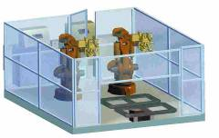
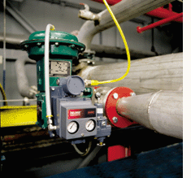

MMS - Concept of Virtual Manufacturing Device (VMD)
robot
flow meter
A virtual device represents a (complex) piece of equipment
cell
MMS client
Virtual
Virtual
Virtual
Application-specific
object models
Device
Device
Device
connection
Application Programming Interface
MMS messages
establishment
(MMSI = MMS interface)
ACSE
communication
ACSE
stack
A physical device (PLC) may implement one or more virtual devices
presentation
presentation
session
session
transport
transport
network
network
link
link
physical
physical

Slide 15
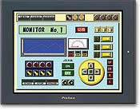
MMS - Objects in a PLC device
memory regions
upload / download
tasks
PLC
domains
program
invocations
remote control the PLC
local Human-Machine
Interface
keep track of
history
Journal
initiate
start/stop
semaphores
identification
Operator
Station
Files
if mass storage available
variables
events
named
variables
variable
lists
events
& alarms
user-defined variables
state machines for alarms and events
groups of variables

Slide 16
MMS – Object Name
All objects are identified by an object name, that may be
- [0] VMD - specific persistent, pre-loaded, all clients see the same
“VMDstatus"
- [1] Domain -specific exists as long as the corresponding domain*
"e.g. { “Domain1”, “Valve3.Position“}
- [2] Application-Association specific exists as long as the client remains connected, applies to non-persistent objects such as data sets that the client created
“@/MyDataSet”
The identifier itself is a "visible string“ (e.g. “Call.Robot1.Joint3.Pos”).
Access to all objects can be controlled by a special object, the Access Control List
that tells which client can delete or modify the object.
The service GetNameList retrieves the name and type of all named objects in the VMD.
(directory service)
* a domain is a (named) memory region that contains programs, variables, data

Slide 17
MMS - Initialisation
An MMS client establishes first an Association (connection) with an MMS Server
A server may sustain several simultaneous associations with different clients
(to synchronize access, MMS provides semaphores)
At initialisation time, the client lists the capabilities it expects and the server responds with the capabilities it offers.
The capabilities are defined by Conformance Building Block parameters.
e.g. cto ∈ CBB means that the server agreed to provide an Access Control List
Status
GetCapabilityList
GetNameList
Rename
Identify
Initiate
ConcludeAbort
Reject
Cancel
initialisation services:

Slide 18
MMS – Association establishment
MMS Requester
MMS Responder
(Requesting MMS-user)
(Receiving MMS-user)
Request
Indication
Confirmation
Response
M_Associate_Req(
M_Associate_Ind(
MMS_responder_address,
MMS_responder_address,
calling_application_reference,
calling_application_reference,
called_application_reference,
called_application_reference,
communication_parameters,
communication_parameters,
authentication,..
authentication,..
this is no application interface, but a short way to describe the messages exchanged

Slide 19
MMS connection establishment and release
MMS Client
network
MMS Server
Associate
Indication
accept
Confirmation
Response
Request
repeat indefinitely
in any order
on demand
Response
Confirmation
Indication
spontaneous
Release
Confirm
how the association is set up is beyond the scope of MMS (it depends on the stack)

Slide 20
MMS - Addressing
MMS does not specify how to address clients and servers.
Messages contain only a communication reference
(number which identifies the connection)
obtained by unspecified means.
In practice, clients and servers are addressed by their IP address and the MMS server uses port number 102.

Slide 21
MMS services
The most important services are:
-Variables,
-Domains,
-Program invocations
-Events,
for the other services, see the ISO / IEC standard 9506

Slide 22
MMS Variables Service
Variables are the most important object type in MMS.
Through this service, a client can read and write local variables in a remote device.
Variables can be read or written as individual variables or better as lists.
A Variable is characterized by:
its Name
its Data Type
its attributes:
  MMS deletable (access to the variable can be deleted by the
  Access method (public,..)

Slide 23
MMS Variables service - reading
MMS client process database
(cache)
MMS client
MMS client
MMS client
MMS server
MMS server
MMS server
MMS server
VMD
process database
1) Polling:
a) the bus scans periodically the variables and actualises the local databases
b) the Operator Workstation polls cyclically the variables it is interested in
2) Events:
a) the Controllers signal predefined events and broadcasts the corresponding values
b) the Operator Workstation defines the relevant events and their destination(s)

Slide 24
MMS Variables service - Mapping named to unnamed variables within a PLC
Program 1
Program 2
Program 3
variables data repository
The MMS server accesses the PLC variables through the Vput and Vget functions, which are outside the scope of the standard.
Vput
Vget
MMS
server
Variables
Services
Read
Write
InformationReport
GetVariableAccessAttributes
DefineNamedVariables
DefineNamedVariableList
DefineNamedType
GetNamedVariableListAttributes
GetNamedTypeAttributes
DeleteNamedVariableList
DeleteVaraibleAccess
DeleteNamedType
ACSE
communication
stack
presentation
session
transport
network
link
physical

Slide 25

MMS Variables service - Usage of Named and Unnamed variables
automation
application
controller programming
Reactor_1.Program2
phy. address
symbol
MW%1003
MotorSpeed
Get (192.162.0.2), MW%1003)
code
symbols
MW%1004
Temperature
…
….
Return (192.162.0.0), MW%1003, 112)
download code
download symbol table
MMS
client
MMS
client
The code generator's linker
knows the physical address of the variables in the PLC and their symbol
network
MMS
server
if the name server is not aware of the variable's symbol, the MMS client must have access to the programmer's symbol files
Marker: MW%1003
analog input to : IXD.11.2.1
unnamed variables require a client's a-priori knowledge of the internal structure of the server

Slide 26
MMS Variables service - Variable Lists
MMS provides services to build a Data Set, a group of variables that is to be
transmitted as a whole.
This is generally done for each client specifically (Application-Association specific)
The client defines a list and populates it with the names of the variables and the transmission mode

Slide 27
MMS Variable Service – Summary
Read read a remote variable
Write write a remote variable
InformationReport(optional) spontaneous send the value to a client
GetVariableAccessAttributes get the attributes of the variable
DefineNamedVariable assigns named variable to an unnamed & type
DeleteVariableAccess
DefineNamedVariableList defines lists of variables
GetNamedVariableListAttributes
(Read) for individual variables or lists
(Write)
(Information Report)
DeleteNamedVariableList
DefineNamedType defines the types
GetNamedTypeAttributes
DeleteNamedType
DefineScatteredAccess defines variables group treated as a whole
GetScatteredAccessAttributes (obsolete, but useful)
Notes:
Read
Write
InformationReport
GetVariableAccessAttributes
DefineNamedVariable
DeleteVariableAccess
DefineNamedVariableList
GetNamedVariableListAttributes
DeleteNamedVariableList
DefineNamedType
GetNamedTypeAttributes
DeleteNamedType

Slide 28
MMS Domains Service
Domains are named memory regions, for the purpose of downloading
and uploading large unstructured data such as program code.
Domain loading / uploading requires a special protocol because it can involve the
MMS driver itself or even the communication stack, and storing to stable storage.
Typically, a domain is loaded by segments of a size chosen by the receiver.
When a domain is loaded, it may be saved to EPROM (typical PLC programming).
Domains may be erased.
Objects (Variables, Events, Program invocations,..) may be tied to a domain.

Slide 29
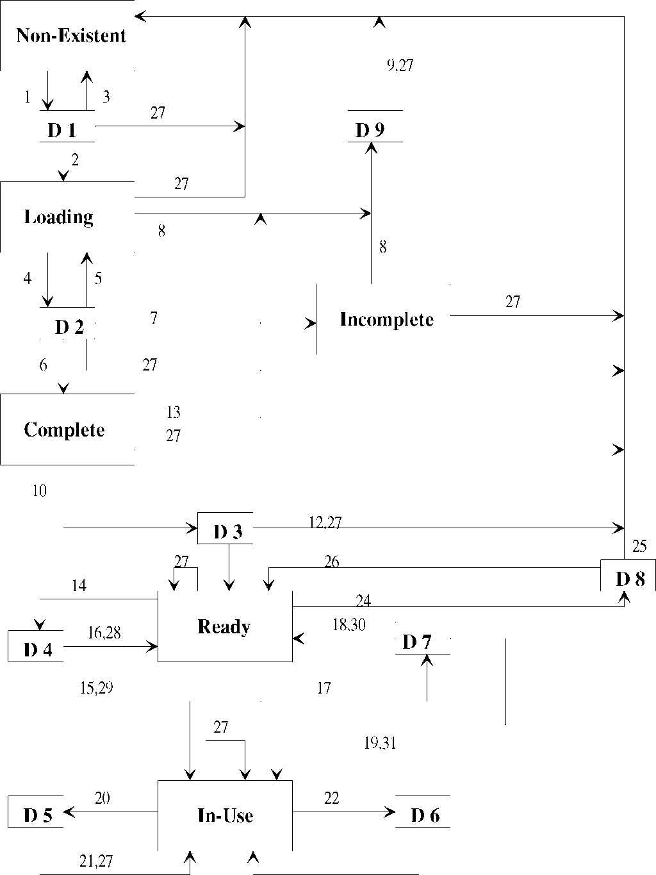
MMS Domain Service - State Diagram
Each domain is controlled by a state machine in MMS.
This is necessary since a domain is large and often needs to be loaded
in several steps.
Also, it may be necessary to write the domain into a non-volatile memory and that needs a tighter
control.

Slide 30
MMS Domains Service - Summary
Operations on domains:
InitiateDownloadSequence Download
DownloadSegment
TerminateDownloadSequence
RequestDomainDownload
InitiateUploadSequence Upload
UploadSegment
TerminateUploadSequence
RequestDomainUpload
LoadDomainContent
StoreDomainContent e.g. to EPROM
DeleteDomain erase
GetDomainAttributes

Slide 31
MMS Program invocations service
Program invocations are tasks running in the VMD.
Programs are tied to domains.
For instance, all tied programs are stopped before loading a domain containing them
CreateProgramInvocation
DeleteProgramInvocation
Start
Stop
Resume
Reset
Kill
GetProgramInvocationAttributes
Select
AlterProgramInvocationAttributes
ReconfigureProgramInvocation

Slide 32
MMS Event services - principle
MMS provides services to:
- Event Condition (define the Boolean condition that triggers an event and its priority)
- Event Enrolment (define the MMS client(s) to notify when an event is triggered)
- Event Action (define the MMS confirmed service to be executed when the event occurs)
MMS client
MMS client
DefineEventCondition
EventNotification
AlterEventCondition
AckEventNotification
MMS server
enables/disables event conditions
Event
Enrolment
Event
Condition
Event
Action
Who?
When?
What?
event notification and confirmation
Events are the most complicated part of MMS

Slide 33
MMS Event services - Event triggering
MMS client
MMS client
TriggerEvent
EventNotification
VMD
AckEventNotification
Network-triggered
Event
Enrolment
Event
Condition
Event
Action
boolean
variable
Monitored
cyclic monitoring
plant
events are triggered by a change in a boolean variable in the server (monitored event) or
by an MMS client (trigger event) as an invitation procedure.

Slide 34
MMS Event services - Summary
The Event services are the most complicated part of MMS.
However, the event mechanism in a SCADA system is complex in nature.
Event Management
TriggerEvent
EventNotification
AcknowledgeEventNotification
GetAlarmSummary
GetAlarmEnrollmentSummary
Event Conditions Lists
DefineEventConditionList
DeleteEventConditionList
AddEventConditionListReference
RemoveEventConditionListReference
GetEventConditionListAttributes
ReportEventConditionListStatus
AlterEventConditionListMonitoring
Event Conditions
DefineEventCondition
DeleteEventCondition
GetEventConditionAttributes
ReportEventConditionStatus
AlterEventConditionMonitoring
Event Enrollment
Event Actions
DefineEventEnrollment
DeleteEventEnrollment
GetEventEnrollmentAttributes
ReportEventEnrollmentStatus
AlterEventEnrollment service
DefineEventAction
DeleteEventAction
GetEventActionAttributes
ReportEventActionStatus

Slide 35
MMS - PDU Notation
MMS uses ASN.1 (ISO 8824) to describe the network messages (PDUs).
MMS specifies the use of BER (Basic Encoding Rules, ISO 8825) of ASN.1
(mandatory for connection establishment, but used in practice for all PDUs)
ObjectName ::= CHOICE {
vmd-specific [0] Identifier,
domain-specific [1] SEQUENCE {
domainId Identifier,
itemId Identifier
},
aa-specific [2] Identifier
}
type
An identifier is a visible string
80
size
visible string
vmd-specific
81
size
8A
visible string
size
8A
size
visible string
domain-specific
82
size
visible string
aa-specific
This notation is quite heavy for simple variable transport (24 bits for one Boolean value)
but decoding costs must be weighted against communication costs.

Slide 36
MMS - Importance
MMS has been during its 15 years of existence a reference model for industry
rather than an actual implementation.
Its high complexity makes it very general, but the requested bandwidth and computing
power were out of reach until few years ago.
It is - sometimes as a proprietary version - part of every PLC today.
It gave rise to several other "simpler" models (DLMS, BacNet, FMS....)
It is the base of IEC 61850 „Communication networks and systems in substations“, which bases on TCP/IP/Ethernet
For more information, see:
http://lamspeople.epfl.ch/kirrmann/mms/
http://www.nettedautomation.com/qanda/mms/#OPC/MMS
EPRI = USA electrical power research institute

Slide 37
Conclusion
Although MMS itself had little success (it is complicated), the concepts behind MMS have inspired numerous other standards.
Industrial Communication protocols require a large bandwidth and a lot of
processing power at the servers, which is incompatible with low-cost, decentralized periphery, but fully in line with the concept “Ethernet in the factory floor”.
While most field busses are able to connect relatively simple devices, the same is not true for MMS and its derivatives.
The MMS concept is being challenged by OPC UA and by Web Services,
but these services will have to rediscover the semantics of MMS.

