Slide 1
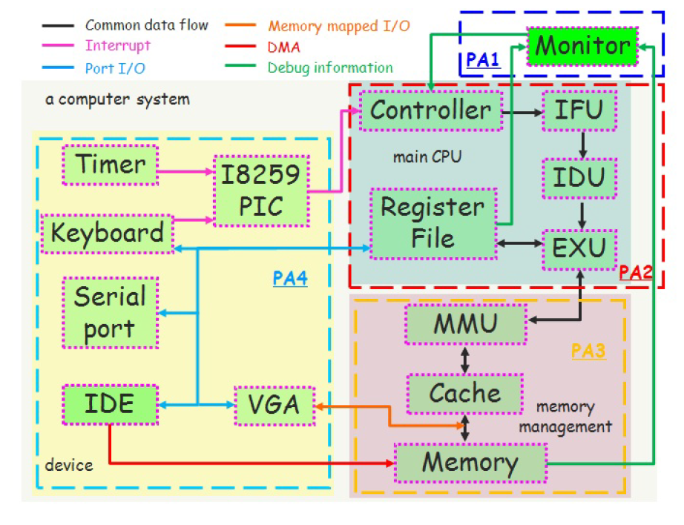

Slide 2
Cpu arch
Controller
IFU
IDU
Register File
EXU
Timer
MMU
Keyboard
Cache
Memory
management
VGA
Memory

