Slide 1
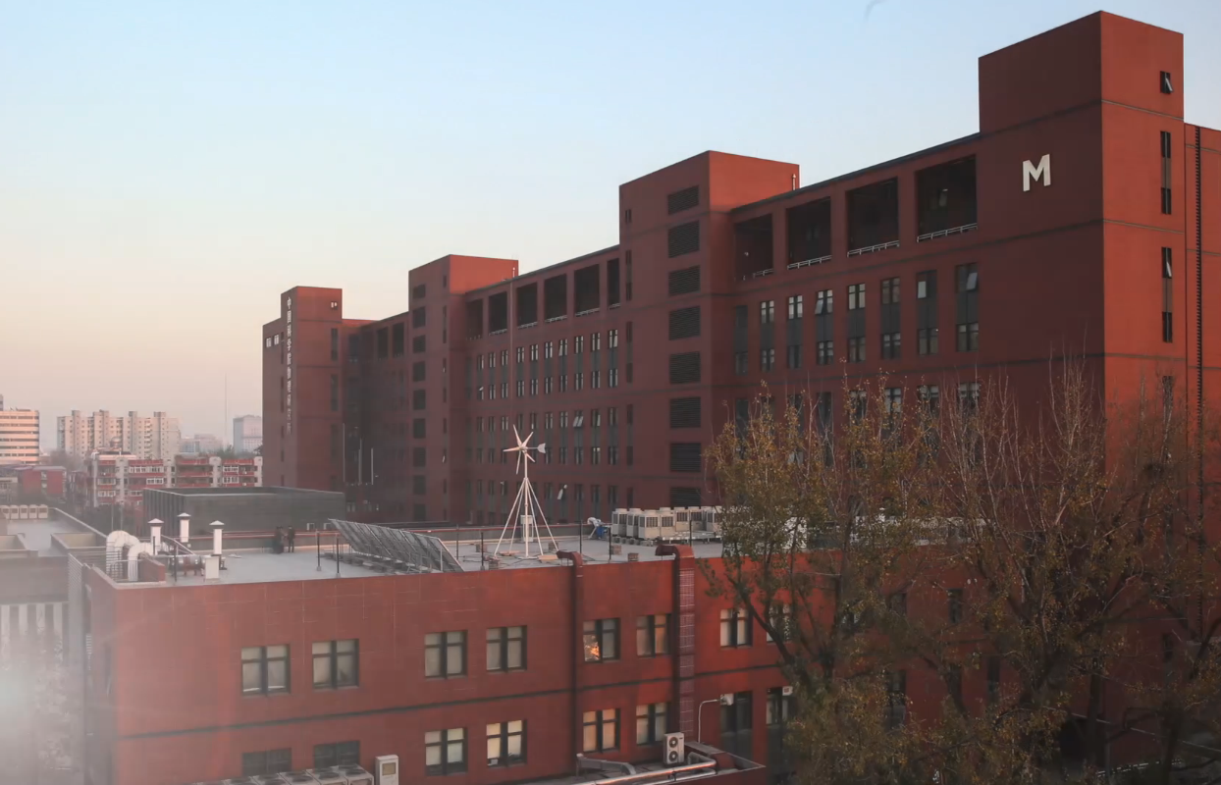
Institute of Physics, CAS
锌砷基稀磁半导体Ba_{1-x}K_{x}(Zn_{0.85}Mn_{0.15})₂As₂薄膜研究
王瑞 黄忠学 曹立新

Slide 2
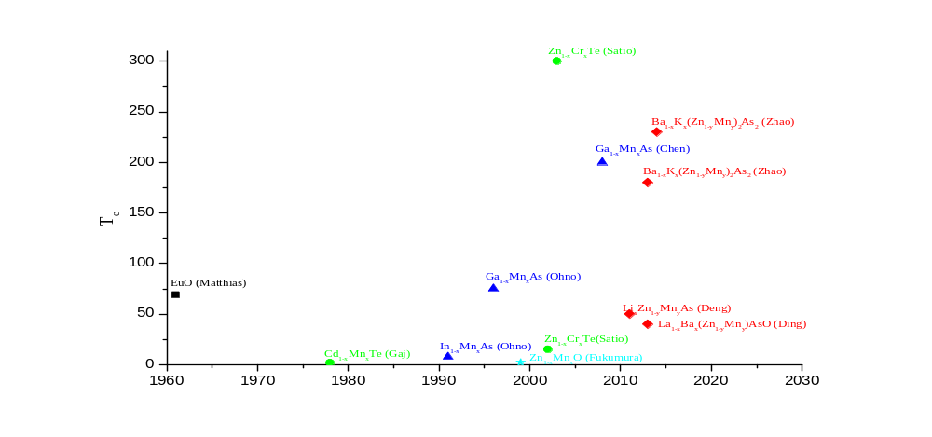
1
锌砷基稀磁半导体Ba_{1-x}K_{x}(Zn_{0.85}Mn_{0.15})₂As₂薄膜研究
A special, free news feature in Science explores 125 big questions that face scientific inquiry over the next quarter-century
No. 41: Is it possible to create magnetic semiconductors that work at room temperature?
First Generation
Second Generation
Concentrated Magnetic
Semiconductors (EuS)
Curie temperature is well
below 300K.
It’s difficult to get high-quality films.
II-VI compounds diluted magnetic semiconductors
P-type and N-type semiconductor both are hard to get which may severely limit application.
Third Generation
Fourth Generation
III-V compounds diluted magnetic semiconductors
Only p-type has been made so far.
Doping both carriers and magnetic atoms at the same time.
Oxides compounds diluted magnetic semiconductors
Curie temperature is well
below 300K.
The origin of the ferro-magnetism may be transition metal clusters.
Fifth Generation
New-type diluted magnetic semiconductors (this work)
Doping carriers and magnetic atoms respectively.
High-quality films has been deposited on several different substrates.
Matthias et al., Phys. Rev. Lett. 26, 1241(1961); Gaj. et al., Phys. Stat. Sol. (b) 89, 655 (1978) ; Saito et al., JAP 91, 8085 (2002); Saito et al., Phys. Rev. Lett. 90, 207202 (2003); Ohno et al., JAP 69, 103(1991); Ohno et al., APL 69, 363(1996); Chen et al., Nano Lett. 11, 2584(2011); Fukumura et al., APL 75,3366(1999); Deng et al., Nature Commun. 2, 422(2011); Zhao et al., Nature Commun. 2, 1422(2013); Zhao et al., Chin. Sci. Bull. 59, 2524 (2014).

Slide 3
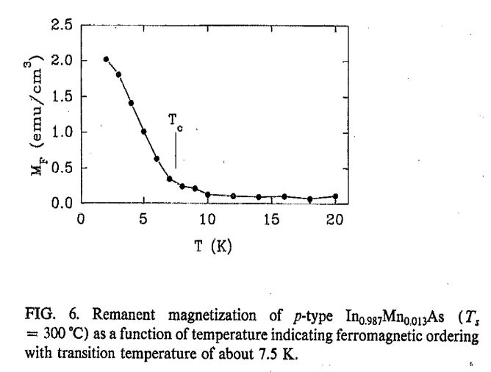
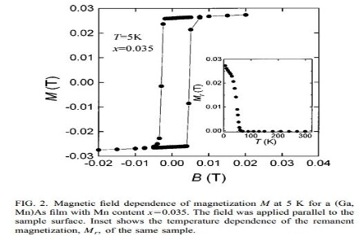
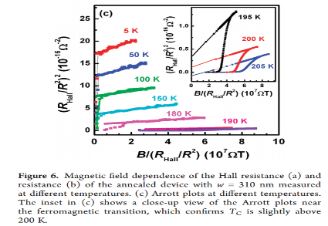

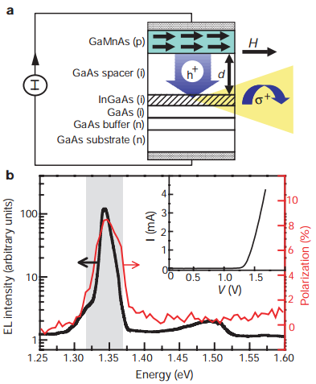
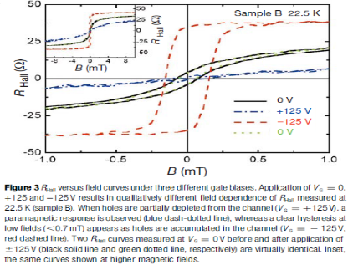
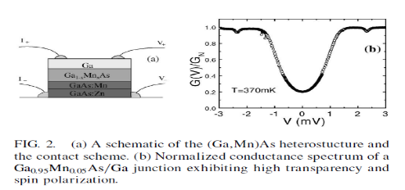
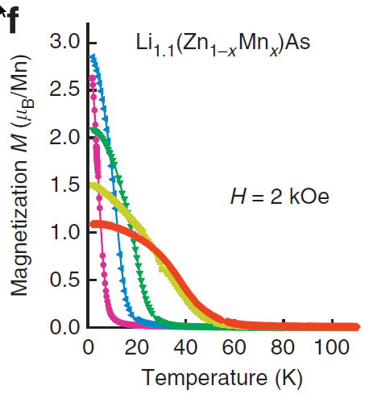
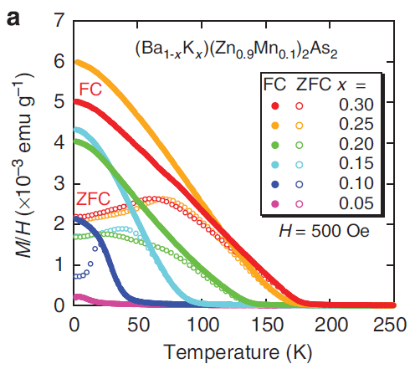
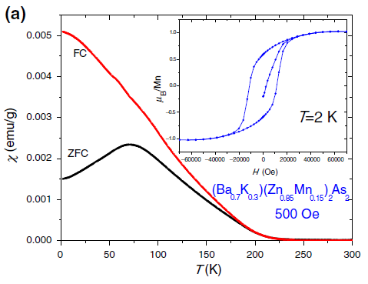

1
锌砷基稀磁半导体Ba_{1-x}K_{x}(Zn_{0.85}Mn_{0.15})₂As₂薄膜研究
Film
III-V
DMS
(In, Mn)As, Tc=7.5 K.
(Ga,Mn)As, Tc=75 K.
(Ga,Mn)As(Nanostructure), Tc=200 K
Spintronic
(Ga, Mn)As, Spin-LED
(In, Mn)As, Spin-FET
(Ga, Mn)As, Andreev reflection
Polycrystal
New-type
DMS
Li_{1-y}Zn_{1-x}Mn_{x}As, Tc=50 K
Ba_{1-x}K_{x}(Zn_{1-y},Mn_{y)2}As₂, Tc=180 K
Ba_{1-x}K_{x}(Zn_{1-y},Mn_{y)2}As₂, Tc=230 K
Film
Step 1: Single-phased, single-oriented films should be deposited on several different substrates
Spintronic
Step 2: Several novel two-dimensional layered structure, like iron-based superconductor DMS interface (Andreev Reflection), DMS Field Effect Transistor (Spin-FET), and p-type DMS n-type DMS interface (p-n Junction)

Slide 4
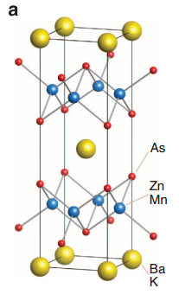
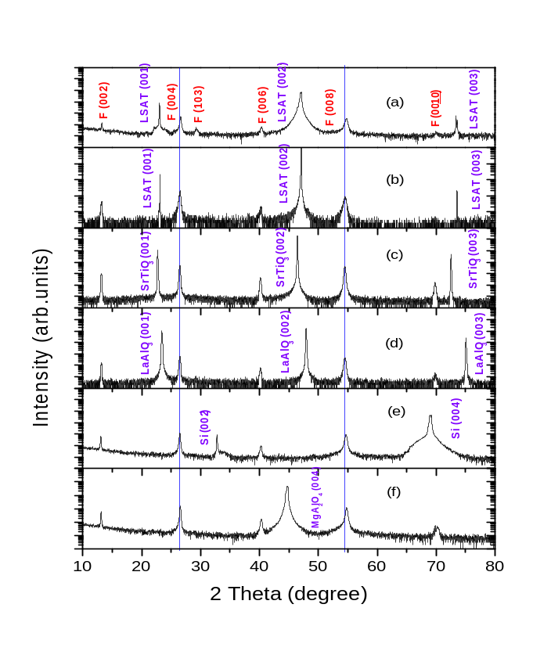
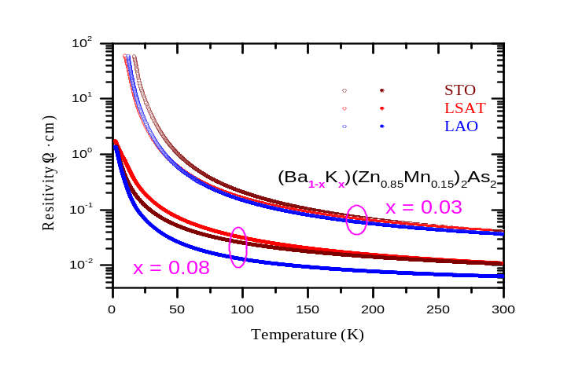
1
锌砷基稀磁半导体Ba_{1-x}K_{x}(Zn_{0.85}Mn_{0.15})₂As₂薄膜研究
A
B
C
新型稀磁半导体Ba_{1-x}K_{x}(Zn_{0.85}Mn_{0.15})₂As₂薄膜。A. (Ba,K)(Zn,Mn)₂As₂ 晶体结构示意图，典型的四方 ThCr₂Si₂ 结构，符合空间群 I4/mmm。B. 生长在不同单晶衬底STO、LSAT、LAO、MAO、Si上的稀磁半导体薄膜的X射线衍射。薄膜单相、外延。两条蓝色的竖线显示出 x=0.03（b,c,d）和 x=0.08（a,e,f）有着不同 c-轴 晶格常数。C. 生长在不同衬底上、不同 K 掺杂的稀磁半导体薄膜电阻率随温度变化曲线。K 掺杂量对电阻率有明显的影响，包括室温电阻率大小及电阻率随温度变化情况。

Slide 5
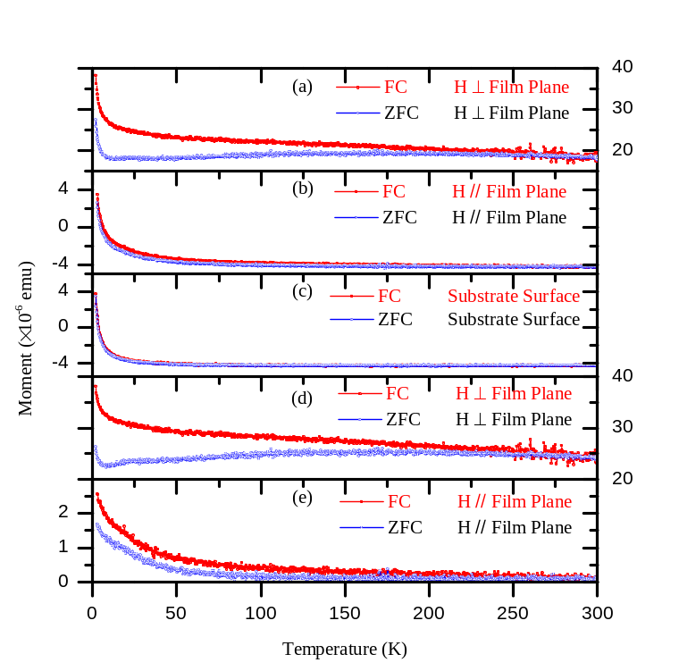
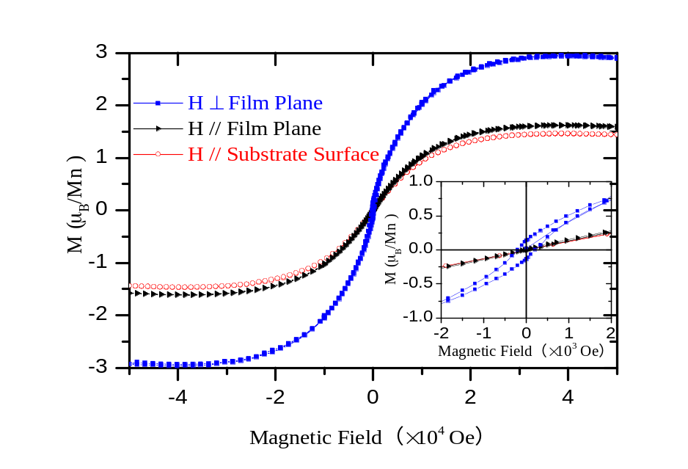
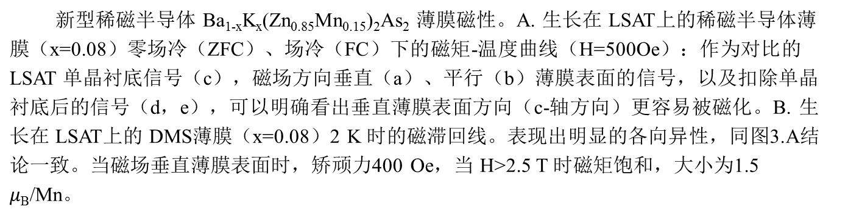
2
锌砷基稀磁半导体Ba_{1-x}K_{x}(Zn_{0.85}Mn_{0.15})₂As₂薄膜研究
A
B

Slide 6
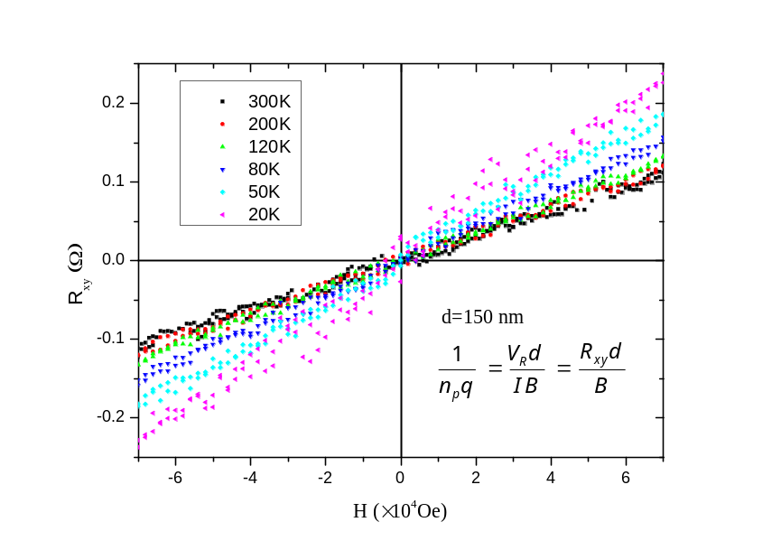
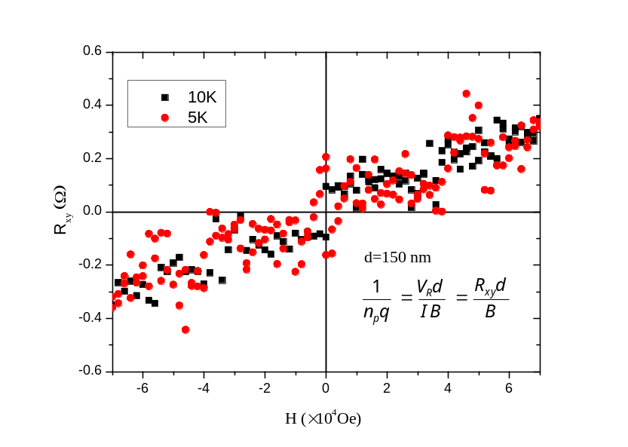
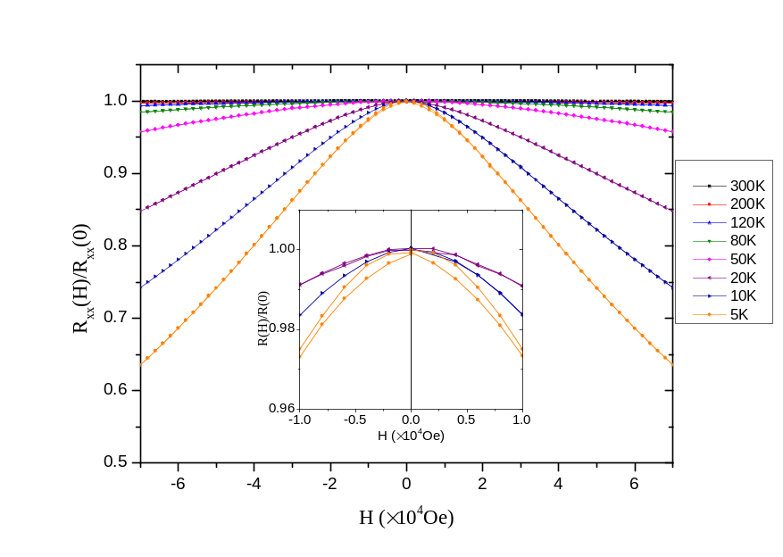
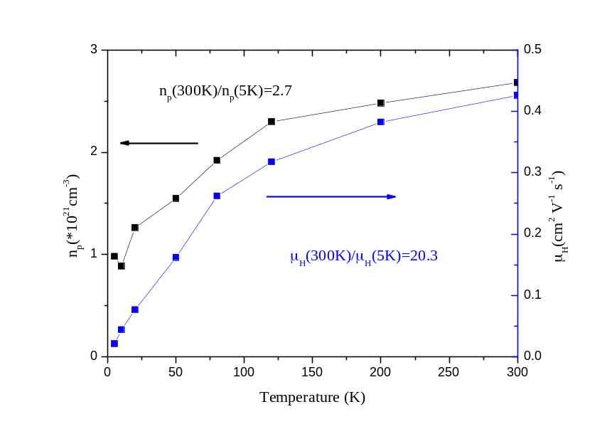
1
锌砷基稀磁半导体Ba_{1-x}K_{x}(Zn_{0.85}Mn_{0.15})₂As₂薄膜研究
A
B
C
D
生长在STO衬底上DMS薄膜的电输运测量（霍尔桥为100um*500um），a, b 分别表示300K-20K和10K、5K时的霍尔电阻，都表现出非常好的线性，但未观察到反常霍尔现象。c 表示薄膜的磁电阻，5K 温度时观察到了Butterfly Line。d 表示不同的温度下按照n_{q}=1/(R_{h}*q)得到的空穴载流子浓度，以及结合电阻率得到的迁移率。

Slide 7

中国科学院物理研究所
Institute of Physics Chinese Academy of Sciences

