Slide 1
CHAPTER 3
STACKS AND QUEUES
All the programs in this file are selected from
Ellis Horowitz, Sartaj Sahni, and Susan Anderson-Freed
“Fundamentals of Data Structures in C”,
CHAPTER 3

Slide 2
A
Stack: a Last-In-First-Out (LIFO) list
B
A
C
B
A
D
C
B
A
E
D
C
B
A
top
D
C
B
A
top
top
top
top
top
Figure 3.1: Inserting and deleting elements in a stack
CHAPTER 3

Slide 3
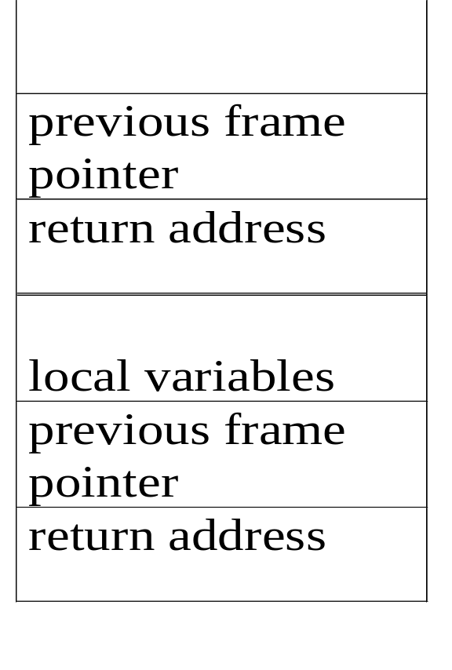
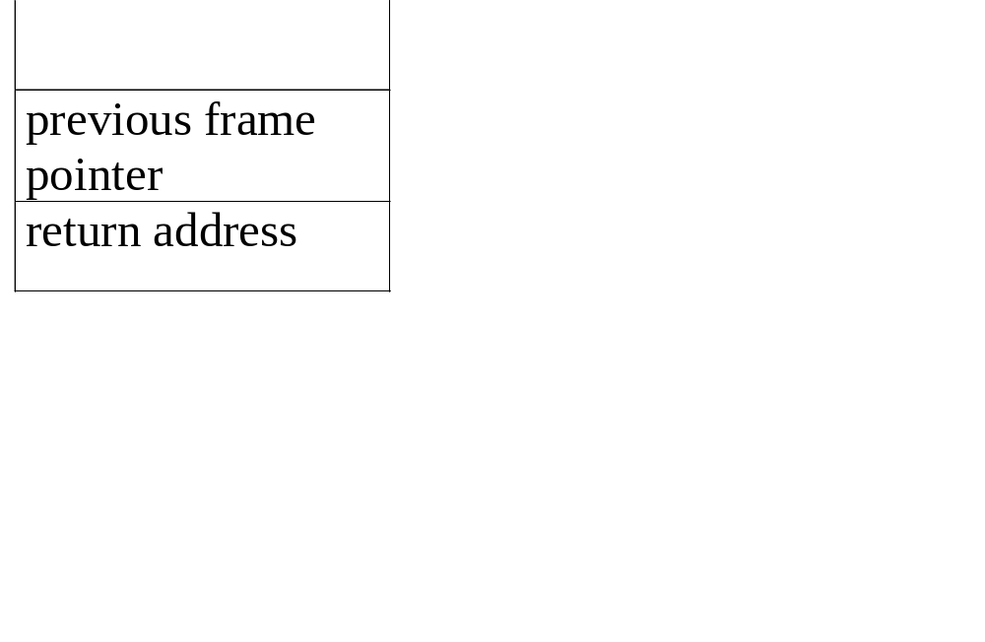
An application of stack:
stack frame of function call
(activation record)
fp
al
fp: a pointer to current stack frame
stack frame of invoking function
fp
main
main
system stack before a1 is invoked
system stack after a1 is invoked
(a) (b)
Figure 3.2: System stack after function call a1
CHAPTER 3
Notes:
Activation :活化（作用）

Slide 4
structure Stack is objects: a finite ordered list with zero or more elements. functions: for all stack ∈ Stack, item ∈ element, max_stack_size
∈ positive integer
Stack CreateS(max_stack_size) ::= create an empty stack whose maximum size is max_stack_size
Boolean IsFull(stack, max_stack_size) ::= if (number of elements in stack == max_stack_size) return TRUE else return FALSE
Stack Push(stack, item) ::= if (IsFull(stack)) return stack_full else insert item into top of stack
abstract data type for stack
CHAPTER 3

Slide 5
Boolean IsEmpty(stack) ::= if(stack == CreateS(max_stack_size)) return TRUE else return FALSE
Element Pop(stack) ::= if(IsEmpty(stack)) return stack_empty else remove and return the item on the top of the stack.
Structure 3.1: Abstract data type Stack
CHAPTER 3

Slide 6
Stack CreateS(max_stack_size) ::=
#define MAX_STACK_SIZE 100 /* maximum stack size */ typedef struct { int key;
/* other fields */
} element; element stack[MAX_STACK_SIZE]; int top = -1;
Boolean IsEmpty(Stack) ::= top< 0;
Boolean IsFull(Stack) ::= top >= MAX_STACK_SIZE-1;
Implementation: using array
CHAPTER 3

Slide 7
Implementation stack by array
用array實作出stack的新增和刪除功能
主要三個function
  插入: push
  刪除: pop
  Stack是否為空的: isEmpty

Slide 8
Implementation stack by array
  插入: push
  依序插入 10, 25, 14
初始狀態
位置
-1
0
1
2
3
Stack
top

Slide 9
Implementation stack by array
  插入: push
  依序插入 10, 25, 14
top+1
位置
-1
0
1
2
3
Stack
top

Slide 10
Implementation stack by array
  插入: push
  依序插入 10, 25, 14
插入10
位置
-1
0
1
2
3
Stack
10
top

Slide 11
Implementation stack by array
  插入: push
  依序插入 10, 25, 14
top+1
位置
-1
0
1
2
3
Stack
10
top

Slide 12
Implementation stack by array
  插入: push
  依序插入 10, 25, 14
插入25
位置
-1
0
1
2
3
Stack
10
25
top

Slide 13
Implementation stack by array
  插入: push
  依序插入 10, 25, 14
top+1
位置
-1
0
1
2
3
Stack
10
25
top

Slide 14
Implementation stack by array
  插入: push
  依序插入 10, 25, 14
插入14
位置
-1
0
1
2
3
Stack
10
25
14
top

Slide 15
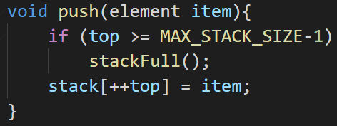
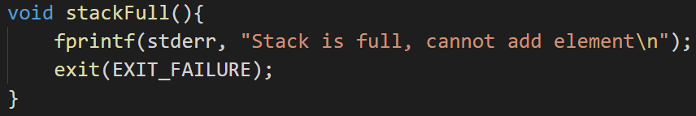
Implementation stack by array
  插入: push
  Stack已滿: stackFull
超出array大小時無法插入資料
將top移到要插入資料的位置
並插入資料

Slide 16
void push(int *top, element item)
{
/* add an item to the global stack */ if (*top >= MAX_STACK_SIZE-1) { stack_full( ); return;
} stack[++*top] = item;
}
Program 3.1: Add to a stack
Add to a stack
CHAPTER 3

Slide 17
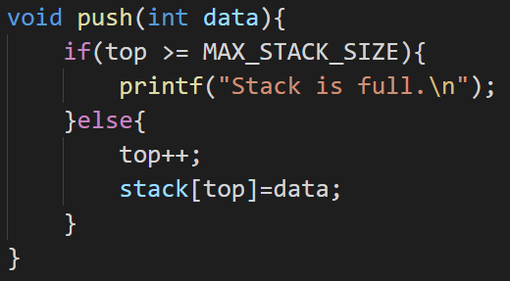
Implementation stack by array
  插入: push
超出array大小時無法插入資料
將top移到要插入資料的位置並插入資料

Slide 18
Implementation stack by array
  刪除: pop
  刪除順序依照”後進先出”
目前stack
位置
-1
0
1
2
3
Stack
10
25
14
top

Slide 19
Implementation stack by array
  刪除: pop
  刪除順序依照”後進先出”
刪除14
位置
-1
0
1
2
3
Stack
10
25
top

Slide 20
Implementation stack by array
  刪除: pop
  刪除順序依照”後進先出”
top-1
位置
-1
0
1
2
3
Stack
10
25
top

Slide 21
Implementation stack by array
  刪除: pop
  刪除順序依照”後進先出”
刪除25
位置
-1
0
1
2
3
Stack
10
top

Slide 22
Implementation stack by array
  刪除: pop
  刪除順序依照”後進先出”
top-1
位置
-1
0
1
2
3
Stack
10
top

Slide 23
Implementation stack by array
  刪除: pop
  刪除順序依照”後進先出”
刪除10
位置
-1
0
1
2
3
Stack
top

Slide 24
Implementation stack by array
  刪除: pop
  刪除順序依照”後進先出”
top-1
位置
-1
0
1
2
3
Stack
top

Slide 25
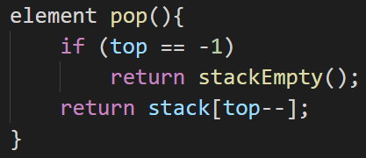
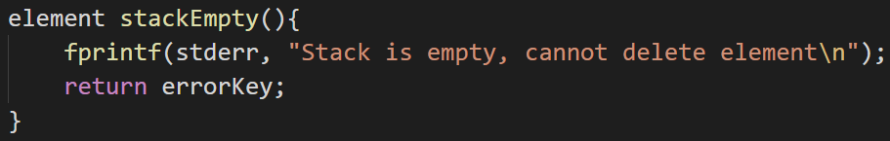
Implementation stack by array
  刪除: pop
  Stack為空: stackEmpty
array是空的則無法刪除資料
指到的資料後回傳

Slide 26
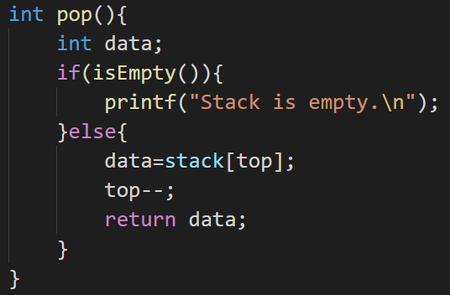
Implementation stack by array
  刪除: pop
array是空的則無法刪除資料
data紀錄了top指到的資料後
把top-1
回傳data

Slide 27
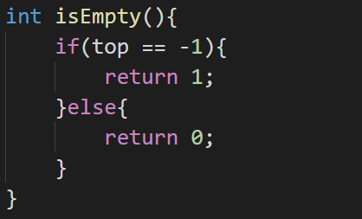
Implementation stack by array
  Stack是否為空的: isEmpty
array是空的則回傳true (1)
array不是空的則回傳false (0)

Slide 28
element pop(int *top)
{
/* return the top element from the stack */ if (*top == -1) return stack_empty( ); /* returns and error key */ return stack[(*top)--];
}
Program 3.2: Delete from a stack
Delete from a stack
CHAPTER 3

Slide 29
Queue: a First-In-First-Out (FIFO) list
A
B
A
C
B
A
D
C
B
A
rear
front
D
C
B
rear
front
rear
front
rear
front
rear
front
Figure 3.4: Inserting and deleting elements in a queue
CHAPTER 3

Slide 30
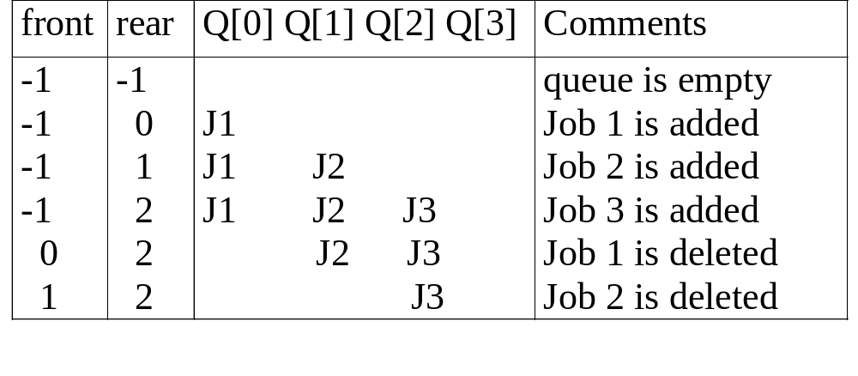
Application: Job scheduling
Figure 3.5: Insertion and deletion from a sequential queue
CHAPTER 3

Slide 31
structure Queue is objects: a finite ordered list with zero or more elements. functions: for all queue ∈ Queue, item ∈ element, max_ queue_ size ∈ positive integer
Queue CreateQ(max_queue_size) ::= create an empty queue whose maximum size is max_queue_size
Boolean IsFullQ(queue, max_queue_size) ::= if(number of elements in queue == max_queue_size) return TRUE else return FALSE
Queue AddQ(queue, item) ::= if (IsFullQ(queue)) queue_full else insert item at rear of queue and return queue
Abstract data type of queue
CHAPTER 3

Slide 32
Boolean IsEmptyQ(queue) ::= if (queue ==CreateQ(max_queue_size)) return TRUE else return FALSE
Element DeleteQ(queue) ::= if (IsEmptyQ(queue)) return else remove and return the item at front of queue.
Structure 3.2: Abstract data type Queue
CHAPTER 3

Slide 33
Queue CreateQ(max_queue_size) ::=
# define MAX_QUEUE_SIZE 100/* Maximum queue size */ typedef struct { int key;
/* other fields */
} element; element queue[MAX_QUEUE_SIZE]; int rear = -1; int front = -1;
Boolean IsEmpty(queue) ::= front == rear
Boolean IsFullQ(queue) ::= rear == MAX_QUEUE_SIZE-1
Implementation 1: using array
CHAPTER 3

Slide 34
Implementation queue by array
用array實作出queue的新增和刪除功能
主要三個function
  插入: addq
  刪除: deleteq
  Queue是否為空的: isEmpty

Slide 35
Implementation queue by array
  插入: addq
  依序插入 10, 25, 14
初始狀態
位置
-1
0
1
2
3
Queue
front
rear

Slide 36
Implementation queue by array
  插入: addq
  依序插入 10, 25, 14
rear+1
位置
-1
0
1
2
3
Queue
front
rear

Slide 37
Implementation queue by array
  插入: addq
  依序插入 10, 25, 14
插入10
位置
-1
0
1
2
3
Queue
10
front
rear

Slide 38
Implementation queue by array
  插入: addq
  依序插入 10, 25, 14
rear+1
位置
-1
0
1
2
3
Queue
10
front
rear

Slide 39
Implementation queue by array
  插入: addq
  依序插入 10, 25, 14
插入25
位置
-1
0
1
2
3
Queue
10
25
front
rear

Slide 40
Implementation queue by array
  插入: addq
  依序插入 10, 25, 14
rear+1
位置
-1
0
1
2
3
Queue
10
25
front
rear

Slide 41
Implementation queue by array
  插入: addq
  依序插入 10, 25, 14
插入14
位置
-1
0
1
2
3
Queue
10
25
14
front
rear

Slide 42
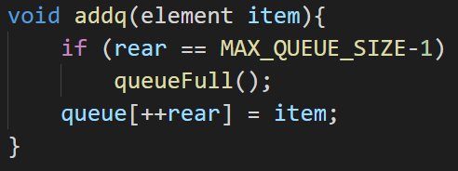
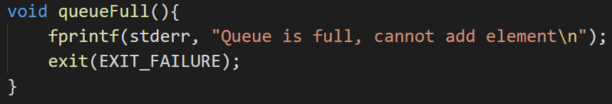
Implementation queue by array
  插入: addq
  Queue已滿: queueFull
array是滿的則無法插入資料
將rear移到要增加資料的位置並插入資料

Slide 43
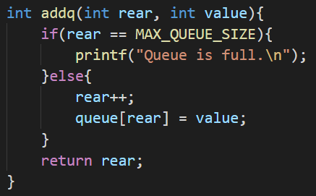
Implementation queue by array
  插入: addq
array是滿的則無法插入資料
將rear移到要增加資料的位置並插入資料

Slide 44
void addq(int rear, element item)
{
/* add an item to the queue */ if (rear == MAX_QUEUE_SIZE-1) { queue_full( ); return;
} queue [++rear] = item;
}
Program 3.5: Add to a queue
Add to a queue
CHAPTER 3

Slide 45
Implementation queue by array
  刪除: deleteq
  刪除順序依照”先進先出”
目前queue
位置
-1
0
1
2
3
Queue
10
25
14
front
rear

Slide 46
Implementation queue by array
  刪除: deleteq
  刪除順序依照”先進先出”
front+1
位置
-1
0
1
2
3
Queue
10
25
14
front
rear

Slide 47
Implementation queue by array
  刪除: deleteq
  刪除順序依照”先進先出”
刪除10
位置
-1
0
1
2
3
Queue
25
14
front
rear

Slide 48
Implementation queue by array
  刪除: deleteq
  刪除順序依照”先進先出”
front+1
位置
-1
0
1
2
3
Queue
25
14
front
rear

Slide 49
Implementation queue by array
  刪除: deleteq
  刪除順序依照”先進先出”
刪除25
位置
-1
0
1
2
3
Queue
14
front
rear

Slide 50
Implementation queue by array
  刪除: deleteq
  刪除順序依照”先進先出”
front+1
位置
-1
0
1
2
3
Queue
14
rear
front

Slide 51
Implementation queue by array
  刪除: deleteq
  刪除順序依照”先進先出”
刪除14
位置
-1
0
1
2
3
Queue
rear
front

Slide 52
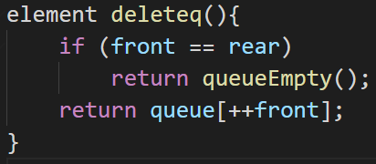
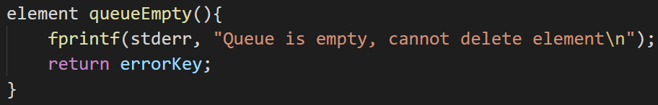
Implementation queue by array
  刪除: deleteq
  Queue為空: queueEmpty
array是空的則無法刪除資料
將front往要刪除的資料方向移動並刪除資料

Slide 53
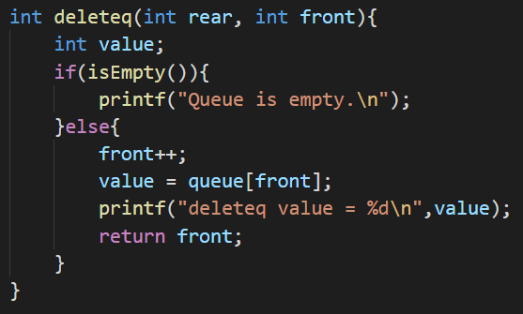
Implementation queue by array
  刪除: deleteq
array是空的則無法刪除資料
將front往要刪除的資料方向移動並刪除資料

Slide 54
element deleteq(int front, int rear)
{
/* remove element at the front of the queue */ if ( front == rear) return queue_empty( ); /* return an error key */ return queue [++ front];
}
Program 3.6: Delete from a queue
Delete from a queue
problem: there may be available space when IsFullQ is true i.e., movement is required.
CHAPTER 3

Slide 55
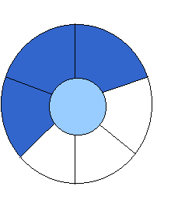
Implementation 2: regard an array as a circular queue
front: one position counterclockwise from the first element
rear: current end
EMPTY QUEUE
[2]
[3] [2] [3]
J2
J3
[1] [4] [1] [4]
J1
[0] [5] [0] [5]
front = 0 front = 0
rear = 0 rear = 3
Figure 3.6: Empty and nonempty circular queues
Notes:
Counterclockwise: 自右向左的

Slide 56

Problem: one space is left when queue is full
FULL QUEUE FULL QUEUE
[2] [3] [2] [3]
J2 J3
J8 J9
J7
[1] [4][1] [4]
J1 J4
J5
J6 J5
[0] [5] [0] [5]
front =0
rear = 5
front =4
rear =3
Figure 3.7: Full circular queues and then we remove the item
CHAPTER 3

Slide 57
void addq(element item)
{
/* add an item to the queue */ rear = (rear +1) % MAX_QUEUE_SIZE; if (front == rear) /* reset rear and print error */ queueFull();
} queue[rear] = item;
}
Program 3.7: Add to a circular queue
Add to a circular queue
CHAPTER 3

Slide 58
element deleteq()
{ element item;
/* remove front element from the queue and put it in item */ if (front == rear) return queueEmpty( );
/* queue_empty returns an error key */ front = (front+1) % MAX_QUEUE_SIZE; return queue[front];
}
Program 3.8: Delete from a circular queue
Delete from a circular queue
CHAPTER 3

Slide 59
A Mazing Problem
0 1 0 0 0 1 1 0 0 0 1 1 1 1 1
1 0 0 0 1 1 0 1 1 1 0 0 1 1 1
0 1 1 0 0 0 0 1 1 1 1 0 0 1 1
1 1 0 1 1 1 1 0 1 1 0 1 1 0 0
1 1 0 1 0 0 1 0 1 1 1 1 1 1 1
0 0 1 1 0 1 1 1 0 1 0 0 1 0 1
0 1 1 1 1 0 0 1 1 1 1 1 1 1 1
0 0 1 1 0 1 1 0 1 1 1 1 1 0 1
1 1 0 0 0 1 1 0 1 1 0 0 0 0 0
0 0 1 1 1 1 1 0 0 0 1 1 1 1 0
0 1 0 0 1 1 1 1 1 0 1 1 1 1 0
entrance
exit
1: blocked path
0: through path
*Figure 3.8: An example maze
CHAPTER 3

Slide 60
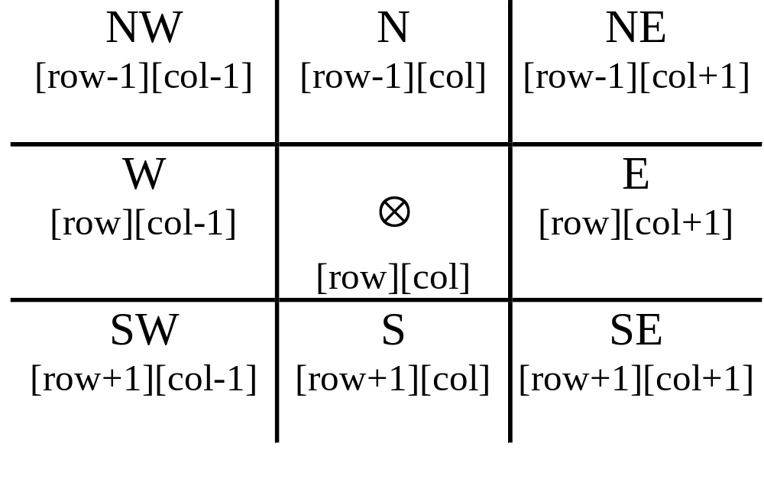
a possible representation
Figure 3.9: Allowable moves
CHAPTER 3

Slide 61
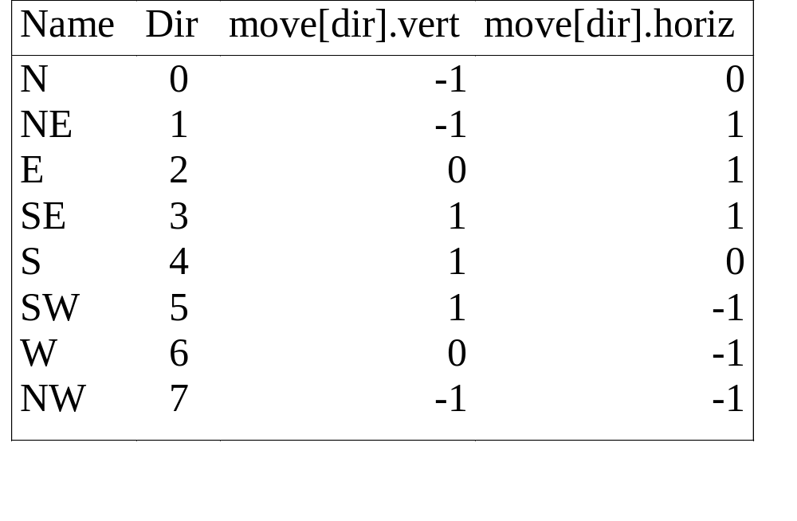
typedef struct { short int vert; short int horiz;
} offsets; offsets move[8]; /*array of moves for each direction*/
a possible implementation
next_row = row + move[dir].vert;
next_col = col + move[dir].horiz;
CHAPTER 3

Slide 62
#define MAX_STACK_SIZE 100
/*maximum stack size*/ typedef struct { short int row; short int col; short int dir;
} element; element stack[MAX_STACK_SIZE];
Use stack to keep pass history
CHAPTER 3

Slide 63
A Mazing Problem
設計一個地圖，用stack記錄從起點走到終點的路徑
實行步驟:
  initMap()
    初始地圖map[][]
    初始標記mark[][]
    初始方位(八方位)
  path()
起點
1 | 1 | 1 | 1 | 1 | 1
1 | 0 | 0 | 1 | 0 | 1
1 | 0 | 0 | 0 | 1 | 1
1 | 0 | 1 | 1 | 1 | 1
1 | 0 | 0 | 0 | 0 | 1
1 | 1 | 1 | 1 | 1 | 1
map[6][6]
終點

Slide 64
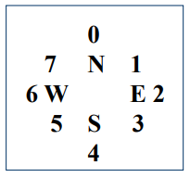
A Mazing Problem
init
0是路(可以走的)，1是牆(不能走的)，*是走過的路
1 | 1 | 1 | 1 | 1 | 1
1 | 0 | 0 | 1 | 0 | 1
1 | 0 | 0 | 0 | 1 | 1
1 | 0 | 1 | 1 | 1 | 1
1 | 0 | 0 | 0 | 0 | 1
1 | 1 | 1 | 1 | 1 | 1
1 | 1 | 1 | 1 | 1 | 1
1 | 0 | 0 | 0 | 0 | 1
1 | 0 | 0 | 0 | 0 | 1
1 | 0 | 0 | 0 | 0 | 1
1 | 0 | 0 | 0 | 0 | 1
1 | 1 | 1 | 1 | 1 | 1
map[6][6]
mark[6][6]
八方位

Slide 65
A Mazing Problem
第一步
從起點(1, 1)開始，mark標記已走過，直到方向2有路且沒有走過
1 | 1 | 1 | 1 | 1 | 1
1 | * | 0 | 1 | 0 | 1
1 | 0 | 0 | 0 | 1 | 1
1 | 0 | 1 | 1 | 1 | 1
1 | 0 | 0 | 0 | 0 | 1
1 | 1 | 1 | 1 | 1 | 1
1 | 1 | 1 | 1 | 1 | 1
1 | * | 0 | 0 | 0 | 1
1 | 0 | 0 | 0 | 0 | 1
1 | 0 | 0 | 0 | 0 | 1
1 | 0 | 0 | 0 | 0 | 1
1 | 1 | 1 | 1 | 1 | 1
map[6][6]
mark[6][6]
八方位

Slide 66
A Mazing Problem
第二步
走向(1, 2)，mark標記已走過，直到方向3有路且沒有走過
1 | 1 | 1 | 1 | 1 | 1
1 | * | * | 1 | 0 | 1
1 | 0 | 0 | 0 | 1 | 1
1 | 0 | 1 | 1 | 1 | 1
1 | 0 | 0 | 0 | 0 | 1
1 | 1 | 1 | 1 | 1 | 1
1 | 1 | 1 | 1 | 1 | 1
1 | * | * | 0 | 0 | 1
1 | 0 | 0 | 0 | 0 | 1
1 | 0 | 0 | 0 | 0 | 1
1 | 0 | 0 | 0 | 0 | 1
1 | 1 | 1 | 1 | 1 | 1
map[6][6]
mark[6][6]
八方位

Slide 67
A Mazing Problem
第三步
走向(2, 3)，mark標記已走過，直到方向1有路且沒有走過
1 | 1 | 1 | 1 | 1 | 1
1 | * | * | 1 | 0 | 1
1 | 0 | 0 | * | 1 | 1
1 | 0 | 1 | 1 | 1 | 1
1 | 0 | 0 | 0 | 0 | 1
1 | 1 | 1 | 1 | 1 | 1
1 | 1 | 1 | 1 | 1 | 1
1 | * | * | 0 | 0 | 1
1 | 0 | 0 | * | 0 | 1
1 | 0 | 0 | 0 | 0 | 1
1 | 0 | 0 | 0 | 0 | 1
1 | 1 | 1 | 1 | 1 | 1
map[6][6]
mark[6][6]
八方位

Slide 68
A Mazing Problem
第四步
走向(1, 4)，mark標記已走過，所有方向都沒路，退回上一步
1 | 1 | 1 | 1 | 1 | 1
1 | * | * | 1 | 0 | 1
1 | 0 | 0 | * | 1 | 1
1 | 0 | 1 | 1 | 1 | 1
1 | 0 | 0 | 0 | 0 | 1
1 | 1 | 1 | 1 | 1 | 1
1 | 1 | 1 | 1 | 1 | 1
1 | * | * | 0 | * | 1
1 | 0 | 0 | * | 0 | 1
1 | 0 | 0 | 0 | 0 | 1
1 | 0 | 0 | 0 | 0 | 1
1 | 1 | 1 | 1 | 1 | 1
map[6][6]
mark[6][6]
八方位

Slide 69
A Mazing Problem
第五步
走向(2, 3)，從方向2開始繼續找路，直到方向6有路且沒有走過
1 | 1 | 1 | 1 | 1 | 1
1 | * | * | 1 | 0 | 1
1 | 0 | 0 | * | 1 | 1
1 | 0 | 1 | 1 | 1 | 1
1 | 0 | 0 | 0 | 0 | 1
1 | 1 | 1 | 1 | 1 | 1
1 | 1 | 1 | 1 | 1 | 1
1 | * | * | 0 | * | 1
1 | 0 | 0 | * | 0 | 1
1 | 0 | 0 | 0 | 0 | 1
1 | 0 | 0 | 0 | 0 | 1
1 | 1 | 1 | 1 | 1 | 1
map[6][6]
mark[6][6]
八方位

Slide 70
A Mazing Problem
第六步
走向(2, 2)，mark標記已走過，直到方向5有路且沒有走過
1 | 1 | 1 | 1 | 1 | 1
1 | * | * | 1 | 0 | 1
1 | 0 | * | * | 1 | 1
1 | 0 | 1 | 1 | 1 | 1
1 | 0 | 0 | 0 | 0 | 1
1 | 1 | 1 | 1 | 1 | 1
1 | 1 | 1 | 1 | 1 | 1
1 | * | * | 0 | * | 1
1 | 0 | * | * | 0 | 1
1 | 0 | 0 | 0 | 0 | 1
1 | 0 | 0 | 0 | 0 | 1
1 | 1 | 1 | 1 | 1 | 1
map[6][6]
mark[6][6]
八方位

Slide 71
A Mazing Problem
以此類推
1 | 1 | 1 | 1 | 1 | 1
1 | * | * | 1 | 0 | 1
1 | 0 | * | * | 1 | 1
1 | * | 1 | 1 | 1 | 1
1 | 0 | 0 | 0 | 0 | 1
1 | 1 | 1 | 1 | 1 | 1
1 | 1 | 1 | 1 | 1 | 1
1 | * | * | 0 | * | 1
1 | 0 | * | * | 0 | 1
1 | * | 0 | 0 | 0 | 1
1 | 0 | 0 | 0 | 0 | 1
1 | 1 | 1 | 1 | 1 | 1
map[6][6]
mark[6][6]
八方位

Slide 72
A Mazing Problem
以此類推
1 | 1 | 1 | 1 | 1 | 1
1 | * | * | 1 | 0 | 1
1 | 0 | * | * | 1 | 1
1 | * | 1 | 1 | 1 | 1
1 | 0 | 0 | 0 | 0 | 1
1 | 1 | 1 | 1 | 1 | 1
1 | 1 | 1 | 1 | 1 | 1
1 | * | * | 0 | * | 1
1 | * | * | * | 0 | 1
1 | * | 0 | 0 | 0 | 1
1 | 0 | 0 | 0 | 0 | 1
1 | 1 | 1 | 1 | 1 | 1
map[6][6]
mark[6][6]
八方位

Slide 73
A Mazing Problem
以此類推
1 | 1 | 1 | 1 | 1 | 1
1 | * | * | 1 | 0 | 1
1 | 0 | * | * | 1 | 1
1 | * | 1 | 1 | 1 | 1
1 | 0 | 0 | 0 | 0 | 1
1 | 1 | 1 | 1 | 1 | 1
1 | 1 | 1 | 1 | 1 | 1
1 | * | * | 0 | * | 1
1 | * | * | * | 0 | 1
1 | * | 0 | 0 | 0 | 1
1 | 0 | 0 | 0 | 0 | 1
1 | 1 | 1 | 1 | 1 | 1
map[6][6]
mark[6][6]
八方位

Slide 74
A Mazing Problem
以此類推
1 | 1 | 1 | 1 | 1 | 1
1 | * | * | 1 | 0 | 1
1 | 0 | * | * | 1 | 1
1 | * | 1 | 1 | 1 | 1
1 | 0 | * | 0 | 0 | 1
1 | 1 | 1 | 1 | 1 | 1
1 | 1 | 1 | 1 | 1 | 1
1 | * | * | 0 | * | 1
1 | * | * | * | 0 | 1
1 | * | 0 | 0 | 0 | 1
1 | 0 | * | 0 | 0 | 1
1 | 1 | 1 | 1 | 1 | 1
map[6][6]
mark[6][6]
八方位

Slide 75
A Mazing Problem
以此類推
1 | 1 | 1 | 1 | 1 | 1
1 | * | * | 1 | 0 | 1
1 | 0 | * | * | 1 | 1
1 | * | 1 | 1 | 1 | 1
1 | 0 | * | * | 0 | 1
1 | 1 | 1 | 1 | 1 | 1
1 | 1 | 1 | 1 | 1 | 1
1 | * | * | 0 | * | 1
1 | * | * | * | 0 | 1
1 | * | 0 | 0 | 0 | 1
1 | 0 | * | * | 0 | 1
1 | 1 | 1 | 1 | 1 | 1
map[6][6]
mark[6][6]
八方位

Slide 76
A Mazing Problem
以此類推，最後走到終點
1 | 1 | 1 | 1 | 1 | 1
1 | * | * | 1 | 0 | 1
1 | 0 | * | * | 1 | 1
1 | * | 1 | 1 | 1 | 1
1 | 0 | * | * | * | 1
1 | 1 | 1 | 1 | 1 | 1
1 | 1 | 1 | 1 | 1 | 1
1 | * | * | 0 | * | 1
1 | * | * | * | 0 | 1
1 | * | 0 | 0 | 0 | 1
1 | 0 | * | * | * | 1
1 | 1 | 1 | 1 | 1 | 1
map[6][6]
mark[6][6]
八方位

Slide 77
Initialize a stack to the maze’s entrance coordinates and direction to north; while (stack is not empty){
/* move to position at top of stack */
<row, col, dir> = delete from top of stack; while (there are more moves from current position) {
<next_row, next_col > = coordinates of next move; dir = direction of move; if ((next_row == EXIT_ROW)&& (next_col == EXIT_COL)) success; /* find out the destination */ if (maze[next_row][next_col] == 0 && mark[next_row][next_col] == 0) {
CHAPTER 3
Notes:
Coordinate:座標

Slide 78
/* legal move and haven’t been there */ mark[next_row][next_col] = 1;
/* save current position and direction */ add <row, col, dir> to the top of the stack; row = next_row; col = next_col; dir = north;
}
}
} printf(“No path found\n”);
*Program 3.11: Initial maze algorithm
CHAPTER 3
Notes:
Legal:合法的，正當的

Slide 79
The size of a stack?
000001
111110
100001
011111
100001
111110
100001
011111
100000
m*p
mp --> ┌ m/2┐p, mp --> ┌ p/2┐m
The worst case complexity of the algorithm is O(mp)
Figure 3.11: Simple maze with a long path
CHAPTER 3

Slide 80
void path (void)
{
/* output a path through the maze if such a path exists */ int i, row, col, next_row, next_col, dir, found = FALSE; element position; mark[1][1] = 1; top =0; stack[0].row = 1; stack[0].col = 1; stack[0].dir = 1; while (top > -1 && !found) { position = pop(); row = position.row; col = position.col; dir = position.dir; while (dir < 8 && !found) {
/*move in direction dir */ next_row = row + move[dir].vert; next_col = col + move[dir].horiz;
(1,1)
(m,p)
(m+2)*(p+2)
0
7 N 1
6 W E 2
5 S 3
4
CHAPTER 3

Slide 81
if (next_row==EXIT_ROW && next_col==EXIT_COL) found = TRUE; //Find the Exit else if ( !maze[next_row][next_col] &&
!mark[next_row][next_col] { mark[next_row][next_col] = 1; position.row = row; position.col = col; position.dir = ++dir; push(position); row = next_row; col = next_col; dir = 0;
} else ++dir; // Change to different directions
}
}
CHAPTER 3

Slide 82
if (found) { printf(“The path is :\n”); printf(“row col\n”); for (i = 0; i <= top; i++) printf(“ %2d%5d”, stack[i].row, stack[i].col); printf(“%2d%5d\n”, row, col); printf(“%2d%5d\n”, EXIT_ROW, EXIT_COL);
} else printf(“The maze does not have a path\n”);
}
Program 3.12:Maze search function
CHAPTER 3

Slide 83
X = a / b - c + d * e - a * c a = 4, b = c = 2, d = e = 3
Interpretation 1:
((4/2)-2)+(3*3)-(4*2)=0 + 9 - 8=1
Interpretation 2:
(4/(2-2+3))*(3-4)*2=(4/3)*(-1)*2=-2.66666…
Evaluation of Expressions
How to generate the machine instructions corresponding to a given expression?
precedence rule + associative rule
CHAPTER 3
Notes:
Interpretation:解釋；闡明
precedence rule : 優先規則
associative rule :聯合律

Slide 84
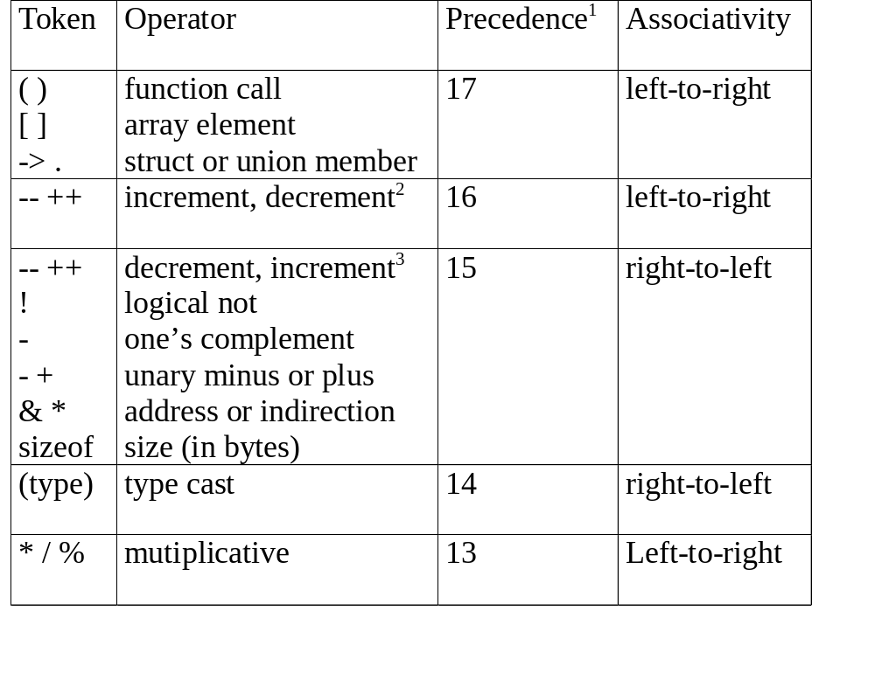
CHAPTER 3

Slide 85
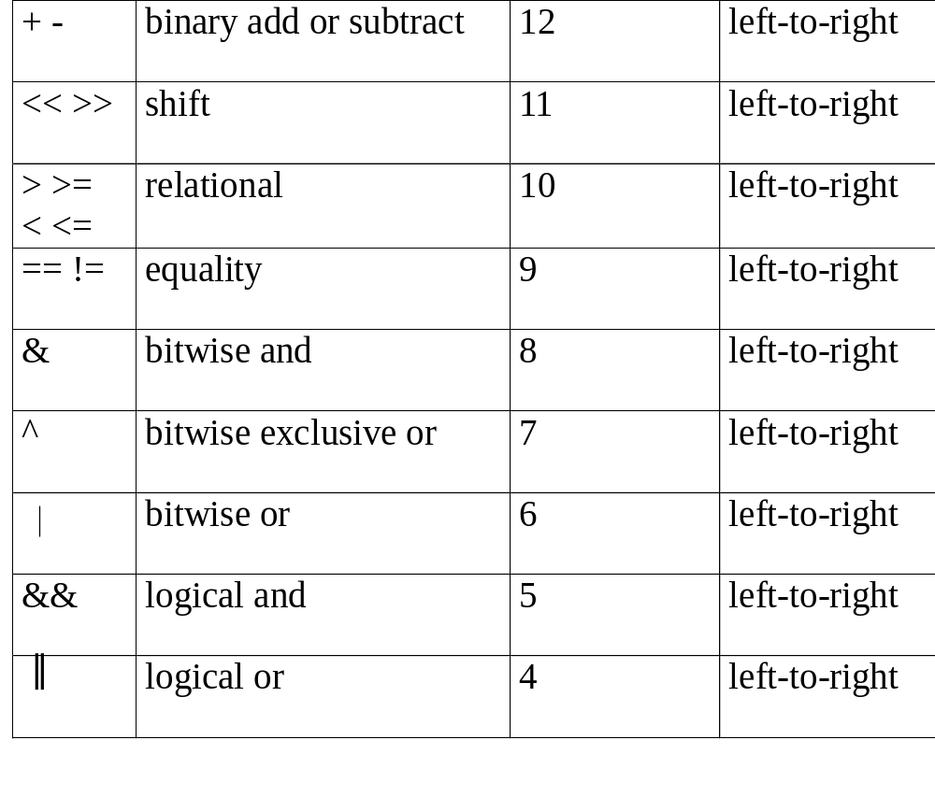

Slide 86
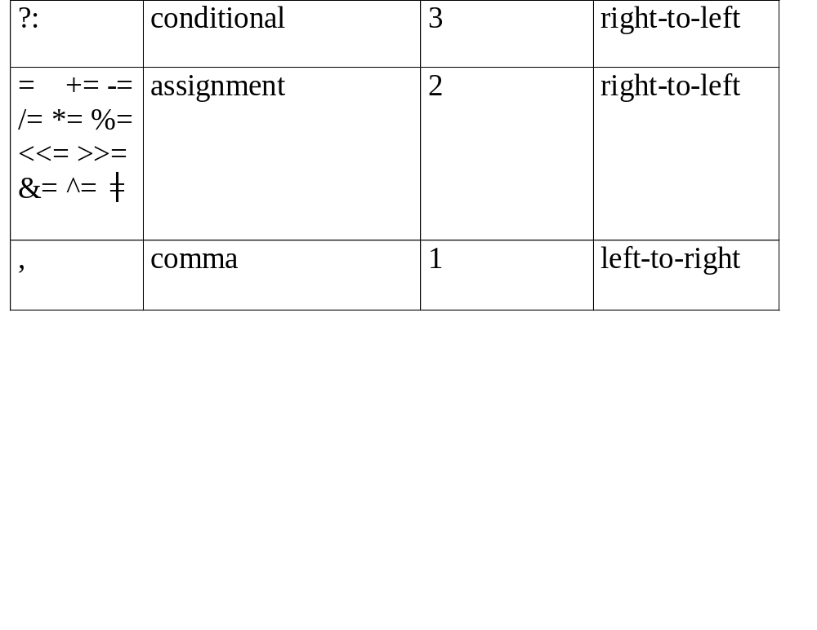
1.The precedence column is taken from Harbison and Steele.
2.Postfix form
3.prefix form
Figure 3.12: Precedence hierarchy for C
CHAPTER 3
Notes:
哈比森（Harbison S.P.），（ ）斯蒂爾（Steele G.L.）著

Slide 87
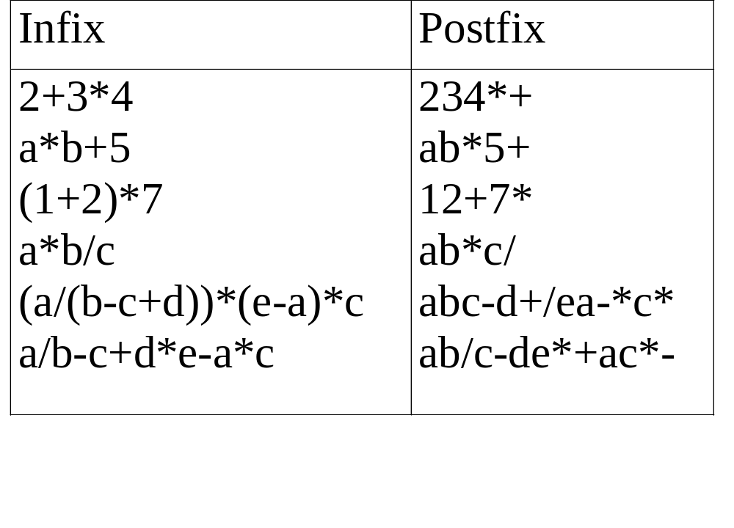
user
compiler
Figure 3.13: Infix and postfix notation
Postfix: no parentheses, no precedence
CHAPTER 3
Notes:
precedence rule : 優先規則

Slide 88
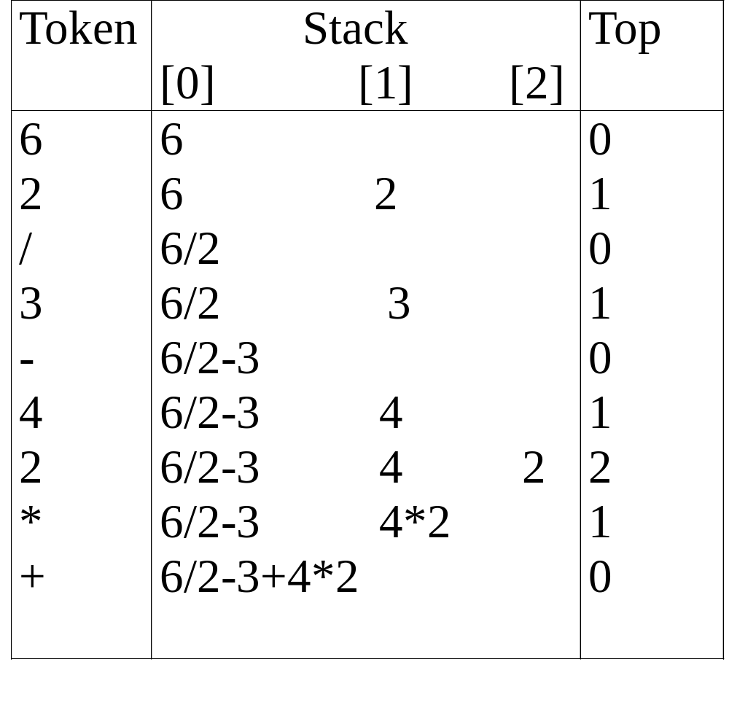
Figure 3.14: Postfix evaluation
CHAPTER 3

Slide 89
Infix to postfix
輸入infix，輸出postfix
主要二個function
  token to string: getToken()
  infix to postfix: postfix()

Slide 90
Infix to postfix
input: a*(b+c)*d
token
output
a
*
(
b
+
c
)
*
d
a
b
c
+
*
d
*
+
top = 2
(
top = 1
*
top = 0
stack
top = -1
Notes:
P135 Figure 3.16

Slide 91
#define MAX_STACK_SIZE 100 /* maximum stack size */
#define MAX_EXPR_SIZE 100 /* max size of expression */ typedef enum{1paran, rparen, plus, minus, times, divide, mod, eos, operand} precedence; int stack[MAX_STACK_SIZE]; /* global stack */ char expr[MAX_EXPR_SIZE]; /* input string */
Goal: infix --> postfix
Assumptions:
operators: +, -, *, /, %
operands: single digit integer
CHAPTER 3
eos : end of string
Notes:
Eos : end of string

Slide 92
int eval(void)
{
/* evaluate a postfix expression, expr, maintained as a global variable, ‘\0’ is the the end of the expression.
The stack and top of the stack are global variables. get_token is used to return the token type and the character symbol. Operands are assumed to be single character digits */ precedence token; char symbol; int op1, op2; int n = 0; /* counter for the expression string */ int top = -1; token = get_token(&symbol, &n); while (token != eos)
{ if (token == operand) push(symbol-’0’); /* stack insert */
/* ASCII 0*/
exp: character array
CHAPTER 3
Notes:
ASCII 0 是48

Slide 93
else {
/* remove two operands, perform operation, and return result to the stack */ op2 = pop(); /* stack delete */ op1 = pop(); switch(token) { case plus: push(op1+op2); break; case minus: push(op1-op2); break; case times: push(op1*op2); break; case divide: push(op1/op2); break; case mod: push(op1%op2);
}
} token = get_token (&symbol, &n);
} return pop(); /* return result */
}
Program 3.13: Function to evaluate a postfix expression
Notes:
ASCII 0 是48

Slide 94
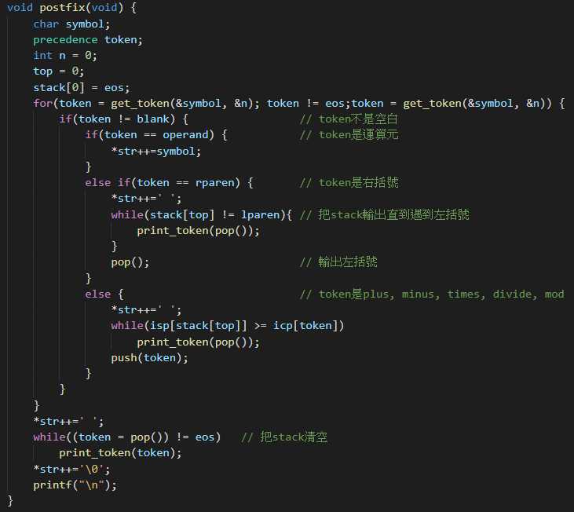
Infix to postfix
Notes:
P137 program 3.15

Slide 95
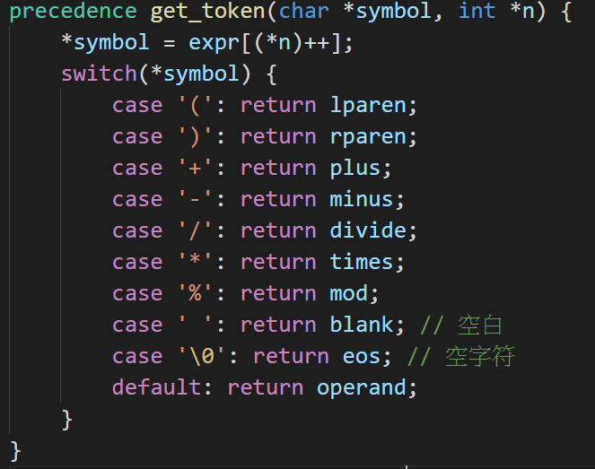
Infix to postfix
Notes:
P134 program 3.14
P132 有token to string的原因

Slide 96
precedence get_token(char *symbol, int *n)
{
/* get the next token, symbol is the character representation, which is returned, the token is represented by its enumerated value, which is returned in the function name */
*symbol =expr[(*n)++]; switch (*symbol) { case ‘(‘ : return lparen; case ’)’ : return rparen; case ‘+’: return plus; case ‘-’ : return minus;
CHAPTER 3
Notes:
enumerated :數，點列舉；枚舉

Slide 97
case ‘/’ : return divide; case ‘*’ : return times; case ‘%’ : return mod; case ‘\0‘ : return eos; default : return operand;
/* no error checking, default is operand */
}
}
Program 3.14: Function to get a token from the input string
CHAPTER 3

Slide 98
Infix to Postfix Conversion
(Intuitive Algorithm)
(1) Fully parenthesize expression
a / b - c + d * e - a * c -->
((((a / b) - c) + (d * e)) - a * c))
(2) All operators replace their corresponding right
parentheses.
((((a / b) - c) + (d * e)) - a * c))
(3) Delete all parentheses.
ab/c-de*+ac*-
two passes
/
-
*
+
*
-
CHAPTER 3

Slide 99
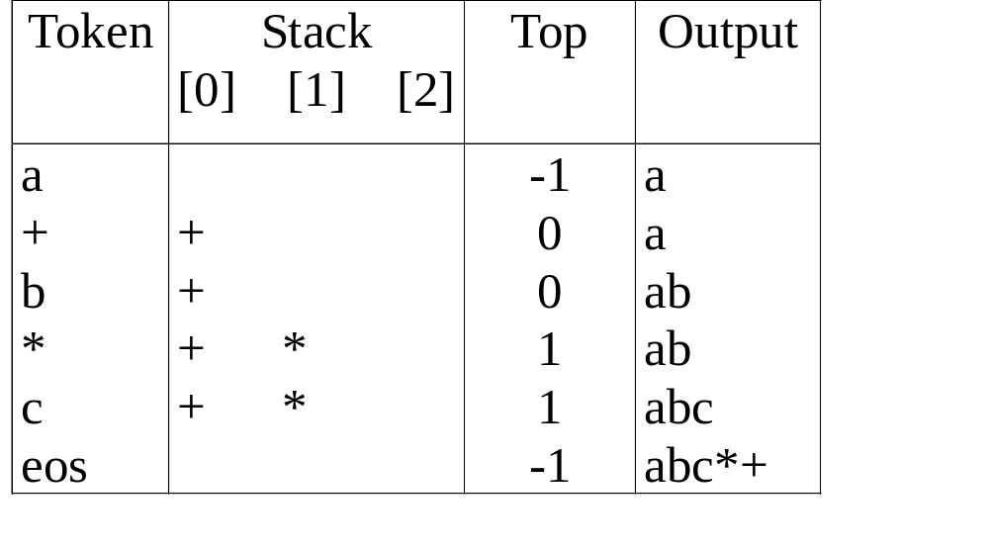
The orders of operands in infix and postfix are the same.
a + b * c
Figure 3.15: Translation of a+b*c to postfix
CHAPTER 3

Slide 100
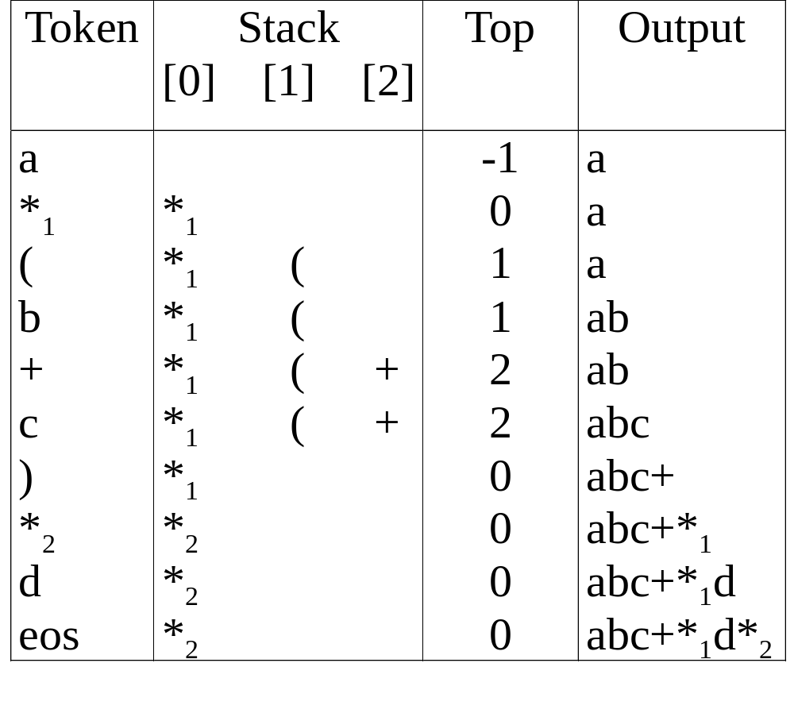
a *₁ (b +c) *₂ d
match )
*₁ = *₂
CHAPTER 3
Figure 3.16: Translation of a*(b+c)*d to postfix

Slide 101
Rules
(1) Operators are taken out of the stack as long as their
in-stack precedence (isp) is higher than or equal to the
incoming precedence (icp) of the new operator.
(2) “( “ has low in-stack precedence, and high incoming
precedence.
( ) + - * / % eos
isp 0 19 12 12 13 13 13 0
icp 20 19 12 12 13 13 13 0
CHAPTER 3
Notes:
take out:取出;

Slide 102
precedence stack[MAX_STACK_SIZE];
/* isp and icp arrays -- index is value of precedence lparen, rparen, plus, minus, times, divide, mod, eos */ static int isp [ ] = {0, 19, 12, 12, 13, 13, 13, 0}; static int icp [ ] = {20, 19, 12, 12, 13, 13, 13, 0};
isp: in-stack precedence
icp: incoming precedence
CHAPTER 3

Slide 103
void postfix(void)
{
/* output the postfix of the expression. The expression string, the stack, and top are global */ char symbol; precedence token; int n = 0; int top = 0; /* place eos on stack */ stack[0] = eos; for (token = get _token(&symbol, &n); token != eos; token = get_token(&symbol, &n)) { if (token == operand) printf (“%c”, symbol); else if (token == rparen ){
CHAPTER 3

Slide 104
/*unstack tokens until left parenthesis */ while (stack[top] != lparen) print_token(pop()); pop(); /*discard the left parenthesis */
} else{
/* remove and print symbols whose isp is greater than or equal to the current token’s icp */ while(isp[stack[top]] >= icp[token] ) print_token(pop(&top)); push(token);
}
} while ((token = pop(&top)) != eos) print_token(token); print(“\n”);
}
*Program 3.15: Function to convert from infix to postfix
f(n)=θ(g(n)) iff there exist positive
constants c₁, c₂, and n₀ such
that c₁g(n)≤f(n)≤c₂g(n) for all
n, n≥n₀.
f(n)=θ(g(n)) iff g(n) is both an
upper and lower bound on f(n).
θ(n)
CHAPTER 3
Notes:
in-stack precedence (isp)
incoming precedence (icp)
Asymptotic Notation (O) : Definition
f(n) = O(g(n)) iff there exist positive constants c and n₀ such that f(n) ≤ cg(n) for all n, n ≥ n₀.

Slide 105
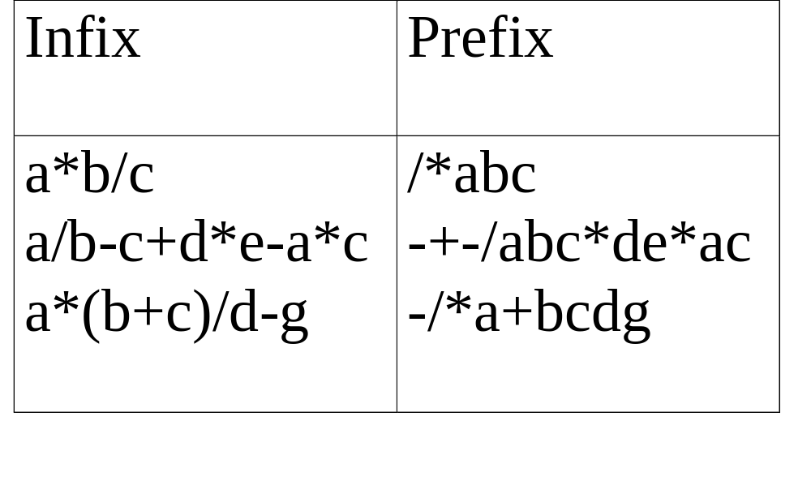
(1) evaluation
(2) transformation
*Figure 3.17: Infix and postfix expressions
CHAPTER 3
Notes:
Evaluation :估價，評價；估算
Transformation : 變化；轉變；變形；變質

Slide 106
Multiple Stacks and Queues
Two stacks
m[0], m[1], …, m[n-2], m[n-1]
bottommost bottommost
stack 1 stack 2
More than two stacks (n)
memory is divided into n equal segments
boundary[stack_no]
0 ≤ stack_no < MAX_STACKS
top[stack_no]
0 ≤ stack_no < MAX_STACKS
CHAPTER 3

Slide 107
Initially, boundary[i]=top[i].
0 1 [ m/n ] 2[ m/n ] m-1
boundary[ 0] boundary[1] boundary[ 2] boundary[n]
top[ 0] top[ 1] top[ 2]
All stacks are empty and divided into roughly equal segments.
*Figure 3.18: Initial configuration for n stacks in memory [m].
CHAPTER 3

Slide 108
#define MEMORY_SIZE 100 /* size of memory */
#define MAX_STACK_SIZE 100
/* max number of stacks plus 1 */
/* global memory declaration */ element memory[MEMORY_SIZE]; int top[MAX_STACKS]; int boundary[MAX_STACKS]; int n; /* number of stacks entered by the user */ top[0] = boundary[0] = -1; for (i = 1; i < n; i++) top[i] =boundary[i] =(MEMORY_SIZE/n)*i; boundary[n] = MEMORY_SIZE-1;
CHAPTER 3

Slide 109
void push(int i, element item)
{
/* add an item to the ith stack */ if (top[i] == boundary [i+1]) stackFull(i); memory[++top[i]] = item;
}
*Program 3.16:Add an item to the stack stack-no element pop(int i)
{
/* remove top element from the ith stack */ if (top[i] == boundary[i]) return stackEmpty(i); return memory[top[i]--];
}
*Program 3.17:Delete an item from the stack stack-no
but it may have unused storage

Slide 110
(往右)
Find j, stack_no < j < n
such that top[j] < boundary[j+1]
or, 0 ≤ j < stack_no
(往左)
b[0] t[0] b[1] t[1] b[i] t[i] t[i+1] t[j] b[j+1] b[n]
b[i+1] b[i+2]
b=boundary, t=top
*Figure 3.19: Configuration when stack i meets stack i+1,
but the memory is not full (p.130)
meet
往左或右找一個空間
CHAPTER 3

