Slide 1

Lustre Monitoring
DataDirect Networks Japan, Inc.
2016/10/8
Shilong Wang, Shuichi Ihara

Slide 2
Background of Lustre monitoring
Activities on the Lustre are black box
  Users and Administrators want to know “what’s going on?”
  Find “Crazy Jobs” in advance to prevent slow down.
Lustre statistics are valuable big data
  Not only monitoring and visualization, but also analysis
  Predictable operations could be possible.
  It helps optimize applications and data relocation.
Open Source based monitoring tool
  In general, open source is common in the HPC system and it’s straightforward.
  Various combination is possible and make new use cases.

Slide 3
C/S monitoring
Collecting Data from monitor target, usually it could be MDS/MGS, OSS, client.
Sending collected data to persistent Storage.
Collected data could be reviewed by Users friendly.(Time series, Rates etc.)

Slide 4
1. Architecture of Lustre monitoring
monitor target
monitor target
monitor target
read
read
read
http
data collecter
data collecter
data collecter
Frontend
put
put
put
data query
Backend Storage

Slide 5
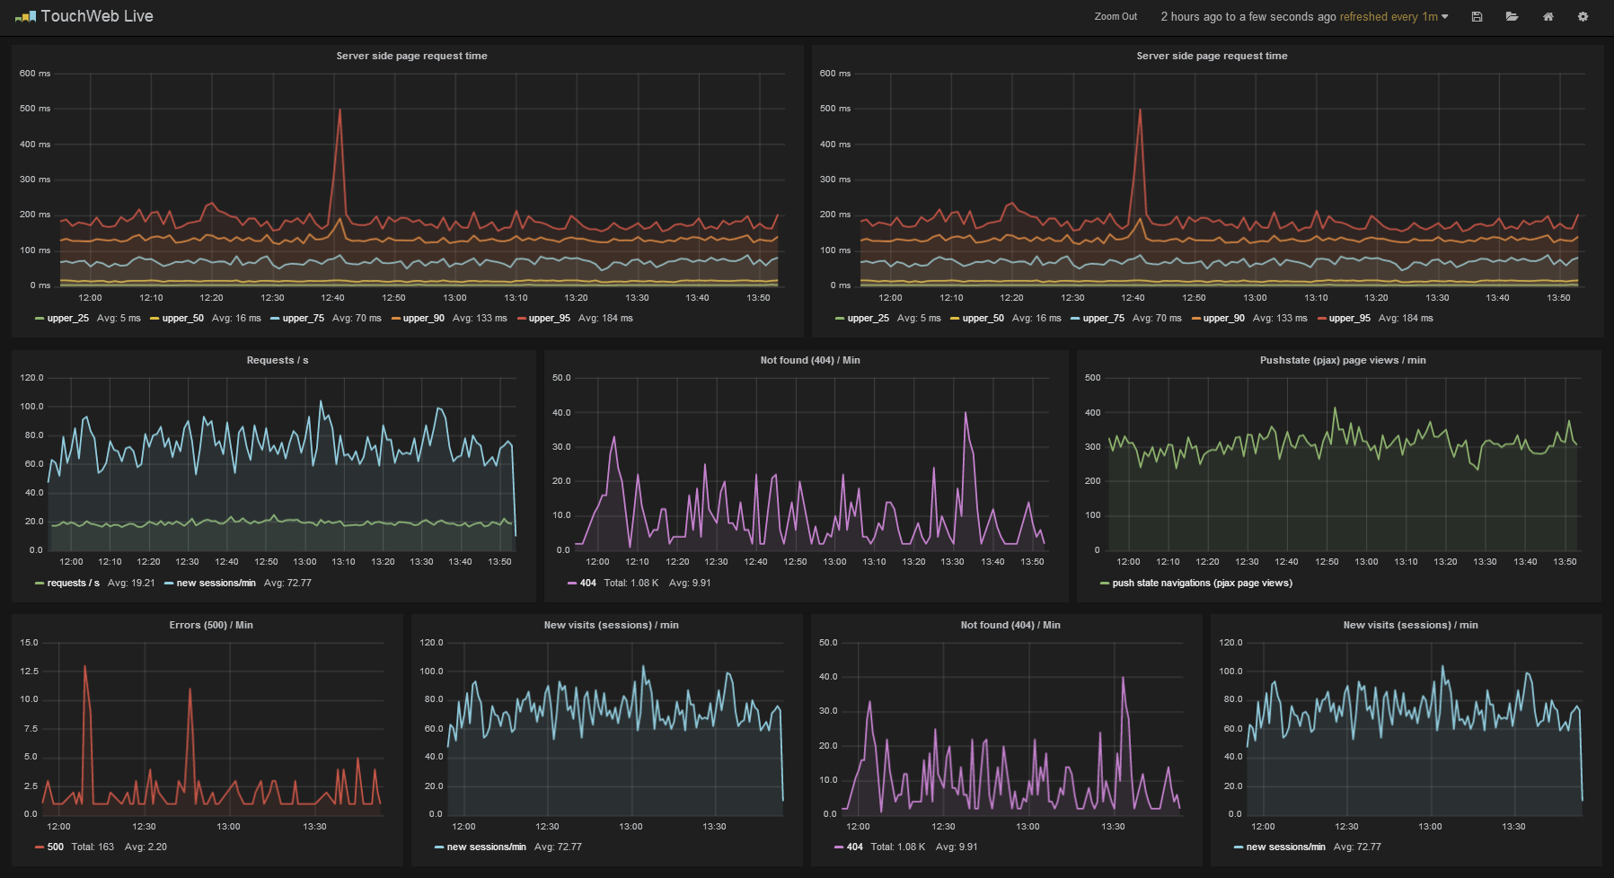
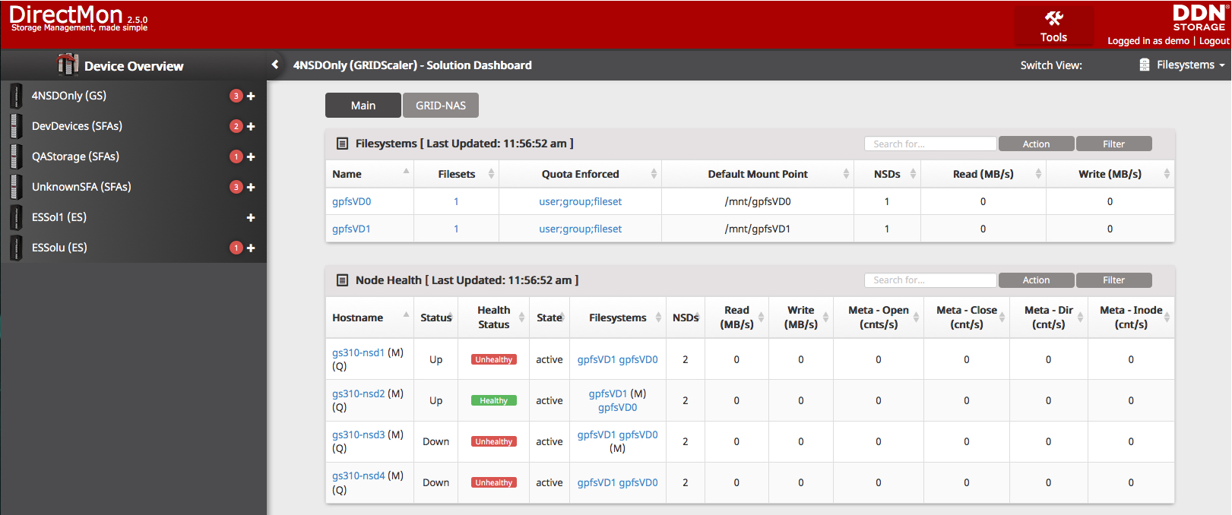
Standalone Configuration
ES Nodes
ES Nodes
ES Nodes
System State
& Config Data
ES Nodes
ES Nodes
ES Nodes
ES Nodes
GS Nodes
SFA
Time-Series Metric Stats
Collectd
Plugin
Collectd
Plugin
Collectd
Plugin
Collectd
Plugin
Collectd
Plugin
Collectd
Plugin
Collectd
Plugin
NSQ
Collectd
Plugin
NSQ
Open Source
Components
Network
Discovery & Registration
Collectd
Plugin
Events
APScheduler
Grafana Web
Redis
NSQ
Metric
Stats
System State
& Config Data
DM Admin UI
OpenTSDB | KairosDB
HBase | Cassandra | MapR
data
customer provided shared storage for daily snapshots

Slide 6
2. Components of Lustre monitoring
Data collecter
  Collects statisticsfrom Lustre /proc and sends them to monitoring server over the network.
  Runs on servers as well as client and routers.
Backend Storage
  Receive stats from agents and store them into database.
  It can be historical and query-able data
Frontend
  Collected data is not only visualized, but also analytics.
  Application I/O analytics and

Slide 7
2.1. Flexible data collector (Agent)
A lot of agents existed to collect Lustre performance statistics
Collectd is one of reasonable options
  Actively developed, supported and documented
  Running at many Enterprise/HPC system
  Written in C and over 100 plugins are available.
  Supports many backend database for data store.
  Unfortunately, Lustre plugin is not available, but we made it!
  Publish the lustre-plugin codes? Yes, we want, but there were several discussions at LUG15. (e.g. stats in /proc or /sys in the future?)

Slide 8
2.1. Architecture of Collectd
plugin List
write queue
global cache
cpu plugin
CollectD demon
...
..
disk plugin
lustre plugin
write_http plugin
Read callback
chain plugin
rrdtool plugin
csv plugin
DB

Slide 9
2.2. Scalable backend data store
RDD and SQL based data store dose not scale
  RDD works well on small system, writing 10M statics into files are very challenging (few million IOPS!)
  SQL is faster than RDD, but still hit next level scalability. And it’s complex to make database deign.
NoSQL based key-value store shines
  OpenTSDB/Hbase. KairosDB/Cassandra
  key, value and tags are easy adaption for Lustre statics data store. No need complex database schema.
  Need to be aware of managing for statics data archiving. (retention)

Slide 10
2.2.1 OpenTSDB/KairosDB
Open Source Time Series Database
  OpenTSDB is distributed model (multiple TSDs). It runs on top of HBase.
  It’s scaling very well and depends on Hadoop cluster.
  Trillion data point store is easily possible.
Many Ingest and Query options are available
  A lot of open source based agent available. (collectd has OpenTSDB plugin)
  GUI (part of OpenTSDB) or other open source visualization tool (Grafana)
  CLI, HTTP API

Slide 11
Scaling up the Database-Tier minimal requirements
OpenTSDB/HBase:
HBase Master
HBase Standby
ZooKeeper
ZooKeeper
OpenTSDB
OpenTSDB
OpenTSDB
Quorum Journal Mgr.
Quorum Journal Mgr.
HBase Region Server
HBase Region Server
HBase Region Server
Name Node primary
Job Tracker/Node
Resource_Mgr active
Name Node secondary
Job Tracker/Node
Resource_Mgr standby
Data Node #1
Task Tracker/Node
Manager
Data Node #2
Task Tracker/Node
Manager
Data Node #3
Task Tracker/Node
Manager
minimal two name-nodes
minimal three data-nodes
KairoDB/Cassandra:
KairosDB
KairosDB
built-in replication
Cassandra can be grown horizontally from 1 to 2, 3,4,5… nodes
Cassandra daemon
Cassandra daemon
minimal two nodes
(Active-Active)

Slide 12
2.2.3 Loadbalance on DB Cluster
host1
host2
collectd1
collectd2
Chain plugin
Chain plugin
failover DB2
failover DB1
DB1
DB2
Replicated

Slide 13
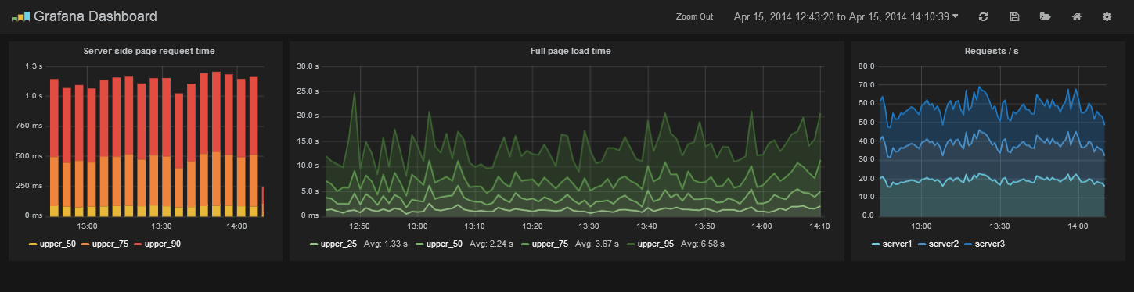
2.3 Frontend
Grafana
Grafana is an open source, feature rich metrics dashboard and graph editor for Graphite, Elasticsearch, OpenTSDB, Prometheus and InfluxDB.

Slide 14
3. A deign of lustre-plugin in collectd
A framework consists of two core components
  Core logic layer (Lustre plugin)
  Statistics definition layer(XML file and XML parser)
Defined XML for Lustre /proc information
  A single XML file for all definitions of Lustre data collection
  No need to maintain massive error-prone scripts.
  Extendable without core logic layer change.
  Easy to support multiple Lustre version and Lustre distributions in the same cluster.

Slide 15
Architecture of lustre-plugin and configuration
CPU
Memory
Network
Existing Collectd standard plugin.
Lustre
1.8
Lustre
2.1
DDN Lustre
2.5
GPFS
StorageH/W
XML
XML
XML
XML
XML
collectd
collectd
collectd
collectd
collectd
...
OpenTSDB/KairosDB
OpenTSDB/KairosDB
OpenTSDB/KairosDB
Hbase/Cassandra

Slide 16
Adaption of Lustre stats into TimeSeries
Major 3 times on TimeSeries database for Lustre stats
  Metrics
    Defined each metric with each Lustre’s proc entry
    e.g.) /proc/fs/lustre/obdfilter/*/stats
  Tags
    Items in each proc entry
    Additional items
      FS name, NID, custom unique ID
  Data Points
    Timestamp and value
    fs_name=lustre1 optype=write ost_index=0

Slide 17
An demonstration of 1.7 Trillion data point store in 24 hours
Developed “Stress” plugin for collectd
  Generating “dummy” stats with collectd
  For regression tests and benchmark tool of Lustre monitoring.
  It works conjunctions with other collectd plugins.
Stress test on Lustre-plugin and OpenTSDB
  Setup two nodes hadoop/hbase cluster and OpenTSDB runs top of it.
  16 metrics generators(servers). Total 20M stats generated every second and send two OpenTSDB servers.
  Passed 24 hours stress test and stored 1.7 Trillion stats without any problems.

Slide 18
3. Application aware I/O monitoring
Scalable backend data store
  Now, we have scalable backend data store OpenTSDB.
  Store any type of mercies whatever we want to collect.
Lustre Job stats is awesome, but need to be integration.
  Lustre JOB stats feature is useful, but administrator is not interested in I/O stats just only based on JOBID. (Array jobs. Job associates with another jobs, e.g. Genmic pipeline)
  Lustre performance stats should be associated with all JOBID/GID/UID/NID or custom any IDs.

Slide 19
3.1 Monitor Usage and IO performace
Inodes total, free?
OST space usaed and how fast it grow?
What is MDS IOPS?
What is Filesystem throughout? per OSS/OST?

Slide 20
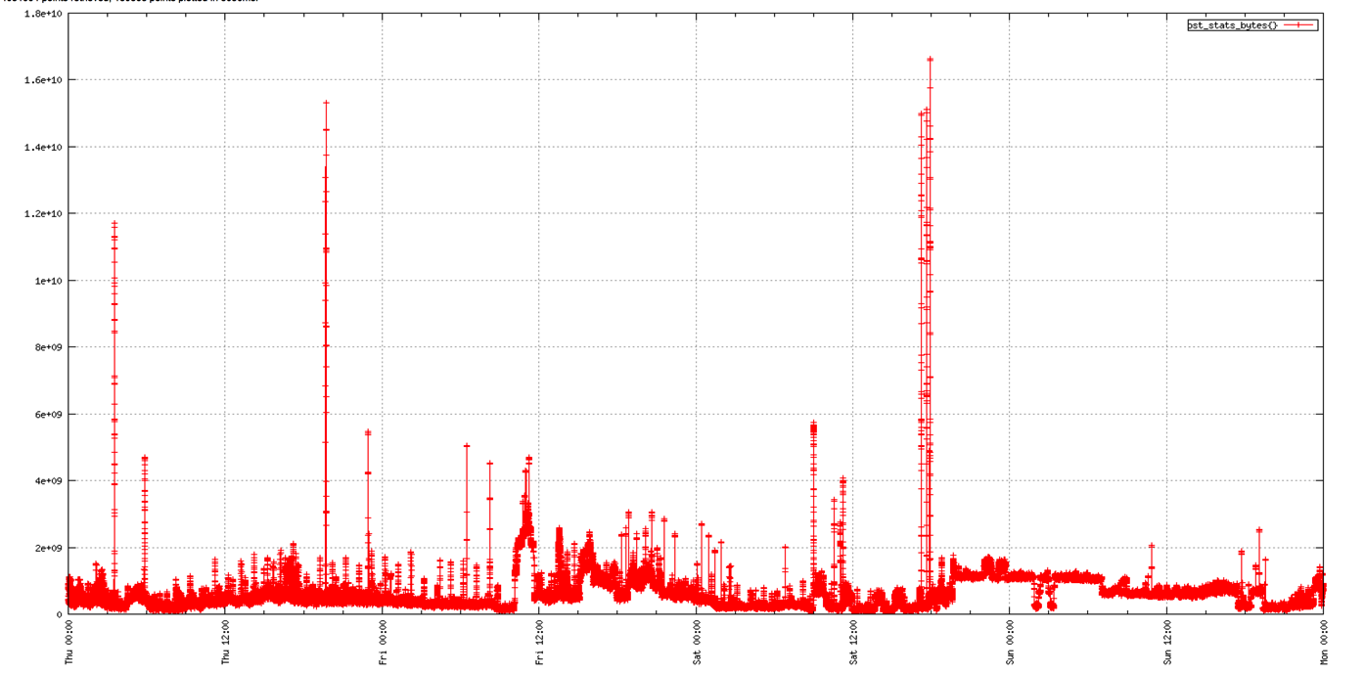
3.2. What Jobs Caused burst I/O?
What happened here?
Who(Users or Group) or What jobs caused burst I/O?
If it’s not single job and single user. What is top10 user/group and job of active Lustre I/O?

Slide 21
3.3. TopN Query with OpenTSDB
Implemented TopN Query based on OpenTSDB
# topn -m mdt_jobstats_samples -r 1434973270 -s -t slurm_job_uid
Time(ms): 2015-06-22 20:41:25.000000 Interval: 5(s)
rate | fs_name | mdt_index | slurm_job_uid | fqdn | slurm_job_id | slurm_job_gid |
15264.00 | scratch1 | MDT0000 | 1044 | mds06 | 13290 | 1044 |
15076.80 | scratch1 | MDT0000 | 1045 | mds06 | 13286 | 1045 |
13812.40 | scratch1 | MDT0000 | 1049 | mds06 | - | 1049 |
13456.80 | scratch1 | MDT0000 | 1048 | mds06 | - | 1048 |
9180.80 | scratch1 | MDT0000 | 1050 | mds06 | 13285 | 1050 |
8909.40 | scratch1 | MDT0000 | 1047 | mds06 | 13289 | 1047 |
8779.60 | scratch1 | MDT0000 | 502 | mds06 | - | 503 |
5049.00 | scratch1 | MDT0000 | 501 | mds06 | 13291 | 502 |
Not only monitoring, but also it’s diagnostic tool!
  You can issue query on live and specific time period. (Rewind feature)
  Lustre job stats associated with not only single ID, but all UID/GID/JOBID/NID (or custom ID) into OpenTSDB.

Slide 22
4.1 Iflyteck(KairosDB)
1PB Lustre Filesystem(2 OSS, 1MDS, 1MGS)
They are using Lustre very heavy, and need monitor IO throughout, CPU, Memory usage for Servers

Slide 23
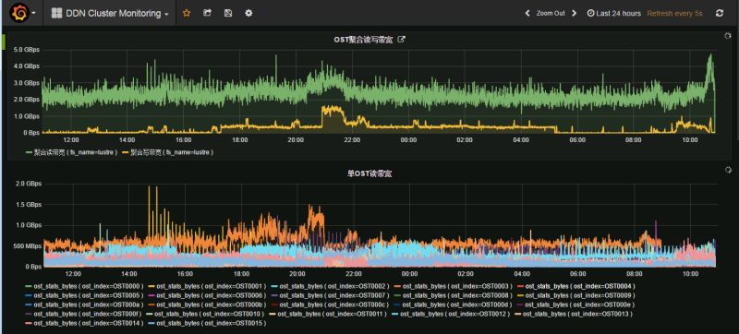
Examples
DDN monitoring in Iflytech(1)

Slide 24
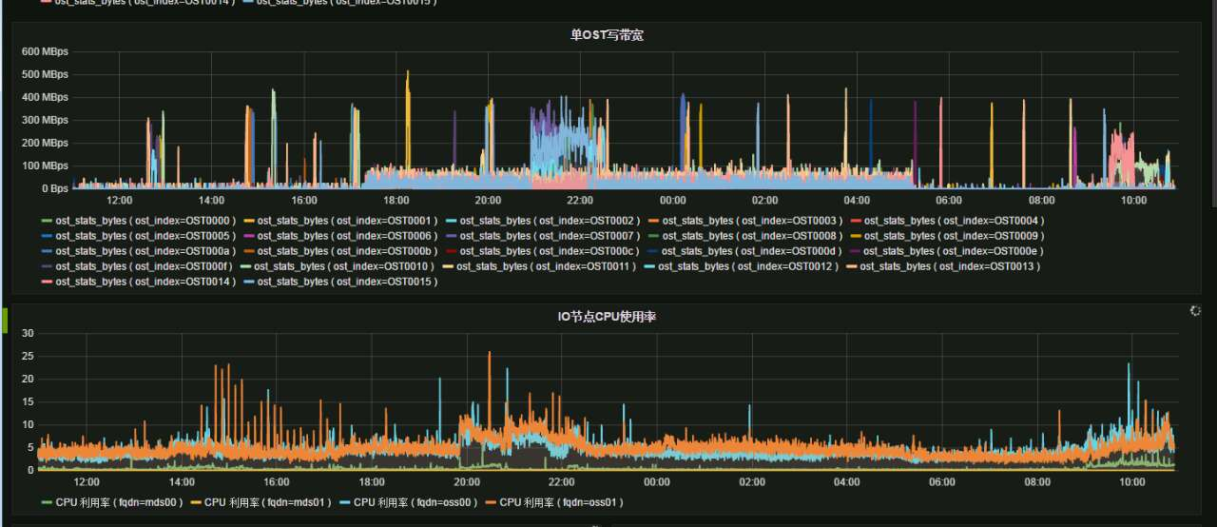
Examples
DDN monitoring in Iflytech(2)

Slide 25
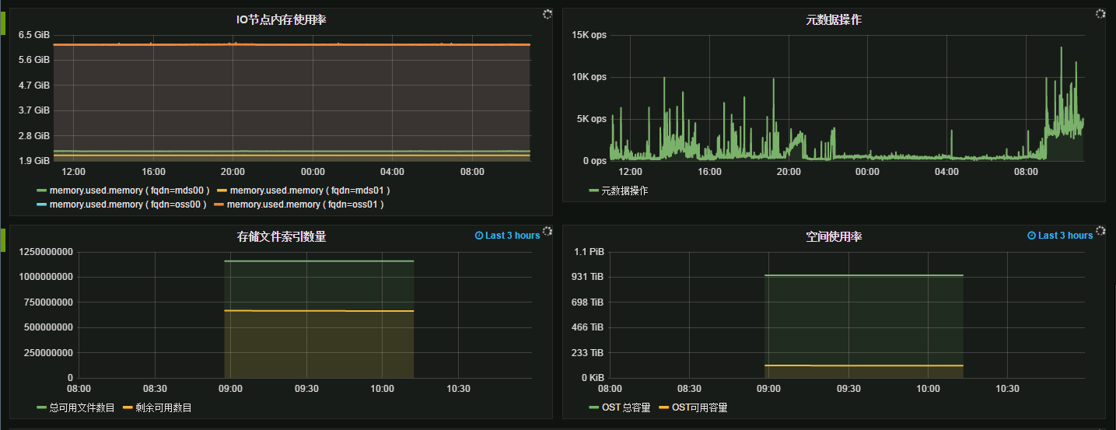
Examples
DDN monitoring in Iflytech(3)

Slide 26

4.2 Tokyo Institute of Technology
More than 1.2M stats into single monitoring server every 30 sec
  16 Lustre servers, 120 OSTs for 3 lustre filesystems
  1700 clients mount all 3 filesystems
  Lustre-2.1 is running. No jobstats! But collecting client based stats from “export” directory in /proc on Lusre servers.
    (Total stats = #OST * #Client * #metrics)
  Demonstrated more than half Trillion stats stored into opentsdb for 6 months.

Slide 27

4.3
OIST(Okinawa Institute of Science and Technology Graduate University)
3PB Lustre filesystem (12 x OSS, 400 x client)
Lustre jobstats integrated with SLRUM and running on the production system
  Unique Lustre Jobstats configuration with Collectd Lustre plugin and runs on existing on Jobstats framework.
  Collect jobs stats associated with all UID/GID/JOBID and store them into OpenTSDB.
  It helps to find a root cause so quickly when unexpected burst I/O happen. Who and what jobs caused problem.

Slide 28
Conclusions
Developed new lustre plugin of collected. It’s flexible, extendable and easy maintainable.
Deigned a Lustre monitoring framework based on lustre-plugin and OpenTSDB. The framework is running on several production systems to solve today’s lustre monitoring limitation.
Demonstrated 1.7 Trillion data store into OpenTSDB in 24 hours. We will continue scalable testing for multi-Trillion data store in few hours.
Started data analysis

Slide 29

Thank you!

