Slide 1
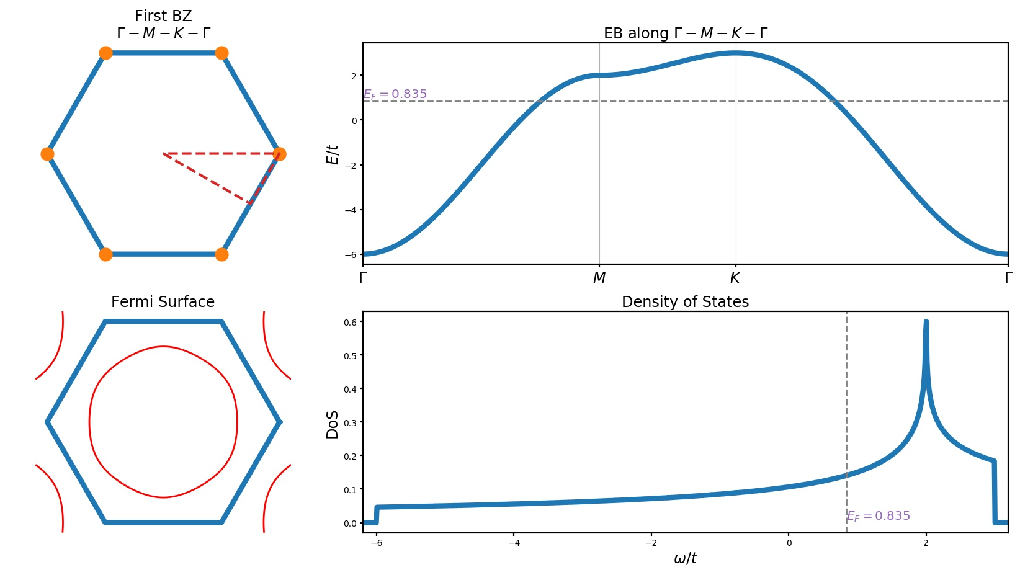
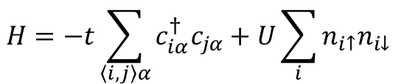
$$H=−t\sum_{\left\langle i,j\right\rangle α}{c_{iα}^{†}c_{jα}}+U\sum_{i}{n_{i↑}n_{i↓}}$$
Simple tight-binding model on triangular lattice

Slide 2
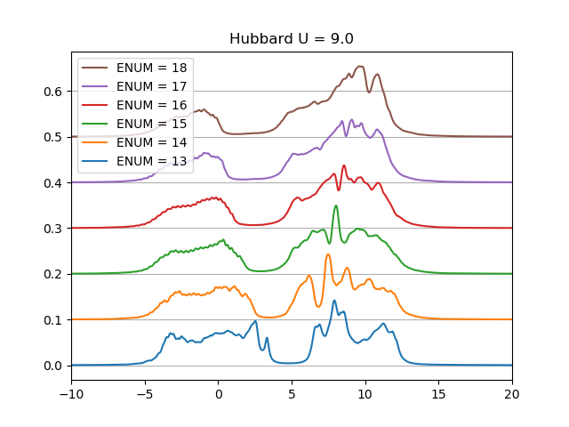

Slide 3
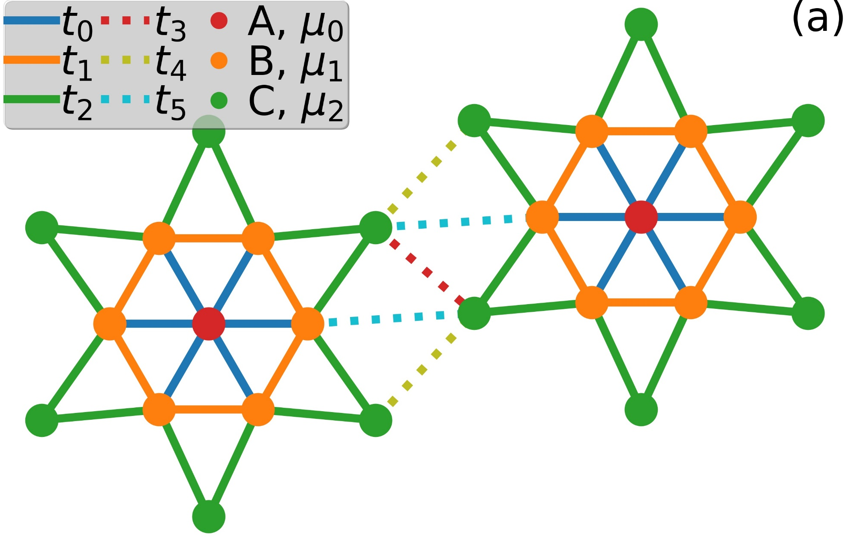
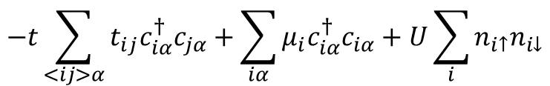
$$−t\sum_{<ij>α}{t_{ij}c_{iα}^{†}c_{jα}}+\sum_{iα}{μ_{i}c_{iα}^{†}c_{iα}}+U\sum_{i}{n_{i↑}n_{i↓}}$$
Star-of-David tight-binding model

Slide 4
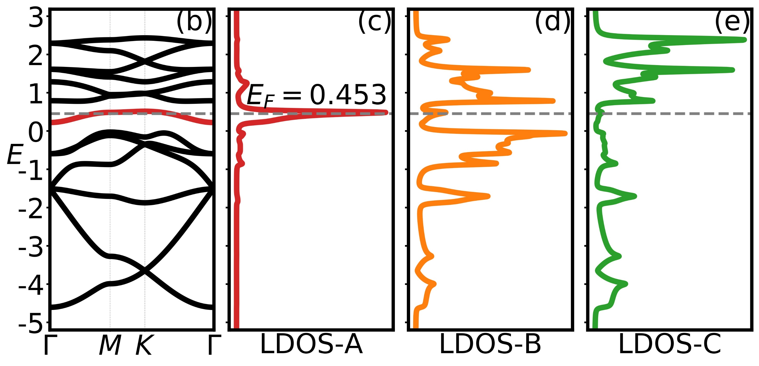

$$μ_{0}=0.4,μ_{1}=−0.2,μ_{2}=0.1$$
$$\left\langle n_{a}\right\rangle =1.00,\left\langle n_{b}\right\rangle =1.24,\left\langle n_{c}\right\rangle =0.76$$
$$t_{0}=−0.2,t_{1}=−0.2,t_{2}=−0.8,t_{3}=−1.0,t_{4}=−1.0,t_{5}=−1.0$$

Slide 5
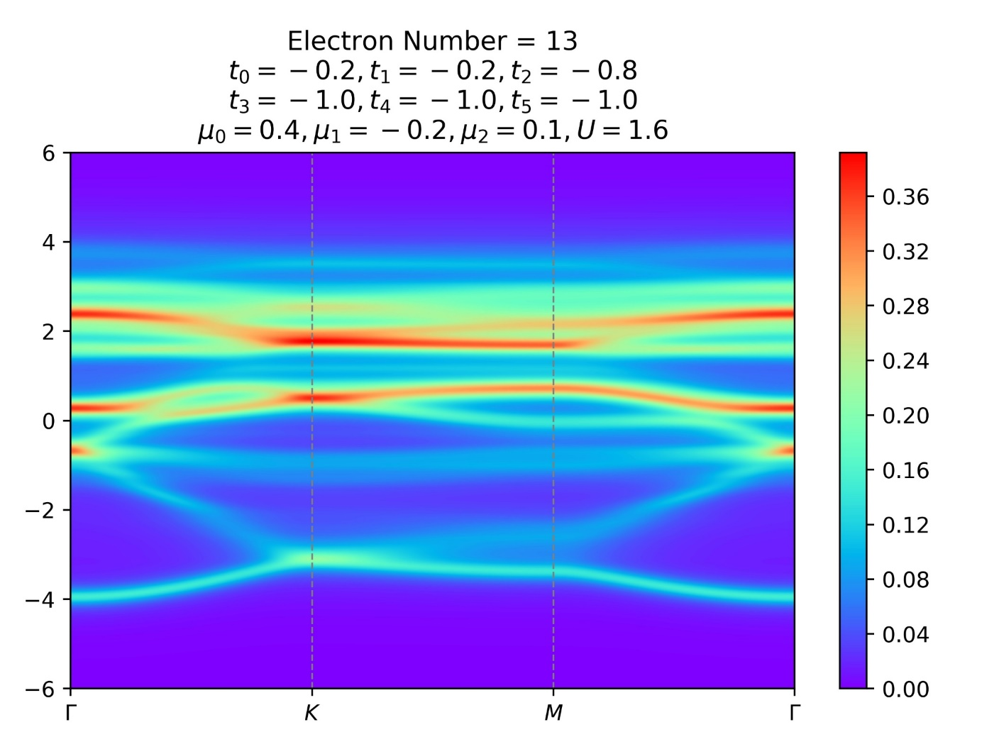


Slide 6
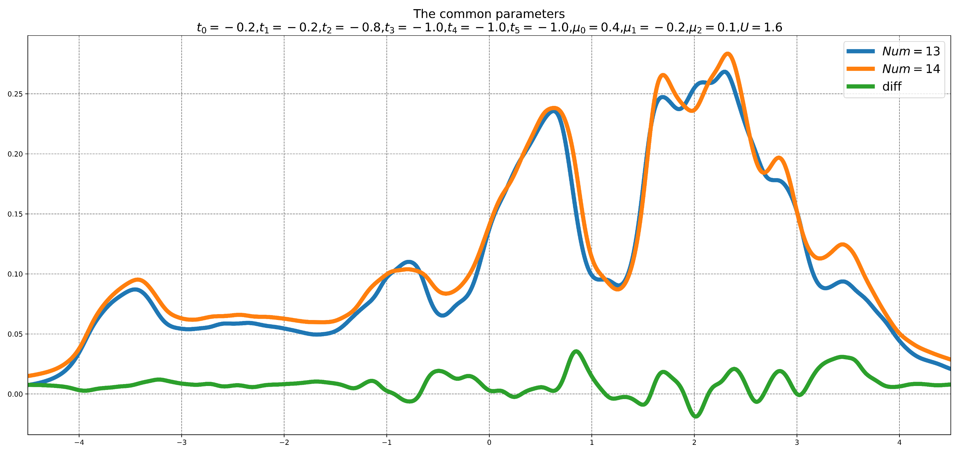

Slide 7
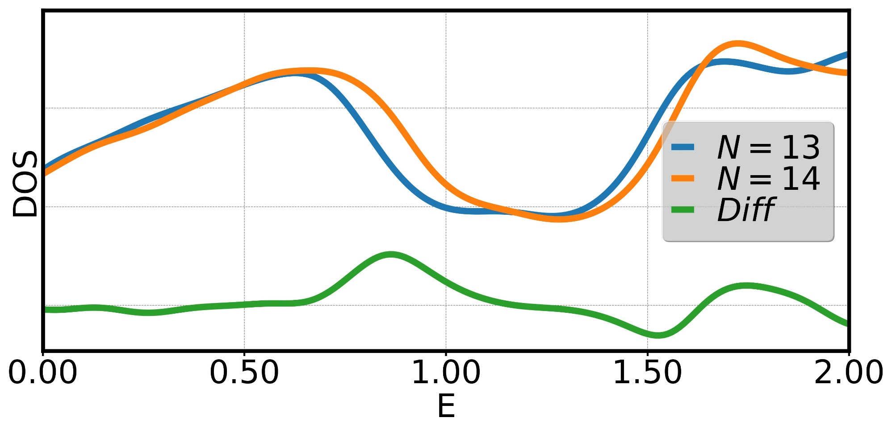

Slide 8
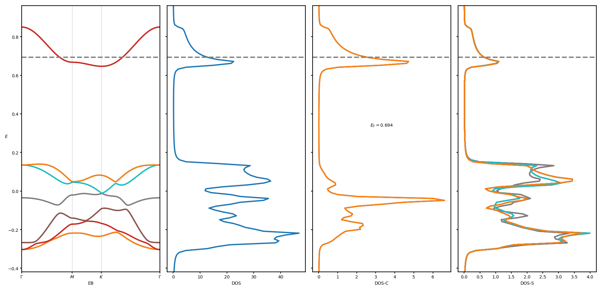
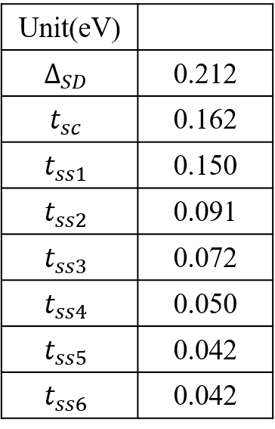

Seven-Orbits Model
$$H=Δ_{SD}\sum_{I}{c_{I}^{†}c_{I}}+t_{sc}\sum_{Iα}{(c_{I}^{†}s_{Iα}+H.c.)}+\sum_{⟨Iα,Jβ⟩}{t_{ss}^{Iα,Jβ}s_{Iα}^{†}s_{Jβ}}+U_{c}\sum_{I}{c_{I↑}^{†}c_{I↓}^{†}c_{I↓}c_{I↑}}$$
$$\left\langle n_{c}\right\rangle =1.66$$
$$\left\langle n_{s}\right\rangle =1.89$$

Slide 9
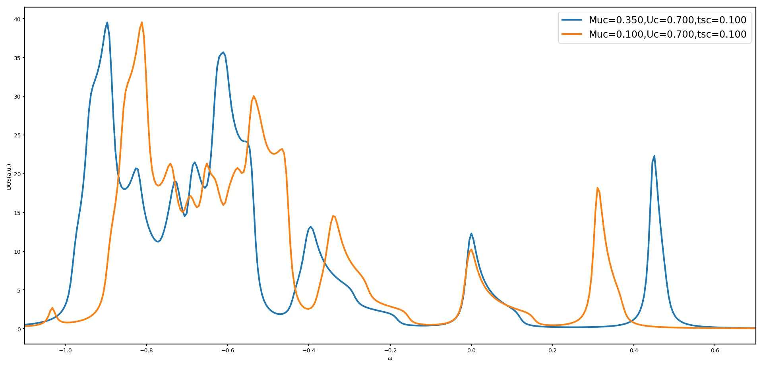

Slide 10
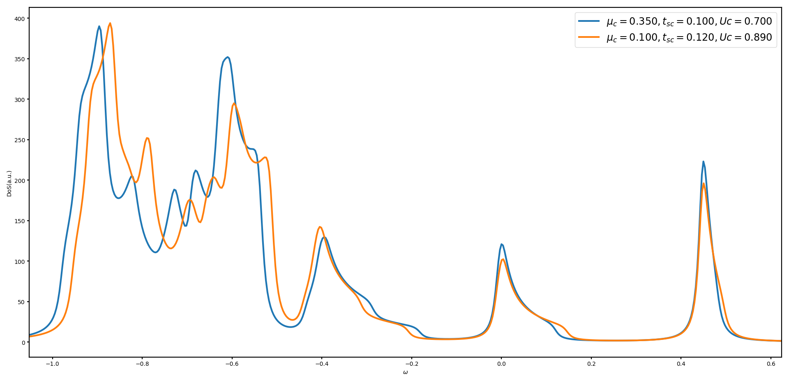

Slide 11
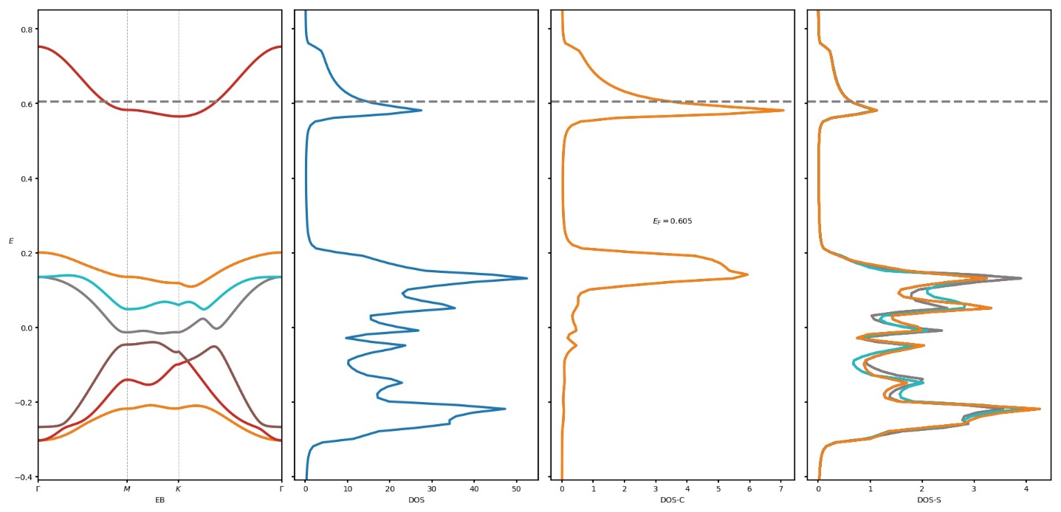
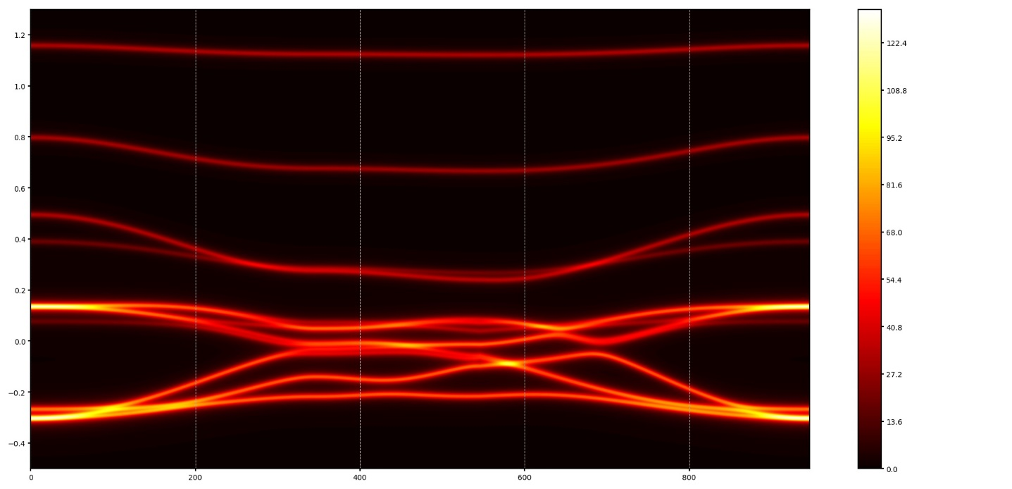
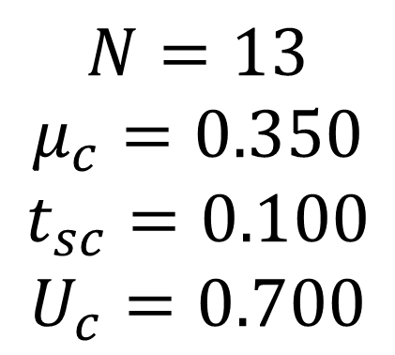
$$N=13$$
$$μ_{c}=0.350$$
$$t_{sc}=0.100$$
$$U_{c}=0.700$$

Slide 12
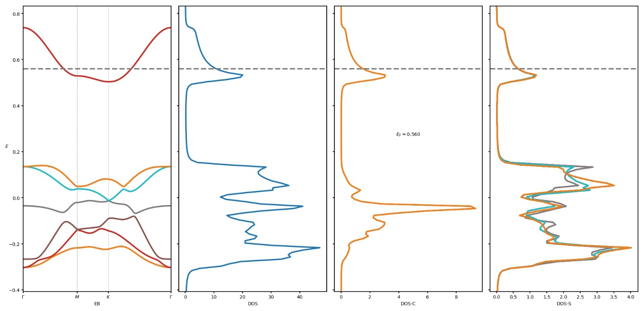
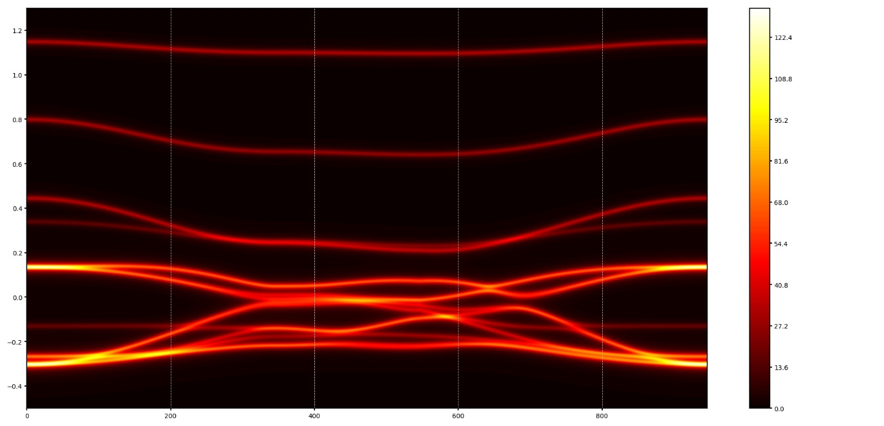
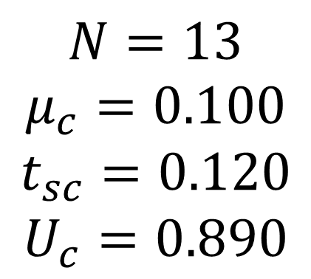
$$N=13$$
$$μ_{c}=0.100$$
$$t_{sc}=0.120$$
$$U_{c}=0.890$$

Slide 13
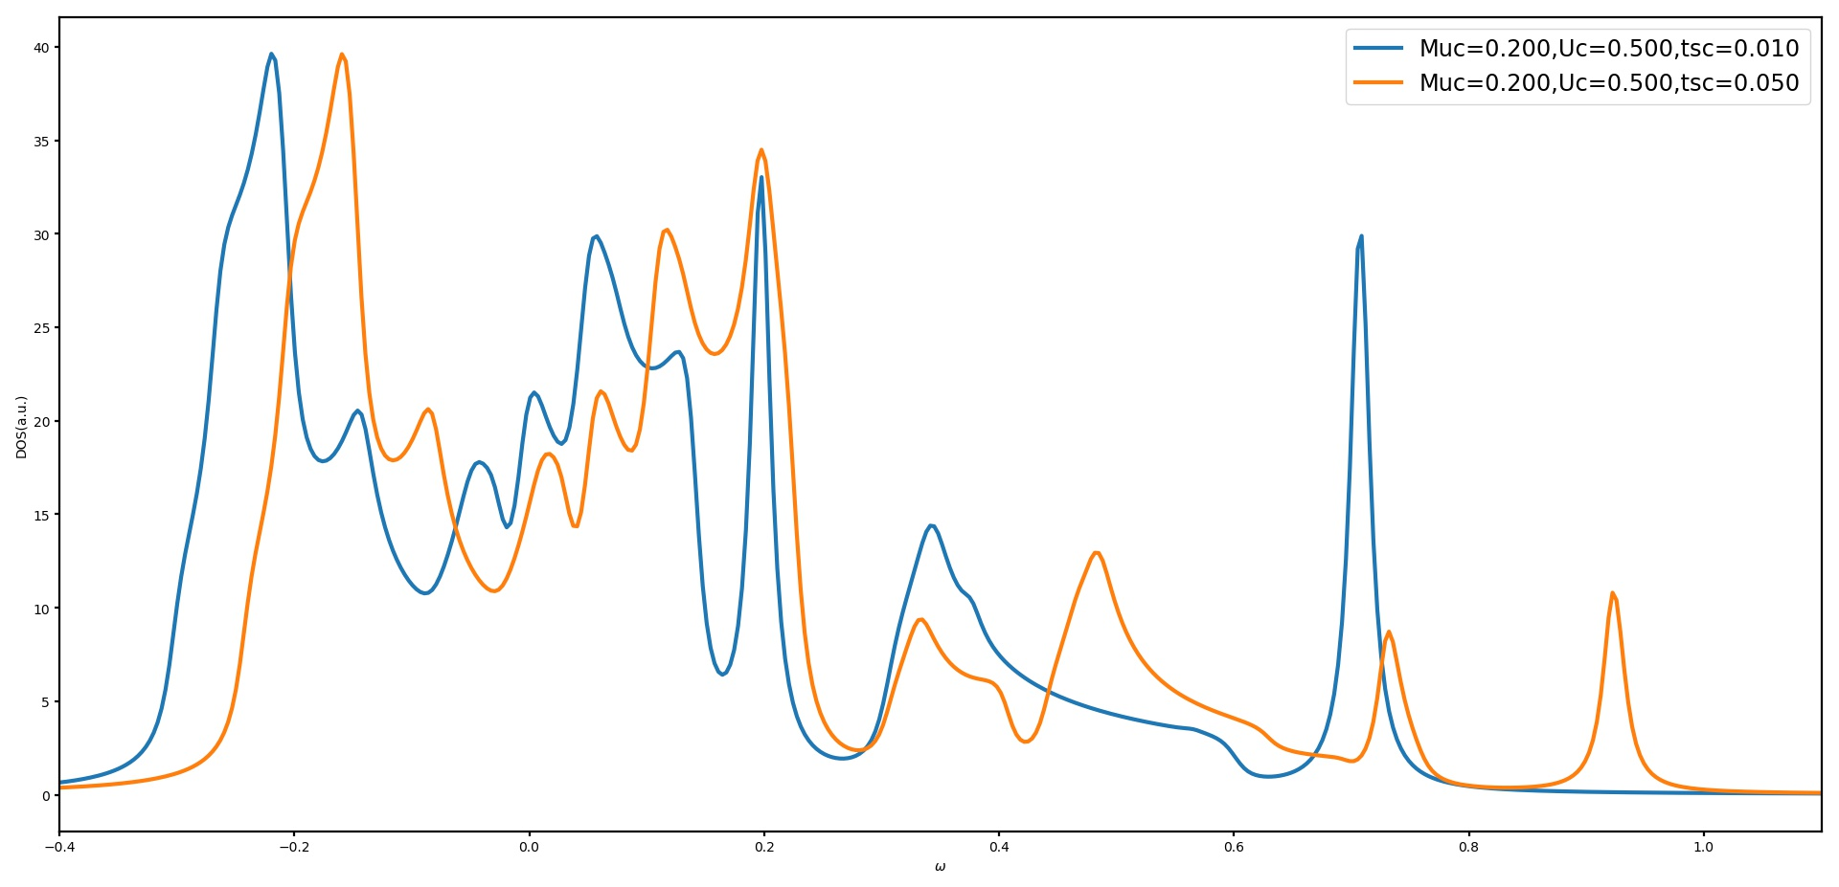

Slide 14
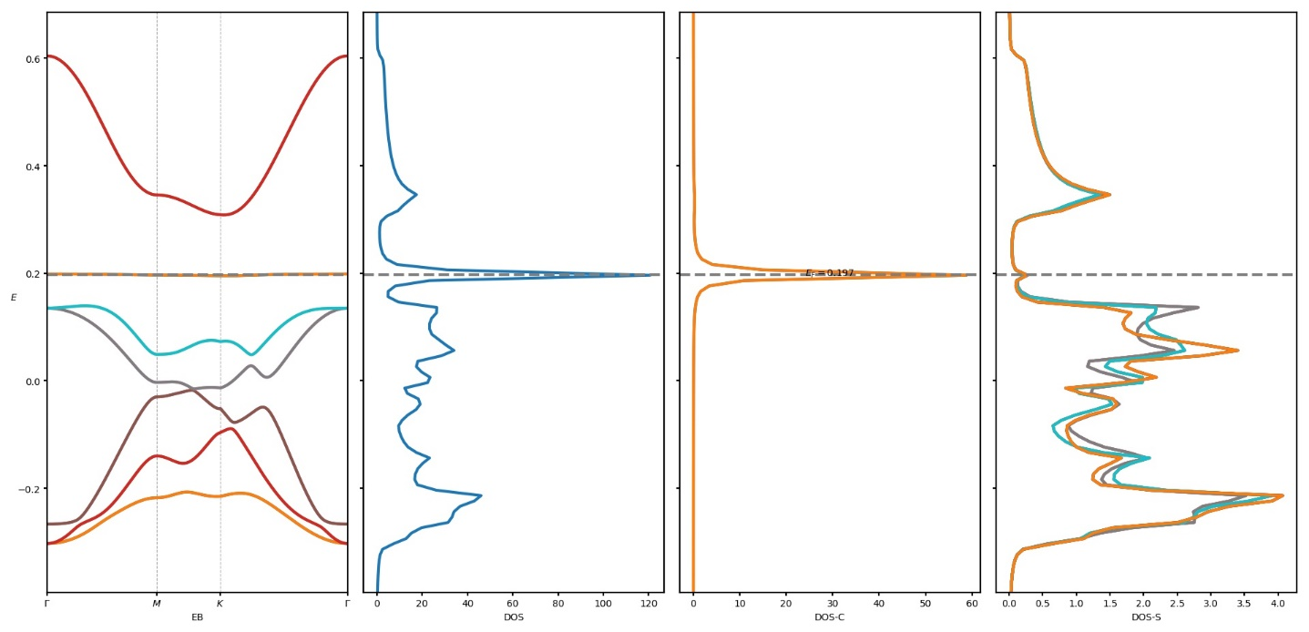
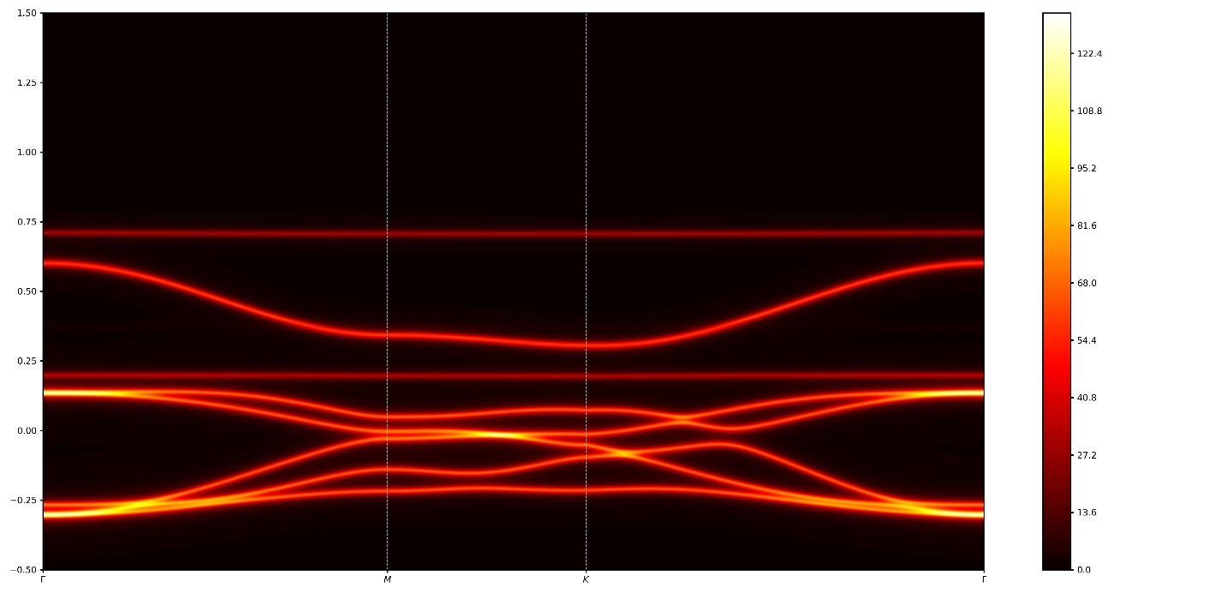
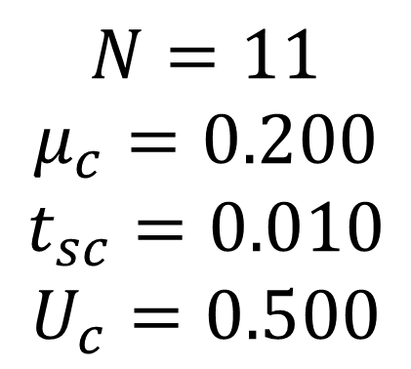
$$N=11$$
$$μ_{c}=0.200$$
$$t_{sc}=0.010$$
$$U_{c}=0.500$$

Slide 15
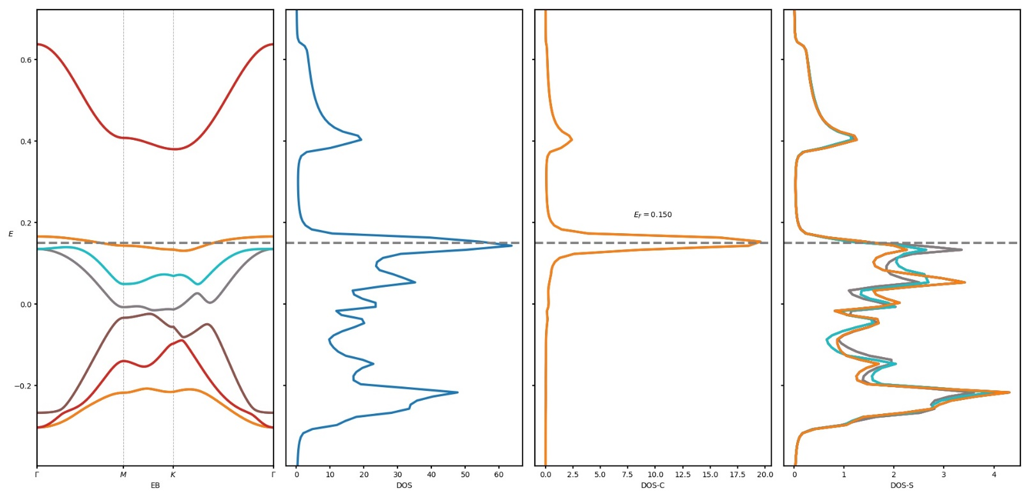

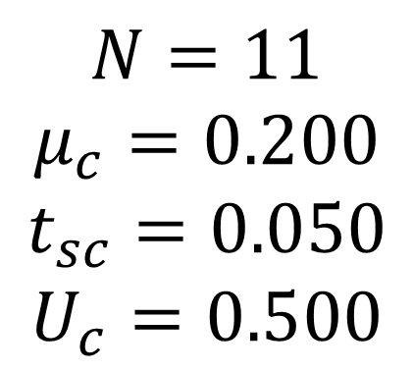
$$N=11$$
$$μ_{c}=0.200$$
$$t_{sc}=0.050$$
$$U_{c}=0.500$$

