Slide 1
Exact Diagonalization(ED) Based Studies of Quantum Spin Model
汪 士
2019年6月26日

Slide 2
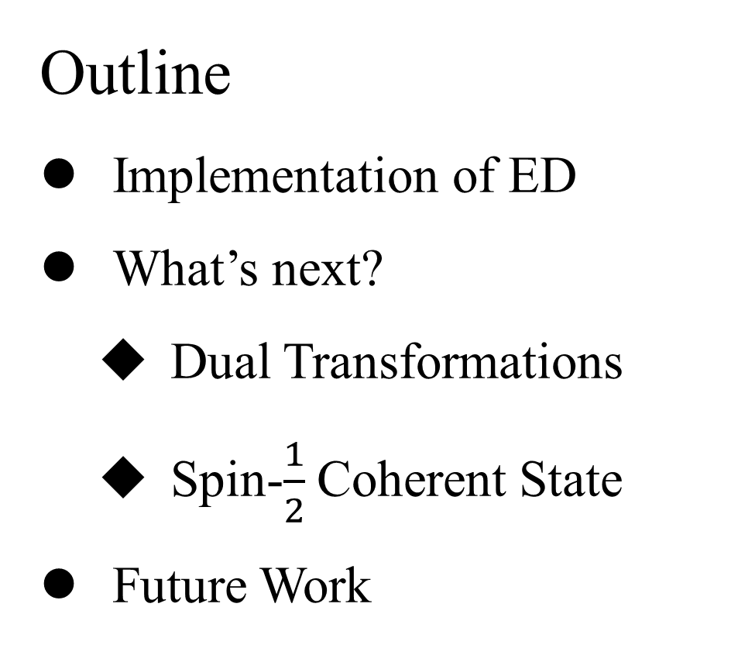
Outline
Implementation of ED
What’s next?
Dual Transformations
Spin-$\frac{1}{2}$ Coherent State
Future Work

Slide 3
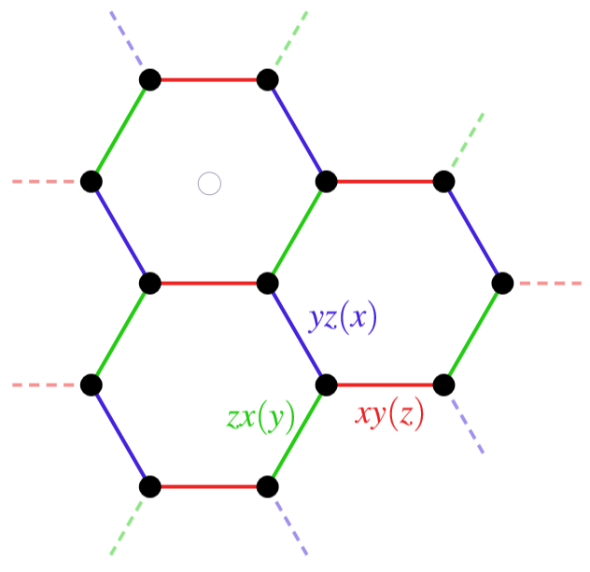
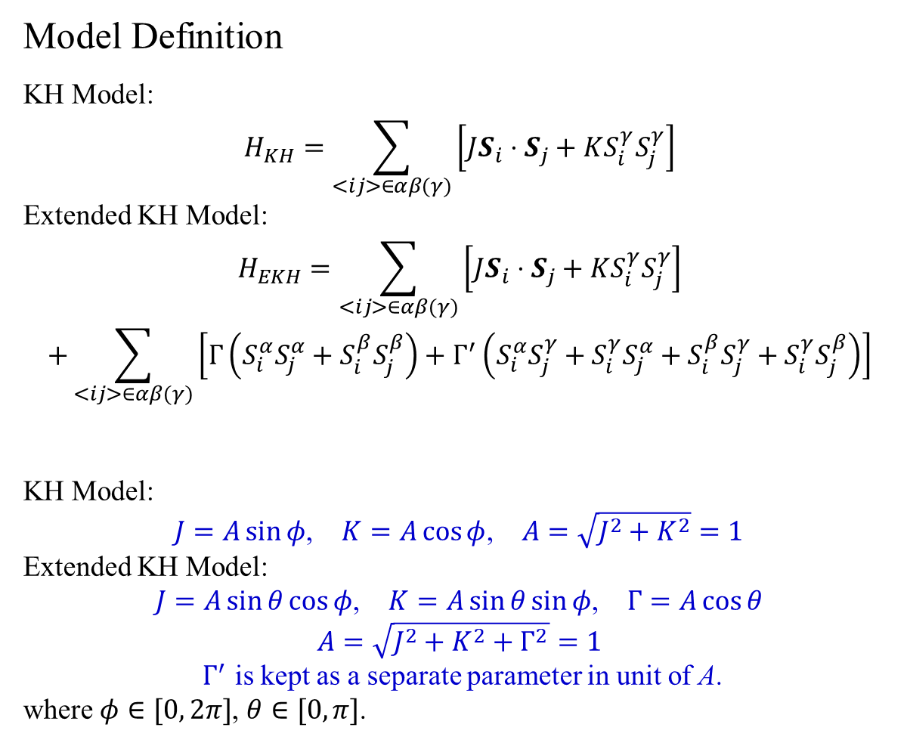
Model Definition
KH Model:
$$H_{KH}=\sum_{<ij>∈αβ(γ)}{\left[JS_{i}⋅S_{j}+KS_{i}^{γ}S_{j}^{γ}\right]}$$
Extended KH Model:
$$H_{EKH}=\sum_{<ij>∈αβ(γ)}{\left[JS_{i}⋅S_{j}+KS_{i}^{γ}S_{j}^{γ}\right]}$$
$$+\sum_{<ij>∈αβ(γ)}{\left[Γ\left(S_{i}^{α}S_{j}^{α}+S_{i}^{β}S_{j}^{β}\right)+Γ^{′}\left(S_{i}^{α}S_{j}^{γ}+S_{i}^{γ}S_{j}^{α}+S_{i}^{β}S_{j}^{γ}+S_{i}^{γ}S_{j}^{β}\right)\right]}$$
KH Model:
$J=A\sin{φ}$, $K=A\cos{φ}$, $A=\sqrt{J^{2}+K^{2}}=1$
Extended KH Model:
$J=A\sin{θ}\cos{φ}$, $K=A\sin{θ}\sin{φ}$, $Γ=A\cos{θ}$
$$A=\sqrt{J^{2}+K^{2}+Γ^{2}}=1$$
$Γ^{′}$ is kept as a separate parameter in unit of A.
where $φ∈[0, 2π]$, $θ∈[0, π]$.

Slide 4
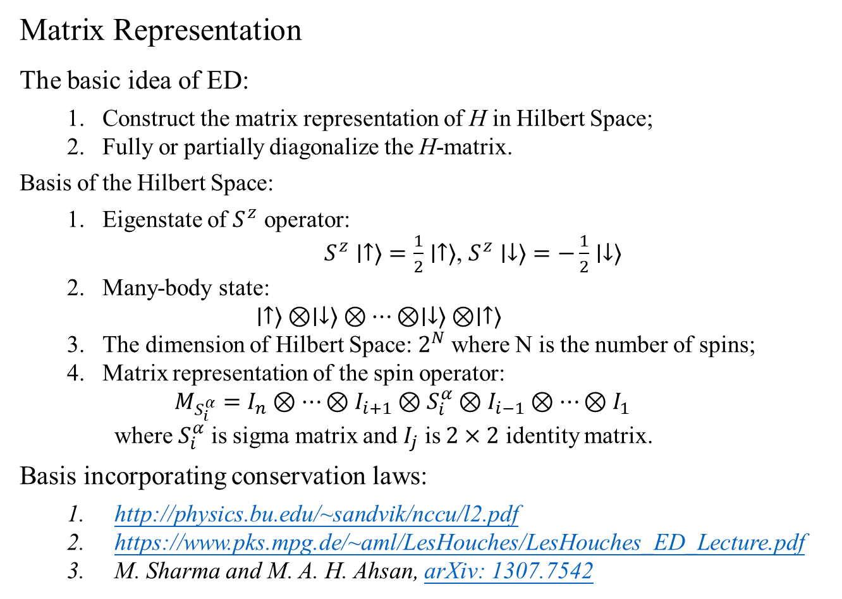
Matrix Representation
The basic idea of ED:
Construct the matrix representation of H in Hilbert Space;
Fully or partially diagonalize the H-matrix.
Basis of the Hilbert Space:
Eigenstate of $S^{z}$ operator:
$S^{z}∣↑⟩=\frac{1}{2}∣↑⟩$, $S^{z}∣↓⟩=−\frac{1}{2}∣↓⟩$
Many-body state:
$$∣↑⟩⊗∣↓⟩⊗⋯⊗∣↓⟩⊗∣↑⟩$$
The dimension of Hilbert Space: $2^{N}$ where N is the number of spins;
Matrix representation of the spin operator:
$$M_{S_{i}^{α}}=I_{n}⊗⋯⊗I_{i+1}⊗S_{i}^{α}⊗I_{i−1}⊗⋯⊗I_{1}$$
where $S_{i}^{α}$ is sigma matrix and $I_{j}$ is $2×2$ identity matrix.
Basis incorporating conservation laws:
http://physics.bu.edu/~sandvik/nccu/l2.pdf
https://www.pks.mpg.de/~aml/LesHouches/LesHouches_ED_Lecture.pdf
M. Sharma and M. A. H. Ahsan, arXiv: 1307.7542

Slide 5
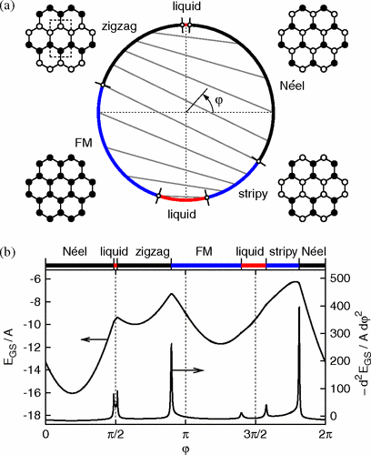
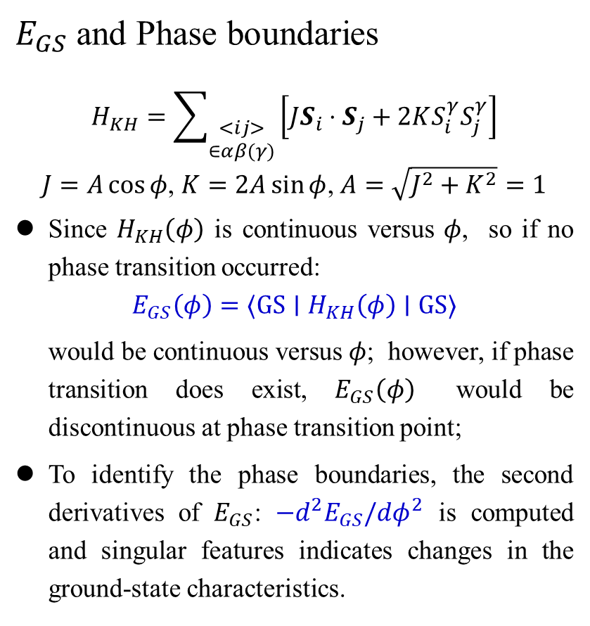
$E_{GS}$ and Phase boundaries
$$H_{KH}=\sum_{\begin{aligned}<ij> \\ ∈αβ(γ)\end{aligned}}{\left[JS_{i}⋅S_{j}+2KS_{i}^{γ}S_{j}^{γ}\right]}$$
$J=A\cos{φ}$, $K=2A\sin{φ}$, $A=\sqrt{J^{2}+K^{2}}=1$
Since $H_{KH}\left(φ\right)$ is continuous versus $φ$, so if no phase transition occurred:
$$E_{GS}\left(φ\right)=⟨GS∣H_{KH}\left(φ\right)∣GS⟩$$
would be continuous versus $φ$; however, if phase transition does exist, $E_{GS}\left(φ\right)$ would be discontinuous at phase transition point;
To identify the phase boundaries, the second derivatives of $E_{GS}$: $−d^{2}E_{GS}/dφ^{2}$ is computed and singular features indicates changes in the ground-state characteristics.
Khaliullin etc., Phys. Rev. Lett. 110, 097204 (2013)

Slide 6
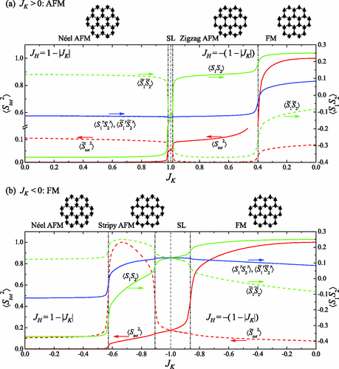
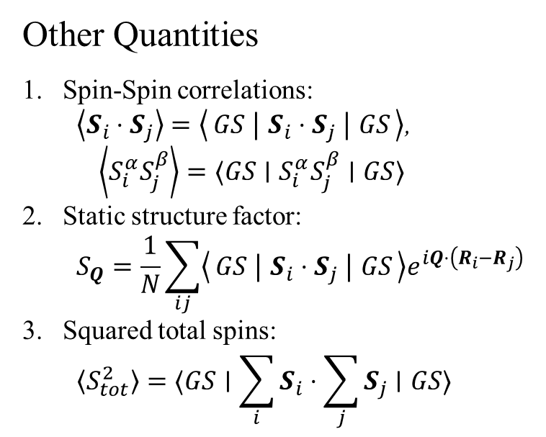
Other Quantities
Spin-Spin correlations:
$\left\langle S_{i}⋅S_{j}\right\rangle =\left\langle GS ∣ S_{i}⋅S_{j} ∣ GS\right\rangle$,
$$\left\langle S_{i}^{α}S_{j}^{β}\right\rangle =⟨GS∣S_{i}^{α}S_{j}^{β}∣GS⟩$$
Static structure factor:
$$S_{Q}=\frac{1}{N}\sum_{ij}{\left\langle GS ∣ S_{i}⋅S_{j} ∣ GS\right\rangle e^{iQ⋅\left(R_{i}−R_{j}\right)}}$$
Squared total spins:
$$\left\langle S_{tot}^{2}\right\rangle =⟨GS∣\sum_{i}{S_{i}}⋅\sum_{j}{S_{j}}∣GS⟩$$
S. Okamoto, Phys. Rev. B 87, 064508 (2013).

Slide 7

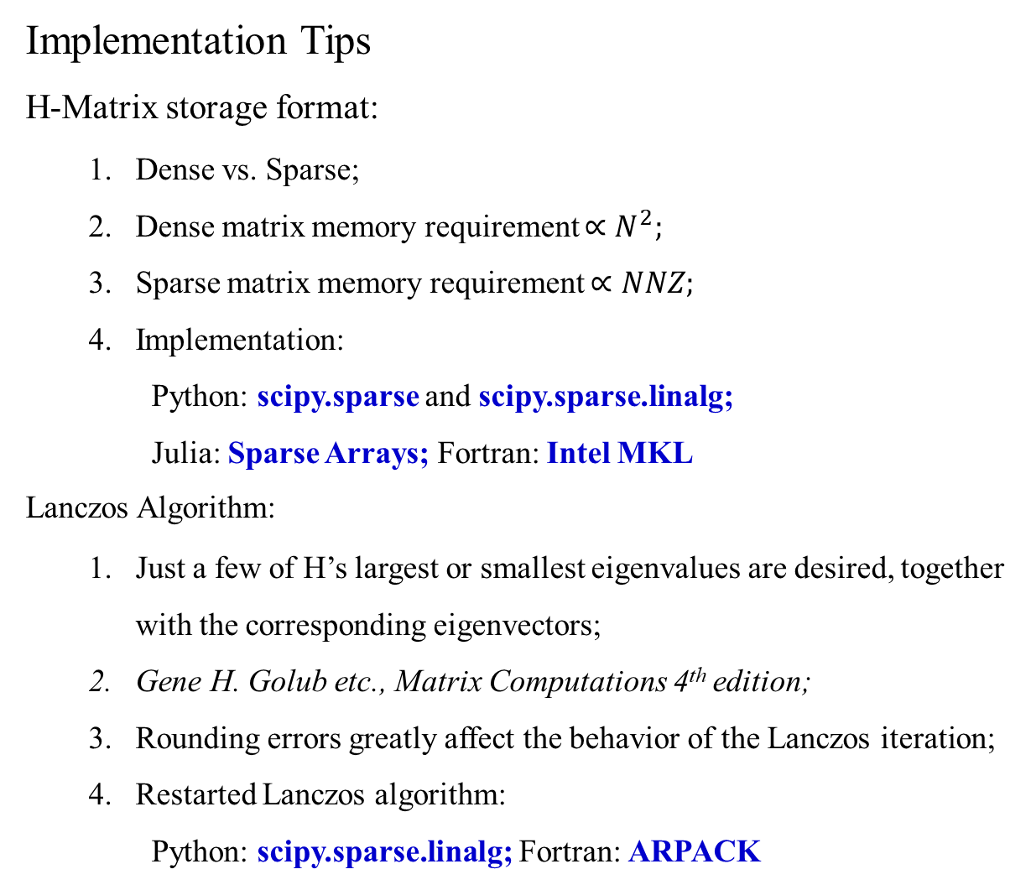
Implementation Tips
H-Matrix storage format:
Dense vs. Sparse;
Dense matrix memory requirement $∝N^{2};$
Sparse matrix memory requirement $∝NNZ;$
Implementation:
Python: scipy.sparse and scipy.sparse.linalg;
Julia: Sparse Arrays; Fortran: Intel MKL
Lanczos Algorithm:
Just a few of H’s largest or smallest eigenvalues are desired, together with the corresponding eigenvectors;
Gene H. Golub etc., Matrix Computations 4th edition;
Rounding errors greatly affect the behavior of the Lanczos iteration;
Restarted Lanczos algorithm:
Python: scipy.sparse.linalg; Fortran: ARPACK
(0, 0), 1
(1, 1), -1
(2, 2), -1
(3, 3), 1
$$S_{0}^{z}S_{1}^{z}=\left[\begin{matrix}\begin{matrix}1 & 0 \\ 0 & −1\end{matrix} & \begin{matrix}0 & 0 \\ 0 & 0\end{matrix} \\ \begin{matrix}0 & 0 \\ 0 & 0\end{matrix} & \begin{matrix}−1 & 0 \\ 0 & 1\end{matrix}\end{matrix}\right]$$

Slide 8
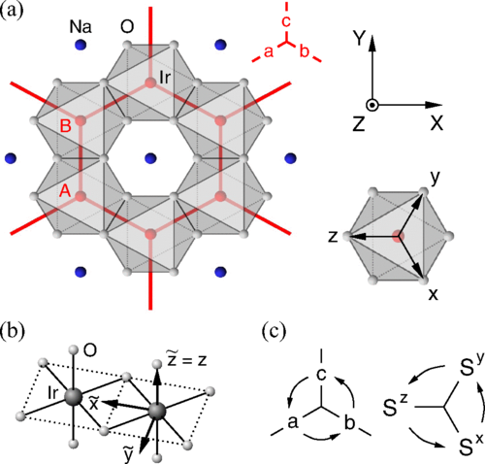
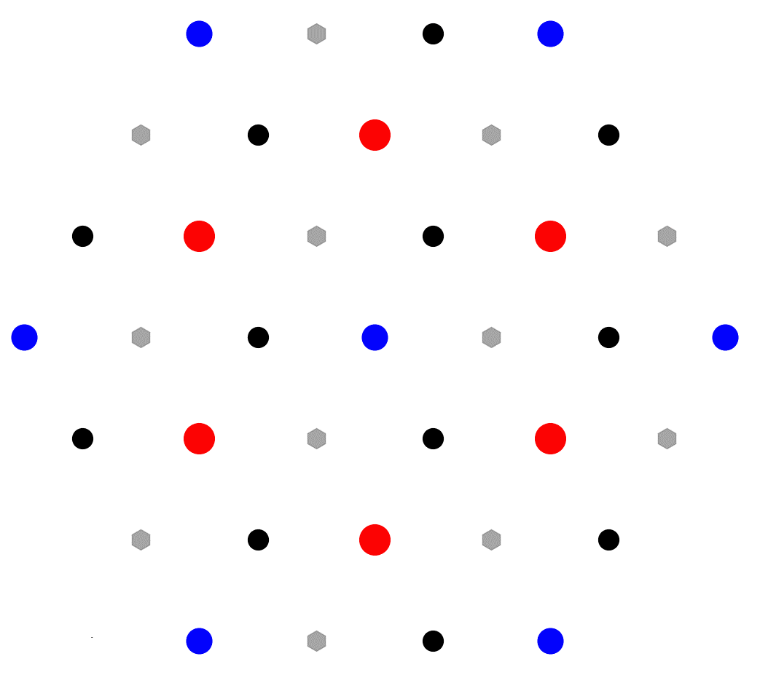
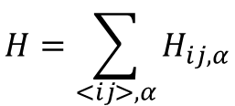
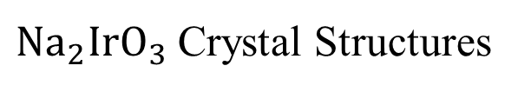
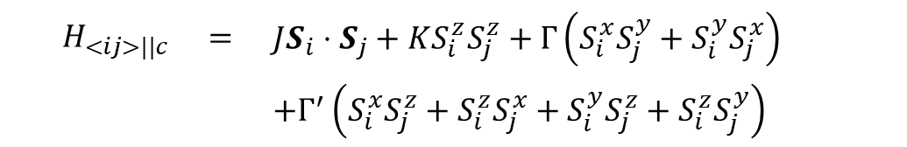
$Na_{2}IrO_{3}$ Crystal Structures
$$H=\sum_{<ij>,α}{H_{ij,α}}$$
$$H_{<ij>||c}$$ | $$=$$ | $$JS_{i}⋅S_{j}+KS_{i}^{z}S_{j}^{z}+Γ\left(S_{i}^{x}S_{j}^{y}+S_{i}^{y}S_{j}^{x}\right)$$
 |  | $$+Γ^{′}\left(S_{i}^{x}S_{j}^{z}+S_{i}^{z}S_{j}^{x}+S_{i}^{y}S_{j}^{z}+S_{i}^{z}S_{j}^{y}\right)$$

Slide 9
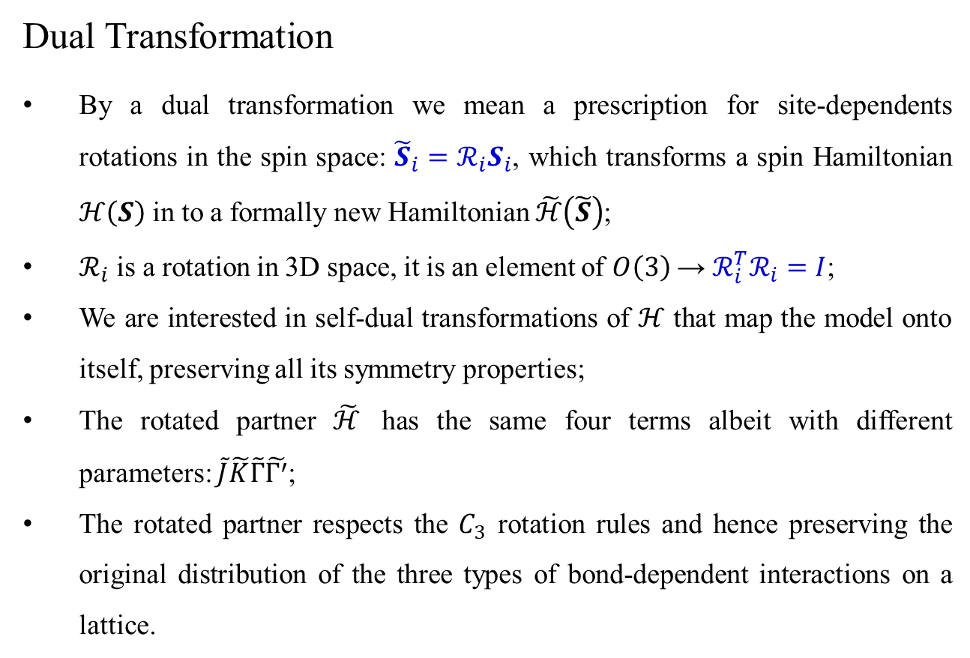
Dual Transformation
By a dual transformation we mean a prescription for site-dependents rotations in the spin space: ${\tilde{S}}_{i}=ℛ_{i}S_{i}$, which transforms a spin Hamiltonian $ℋ\left(S\right)$ in to a formally new Hamiltonian $\tilde{ℋ}\left(\tilde{S}\right)$;
$ℛ_{i}$ is a rotation in 3D space, it is an element of $O\left(3\right)$ → $ℛ_{i}^{T}ℛ_{i}=I$;
We are interested in self-dual transformations of $ℋ$ that map the model onto itself, preserving all its symmetry properties;
The rotated partner $\tilde{ℋ}$ has the same four terms albeit with different parameters: $\tilde{J}\tilde{K}\tilde{Γ}\tilde{Γ^{′}}$;
The rotated partner respects the $C_{3}$ rotation rules and hence preserving the original distribution of the three types of bond-dependent interactions on a lattice.
J. Chaloupka and G. Khaliullin, Phys. Rev. B 92, 024413 (2015).

Slide 10
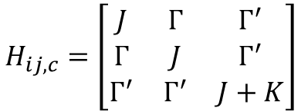
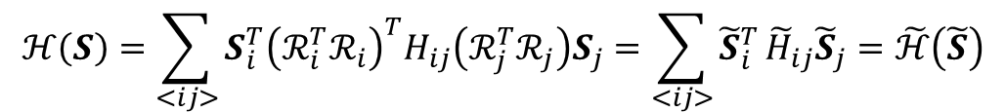
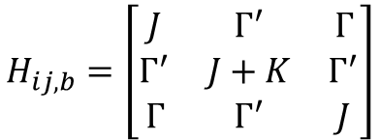
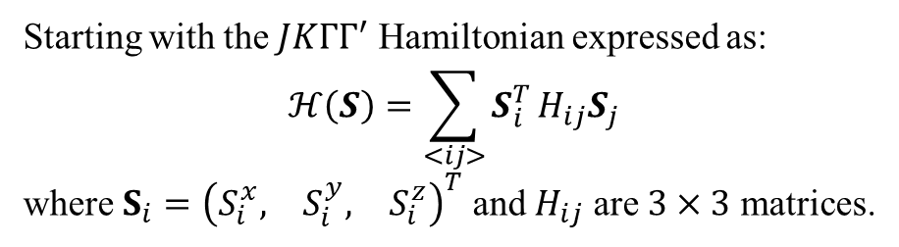
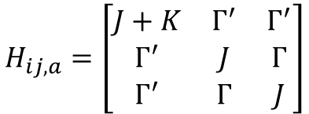
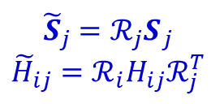
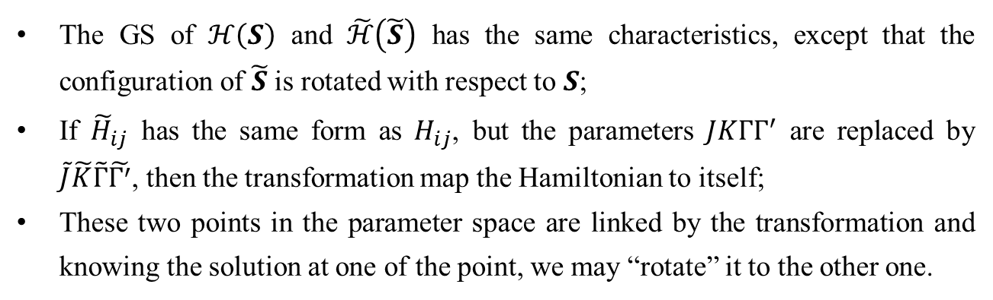
Starting with the $JKΓΓ^{′}$ Hamiltonian expressed as:
$$ℋ\left(S\right)=\sum_{<ij>}{S_{i}^{T}}H_{ij}S_{j}$$
where $S_{i}={\left(\begin{matrix}S_{i}^{x}, & S_{i}^{y}, & S_{i}^{z}\end{matrix}\right)}^{T}$ and $H_{ij}$ are $3×3$ matrices.
$$H_{ij,a}=\left[\begin{matrix}J+K & Γ^{′} & Γ^{′} \\ Γ^{′} & J & Γ \\ Γ^{′} & Γ & J\end{matrix}\right]$$
$$H_{ij,b}=\left[\begin{matrix}J & Γ^{′} & Γ \\ Γ^{′} & J+K & Γ^{′} \\ Γ & Γ^{′} & J\end{matrix}\right]$$
$$H_{ij,c}=\left[\begin{matrix}J & Γ & Γ^{′} \\ Γ & J & Γ^{′} \\ Γ^{′} & Γ^{′} & J+K\end{matrix}\right]$$
$$ℋ\left(S\right)=\sum_{<ij>}{S_{i}^{T}{\left(ℛ_{i}^{T}ℛ_{i}\right)}^{T}H_{ij}\left(ℛ_{j}^{T}ℛ_{j}\right)S_{j}}=\sum_{<ij>}{{\tilde{S}}_{i}^{T}}{\tilde{H}}_{ij}{\tilde{S}}_{j}=\tilde{ℋ}\left(\tilde{S}\right)$$
$${\tilde{S}}_{j}={ℛ_{j}S}_{j}$$
$${\tilde{H}}_{ij}=ℛ_{i}H_{ij}ℛ_{j}^{T}$$
The GS of $ℋ\left(S\right)$ and $\tilde{ℋ}\left(\tilde{S}\right)$ has the same characteristics, except that the configuration of $\tilde{S}$ is rotated with respect to $S$;
If ${\tilde{H}}_{ij}$ has the same form as $H_{ij}$, but the parameters $JKΓΓ^{′}$ are replaced by $\tilde{J}\tilde{K}\tilde{Γ}\tilde{Γ^{′}}$, then the transformation map the Hamiltonian to itself;
These two points in the parameter space are linked by the transformation and knowing the solution at one of the point, we may “rotate” it to the other one.
J. Chaloupka and G. Khaliullin, Phys. Rev. B 92, 024413 (2015).

Slide 11
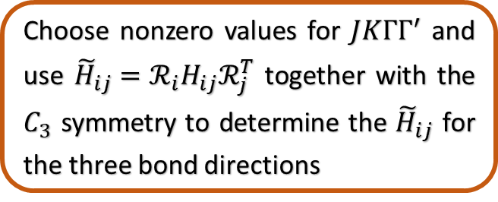
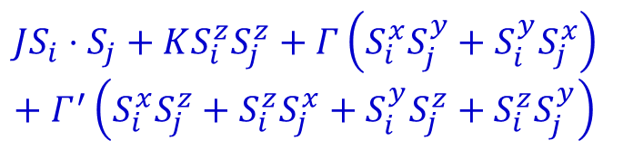

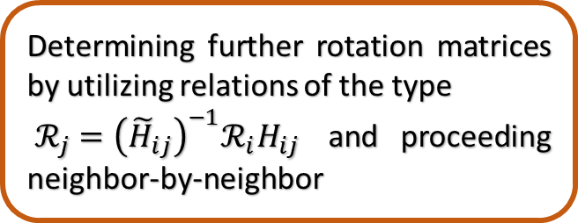
Algorithm
Choose two rotation $ℛ_{i}$, $ℛ_{j}$ on selected bond $⟨ij⟩$, which preserve the H form
Choose nonzero values for $JKΓΓ^{′}$ and use ${\tilde{H}}_{ij}=ℛ_{i}H_{ij}ℛ_{j}^{T}$ together with the $C_{3}$ symmetry to determine the ${\tilde{H}}_{ij}$ for the three bond directions
Determining further rotation matrices by utilizing relations of the type
$ℛ_{j}={\left({\tilde{H}}_{ij}\right)}^{−1}ℛ_{i}H_{ij}$ and proceeding neighbor-by-neighbor
$$JS_{i}⋅S_{j}+KS_{i}^{z}S_{j}^{z}+Γ\left(S_{i}^{x}S_{j}^{y}+S_{i}^{y}S_{j}^{x}\right)+Γ^{′}\left(S_{i}^{x}S_{j}^{z}+S_{i}^{z}S_{j}^{x}+S_{i}^{y}S_{j}^{z}+S_{i}^{z}S_{j}^{y}\right)$$
Use the remaining bonds to check consistency

Slide 12
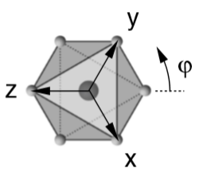
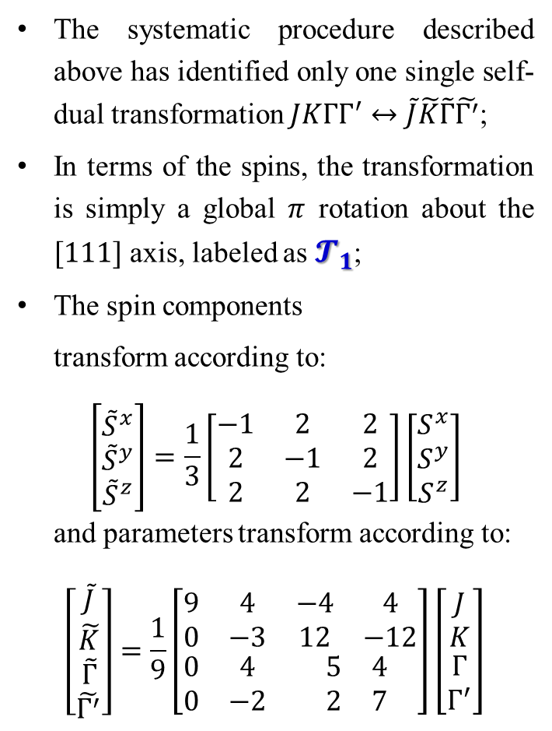
Algorithm
Choose two rotation $ℛ_{i}$, $ℛ_{j}$ on selected bond $⟨ij⟩$, which preserve the H form
The systematic procedure described above has identified only one single self-dual transformation $JKΓΓ^{′}↔\tilde{J}\tilde{K}\tilde{Γ}\tilde{Γ^{′}}$;
In terms of the spins, the transformation is simply a global $π$ rotation about the $[111]$ axis, labeled as $𝓣_{1}$;
The spin components
transform according to:
$$\left[\begin{matrix}{\tilde{S}}^{x} \\ {\tilde{S}}^{y} \\ {\tilde{S}}^{z}\end{matrix}\right]=\frac{1}{3}\left[\begin{matrix}−1 & 2 & 2 \\ 2 & −1 & 2 \\ 2 & 2 & −1\end{matrix}\right]\left[\begin{matrix}S^{x} \\ S^{y} \\ S^{z}\end{matrix}\right]$$
and parameters transform according to:
$$\left[\begin{matrix}\begin{matrix}\tilde{J} \\ \tilde{K}\end{matrix} \\ \begin{matrix}\tilde{Γ} \\ \tilde{Γ^{′}}\end{matrix}\end{matrix}\right]=\frac{1}{9}\left[\begin{matrix}\begin{matrix}9 & 4 \\ 0 & −3\end{matrix} & \begin{matrix}−4 & 4 \\ 12 & −12\end{matrix} \\ \begin{matrix}0 & 4 \\ 0 & −2\end{matrix} & \begin{matrix}5 & 4 \\ 2 & 7\end{matrix}\end{matrix}\right]\left[\begin{matrix}\begin{matrix}J \\ K\end{matrix} \\ \begin{matrix}Γ \\ Γ^{′}\end{matrix}\end{matrix}\right]$$
Choose nonzero values for $JKΓΓ^{′}$ and use ${\tilde{H}}_{ij}=ℛ_{i}H_{ij}ℛ_{j}^{T}$ together with the $C_{3}$ symmetry to determine the ${\tilde{H}}_{ij}$ for the three bond directions
Determining further rotation matrices by utilizing relations of the type
$ℛ_{j}={\left({\tilde{H}}_{ij}\right)}^{−1}ℛ_{i}H_{ij}$ and proceeding neighbor-by-neighbor
Use the remaining bonds to check consistency

Slide 13
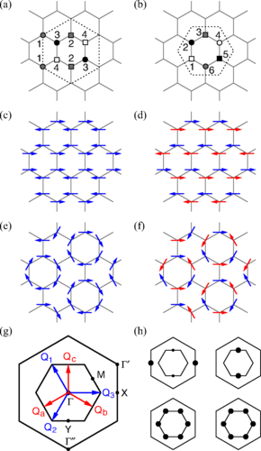
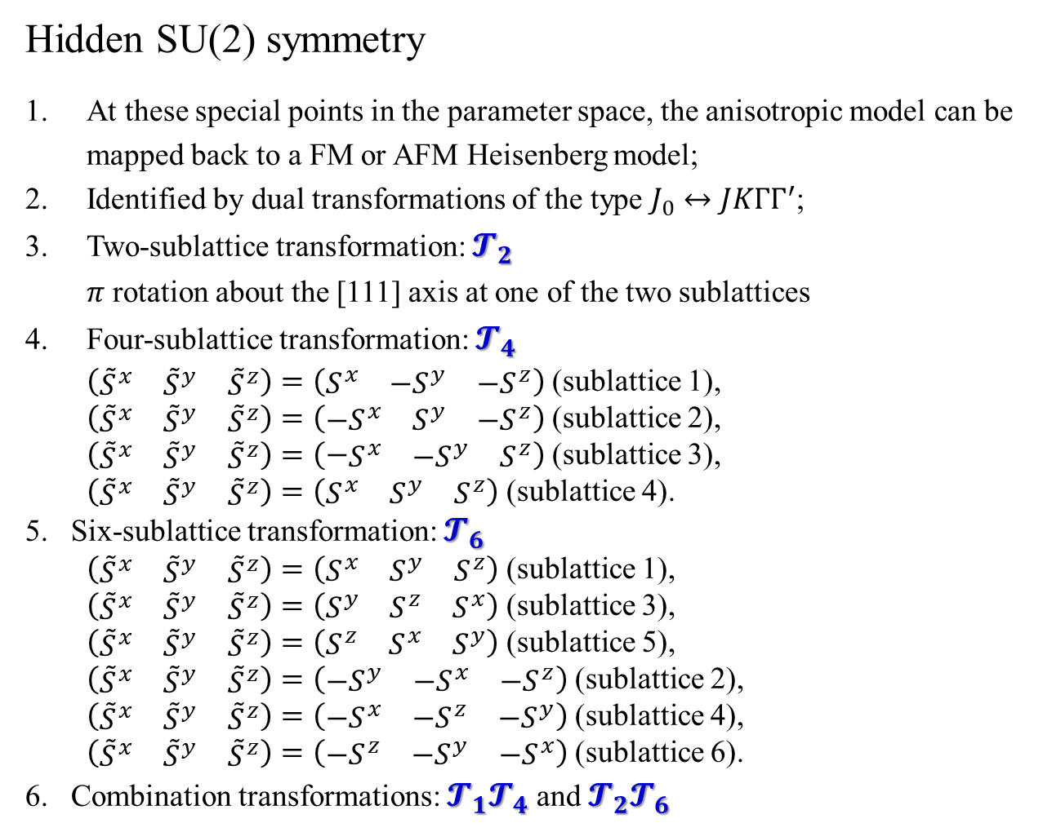
Hidden SU(2) symmetry
At these special points in the parameter space, the anisotropic model can be mapped back to a FM or AFM Heisenberg model;
Identified by dual transformations of the type $J_{0}↔JKΓΓ^{′}$;
Two-sublattice transformation: $𝓣_{2}$
$π$ rotation about the [111] axis at one of the two sublattices
Four-sublattice transformation: $𝓣_{4}$
$\left(\begin{matrix}{\tilde{S}}^{x} & {\tilde{S}}^{y} & {\tilde{S}}^{z}\end{matrix}\right)=\left(\begin{matrix}S^{x} & {−S}^{y} & {−S}^{z}\end{matrix}\right)$ (sublattice 1),
$\left(\begin{matrix}{\tilde{S}}^{x} & {\tilde{S}}^{y} & {\tilde{S}}^{z}\end{matrix}\right)=\left(\begin{matrix}{−S}^{x} & S^{y} & {−S}^{z}\end{matrix}\right)$ (sublattice 2),
$\left(\begin{matrix}{\tilde{S}}^{x} & {\tilde{S}}^{y} & {\tilde{S}}^{z}\end{matrix}\right)=\left(−\begin{matrix}S^{x} & {−S}^{y} & S^{z}\end{matrix}\right)$ (sublattice 3),
$\left(\begin{matrix}{\tilde{S}}^{x} & {\tilde{S}}^{y} & {\tilde{S}}^{z}\end{matrix}\right)=\left(\begin{matrix}S^{x} & S^{y} & S^{z}\end{matrix}\right)$ (sublattice 4).
Six-sublattice transformation: $𝓣_{6}$
$\left(\begin{matrix}{\tilde{S}}^{x} & {\tilde{S}}^{y} & {\tilde{S}}^{z}\end{matrix}\right)=\left(\begin{matrix}S^{x} & S^{y} & S^{z}\end{matrix}\right)$ (sublattice 1),
$\left(\begin{matrix}{\tilde{S}}^{x} & {\tilde{S}}^{y} & {\tilde{S}}^{z}\end{matrix}\right)=\left(\begin{matrix}S^{y} & S^{z} & S^{x}\end{matrix}\right)$ (sublattice 3),
$\left(\begin{matrix}{\tilde{S}}^{x} & {\tilde{S}}^{y} & {\tilde{S}}^{z}\end{matrix}\right)=\left(\begin{matrix}S^{z} & S^{x} & S^{y}\end{matrix}\right)$ (sublattice 5),
$\left(\begin{matrix}{\tilde{S}}^{x} & {\tilde{S}}^{y} & {\tilde{S}}^{z}\end{matrix}\right)=\left(\begin{matrix}{−S}^{y} & {−S}^{x} & {−S}^{z}\end{matrix}\right)$ (sublattice 2),
$\left(\begin{matrix}{\tilde{S}}^{x} & {\tilde{S}}^{y} & {\tilde{S}}^{z}\end{matrix}\right)=\left(\begin{matrix}{−S}^{x} & {−S}^{z} & {−S}^{y}\end{matrix}\right)$ (sublattice 4),
$\left(\begin{matrix}{\tilde{S}}^{x} & {\tilde{S}}^{y} & {\tilde{S}}^{z}\end{matrix}\right)=\left(\begin{matrix}{−S}^{z} & {−S}^{y} & {−S}^{x}\end{matrix}\right)$ (sublattice 6).
Combination transformations: $𝓣_{1}𝓣_{4}$ and $𝓣_{2}𝓣_{6}$

Slide 14
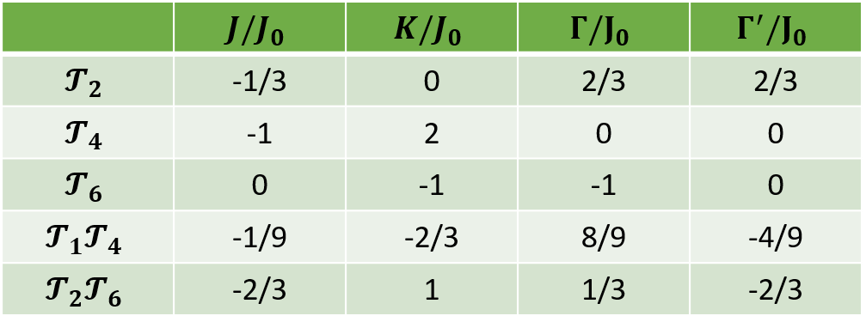
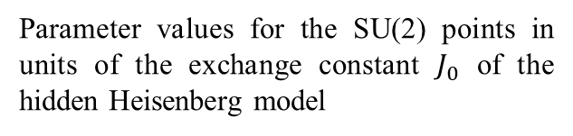
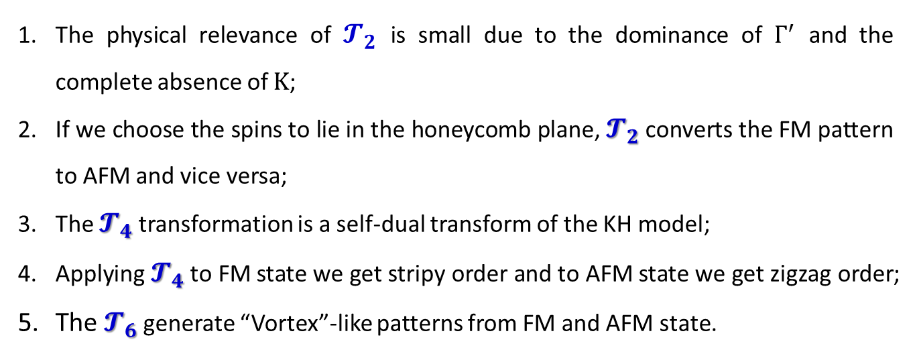
Parameter values for the SU(2) points in units of the exchange constant $J_{0}$ of the hidden Heisenberg model
The physical relevance of $𝓣_{2}$ is small due to the dominance of $Γ^{′}$ and the complete absence of $K$;
If we choose the spins to lie in the honeycomb plane, $𝓣_{2}$ converts the FM pattern to AFM and vice versa;
The $𝓣_{4}$ transformation is a self-dual transform of the KH model;
Applying $𝓣_{4}$ to FM state we get stripy order and to AFM state we get zigzag order;
The $𝓣_{6}$ generate “Vortex”-like patterns from FM and AFM state.

Slide 15
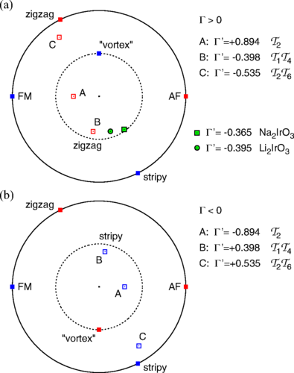
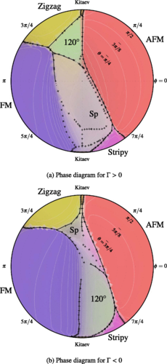
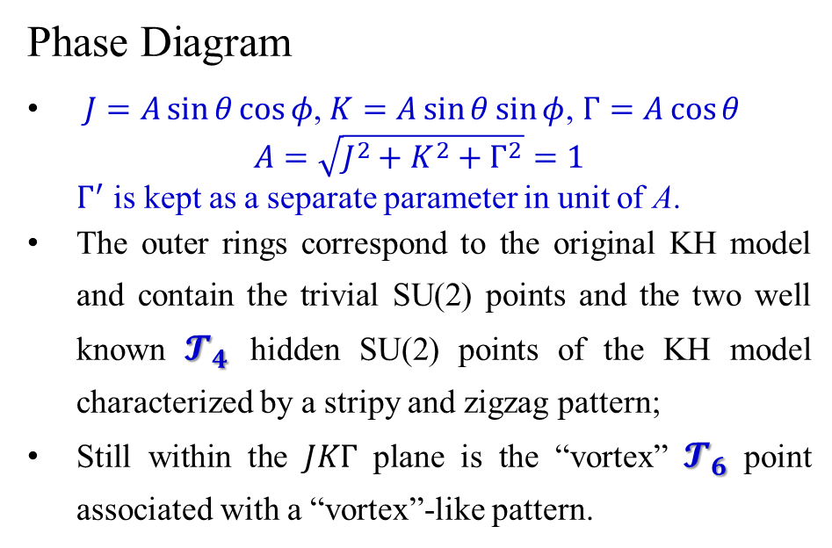
Phase Diagram
$J=A\sin{θ}\cos{φ}$, $K=A\sin{θ}\sin{φ}$, $Γ=A\cos{θ}$
$$A=\sqrt{J^{2}+K^{2}+Γ^{2}}=1$$
$Γ^{′}$ is kept as a separate parameter in unit of A.
The outer rings correspond to the original KH model and contain the trivial SU(2) points and the two well known $𝓣_{4}$ hidden SU(2) points of the KH model characterized by a stripy and zigzag pattern;
Still within the $JKΓ$ plane is the “vortex” $𝓣_{6}$ point associated with a “vortex”-like pattern.
J. Chaloupka, and G. Khaliullin, Phys. Rev. B 92, 024413 (2015);
J. G. Rau, E. Kin-Ho Lee, and Hae-Young Kee, Phys. Rev. Lett. 112, 077204(2014).

Slide 16
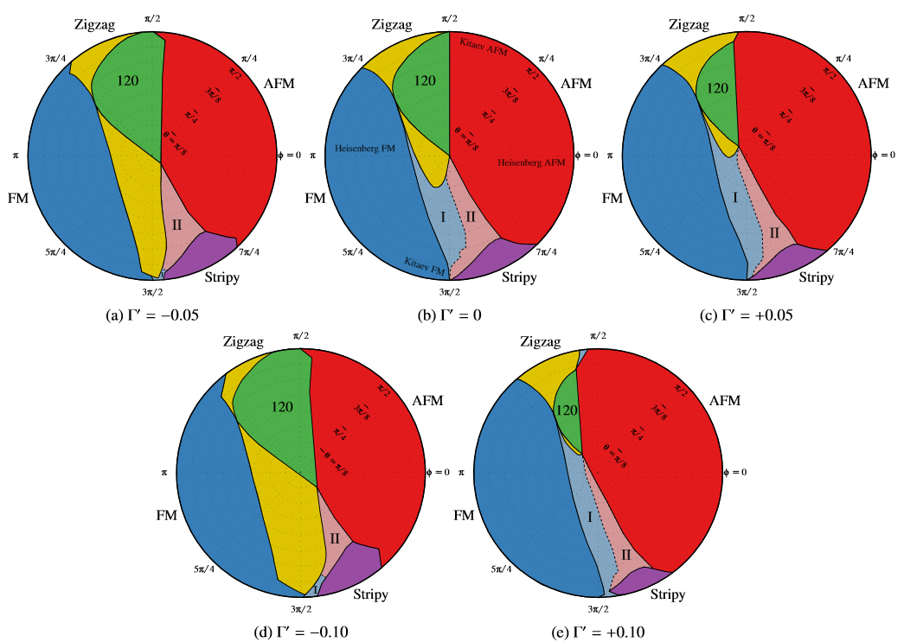
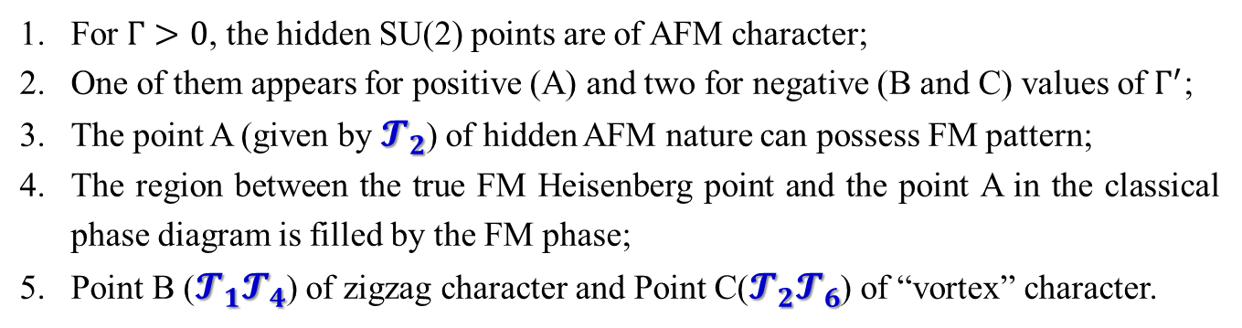
J. G. Rau, and Hae-Young Kee, arXiv:1408.4811
For $Γ>0$, the hidden SU(2) points are of AFM character;
One of them appears for positive (A) and two for negative (B and C) values of $Γ^{′}$;
The point A (given by $𝓣_{2}$) of hidden AFM nature can possess FM pattern;
The region between the true FM Heisenberg point and the point A in the classical phase diagram is filled by the FM phase;
Point B ($𝓣_{1}𝓣_{4}$) of zigzag character and Point C($𝓣_{2}𝓣_{6}$) of “vortex” character.

Slide 17
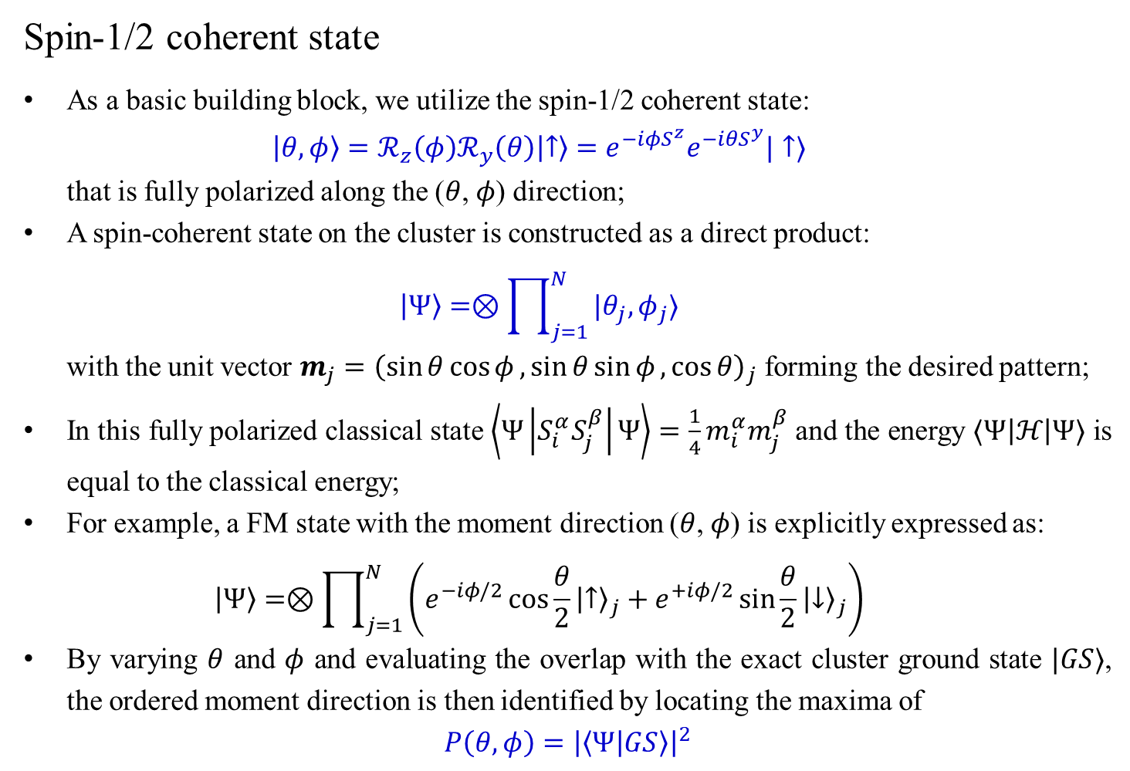
Spin-1/2 coherent state
As a basic building block, we utilize the spin-1/2 coherent state:
$$\left|θ,φ\right\rangle =ℛ_{z}\left(φ\right)ℛ_{y}\left(θ\right)\left|↑\right\rangle =e^{−iφS^{z}}e^{−iθS^{y}}|↑⟩$$
that is fully polarized along the ($θ$, $φ$) direction;
A spin-coherent state on the cluster is constructed as a direct product:
$$\left|Ψ\right\rangle =⊗\prod_{j=1}^{N}{|θ_{j},φ_{j}⟩}$$
with the unit vector $m_{j}={\left(\sin{θ}\cos{φ},\sin{θ}\sin{φ}, \cos{θ}\right)}_{j}$ forming the desired pattern;
In this fully polarized classical state $\left\langle Ψ\left|S_{i}^{α}S_{j}^{β}\right|Ψ\right\rangle =\frac{1}{4}m_{i}^{α}m_{j}^{β}$ and the energy $⟨Ψ\left|ℋ\right|Ψ⟩$ is equal to the classical energy;
For example, a FM state with the moment direction ($θ$, $φ$) is explicitly expressed as:
$$\left|Ψ\right\rangle =⊗\prod_{j=1}^{N}{\left(e^{−iφ/2}\cos{\frac{θ}{2}}{\left|↑\right\rangle }_{j}+e^{+iφ/2}\sin{\frac{θ}{2}}{\left|↓\right\rangle }_{j}\right)}$$
By varying $θ$ and $φ$ and evaluating the overlap with the exact cluster ground state $|GS⟩$, the ordered moment direction is then identified by locating the maxima of
$$P\left(θ,φ\right)={\left|\left\langle Ψ | GS\right\rangle \right|}^{2}$$
J. Chaloupka and G. Khaliullin, Phys. Rev. B 94, 064435 (2016)

Slide 18
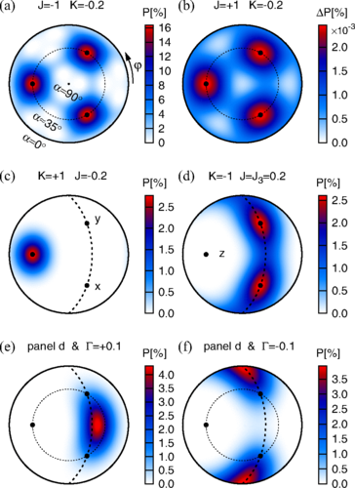
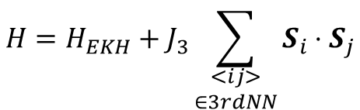
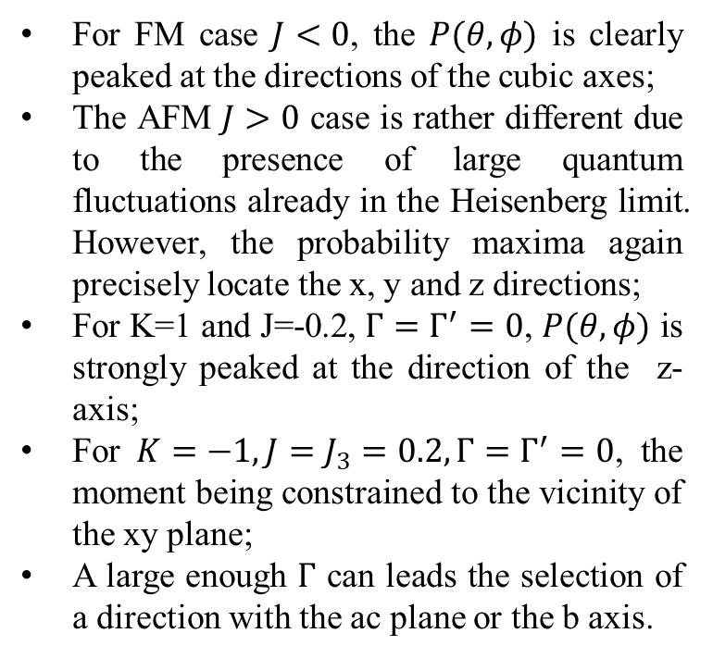
$$H=H_{EKH}+J_{3}\sum_{\begin{aligned}<ij> \\ ∈3rdNN\end{aligned}}{S_{i}⋅S_{j}}$$
For FM case $J<0$, the $P(θ,φ)$ is clearly peaked at the directions of the cubic axes;
The AFM $J>0$ case is rather different due to the presence of large quantum fluctuations already in the Heisenberg limit. However, the probability maxima again precisely locate the x, y and z directions;
For K=1 and J=-0.2, $Γ=Γ^{′}=0$, $P(θ,φ)$ is strongly peaked at the direction of the z-axis;
For $K=−1,J=J_{3}=0.2, Γ=Γ^{′}=0$, the moment being constrained to the vicinity of the xy plane;
A large enough $Γ$ can leads the selection of a direction with the ac plane or the b axis.
J. Chaloupka and G. Khaliullin, Phys. Rev. B 94, 064435 (2016)

Slide 19
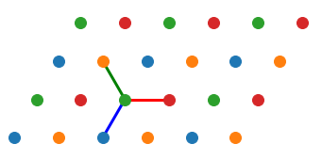
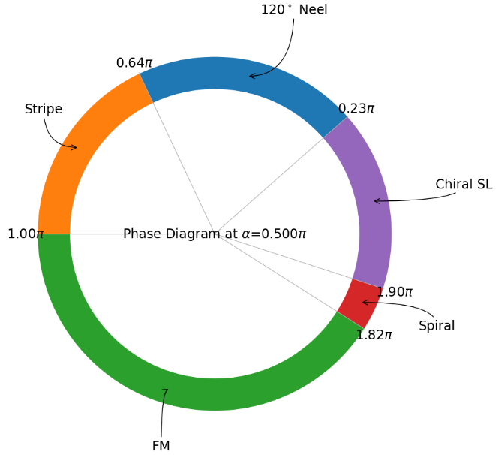
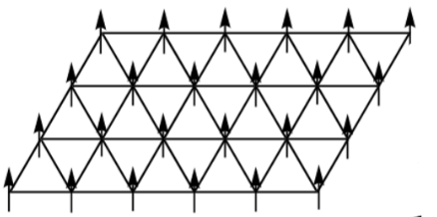
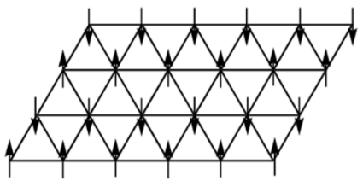
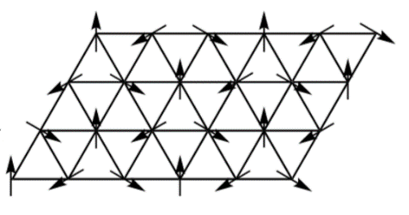
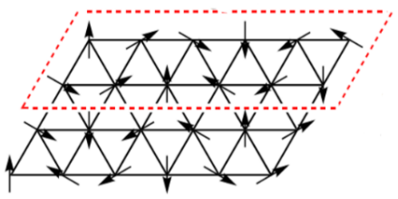

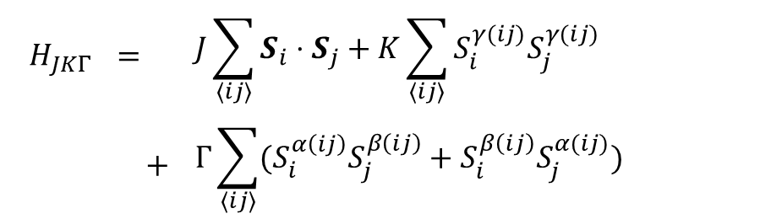

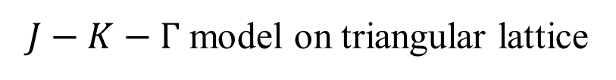





$J−K−Γ$ model on triangular lattice
$$H_{JKΓ}$$ | $$=$$ | $$J\sum_{⟨ij⟩}{S_{i}⋅S_{j}}+K\sum_{⟨ij⟩}{S_{i}^{γ(ij)}S_{j}^{γ(ij)}}$$
 | $$+$$ | $$Γ\sum_{⟨ij⟩}{(S_{i}^{α\left(ij\right)}S_{j}^{β\left(ij\right)}+S_{i}^{β\left(ij\right)}S_{j}^{α(ij)})}$$
y$(zx)$
$$r_{2}$$
$$r_{1}$$
z$(xy)$
$$x(yz)$$
$$r_{3}$$
$$J=A\sin{β}\sin{α}$$ | $$K=A\sin{β}\cos{α}$$ | $$Γ=A\cos{β}$$ | $$A=\sqrt{J^{2}+K^{2}+Γ^{2}}=1$$
FM
Stripe
${120}^{∘}$ Neel
Spiral
Kai Li, Shun-Li Yu and Jian-Xin Li, New J. Phys. 17, 043032 (2015)

Slide 20

Global Phase Diagram

Slide 21
Thank you!

