Slide 1
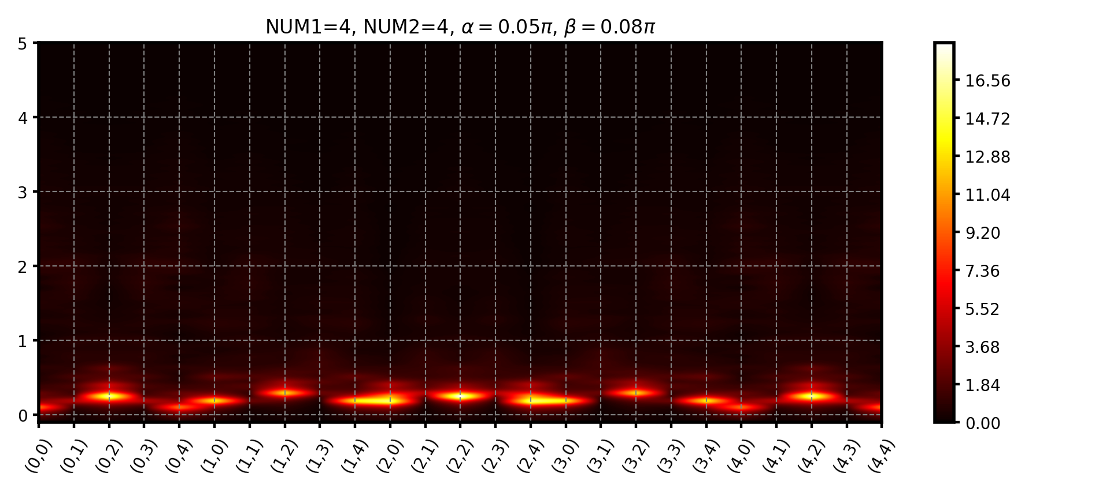
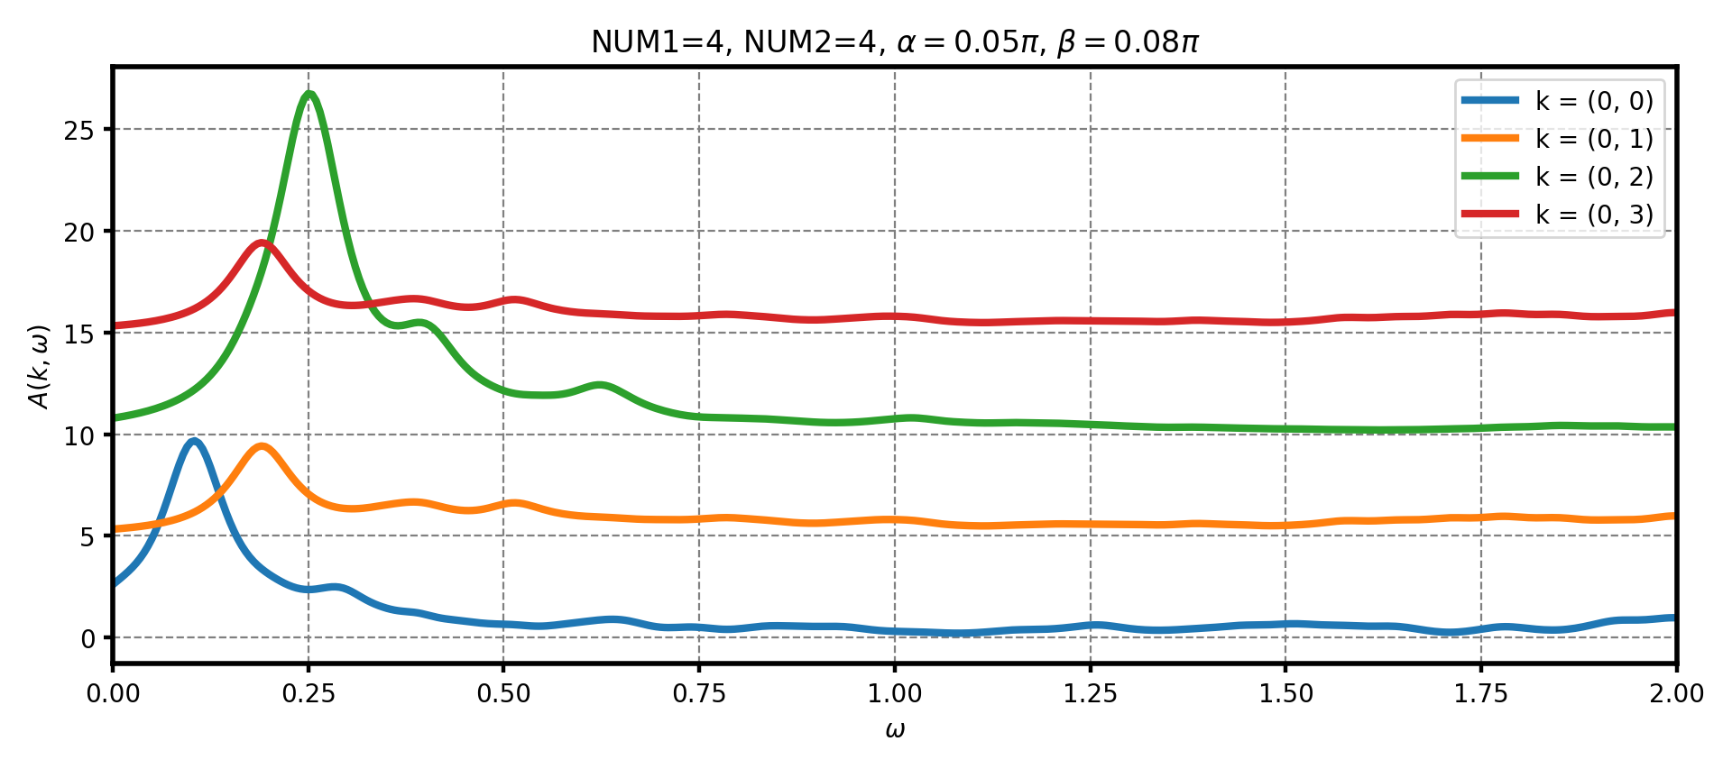
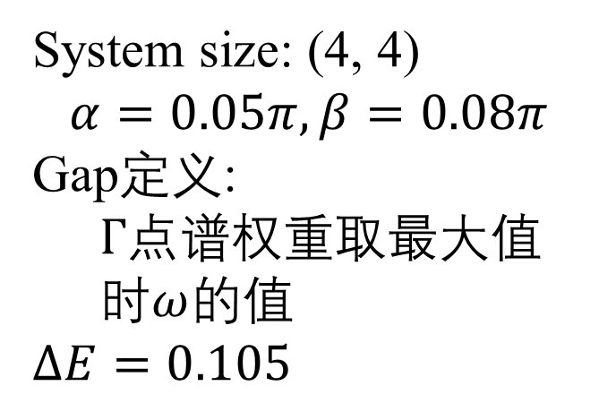
System size: (4, 4)
$$α=0.05π, β=0.08π$$
Gap定义:
$Γ$点谱权重取最大值时$ω$的值
$$ΔE=0.105$$

Slide 2
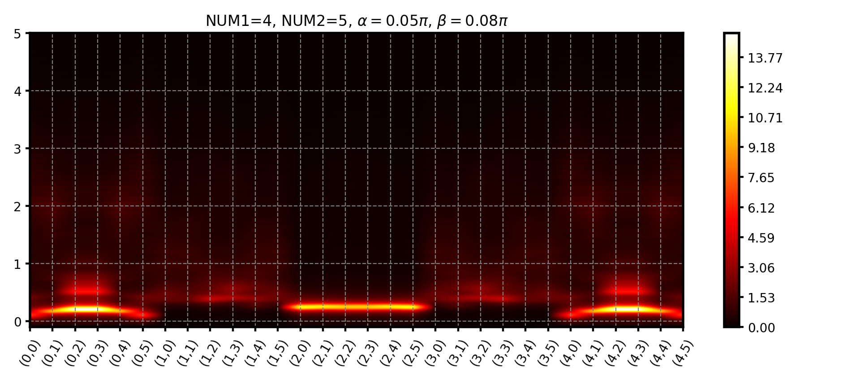
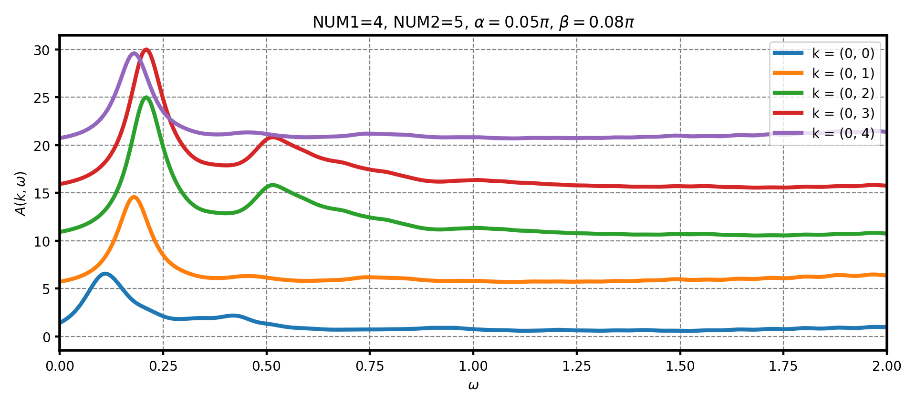
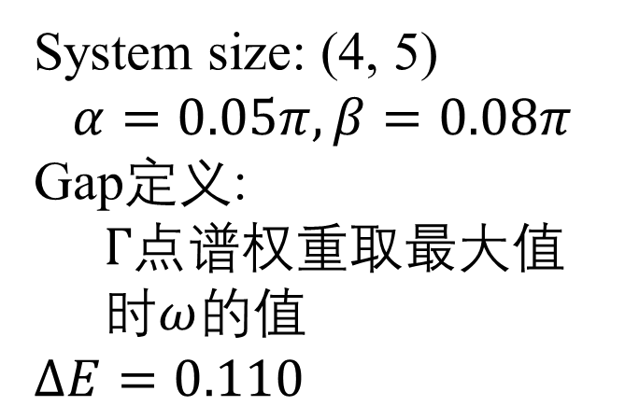
System size: (4, 5)
$$α=0.05π, β=0.08π$$
Gap定义:
$Γ$点谱权重取最大值时$ω$的值
$$ΔE=0.110$$

Slide 3

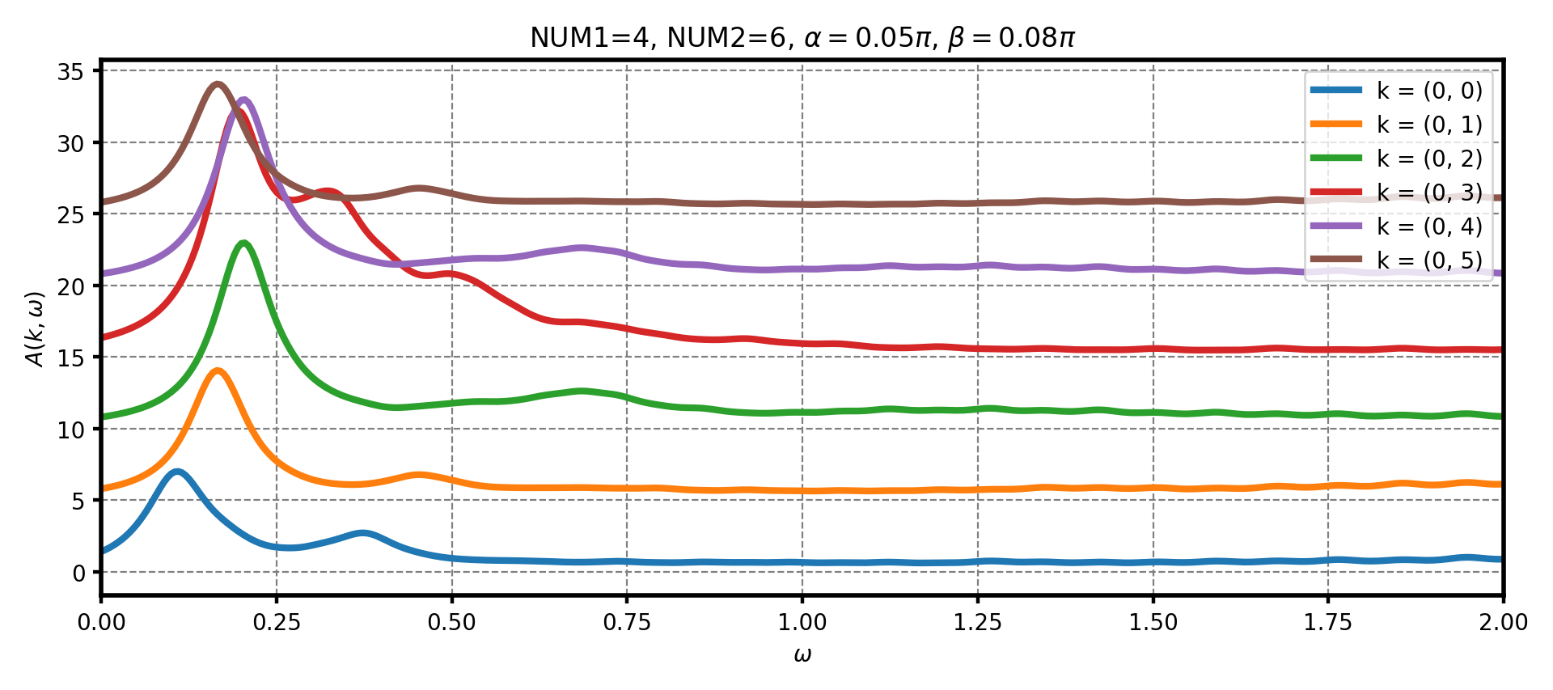
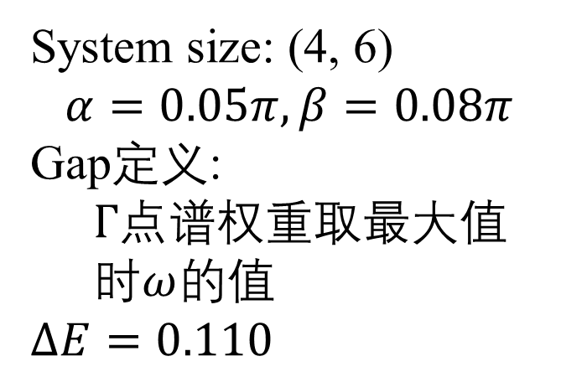
System size: (4, 6)
$$α=0.05π, β=0.08π$$
Gap定义:
$Γ$点谱权重取最大值时$ω$的值
$$ΔE=0.110$$

Slide 4
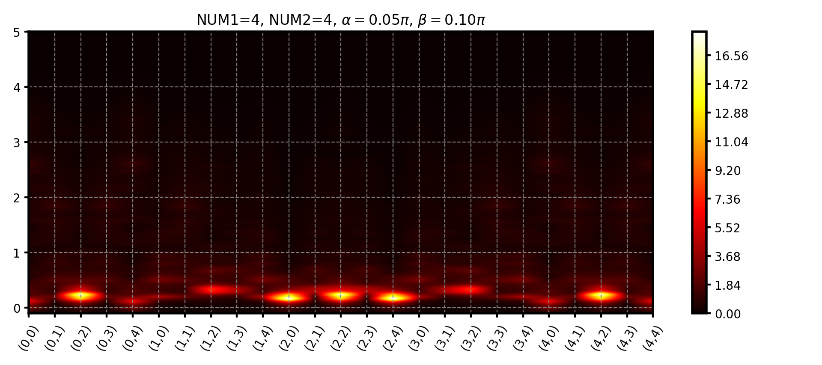
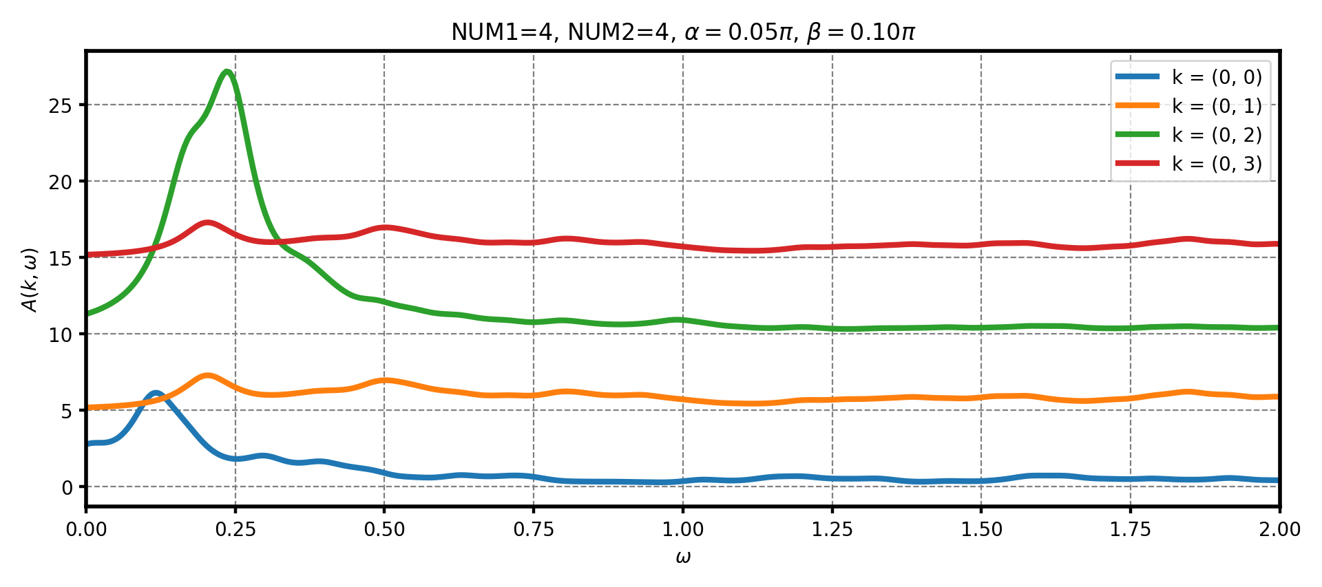
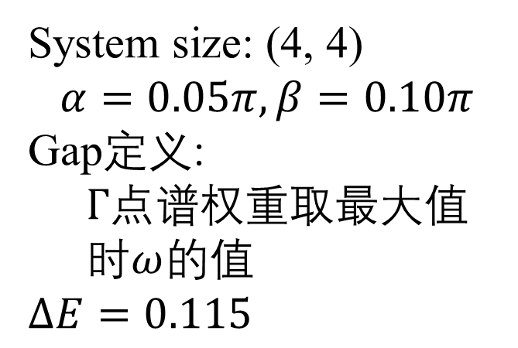
System size: (4, 4)
$$α=0.05π, β=0.10π$$
Gap定义:
$Γ$点谱权重取最大值时$ω$的值
$$ΔE=0.115$$

Slide 5

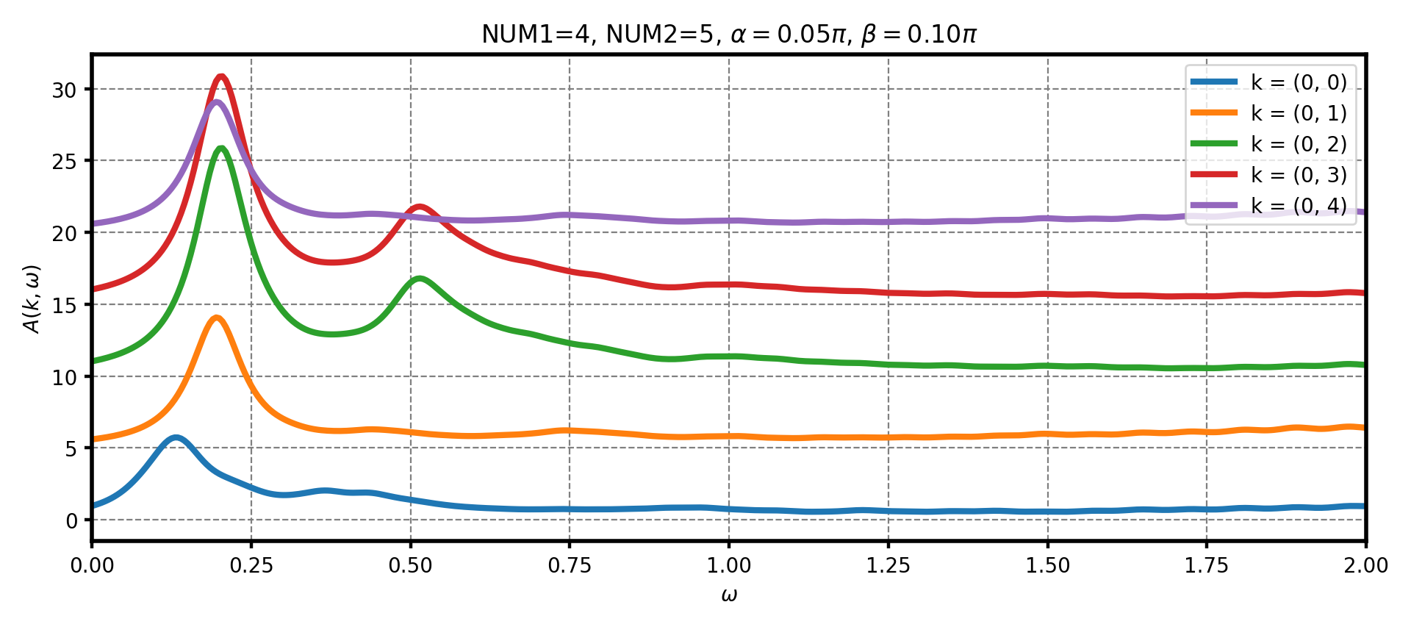
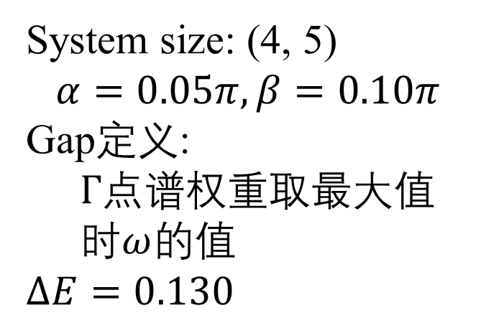
System size: (4, 5)
$$α=0.05π, β=0.10π$$
Gap定义:
$Γ$点谱权重取最大值时$ω$的值
$$ΔE=0.130$$

Slide 6

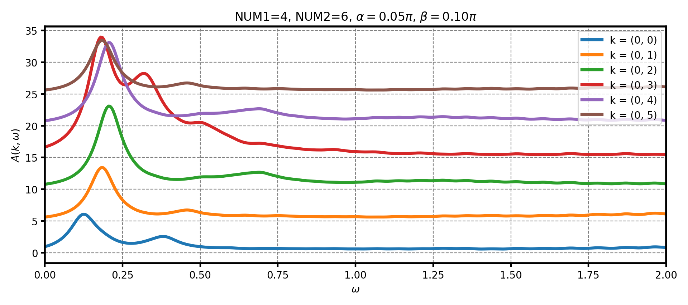
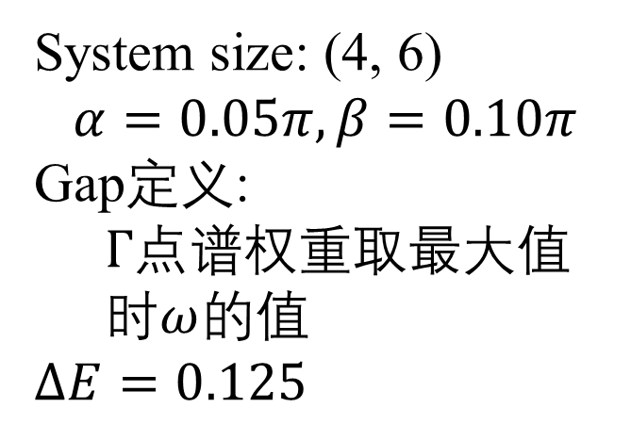
System size: (4, 6)
$$α=0.05π, β=0.10π$$
Gap定义:
$Γ$点谱权重取最大值时$ω$的值
$$ΔE=0.125$$

Slide 7
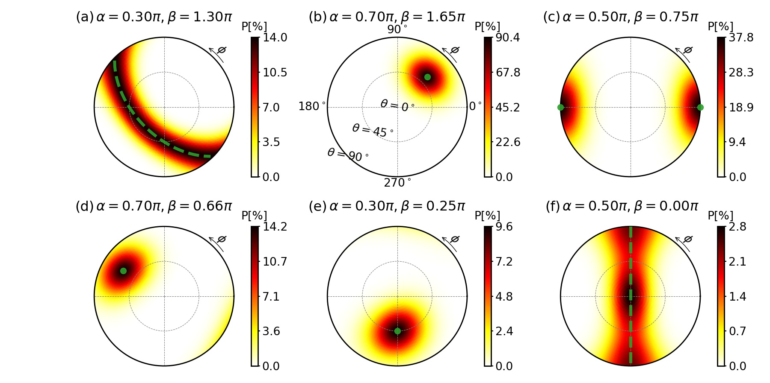
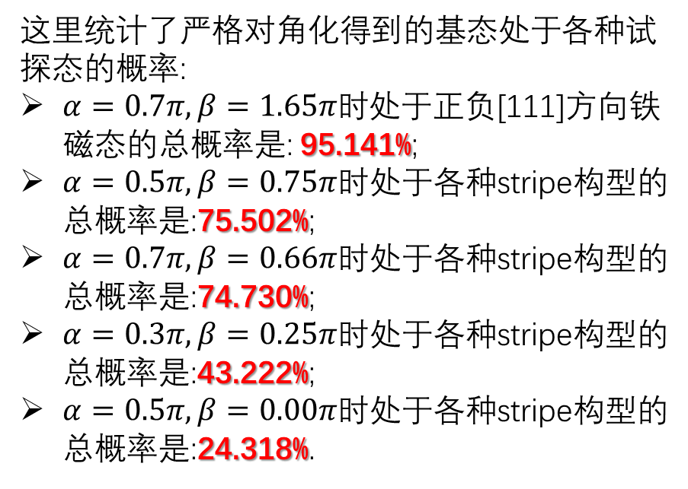
num1 | num2 | alpha | beta | + | - |  |  |  |  | total
4 | 6 | 0.70 | 1.65 | 48.888% | 46.253% |  |  |  |  | 95.141%
 |  |  |  | Config-X |  | Config-Y |  | Config-Z
 |  |  |  | + | - | + | - | + | -
4 | 6 | 0.50 | 0.75 | 0.017% | 0.017% | 4.161% | 4.161% | 33.573% | 33.573% | 75.502%
4 | 6 | 0.70 | 0.66 | 14.243% | 14.243% | 13.175% | 13.175% | 9.947% | 9.947% | 74.730%
4 | 6 | 0.30 | 0.25 | 9.640% | 9.640% | 3.450% | 3.450% | 8.521% | 8.521% | 43.222%
4 | 6 | 0.50 | 0.00 | 5.183% | 5.183% | 3.300% | 3.300% | 3.676% | 3.676% | 24.318%
这里统计了严格对角化得到的基态处于各种试探态的概率:
$α=0.7π,β=1.65π时$处于正负[111]方向铁磁态的总概率是: 95.141%;
$α=0.5π,β=0.75π$时处于各种stripe构型的总概率是:75.502%;
$α=0.7π,β=0.66π$时处于各种stripe构型的总概率是:74.730%;
$α=0.3π,β=0.25π$时处于各种stripe构型的总概率是:43.222%;
$α=0.5π,β=0.00π$时处于各种stripe构型的总概率是:24.318%.

