Slide 1
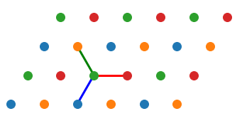



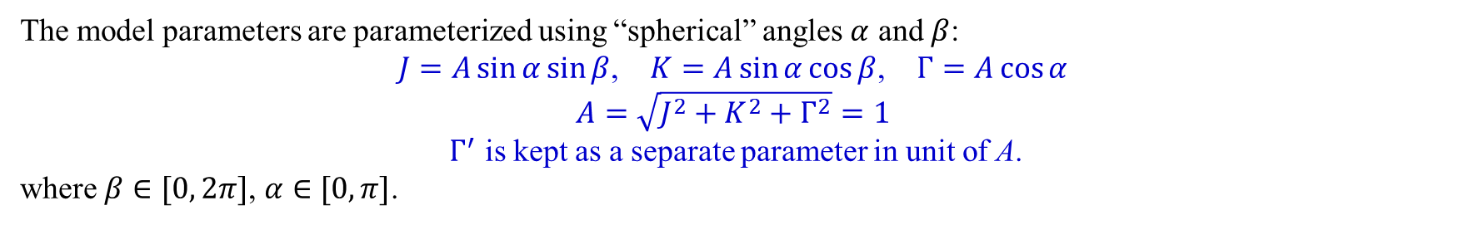

$J−K−Γ−Γ^{′}$ model on triangular lattice
$$r_{2}$$
y
$$r_{1}$$
z
$$x$$
$$r_{3}$$
$$H=\sum_{<ij>γ}{\left[JS_{i} ⋅S_{j}+KS_{i}^{γ}S_{j}^{γ}\right]}+\sum_{<ij>γ}{\left[Γ\left(S_{i}^{α}S_{j}^{β}+S_{i}^{β}S_{j}^{α}\right)+Γ^{′}\left(S_{i}^{γ}S_{j}^{α}+S_{i}^{α}S_{j}^{γ}+S_{i}^{γ}S_{j}^{β}+S_{i}^{β}S_{j}^{γ}\right)\right]}$$
The model parameters are parameterized using “spherical” angles $α$ and $β$:
$J=A\sin{α}\sin{β}$, $K=A\sin{α}\cos{β}$, $Γ=A\cos{α}$
$$A=\sqrt{J^{2}+K^{2}+Γ^{2}}=1$$
$Γ^{′}$ is kept as a separate parameter in unit of A.
where $β∈[0, 2π]$, $α∈[0, π]$.

Slide 2
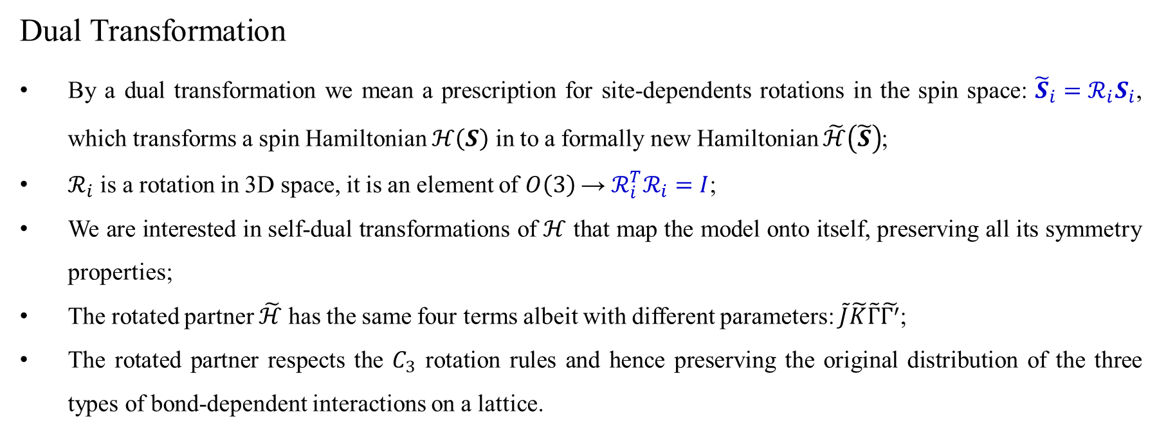
Dual Transformation
By a dual transformation we mean a prescription for site-dependents rotations in the spin space: ${\tilde{S}}_{i}=ℛ_{i}S_{i}$, which transforms a spin Hamiltonian $ℋ\left(S\right)$ in to a formally new Hamiltonian $\tilde{ℋ}\left(\tilde{S}\right)$;
$ℛ_{i}$ is a rotation in 3D space, it is an element of $O\left(3\right)$ → $ℛ_{i}^{T}ℛ_{i}=I$;
We are interested in self-dual transformations of $ℋ$ that map the model onto itself, preserving all its symmetry properties;
The rotated partner $\tilde{ℋ}$ has the same four terms albeit with different parameters: $\tilde{J}\tilde{K}\tilde{Γ}\tilde{Γ^{′}}$;
The rotated partner respects the $C_{3}$ rotation rules and hence preserving the original distribution of the three types of bond-dependent interactions on a lattice.
J. Chaloupka and G. Khaliullin, Phys. Rev. B 92, 024413 (2015).

Slide 3
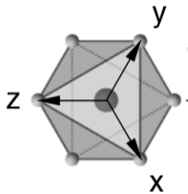

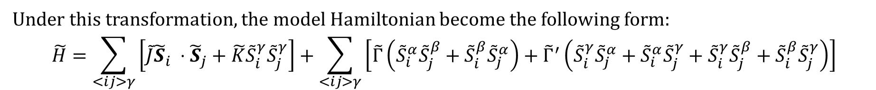
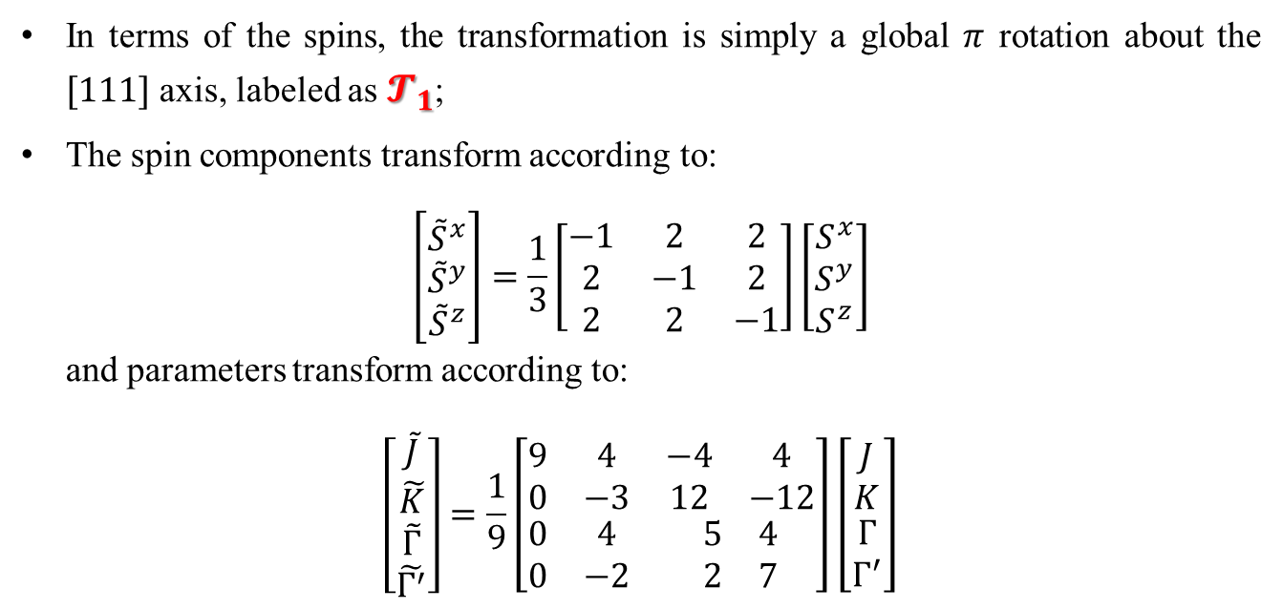
Dual transformation: $𝓣_{1}$
In terms of the spins, the transformation is simply a global $π$ rotation about the $[111]$ axis, labeled as $𝓣_{1}$;
The spin components transform according to:
$$\left[\begin{matrix}{\tilde{S}}^{x} \\ {\tilde{S}}^{y} \\ {\tilde{S}}^{z}\end{matrix}\right]=\frac{1}{3}\left[\begin{matrix}−1 & 2 & 2 \\ 2 & −1 & 2 \\ 2 & 2 & −1\end{matrix}\right]\left[\begin{matrix}S^{x} \\ S^{y} \\ S^{z}\end{matrix}\right]$$
and parameters transform according to:
$$\left[\begin{matrix}\begin{matrix}\tilde{J} \\ \tilde{K}\end{matrix} \\ \begin{matrix}\tilde{Γ} \\ \tilde{Γ^{′}}\end{matrix}\end{matrix}\right]=\frac{1}{9}\left[\begin{matrix}\begin{matrix}9 & 4 \\ 0 & −3\end{matrix} & \begin{matrix}−4 & 4 \\ 12 & −12\end{matrix} \\ \begin{matrix}0 & 4 \\ 0 & −2\end{matrix} & \begin{matrix}5 & 4 \\ 2 & 7\end{matrix}\end{matrix}\right]\left[\begin{matrix}\begin{matrix}J \\ K\end{matrix} \\ \begin{matrix}Γ \\ Γ^{′}\end{matrix}\end{matrix}\right]$$
Under this transformation, the model Hamiltonian become the following form:
$$\tilde{H}=\sum_{<ij>γ}{\left[\tilde{J}{\tilde{S}}_{i} ⋅{\tilde{S}}_{j}+\tilde{K}{\tilde{S}}_{i}^{γ}{\tilde{S}}_{j}^{γ}\right]}+\sum_{<ij>γ}{\left[\tilde{Γ}\left({\tilde{S}}_{i}^{α}{\tilde{S}}_{j}^{β}+{\tilde{S}}_{i}^{β}{\tilde{S}}_{j}^{α}\right)+{\tilde{Γ}}^{′}\left({\tilde{S}}_{i}^{γ}{\tilde{S}}_{j}^{α}+{\tilde{S}}_{i}^{α}{\tilde{S}}_{j}^{γ}+{\tilde{S}}_{i}^{γ}{\tilde{S}}_{j}^{β}+{\tilde{S}}_{i}^{β}{\tilde{S}}_{j}^{γ}\right)\right]}$$

Slide 4
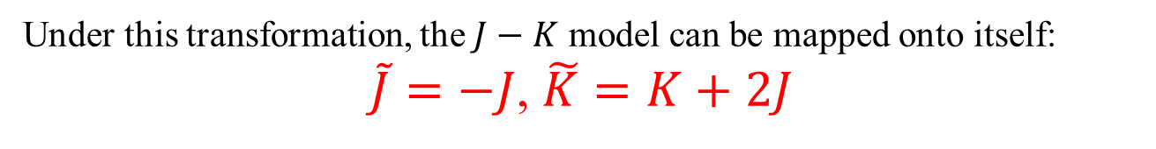

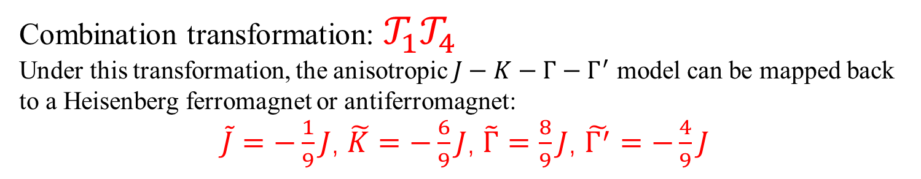




Four-sublattice transformation: $𝒯_{4}$
$${\tilde{S}}_{0}=S_{0}$$
$${\tilde{S}}_{1}=(S_{1}^{x}, −S_{1}^{y}, −S_{1}^{z})$$
$$r_{2}$$
y
$$r_{1}$$
$${\tilde{S}}_{2}=({−S}_{2}^{x}, S_{2}^{y}, −S_{2}^{z})$$
z
$$x$$
$$r_{3}$$
$${\tilde{S}}_{3}=({−S}_{3}^{x}, S_{3}^{y}, −S_{3}^{z})$$
Under this transformation, the $J−K$ model can be mapped onto itself:
$\tilde{J}=−J$, $\tilde{K}=K+2J$
Combination transformation:$𝒯_{1}𝒯_{4}$
Under this transformation, the anisotropic $J−K−Γ−Γ^{′}$ model can be mapped back to a Heisenberg ferromagnet or antiferromagnet:
$\tilde{J}=−\frac{1}{9}J$, $\tilde{K}=−\frac{6}{9}J$, $\tilde{Γ}=\frac{8}{9}J$, $\tilde{Γ^{′}}=−\frac{4}{9}J$

Slide 5
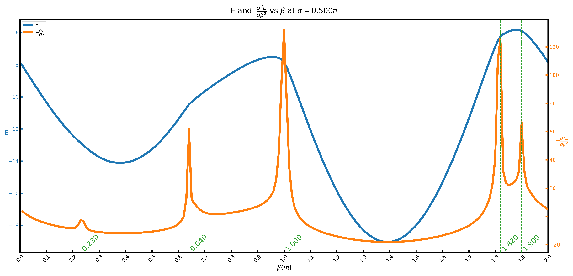
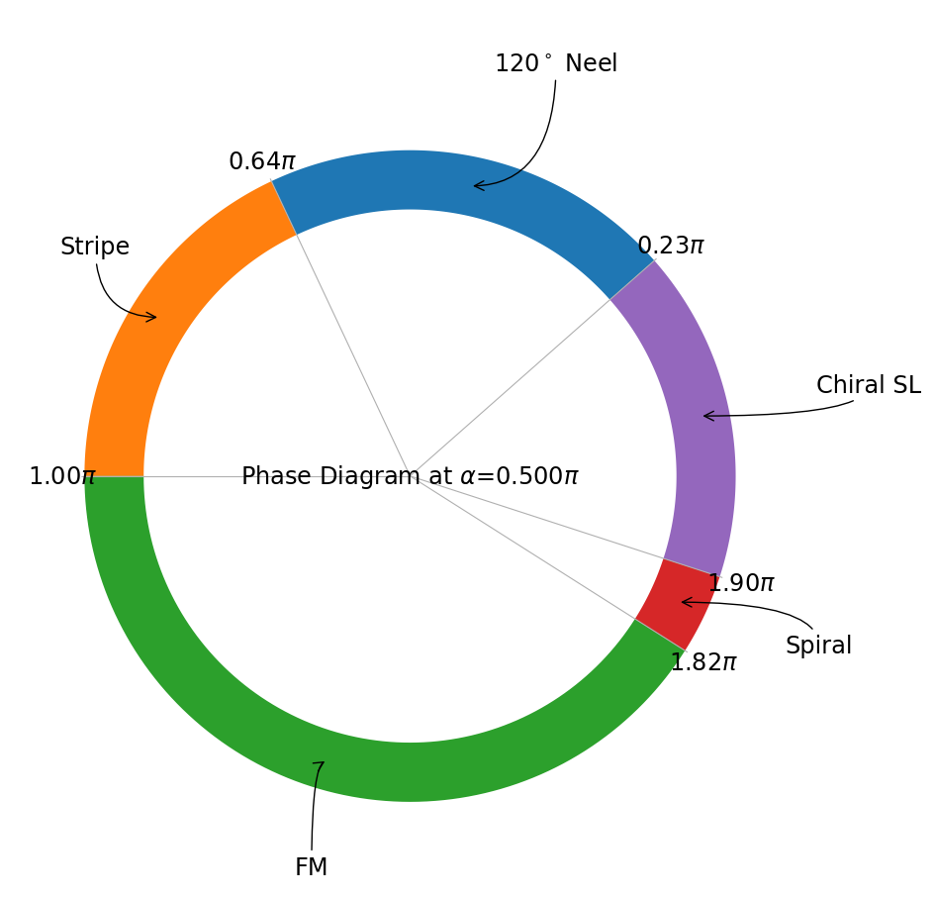
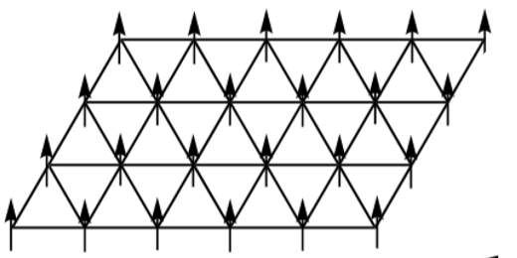
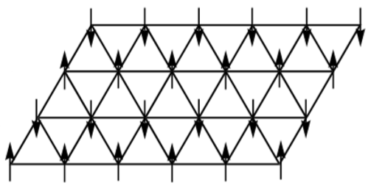
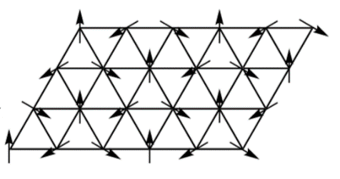
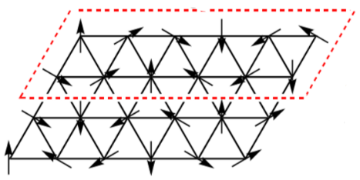

Phase diagram of J-K model
FM
Stripe
${120}^{∘}$ Neel
Spiral

Slide 6
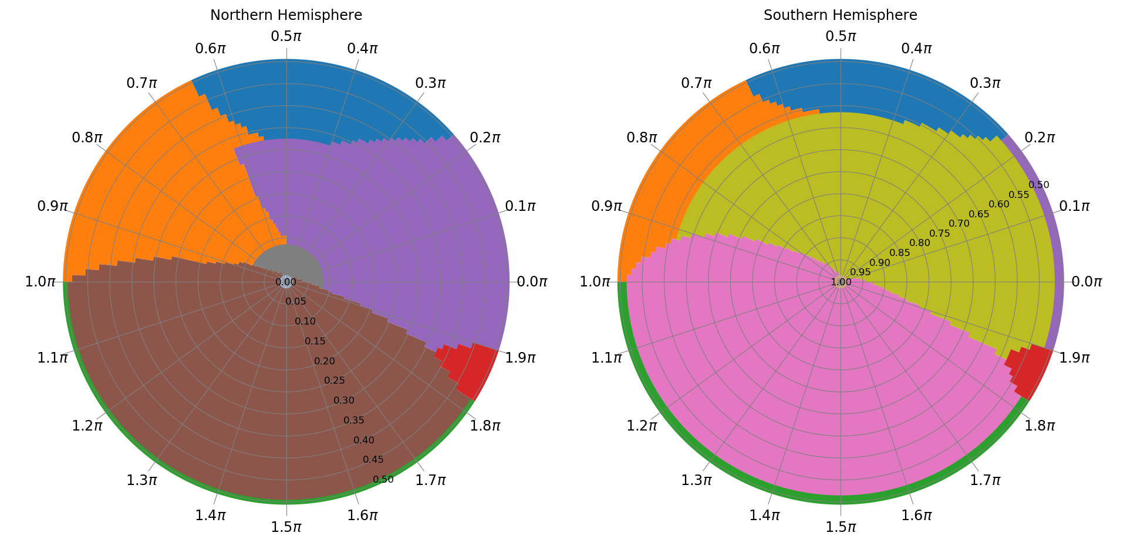


Global Phase Diagram
$J=A\sin{α}\sin{β}$, $K=A\sin{α}\cos{β}$, $Γ=A\cos{α}$
$$α∈[0, π/2]$$
$$α∈[\frac{π}{2},π]$$
120度Neel序
Stripe沿着(111)方向整体旋转180度
Stripe
Z2-Vortex
FM垂直于(111)方向的平面内
FM沿着(111)方向
Spiral
FM任意方向

Slide 7
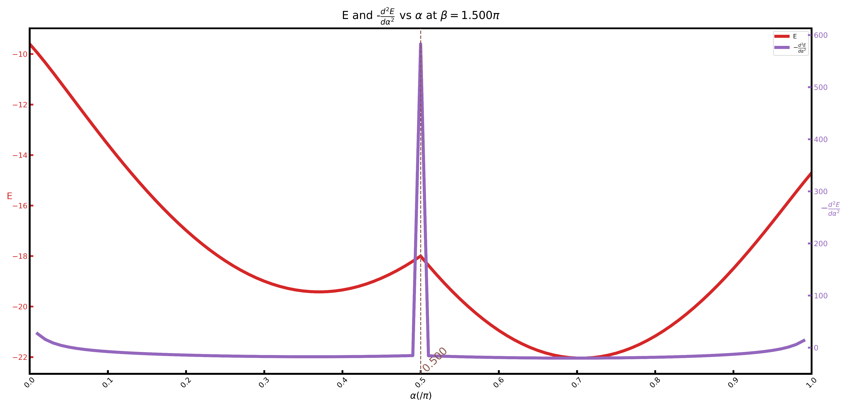
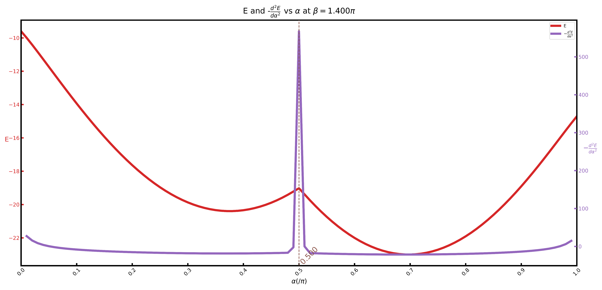
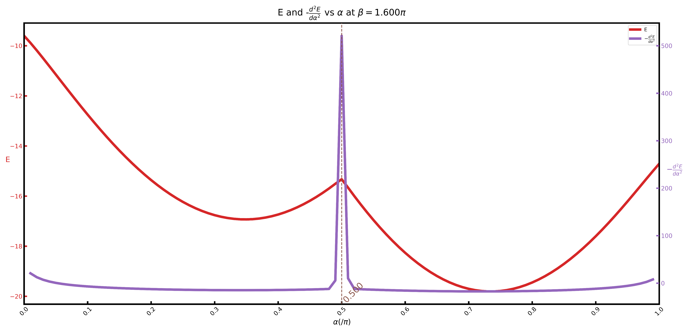

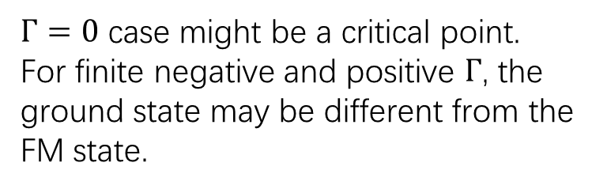
The effect $Γ$-term on the FM phase
$Γ=0$ case might be a critical point.
For finite negative and positive $Γ$, the ground state may be different from the FM state.

Slide 8
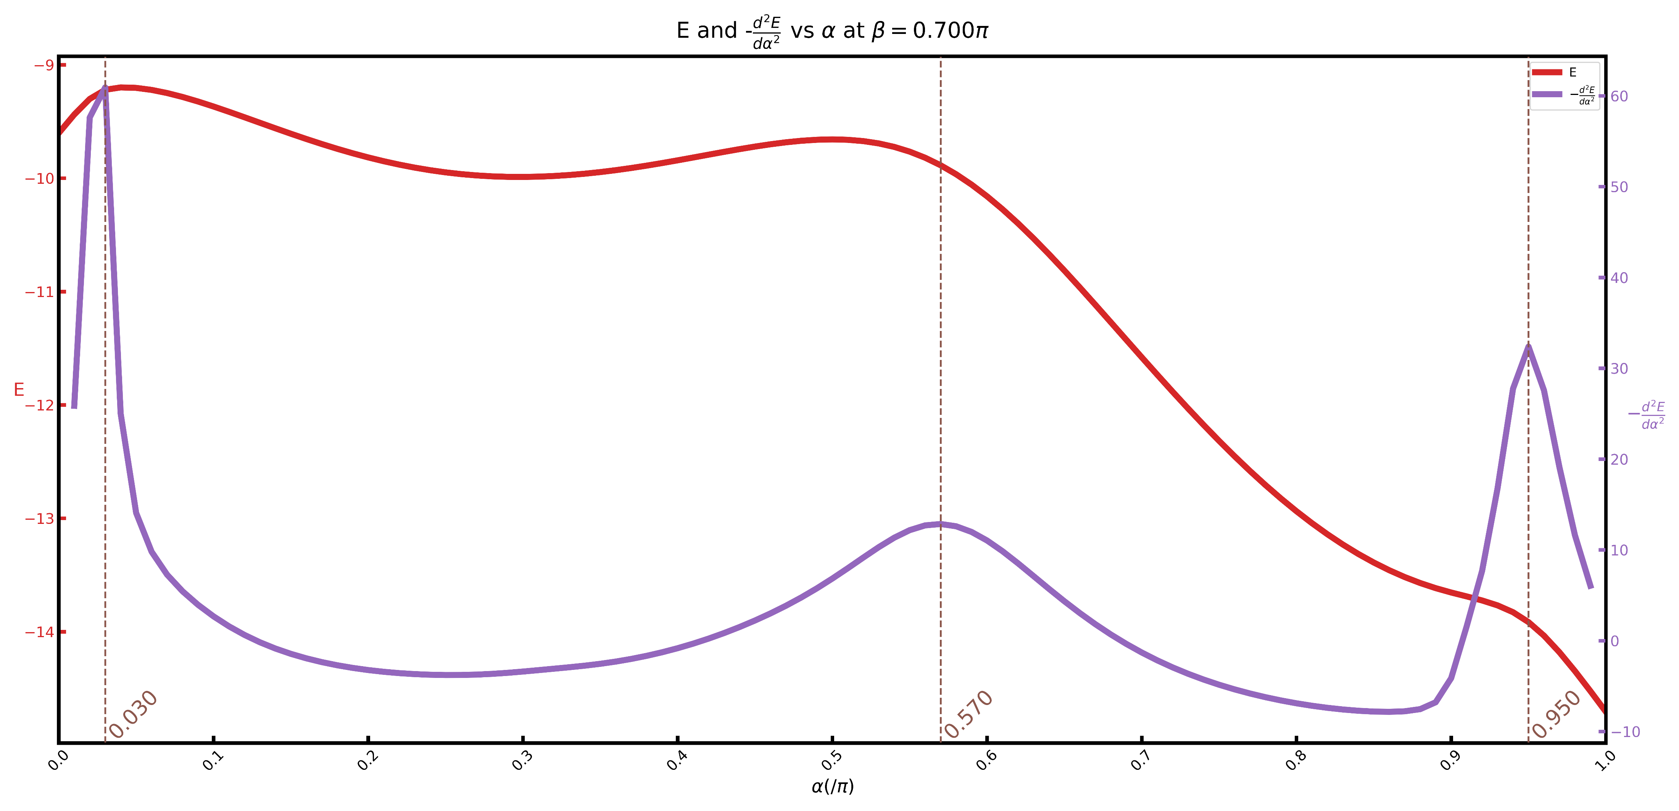

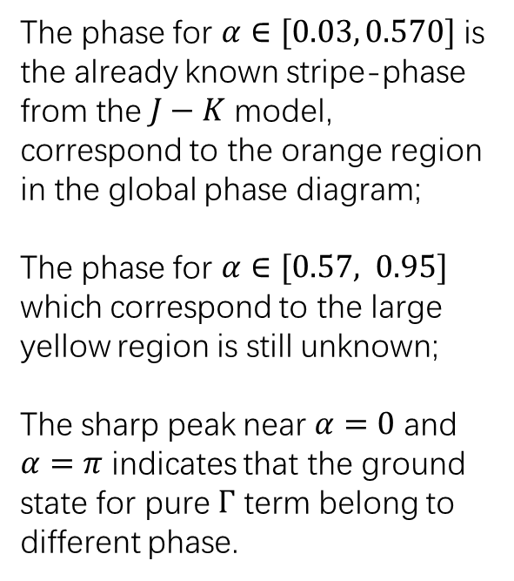
The effect $Γ$-term on the stripe phase
The phase for $α∈[0.03, 0.570]$ is the already known stripe-phase from the $J−K$ model, correspond to the orange region in the global phase diagram;
The phase for $α∈[0.57, 0.95]$ which correspond to the large yellow region is still unknown;
The sharp peak near $α=0$ and $α=π$ indicates that the ground state for pure $Γ$ term belong to different phase.

Slide 9
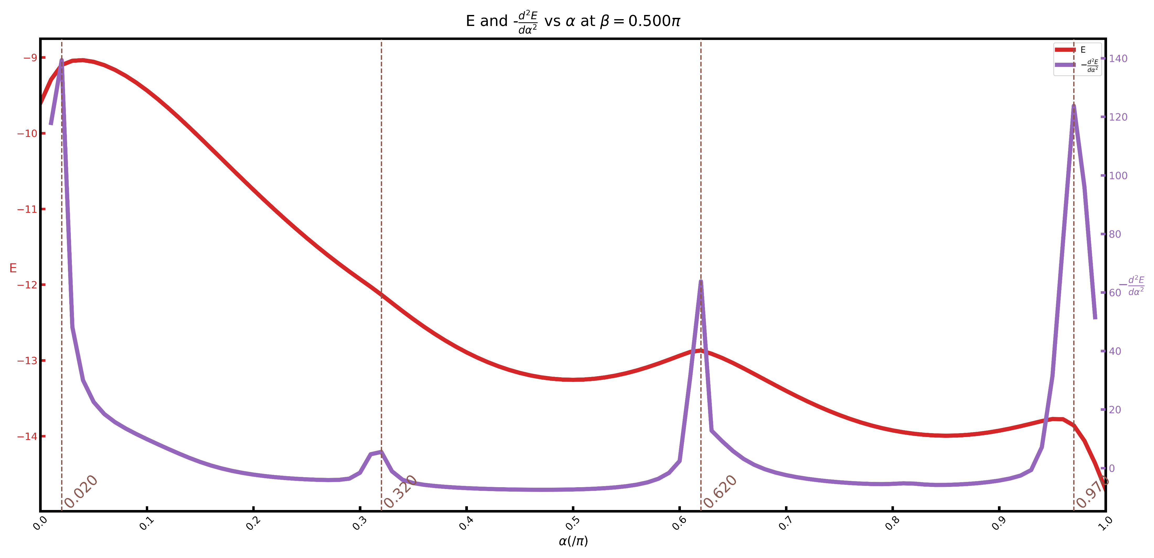
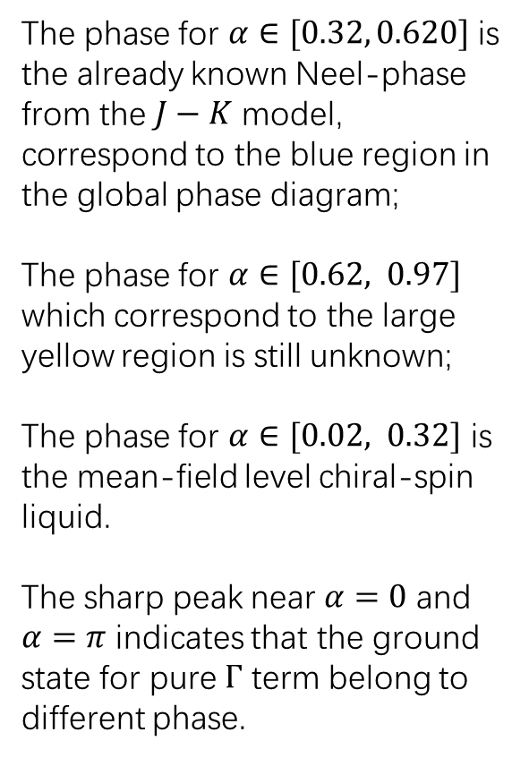
The effect $Γ$-term on the $120°$-Neel phase
The phase for $α∈[0.32, 0.620]$ is the already known Neel-phase from the $J−K$ model, correspond to the blue region in the global phase diagram;
The phase for $α∈[0.62, 0.97]$ which correspond to the large yellow region is still unknown;
The phase for $α∈[0.02, 0.32]$ is the mean-field level chiral-spin liquid.
The sharp peak near $α=0$ and $α=π$ indicates that the ground state for pure $Γ$ term belong to different phase.

Slide 10
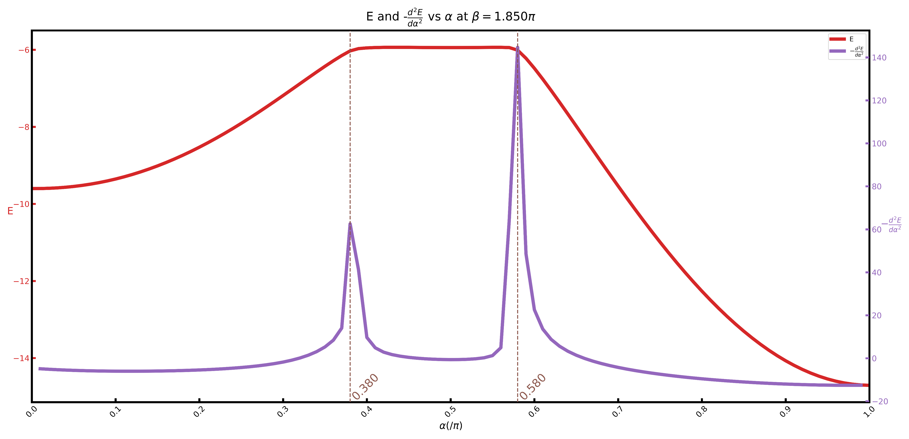
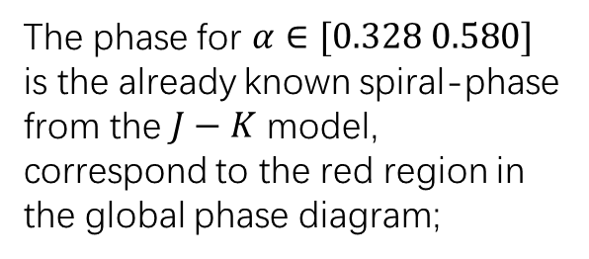
The effect $Γ$-term on the spiral phase
The phase for $α∈[0.328 0.580]$ is the already known spiral-phase from the $J−K$ model, correspond to the red region in the global phase diagram;

Slide 11
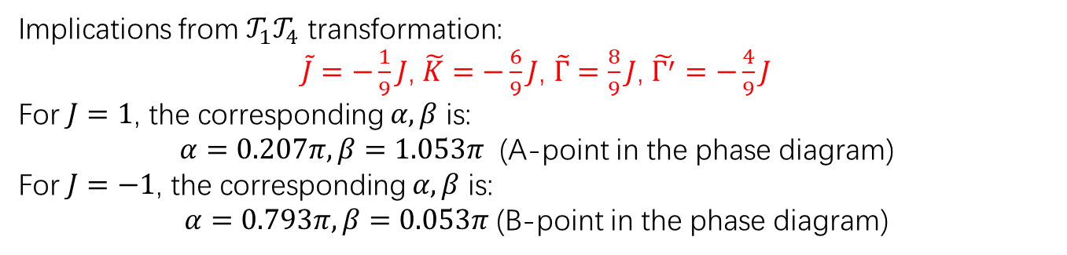
Implications from $𝒯_{1}𝒯_{4}$ transformation:
$\tilde{J}=−\frac{1}{9}J$, $\tilde{K}=−\frac{6}{9}J$, $\tilde{Γ}=\frac{8}{9}J$, $\tilde{Γ^{′}}=−\frac{4}{9}J$
For $J=1$, the corresponding $α,β$ is:
$α=0.207π,β=1.053π$ (A-point in the phase diagram)
For $J=−1$, the corresponding $α,β$ is:
$α=0.793π,β=0.053π$ (B-point in the phase diagram)
B
A

Slide 12
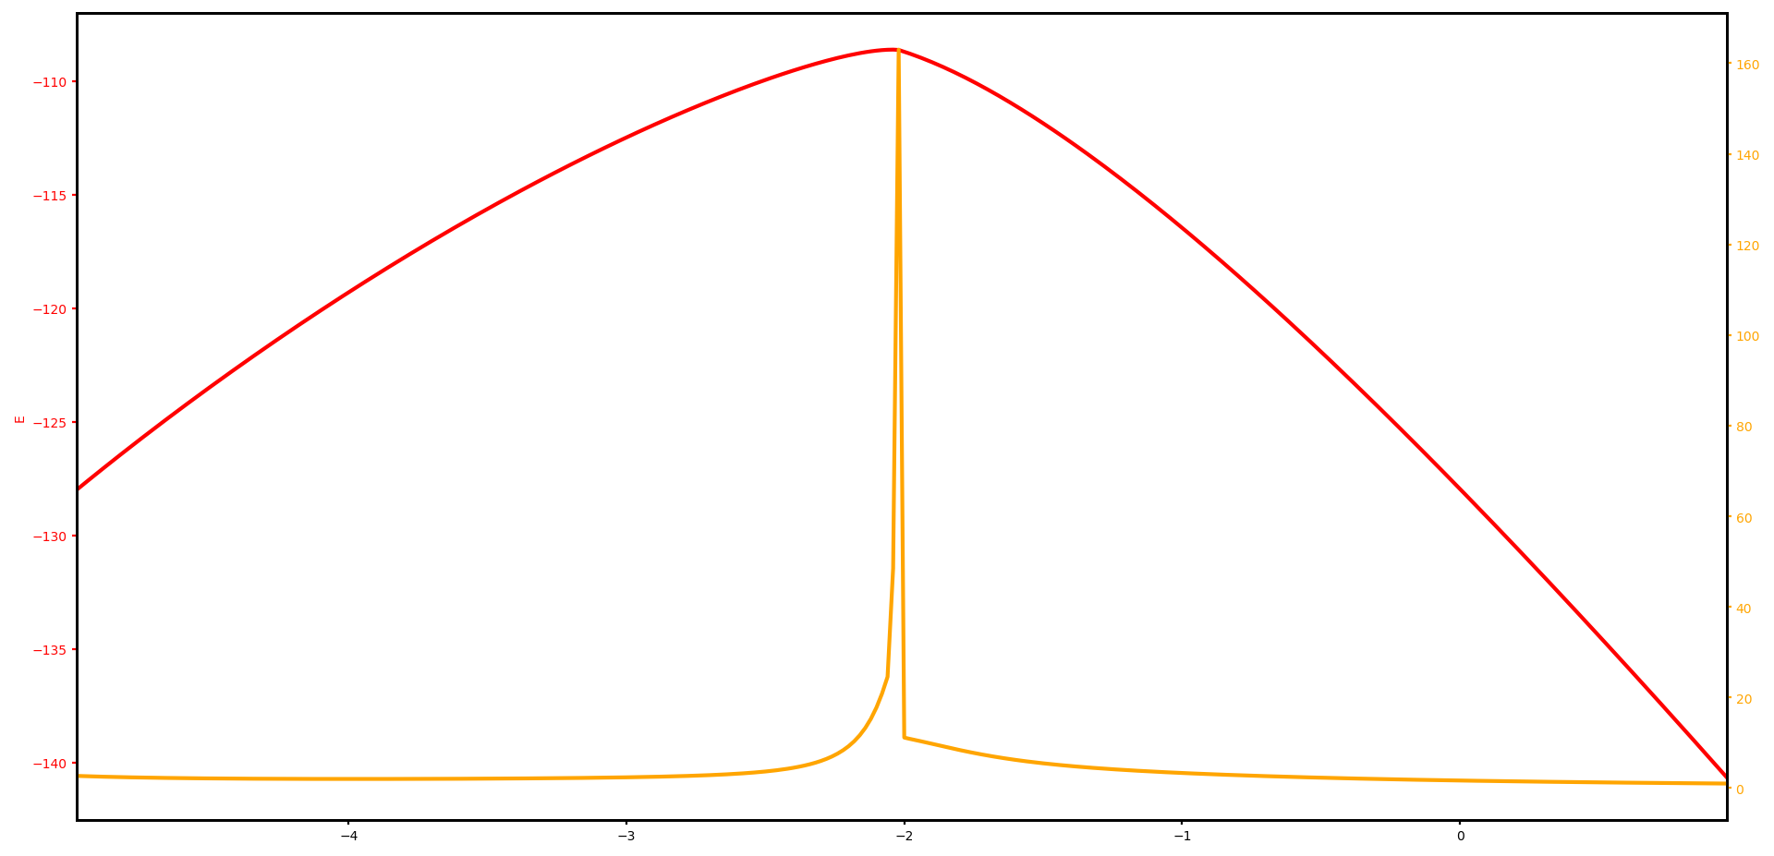
Ground state energy from A point to the Hidden SU(2) point which can be mapped back to Ferromagnet Heisenberg model by $𝒯_{1}𝒯_{4}$ transformation; The sharp peak at $Γ^{′}$ indicates a phase transition.

Slide 13
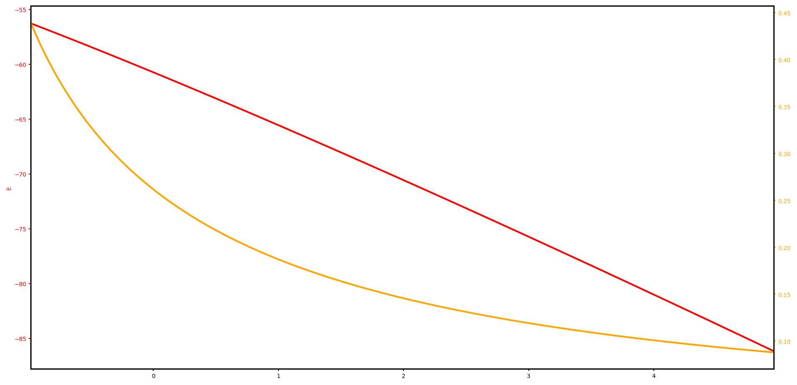
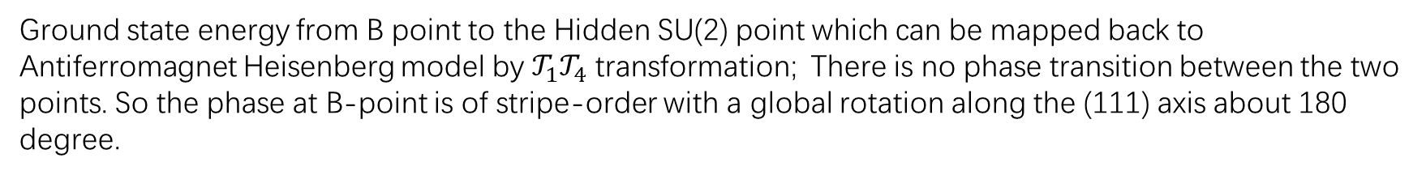
Ground state energy from B point to the Hidden SU(2) point which can be mapped back to Antiferromagnet Heisenberg model by $𝒯_{1}𝒯_{4}$ transformation; There is no phase transition between the two points. So the phase at B-point is of stripe-order with a global rotation along the (111) axis about 180 degree.

