Slide 1
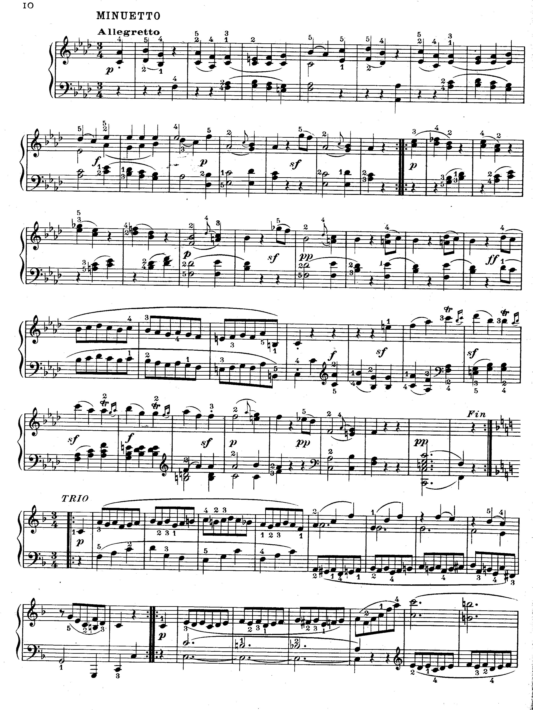
Starts here.
(2nd time)
Ends here.

