Slide 1
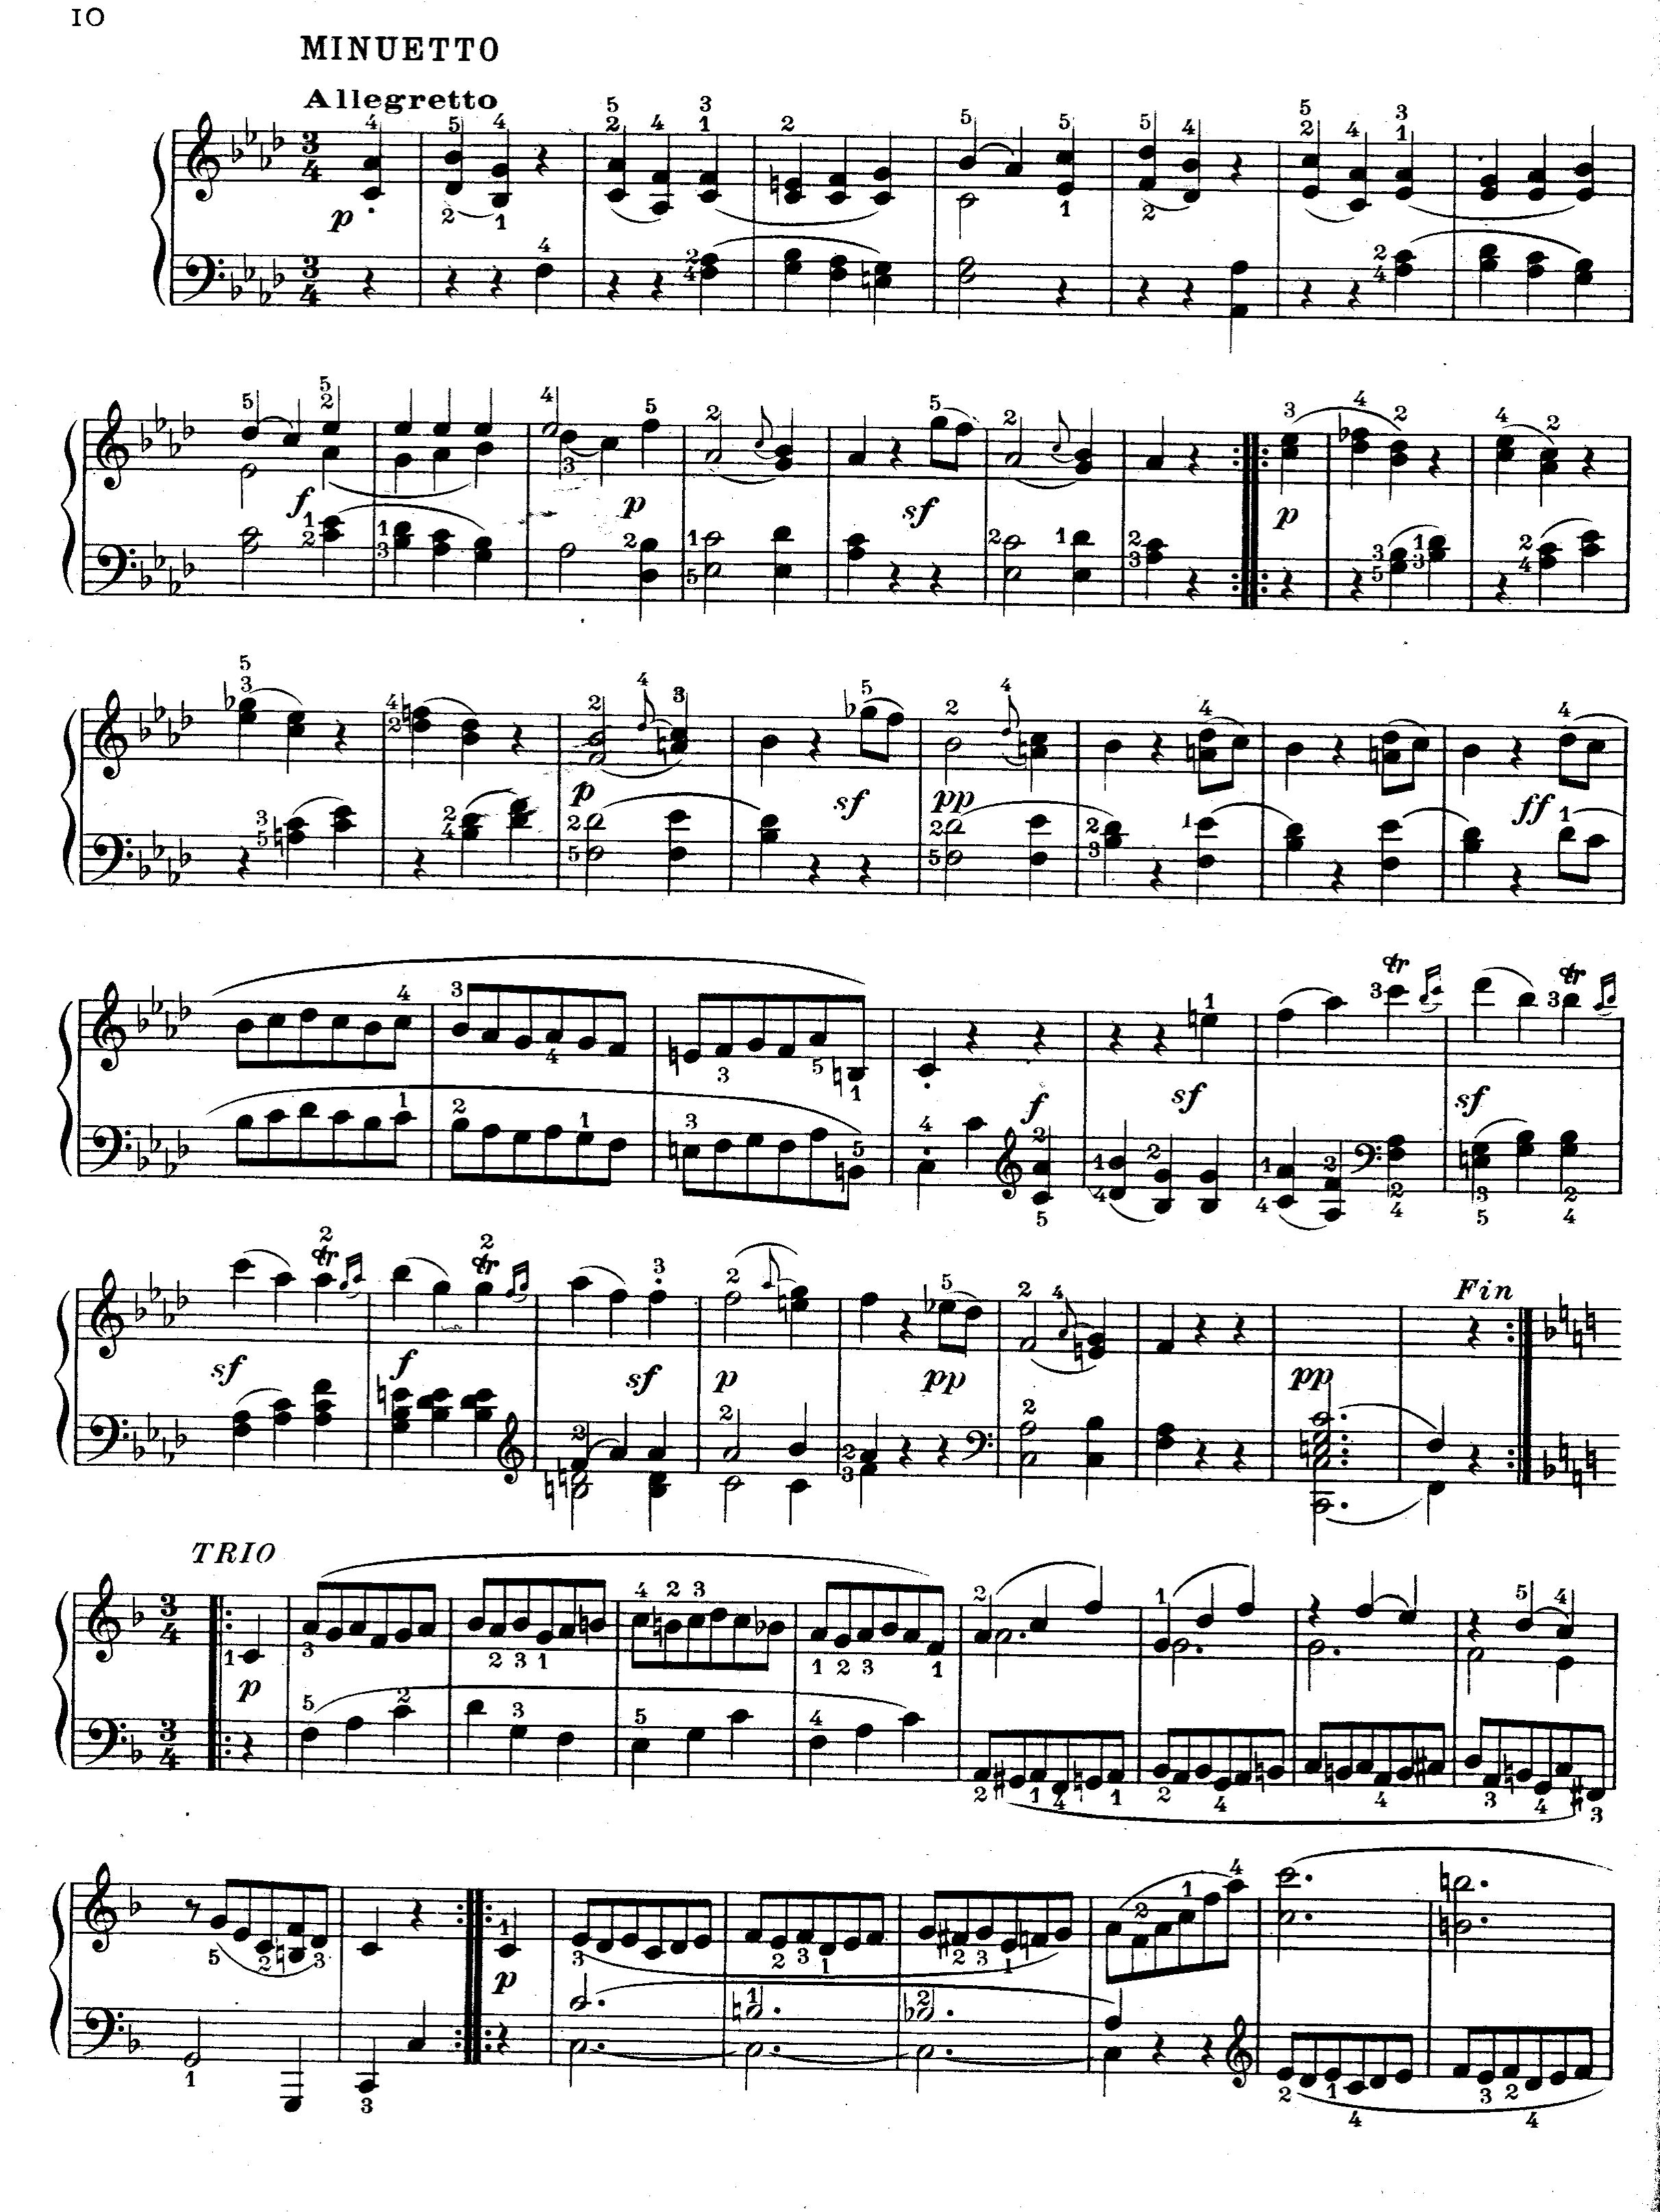
Starts here.
Ends here.

