Slide 1
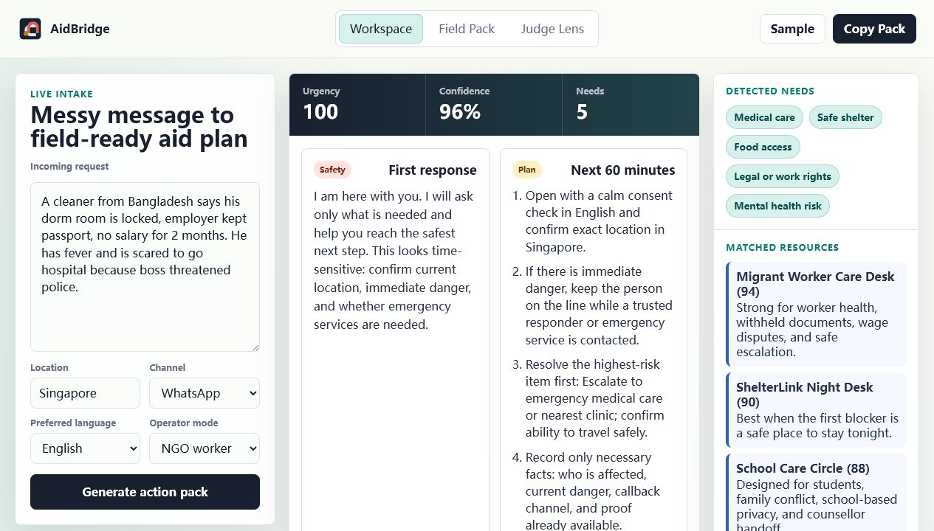
AIDBRIDGE
A chaotic cry for help becomes a safe, auditable community response.
Multilingual aid triage for volunteers, counsellors, NGOs, and mutual-aid teams.
Risk + privacy + resource matching + field pack
UCWS Singapore Hackathon 2026 · Application + DeepResearch-ready

Slide 2
THE FIRST MINUTES
Community aid breaks before the right person ever sees the case.
01
02
03
04
Messy intake
→
Volunteer improvises
→
Evidence gets messy
→
Handoff is late
WhatsApp, hotline, or walk-in message is incomplete, emotional, multilingual.
Questions vary; urgent facts and consent can be missed.
Sensitive details may be overshared while useful proof disappears.
The case waits instead of routing to a trusted resource with ownership.
AidBridge targets the moment where small mistakes compound into unsafe outcomes.
AidBridge / UCWS 2026

Slide 3
PRODUCT WORKFLOW
AidBridge does not stop at an answer; it creates a handoff system.
01
02
03
04
05
06
Intake
Detect
Redact
Match
Clock
Export
Paste messy message
Needs + risk
Privacy-safe brief
Trusted resources
Follow-up timing
Field pack
Result: a one-page operator brief for WhatsApp, helpdesk notes, NGO CRM, or human case review.
AidBridge / UCWS 2026

Slide 4
DIFFERENTIATION
The public field is agent-heavy; AidBridge is a public-good application with a visible user loop.
Operational workflow
AidBridge
community response
Finance
agents
Agent
frameworks
Voice + travel
apps
Developer
skills
Concept / tool
Developer-only
Frontline user
Public GitHub search shows low stars across UCWS-specific repos, so clarity, usability, repo quality, and submission completeness are leverage.

Slide 5
SCORING BRIDGE
AidBridge is built directly around the official 30 / 30 / 40 evaluation model.
30%
Community Vote
Immediate demo, emotional clarity, shareable public-good story
30%
AI Evaluation
Clean repo, deterministic engine, tests, screenshots, docs
40%
Expert Judges
Real-world stakes, privacy safeguards, global resource-directory path
Official platform API long description: Community Vote 30%, AI Evaluation 30%, Expert Judges 40%.

Slide 6
READY TO SUBMIT
The project is ready; the remaining steps are account actions.
✓
Static app + local server
Next external actions
✓
README + Project Wall fields
1. Push GitHub repo
2. Deploy public demo
3. Fill Demo URL + Repo URL
4. Add real team members
5. Submit on Project Wall
✓
Tests for triage, redaction, resource matching
✓
Screenshots + deployment guide
✓
Submission audit + demo script
Close: AidBridge wins because it makes AI useful when a human helper cannot afford to improvise.

