Slide 1
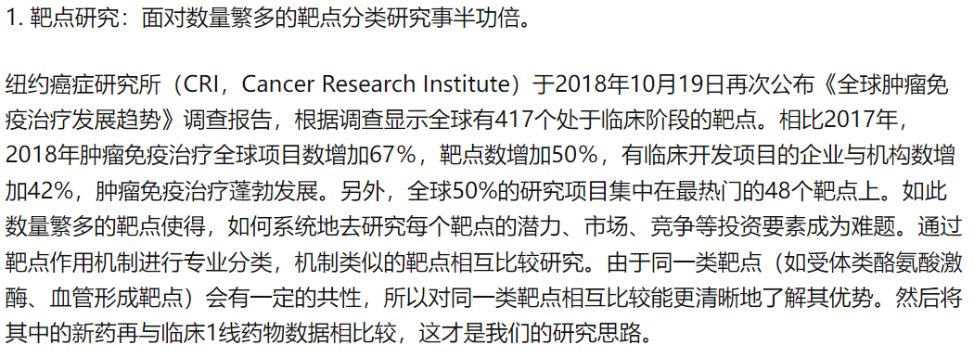
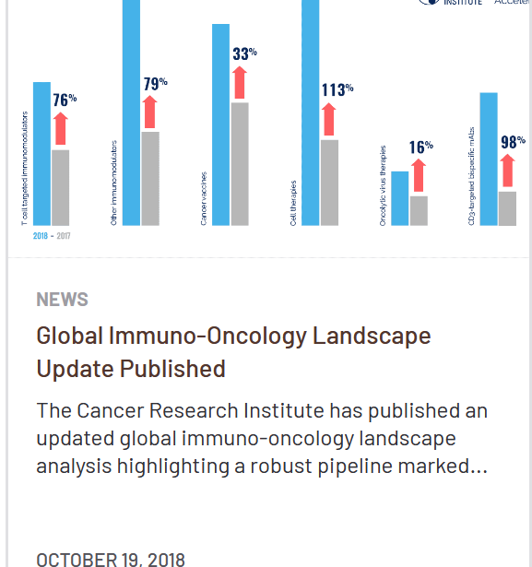
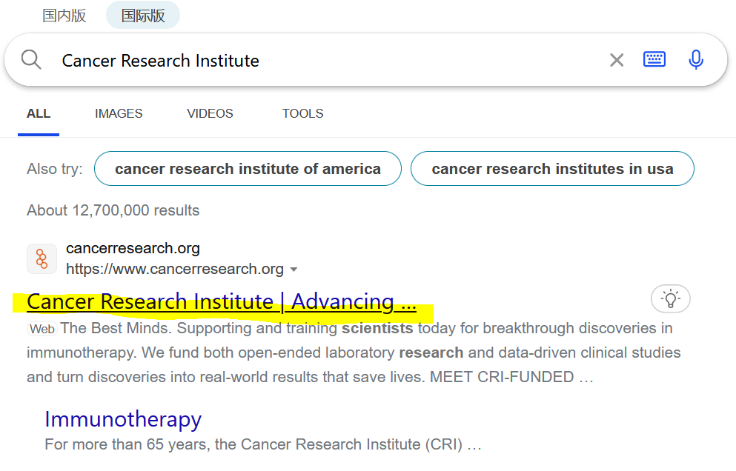
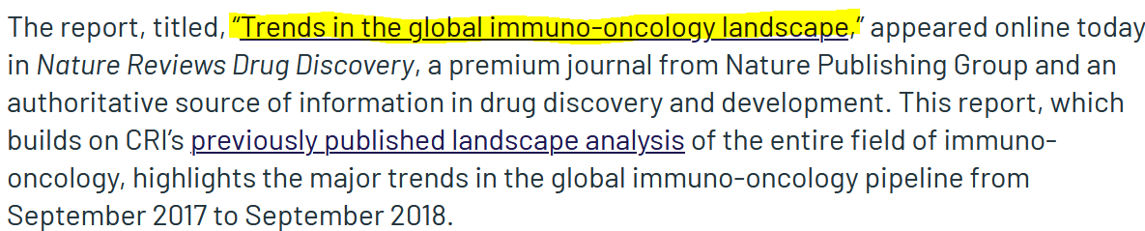
从知乎上面看到这句话，然后搜索CRI，进入其官网
点开就能看到文献，在文献中找到靶标表格
直接在官网里面搜索trend

Slide 2
1.查找
‘regulate/modulate/increase activity’ or ‘activate’ 证明 phosphorylation与 activation有关
靶点汇总
在bing和PubMed中搜索’target’ phosphorylation activation
在bing和PubMed中搜索’target’ phosphorylation activation
在bing和PubMed中搜索关键词’Target’ phosphorylation cancer
2.判断
‘位点 ’ and ‘regulate or modulate or increase activity or‘induce’ or ‘upstream’ or ‘mediate’ or ‘upregulate’ or ‘证明 phosphorylation与 activation有关
activity
unrelated
否
人为判断：’位点’ and ‘phosphorylation’ and ‘anti-apoptotic’ or cancer’ or ‘carcinoma’ or ‘tumor’ or ‘migration’ or ‘cell growth’ or ‘proliferation’ or ‘invasion’ or ‘lymphoma’ or ‘leukemia’ or ‘carcinogenesis’ or ‘Oncogenesis’ or ’Neoplasia’ or ‘Neoplastic’ or ‘Malignancy’ or ‘Malignancies’ or ‘Metastasis’ or ’ Metastatic dissemination’ or ‘Carcinogenic’ or ‘Oncogenic’ or ‘neuroblastoma’ or ‘Adenocarcinoma’ or ‘angiogenesis’ or ‘tumorigenic’ or ‘tumorigenesis’ or ‘melanoma’ or ‘oncoprotein’ or ‘sarcomas’ or ‘dysplasia’ or ‘precancerous lesions’ or ‘precancerosis’ or ‘ proapoptotic’
是
v
否
在bing和PubMed中搜索’target’ phosphorylation
人为判断：结合上述两个
判断，如果出现‘phosphorylation’ and ‘anti-apoptotic’ or cancer’ or ‘carcinoma’ or ‘tumor’ or ‘migration’ or ‘cell growth’ or ‘proliferation’ or ‘invasion’则走cancer；
[补充到和第一个框一样]
如果出现：‘regulate/modulate/promote/increase activity’ or ‘activate’ 则走activity；如果没有上述关键词则走unrelated
在bing或PubMed中搜索target cancer
是
3.查找
人为判断：
‘overexpression’,’activity’,‘oncogenic’, ‘cancer’,‘tumor’, ‘anti-apoptotic’
否
在bing或PubMed中搜索target cancer
4.判断
是
人为判断：
‘overexpression’,’activity’,‘oncogenic’, ‘cancer’,‘tumor’, ‘anti-apoptotic’, ‘anti-apoptotic’ or cancer’ or ‘carcinoma’ or ‘tumor’ or ‘migration’ or ‘cell growth’ or ‘proliferation’ or ‘invasion’
证明’target’某位点的 phosphorylation和cancer有关
否
unrelated
是
是
证明’target’ phosphorylation和cancer有关
否
unrelated
证明’target’ phosphorylation和cancer有关
cancer
unrelated

Slide 3
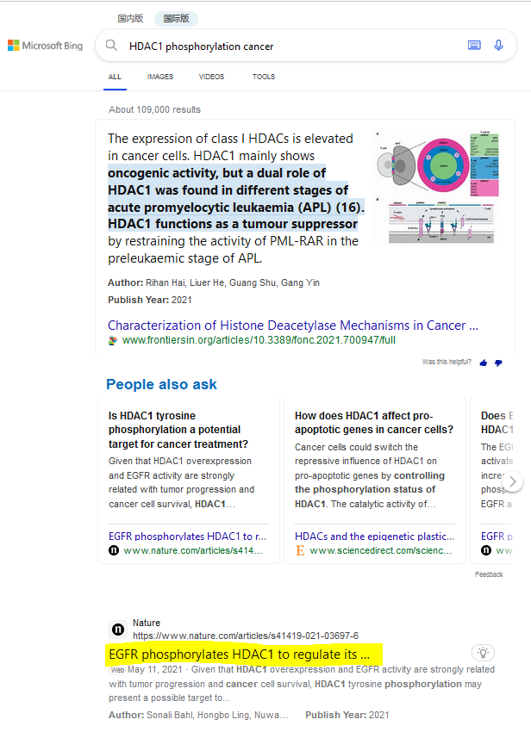
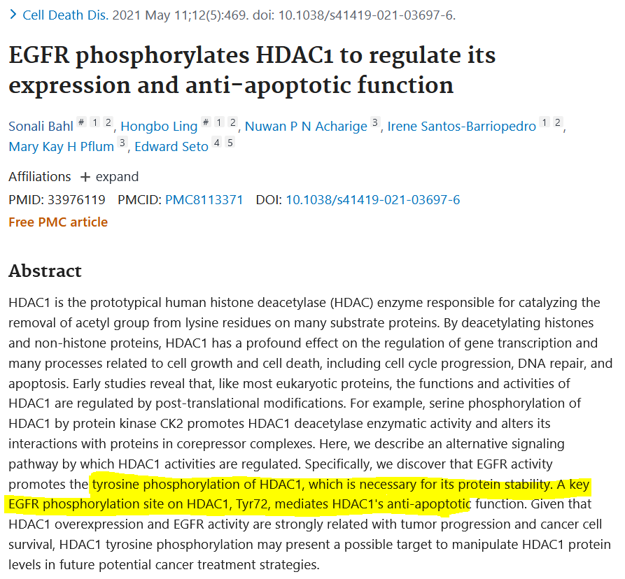
在bing和PubMed中搜索关键词HDAC1 phosphorylation cancer
文章摘要中提到磷酸化位点与其蛋白稳定性和其抗凋亡能力有关，则可以证明HDAC1的磷酸化与癌症有关

Slide 4
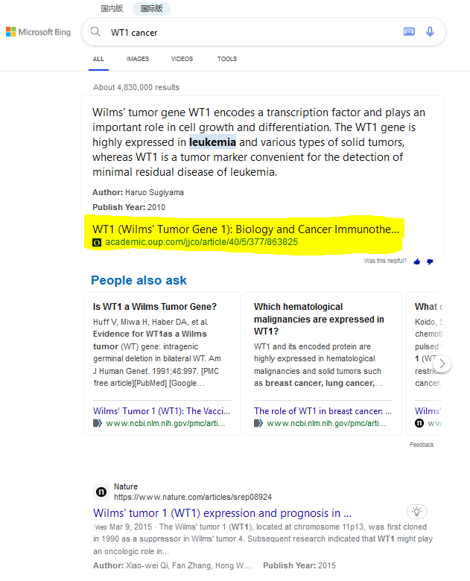
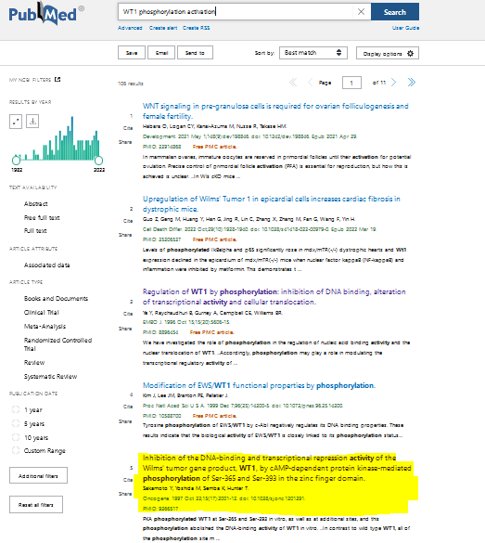
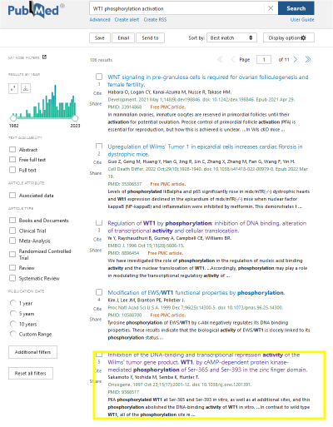
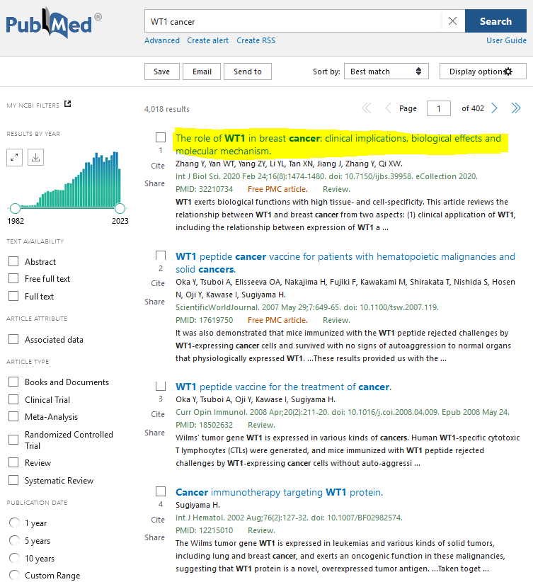
1.查找
在bing和PubMed中搜索关键词WT1 phosphorylation cancer
在bing和PubMed中搜索WT1 phosphorylation activation
4.判断
2.判断
人为判断:
‘位点 ’ and ‘regulate/modulate/increase activity’ or ‘activate’
人为判断：
‘overexpression’,’activity’,‘oncogenic’, ‘cancer’,‘tumor’, ‘anti-apoptotic’,
人为判断：
’位点’ and ‘phosphorylation’ and ‘anti-apoptotic’ or cancer’ or ‘carcinoma’ or ‘tumor’ or ‘migration’ or ‘cell growth’ or ‘proliferation’ or ‘invasion’
否
没有和位点相关
3.查找
在bing或PubMed中搜索WT1 cancer
证明WT1位点的 phosphorylation和cancer有关

Slide 5
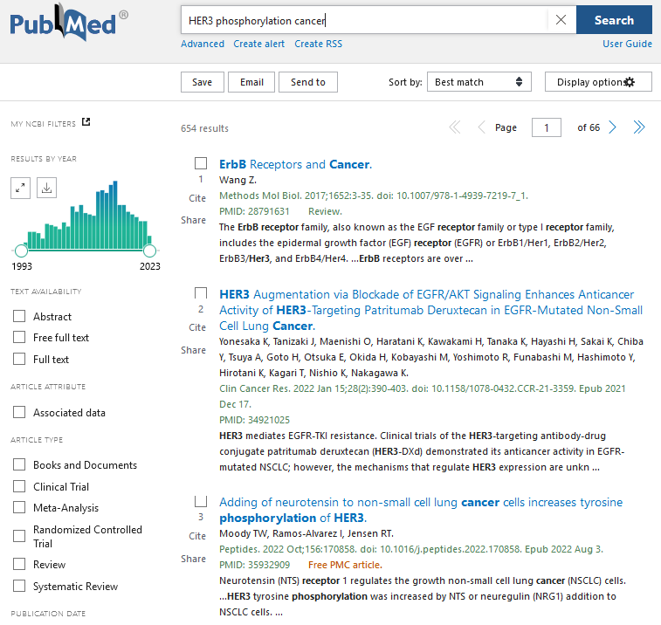
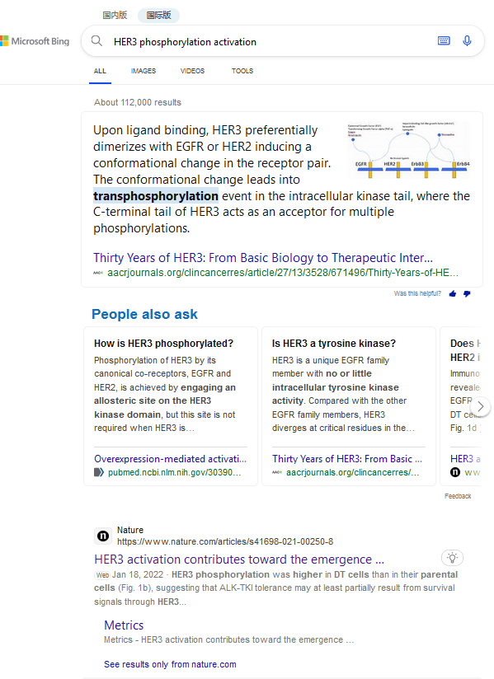
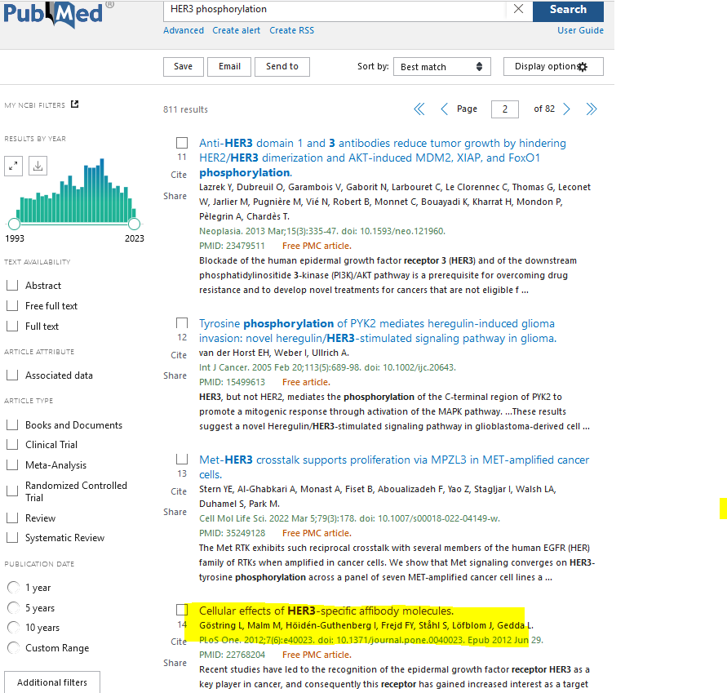
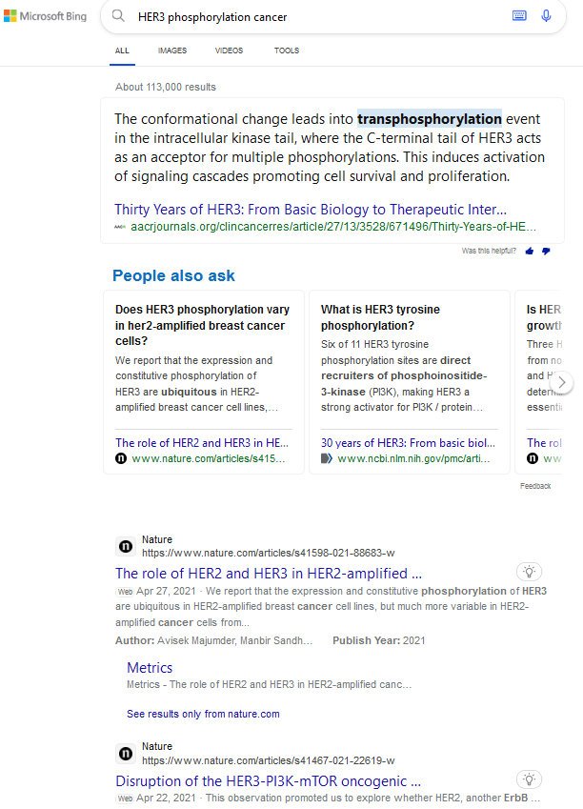
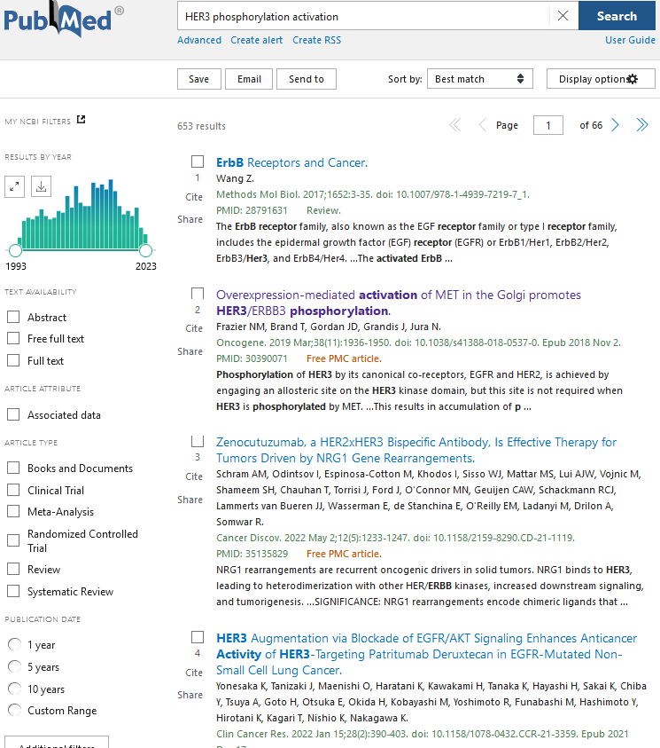
在bing和PubMed中搜索关键词HER3 phosphorylation cancer
在bing和PubMed中搜索HER3 phosphorylation activation
在bing和PubMed中搜索HER3 phosphorylation
人为判断：结合上述两个
判断，如果出现‘phosphorylation’ and ‘anti-apoptotic’ or cancer’ or ‘carcinoma’ or ‘tumor’ or ‘migration’ or ‘cell growth’ or ‘proliferation’ or ‘invasion’则走cancer；
如果出现：‘regulate/modulate/promote/increase activity’ or ‘activate’ 则走activity；如果没有上述关键词则走unrelated
人为判断:
‘位点 ’and ‘regulate/modulate/promote/increase activity’ or ‘activate’
人为判断：’位点’ and ‘phosphorylation’ and ‘anti-apoptotic’ or cancer’ or ‘carcinoma’ or ‘tumor’ or ‘migration’ or ‘cell growth’ or ‘proliferation’ or ‘invasion’
否
没有和位点相关
cancer
证明’target’ phosphorylation和cancer有关

Slide 6
