Slide 1
Experiment Summary
Tianyu Wang
07/27/2022

Slide 2
Goal
Current Problem in DRO non-asymptotic generalization bound is (which cannot bypass the curse of dimensionality or function complexity fully)
When the function complexity or random variable dimension is very large, these terms would have terrible effects on the model performance.
However, in some cases, the underlying distribution can be approximated by a parametric distribution or embedded in a lower dimension…
Question: Can we borrow some modeling techniques on the distribution to improve these bounds?
Yes we can!
Fully parametric models: for Wasserstein, f-divergence we can have O(dist-complexity/sqrt{n}) in general.
In general, using some param-GAN, we can obtain bounds fully parametric…

Slide 3
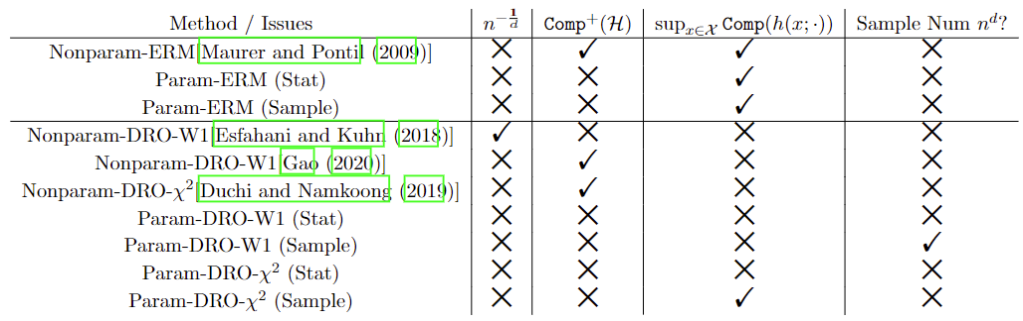
Generalization Bound
Best known generalization bound
× means does not have; √ means have in the bound.

Slide 4




Synthetic Dataset
Consider the following downside risk objective:
With decision space
\alpha and \tau are used to control the degree of function complexity…
In the base case, we assume the true distribution to be a variant of independent Beta distributions…
Theoretically, we have:
Ambiguity size $O(\sqrt{d/n})$ is enough for the coverage of the true distribution..
In practice, we deploy CV (from 0.001 to 1). Due to time limits, we only show the results of fixed parameters to show the trend.

Slide 5
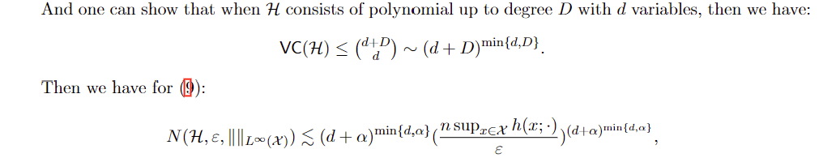
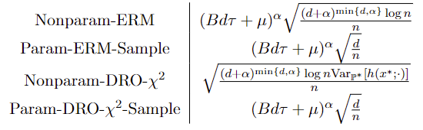
Formative Analysis (Theory Expectation)
Expected Bound:

Slide 6
Results
With suitable ambiguity param (can be tuned via CV), param-DRO models can outperform its ERM version.
Although not obvious numerically, the p-value is very low…

Slide 7
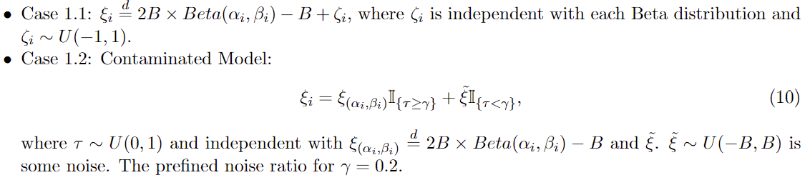
Model misspecification
Now if the true underlying distribution is not fully parametric w.r.t. parametric family…
For example, we test the case when the true distribution satisfies the following case:
Under such case, our model has larger margins over ERM models…

Slide 8
Example: CV results for Case 1.1
Due to computational limits…
(second line of each model result indicates the statistical significance level compared with corresponding ERM cases.
sample size | dom order | ERM-nonparam | ERM-param | DRO-nonparam | DRO-param
50 | 2 | 503.935 | 17.16543 | 381.4961 | 16.37219
 |  | 1 | 1 | 8.03E-06 | 1.31E-08
50 | 4 | 2348706 | 474.1068 | 2648273 | 440.7186
 |  | 1 | 1 | 0.239714 | 5.64E-11

Slide 9
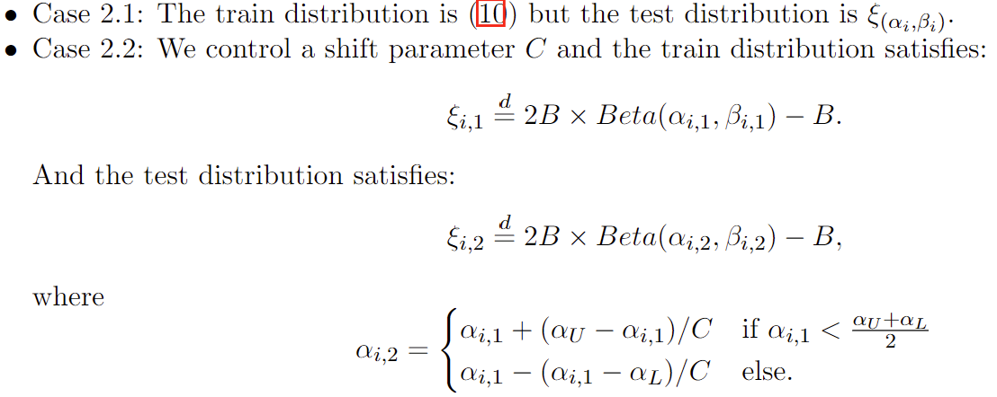
Distribution Shift
We consider the case when the train and test distribution differs.
Consider the two following different shift types:
We should be careful here e.g. if we change the distribution shift reversely (since reversed shift distribution is not the worst-case w.r.t. the train model).

Slide 10
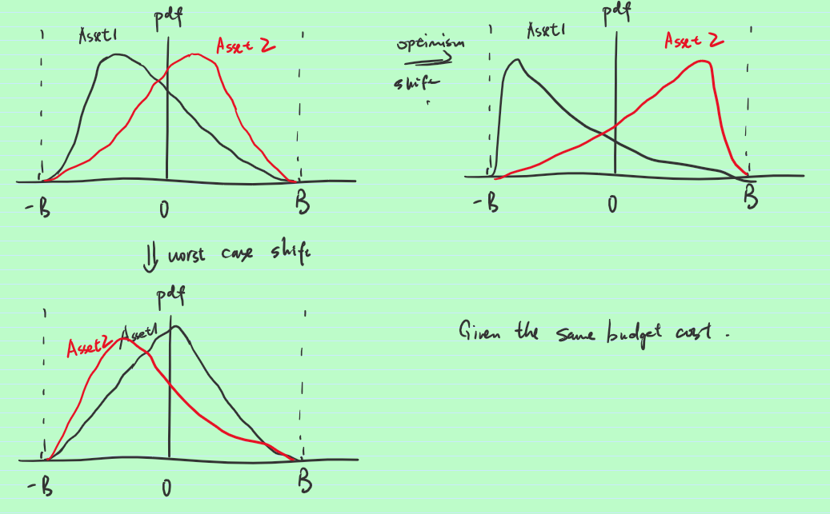
An obvious tricky example
ERM would prefer Asset 2 more while DRO should have similar weights on the two assets…
In the worst case shift, DRO wins…
In the optimism shift, ERM wins…

Slide 11
Results for Case 2.1…
Parametric Ones…

Slide 12
Results for Case 2.2
Parametric with BD = 10…(Consider the variants of shift prop C = 2 or 5)…

Slide 13
Real Dataset
Consider a true market and we adopt a “rolling-window” approach with window size M = 60 months from 1963 to 2020…
Each model with over 600 sequential time periods to test
https://mba.tuck.dartmouth.edu/pages/faculty/ken.french/data_library.html
Observations (here we just fix one parameter):
Beta: ERM and DRO versions do not differ much…
Normal: Our DRO models can reduce generalization error by a lot…

Slide 14
Remaining Questions
What to do next:
Is there some lower bound guarantee for these models?
Faster Rate under some cases?
High Dimension Region, when $d \asymp n$.
Asymptotic Analysis: is it necessary? Distinguish between asymptotic and non-asymptotic region…
Empirically…
Some explanations for this U-curve and the variation of the turning point under some circumstances…
Extend to GAN Setup (from parametric to a more general setup..

Slide 15
Problem in this draft…
Notation Representation… Comp, Comp+ (for parameter space…)
Param-DRO-chi2-sample case…not know how to prove without sup (since we do not have the coverage assumption then…
In the experiment, we can adjust problem dimension if needed since it also control the complexity of the whole loss function…

