Slide 1
Which covariates drive the ML predictions?
SHAP rankings for the best 2 ML models per arm | ACoP 2026 DM1 Hackathon, Team 9

Slide 2
How the two models per arm were chosen
Arm | Model 1 | CV RMSE | Model 2 | CV RMSE | Null test RMSE
Mexiletine | RF (tuned) | 0.79 ± 0.10 | XGBoost (tuned) | 0.80 ± 0.10 | 1.47
Oligonucleotide | SVR (tuned) | 1.51 ± 0.15 | RF (tuned) | 1.53 ± 0.16 | 1.85
Tideglusib | XGBoost (tuned) | 2.05 ± 0.33 | RF (untuned) | 2.09 ± 0.35 | 3.39
Notes:
CV RMSE is mean ± SD over the 15 outer folds. The two models within each arm are within one SD of each other, so neither one is the clear winner.

Slide 3
Selection rule and how to read the plots
Best variant from each ML family (RF, XGBoost, SVR), ranked by outer CV RMSE on training data. The test set was not used for selection.
Full 16-covariate set (15 for Mexiletine). SHAP computed on the training set.
Bar length is mean |SHAP|. Colour is the share of 15 CV folds where the covariate ranked in the top 3, i.e. its stability.
Bar labels show the covariate’s share of total |SHAP| and its direction (↑ value → ↑/↓ prediction; for categoricals, levels ordered by mean SHAP).
RF and XGBoost use TreeSHAP. SVR uses model-agnostic permutation SHAP. Both are in outcome units.

Slide 4
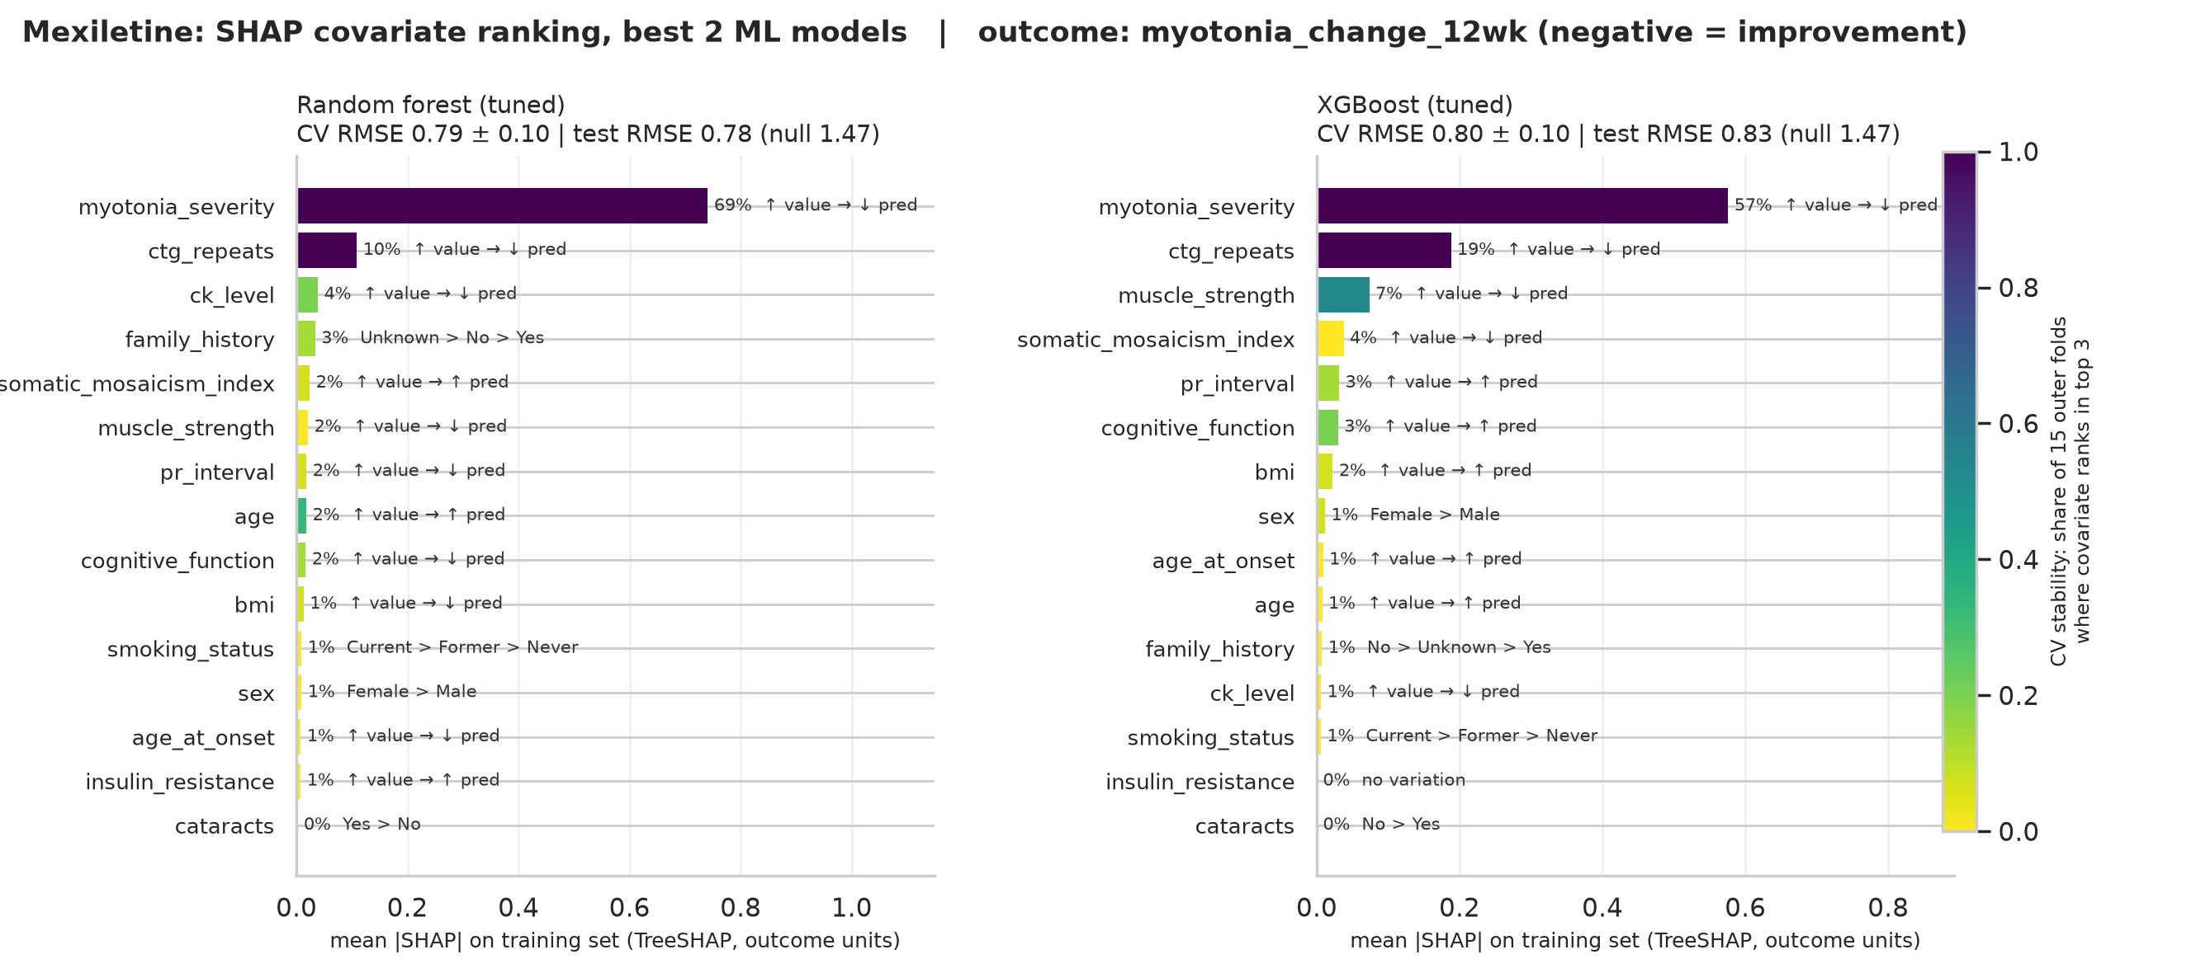
Mexiletine: myotonia_severity dominates, ctg_repeats is a stable #2
Notes:
In both models, myotonia_severity carries 57-69% of total |SHAP| and ranks in the top 3 in every CV fold. Higher baseline severity gives a lower (more negative, i.e. better) predicted myotonia change, which fits a symptomatic Na+ channel blocker. ctg_repeats is also top 3 in every fold for both models. Below rank 3, the order changes between models and folds, so treat it as noise.

Slide 5
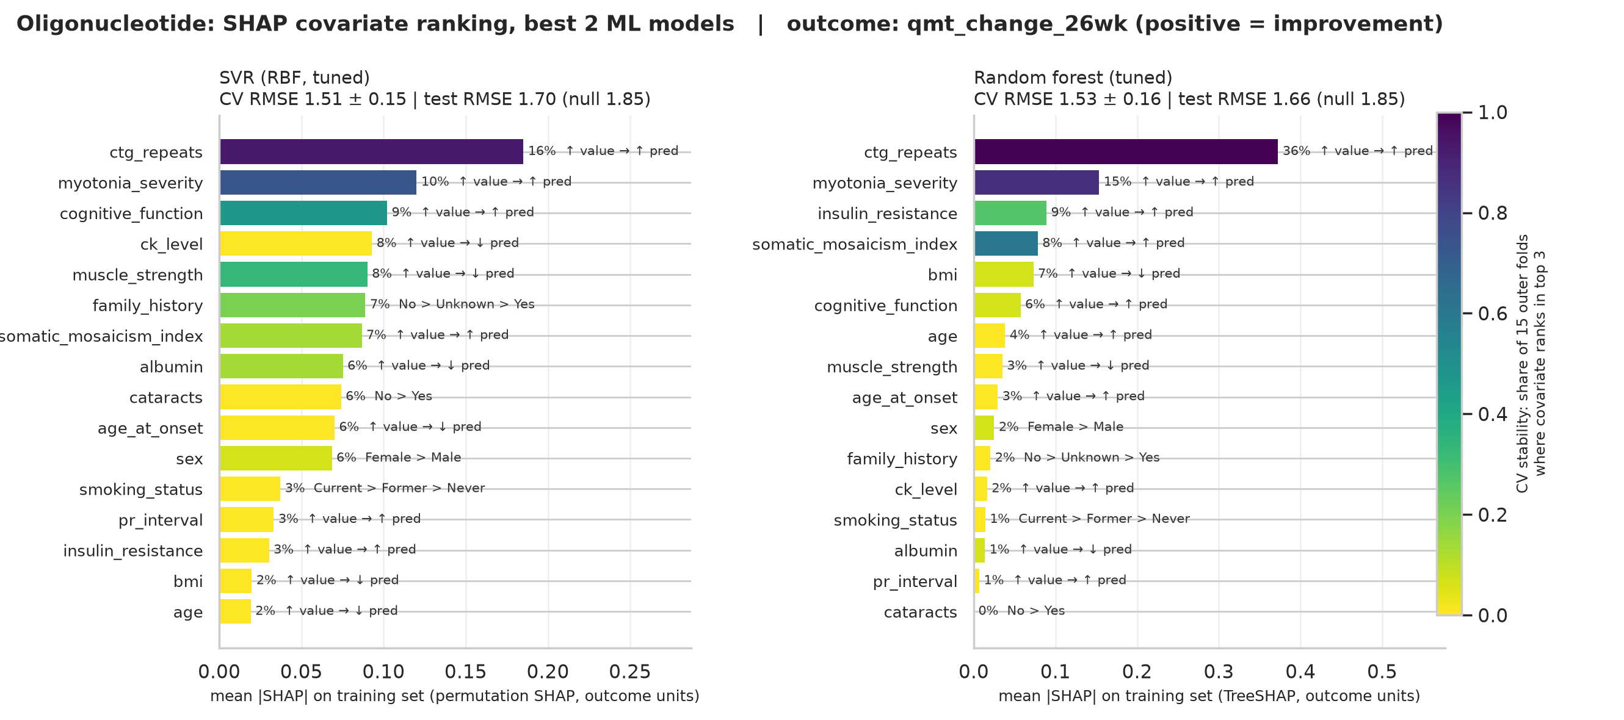
Oligonucleotide: ctg_repeats leads in both models, but the signal is weak
Notes:
ctg_repeats ranks #1 for both SVR and RF, and higher repeat count predicts a larger QMT gain. That fits an ASO that targets the toxic DMPK RNA. myotonia_severity is a consistent #2. Overall predictive power is low (test R2 about 0.14-0.19, and the test RMSE intervals overlap the null), and importance in the SVR is spread out. Beyond the top 2, the ranking is not reliable.

Slide 6
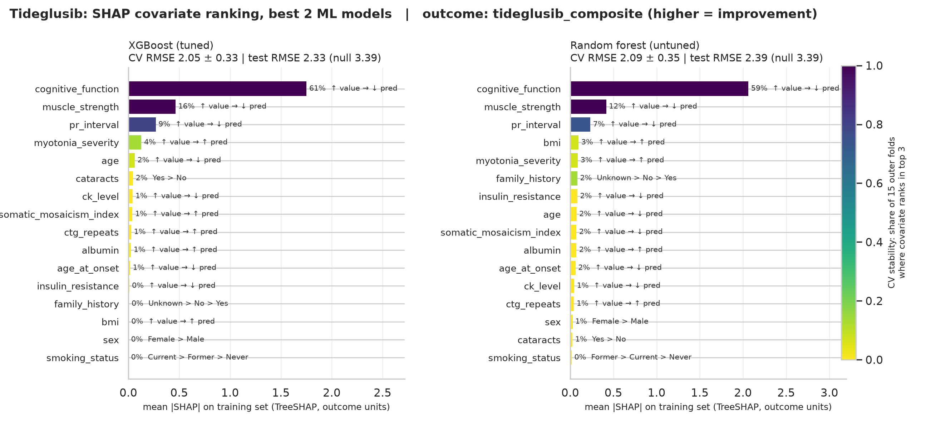
Tideglusib: cognitive_function, muscle_strength and pr_interval agree across models
Notes:
XGBoost and RF give the same top 3 in the same order. cognitive_function carries about 60% of |SHAP| and is top 3 in every fold. muscle_strength is also top 3 in every fold, and pr_interval in 73-80% of folds. All three point the same way: higher baseline value, lower predicted composite score.

Slide 7
Signal vs noise across arms
Arm | Agreed top covariates (both models, top 3 in ≥ 70% of CV folds) | Test R² (model 1 / model 2)
Mexiletine | myotonia_severity, ctg_repeats | 0.72 / 0.68
Oligonucleotide | ctg_repeats, myotonia_severity | 0.14 / 0.19
Tideglusib | cognitive_function, muscle_strength, pr_interval | 0.53 / 0.50

Slide 8
Interpretation and caveats
The top covariate in each arm matches the drug’s mechanism: symptom severity for Mexiletine, repeat burden for the ASO, cognition plus motor for Tideglusib.
Covariates outside this list are unstable across folds and models, so we treat them as noise.
SHAP explains what the model uses, not causal effects. Each test set has only 20-35 patients, so small differences between models are not meaningful.

