Slide 1

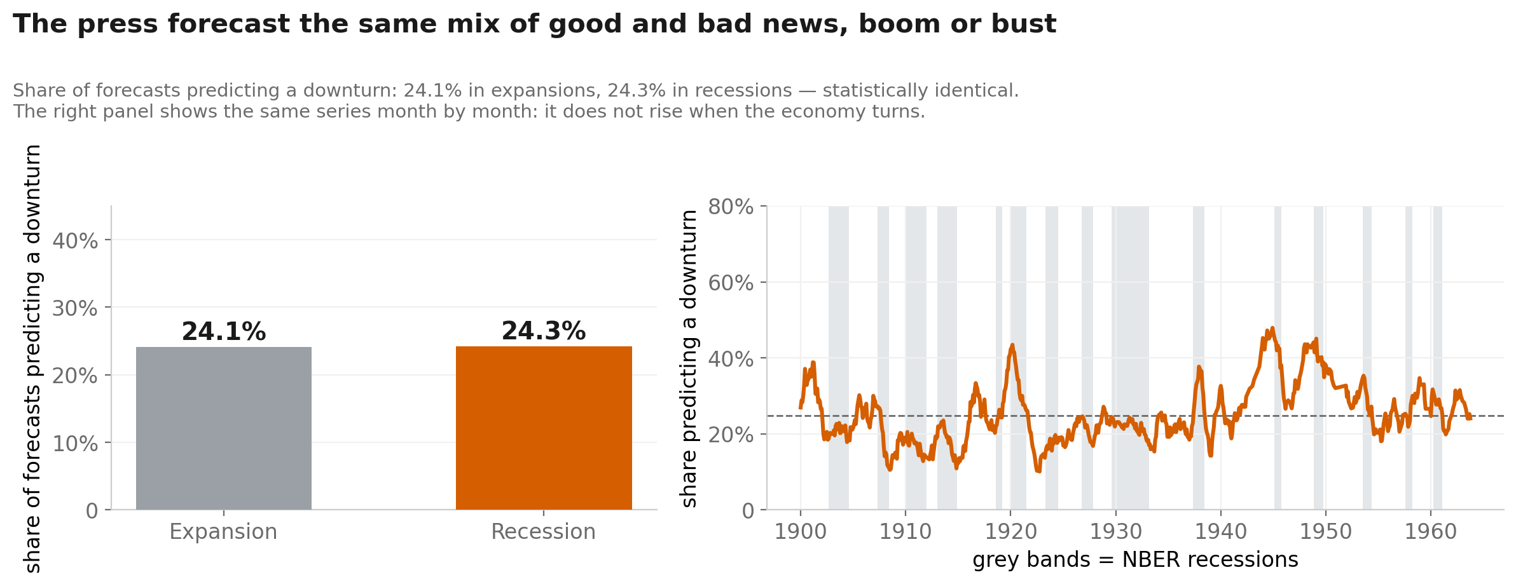
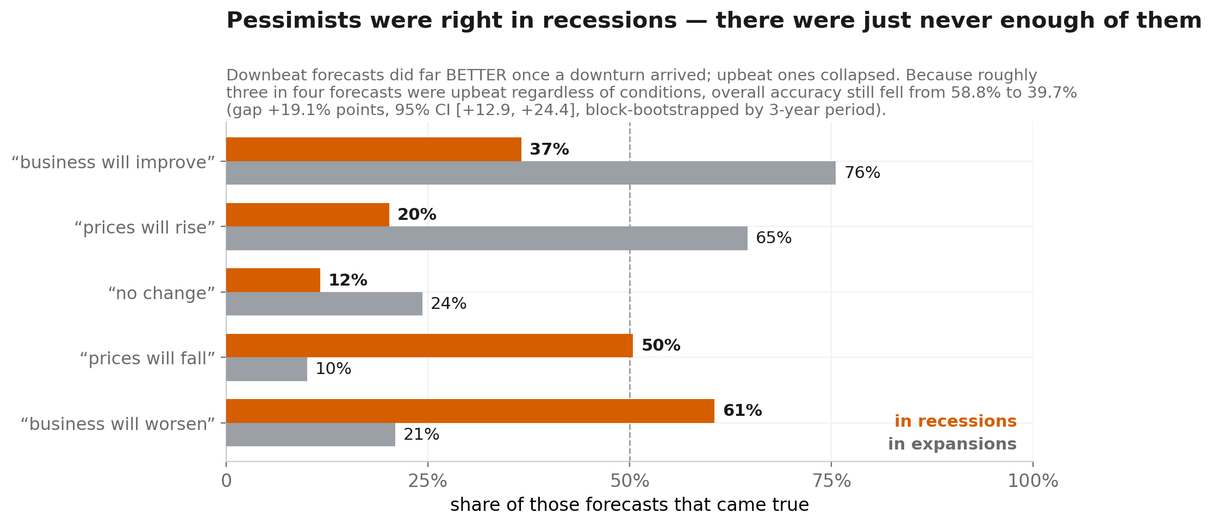
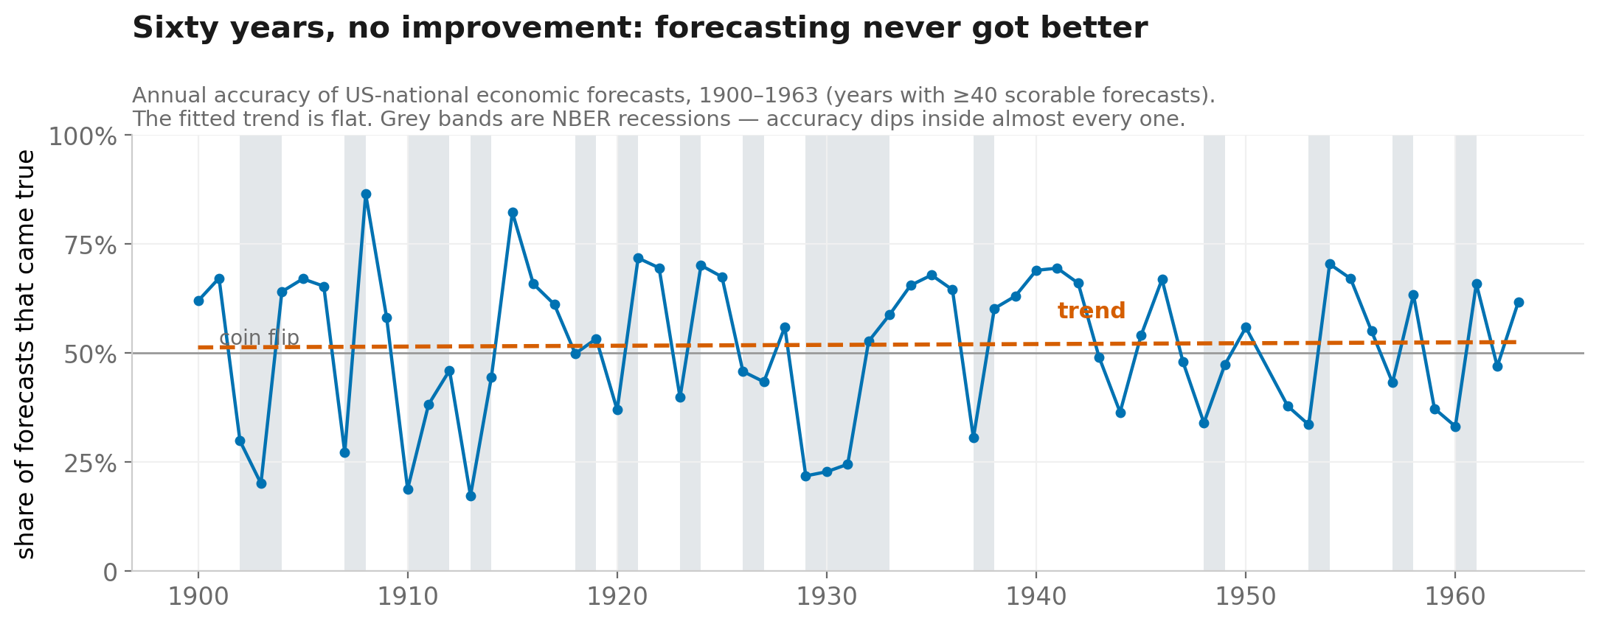
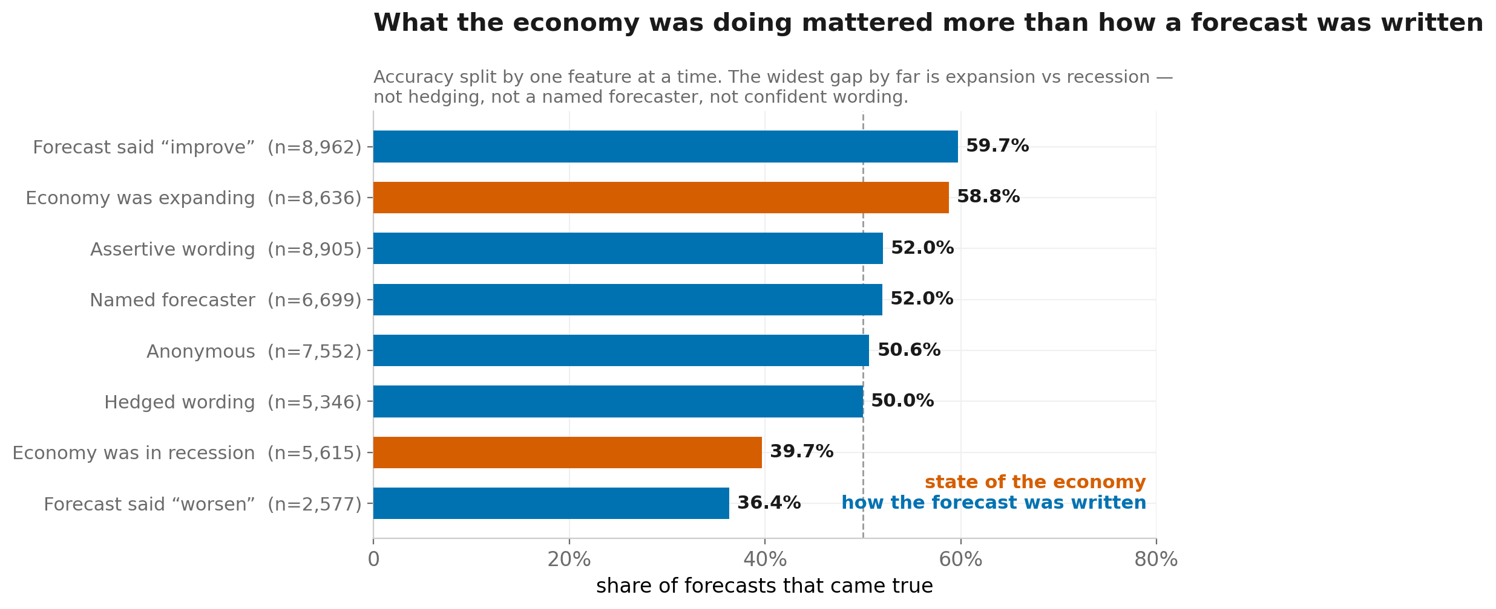
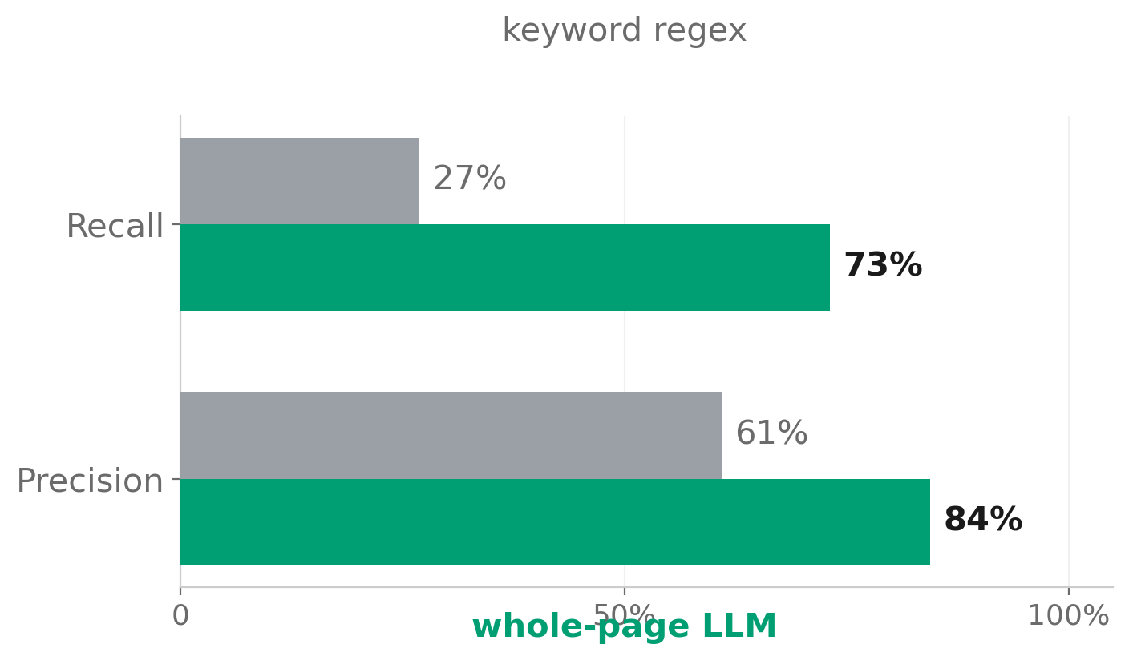
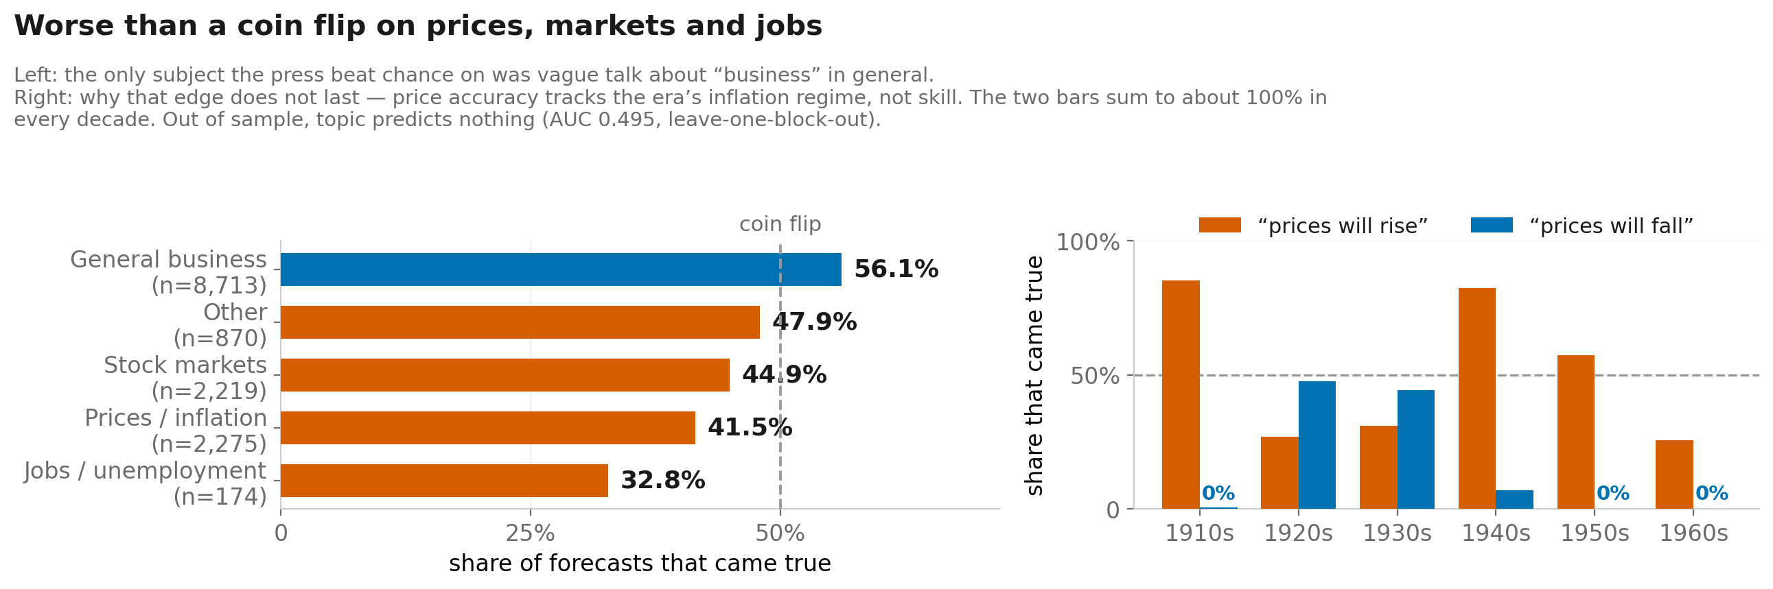
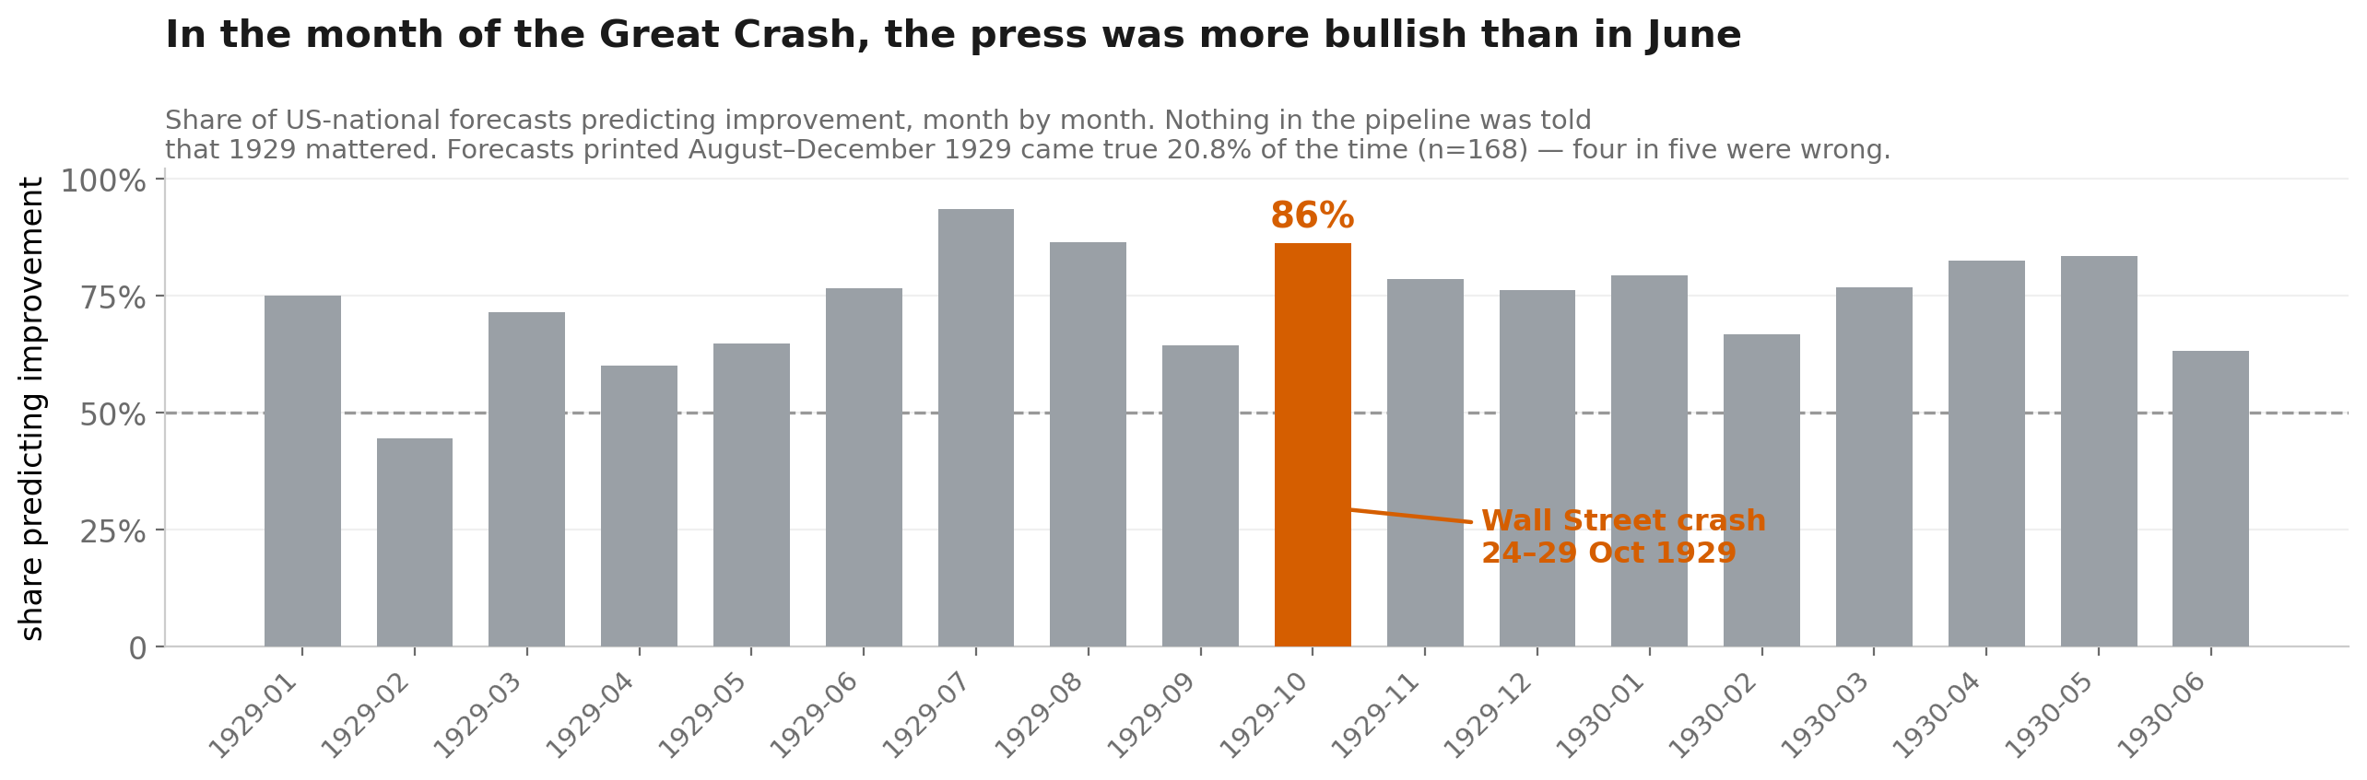
Did Anyone See It Coming?
Machine-reading a century of American newspaper economic forecasts, 1900–1963
BU RISE Practicum — Data Science
Introduction
Results
Discussion/
Conclusions
For sixty years American newspapers told readers what the economy would do next. Were they right?
The record has never been scored at scale. Reading a century of newspapers by hand is infeasible — and the standard shortcut, keyword search, turns out to lose most of the evidence.
We ask two questions:
1. Can a language model extract historical forecasts reliably enough to score them?
2. Did the press see downturns coming — and did it ever get better?
The design rule: the model decides WHAT was predicted; real economic data decides WHETHER IT CAME TRUE. The model is never asked if a forecast was right.
1. The forecast mix never responded to the economy
The press told readers the economy would improve — in booms and busts alike, in the same proportion, for sixty years.
When downturns came, roughly three in four forecasts were pointing the wrong way. Forecasting the economy's direction was, and remained, close to a coin flip.
A finding that reversed
On a smaller crisis-only sample (n=232), forecasts that went against the press consensus looked MORE accurate (52% vs 43%). On the full continuous corpus (n=1,967) it reverses: 38.7% vs 53.3%. The first result was small-sample noise. This is the clearest argument for building the continuous corpus — it overturned its own earlier finding.
Nor is this only a newspaper problem
Scored the same way, the Federal Reserve’s own internal Greenbook forecasts (490, 1967–2020) come in at 54.0% — and they called a downturn just 6 times, getting 0% of those right. Different era and variable, so this is a reference point rather than a controlled comparison — but directional forecasting is hard for everyone.
Limitations
• The monthly corpus used a cheaper extractor (F1≈0.53–0.61, depending on the reasoning-effort setting, which the run log does not record) than the methods comparison (F1≈0.79), to fit a $25 budget.
• The gold standard is model-adjudicated; a two-person human recode is the next step.
• Digitization thins after 1940, so the late series is noisier.
• Our index does not correlate with the published historical policy-uncertainty index (|r|<0.08) — we measure forecast direction, a different construct. We report the null.
• Forecasts cluster within eras: the effective sample is ~21 time blocks, not 14,251 claims. All inference uses grouped CV and block bootstraps.
Contribution
A validated, reproducible pipeline that turns a century of qualitative forecasts into scored data — and evidence that the standard keyword approach would have distorted the answer.
Downbeat forecasts were 24.1% of the total in expansions and 24.3% in recessions — identical. About 72% of all forecasts were upbeat, in booms and busts alike. This survives a within-decade comparison and a block bootstrap.
2. So accuracy collapsed exactly when it mattered
Because the mix never moved, accuracy fell from 58.8% in expansions to 39.7% in recessions — a consequence of panel 1, not a separate finding (gap +19.1% points, 95% CI [+12.9, +24.4]). Pessimists were right when it counted; there were never enough of them.
3. Sixty years, no improvement
Methods
15,721 newspaper pages
Library of Congress Chronicling America. Sampled from every one of the 768 months from 1900-01 to 1963-12, with no gaps, using a fixed direction-neutral search phrase set held constant across all months. 761 of those months yield at least one scorable US-national forecast.
30,765 forecasts extracted
An LLM reads each full page and returns structured claims: direction, topic, horizon, hedging, speaker, and scope.
14,251 scored against reality
A deterministic scorer compares each forecast to what NBER business-cycle dates and Federal Reserve series actually did over its horizon. No model judgement. Claims that cannot be fairly scored — foreign, regional, or outside a series' coverage — are marked unscorable, never guessed.
Validation
16 pages hand-annotated before any model ran (52 forecasts, 44 boundary cases). The scorer is proven by 33 known-answer tests.
Annual accuracy is flat across six decades (53.7% in the 1900s to 49.9% in the 1960s). No publisher did better either: seven papers with 200+ scored forecasts all fall between 44% and 56%.
4. What predicts whether a forecast came true?
Out-of-fold AUC (leave-one-block-out, 21 three-year blocks): macroeconomic conditions 0.505 — chance. How the forecast was written 0.561. Both combined 0.588. We do not claim to predict which forecasts come true; 0.561 is barely above chance, and saying so is the result.
5. Worse than chance on prices, markets and jobs
References
Accuracy varies far more by subject than by wording — a 23-point spread, against 2 points for hedging. The one above-chance category is vague optimism about “business”. Price calls track the era’s inflation regime, not skill: after 1948, “prices will fall” was right 0 times in 93.
Library of Congress, Chronicling America (loc.gov API). • National Bureau of Economic Research, US Business Cycle Expansions and Contractions. • Federal Reserve Bank of St. Louis, FRED: INDPRO, CPIAUCNS, UNRATE, historical common-stock index. • Baker, Bloom & Davis (2016), Measuring Economic Policy Uncertainty, QJE.
Keyword search finds one forecast in four. Whole-page LLM reading finds three in four, at higher precision — measured against the hand-built gold standard.
6. October 1929: no one saw it coming
Acknowledgements
In the month of the Great Crash, 86% of US-national forecasts still predicted improvement — more than in June. Forecasts printed August–December 1929 came true 20.8% of the time. Found with no episode labels and no outcome information.
Thanks to the BU RISE Practicum instructors and to the Library of Congress for open access to the Chronicling America corpus. All code, data-building scripts and tests are in the project repository.

