Slide 1

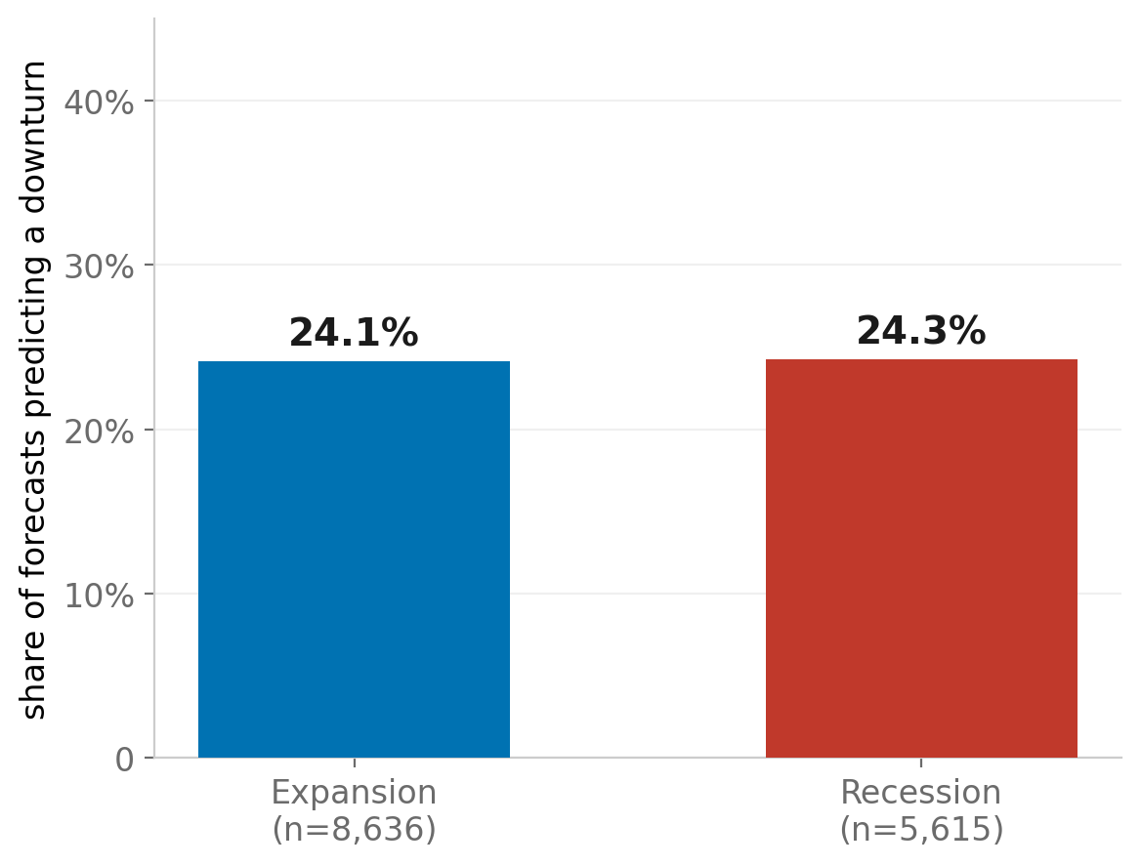
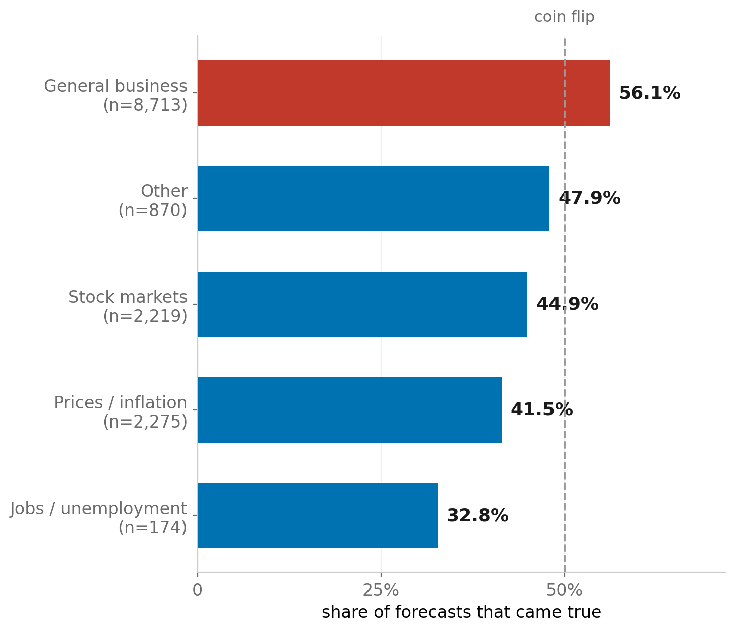
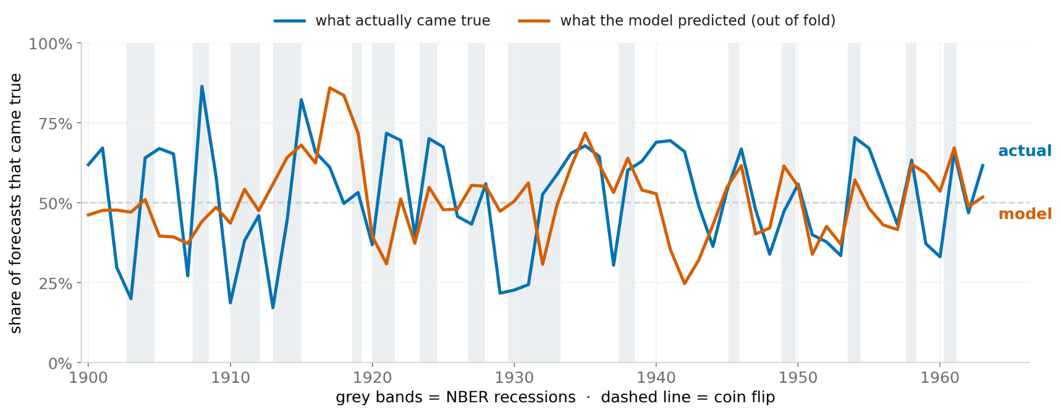
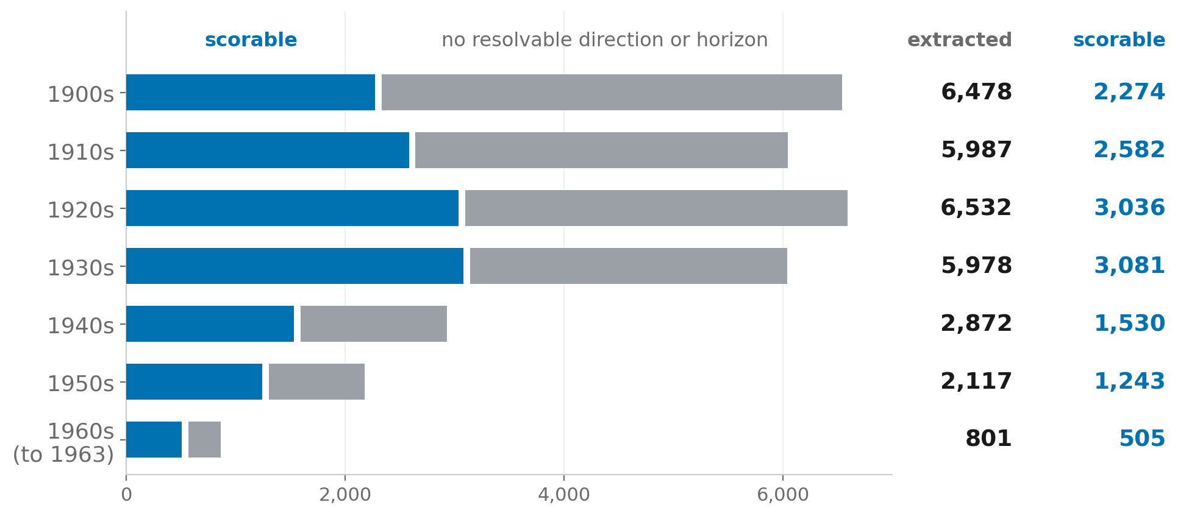
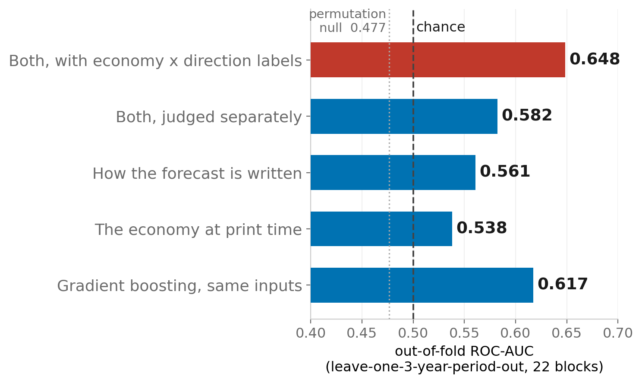
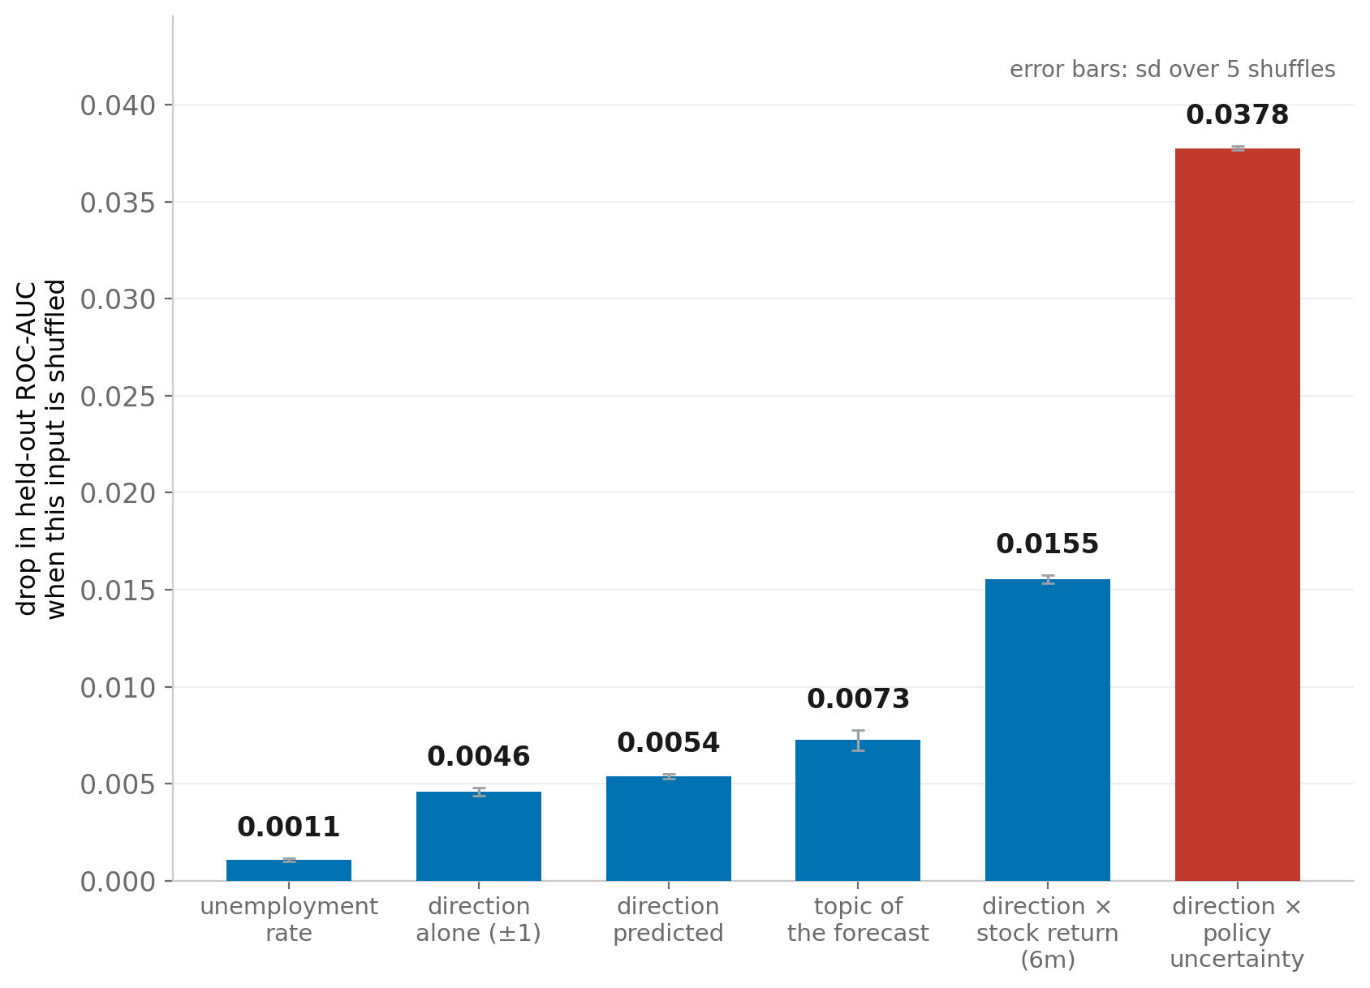
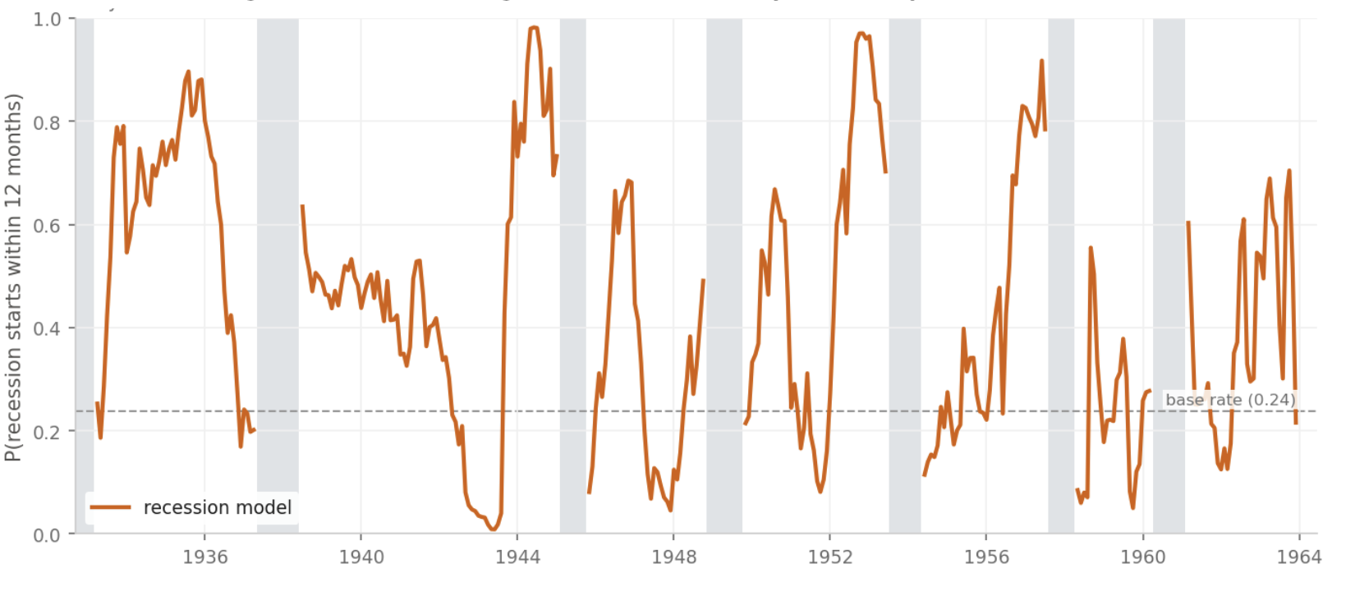

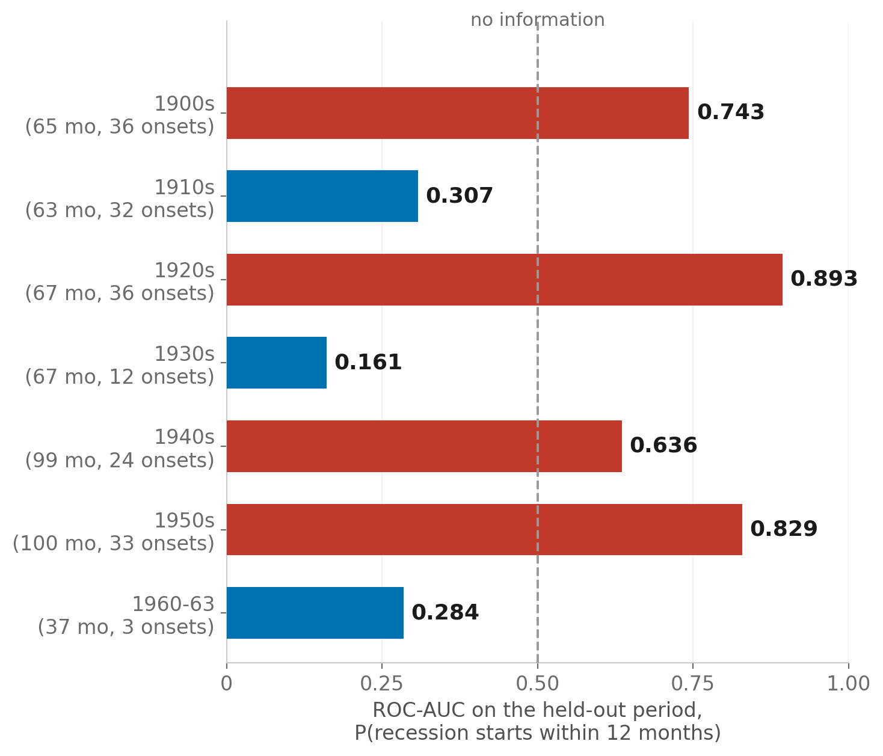
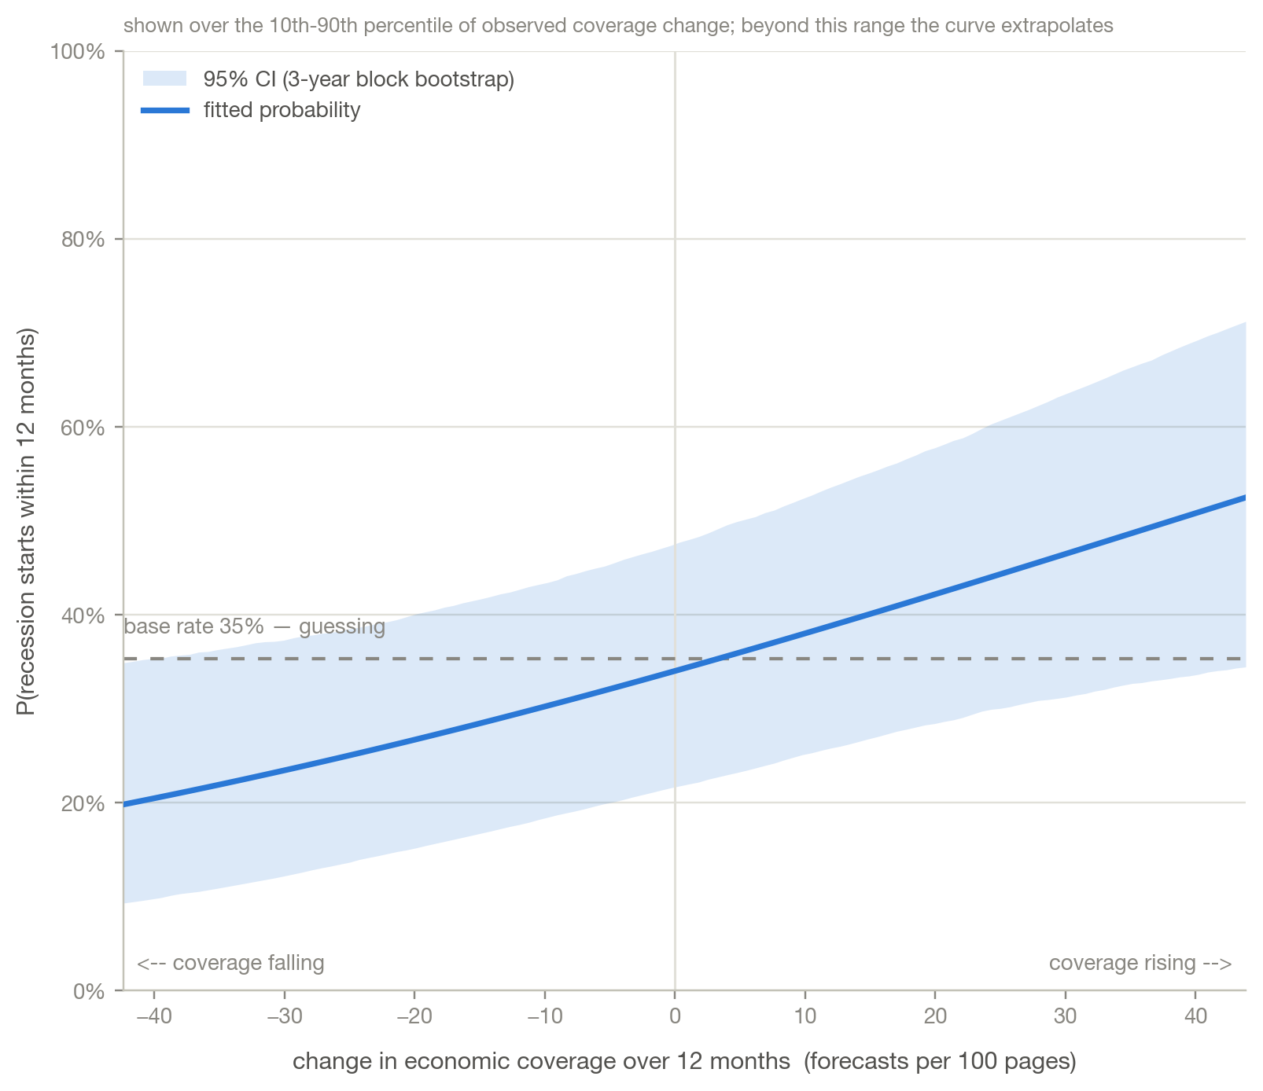

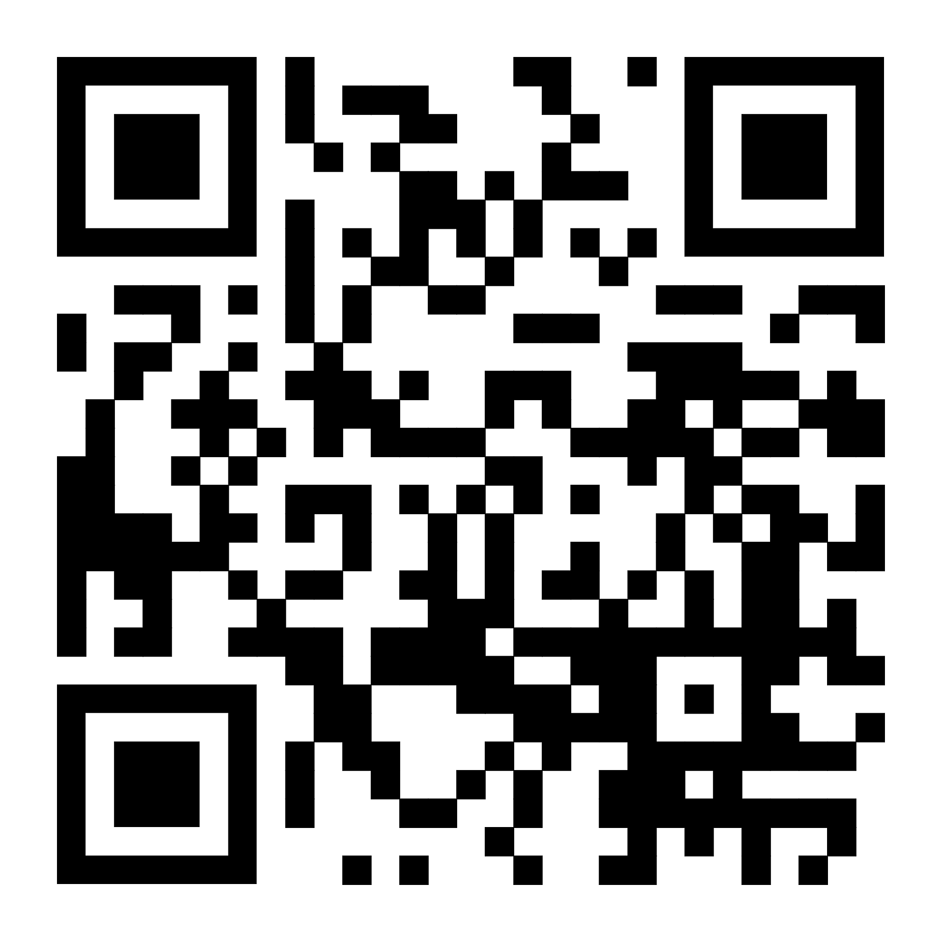
A Historical Analysis of Newspaper and Economic Forecasts Incorporating Machine Learning
Bode Bosell^{2, 4}*, Jeremy Liu^{3, 4}*, Vincent Wang^{1, 4}*, Eugene Pinsky⁴
Valley Christian High School, 100 Skyway Dr 130, San Jose, CA 95111¹; Northview Highschool 10625 Parsons Road, Johns Creek, GA, 30097²; Strake Jesuit College Preparatory, 8900 Bellaire Blvd, Houston, TX 77036³; Boston University, Boston, MA, USA⁴
^{*Authors contributed equally}
Introduction
Results
Discussion
Newspapers have attempted to predict the economy for over 100 years, but those predictions have never been graded against what actually occurred.
Modern forecasters are inaccurate. Campbell (2024) found they were overconfident: 53% confidence but correct only 23%. The historical press has never been tested in a similar vein.
Our question: when the press said the economy would improve or worsen, was it right?
We analyze forecasts across time periods to find patterns.
We made a model that predicts whether or not a forecast will happen
We made a model that predicts if a recession will happen in the next 12 months
Analysis
The Press was always optimistic Right before downturns accuracy dropped sharply, showing the press could not predict shifts. In fact, newspapers generally became more optimistic just as a recession was about to happen.
Accuracy stayed the same From the 1900's (53.7%) to the 1960's (49.9%), no newspaper had a significant advantage. All fell within (44.2%-56.4%).
Professionals failed too Survey of Professional Forecasters: 54.1%, Livingston: 54.4%, Federal Reserve Greenbook: 54.0%, similar to newspaper accuracy.
Forecast Model Letting the model use newspaper labels and economic data interact by including economy x direction labels reached out-of-fold ROC-AUC 0.648. A block permutation test puts the null at 0.477, and the model is significant at p = 0.048. The brier score is 0.240, .01 lower than the base rate of .250. The Gradient Boosted Classifier scored 0.617, so linearity was not the constraint.
Recession Prediction Model
The model is statistically insignificant
The AUC of the forward testing model is 0.641. Something worth noting is that the model’s p-value is 0.187. This is due to a lack of data: there are only 6 recessions, so these results are achievable by chance. The brier score of the forward testing model was 0.233, 0.012 higher than the base rate. This is because it was way off in the 1930’s, with a score of 0.425.
What we still found
There is a linear correlation between how much economic coverage exists at the time and the likelihood of recession.
Which way the papers leaned(optimistic or pessimistic) had no correlation with the likelihood of a recession. How much they disagreed did.
Limitations:
We were only able to get 14,251 scorable claims, and unable to get substantial newspaper representation past 1963.
The Library of Congress data is noisy due to messy OCR, advertisement/unrelated literature.
We were limited on datasets because NYT only returns article titles and ProQuest only supports GPT 4o mini.
For budget reasons, we labeled the data using gpt-oss-120b on low, precision 0.615 and recall 0.462. F1 score was 0.527
Future work
We can try to retrieve more data past 1963 using other databases such as ProQuest.
Grading on a better LLM
Incorporate regional and international claims instead of focusing solely on national claims
The recession model could also attempt to predict if the recession will continue while in a recession.
If we get more, higher quality data, we would be able to test more advanced models (more machine-learning esque—like CNN’s)
Analysis
Downturns do not affect forecaster
optimism
Only predictions about the general economy had a hit rate above 50%
Methods
Forecast Model
Data Extraction:
We used an LLM to read 15,721 pages from the Library of Congress, with the purpose of extracting forecasts.
The LLM then assigned labels (topic, direction, voice, etc.) to each of those claims.
The LLM was able to extract 30,765 forecasts, of which 14,251 were scorable. (Unscorable claims are claims that are foreign, regional, or outside of coverage.)
We hand annotated 16 pages (52 forecasts), and comparing that extraction with the LLM, found it had 61.5% Precision and 46.2% Recall.
Amount of Scorable Predictions per Decade:
Forecasting Model and Newspaper Accuracy graphed over time (Predicted vs. Actual)
AUC of the model, compared with alternatives.
Direction x policy uncertainty was by far the most important label
1st Model (predicting newspaper accuracy)
Used the Following three kinds of labels:
Used a Logistic Regression with L1 regularization and a Regularization Coefficient of 0.5.
Newspaper labels: direction (improve/worsen/no change), topic(business, prices, market, employment, other), voice(official, journalist, layperson, expert), hedged(quoted forecaster, named speaker measuring publisher’s confidence) Economy labels: industrial production (6m, 12m, acceleration), CPI year over year, unemployment level (6m), stocks (6m return, 6m volatility)
Economy x Direction Labels: +1 (Improve) or 0 (unclear) or -1 (worsen) * macro terms (Stock market, 6m return; stock market vs. it’s 2 year peak; economic policy uncertainty; output acceleration (6m -12m)
published when the forecast went to print.
*Industrial Production, CPI and unemployment were lagged 2 months, to prevent leakage.
Recession Model
Forward testing model, starting from 1930. Gray bars represent NBER recessions.
Equation for the Logistic Regression: z = b0 + b_news' * x_news + b_econ' * x_econ + b_int' * (x_econ * d)
*Newspaper Labels were extracted from the LLM, Economic data was extracted from FRED, NBER stock Index, and Economic Policy Uncertainty Index
We then compared the model to a Gradient Boosted Classifier, to see if linearity was the best option for classifying newspaper claims.
More Forecast Coverage
For the per decade model, the model had an AUC above 50% for 4/7 decades
2nd Model (predicting recessions)
Higher predicted economic risk
References
Predicted whether a recession would occur in the next 12 months.
Used a Logistic Regression with L2 regularization and C = 1. For each feature, we looked at any directional claim (not region locked)
Uses 5 distinct features.
Each feature was calculated by taking the average over the last 12 months (EX: Net direction over last 12 months) and subtract the average of the 12 months before that.
Net Direction: (# that said improve - # that said worsen)/# of directional claims
Disagreement: 1-|Net direction|
hedge_rate: # of hedged claims/all claims
expert rate: # of claims by experts/all claims
attention: forecasts/pages sampled
Tested it two different ways:
We trained the model on every decade but one and tested it over that decade
We trained it from data from 1900-1930, and then made a forward testing model. The model refits after every year.
Github Repo Citations
Graph showing positive correlation between amount of coverage and predicted probability of recession.
We split this model by decade. Because there was only one recession between 1960-1963, and it happened in April, so the AUC score from 1960-1963 was only graded based on three months.
Acknowledgements
Special thanks to our mentors, Eugene Pinsky and Indrajit Kalita, for their expertise and their guidance throughout the project. Finally, thank you to RISE data science fo the opportunity to do in depth research.

