Slide 1
Beating Mancala with Minimax + Alpha–Beta
State-based engine • Extra-turn depth rule • Move ordering
Hands-on demo
Notes:
Welcome! We'll start with a quick playtest against a Minimax bot, then build the algorithmic pieces.

Slide 2
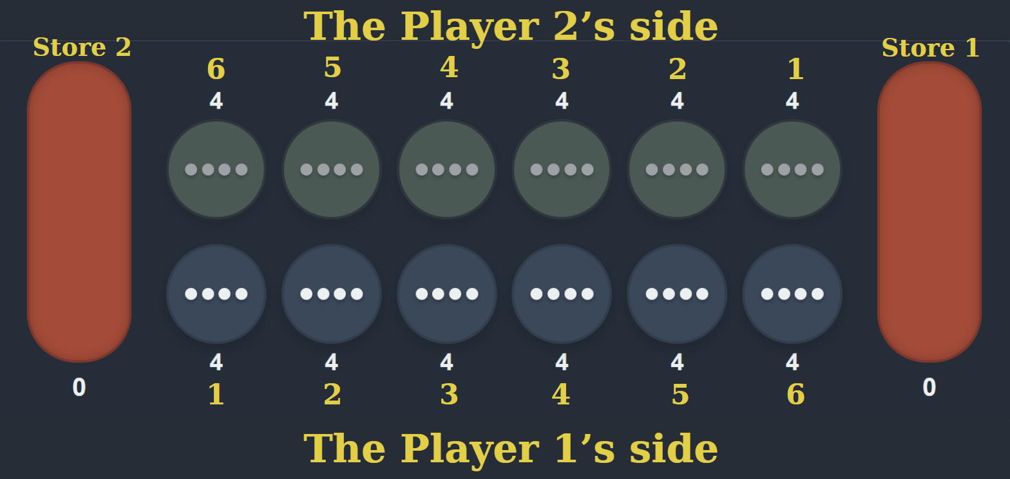
Rules Refresher
6 pits per side + 1 store each
Sow counter-clockwise; skip opponent’s store
Extra turn if last stone lands in your store
Capture if last stone lands in your empty pit → take opposite pit
Game ends when either side’s pits are empty; sweep remaining stones; highest store wins
Notes:
Anchor the engine semantics we code against.

Slide 3
State Representation (engine)
state = {
'pits': [[int]*6, [int]*6], # row 0=P0, row 1=P1
'stores': [int, int], # stores[0]=P0, stores[1]=P1
'current_player': 0 | 1
}
Notes:
We use a clean, serializable state. Board-to-state helpers exist internally.

Slide 4
Engine API We Use
legal_actions(state) → [0..5] indices for current player
step(state, action) → (next_state, reward, done)
evaluate(state) → heuristic score (higher is better for current player)
Extra-turn nuance: if next_state.current_player == state.current_player → do NOT reduce depth
Notes:
Depth is supposed to measure “how many opponent replies you get to see,” not just “how many moves total.”

Slide 5
Simple Evaluation (fast & explainable)
score = (my_store − opp_store)
Notes:
Keep eval cheap—search gets the time budget.

Slide 6
Minimax (with extra-turn depth rule)
Max node: choose move that maximizes heuristic score
Min node: choose move that minimizes heuristic score
Complexity: O(b^d) with b ≤ 6
Extra turn ⇒ do NOT decrement depth for that child (same ply)
Notes:
Demo in 01_minimax.ipynb; show node count vs depth.

Slide 7
Alpha–Beta Pruning
Carry α (best so far for Max) and β (best for Min) down the tree
If a node cannot improve parent’s outcome → prune subtree
Same correctness as minimax; far fewer nodes with good ordering
Notes:
Demonstrate cutoffs in the notebook; highlight speedups.

Slide 8
Move Ordering (1-ply scoring)
For each move: step → score child from root’s perspective
Sort moves descending by that score; search in that order
Effect: earlier α–β cutoffs → deeper search in same time
Notes:
One-ply lookahead isn't cheating; still same ply.

Slide 9
Experiments & Metrics
Matchups: Minimax vs Random; Alpha–Beta vs Random (± ordering)
Metrics: win rate, avg time per move, avg nodes per move, avg moves per game
Repro: fixed seeds, stable tiebreaks, same positions/time budgets
Notes:
Encourage disciplined experiment protocol.

Slide 10
Exercise (Core)
Implement: score_for, Minimax, Alpha–Beta (extra-turn rule)
Implement: move ordering (1-ply) and compare node visits
Run 5-10-game series; report metrics
Design + test your own heuristic minimax vs Minimax
Notes:
Point to NO_SOLUTIONS notebook.

Slide 11
Common Pitfalls
Forgetting extra-turn depth rule
Slow/unstable evaluation
Non-reproducible results (randomness/ties)
Notes:
Profile and add invariants tests.

Slide 12
Q&A + Next Steps
Play against the bot; inspect principal variation (PV)
Try your heuristic; measure and iterate
Post results, happy to review!
Notes:
Invite questions; encourage sharing metrics.

