Slide 1
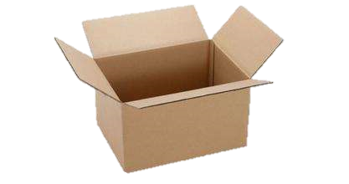

object
variable
memory

Slide 2
“abc”
“def”
x
x
memory
memory

Slide 3
“def”
x
“abc”
memory
x
y
memory
“abc”
y
memory

Slide 4
4
3
1, 2, 3
1, 2
x
[ ]
x
[ ]
y
y
memory
memory

Slide 5
4
3
1, 2, 3
1, 2
[ ]
[ ]
x
x
memory
memory
1,2,3
1,2,3
[ ]
[ ]
y
y
memory
memory

Slide 6
4, 5, 6
1, 2, 3
1, 2, 3
[ ]
[ ]
x
memory
memory

Slide 7
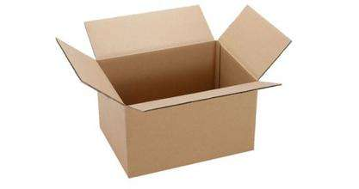
“abc”
“edf”
X
X
x
x

Slide 8
[1,2,3]
[4,5,6]
X
X
Memory
Memory

Slide 9
“edf”
“abc”
“abc”
x
x

Slide 10
[4,5,6]
[1,2,3]
[1,2,3]
x
x

Slide 11
[1,2,3]
[1,2]
[1]
x
x
x
[]
[4]
[4,5]
[4,5,6]
x
x
x
x

