Slide 1
Metrics--Measure，Don't Guess
讲师：汪文君（Alex Wang）
taobao: http://wangwenjun0609.taobao.com QQ:532500648

Slide 2
Agenda
01
The Metrics Introduction
02
Metric
03
Reporting
taobao: http://wangwenjun0609.taobao.com QQ:532500648

Slide 3
What is Metrics
The Metrics Intoduction
01
Metrics provides a powerful toolkit of ways to measure the behavior of critical components in your production environment.
https://metrics.dropwizard.io/3.1.0/

Slide 4





The well-known project are using Metrics
Almost all mainstream frameworks are in use
taobao: http://wangwenjun0609.taobao.com QQ:532500648

Slide 5
Published Courses
The series courses of XiLan talke JAVA
100
90
80
70
60
50
40
30
20
10
10
20
30
40
50
60
70
80
90
100
PowerMock
A
Scala In Action
Mockito
B
Google Guava
Concordion
C
Java Concurrencnt First Season
Java 8 In Action
D
Java Concurrencnt Second Season
Apache Flume
E
Java Concurrencnt Third Season
Apache Kafka
F
Metrics
Apache Sqoop
G
JMH
taobao: http://wangwenjun0609.taobao.com QQ:532500648

Slide 6


Published Book
The published book of XiLan talke JAVA
https://item.jd.com/12368970.html
taobao: http://wangwenjun0609.taobao.com QQ:532500648

Slide 7

The Metrics Development Environment setup
How to setup the development environment
<dependency>
<groupId>io.dropwizard.metrics</groupId>
<artifactId>metrics-core</artifactId>
<version>3.2.6</version>
</dependency>
taobao: http://wangwenjun0609.taobao.com QQ:532500648

Slide 8


Metrics In Action-Metric
Part Two
02
taobao: http://wangwenjun0609.taobao.com QQ:532500648

Slide 9


The Meter of Metric
A meter measures the rate at which a set of events occur
taobao: http://wangwenjun0609.taobao.com QQ:532500648

Slide 10
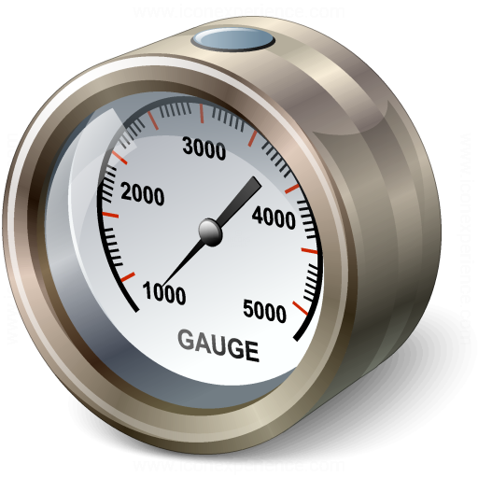
The Gauge of Metric
A gauge is the simplest metric type. It just returns a value.
taobao: http://wangwenjun0609.taobao.com QQ:532500648

Slide 11
The Gauge family
all of Gauge the metrics provided
Simple Gauge
JMX Gauge
Ratio Gauges
Cached Gauge
Derivative Guages
taobao: http://wangwenjun0609.taobao.com QQ:532500648

Slide 12

The Counters of Metric
A counter is a simple incrementing and decrementing 64-bit integer
taobao: http://wangwenjun0609.taobao.com QQ:532500648

Slide 13
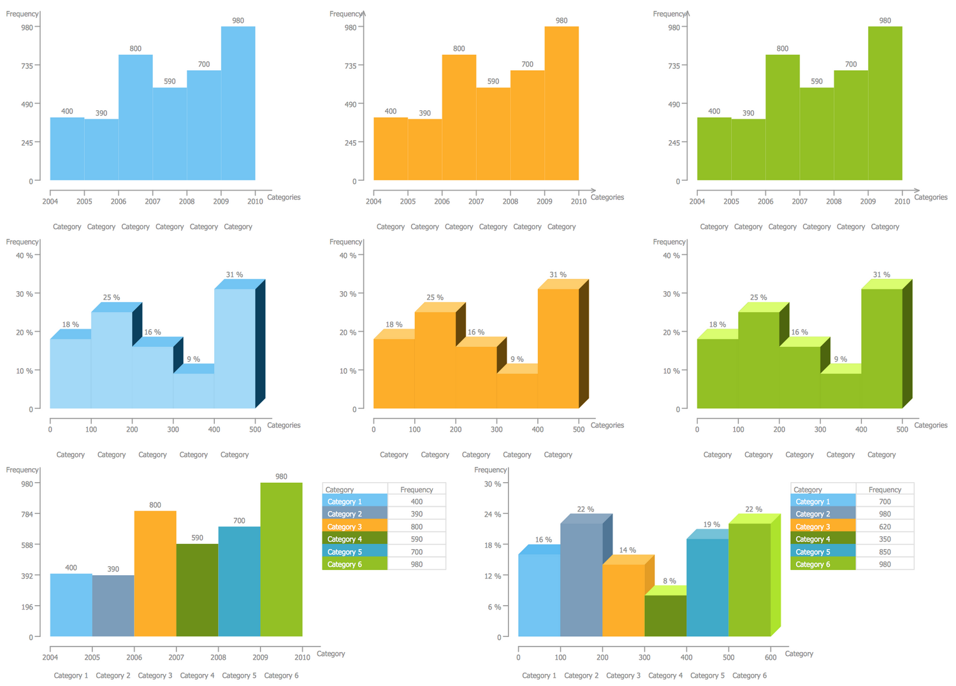
The Histograms of Metric
A Histogram measures the distribution of values in a stream of data
taobao: http://wangwenjun0609.taobao.com QQ:532500648

Slide 14
The Reservoirs of Histograms
can quickly and easily calculate quantiles which are valid approximations of the actual quantiles. This technique is called reservoir sampling.
Uniform Reservoirs
Exponentially Decaying
Sliding Window
Sliding Time Window
taobao: http://wangwenjun0609.taobao.com QQ:532500648

Slide 15

The Timers of Metric
A timer is basically a histogram of the duration of a type of event and a meter of the rate of its occurrence.
taobao: http://wangwenjun0609.taobao.com QQ:532500648

Slide 16


Part Three
03
taobao: http://wangwenjun0609.taobao.com QQ:532500648

Slide 17
JMX reporter
expose the metrics by jmx mbean
JMX
taobao: http://wangwenjun0609.taobao.com QQ:532500648

Slide 18

CSV reporter
record the metrics to csv reporter file
taobao: http://wangwenjun0609.taobao.com QQ:532500648

Slide 19

LOG reporter
log the metrics information to the log file
taobao: http://wangwenjun0609.taobao.com QQ:532500648

Slide 20

CONSOLE reporter
output the metrics information to the console
taobao: http://wangwenjun0609.taobao.com QQ:532500648

Slide 21

Part Four
04
taobao: http://wangwenjun0609.taobao.com QQ:532500648

Slide 22
JVM Instrumentation
The metrics-jvm module contains a number of reusable gauges and metric sets which allow you to easily instrument JVM internals.
Supported metrics include:
Run count and elapsed times for all supported garbage collectors
Memory usage for all memory pools, including off-heap memory
Breakdown of thread states, including deadlocks
File descriptor usage
Buffer pool sizes and utilization (Java 7 only)
JVM
taobao: http://wangwenjun0609.taobao.com QQ:532500648

Slide 23

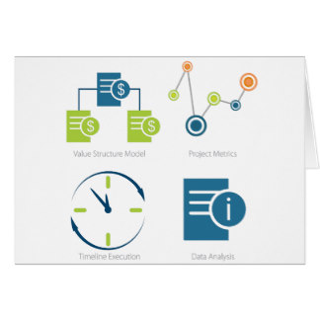
The Metrics Set
taobao: http://wangwenjun0609.taobao.com QQ:532500648

Slide 24

The Metrics Work Flow
taobao: http://wangwenjun0609.taobao.com QQ:532500648

Slide 25

Part Five
05
taobao: http://wangwenjun0609.taobao.com QQ:532500648

Slide 26

The Metrics health check module
taobao: http://wangwenjun0609.taobao.com QQ:532500648

Slide 27
The Metrics health check module
<dependency>
<groupId>io.dropwizard.metrics</groupId>
<artifactId>metrics-healthchecks</artifactId>
<version>3.2.6</version>
</dependency>
<dependency>
<groupId>com.squareup.okhttp3</groupId>
<artifactId>okhttp</artifactId>
<version>3.11.0</version>
</dependency>
taobao: http://wangwenjun0609.taobao.com QQ:532500648

Slide 28
The Metrics Servlet module
<dependency>
<groupId>io.dropwizard.metrics</groupId>
<artifactId>metrics-servlets</artifactId>
<version>3.2.6</version>
</dependency>
taobao: http://wangwenjun0609.taobao.com QQ:532500648

Slide 29
The Metrics Servlet module -healthcheck
<listener>
<listener-class>com.wangwenjun.test.listener.MyHealthCheckServletContextListener</listener-class>
</listener>
<servlet>
<servlet-name>healthCheck</servlet-name>
<servlet-class>com.codahale.metrics.servlets.HealthCheckServlet</servlet-class>
</servlet>
<servlet-mapping>
<servlet-name>healthCheck</servlet-name>
<url-pattern>/healthcheck</url-pattern>
</servlet-mapping>
taobao: http://wangwenjun0609.taobao.com QQ:532500648

Slide 30
The Metrics Servlet module -threaddump
<servlet>
<servlet-name>threadDump</servlet-name>
<servlet-class>com.codahale.metrics.servlets.ThreadDumpServlet</servlet-class>
</servlet>
<servlet-mapping>
<servlet-name>threadDump</servlet-name>
<url-pattern>/threaddump</url-pattern>
</servlet-mapping>
taobao: http://wangwenjun0609.taobao.com QQ:532500648

Slide 31
The Metrics Servlet module -ping
<servlet>
<servlet-name>ping</servlet-name>
<servlet-class>com.codahale.metrics.servlets.PingServlet</servlet-class>
</servlet>
<servlet-mapping>
<servlet-name>ping</servlet-name>
<url-pattern>/ping</url-pattern>
</servlet-mapping>
taobao: http://wangwenjun0609.taobao.com QQ:532500648

Slide 32
The Metrics Servlet module -metrics
<listener>
<listener-class>com.wangwenjun.test.listener.MyMetricsServletContextListener</listener-class>
</listener>
<servlet>
<servlet-name>metrics</servlet-name>
<servlet-class>com.codahale.metrics.servlets.MetricsServlet</servlet-class>
</servlet>
<servlet-mapping>
<servlet-name>metrics</servlet-name>
<url-pattern>/metrics</url-pattern>
</servlet-mapping>
taobao: http://wangwenjun0609.taobao.com QQ:532500648

Slide 33
The Metrics Servlet module -admin
<servlet>
<servlet-name>admin</servlet-name>
<servlet-class>com.codahale.metrics.servlets.AdminServlet</servlet-class>
</servlet>
<servlet-mapping>
<servlet-name>admin</servlet-name>
<url-pattern>/admin/*</url-pattern>
</servlet-mapping>
taobao: http://wangwenjun0609.taobao.com QQ:532500648

Slide 34
Thanks.
汪文君（Alex Wang） 532500648

