Slide 1
Financial Information eXchange
  General Conference
  Hong Kong
  March 30, 2000

Slide 2

Agenda
3:30 - 4:00 Reception & Registration
4:00 - 4:05 Welcome
        James Leman
        Salomon Smith Barney
4:05 - 4:15 Financial Information Exchange (FIX)
        James Leman, Salomon Smith Barney
4:15 - 5:15 Buy-Side Business Perspective
        Scott Atwell, American Century
        Sell-Side Business Perspective
        Michael O’ Conor, Merrill Lynch
        Technology & Implementation Issues
        Peter White, Goldman Sachs

Slide 3
Agenda
5:15 - 5:45 Why FIX? - Discussion Panel
        Bradford Freer Capital Research Company
        Michael Brady Jardine Fleming Asset Management
        Mark Northwood Fidelity
        Michael Yeatts Salomon Smith Barney
        Maria Domnick Donaldson, Lufkin & Jenrette
5:45 - 6:00 Organizational Structure & Close
        James Leman, Salomon Smith Barney

Slide 4
Welcome to the FIX Conference
  James Leman
  Salomon Smith Barney

Slide 5
FIX Overview
  James Leman
  Managing Director
  Salomon Smith Barney

Slide 6
What is FIX ?
A standard way to communicate trading information electronically between brokers, buy-side institutions, and markets.
A flexible means of handling many types of information.
Platform independent, so it works with various types of computers and communication systems.

Slide 7
FIX is not…..
a stock exchange
a crossing network
a black-box matching mechanism

Slide 8
What FIX Does For You
Provides an industry standard means to communicate the information you wish to communicate electronically. This could be:
  Indications of Interest
  Orders and Order Acknowledgment
  Fills
  Account Allocations
  News, E-Mail, Program Trading Lists,
  Administrative Messages
Connects you with an expanding list of buy and sell-side institutions
Delivers information in real-time

Slide 9
FIX US Steering Committee
Institutions: Brokers:
Alliance Capital DLJ
American Century Fidelity Capital Markets
Credit Suisse Asset Management Goldman Sachs
Fidelity Mgmt & Research Merrill Lynch
Putnam Morgan Stanley Dean Witter
State Street Global Advisors PaineWebber
The Capital Group Salomon Smith Barney

Slide 10
FIX European Steering Committee
Institutions: Brokers:
Alliance Capital Credit Suisse First Boston
AXA Sun Life Deutsche Bank
Dresdner RCM DLJ
Fidelity International Goldman Sachs
Foreign & Colonial Mgmt. Ltd. HSBC
Invesco Instinet
Mercury Asset Mgmt Merrill Lynch International
Prudential Portfolio Mgrs Salomon Smith Barney
Royal Sun Alliance Warburg Dillon Read

Slide 11
FIX Japanese Steering Committee
Institutions: Brokers:
Daiwa Bank Daiwa Securities
DLIBJ Asset Management Goldman Sachs
Mitsubishi Trust and Banking Merrill Lynch
Mitsui Trust and Banking Morgan Stanley
Nippon Life Insurance Company Nikko Salomon Smith Barney
Nomura Asset Management Nomura Securities
Sumitomo Trust and Banking Warburg Dillon Read

Slide 12
The History of FIX
Key Dates:
  Dec 1993 Fidelity-Salomon Pilot
  Jun 1994 FIX Committee formed
  Jan 1995 NY FIX General Conference / FIX 2.7 Released
  Mar 1995 First Technical Committee Meeting
  Sep 1995 FIX 3.0 Released
  Jun 1996 London FIX General Conference
  Jan 1997 FIX 4.0 Released
  Apr 1998 FIX 4.1 Released
  Jun 1998 FIX Committee Structure Formalized
  Oct 1998 Tokyo FIX Introduction

Slide 13
The History of FIX
  Key Dates:
  Mar 1999 Japanese FIX Committee Formalized
  Apr 1999 FIX Protocol Ltd. Created
  Jun 1999 Certification effort formalized w/PwC
  Dec 1999 First Draft of Version 4.2 Published
  Mar 2000 4.2 Released
  Mar 2000 Open/Vendor Forums in NY, London, and Tokyo
  Mar 2000 Hong Kong FIX General Conference

Slide 14
Buy-Side Perspective
  Scott Atwell
  Manager of FIX Trading & Connectivity
  American Century Investments
  Co-Chair FIX Technical Committee

Slide 15
American Century
Large Mutual Fund company
Manages over $100 billion in assets
Headquarters in Kansas City, Missouri (USA)
Asia Pacific trading desk in Singapore
Formerly named Twentieth Century and the Benham Group
Live with FIX since April 1996

Slide 16
Our STP Today
Broker/Dealer
PMs
Order Management System
FIX
Traders
Accountants
Fund Accounting System
ISITC
Custodian

Slide 17
Current Use of FIX
Use FIX with virtually all of our brokers
  Over 65 brokers worldwide (53 FIX sessions)
  Connections 24 hours/day, 5.5 days/week
FIX Messages Supported
  Indications of Interest, Advertisements & News
  Orders, Execution Reports and Don’t Know Trade
  Allocations and Allocation Acknowledgments
  FIX 2.7, 3.0, 4.0, and 4.1 versions

Slide 18
Current Use of FIX
Security Types we process via FIX
  US Equities
  International Equities (all markets)
  ADRs
  Convertible Bonds
  Futures
  Foreign Exchange trading

Slide 19
Our Implementation
FIX System
  Developed our own as an interface to our proprietary Order Management System
Connectivity (some have multiple sessions)
  Majority (over 25) via the Internet
  Less than 6 via private circuits
  More than 15 via shared private networks
  Over 35 via Bloomberg session (primarily Int’l)

Slide 20
FIX Activity in 1999
Processed 3.5 million IOIs
  Peak day over 26,000
Processed 930,000 ExecutionRpts
  Peak day over 15,000
  97% of total domestic and int’l equity trading
    97% of all domestic, 93% of all int’l trading
Sent 56,000 Allocation messages
  Peak day over 540

Slide 21
Buyside Perspective:
It Costs, FIX Helps
We don’t use FIX because it’s cool technology. We use FIX because it helps us run our business.
Trading and Fund Accounting are cost centers
  Commissions are paid by the funds involved directly affecting their NAV
  Personnel and technology (staff and systems) are paid from the firm’s revenue (asset mgmt fees)
  Errors are paid from the firm’s revenue

Slide 22
Errors & Inefficiencies:
Add to costs
Inefficient market structure penalizes a fund’s performance and its shareholders
Processing inefficiencies can lead to errors
Errors become more expensive the later in processing they are detected
These costs can be very significant

Slide 23
Benefits of Automation
1) Enhance Productivity and Liquidity
  Handle more trades with fewer personnel
  Process and prioritize information
  Manage global “book” around the globe
  Better source liquidity
2) Reduce Errors and Risk
  Reduce errors overall and detect them earlier
  Reduce settlement cycle & likelihood of errors

Slide 24
Productivity & Liquidity:
Benefits
Prioritize, filter, and archive IOI’s
  75% are discarded
  Alert traders as specific opportunities appear
  Trading opportunities available to all traders regardless of location (24 hour book)
Significant decrease in clerical tasks
History and statistics for management reporting
Able to scale with recent market volume

Slide 25
Productivity & Liquidity:
Trader’s Perspective
“Has allowed trading volumes to increase without corresponding increases in staffing.”
“Allows traders to focus on dialogue and not on clerical tasks.”
“Allows an individual to trade more stocks and decrease the chance of errors at the same time.”
“With the increased volatility in the marketplace, FIX enables me to stay on top of my positions in real-time.”

Slide 26
Error & Risk Reduction:
Benefits
Execution Reports matched to authorized orders
  Centrally controlled regardless of trader’s location
  Avoid mistakes (wrong symbol, side, qty, etc)
  Protect against a “Nick Leeson” incident
Notify if an error occurs
  Pop-up error messages to trading desk
  Send Don’t Know Trade (DK) to sales trader

Slide 27
Error & Risk Reduction:
Trader’s Perspective
“Provides automatic cancels on orders that do not exist on our OMS without any human intervention.”
“Enables global compliance mechanisms that allow for real-time monitoring and accountability”
“Prevents Nick Leeson-type activities before they can even happen, not just next day on confirmation or on settlement day.”

Slide 28
Error & Risk Reduction:
Allocation & Settlement
Allocations were sent via fax to brokers
Allocations now delivered via FIX
  Instantaneous delivery/receipt vs. 1-2 min each
  Broker can directly feed and match their data
  Broker can provide positive or negative acknowledgment for each one
  No transaction costs
Working on Int’l Allocations & Settlement Instructions

Slide 29
Error & Risk Reduction:
Business Perspective
“The speed and accuracy of FIX for post-trade communication to the broker enables us to reduce the likelihood of errors and identify discrepancies earlier.”
“The industry standard is to confirm trades and include in a fund’s NAV on T+1. With FIX and other automation, at month end we now record our trades on trade date and are considering making this standard practice. This would be same day confirmation.”

Slide 30
Head of Desk’s Perspective
“FIX has enabled our traders to focus on the business of trading. We don't spend a lot of money on people to answer phones and manually enter trade reports; we spend our money on value-added professional judgments on when to hit bids and take offers. The more our traders get away from data processing tasks, the more professional the position. We almost doubled the number of shares traded in the first two years after installing our FIX engine and we didn't need to add a trader.”

Slide 31
Sell Side Perspective
Michael A. O’Conor
Director
Equity Client Connectivity
Merrill Lynch & Company

Slide 32
CLIENTS!!!!!

Slide 33
What are clients looking for?
Strong desire to improve the current process supporting the buying and selling of equities
Specifically, indications of interest (bids/offers), execution reports (fills), orders, and allocations are critical components of data requested
The electronic delivery of pre and post trade information will have a significant impact on the way investors do business and with what firms they do business

Slide 34
Mutual Benefits of Fix Connectivity
More efficient and timely access to information
Elimination of unnecessary telephone calls
Decrease of paper flow
Reduction of fails
Ability to track orders
Leverage resources to do more business
More time to focus on research and analytics
Straight through processing

Slide 35
Sell Side Benefits of FIX Connectivity
Maintaining order flow
  Firm will be at a competitive disadvantage if it cannot provide electronic connectivity and will potentially lose order flow
Leverage sales force as producers versus processors
Incremental business
  Targeted delivery of IOI’s produce additional order flow
  Handling small orders electronically will enhance and expand your business
  Providing automated execution reports and efficient allocation processing will be an incentive for clients to do more business
New business
  Allow sales force to focus on higher value transactions and expanding client base
Reduction of operations costs (straight through processing)

Slide 36
Concerns with
FIX Connectivity
Loss of contact with the client
Being Replaced by a computer
No “color” from a box
Multiple boxes on their desk
FIX standard being forced on clients
Sales and trading personnel must complement Electronic trading capabilities.
The human element can never and should never be replaced

Slide 37
Merrill’s Approach

Slide 38
FIX’s Impact on our Business
Global & US-based client demand for FIX connectivity is overwhelming
Regional client demand for FIX connectivity grows daily
Vendor support for FIX has allowed us to replace proprietary interfaces
We have attracted new relationships and improved existing ones by enhancing our service levels
We are leveraging this technology globally

Slide 39
FIX Integration
With Our Systems
Our FIX gateway interfaces directly with global sales and trading systems…
  trading desks: indications of interest, trade advertisements
  order management: orders, confirms, executions
  BackOffice: allocations and confirms
… providing our clients with electronic access to all markets where we trade

Slide 40
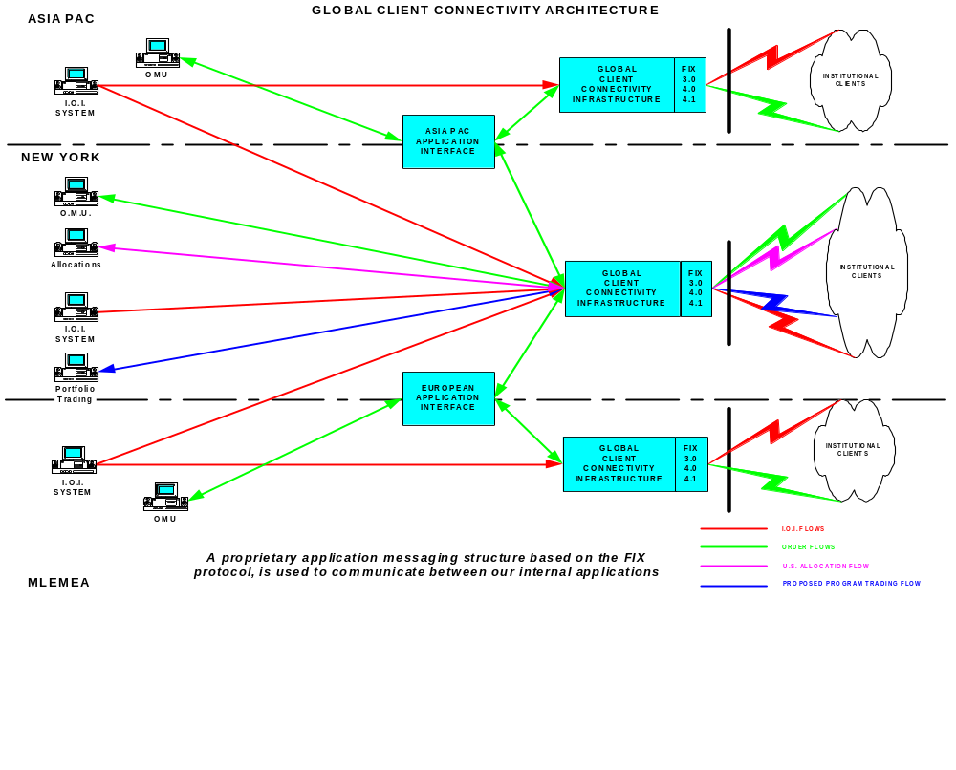

Slide 41
Merrill’s Capabilities
Multi-functional Client Connectivity Architecture utilizing FIX 4.0 supporting the electronic handling of:
  Indications of Interest 325+ Clients
    Listed, NASDAQ, ADR’s, UK, European, Asian
  Order Routing & Reports 190+ Clients
    Listed, NASDAQ, ADR’s
  Reports only 8 Clients
    Listed, NASDAQ, ADR’s, International
  Client Driven
  Growing Daily

Slide 42
Future Directions for FIX
For equities, FIX expands in all markets globally
FIX and Fixed Income
FIX for other products such as currencies, derivatives, futures
FIX and exchange connectivity

Slide 43
Technical Overview
  Peter White
  Project Manager
  Goldman Sachs & Co
  Co-Chair FIX Technical Committee

Slide 44
FIX Session Level Messages
Logon - handshake to authenticate counterparty
Resend Requests - used to request missed messages after detecting a message gap
Heartbeats/Test Requests - keep alive packets used to detect problems during slow message traffic periods

Slide 45

FIX Application Messages
Institution Originated
  Quote Requests
  Orders, Modifications, Cancels
  Allocations
  Email
  List Orders/Program/Basket Trading
  Market Data Request, Security Definition Request, Security Status Request, Trading Session Status Request, etc.

Slide 46
FIX Application Messages
Broker Originated
  Indications of Interest, News, Email
  Post Trade Advertisements
  Quotes
  Order Acknowledgments, Change Acknowledgments(cancels, modifications)
  Partial Fills, Fills, Done For Days
  Market Data, Security Definition, Security Status, Trading Session Status, Mass Quote, etc

Slide 47


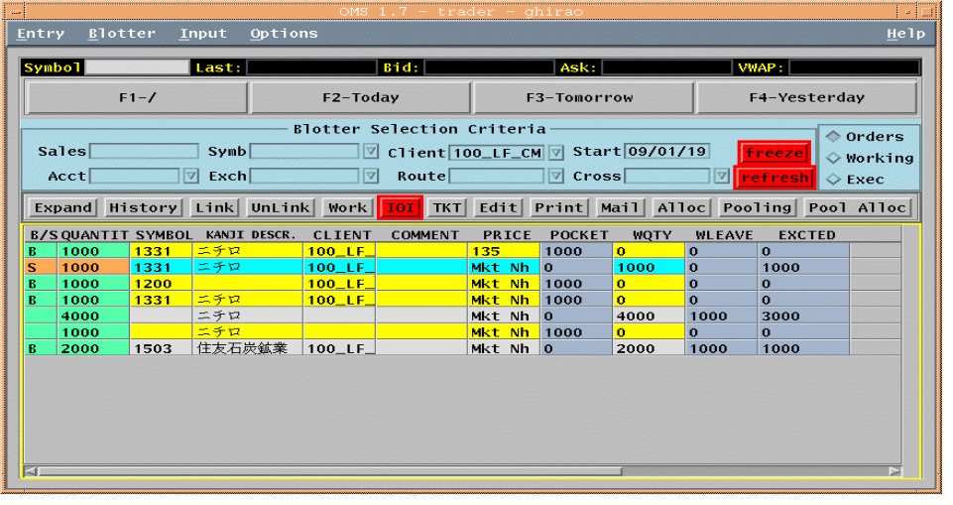
FIX Customer/Broker Example
Step 1 - Customer A’s Order
FIX Order
Symbol = 0001.HK, Side = Sell, OrderQty = 1000, OrdType = Market
[35=D;55=0001.HK;54=2;38=1000;40=1]
Broker
Sell
1000
Cheung Kong
Accept Sell
1000
Cheung Kong
Customer A
FIX Order Accept (Execution Report)
Symbol = 0001.HK
Side = Sell
OrderQty = 1000, OrdType = Market
OrdStatus = New
[35=8;55=0001.HK;54=2;38=1000;40=1;39=0]

Slide 48


FIX Customer/Broker Example
Step 2 - Sending an IOI
FIX Network
Seller of
1000
Cheung Kong
Broker/
Position Trader
Customers
FIX IOI
Symbol = 0001.HK
Side = Sell
IOIShares = 1000
Price = 101
IOINaturalFlag = Y
[35=6;55=0001.HK;54=2;27=1000;44=101;130=Y;]

Slide 49
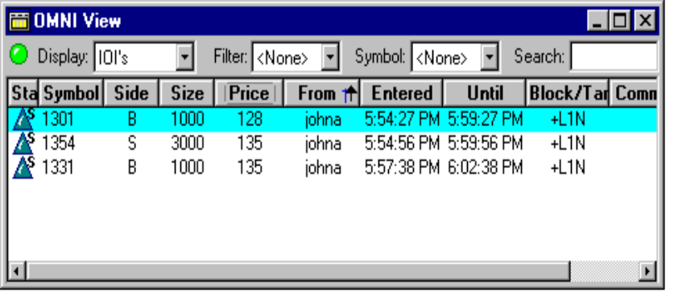
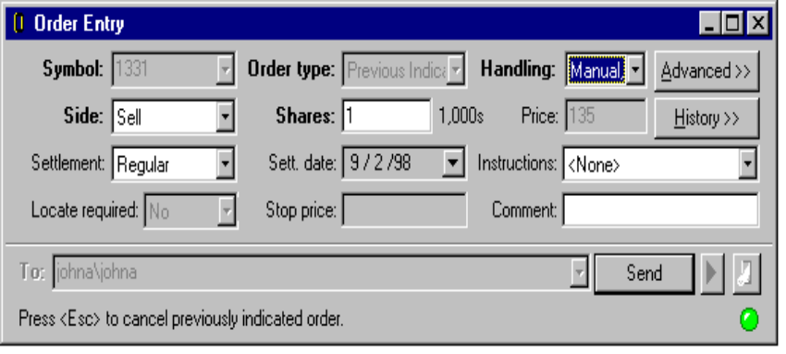
FIX Customer/Broker Example
Step 3 - Filter IOIs, Cust B’s Order
FIX Order
Symbol = 0001.HK
Side = Buy
OrderQty = 1000
OrdType = Market
[35=D;55=0001.HK;54=1;38=1000;40=1]
Buy 1000
Cheung Kong
Accept Buy 1000
Cheung Kong
Broker/
Sales Trader
Customer B
FIX Order Accept (Execution Report)
Symbol = 0001.HK
Side = Buy
OrderQty = 1000, OrdType = Market
OrdStatus = New
[35=8;55=0001.HK;54=1;38=1000;40=1;39=0]

Slide 50
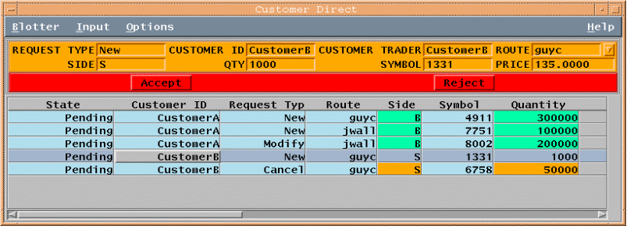


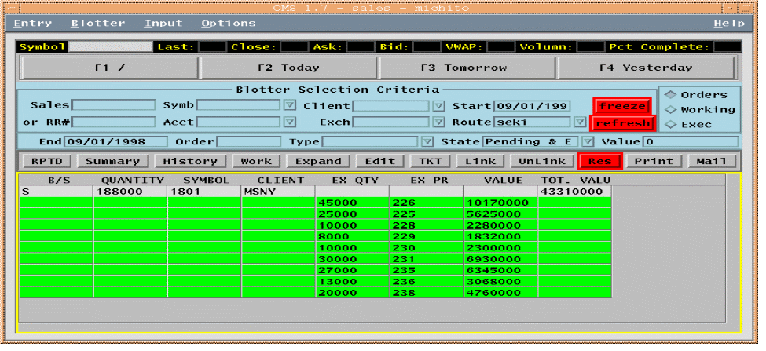
FIX Customer/Broker Example
Step 4 - Traded, Execution Rpts
FIX Execution Report (Filled)
Symbol = 0001.HK, Side = Buy, OrderQty = 1000,
OrdStatus = Filled, LastShares=1000, LastPx=101
[35=8;55=0001.HK;54=1;38=1000;39=2;32=1000;31=101]
Bought 1000
Cheung Kong
Customer B
Broker
Sales Trader
Sold 1000
Cheung Kong
Customer A
FIX Execution Report (Filled)
Symbol = 0001.HK, Side = Sell, OrderQty = 1000,
OrdStatus = Filled, LastShares=1000, LastPx=101
[35=8;55=0001.HK;54=2;38=1000;39=2;32=1000;31=101]

Slide 51
FIX System Connectivity
Customer (i.e. Investment Mgr)
Supplier (i.e. Broker/Dealer)
FIX System
FIX System
Wide Area Network Link
Business Msg Processing
FIX Engine
FIX Engine
Business Msg Processing
TCP/IP
(TCP Socket opened by customer, persists during life of FIX session)
Business Msg Processing
Business Msg Processing
Order Management System
Order Management System
Trader
Trader
Trader
Trader
Trader
Trader
Trader in Foreign Office
Trader in Foreign Office

Slide 52
Networking Options
Internet - Ubiquitous, lowest cost, varying latency, varying reliability
Leased Line - more reliable, stable, expensive, costly scalability
Virtual Private Networks (VPN) - hybrid option allows for scalability, lower costs; several exist, not yet interconnected

Slide 53
Security Considerations
Firewalls - use for any of the three network options
Encryption - PGP/FIX message level public/private key encryption
Router level encryption

Slide 54
Software
FIX Engine - what should it do?
  Manage the “FIX session”
    FIX message formatting & parsing
    message level encryption management
    manage/validate counterparty connections
    message gap recovery
  Propagate application messages upstream to order management system

Slide 55
How do I get started?
FIX website is primary source of information
  Specification document is available for free
  Discussion forums allow for Q&A
  Vendors section contains FIX vendors
  Principals section identifies other buy and sellside firms
Investigate vendor offerings
Work with existing FIX user base
http://www.fixprotocol.org

Slide 56
Panel Discussion
  Bradford Freer Capital Research Company
  Michael Brady Jardine Fleming Asset Mgmt
  Mark Northwood Fidelity
  Michael Yeatts Salomon Smith Barney
  Maria Domnick Donaldson, Lufkin & Jenrette

Slide 57
FIX Organizational Structure
  James Leman
  Managing Director
  Salomon Smith Barney

Slide 58
New FIX Organizational Structure
Global Steering Committee
Regional Steering Committees
Support
Technical
Committee
US
Europe
Japan
Other Regions
…
Business Working Groups
Technical Working Groups
IOI
Group 2
Group 3
Group 1
Group 2
Group 3
...
...

Slide 59
FIX Technical Committee
American Century
Commerzbank
Credit Suisse Asset Mgmt
DLJ
Fidelity Capital Markets
Fidelity Investments
Goldman Sachs
Merrill Lynch
Morgan Stanley, DW&D
PaineWebber
Putnam Investments
Salomon Smith Barney
State Street Global Advisors
Townsend Analytics, Ltd.
Warburg Dillon Read

Slide 60
Working Groups
Technical
ECNs and Exchanges
Encryption, Authentication, Digital Certificates
Fixed Income Trading
FIX/XML and Emerging Standards
Program/ List Trading
Business
Indications of interest
Global Straight-Through Processing Committee / FIX
Industry Coordination

Slide 61
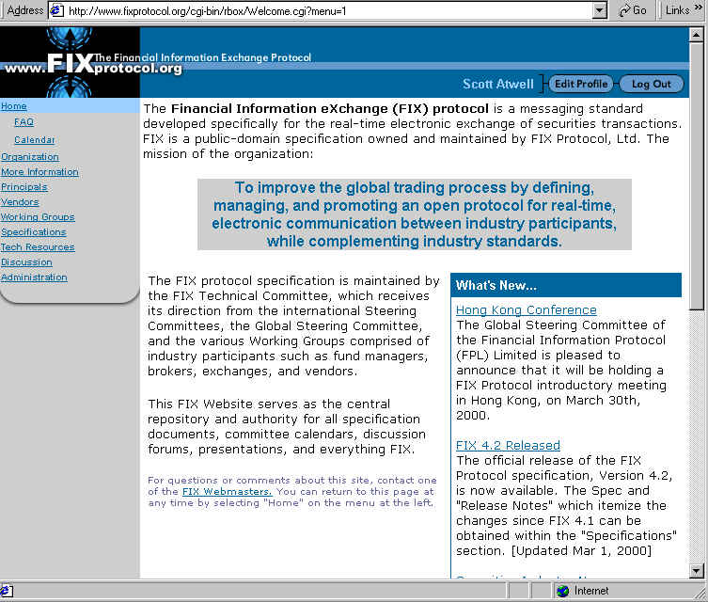
FIX Web-site

Slide 62
Access to FIX On-line
www.fixprotocol.org
Features
  Organization
  More Information
  Principals
  Vendors
  Working Groups
  Specifications
  Discussion Groups

Slide 63
Next Steps
Complete Questionnaire on Interest in FIX Participation
  Institutions
  Brokers
  Vendors
Schedule follow-up meeting with interested participants
Create Asia/Pacific Steering Committee
Create technical and business working groups for unique Asia/Pacific markets needs
Identify changes to FIX for Asia/Pacific markets’ trading, IOI’s, and ticketing

