Slide 1


Before Reading_Main
Before Reading
Global Reading
Detailed Reading
After Reading
1. About the Author and the Story
2. India
3. Cobra
4. Prejudice Against Women
5. Discussion

Slide 2

Before Reading_1
Before Reading
Global Reading
Detailed Reading
After Reading
About the Author and the Story
Mona Gardner, an American woman writer. Most of her short stories were written for the Saturday Evening Post magazine and Collier’s Weekly magazine during the 1930s and 1940s. The Dinner Party first appeared in the Saturday Review of Literature, Vol. 25, No. 5, January 31, 1941.
■

Slide 3

Before Reading_1_Saturday Evening Post
Before Reading
Global Reading
Detailed Reading
After Reading

Slide 4

Before Reading_1_Collier’s Weekly
Before Reading
Global Reading
Detailed Reading
After Reading

Slide 5
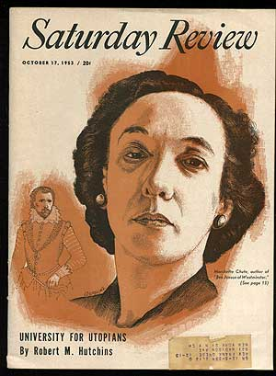
Before Reading_1_Saturday Review
Before Reading
Global Reading
Detailed Reading
After Reading

Slide 6
Before Reading_India
Before Reading
Global Reading
Detailed Reading
After Reading
India
1.
2.
3.
4.
5.
6.
7.
8.
Location and Capital
National Flag
British Colony
Mahatma Gandhi
The Taj Mahal
The Victoria Memorial
Marriage
Sacred Cow

Slide 7
Before Reading_India_Location and Capital
Before Reading
Global Reading
Detailed Reading
After Reading
Location and Capital
India, officially called Republic of India, is a country in southern Asia, located on the subcontinent of India. It is bounded on the north by Afghanistan, China, Nepal, and Bhutan; on the east by Bangladesh, Myanmar (also known as Burma), and the Bay of Bengal; on the south by the Palk Strait and the Gulf of Mannâr (which separates it from Sri Lanka) and the Indian Ocean; and on the west by the Arabian Sea and Pakistan. India is divided into 26 states and 7 union territories. New Delhi is the country’s capital and one of its largest cities.
■

Slide 8
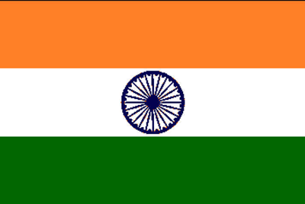
Before Reading_India_ National Flag
Before Reading
Global Reading
Detailed Reading
After Reading
National Flag
The colors of the Indian flag were taken from the flag of the Indian National Congress. Dark orange represents courage and sacrifice. Green represents faith, fertility, and chivalry. White represents truth and peace. The emblem in the center was added upon independence in 1947. It is a Buddhist dharma chakra, or wheel of life, used in India thousands of years ago.
■

Slide 9
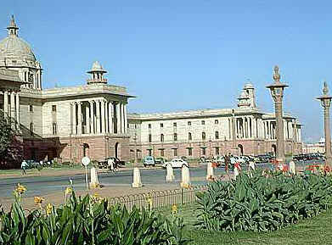
Before Reading_India_ British Colony
Before Reading
Global Reading
Detailed Reading
After Reading
British Colony

Slide 10
Before Reading_India_ British Colony
Before Reading
Global Reading
Detailed Reading
After Reading
In the early 18th century, following the decline of the Mughal Empire, Britain expanded its power in India, where British influence had begun in the early 1600s. In 1935 Britain began to relinquish its hold on India and passed legislation providing for autonomous Indian legislative bodies. Executive power remained with the British government, however, until 1947 when the Indian people, under Gandhi’s leadership, won their struggle for independence and British rule in Indian ended.
■

Slide 11
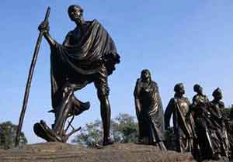
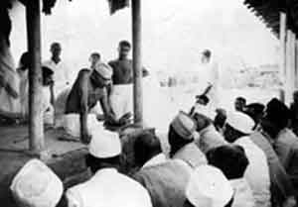
Before Reading_India_ Mahatma Gandhi
Before Reading
Global Reading
Detailed Reading
After Reading
Mahatma Gandhi (1869-1948) -- Indian Nationalist Leader
The campaign of nonviolent civil resistance organized by Indian nationalist leader Mahatma Gandhi against British rule in India led to the country’s independence in 1947. A member of the merchant caste, Mohandas K. Gandhi, later called Mahatma (Sanskrit for “great soul”), Gandhi studied law in London, England. As a lawyer and later as a political activist, he effectively fought discrimination with the principles of truth, nonviolence, and courage, which he derived in part from the teachings of Hinduism.
■

Slide 12
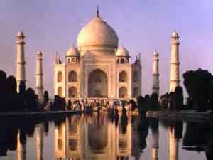
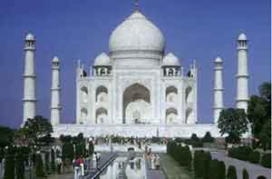
Before Reading_India_ The Taj Mahal
Before Reading
Global Reading
Detailed Reading
After Reading
The Taj Mahal
The Taj Mahal, designed as a tomb for the wife of a 17th-century Mughal emperor, was constructed by about 20,000 workers from 1631 to 1653 in a city in northern India. The massive domed structure was constructed in the Indo-Islamic style, using white marble and inlaid gems. At each corner is a minaret (prayer tower), and passages from the Koran, the Muslim holy book, adorn the outside walls. The bodies of the emperor and his wife remain in a vault below the building.
■

Slide 13
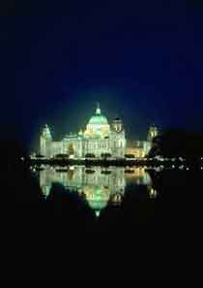
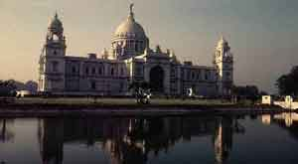
Before Reading_India_ The Victoria Memorial
Before Reading
Global Reading
Detailed Reading
After Reading
The Victoria Memorial
The Victoria Memorial was built to commemorate Queen Victoria’s 25-year reign over India. After the Sepoy Rebellion of 1857, the British government assumed direct control of the country, and in 1876 the British parliament made Victoria the Empress of India. Her reign ended with her death in 1901.
■

Slide 14
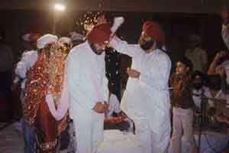
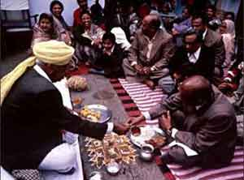
Before Reading_India_ Marriage
Before Reading
Global Reading
Detailed Reading
After Reading
Marriage
During a Sikh marriage ceremony, the bride and groom in traditional clothing encircle the Sikh Holy Book four times while chanting wedding hymns. Sikhism, a religion that combines elements of Islam and Hinduism, developed in India during the late 15th and early 16th centuries. Today, Sikhs make up more than half the population of Punjab.
■

Slide 15
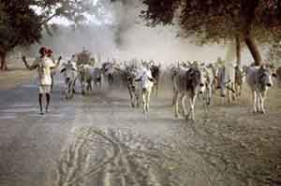
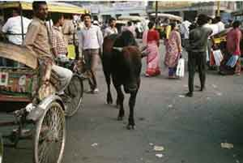
Before Reading_India_ Sacred Cow
Before Reading
Global Reading
Detailed Reading
After Reading
Sacred Cow
India has more cattle than any other country in the world. As a central part of India’s agrarian economy, cattle haul carts, plow fields and produce milk for dairy products. Considered sacred by many Hindus, cattle are protected from slaughter in most states and are often allowed to roam free.
■

Slide 16
Before Reading_Cobra
Before Reading
Global Reading
Detailed Reading
After Reading
Cobra
Cobras, found in some parts of Africa and Asia, are poisonous snakes. Most cobras bite their victims and their bite may cause death within a few hours.
The king cobra, the largest of all poisonous snakes, may reach a length of
18 ft (5.5 m) and feeds chiefly on other snakes. When disturbed, it raises its hooded head to get a better view or to strike. Large individuals may raise themselves to a height of about 1 m (about 4 ft).
The Indian cobra is usually 4-5 ft (1.2–1.6 m) long. The snake’s color ranges from yellowish to dark brown. It has a mark like a pair of spectacles on the back of its hood. It preys on rats and is therefore often found in houses. The Indian cobra and the Egyptian cobra are often displayed by snake charmers. The cobras appear to respond to the music played by the charmer, but, like all snakes, they are deaf and only follow the movements of the charmer.
■

Slide 17
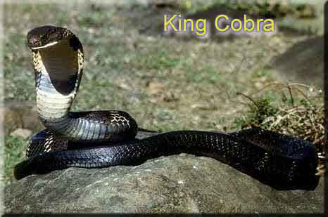
Before Reading_Cobra_The king cobra
Before Reading
Global Reading
Detailed Reading
After Reading

Slide 18
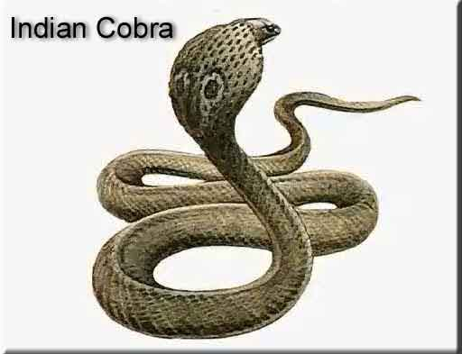
Before Reading_Cobra_The Indian cobra
Before Reading
Global Reading
Detailed Reading
After Reading

Slide 19
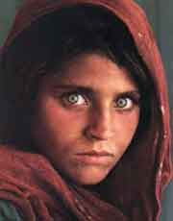
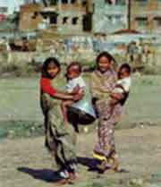
Before Reading_Prejudice Against Women
Before Reading
Global Reading
Detailed Reading
After Reading
Prejudice Against Women
Women have been prejudiced against for centuries perhaps ever since life on earth. They have long been referred to as “weaker sex” or “fairer sex,” considered naturally weaker than men, squeamish, unable to perform the work that requires muscles or pluck the courage to face up to any crisis. As we know, Plato, Aristotle, Shakespeare, and Confucius all made negative remarks about women. And even today, such a prejudice has not entirely been eliminated and the argument in the text shows how hard long-standing prejudices die.
■

Slide 20
Before Reading_Discussion
Before Reading
Global Reading
Detailed Reading
After Reading
Discussion
1.
2.
3.
Who do you think are braver, women or men? Please give examples to support your statement.
Do you have the same feeling when you see a woman screaming over an insect and a man screaming over an insect? Why or why not?
Do you think women can do everything men can? Why or why not?

Slide 21
Globe Reading_main
Before Reading
Global Reading
Detailed Reading
After Reading
1. Questions About the Text
2. Rearrange the Order of the Pictures
3. Complete the Missing Information of the Story
4. True or False

Slide 22

Globe Reading._Questions About the Text1
Before Reading
Global Reading
Detailed Reading
After Reading
Questions About the Text
How many persons are mentioned in this story except the servants? Who are they?
Twenty one. They are the host, hostess and their guests.
What was the subject of the discussion between the young girl and the
major?
They had a heated discussion about how women react to a crisis.
3. How was the American naturalist aware of the existence of a snake?
He noticed what was happening to the hostess and the boy.

Slide 23
Globe Reading._Questions About the Text2
Before Reading
Global Reading
Detailed Reading
After Reading
Questions About the Text
4. What did the American naturalist do to get over the crisis?
He said that he wanted to know how well they could control themselves and asked them to sit still until he counted up to three hundred.
5. What do you think of what the hostess did that day?
(Open-ended.)

Slide 24
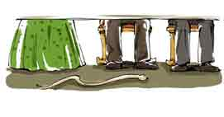
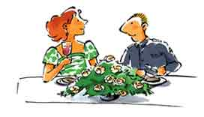
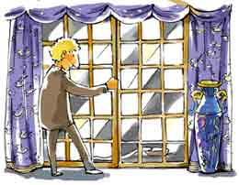
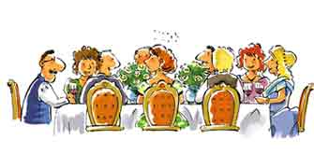
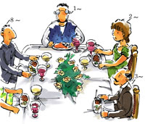
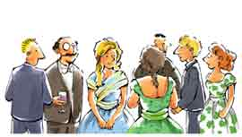
Globe Reading._Rearrange the Order of the Pictures
Before Reading
Global Reading
Detailed Reading
After Reading
Rearrange the Order of the Pictures
5
______
______
3
2
______
______
4
______
______
6
1

Slide 25
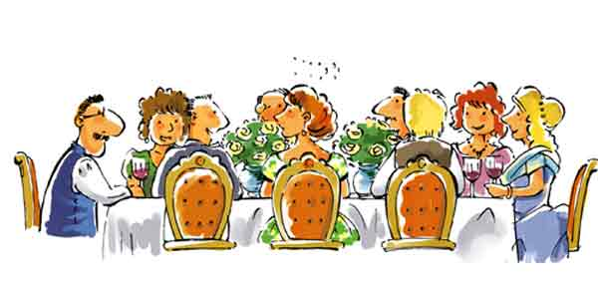
After Reading_6_1
Before Reading
Global Reading
Detailed Reading
After Reading

Slide 26

After Reading_6_2
Before Reading
Global Reading
Detailed Reading
After Reading

Slide 27
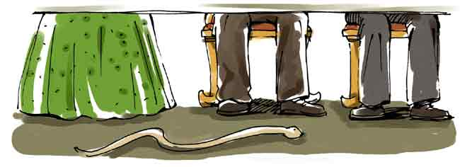
After Reading_6_3
Before Reading
Global Reading
Detailed Reading
After Reading

Slide 28
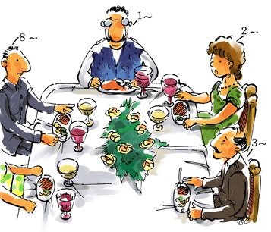
After Reading_6_4
Before Reading
Global Reading
Detailed Reading
After Reading

Slide 29
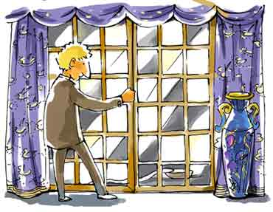
After Reading_6_5
Before Reading
Global Reading
Detailed Reading
After Reading

Slide 30
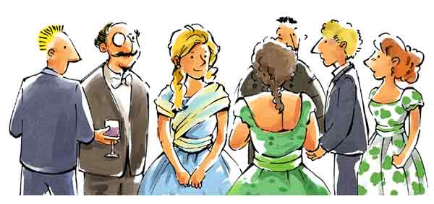
After Reading_6_6
Before Reading
Global Reading
Detailed Reading
After Reading

Slide 31
Globe Reading._ Complete the Missing…1
Before Reading
Global Reading
Detailed Reading
After Reading
Complete the Missing Information of the Story
1.
2.
3.
4.
5.
6.
7.
8.
9.
10.
At the beginning of the story, all the people are sitting in the dining room.
A young girl and a major .
The American naturalist .
The hostess .
The native boy .
The native boy .
The American .
All the people .
The American .
The hostess .
__________________
are discussing a topic
______________________________________
sees a strange expression on the hostess’ face
____________________
signals to the native boy
__________________________
is surprised and leaves the room
____________________________
puts a bowl of milk on the veranda
_______________________________________________
asks people present not to move a muscle when he counts
_____________________________
sit like stone images while he counts
___________________
jumps to slam the door
___________________
replies to the American

Slide 32
Globe Reading_ True or False1
Before Reading
Global Reading
Detailed Reading
After Reading
True or False
1.
The setting of the story is in India and the time of the story is during the First
World War.
( )
It took place before the First World War.
F
T
2.
( )
The guests attending the party are the persons with high social status.
3.
The room where the party was held is very big and quite good.
T
( )
4.
In the discussion, the young girl points out that women are braver than men.
( )
The girl only means women are now braver than they were in the past.
F

Slide 33
Globe Reading_ True or False2
Before Reading
Global Reading
Detailed Reading
After Reading
5.
When the American naturalist notices a strange expression coming over the hostess’ face, he immediately knows that there is a snake in the room.
( )
F
It is not until he sees the boy place a bowl of milk on the veranda that he knows that.
6.
After the American realizes what is happening in the room, he is very astonished.
( )
T
7.
The trick the American uses then shows that he is a cowardly man.
( )
F
He is a clever and calm man.
8.
From the last sentence of the story, we can come to the conclusion that the hostess is calmer than the American.
( )
T

Slide 34


Article_S
Before Reading
Global Reading
Detailed Reading
After Reading
A heated discussion about whether men are braver than women is settled in a rather unexpected way.

Slide 35
Article1-2_S
Before Reading
Global Reading
Detailed Reading
After Reading
The Dinner Party
Mona Gardner
I first heard this tale in India, where it is told as if true — though any naturalist would know it couldn’t be. Later someone told me that the story appeared in a magazine shortly before the First World War. That magazine story, and the person who wrote it, I have never been able to track down.
The country is India. A colonial official and his wife are giving a large dinner party. They are seated with their guests — officers and their wives, and a visiting American naturalist — in their spacious dining room, which has a bare marble floor, open rafters and wide glass doors opening onto a veranda.

Slide 36
Article3-5_S
Before Reading
Global Reading
Detailed Reading
After Reading
A spirited discussion springs up between a young girl who says that women have outgrown the jumping-on-a-chair-at-the-sight-of-a-mouse era and a major who says that they haven’t.
“A woman’s reaction in any crisis,” the major says, “is to scream. And while a man may feel like it, he has that ounce more of control than a woman has. And that last ounce is what really counts.”
The American does not join in the argument but watches the other guests. As he looks, he sees a strange expression come over the face of the hostess. She is staring straight ahead, her muscles contracting slightly. She motions to the native boy standing behind her chair and whispers something to him. The boy’s eyes widen: he quickly leaves the room.

Slide 37

Article6-9_S
Before Reading
Global Reading
Detailed Reading
After Reading
Of the guests, none except the American notices this or sees the boy place a bowl of milk on the veranda just outside the open doors.
The American comes to with a start. In India, milk in a bowl means only one thing — bait for a snake. He realizes there must be a cobra in the room. He looks up at the rafters — the likeliest place — but they are bare. Three corners of the room are empty, and in the fourth the servants are waiting to serve the next course. There is only one place left — under the table.
His first impulse is to jump back and warn the others, but he knows the commotion would frighten the cobra into striking. He speaks quickly, the tone of his voice so commanding that it silences everyone.
“I want to know just what control everyone at this table has. I will count three hundred — that’s five minutes — and not one of you is to move a muscle. Those who move will forfeit 50 rupees. Ready!”

Slide 38
Article10-13_S
Before Reading
Global Reading
Detailed Reading
After Reading
The 20 people sit like stone images while he counts. He is saying “... two hundred and eighty…” when, out of the corner of his eye, he sees the cobra emerge and make for the bowl of milk. Screams ring out as he jumps to slam the veranda doors safely shut.
“You were right, Major!” the host exclaims. “A man has just shown us an example of perfect self-control.”
“Just a minute,” the American says, turning to his hostess. “Mrs. Wynnes, how did you know that cobra was in the room?”
A faint smile lights up the woman’s face as she replies: “Because it was crawling across my foot.”

Slide 39
Article_W
Before Reading
Global Reading
Detailed Reading
After Reading
A heated discussion about whether men are braver than women is settled in a rather unexpected way.

Slide 40
Article1-2_W
Before Reading
Global Reading
Detailed Reading
After Reading
The Dinner Party
Mona Gardner
I first heard this tale in India, where it is told as if true — though any naturalist would know it couldn’t be. Later someone told me that the story appeared in a magazine shortly before the First World War. That magazine story, and the person who wrote it, I have never been able to track down.
The country is India. A colonial official and his wife are giving a large dinner party. They are seated with their guests — officers and their wives, and a visiting American naturalist — in their spacious dining room, which has a bare marble floor, open rafters and wide glass doors opening onto a veranda.

Slide 41
Article3-5_W
Before Reading
Global Reading
Detailed Reading
After Reading
A spirited discussion springs up between a young girl who says that women have outgrown the jumping-on-a-chair-at-the-sight-of-a-mouse era and a major who says that they haven’t.
“A woman’s reaction in any crisis,” the major says, “is to scream. And while a man may feel like it, he has that ounce more of control than a woman has. And that last ounce is what really counts.”
The American does not join in the argument but watches the other guests. As he looks, he sees a strange expression come over the face of the hostess. She is staring straight ahead, her muscles contracting slightly. She motions to the native boy standing behind her chair and whispers something to him. The boy’s eyes widen: he quickly leaves the room.

Slide 42
Article6-9_W
Before Reading
Global Reading
Detailed Reading
After Reading
Of the guests, none except the American notices this or sees the boy place a bowl of milk on the veranda just outside the open doors.
The American comes to with a start. In India, milk in a bowl means only one thing — bait for a snake. He realizes there must be a cobra in the room. He looks up at the rafters — the likeliest place — but they are bare. Three corners of the room are empty, and in the fourth the servants are waiting to serve the next course. There is only one place left — under the table.
His first impulse is to jump back and warn the others, but he knows the commotion would frighten the cobra into striking. He speaks quickly, the tone of his voice so commanding that it silences everyone.
“I want to know just what control everyone at this table has. I will count three hundred — that’s five minutes — and not one of you is to move a muscle. Those who move will forfeit 50 rupees. Ready!”

Slide 43
Article10-13_W
Before Reading
Global Reading
Detailed Reading
After Reading
The 20 people sit like stone images while he counts. He is saying “... two hundred and eighty…” when, out of the corner of his eye, he sees the cobra emerge and make for the bowl of milk. Screams ring out as he jumps to slam the veranda doors safely shut.
“You were right, Major!” the host exclaims. “A man has just shown us an example of perfect self-control.”
“Just a minute,” the American says, turning to his hostess. “Mrs. Wynnes, how did you know that cobra was in the room?”
A faint smile lights up the woman’s face as she replies: “Because it was crawling across my foot.”

Slide 44


Article1-2_S_I first heard …
Before Reading
Global Reading
Detailed Reading
After Reading
The Dinner Party
Mona Gardner
I first heard this tale in India, where it is told as if true — though any naturalist would know it couldn’t be. Later someone told me that the story appeared in a magazine shortly before the First World War. That magazine story, and the person who wrote it, I have never been able to track down.
Why does the author say “though any naturalist would know it couldn’t be? ”
Because cobras generally eat small animals such as rabbits and mice, a naturalist would tell us that milk is not a favorite food for the cobras.
The country is India. A colonial official and his wife are giving a large dinner party. They are seated with their guests — officers and their wives, and a visiting American naturalist — in their spacious dining room, which has a bare marble floor, open rafters and wide glass doors opening onto a veranda.

Slide 45
Article3-5_S_A spirited…
Before Reading
Global Reading
Detailed Reading
After Reading
A spirited discussion springs up between a young girl who says that women have outgrown the jumping-on-a-chair-at-the-sight-of-a-mouse era and a major who says that they haven’t.
“A woman’s reaction in any crisis,” the major says, “is to scream. And while a man may feel like it, he has that ounce more of control than a woman has. And that last ounce is what really counts.”
Translate this sentence into Chinese.
席间，一位年轻的女士与一位少校展开了激烈的讨论。年轻的女士认为，妇女已经有所进步，不再像过去那样一见到老鼠就吓得跳到椅子上；少校则不以为然。
The American does not join in the argument but watches the other guests. As he looks, he sees a strange expression come over the face of the hostess. She is staring straight ahead, her muscles contracting slightly. She motions to the native boy standing behind her chair and whispers something to him. The boy’s eyes widen: he quickly leaves the room.

Slide 46
Article3-5_S_ And that…
Before Reading
Global Reading
Detailed Reading
After Reading
A spirited discussion springs up between a young girl who says that women have outgrown the jumping-on-a-chair-at-the-sight-of-a-mouse era and a major who says that they haven’t.
“A woman’s reaction in any crisis,” the major says, “is to scream. And while a man may feel like it, he has that ounce more of control than a woman has. And that last ounce is what really counts.”
What’s the meaning of “what really counts? ”
It means “something that is really important”.
The American does not join in the argument but watches the other guests. As he looks, he sees a strange expression come over the face of the hostess. She is staring straight ahead, her muscles contracting slightly. She motions to the native boy standing behind her chair and whispers something to him. The boy’s eyes widen: he quickly leaves the room.

Slide 47

Article3-5_S_ As he looks…
Before Reading
Global Reading
Detailed Reading
After Reading
A spirited discussion springs up between a young girl who says that women have outgrown the jumping-on-a-chair-at-the-sight-of-a-mouse era and a major who says that they haven’t.
“A woman’s reaction in any crisis,” the major says, “is to scream. And while a man may feel like it, he has that ounce more of control than a woman has. And that last ounce is what really counts.”
What’s the meaning of “look” and “see” in this sentence?
“Look” means “to try to find something using your eyes” while “see” means “to use your eyes to look at things and know what they are. ”
More examples:
The twins looked at each other and smiled.
The American does not join in the argument but watches the other guests. As he looks, he sees a strange expression come over the face of the hostess. She is staring straight ahead, her muscles contracting slightly. She motions to the native boy standing behind her chair and whispers something to him. The boy’s eyes widen: he quickly leaves the room.
I can’t see a thing without my glasses!

Slide 48
Article3-5_S_ … her muscles…
Before Reading
Global Reading
Detailed Reading
After Reading
Paraphrase and analyze this part.
A spirited discussion springs up between a young girl who says that women have outgrown the jumping-on-a-chair-at-the-sight-of-a-mouse era and a major who says that they haven’t.
“A woman’s reaction in any crisis,” the major says, “is to scream. And while a man may feel like it, he has that ounce more of control than a woman has. And that last ounce is what really counts.”
… her muscles tightened almost unnoticeably.
2) This is an absolute construction（独立主格结构） used as
an adverbial of behavior or way. Instead of v-ing form
we can also use v-ed form, adjective, adverbial,
prepositional phrase, or even infinitive in this structure.
More examples:
He groaned and fell to the floor, blood streaming from his nose.
He rushed into the room, his face covered with sweat.
The American does not join in the argument but watches the other guests. As he looks, he sees a strange expression come over the face of the hostess. She is staring straight ahead, her muscles contracting slightly. She motions to the native boy standing behind her chair and whispers something to him. The boy’s eyes widen: he quickly leaves the room.
The girl entered the classroom, her nose red with cold.
The attacker entered the dark room, gun in hand.

Slide 49
Article3-5_S_ The boy’s…
Before Reading
Global Reading
Detailed Reading
After Reading
A spirited discussion springs up between a young girl who says that women have outgrown the jumping-on-a-chair-at-the-sight-of-a-mouse era and a major who says that they haven’t.
“A woman’s reaction in any crisis,” the major says, “is to scream. And while a man may feel like it, he has that ounce more of control than a woman has. And that last ounce is what really counts.”
What can we infer from this sentence?
What the hostess tells the boy is so terrible that even a native boy feels astonished.
The American does not join in the argument but watches the other guests. As he looks, he sees a strange expression come over the face of the hostess. She is staring straight ahead, her muscles contracting slightly. She motions to the native boy standing behind her chair and whispers something to him. The boy’s eyes widen: he quickly leaves the room.

Slide 50
Article6-9_S _ Of the guests…
Before Reading
Global Reading
Detailed Reading
After Reading
Of the guests, none except the American notices this or sees the boy place a bowl of milk on the veranda just outside the open doors.
The American comes to with a start. In India, milk in a bowl means only one thing — bait for a snake. He realizes there must be a cobra in the room. He looks up at the rafters — the likeliest place — but they are bare. Three corners of the room are empty, and in the fourth the servants are waiting to serve the next course. There is only one place left — under the table.
His first impulse is to jump back and warn the others, but he knows the commotion would frighten the cobra into striking. He speaks quickly, the tone of his voice so commanding that it silences everyone.
1) Translate this sentence into Chinese.
在座的客人中除了那个美国人以外谁也没有注意到这一幕，也没有看到那个男仆把一碗牛奶放在紧靠门边的走廊上。
2) Can we use “and” to replace the word “or” in this sentence?
Why or why not?
No. Because according to the grammar you must use “or” instead of “and” after a negative word such as “none” and “not”.
More examples:
“I want to know just what control everyone at this table has. I will count three hundred — that’s five minutes — and not one of you is to move a muscle. Those who move will forfeit 50 rupees. Ready!”
“I want to know just what control everyone at this table has. I will count three hundred — that’s five minutes — and not one of you is to move a muscle. Those who move will forfeit 50 rupees. Ready!”
I do not like coffee or tea.
The situation is just not fair on the children or their parents.

Slide 51
Article6-9_S _ The American …
Before Reading
Global Reading
Detailed Reading
After Reading
Of the guests, none except the American notices this or sees the boy place a bowl of milk on the veranda just outside the open doors.
The American comes to with a start. In India, milk in a bowl means only one thing — bait for a snake. He realizes there must be a cobra in the room. He looks up at the rafters — the likeliest place — but they are bare. Three corners of the room are empty, and in the fourth the servants are waiting to serve the next course. There is only one place left — under the table.
His first impulse is to jump back and warn the others, but he knows the commotion would frighten the cobra into striking. He speaks quickly, the tone of his voice so commanding that it silences everyone.
1) Paraphrase this sentence.
The American suddenly realizes what is happening and this startles him.
2) What can we infer from this sentence?
Before he sees a bowl of milk being placed on the veranda, the American naturalist always keeps a relaxed and somewhat indifferent manner.
“I want to know just what control everyone at this table has. I will count three hundred — that’s five minutes — and not one of you is to move a muscle. Those who move will forfeit 50 rupees. Ready!”

Slide 52
Article10-13_S _ “You were…
Before Reading
Global Reading
Detailed Reading
After Reading
The 20 people sit like stone images while he counts. He is saying “... two hundred and eighty…” when, out of the corner of his eye, he sees the cobra emerge and make for the bowl of milk. Screams ring out as he jumps to slam the veranda doors safely shut.
“You were right, Major!” the host exclaims. “A man has just shown us an example of perfect self-control.”
“Just a minute,” the American says, turning to his hostess. “Mrs. Wynnes, how did you know that cobra was in the room?”
A faint smile lights up the woman’s face as she replies: “Because it was crawling across my foot.”
What can we infer from this part?
The host only knows part of the story. That’s to say, he only knows the American jumps to slam the door when he finds the existence of a cobra but he doesn’t know the cobra is crawling across his wife’s foot.

Slide 53
Article10-13_S _ “Just a minute…
Before Reading
Global Reading
Detailed Reading
After Reading
The 20 people sit like stone images while he counts. He is saying “... two hundred and eighty…” when, out of the corner of his eye, he sees the cobra emerge and make for the bowl of milk. Screams ring out as he jumps to slam the veranda doors safely shut.
“You were right, Major!” the host exclaims. “A man has just shown us an example of perfect self-control.”
“Just a minute,” the American says, turning to his hostess. “Mrs. Wynnes, how did you know that cobra was in the room?”
A faint smile lights up the woman’s face as she replies: “Because it was crawling across my foot.”
Why does the American ask this question?
Because he wants to know whether it’s true that the hostess is calmer than him.

Slide 54
Article10-13_S _ “Because it …
Before Reading
Global Reading
Detailed Reading
After Reading
The 20 people sit like stone images while he counts. He is saying “... two hundred and eighty…” when, out of the corner of his eye, he sees the cobra emerge and make for the bowl of milk. Screams ring out as he jumps to slam the veranda doors safely shut.
“You were right, Major!” the host exclaims. “A man has just shown us an example of perfect self-control.”
“Just a minute,” the American says, turning to his hostess. “Mrs. Wynnes, how did you know that cobra was in the room?”
A faint smile lights up the woman’s face as she replies: “Because it was crawling across my foot.”
What can we learn from this sentence?
The author just wants to come to the conclusion that in this story the hostess is calmer than the American. That’s to say, sometimes women are calmer than men.

Slide 55

Article_W_ heated
Before Reading
Global Reading
Detailed Reading
After Reading
heated: adj. angry; excited
A heated discussion about whether men are braver than women is settled in a rather unexpected way.
At a heated moment in the discussion, I lost my self-control.
Ed and I used to stay up all night, drinking wine and having heated arguments about politics.
NB:
heated的名词形式为heat意为“激烈, 激动”。例如：
此外，还可以用在词组take the heat out of the situation中，意为“让局面缓和下来”。
In the heat of the argument, I became so excited that I shouted very loudly.
在激烈辩论中，我变得如此激动以至于大声叫了起来。

Slide 56
Article1-2_W_ track down
Before Reading
Global Reading
Detailed Reading
After Reading
The Dinner Party
Mona Gardner
I first heard this tale in India, where it is told as if true — though any naturalist would know it couldn’t be. Later someone told me that the story appeared in a magazine shortly before the First World War. That magazine story, and the person who wrote it, I have never been able to track down.
track down: find (sb./sth.) by hunting or searching
It was almost two weeks before they tracked down the facts they needed.
The country is India. A colonial official and his wife are giving a large dinner party. They are seated with their guests — officers and their wives, and a visiting American naturalist — in their spacious dining room, which has a bare marble floor, open rafters and wide glass doors opening onto a veranda.
警察需要你来帮助追捕杀人犯。
The police need your help to track down the murderer.

Slide 57

Article1-2_W_ bare1
Before Reading
Global Reading
Detailed Reading
After Reading
The Dinner Party
Mona Gardner
bare:
1. adj.
1) not covered; with no plants growing on it
I first heard this tale in India, where it is told as if true — though any naturalist would know it couldn’t be. Later someone told me that the story appeared in a magazine shortly before the First World War. That magazine story, and the person who wrote it, I have never been able to track down.
如果我记得不错的话， 在你家乡附近有座光秃秃的小山。
If my memory serves me, there was a bare hill near your hometown.
The country is India. A colonial official and his wife are giving a large dinner party. They are seated with their guests — officers and their wives, and a visiting American naturalist — in their spacious dining room, which has a bare marble floor, open rafters and wide glass doors opening onto a veranda.
2) no more than; mere
The candidate won the election by a bare majority.
He earns a bare living by his work.
2. v.
reveal
The lady screamed as the snake bared its teeth.

Slide 58
Article1-2_W_ bare2
Before Reading
Global Reading
Detailed Reading
After Reading
The Dinner Party
Mona Gardner
CF:
bare, bald, naked & nude
这几个形容词都含“赤裸的”之意。
bare 指缺少必要的遮盖物。用于人时，多指身体的部分裸露。例如：
I first heard this tale in India, where it is told as if true — though any naturalist would know it couldn’t be. Later someone told me that the story appeared in a magazine shortly before the First World War. That magazine story, and the person who wrote it, I have never been able to track down.
He exposed a bare back to the sun.
他把赤裸的背部暴露在日光下。
bald 指头上无发，地上无草木，树上无叶等。例如：
He was already bald at the age of 25.
The country is India. A colonial official and his wife are giving a large dinner party. They are seated with their guests — officers and their wives, and a visiting American naturalist — in their spacious dining room, which has a bare marble floor, open rafters and wide glass doors opening onto a veranda.
他25岁就秃顶了。
naked 指全身一丝不挂，暴露无遗。例如：
They found the body lying half naked in the grass.
他们发现尸体半裸着躺在草丛中。
The children ran naked through the yard.
孩子们光着身子跑过院子。
nude主要指人体裸露，也可指房间无装饰。例如：
The boys went swimming in the nude.
男孩们光着屁股去游泳。

Slide 59
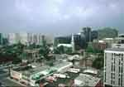
Article3-5_W_ spring up
Before Reading
Global Reading
Detailed Reading
After Reading
A spirited discussion springs up between a young girl who says that women have outgrown the jumping-on-a-chair-at-the-sight-of-a-mouse era and a major who says that they haven’t.
“A woman’s reaction in any crisis,” the major says, “is to scream. And while a man may feel like it, he has that ounce more of control than a woman has. And that last ounce is what really counts.”
spring up: begin suddenly, increase or grow quickly and as if
from nowhere
许多楼房已在原是一片沙漠的地带涌现出来。
Many buildings have sprung up in what was a desert.
A strange idea sprang up in her mind.
The American does not join in the argument but watches the other guests. As he looks, he sees a strange expression come over the face of the hostess. She is staring straight ahead, her muscles contracting slightly. She motions to the native boy standing behind her chair and whispers something to him. The boy’s eyes widen: he quickly leaves the room.

Slide 60
Article3-5_W_ outgrow
Before Reading
Global Reading
Detailed Reading
After Reading
A spirited discussion springs up between a young girl who says that women have outgrown the jumping-on-a-chair-at-the-sight-of-a-mouse era and a major who says that they haven’t.
“A woman’s reaction in any crisis,” the major says, “is to scream. And while a man may feel like it, he has that ounce more of control than a woman has. And that last ounce is what really counts.”
outgrow: vt.
1) grow more than
他长得比他哥哥还高。
He has outgrown his elder brother.
2) grow too large for
The boy has outgrown this suit.
3) lose or discard in the course of maturation
The American does not join in the argument but watches the other guests. As he looks, he sees a strange expression come over the face of the hostess. She is staring straight ahead, her muscles contracting slightly. She motions to the native boy standing behind her chair and whispers something to him. The boy’s eyes widen: he quickly leaves the room.
她长大成熟后不再拥有年轻时代的幻想。
She outgrew her youthful idealism.
He has outgrown these toys.

Slide 61
Article3-5_W_ jumping-on-a-chair-at-the-sight-of-a-mouse
Before Reading
Global Reading
Detailed Reading
After Reading
A spirited discussion springs up between a young girl who says that women have outgrown the jumping-on-a-chair-at-the-sight-of-a-mouse era and a major who says that they haven’t.
“A woman’s reaction in any crisis,” the major says, “is to scream. And while a man may feel like it, he has that ounce more of control than a woman has. And that last ounce is what really counts.”
jumping-on-a-chair-at-the-sight-of-a-mouse
NB:
这是一个由定语从句 (the era) when they would jump on a chair at the sight of a mouse变化而来的复合形容词。更多的例子如下：
a not-so-easy-to-operate machine
stick-in-the-mud people
The American does not join in the argument but watches the other guests. As he looks, he sees a strange expression come over the face of the hostess. She is staring straight ahead, her muscles contracting slightly. She motions to the native boy standing behind her chair and whispers something to him. The boy’s eyes widen: he quickly leaves the room.

Slide 62
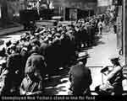
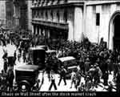
Article3-5_W_ crisis1
Before Reading
Global Reading
Detailed Reading
After Reading
A spirited discussion springs up between a young girl who says that women have outgrown the jumping-on-a-chair-at-the-sight-of-a-mouse era and a major who says that they haven’t.
“A woman’s reaction in any crisis,” the major says, “is to scream. And while a man may feel like it, he has that ounce more of control than a woman has. And that last ounce is what really counts.”
crisis: n. time of difficulty, danger, etc.
Many American people lost their jobs in the economic crisis of 1929.
但愿我们能度过这一危机时刻。
We hope we can survive this time of crisis.
CF:
crisis & emergency
这两个名词都有“危急”之意。
The American does not join in the argument but watches the other guests. As he looks, he sees a strange expression come over the face of the hostess. She is staring straight ahead, her muscles contracting slightly. She motions to the native boy standing behind her chair and whispers something to him. The boy’s eyes widen: he quickly leaves the room.
crisis 含义广泛，可指国家存亡、历史、经济或人
的生命、疾病等面临危急关头；也可指好的
或恶化的转折点。
emergency 多指突然发生的出乎意料的紧急情况
或事故。

Slide 63
Article3-5_W_ crisis2
Before Reading
Global Reading
Detailed Reading
After Reading
A spirited discussion springs up between a young girl who says that women have outgrown the jumping-on-a-chair-at-the-sight-of-a-mouse era and a major who says that they haven’t.
“A woman’s reaction in any crisis,” the major says, “is to scream. And while a man may feel like it, he has that ounce more of control than a woman has. And that last ounce is what really counts.”
Directions:
Fill in the blanks with the words above. Change the form where necessary.
1.
2.
3.
4.
A fire started in the cargo area, and the pilot was forced to make a(n) landing.
In a(n) , dial 911 for police, the fire department or an ambulance.
The country now faces an economic .
The President announced his resignation, sparking a(n)
in the government.
_________
emergency
__________
emergency
The American does not join in the argument but watches the other guests. As he looks, he sees a strange expression come over the face of the hostess. She is staring straight ahead, her muscles contracting slightly. She motions to the native boy standing behind her chair and whispers something to him. The boy’s eyes widen: he quickly leaves the room.
____
crisis
____
crisis

Slide 64
Article3-5_W_ crisis3
Before Reading
Global Reading
Detailed Reading
After Reading
A spirited discussion springs up between a young girl who says that women have outgrown the jumping-on-a-chair-at-the-sight-of-a-mouse era and a major who says that they haven’t.
“A woman’s reaction in any crisis,” the major says, “is to scream. And while a man may feel like it, he has that ounce more of control than a woman has. And that last ounce is what really counts.”
Collocation:
at a crisis
在紧急关头
bring to a crisis
使陷入危机
come to a crisis
陷入危机
face a crisis
面临危机
The American does not join in the argument but watches the other guests. As he looks, he sees a strange expression come over the face of the hostess. She is staring straight ahead, her muscles contracting slightly. She motions to the native boy standing behind her chair and whispers something to him. The boy’s eyes widen: he quickly leaves the room.
pass a crisis
渡过危机, 脱离危险期

Slide 65
Article3-5_W_ feel like
Before Reading
Global Reading
Detailed Reading
After Reading
A spirited discussion springs up between a young girl who says that women have outgrown the jumping-on-a-chair-at-the-sight-of-a-mouse era and a major who says that they haven’t.
“A woman’s reaction in any crisis,” the major says, “is to scream. And while a man may feel like it, he has that ounce more of control than a woman has. And that last ounce is what really counts.”
feel like: have a liking for, wish for; want (sth. to do sth.)
多么好的天气啊！我真想去游泳。
What lovely weather! I do feel like a swim.
Mary doesn’t feel like playing tennis today because she feels tired.
The American does not join in the argument but watches the other guests. As he looks, he sees a strange expression come over the face of the hostess. She is staring straight ahead, her muscles contracting slightly. She motions to the native boy standing behind her chair and whispers something to him. The boy’s eyes widen: he quickly leaves the room.

Slide 66
Article3-5_W_ count
Before Reading
Global Reading
Detailed Reading
After Reading
A spirited discussion springs up between a young girl who says that women have outgrown the jumping-on-a-chair-at-the-sight-of-a-mouse era and a major who says that they haven’t.
“A woman’s reaction in any crisis,” the major says, “is to scream. And while a man may feel like it, he has that ounce more of control than a woman has. And that last ounce is what really counts.”
count: vi. be of value or importance
It's not the weapons but the men who use them that count.
你读了多少书并不重要，而你读了什么书才是真正重要的。
It is not how much you read but what you read that really counts.
The American does not join in the argument but watches the other guests. As he looks, he sees a strange expression come over the face of the hostess. She is staring straight ahead, her muscles contracting slightly. She motions to the native boy standing behind her chair and whispers something to him. The boy’s eyes widen: he quickly leaves the room.

Slide 67
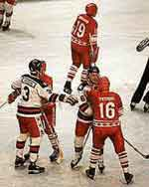
Article3-5_W_ argument1
Before Reading
Global Reading
Detailed Reading
After Reading
argument: n.
1) discussion by persons who disagree; dispute
A spirited discussion springs up between a young girl who says that women have outgrown the jumping-on-a-chair-at-the-sight-of-a-mouse era and a major who says that they haven’t.
“A woman’s reaction in any crisis,” the major says, “is to scream. And while a man may feel like it, he has that ounce more of control than a woman has. And that last ounce is what really counts.”
The two teams were having an argument over the score.
The two countries held a lengthy argument about / over the control of a tiny island.
2) reason given to support or disapprove sth.
There are many arguments against smoking.
The American does not join in the argument but watches the other guests. As he looks, he sees a strange expression come over the face of the hostess. She is staring straight ahead, her muscles contracting slightly. She motions to the native boy standing behind her chair and whispers something to him. The boy’s eyes widen: he quickly leaves the room.
然而,他的论点是站不住脚的。
His argument, however, does not hold water.

Slide 68
Article3-5_W_ argument2
Before Reading
Global Reading
Detailed Reading
After Reading
Collocation:
A spirited discussion springs up between a young girl who says that women have outgrown the jumping-on-a-chair-at-the-sight-of-a-mouse era and a major who says that they haven’t.
“A woman’s reaction in any crisis,” the major says, “is to scream. And while a man may feel like it, he has that ounce more of control than a woman has. And that last ounce is what really counts.”
be engaged in an argument with sb.
与某人发生一场争论
clinch an / the argument
作出最后的结论; 使争论获得完全解决
drive an argument home
把论点讲透彻, 阐明观点
get / fall into an argument with
与…发生争论
knock-down argument
使人无法反驳的论据; 压倒性的理由
put forward an argument
提出论点
The American does not join in the argument but watches the other guests. As he looks, he sees a strange expression come over the face of the hostess. She is staring straight ahead, her muscles contracting slightly. She motions to the native boy standing behind her chair and whispers something to him. The boy’s eyes widen: he quickly leaves the room.
stock argument
常见的论点, 老一套的论点

Slide 69
Article3-5_W_ argument3
Before Reading
Global Reading
Detailed Reading
After Reading
A spirited discussion springs up between a young girl who says that women have outgrown the jumping-on-a-chair-at-the-sight-of-a-mouse era and a major who says that they haven’t.
“A woman’s reaction in any crisis,” the major says, “is to scream. And while a man may feel like it, he has that ounce more of control than a woman has. And that last ounce is what really counts.”
CF:
argument, conflict, debate & dispute
这几个名词均有“争执、不和”之意。
argument 指辩论双方均以事实或理由来说服对方的辩论。
conflict 指双方坚持已见、互不妥协，怀有敌意的争论，多暗示分歧极为
严重，有时用语言无法解决，只得诉诸武力。
debate 通常指经过仔细组织和计划的个人或团体之间的辩论。
dispute 普通用词，特指长时间，言词激烈，针锋相对的争辩。
The American does not join in the argument but watches the other guests. As he looks, he sees a strange expression come over the face of the hostess. She is staring straight ahead, her muscles contracting slightly. She motions to the native boy standing behind her chair and whispers something to him. The boy’s eyes widen: he quickly leaves the room.

Slide 70
Article3-5_W_ argument4
Before Reading
Global Reading
Detailed Reading
After Reading
A spirited discussion springs up between a young girl who says that women have outgrown the jumping-on-a-chair-at-the-sight-of-a-mouse era and a major who says that they haven’t.
“A woman’s reaction in any crisis,” the major says, “is to scream. And while a man may feel like it, he has that ounce more of control than a woman has. And that last ounce is what really counts.”
Directions:
Fill in the blanks with the words above. Change the form where necessary.
1.
2.
3.
4.
The new drug has become the subject of heated
within the medical profession.
Morris has been involved in a long legal with his publisher.
Before you judge, you must listen to the of both sides.
For years the region has been torn apart by armed
.
______
debate
dispute
______
arguments
_________
The American does not join in the argument but watches the other guests. As he looks, he sees a strange expression come over the face of the hostess. She is staring straight ahead, her muscles contracting slightly. She motions to the native boy standing behind her chair and whispers something to him. The boy’s eyes widen: he quickly leaves the room.
conflicts
_______

Slide 71
Article3-5_W_ contract
Before Reading
Global Reading
Detailed Reading
After Reading
contract: vi.
1) make or become tighter or narrower
A spirited discussion springs up between a young girl who says that women have outgrown the jumping-on-a-chair-at-the-sight-of-a-mouse era and a major who says that they haven’t.
“A woman’s reaction in any crisis,” the major says, “is to scream. And while a man may feel like it, he has that ounce more of control than a woman has. And that last ounce is what really counts.”
Her stomach contracted at the sight of a cobra.
2) make or become smaller or shorter
金属遇冷收缩。
Metal contracts as it cools.
“I am” is usually contracted to “I'm” in oral speech.
3) settle or arrange by formal arrangement
The American does not join in the argument but watches the other guests. As he looks, he sees a strange expression come over the face of the hostess. She is staring straight ahead, her muscles contracting slightly. She motions to the native boy standing behind her chair and whispers something to him. The boy’s eyes widen: he quickly leaves the room.
Their firm has contracted to build a double-purpose bridge across the river.
我们商店与本地一家服装厂签订了每周100件外衣的合同。
Our shop contracted with a local clothing firm for 100 coats a week.

Slide 72

Article3-5_W_ motion1
Before Reading
Global Reading
Detailed Reading
After Reading
motion：
1. v. give a signal by moving the hand or head; signal to sb.
A spirited discussion springs up between a young girl who says that women have outgrown the jumping-on-a-chair-at-the-sight-of-a-mouse era and a major who says that they haven’t.
“A woman’s reaction in any crisis,” the major says, “is to scream. And while a man may feel like it, he has that ounce more of control than a woman has. And that last ounce is what really counts.”
Tom stood up, motioning to the bartender to bring him another drink.
护士用手指示意叫我过来。
The nurse motioned with her finger for me to come.
Seeing Diana in the doorway, I motioned her to the room.
2. n.
1) signal by hand or head
The American does not join in the argument but watches the other guests. As he looks, he sees a strange expression come over the face of the hostess. She is staring straight ahead, her muscles contracting slightly. She motions to the native boy standing behind her chair and whispers something to him. The boy’s eyes widen: he quickly leaves the room.
He made a motion with his hand, as if to tell me to keep back.
2) moving
千万不要在公共汽车还在动的时候上下车。
Never get on or off a bus while it is in motion.

Slide 73
Article3-5_W_ motion2
Before Reading
Global Reading
Detailed Reading
After Reading
3) proposal to be discussed and voted on at a meeting
A spirited discussion springs up between a young girl who says that women have outgrown the jumping-on-a-chair-at-the-sight-of-a-mouse era and a major who says that they haven’t.
“A woman’s reaction in any crisis,” the major says, “is to scream. And while a man may feel like it, he has that ounce more of control than a woman has. And that last ounce is what really counts.”
The motion put forward by the chairman was adopted / carried but the motion by me was rejected.
Collocation:
go through the motions of (doing sth.)
装出（做某事的）样子
make a motion
用手示意; 提议, 动议
put / set sth. in motion
使某物开始运转（或工作）
in motion
在开动中, 在运转中; 处于兴奋状态
The American does not join in the argument but watches the other guests. As he looks, he sees a strange expression come over the face of the hostess. She is staring straight ahead, her muscles contracting slightly. She motions to the native boy standing behind her chair and whispers something to him. The boy’s eyes widen: he quickly leaves the room.
of one's own motion
自动地; 自愿地

Slide 74
Article3-5_W_ motion3
Before Reading
Global Reading
Detailed Reading
After Reading
A spirited discussion springs up between a young girl who says that women have outgrown the jumping-on-a-chair-at-the-sight-of-a-mouse era and a major who says that they haven’t.
“A woman’s reaction in any crisis,” the major says, “is to scream. And while a man may feel like it, he has that ounce more of control than a woman has. And that last ounce is what really counts.”
CF:
motion, move & movement
这些名词都有“运动”之意。
motion 指不处于静止状态而在移动的过程中，强调运动本身，而不涉及其动因。例如：
move 着重开始的行动或变化。例如：
movement 通常抽象地指有规则的动作或定向运动，特指政治性的运动。例如：
The motion of the planets is not perceptible to the human eye.
行星的运动不为人眼所察觉。
She’s still thinking about her next move.
The American does not join in the argument but watches the other guests. As he looks, he sees a strange expression come over the face of the hostess. She is staring straight ahead, her muscles contracting slightly. She motions to the native boy standing behind her chair and whispers something to him. The boy’s eyes widen: he quickly leaves the room.
她还在考虑下一个步骤。
What do you think of the civil rights movement in that country?
你对那个国家的民权运动有何看法？

Slide 75
Article6-9_W_ come to
Before Reading
Global Reading
Detailed Reading
After Reading
come to: 1) be aware of, regain consciousness
2) occur to sb.
3) amount to, be equal to
Of the guests, none except the American notices this or sees the boy place a bowl of milk on the veranda just outside the open doors.
The American comes to with a start. In India, milk in a bowl means only one thing — bait for a snake. He realizes there must be a cobra in the room. He looks up at the rafters — the likeliest place — but they are bare. Three corners of the room are empty, and in the fourth the servants are waiting to serve the next course. There is only one place left — under the table.
His first impulse is to jump back and warn the others, but he knows the commotion would frighten the cobra into striking. He speaks quickly, the tone of his voice so commanding that it silences everyone.
Directions:
You are required to match the definitions above with the meaning of this phrase in the following sentences.
*
The old lady fainted on the street and found herself in the first aid room when she came to.
Jim’s rent comes to thirty per cent of his salary.
The doctor applied some medicine and the driver began to come to.
It suddenly came to her that she had been wrong all along.
1
( )
*
3
( )
*
1
( )
*
2
( )
“I want to know just what control everyone at this table has. I will count three hundred — that’s five minutes — and not one of you is to move a muscle. Those who move will forfeit 50 rupees. Ready!”

Slide 76
Article6-9_W_ impulse
Before Reading
Global Reading
Detailed Reading
After Reading
impulse: n. sudden wish to do sth.
Of the guests, none except the American notices this or sees the boy place a bowl of milk on the veranda just outside the open doors.
The American comes to with a start. In India, milk in a bowl means only one thing — bait for a snake. He realizes there must be a cobra in the room. He looks up at the rafters — the likeliest place — but they are bare. Three corners of the room are empty, and in the fourth the servants are waiting to serve the next course. There is only one place left — under the table.
His first impulse is to jump back and warn the others, but he knows the commotion would frighten the cobra into striking. He speaks quickly, the tone of his voice so commanding that it silences everyone.
Don’t act on impulse. You will regret it later.
She bought the dress on impulse.
Collocation:
a man of impulse
易冲动的人
act on impulse
意气用事，凭冲动行事
feel an impulse to do sth.
有做某事的冲动
“I want to know just what control everyone at this table has. I will count three hundred — that’s five minutes — and not one of you is to move a muscle. Those who move will forfeit 50 rupees. Ready!”

Slide 77
Article6-9_W_ warn1
Before Reading
Global Reading
Detailed Reading
After Reading
warn: vt. give notice of possible danger to; inform in advance
of what may happen
Of the guests, none except the American notices this or sees the boy place a bowl of milk on the veranda just outside the open doors.
The American comes to with a start. In India, milk in a bowl means only one thing — bait for a snake. He realizes there must be a cobra in the room. He looks up at the rafters — the likeliest place — but they are bare. Three corners of the room are empty, and in the fourth the servants are waiting to serve the next course. There is only one place left — under the table.
His first impulse is to jump back and warn the others, but he knows the commotion would frighten the cobra into striking. He speaks quickly, the tone of his voice so commanding that it silences everyone.
Pattern:
warn sb. of sth.; warn sb. not to do sth.;
warn sb. that-clause
We had warned him of the danger but he turned a deaf ear to our warning.
The boys were warned not to play with the matches.
她曾提醒我们，那个冬季将非常寒冷。
She warned us that the winter would be severe.
“I want to know just what control everyone at this table has. I will count three hundred — that’s five minutes — and not one of you is to move a muscle. Those who move will forfeit 50 rupees. Ready!”

Slide 78
Article6-9_W_ warn2
Before Reading
Global Reading
Detailed Reading
After Reading
CF:
caution, warn, advise & counsel
这些动词均有“劝告、忠告、警告”之意。
Of the guests, none except the American notices this or sees the boy place a bowl of milk on the veranda just outside the open doors.
The American comes to with a start. In India, milk in a bowl means only one thing — bait for a snake. He realizes there must be a cobra in the room. He looks up at the rafters — the likeliest place — but they are bare. Three corners of the room are empty, and in the fourth the servants are waiting to serve the next course. There is only one place left — under the table.
His first impulse is to jump back and warn the others, but he knows the commotion would frighten the cobra into striking. He speaks quickly, the tone of his voice so commanding that it silences everyone.
caution 主要指针对有潜在危险而提出的警告，含小心从事的意味。例如：
warn 含义与caution相同，但语气较重，尤指后果严重。例如：
advise 普通用词，泛指劝告，不涉及对方是否听从劝告。例如：
counsel 正式用词，语气比advise强一些，着重指对重要问题提出的劝告、建议或咨询。例如：
I received a caution from the doctor about fat in my diet.
医生劝告我注意饮食中的脂肪量。
He warned us against pickpockets.
他提醒我们要小心扒手。
His doctor advised him against smoking.
他的医生建议他不要抽烟。
“I want to know just what control everyone at this table has. I will count three hundred — that’s five minutes — and not one of you is to move a muscle. Those who move will forfeit 50 rupees. Ready!”
“I want to know just what control everyone at this table has. I will count three hundred — that’s five minutes — and not one of you is to move a muscle. Those who move will forfeit 50 rupees. Ready!”
My job involves counseling unemployed people on how to find work.
我的工作就是给失业者提供如何找到工作的咨询。

Slide 79
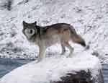
Article6-9_W_ frighten sb
Before Reading
Global Reading
Detailed Reading
After Reading
frighten sb. into doing sth.: cause sb. to do sth. by frightening him
Of the guests, none except the American notices this or sees the boy place a bowl of milk on the veranda just outside the open doors.
The American comes to with a start. In India, milk in a bowl means only one thing — bait for a snake. He realizes there must be a cobra in the room. He looks up at the rafters — the likeliest place — but they are bare. Three corners of the room are empty, and in the fourth the servants are waiting to serve the next course. There is only one place left — under the table.
His first impulse is to jump back and warn the others, but he knows the commotion would frighten the cobra into striking. He speaks quickly, the tone of his voice so commanding that it silences everyone.
Pattern:
frighten sb. into (doing) sth.;
frighten sb. out of doing sth.;
frighten sb. + adv.
A cobra emerged from behind the rock. This frightened the girl into screaming.
He waved his torch to frighten away / off the wolf.
Collocation:
be frightened of
害怕, 对…感到恐惧
frighten away / off
吓跑, 吓走
frighten sb. into / out of doing sth.
用恐吓手段迫使某人做 / 不做某事
“I want to know just what control everyone at this table has. I will count three hundred — that’s five minutes — and not one of you is to move a muscle. Those who move will forfeit 50 rupees. Ready!”
“I want to know just what control everyone at this table has. I will count three hundred — that’s five minutes — and not one of you is to move a muscle. Those who move will forfeit 50 rupees. Ready!”
frighten to death
吓死了

Slide 80
Article6-9_W_ tone
Before Reading
Global Reading
Detailed Reading
After Reading
tone: n.
Of the guests, none except the American notices this or sees the boy place a bowl of milk on the veranda just outside the open doors.
The American comes to with a start. In India, milk in a bowl means only one thing — bait for a snake. He realizes there must be a cobra in the room. He looks up at the rafters — the likeliest place — but they are bare. Three corners of the room are empty, and in the fourth the servants are waiting to serve the next course. There is only one place left — under the table.
His first impulse is to jump back and warn the others, but he knows the commotion would frighten the cobra into striking. He speaks quickly, the tone of his voice so commanding that it silences everyone.
1) quality in one's voice, style
She was speaking now in a cold sarcastic tone.
别用那种腔调跟我说话。
Don't speak to me in that tone.
2) the effect of light and shade
The colors of the birds in the picture matched the tones of the sky.
3) sound with regard to highness, lowness, or strength
汤姆的吉他音质很好。
“I want to know just what control everyone at this table has. I will count three hundred — that’s five minutes — and not one of you is to move a muscle. Those who move will forfeit 50 rupees. Ready!”
Tom's guitar has a nice tone.
Mandarin Chinese has four tones.

Slide 81
Article10-13_W_ emerge1
Before Reading
Global Reading
Detailed Reading
After Reading
emerge: vi. come or appear (from somewhere)
The 20 people sit like stone images while he counts. He is saying “... two hundred and eighty…” when, out of the corner of his eye, he sees the cobra emerge and make for the bowl of milk. Screams ring out as he jumps to slam the veranda doors safely shut.
“You were right, Major!” the host exclaims. “A man has just shown us an example of perfect self-control.”
“Just a minute,” the American says, turning to his hostess. “Mrs. Wynnes, how did you know that cobra was in the room?”
A faint smile lights up the woman’s face as she replies: “Because it was crawling across my foot.”
He emerged from behind the tree.
太阳从云层后面露出来。
The sun emerged from behind the clouds.
If the economy goes on like this, another crisis will emerge soon.
CF:
emerge, appear & loom
这三个动词均有“出现”之意。
emerge 强调缓缓出现的过程。
appear 强调公开露面，被看见。
loom 指朦胧出现，好像从雾中浮现出来一样。

Slide 82
Article10-13_W_ emerge2
Before Reading
Global Reading
Detailed Reading
After Reading
The 20 people sit like stone images while he counts. He is saying “... two hundred and eighty…” when, out of the corner of his eye, he sees the cobra emerge and make for the bowl of milk. Screams ring out as he jumps to slam the veranda doors safely shut.
“You were right, Major!” the host exclaims. “A man has just shown us an example of perfect self-control.”
“Just a minute,” the American says, turning to his hostess. “Mrs. Wynnes, how did you know that cobra was in the room?”
A faint smile lights up the woman’s face as she replies: “Because it was crawling across my foot.”
Directions:
Fill in the blanks with the words above. Change the form where necessary.
1.
2.
3.
Suddenly a mountain up in front of them.
The sun from behind the clouds.
The famous pop singer is unable to tonight because of illness.
loomed
______
_______
emerged
appear
______

Slide 83
Article10-13_W_ make for
Before Reading
Global Reading
Detailed Reading
After Reading
The 20 people sit like stone images while he counts. He is saying “... two hundred and eighty…” when, out of the corner of his eye, he sees the cobra emerge and make for the bowl of milk. Screams ring out as he jumps to slam the veranda doors safely shut.
“You were right, Major!” the host exclaims. “A man has just shown us an example of perfect self-control.”
“Just a minute,” the American says, turning to his hostess. “Mrs. Wynnes, how did you know that cobra was in the room?”
A faint smile lights up the woman’s face as she replies: “Because it was crawling across my foot.”
make for:
1) move (esp. quickly) towards
When the class was over, everyone made for the dining room.
2) cause; lead to; result in; help; favor sth.
Poor service does not make for satisfied customers.

Slide 84
Article10-13_W_ ring out
Before Reading
Global Reading
Detailed Reading
After Reading
The 20 people sit like stone images while he counts. He is saying “... two hundred and eighty…” when, out of the corner of his eye, he sees the cobra emerge and make for the bowl of milk. Screams ring out as he jumps to slam the veranda doors safely shut.
“You were right, Major!” the host exclaims. “A man has just shown us an example of perfect self-control.”
“Just a minute,” the American says, turning to his hostess. “Mrs. Wynnes, how did you know that cobra was in the room?”
A faint smile lights up the woman’s face as she replies: “Because it was crawling across my foot.”
ring out: (of a voice, bell, etc.) sound loudly and clearly
Cheers rang out from the crowd waiting in front of the building.
突然一声枪响，紧接着是一片寂静。
A shot rang out, and then there was silence.

Slide 85
Article10-13_W_ slam
Before Reading
Global Reading
Detailed Reading
After Reading
The 20 people sit like stone images while he counts. He is saying “... two hundred and eighty…” when, out of the corner of his eye, he sees the cobra emerge and make for the bowl of milk. Screams ring out as he jumps to slam the veranda doors safely shut.
“You were right, Major!” the host exclaims. “A man has just shown us an example of perfect self-control.”
“Just a minute,” the American says, turning to his hostess. “Mrs. Wynnes, how did you know that cobra was in the room?”
A faint smile lights up the woman’s face as she replies: “Because it was crawling across my foot.”
slam: v. shut noisily and with great force
He slammed the door so hard that the glass crashed.
The door suddenly slammed.
汤姆使劲关上窗户。
Tom slammed the window.

Slide 86
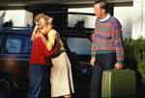
Article10-13_W_ host
Before Reading
Global Reading
Detailed Reading
After Reading
The 20 people sit like stone images while he counts. He is saying “... two hundred and eighty…” when, out of the corner of his eye, he sees the cobra emerge and make for the bowl of milk. Screams ring out as he jumps to slam the veranda doors safely shut.
“You were right, Major!” the host exclaims. “A man has just shown us an example of perfect self-control.”
“Just a minute,” the American says, turning to his hostess. “Mrs. Wynnes, how did you know that cobra was in the room?”
A faint smile lights up the woman’s face as she replies: “Because it was crawling across my foot.”
hostess n.
a person (usu. female) who entertains the guests
Our host and hostess looked after us well.
Mrs. Brown was our hostess at the party.

Slide 87
Article10-13_W_ faint
Before Reading
Global Reading
Detailed Reading
After Reading
The 20 people sit like stone images while he counts. He is saying “... two hundred and eighty…” when, out of the corner of his eye, he sees the cobra emerge and make for the bowl of milk. Screams ring out as he jumps to slam the veranda doors safely shut.
“You were right, Major!” the host exclaims. “A man has just shown us an example of perfect self-control.”
“Just a minute,” the American says, turning to his hostess. “Mrs. Wynnes, how did you know that cobra was in the room?”
A faint smile lights up the woman’s face as she replies: “Because it was crawling across my foot.”
faint: adj. weak or slight; indistinct
他因饥饿而晕倒了。
He felt faint for lack of food.
There is a faint hope that she may be cured.

Slide 88

Article10-13_W_ light up:
Before Reading
Global Reading
Detailed Reading
After Reading
The 20 people sit like stone images while he counts. He is saying “... two hundred and eighty…” when, out of the corner of his eye, he sees the cobra emerge and make for the bowl of milk. Screams ring out as he jumps to slam the veranda doors safely shut.
“You were right, Major!” the host exclaims. “A man has just shown us an example of perfect self-control.”
“Just a minute,” the American says, turning to his hostess. “Mrs. Wynnes, how did you know that cobra was in the room?”
A faint smile lights up the woman’s face as she replies: “Because it was crawling across my foot.”
light up:
1) cause to be bright with light or colour; give light to
The sun rose and began to light up the sky.
2) (cause to) become bright with pleasure or
excitement
Her face lighted / lit up when she heard the good news.

Slide 89
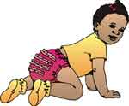
Article10-13_W_ crawl
Before Reading
Global Reading
Detailed Reading
After Reading
The 20 people sit like stone images while he counts. He is saying “... two hundred and eighty…” when, out of the corner of his eye, he sees the cobra emerge and make for the bowl of milk. Screams ring out as he jumps to slam the veranda doors safely shut.
“You were right, Major!” the host exclaims. “A man has just shown us an example of perfect self-control.”
“Just a minute,” the American says, turning to his hostess. “Mrs. Wynnes, how did you know that cobra was in the room?”
A faint smile lights up the woman’s face as she replies: “Because it was crawling across my foot.”
crawl: vi. move forward on one's hands and knees; move very
slowly
The train was crawling deeper into Russia.
The truck had to crawl along because of the snow.
婴儿先能到处爬, 然后才会走。
A baby crawls around before it can walk.

Slide 90
After Reading_main
Before Reading
Global Reading
Detailed Reading
After Reading
1. Useful Expressions
2. Spot Dictation
3. Summary Writing
4. Discussion
5. Role Play
6. Talking About the Pictures
7. Writing Practice
8. Proverbs and Quotations

Slide 91
After Reading_1_1
Before Reading
Global Reading
Detailed Reading
After Reading
Useful Expressions
1.
激烈争论
a heated discussion
2.
出人意料的方式
in an unexpected way
3.
举行盛大晚宴
give a large dinner party
4.
追捕 / 查到
track down
5.
坐下
be seated
6.
来访的美国博物学家
a visiting American naturalist
7.
宽敞的餐厅
a spacious dining room
8.
激烈的讨论
a spirited discussion
9.
一看见
at the sight of
10.
真正重要的是
what really counts

Slide 92
After Reading_1.2
Before Reading
Global Reading
Detailed Reading
After Reading
11. 参加争论
join in an argument
12. 两眼盯着正前方
stare straight ahead
13. 突然醒悟
come to with a start
14. 最有可能的地方
the likeliest place
15. 使…受惊吓而去做…
frighten …into doing …
16. 像石雕一样端坐着
sit like a stone image
17. 走向
make for
18. 镇定自若的典范
an example of perfect self-control
19. 且慢
just a minute
20. 脸上露出一丝淡淡的微笑
a faint smile lights up one’s face

Slide 93
After Reading_2_1
Before Reading
Global Reading
Detailed Reading
After Reading
Spot Dictation
Equal Rights for Women
When a young woman graduates from college and starts looking for a job, she is likely to have a and even demeaning (降低身分的) experience her. If she walks into an office for an interview, the first question she will be asked is, “Do you ?”
There is a calculated system of prejudice that lies behind that question. Why is it for women to be secretaries, , and teachers, but totally unacceptable for them to be managers, administrators, doctors, , and Members of Congress?
The unspoken assumption is that women are different. They do not have executive ability，orderly minds, stability, leadership skills, and
.
frustrating
_________
ahead of
_______
type
____
unspoken
________
acceptable
_________
librarians
________
lawyers
_______
they are too
__________
emotional
________
■

Slide 94
After Reading_2_2
Before Reading
Global Reading
Detailed Reading
After Reading
It has been observed before, that society for a long time, discriminated against another minority, the blacks, on the same basis —
As a black person, I am no stranger to race prejudice. But the truth is that in the political world because I am a woman than because I am black.
that they were different and inferior
____________________________
.
I have been far oftener discriminated against
____________________________________

Slide 95
After Reading_3.1
Before Reading
Global Reading
Detailed Reading
After Reading
Summary Writing
Whether men are braver than women or not is settled in a dinner party in India （某殖民官员和他的夫人正举行的晚宴）
At the party a spirited discussion springs up between a young girl （她认为妇女已经有所进步，不再像过去那样一见到老鼠就吓得跳到椅子上）
and a major （他则不以为然） . Meanwhile, a strange expression comes over the face of the hostess （其脸部肌肉微微抽搐） But she doesn’t say anything. She motions to the native boy（正站在她椅子的后面）
, and whispers to him on the veranda just outside the open doors to place a bowl of milk , （这一碗牛奶，在印度只有一个意思 ── 引蛇的诱饵） . About five minutes later, a cobra emerges and makes for the bowl of milk. （当有人问她如何得知房间里有蛇时）
the hostess simply says, “(因为它当时正从我的脚背上爬过去)
.”
_____________________________________.
which a colonial official and his wife are giving
________________________
who says that women have
_________________________________________________
outgrown the jumping-on-a-chair-at-the-sight-of-a-mouse era
______________________
who says that they haven’t
whose muscles contract slightly
_________________________
.
__________________________
who is standing behind her chair
____________________________________________
which in India means only one thing — bait for a snake
_______________________________________________________
When being asked how she knew that there was a cobra in the room
,
____________________
Because it was crawling
____________
across my foot

Slide 96
After Reading_4
Before Reading
Global Reading
Detailed Reading
After Reading
Discussion
1. After you study this text, who do you think are braver, men or women? Why?
2. What do you think are the differences between men and women?

Slide 97
After Reading_5.1
Before Reading
Global Reading
Detailed Reading
After Reading
Role Play
This role-play should cover the following plots:
1) a discussion between a young girl and a major;
2) what the hostess does when she finds a snake;
3) what the American naturalist does when he is aware of the existence of a cobra; 4) a talk after the happening.
Tips

Slide 98
After Reading_5.2
Before Reading
Global Reading
Detailed Reading
After Reading
1) some ways to express one’s opinion:
In my opinion / view … ; Personally / Frankly, I think … ; From my point of view … ; It seems to me that …
2) some ways to express one’s disagreement:
I quite agree with what you said, but … ; There’s a lot in what you said, but … ; You’re right , but … ; I’m afraid I can’t accept that. ; That’s your opinion, not mine.
3) some ways to ask for reasons:
Why do you think of that? ; What’s your reason for saying that?
4) some ways to give reasons:
As something happens, … ; The reason for … was that … ;
There are … reasons for this.
5) some ways to express comparison:
Compare to / with B, A … ; …, on the contrary … ; If you compare A with B, the latter is more / less … ; All in all, A is more … than B.

Slide 99
After Reading_6
Before Reading
Global Reading
Detailed Reading
After Reading
Talking About the Pictures

Slide 100
After Reading_6_1
Before Reading
Global Reading
Detailed Reading
After Reading

Slide 101
After Reading_6_2
Before Reading
Global Reading
Detailed Reading
After Reading

Slide 102
After Reading_6_3
Before Reading
Global Reading
Detailed Reading
After Reading

Slide 103
After Reading_6_4
Before Reading
Global Reading
Detailed Reading
After Reading

Slide 104
After Reading_6_5
Before Reading
Global Reading
Detailed Reading
After Reading

Slide 105
After Reading_6_6
Before Reading
Global Reading
Detailed Reading
After Reading

Slide 106
After Reading_7.1
Before Reading
Global Reading
Detailed Reading
After Reading
Writing Practice
— Combining Sentences with Coordinating Conjunctions and Conjunctive Adverbs
1. A brief introduction
1. Coordinating conjunction
Coordinating conjunctions are the words which connect words, phrases, and clauses. There are mainly seven coordinating conjunctions. An easy way to remember them is to think of the word FANBOYS. See the following table.
F A N B O Y S
for and nor but or yet so

Slide 107
After Reading_7.2
Before Reading
Global Reading
Detailed Reading
After Reading
2) The following are the examples to show how to connect words, phrases, and
clauses with coordinating conjunctions. Remember, when using a conjunction
to join two sentences, use a comma before the conjunction.
COORDINATING
CONJUNCTIONS
SAMPLE SENTENCES
for
I cannot tell whether she is old or young, for I have never seen her.
and
We have tickets for the symphony and the opera.
nor
Sam was not at the meeting, nor was he at work yesterday.
but
It's an old car, but it's very reliable.
or
Shall we go out to the cinema or stay at home?
yet
The sun was shining, yet it was quite cold.
so
I wanted to sit in the front of the balcony, so I ordered my tickets early.

Slide 108
After Reading_7_3
Before Reading
Global Reading
Detailed Reading
After Reading
2. Conjunctive adverb
Conjunctive adverbs are the words which connect two clauses. Conjunctive adverbs show cause and effect, sequence, contrast, comparison, or other relationships. They usually appear between independent clauses or sentences, but may join a dependent clause to a main (independent) clause. The common conjunctive adverbs are as follows:
accordingly, again, also, besides, consequently, finally, furthermore, however, incidentally, moreover, namely, nevertheless, otherwise, then, therefore, thus

Slide 109
After Reading_7_4
Before Reading
Global Reading
Detailed Reading
After Reading
2) The following are the examples to show how to use conjunctive adverbs. Notice
the conjunctive adverb separates two independent clauses (sentences).
Punctuate conjunctive adverbs using a semicolon (;) at the end of the first
clause, followed by a comma (,) after the conjunctive adverb.
CONJUNCTIVE
ADVERBS
SAMPLE SENTENCES
consequently
Most computer users have never received any formal keyboard training. Consequently, their keyboard skills are inefficient.
furthermore
The majority of Americans increased their wealth in the past decade. Furthermore, the gains were substantial.
accordingly
There aren't many jobs available. Accordingly, companies receive hundreds of resumés for every opening.

Slide 110
After Reading_7_5
Before Reading
Global Reading
Detailed Reading
After Reading
Using language is a very complex enterprise. Moreover, there is more to communication than merely putting sentences together.
moreover
nevertheless
What you said was true. It was, nevertheless, a little unkind.
thus
The houses were used for soldiers. Thus, the structures survived the Civil War.

Slide 111
After Reading_7_6
Before Reading
Global Reading
Detailed Reading
After Reading
2. Homework
1. Fill in the blank in each sentence with one of the coordinating conjunctions in the box.
for and nor but or yet so
1)
2)
3)
4)
5)
She remained silent, her heart was heavy and her spirits low.
I don't expect children to be rude, do I expect to be disobeyed.
They rushed to the hospital, they were too late.
You can pay now when you come back to pick up the paint.
I got hungry, I made a sandwich.
for
__
nor
___
but
___
__
or
__
so

Slide 112
After Reading_7_7
Before Reading
Global Reading
Detailed Reading
After Reading
2. Rewrite the following sentences with one of the conjunctive adverbs in the box.
accordingly, besides, consequently, finally, furthermore, however, moreover, namely, nevertheless, otherwise, therefore
1) This is a cheap and simple process. There are dangers.
This is a cheap and simple process. However there are dangers.
2) There was no news. We went on hoping.
There was no news; nevertheless, we went on hoping.

Slide 113
After Reading_7_8
Before Reading
Global Reading
Detailed Reading
After Reading
3) We must run. We'll be too late.
We must run; otherwise, we'll be too late.
4) It was clear Lucy was unhappy. It comes as no surprise she has decided to resign.
It was clear Lucy was unhappy. Therefore, it comes as no surprise she has decided to resign.
5) I spent most of my money in the first week. I had very little to eat by the end of the
holiday.
I spent most of my money in the first week and consequently I had very little to eat by the end of the holiday.

Slide 114
After Reading_8_1
Before Reading
Global Reading
Detailed Reading
After Reading
Proverbs and Quotations
1. Courage and resolution are the spirit and soul of virtue.
勇敢和坚定是美德的精神和灵魂。
2. Cowards die many times before their deaths.
懦夫常丧命。
3. Brave actions never want a trumpet.
勇敢的行为不需要吹号。
4. There is no medicine for fear.
胆小无药可治。

Slide 115
After Reading_8_2
Before Reading
Global Reading
Detailed Reading
After Reading
5. If you don’t enter a tiger’s den, you can’t get his cubs.
不入虎穴，焉得虎子。
6. The world can only be grasped by action, not by contemplation. The
hand is more important than the eye… The hand is the cutting edge of
the mind.
— Jacob Bronowski, writer of the former Soviet Union
只有勇敢付诸于行动而不是瞻前顾后，才能掌握这个世界。手比眼睛更加重要……手是思想的利剑。
—— 前苏联作家 J. 布络诺夫斯基
7. Dare and the world always yields. If it beats you sometimes, dare it again
and again it will succumb.
— W. M. Thackeray, British novelist
大胆挑战，世界总会让步。如果有时候你被它打败了，不断地挑战，它总会屈服的。
—— 英国小说家 W. M. 萨克雷

