Slide 1
Why do some tree mast and some do not?
Xiaomao Wang

Slide 2
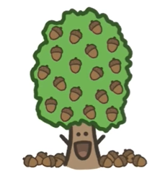
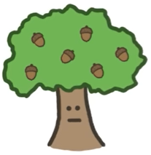
Masting year
Masting year + 1

Slide 3
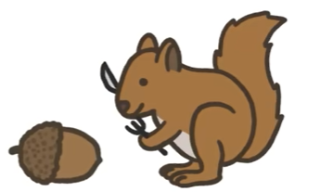
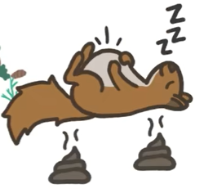
Non-masting year
Masting year

Slide 4
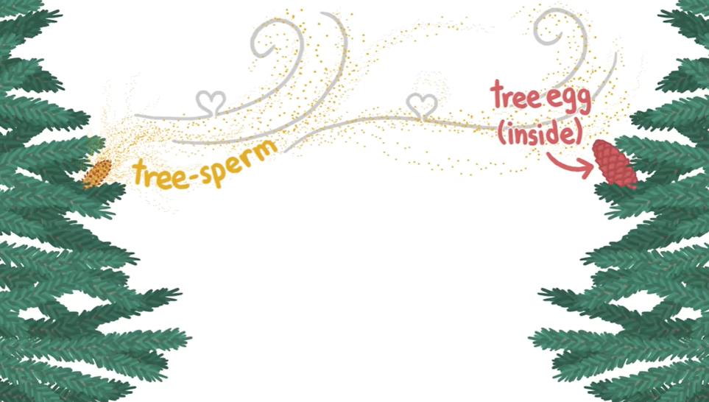
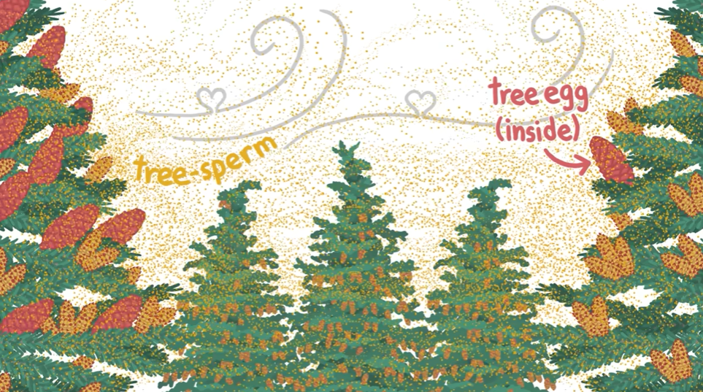
Non-masting year
Masting year

Slide 5
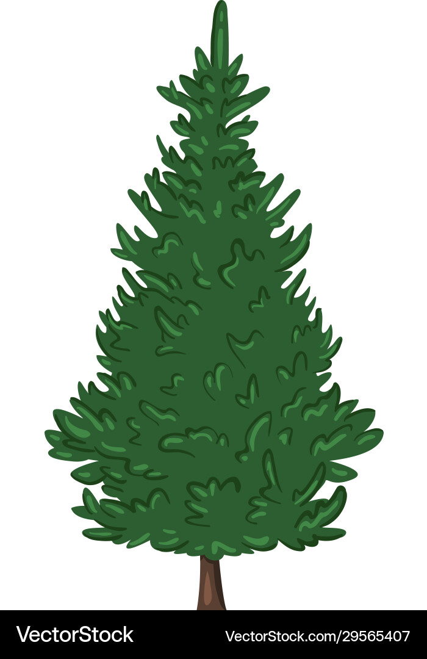
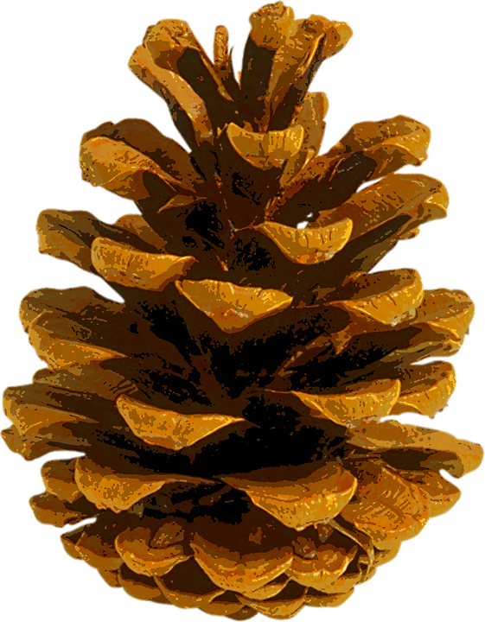
Non-masting year
Masting year

Slide 6
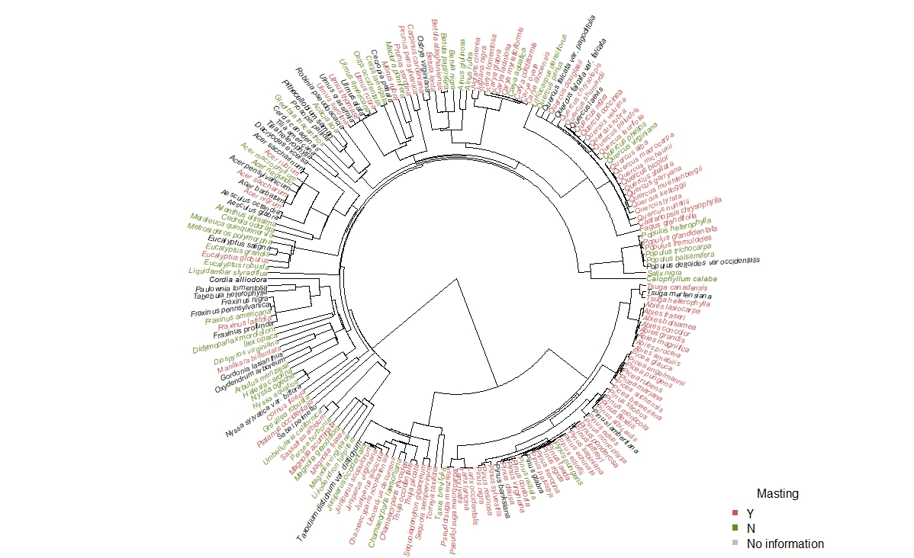
BUT
Not all trees have masting behavior
It seems like certain genus are more likely to mast
Masting is more common in temperate zone
Question
Which reproductive-related traits are related to masting?
Do these traits that relate to different masting hypotheses vary by environment?
(e.g., which traits are more important in different environment)

Slide 7
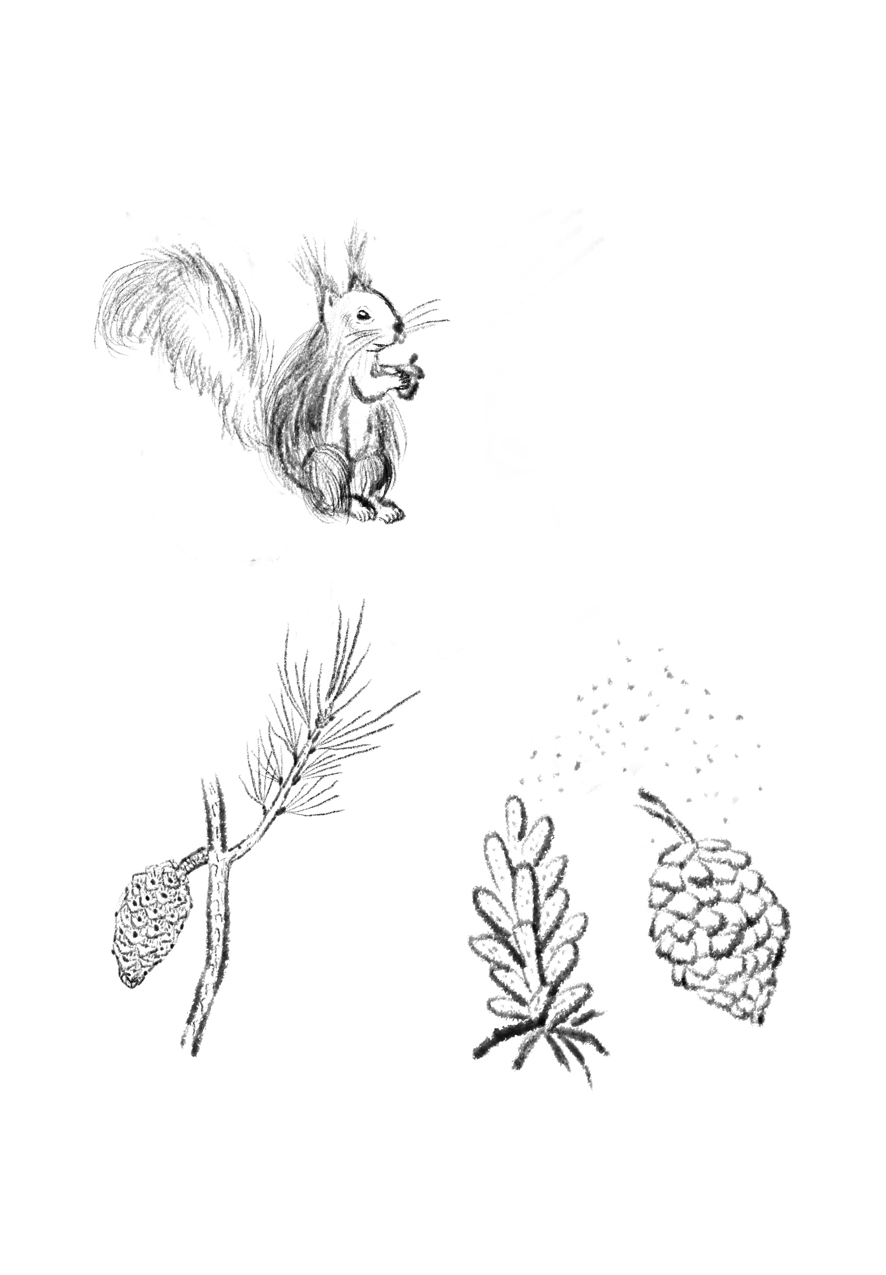
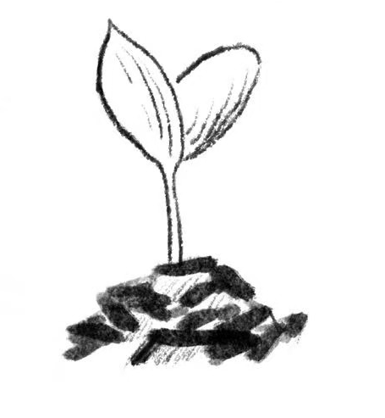




Pollination
Seed maturation
Seed dispersal
Seed size
Nutrient content
Dispersal mode
Seed dormancy
Seed longevity
(continuous)
Type of reproduction
Duration of reproduction
Pollination mode
Leaf longevity
Determinacy
Drought tolerance
(continuous)
(single sex flower or both sexes flowers)
(categorical)
Predator satiation
(continuous)
(how long do leaves persist)
(continuous)
(categorical)
(main seed disperser)
(categorical)
Pollination coupling
Resource matching
(wind pollinated, insects pollinated)
(categorical)
(categorical)
(germinate right after)
(categorical)
(continuous)
Environmental cue

Slide 8
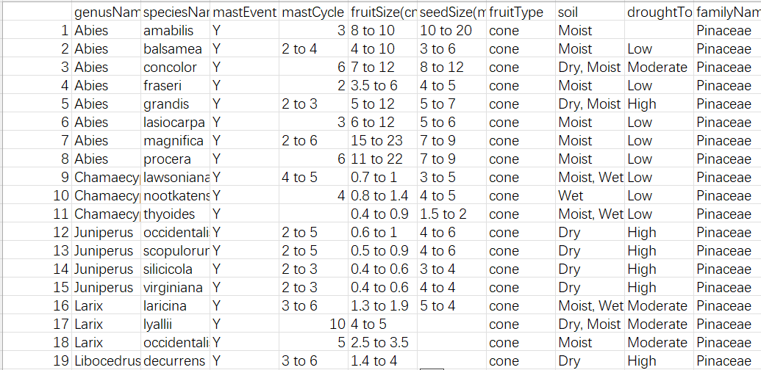
One row of data for each species
Most of the data is a range rather than a single value
Both categorical and continuous

Slide 9
Predictors:
Reproductive traits: mixture of categorical (e.g., pollination mode), and continuous (e.g., seed size).
Climate category: categorical (e.g., soil moisture: wet, moist, dry)
Potential interactions (?): between traits and climate
Response variables:
Binary:: Whether a species have strong masting behavior or not (0/1)
Continuous:: Frequency of mast and variation of the seed production (e.g., CV)

Slide 10
For observation i:
y_{i}​∼Bernoulli(p_{i​})
logit(p_{i}​)=α₀ + α_{soil} + β_{1,soil[i]}​⋅Trait_{1,i​}+β_{2,soil[i]}​⋅Trait_{2,i​}+β_{3,soil[i]}​⋅Trait_{3,i​}
Trait₁ : Seed size (continuous)
Trait₂ : Fruit size (continuous)
Trait₂ : Seed dormancy (categorical)

Slide 11
How to incorporate species variation in the model?
What’s the best way to model variation in trait effects across climates? Should I include interaction terms or hierarchical slopes?
How to best model correlated traits? More specifically, how to model the fruit size, seed size for different fruit types?
Best way to handle different levels of uncertainty or missing data across species?

