Slide 1
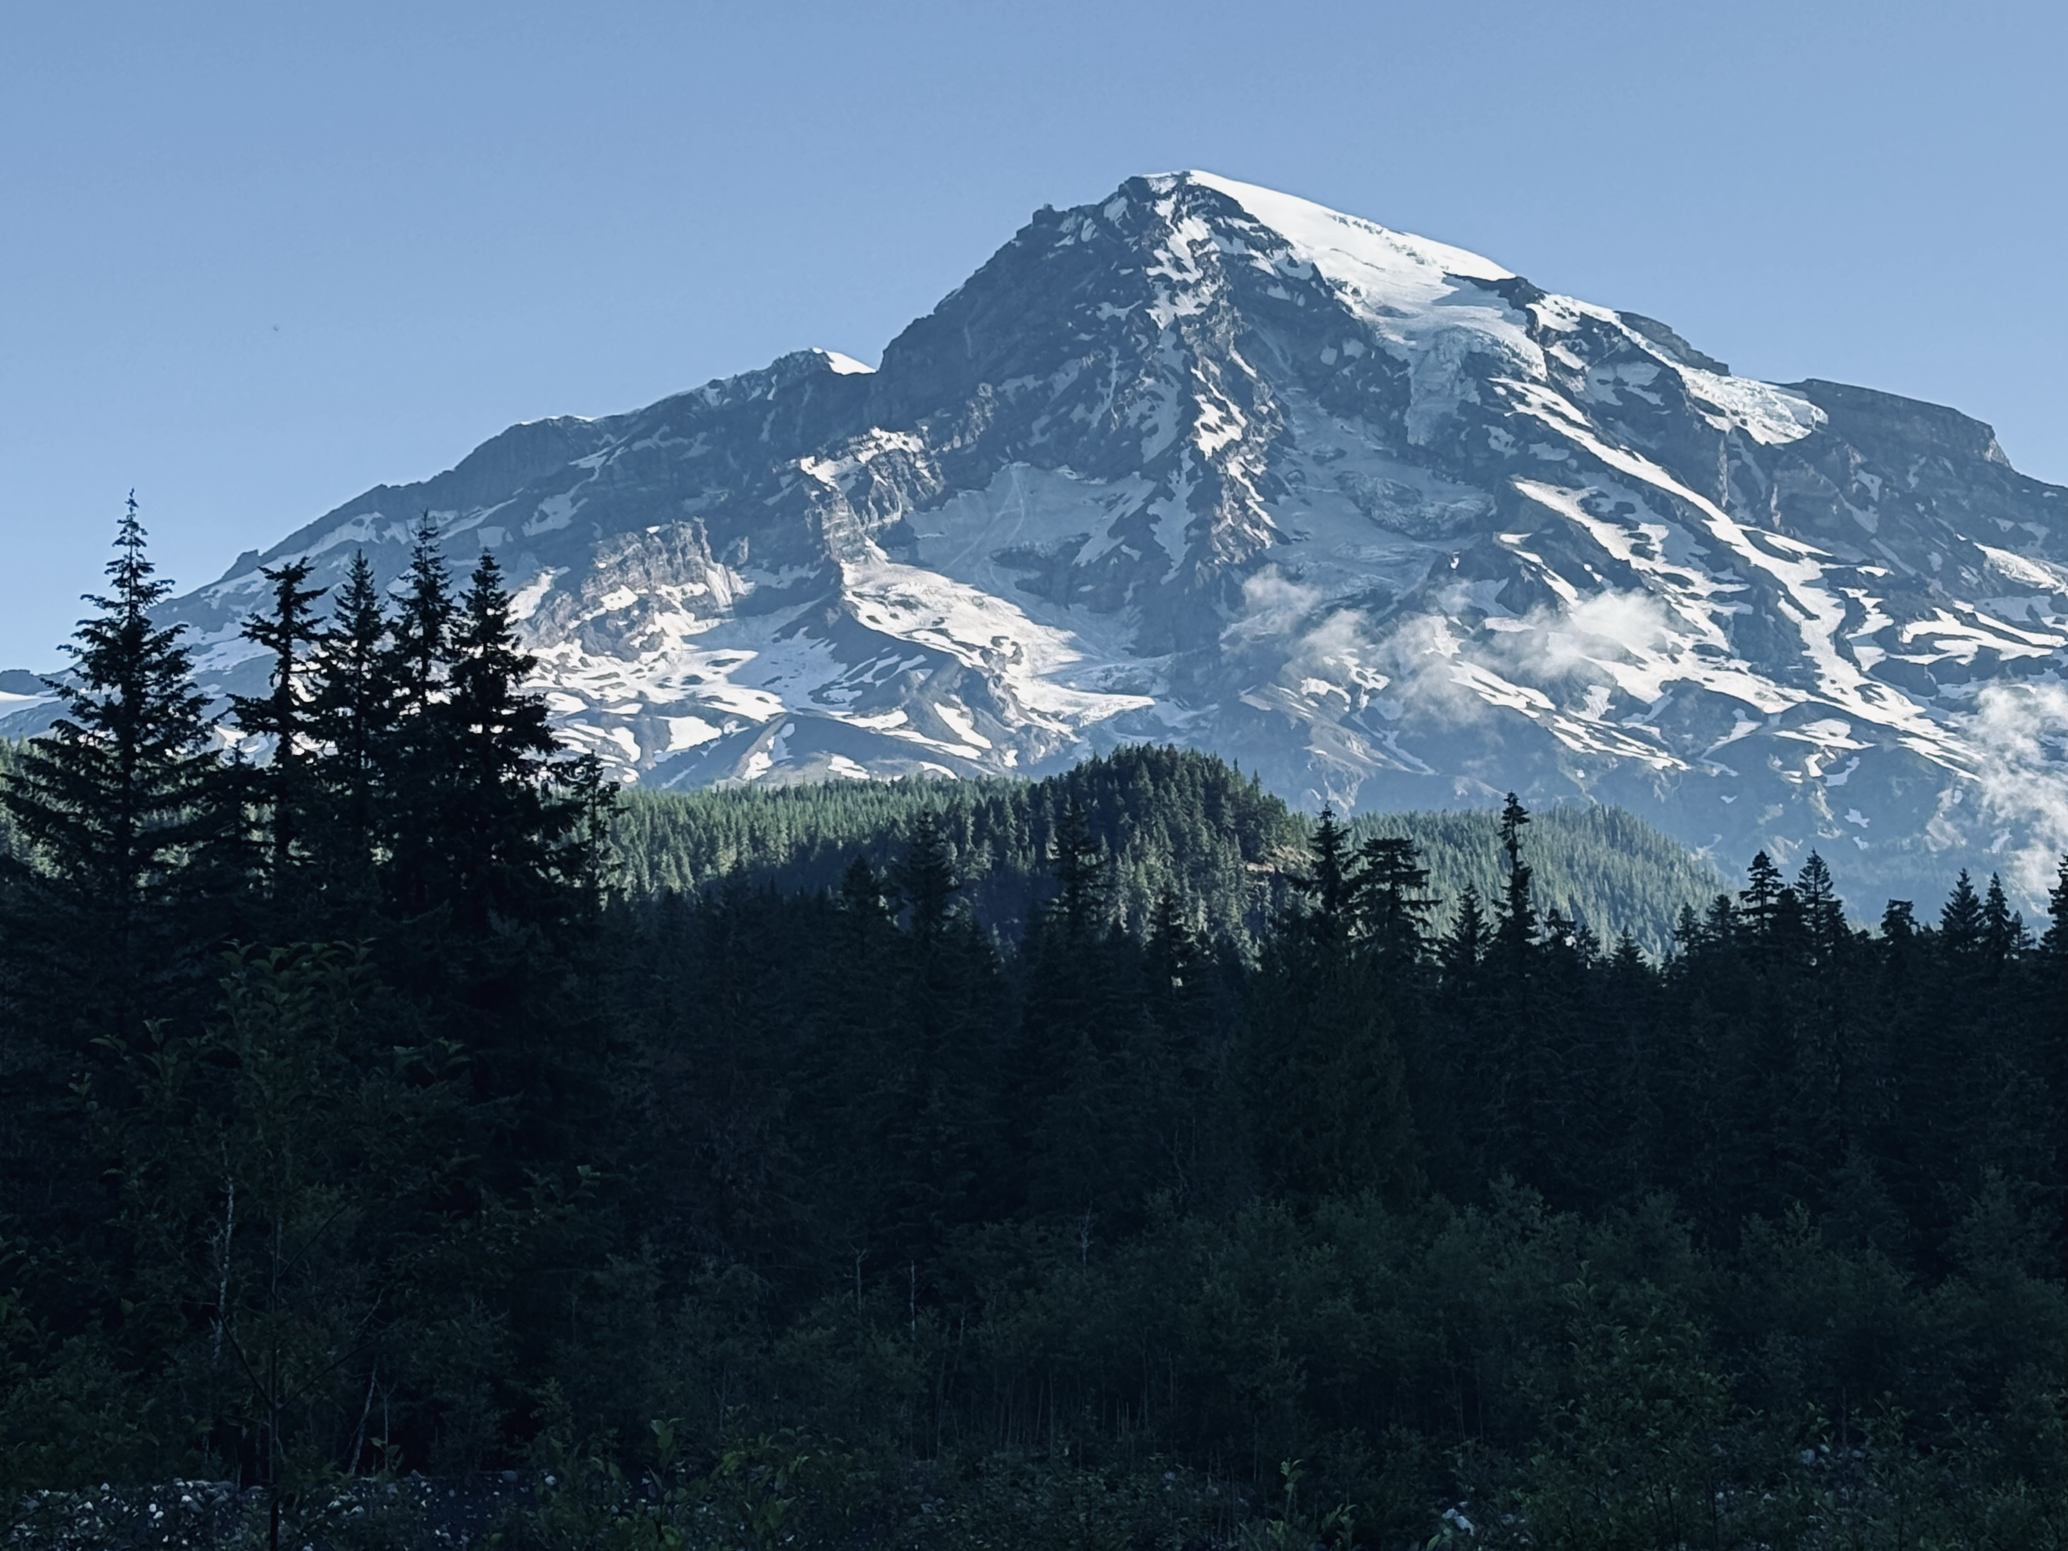

The fine balance
Exploring the Interplay of Reproductive Strategies and Growth Dynamics in Trees
Faculty of Forestry, University of British Columbia
2nd Doctoral Committee Meeting
Xiaomao (Mao) Wang
Supervisor: Elizabeth Wolkovich
Notes:
Hello everyone, thank you for coming to my second committee meeting. Today I am going to report on my current research progress and some other activities I’ve done in the past year besides research.

Slide 2

Table of content
Brief background
Research questions
Individual chapters
Other activities
Notes:
I’ll start with some brief background on masting and review the main research questions of my PhD. Then, I’ll go through the individual chapters, focusing on my current progress, some preliminary results, and the discussions that have come out of the work so far. I’ll finish with a brief overview of some of my other activities over the past year.

Slide 3
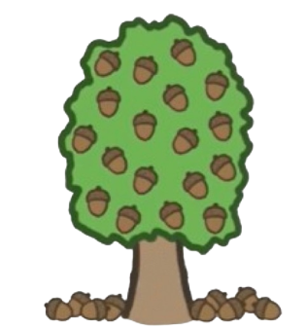

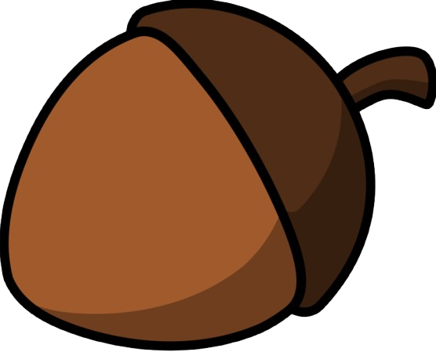
What is masting?
Synchronized variation of large seed crop within a population between years
Characteristics:
Interannual variation
Spatial synchrony
Temporal autocorrelation
Frequency
Mast year
Mast year + 1
Mast year + 2
Notes:
So I’ll start with defining masting again: Masting is a phenomenon in which plants show synchronized variation in seed production across years within a population. It is closely connected to ecosystem-level processes because seeds are an important food source for many mammals and can also serve as hosts for some pathogens.
Masting is generally characterized by four main features.
The first is interannual variation. Seed production varies substantially from year to year, so we see fluctuations in the size of the annual seed crop.
The second is synchrony. Individual plants within a population tend to produce large and small seed crops at the same time, and this synchrony can sometimes extend across hundreds of kilometres.
The third is temporal autocorrelation. In many masting systems, high seed production years tend to be followed by relatively low production years, and vice versa.
And finally, there is frequency. Masting events occur at intervals of several years, and the frequency of these events can remain relatively stable over time.

Slide 4


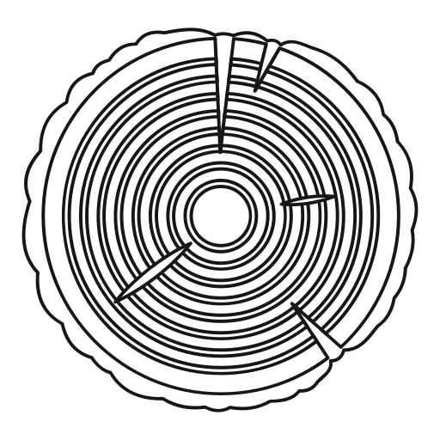

Hypotheses explaining masting
Predator satiation
Pollination coupling
Resource matching
Environmental cues
Notes:
There are four main hypotheses explaining the mechanism of masting. It’s important to remember that these hypotheses are not mutually exclusive. Multiple mechanisms can interact, and the drivers of masting can differ among species. Understanding what influences masting in a particular species helps us predict how its reproductive dynamics may change over time.
(Maybe make it into four slides together with the traits and predictions)

Slide 5
Research questions
Chapter 1: What reproduction-related traits are related to masing?
Chapter 2: What is the relationship between masting and growth?
Chapter 3: How does changing climate affect seed dynamics?
Notes:
So, understanding masting requires us to consider several different aspects of reproduction: how trees reproduce, how they allocate their resources, and how environmental conditions influence these processes. This leads to the overall goal of my PhD, which is to better understand the mechanisms underlying masting and how these mechanisms may influence forest dynamics under changing environmental conditions. My dissertation will have three chapters.
The first chapter looks at the evolutionary perspective. I use a literature-based approach to examine whether reproductive traits are associated with differences in masting among tree species.
The second chapter focuses on resource allocation. Using empirical data, I investigate the growth–reproduction trade-off and ask how investment in growth and reproduction may be related to masting dynamics.
The third chapter will build on the first two chapters to examine how climate change may alter the relationship between growth and reproduction, and ultimately how these changes could affect seed dynamics.
(Move this earlier before the background)

Slide 6
Research questions
Chapter 1: What reproduction-related traits are related to masing?
Chapter 2: What is the relationship between masting and growth?
Chapter 3: How does changing climate affect seed dynamics?
Notes:
Over the past year, I’ve mainly been working on the first two chapters. So today I’ll focus on these two chapters and give some update on where the projects currently stand.
(Highlight the questions when I talk about every individual chapter again

Slide 7
Chapter 1: Mast-Traits
  Masting can involve different, non-mutually exclusive mechanisms at different reproductive stages:
    Pollination coupling (pollination)
    Resource availability (seed maturation)
    Predator satiation (seed dispersal)
  Species differ in traits that may influence these mechanisms.
  Trait–masting associations may therefore provide clues about the evolutionary drivers of masting.
  Trees in North America
Notes:
For my first chapter, I wanted to take a more evolutionary perspective on masting.
As I mentioned earlier, there are multiple mechanisms that can contribute to masting, and these mechanisms are not necessarily mutually exclusive. Different reproductive traits may act at different stages of reproductive cycle and influence masting differently, so I was interested in whether we can use traits to understand why masting varies among species.
So, the main question for this chapter was: Can reproductive traits associated with different hypotheses provide evidence for the mechanisms shaping masting pattern?
To address this, I used data from North American tree species and examined the relationships between reproductive traits and masting while accounting for phylogenetic relationships.
(Move the hypotheses here and replace hypotheses with icons)

Slide 8
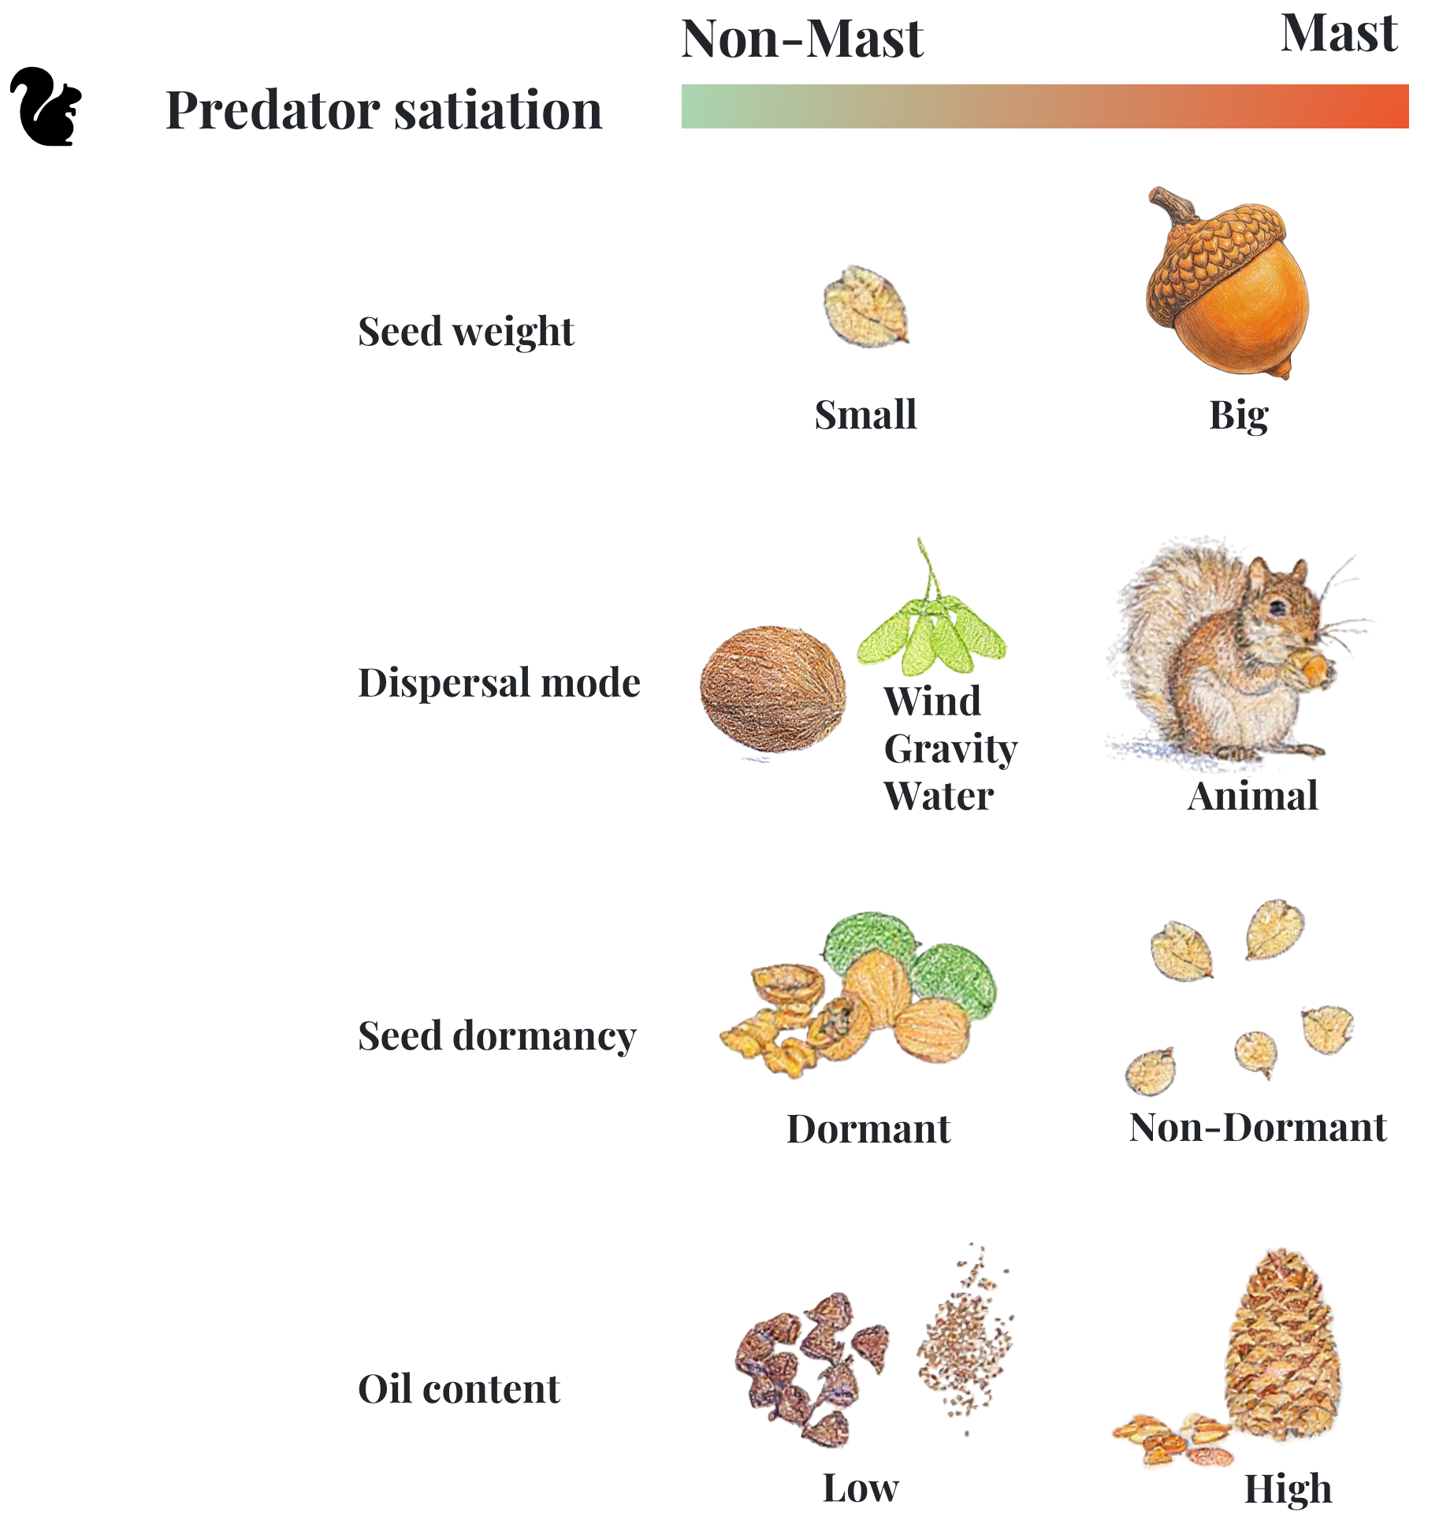
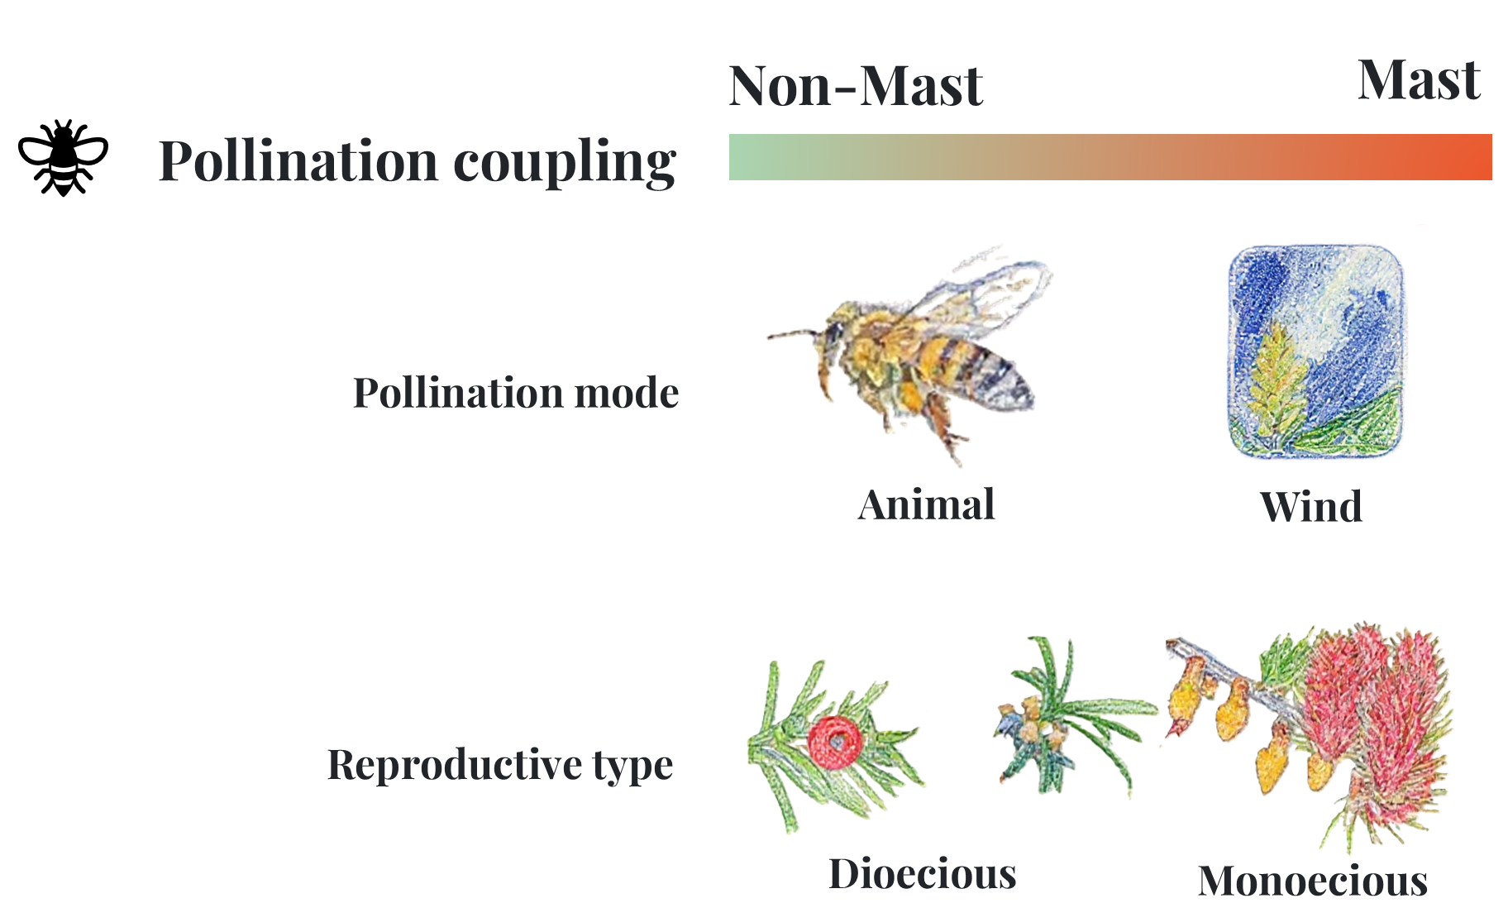
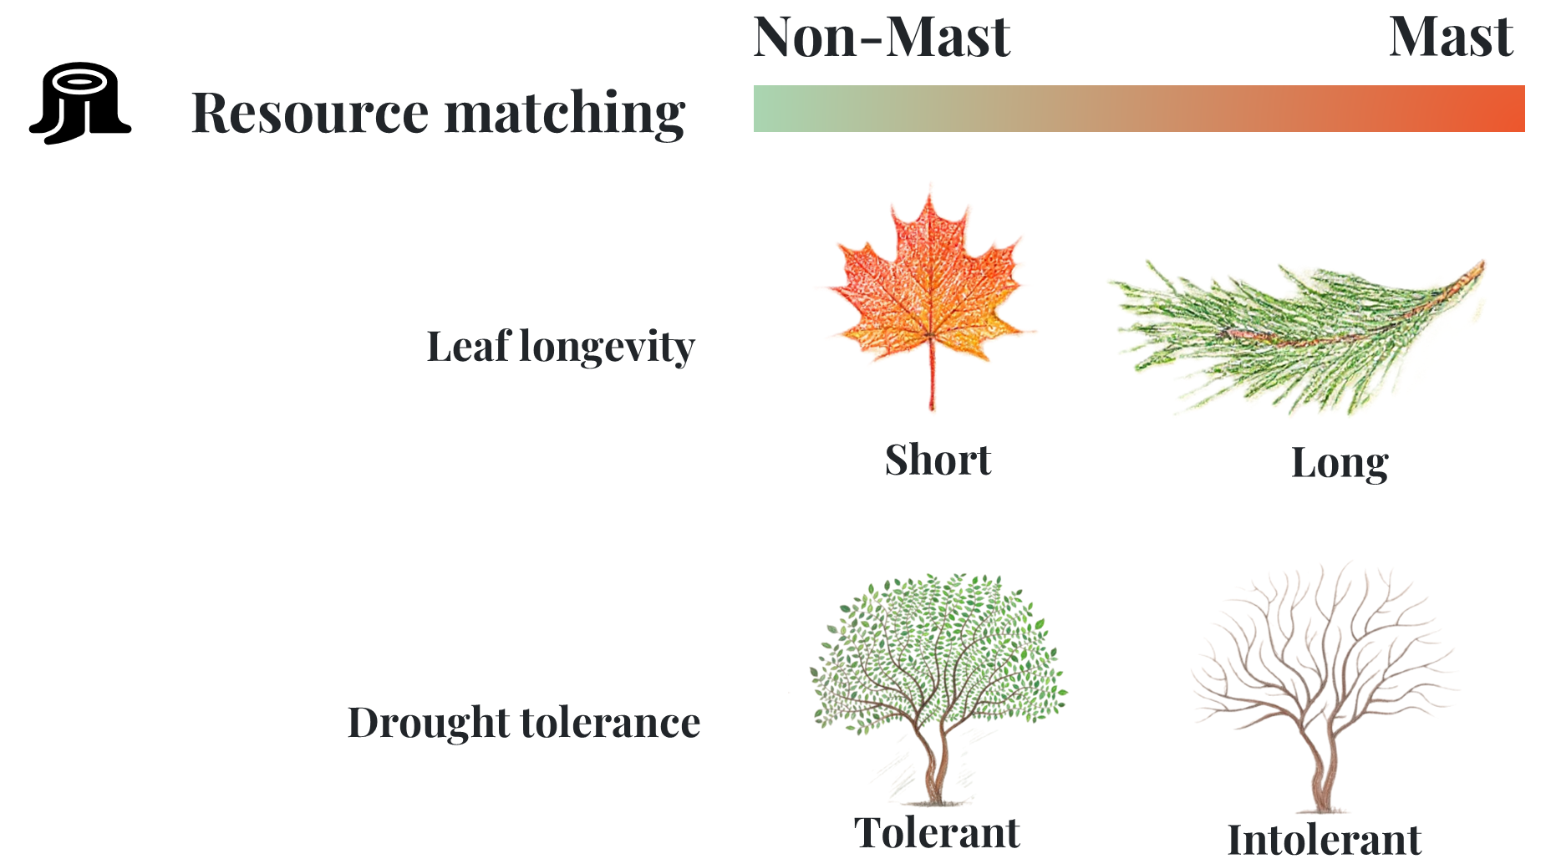
Chapter 1: Mast-Traits
Notes:
So, these are the traits I selected for the analysis, along with the predictions for how each trait is expected to relate to masting. I linked each trait to the hypothesis that I thought it was most directly related to.

Slide 9
Chapter 1: Mast-Traits
Data:
Silvics of North America
Masting: strong or weak
Angiosperm:
  98 with masting data
  51 strong masting
Gymnosperm:
  61 with masting data
  54 strong masting
Notes:
For the masting data, I extracted information from Silvics of North America. The book provides descriptive information on seed production pattern, so I used certain wording as standard to classify species into strong masting and weak masting categories.
In the final dataset, I had 98 angiosperm species with masting information, of which 51 were classified as strong masting species. For gymnosperms, I had 61 species, including 54 strong masting species.
The other trait data came from several different sources. However, data availability varied among traits and species, and some traits were particularly sparse such as leaf longevity and seed oil content.
Box around traits with sparse data.

Slide 10
Chapter 1: Mast-Traits
Data:
Silvics of North America
Masting: strong or weak
Angiosperm:
  98 with masting data
  51 strong masting
Gymnosperm:
  61 with masting data
  54 strong masting
Notes:
For the masting data, I extracted information from Silvics of North America. The book provides descriptive information on seed production pattern, so I used certain wording as standard to classify species into strong masting and weak masting categories.
In the final dataset, I had 98 angiosperm species with masting information, of which 51 were classified as strong masting species. For gymnosperms, I had 61 species, including 54 strong masting species.
The other trait data came from several different sources. However, data availability varied among traits and species, and some traits were particularly sparse such as leaf longevity and seed oil content.
Box around traits with sparse data.

Slide 11
Chapter 1: Mast-Traits
Current progress:
Statistical analyses
  Single trait with phyloglm
  Multivariate analysis with NMDS
Outlines of the paper
Manuscript write-up
Finalize some discussion on evolutionary aspects
Completed
On going
Need discussion
Notes:
For the current progress on this chapter, I have completed the analyses of individual traits using phyloglm.
I also conducted a multivariate analysis using NMDS to examine whether masting patterns are associated with combinations of traits within each hypothesis.
Both of these analyses are now complete, and I have also finished the outline of the manuscript.
I am currently writing the manuscript, with most of my focus now on the Discussion.
So, today I would particularly like to get your feedback on how I can strengthen the evolutionary interpretation of these results and better connect the findings to the evolutionary mechanisms underlying masting.
(Going to share the results today)

Slide 12
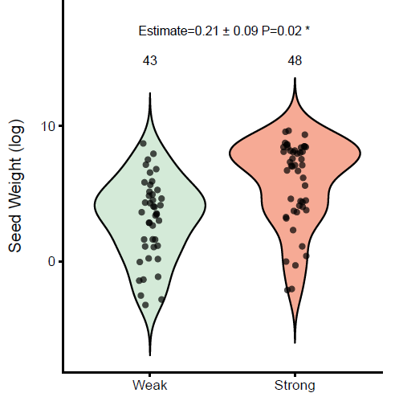
Chapter 1: Mast-Traits
Heavier seeds are associated with strong masting
The effect was stronger among species with biotically dispersed seeds
Notes:
For the results. I found significant relationships between traits related to predator satiation and pollination efficiency and strong masting in angiosperms.
For the traits related to predator satiation, seed weight was the only significant traits. Larger seed weight was associated with a higher probability of strong masting. I also looked into different dispersal groups. This relationship was slightly stronger among species with biotic seed dispersal.

Slide 13
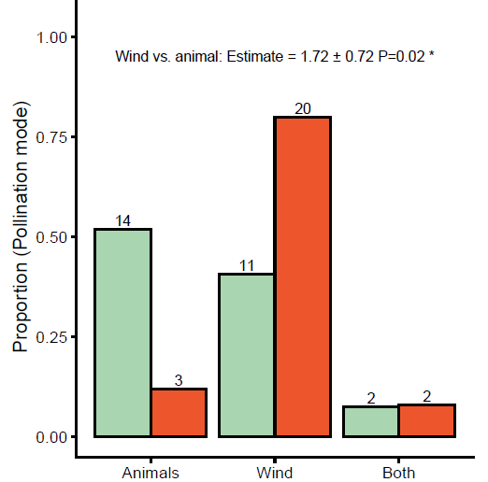
Chapter 1: Mast-Traits
Wind pollinated species are more likely to be strong masting
All gymnosperms are wind-pollinated
Notes:
For pollination related traits, pollination mode was the only significant trait. Wind-pollinated angiosperms had a higher predictied probability of strong masting compared with animal-pollinated species, which align with the literatures. One important point here is that all the gymnosperms species in our dataset were wind-pollinated, at the same time, gymnosperms also had a much higher proportion of strong masting species overall. These results suggest that some reproductive traits are associated with stronger masting, but the patterns may differ between major plant groups.

Slide 14
Notes:
For pollination related traits, pollination mode was the only significant trait. Wind-pollinated angiosperms had a higher predictied probability of strong masting compared with animal-pollinated species, which align with the literatures. One important point here is that all the gymnosperms species in our dataset were wind-pollinated, at the same time, gymnosperms also had a much higher proportion of strong masting species overall. These results suggest that some reproductive traits are associated with stronger masting, but the patterns may differ between major plant groups.

Slide 15
Chapter 1: Mast-Traits
  Reproductive traits point to different stages of selection
    Wind pollination ➡ pollination coupling
    Seed weight ➡ predator satiation
    Coordinated strategies across whole reproductive process
  Masting may be shaped differently across evolutionary contexts
    Masting is population-level phenomenon, while traits were species-level
    Strong phylogenetic structure of traits
    Angiosperms vs. gymnosperms may represent different evolutionary pathways
Notes:
So, for the discussion, there are three main points that I’m thinking about.
First, the results suggest that traits associated with different stages of reproduction may be linked to masting through different mechanisms. The association with wind pollination is consistent with the pollination coupling hypothesis, while the relationship between seed weight and masting is consistent with the predator satiation hypothesis.
These mechanisms operate at different stages of the reproductive process. From an evolutionary perspective, this could potentially indicate that selection favours coordinated strategies that increase the overall probability of successful reproduction and recruitment, rather than acting on only one stage of the reproductive cycle.
Also, bigger seeds usually is linked with higher established success, so this in the masting context make sure the survived seeds from predators can germinate.
Second, I think there are some important limitations to interpreting these relationships at the species level. Masting is fundamentally a population-level phenomenon, while most of the traits in my analysis are species-level. So, some traits that were not significant here may still be important within species or under particular environmental conditions.
There is also strong phylogenetic structure in many of these traits. This makes it difficult to completely separate the effect of a particular trait from the broader evolutionary history of the species.
This leads to my third point, the strong difference between gymnosperms and angiosperms makes me wonder whether masting may have followed different evolutionary trajectories in these two groups. But to understand that, I think we need more targeted comparisons within clades, as well as more data at both the population level and across deeper evolutionary relationships.

Slide 16
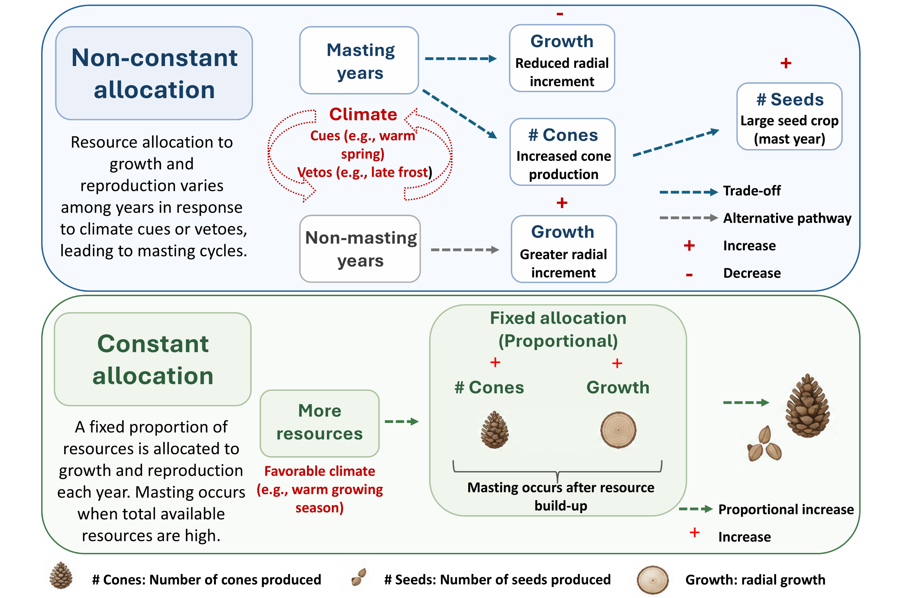
Chapter 2: What’s the relationship between growth and reproduction?
By Mao
Notes:
For the second chapter, I ‘m interested in the resource allocation perspective of masting, and specifically the relationship between growth and reproduction.
The key idea I want to explain with this conceptual figure is that trees have limited resources that can be allocated to different processes, here we concentrate on growth and reproduction.
Under a constant allocation strategy, a relatively consistent proportion of resources is allocated to reproduction each year. In this case, variation in seed mainly reflect resources availability. In contrast, under a non-constant allocation strategy, trees may shift allocation between growth and reproduction across years. This distinction is important to understand masting because if reproductive allocation changes among years, variation in seed production may not simply reflect variation in resource availability. Instead, it could reflect how trees actively allocate resources between growth and reproduction over time. In this chapter, I am using empirical data collected from Mount Rainier to investigate this growth reproduction relationship.
(Add my name to the figure)

Slide 17
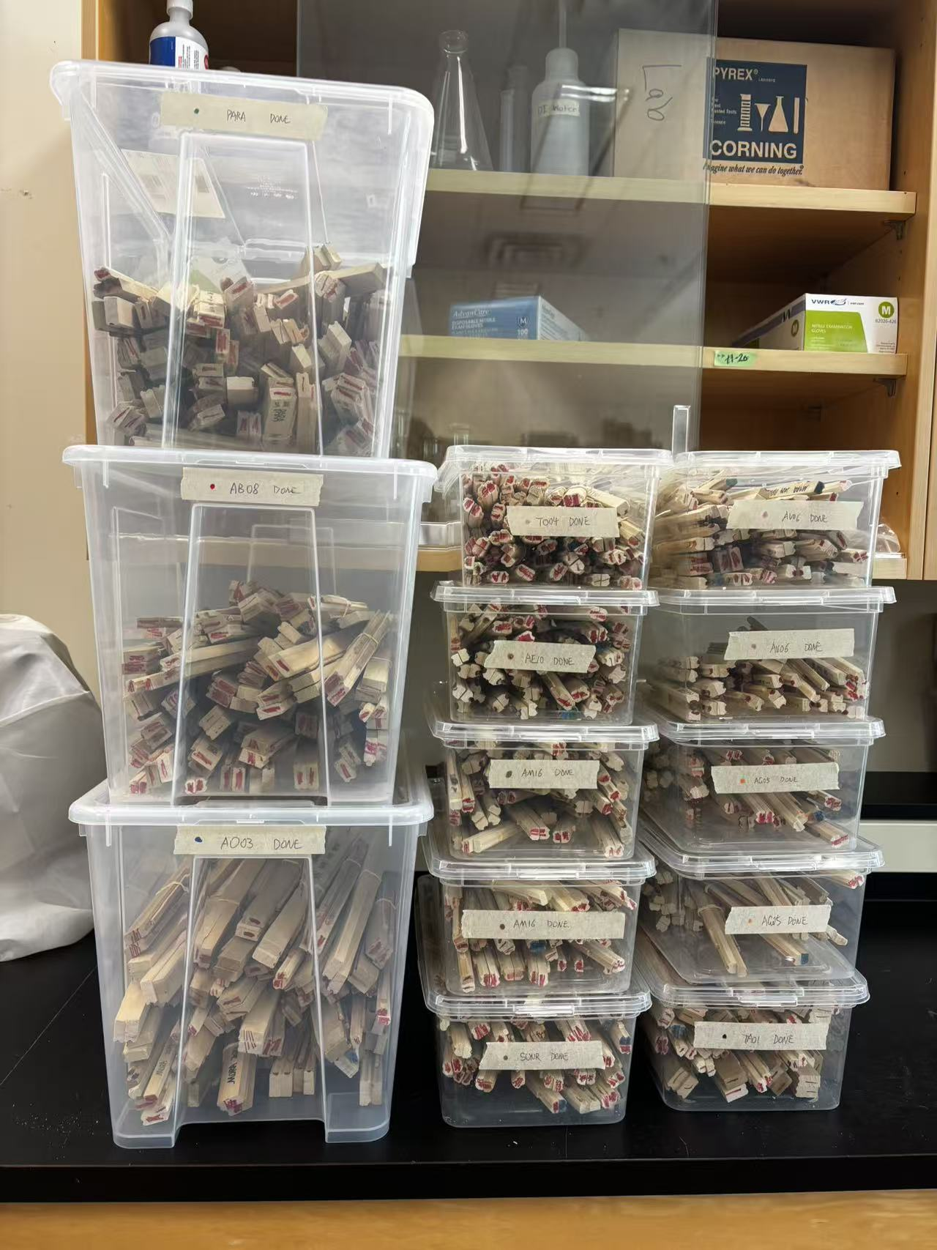
Chapter 2: Growth-Reproduction Trade-off
Current progress:
Core samples scanning
Cores measurement for 6 stands
Cross-dating for cores
Building the model
Completed
On going
Notes:
We collected over 1000 tree cores from Mount Rainier two years ago and in the past year I’ve been working intensively on processing them, scanning them and measuring them with lots of help from our WL students. So far, we’ve finished the scanning of all cores and done with measurement for 5 stands. I still need to work on the cross-dating to make sure all the years are assigned correctly to each ring. At the same time, I’ve also been working on building the model.

Slide 18
Chapter 2: Growth-Reproduction Trade-off
Growth
BAI_{i,t​} ∼ Normal (α_{BAI} ​+ β_{1,SM} * Soil moisture_{t}, σ_{BAI} )
G_{i,t}​ = BAI_{i,t}​ − α_{BAI​} − β_{1,SM} * Soil moisture_{t}
G_{t}​ = mean ​(G _{i,t} ​)
Notes:
We’ve worked on multiple versions of model, and finally decided to go for something simple. We take the mean from each individual tree within each stand to get a stand level growth to pair with stand level seed data. Seed production is directly linked to current year growth and previous year growth.
(Put boxes around gammas)

Slide 19
Chapter 2: Growth-Reproduction Trade-off
Growth
BAI_{i,t​} ∼ Normal (α_{BAI} ​+ β_{1,SM} * Soil moisture_{t}, σ_{BAI} )
G_{i,t}​ = BAI_{i,t}​ − α_{BAI​} − β_{1,SM} * Soil moisture_{t}
G_{t}​ = mean ​(G _{i,t} ​)
Notes:
We’ve worked on multiple versions of model, and finally decided to go for something simple. We take the mean from each individual tree within each stand to get a stand level growth to pair with stand level seed data. Seed production is directly linked to current year growth and previous year growth.
(Put boxes around gammas)

Slide 20
Chapter 2: Growth-Reproduction Trade-off
Growth
BAI_{i,t​} ∼ Normal (α_{BAI} ​+ β_{1,SM} * Soil moisture_{t}, σ_{BAI} )
G_{i,t}​ = BAI_{i,t}​ − α_{BAI​} − β_{1,SM} * Soil moisture_{t}
G_{t}​ = mean ​(G _{i,t} ​)
Notes:
We’ve worked on multiple versions of model, and finally decided to go for something simple. We take the mean from each individual tree within each stand to get a stand level growth to pair with stand level seed data. Seed production is directly linked to current year growth and previous year growth.
(Put boxes around gammas)

Slide 21
Chapter 2: Growth-Reproduction Trade-off
Growth
BAI_{i,t​} ∼ Normal (α_{BAI} ​+ β_{1,SM} * Soil moisture_{t}, σ_{BAI} )
G_{i,t}​ = BAI_{i,t}​ − α_{BAI​} − β_{1,SM} * Soil moisture_{t}
G_{t}​ = mean ​(G _{i,t} ​)
Reproduction
μ_{sc,t} = α_{sc}​ + γ_{current​} ⋅ G_{t} ​+ γ_{lag}​ ⋅ G_{t−1}
sc_{t}​ ∼ LogNormal (μ_{sc,t}​ , σ_{sc​})​
Notes:
We’ve worked on multiple versions of model, and finally decided to go for something simple. We take the mean from each individual tree within each stand to get a stand level growth to pair with stand level seed data. Seed production is directly linked to current year growth and previous year growth.
(Put boxes around gammas)

Slide 22
Chapter 2: Growth-Reproduction Trade-off
Growth
BAI_{i,t​} ∼ Normal (α_{BAI} ​+ β_{1,SM} * Soil moisture_{t}, σ_{BAI} )
G_{i,t}​ = BAI_{i,t}​ − α_{BAI​} − β_{1,SM} * Soil moisture_{t}
G_{t}​ = mean ​(G _{i,t} ​)
Reproduction
μ_{sc,t} = α_{sc}​ + γ_{current​} ⋅ G_{t} ​+ γ_{lag}​ ⋅ G_{t−1}
sc_{t}​ ∼ LogNormal (μ_{sc,t}​ , σ_{sc​})​
Notes:
We’ve worked on multiple versions of model, and finally decided to go for something simple. We take the mean from each individual tree within each stand to get a stand level growth to pair with stand level seed data. Seed production is directly linked to current year growth and previous year growth.
(Put boxes around gammas)

Slide 23
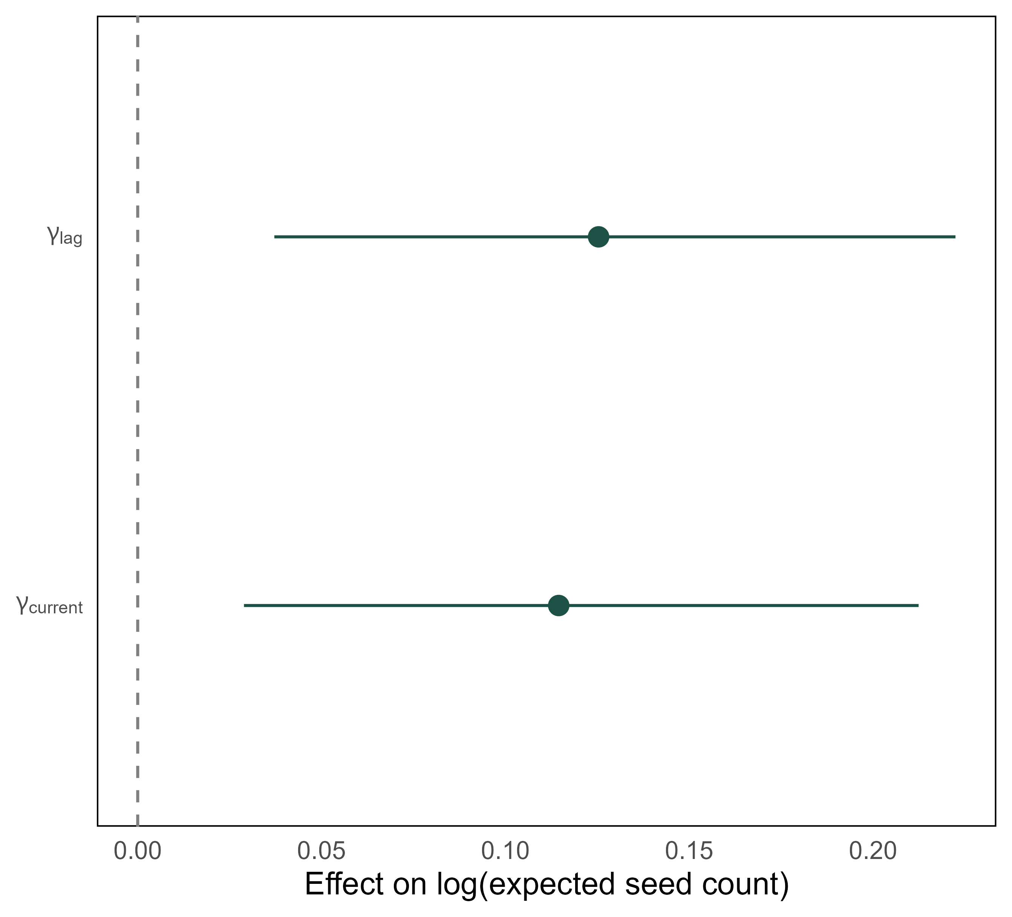
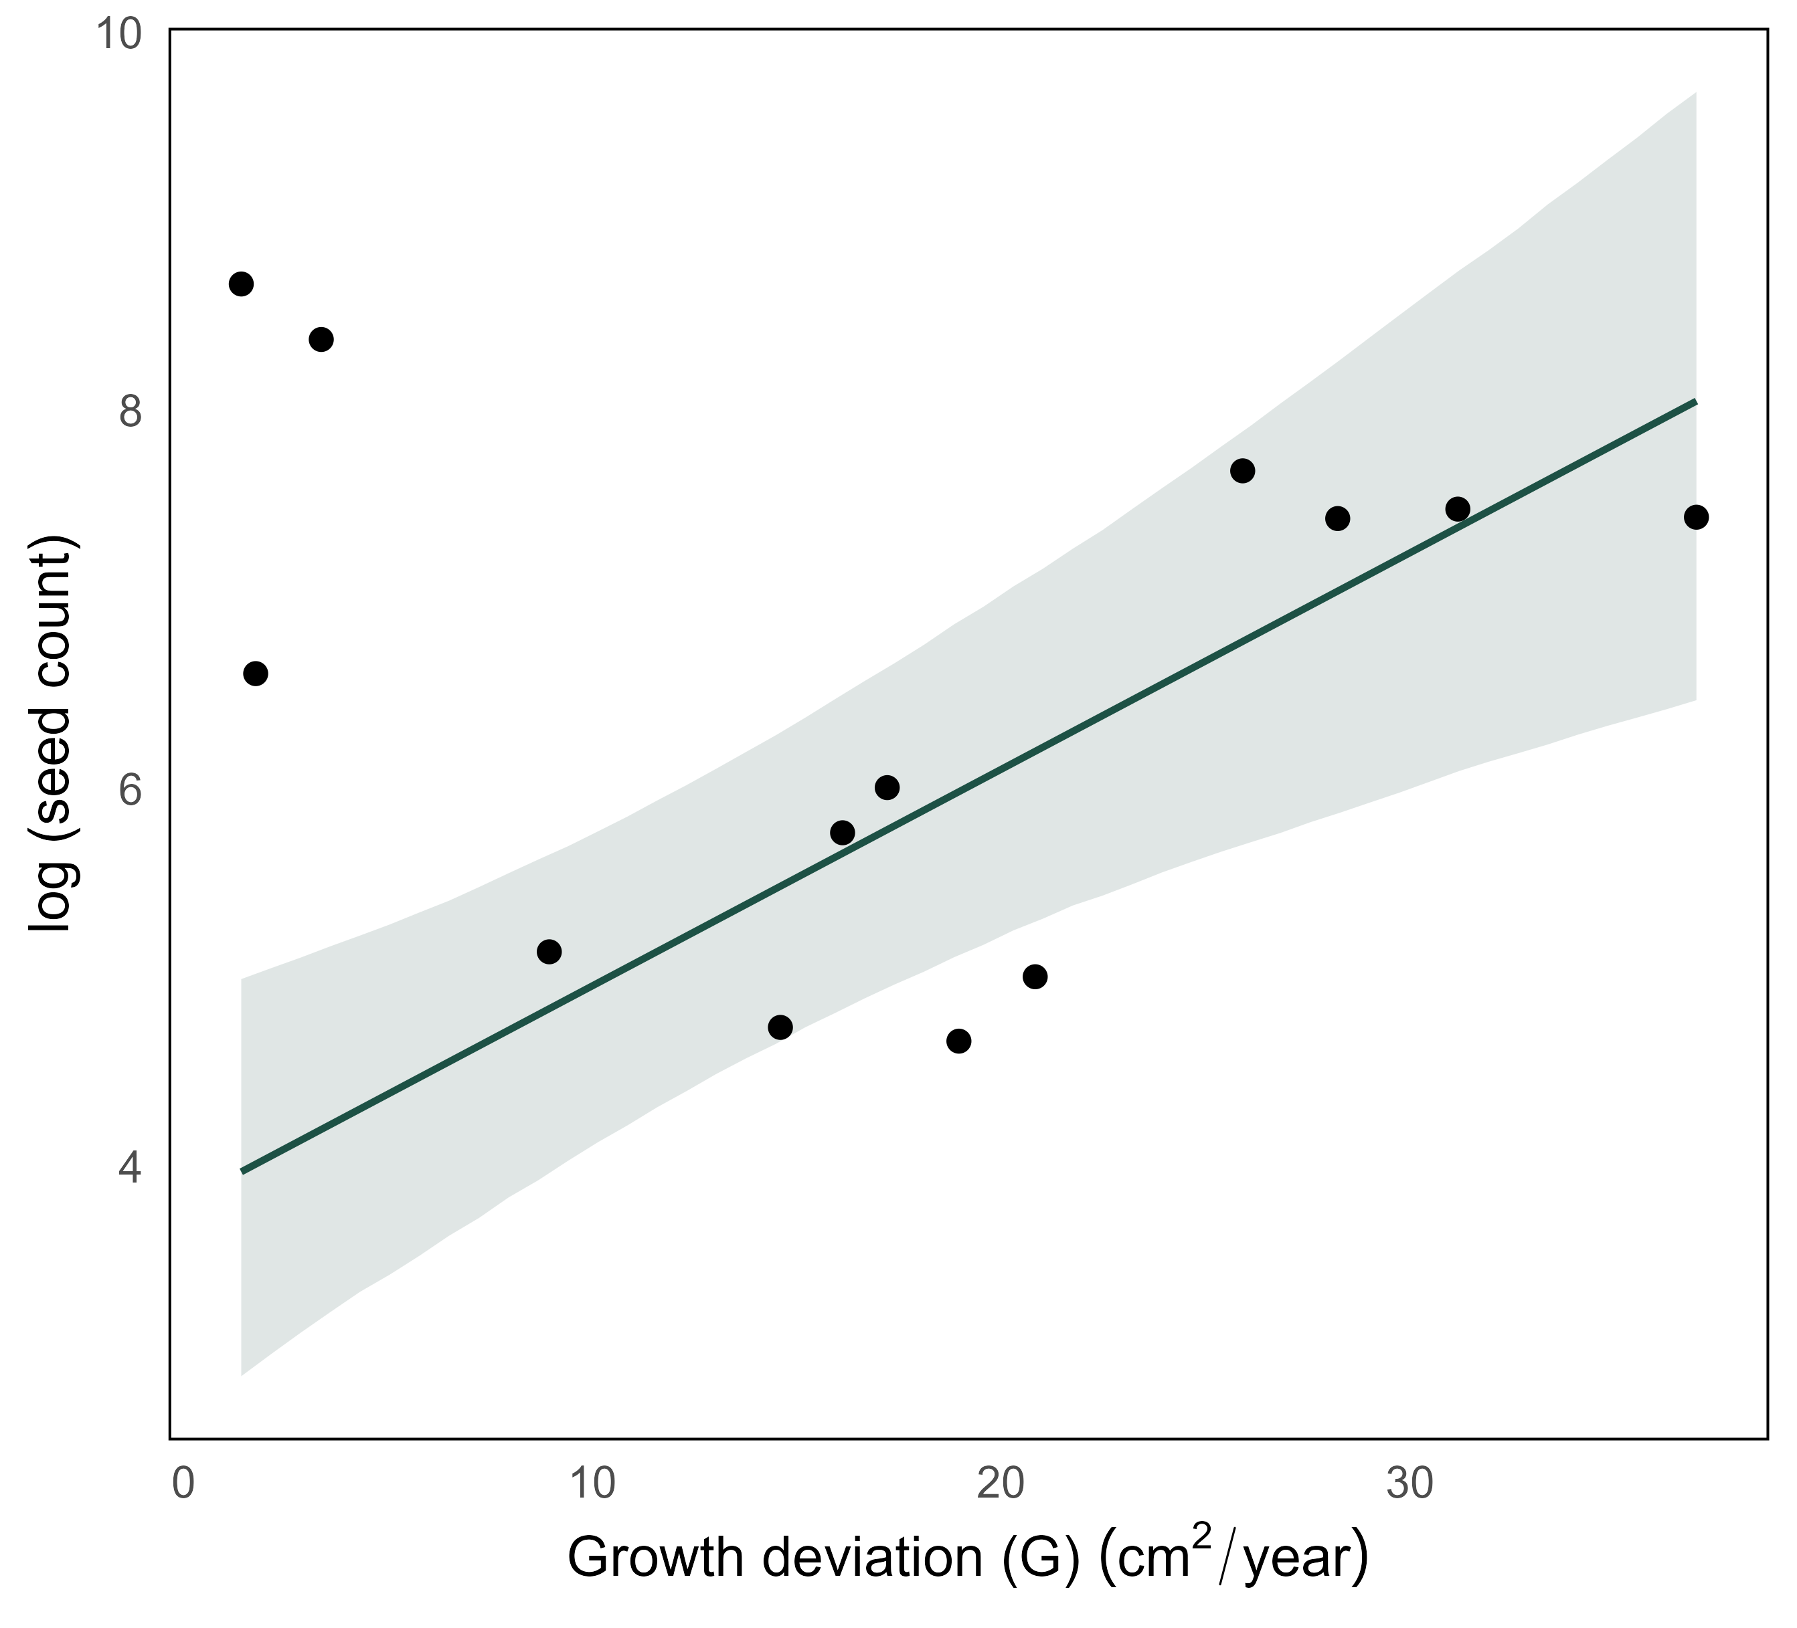
Chapter 2: Growth-Reproduction Trade-off
One species (Tsuga heterophylla) at one stand (21 trees), from 2013 to 2024 (11 years):
Notes:
(For this example species at one stand)
(another slide adding the climate parameters)

Slide 24
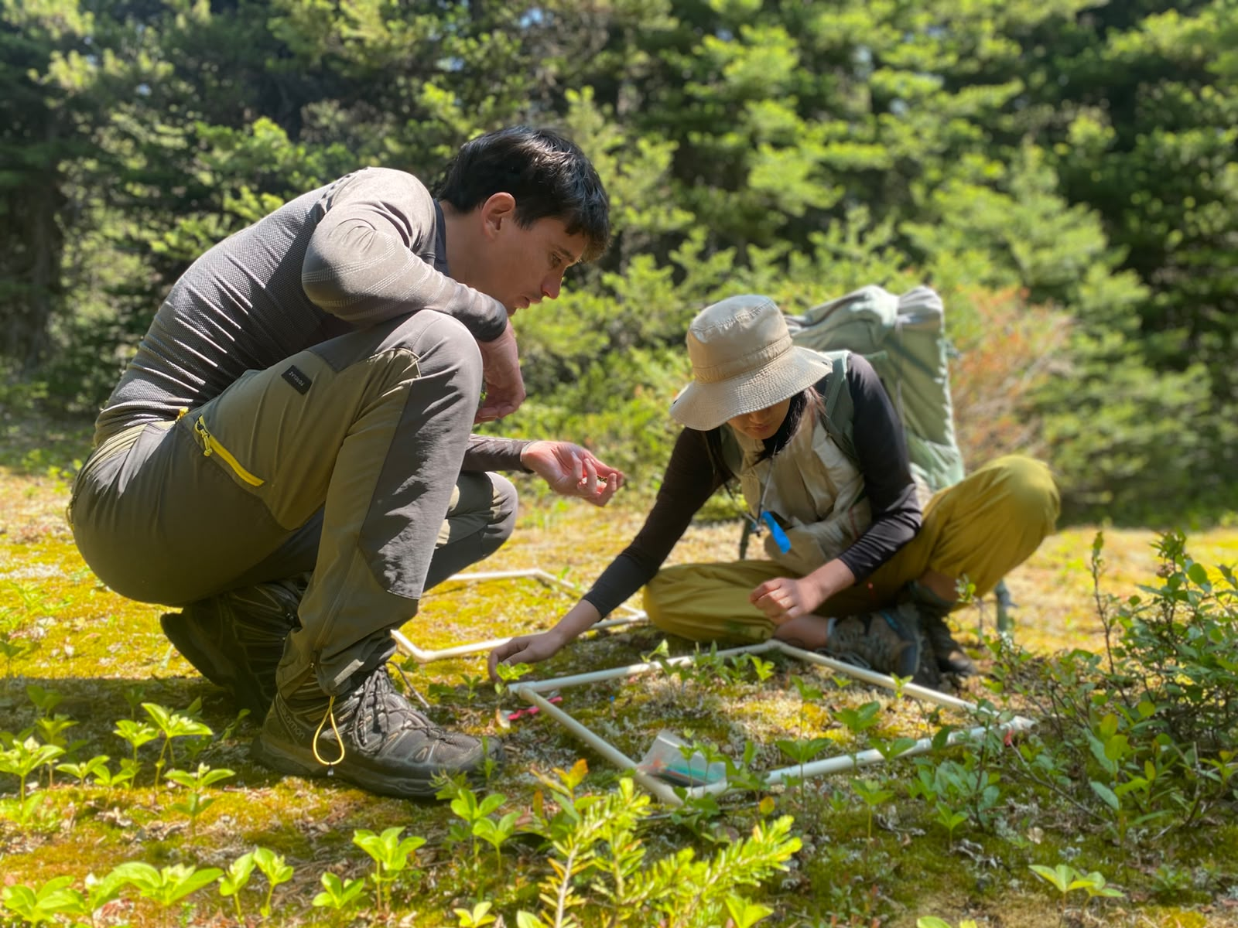
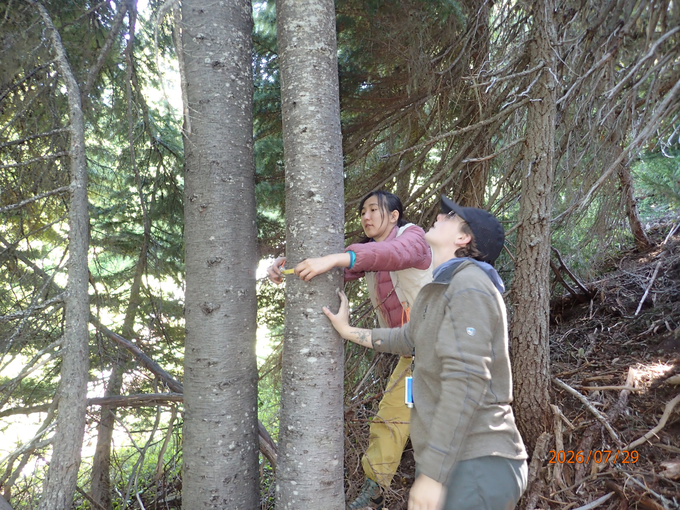
Other activities
Fieldwork at Smithers
Fieldwork at Mount Rainier

Slide 25
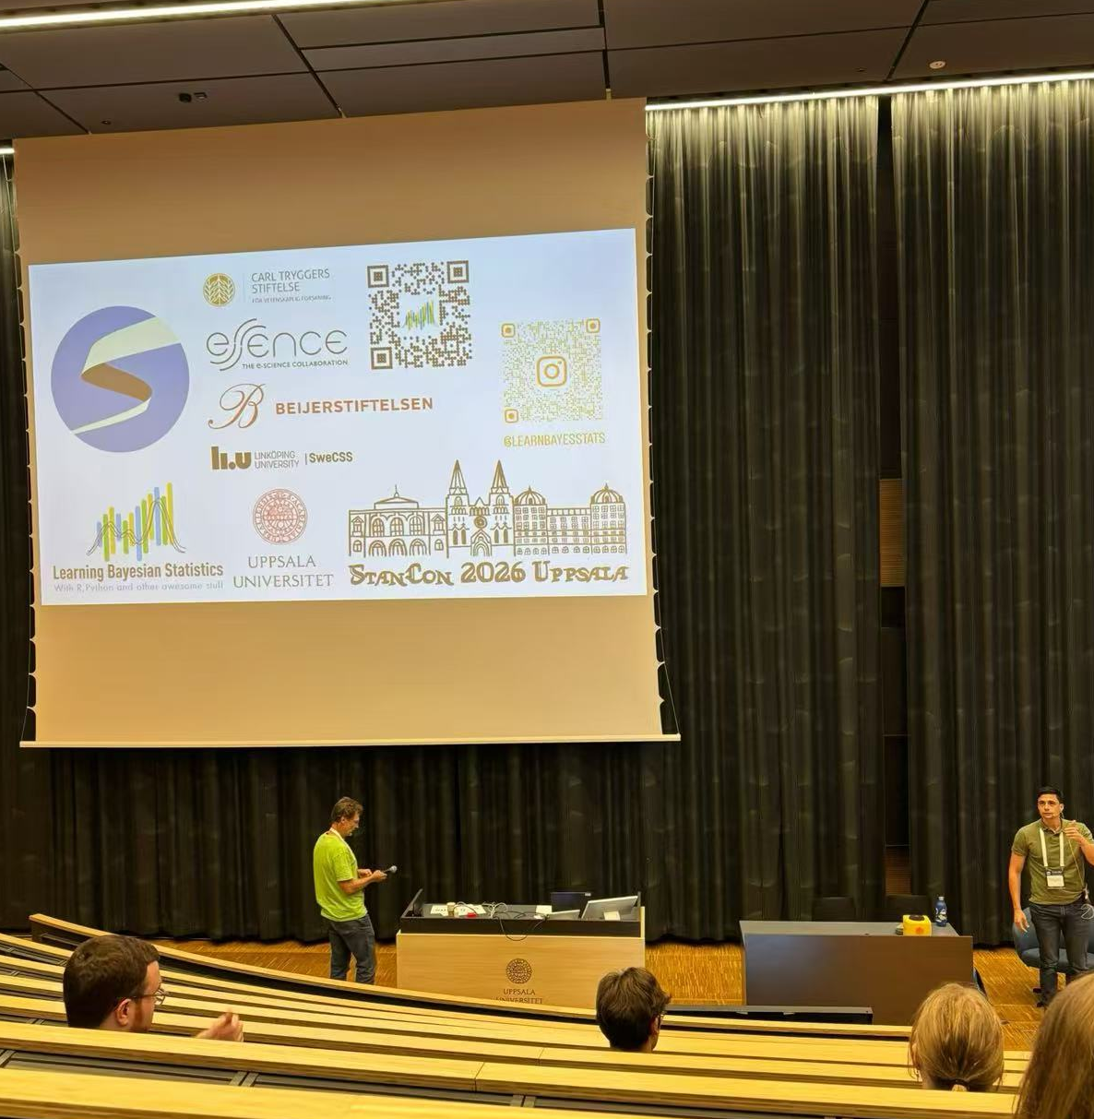
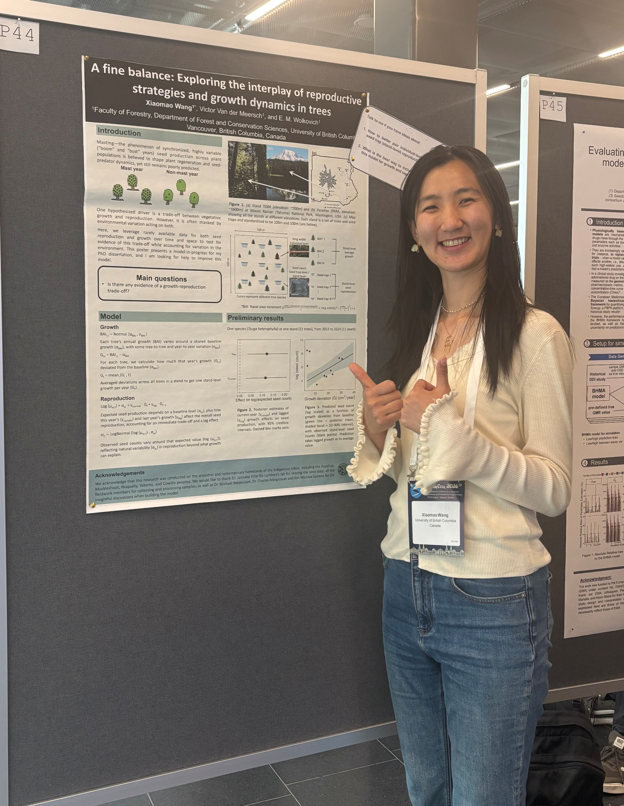
Other activities
Poster presentation at StanCon 2026, Uppsala, Sweden

