Slide 2


Masting year
Masting year+1

Slide 3
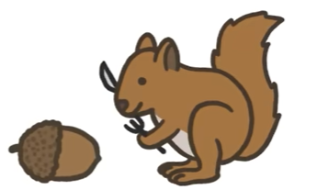
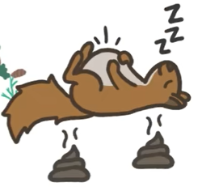
Non masting year

Slide 4
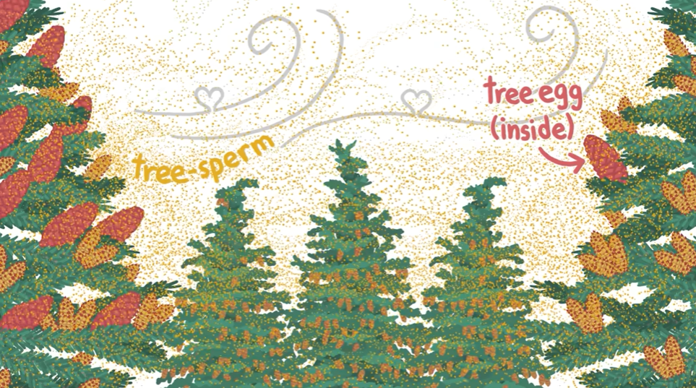

Slide 5

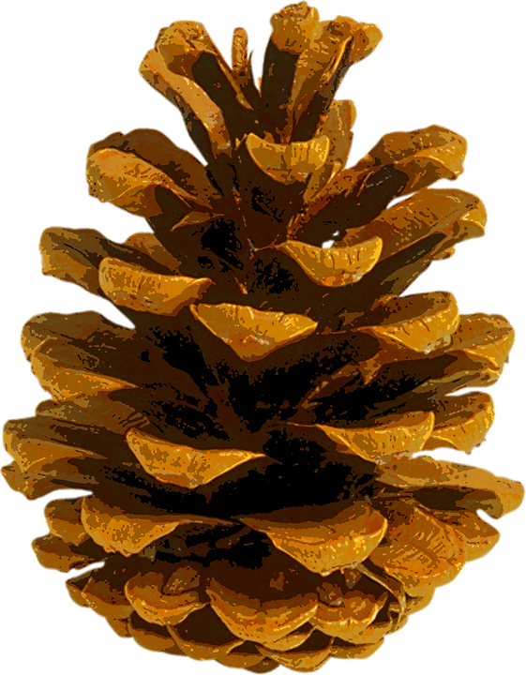

Slide 6
50%-60% trees have some form of masting behavior
Mostly distributed in temperate zone
Which reproductive-related traits are related to masting?
Do these traits that relate to different masting hypotheses vary by environment?

Slide 7
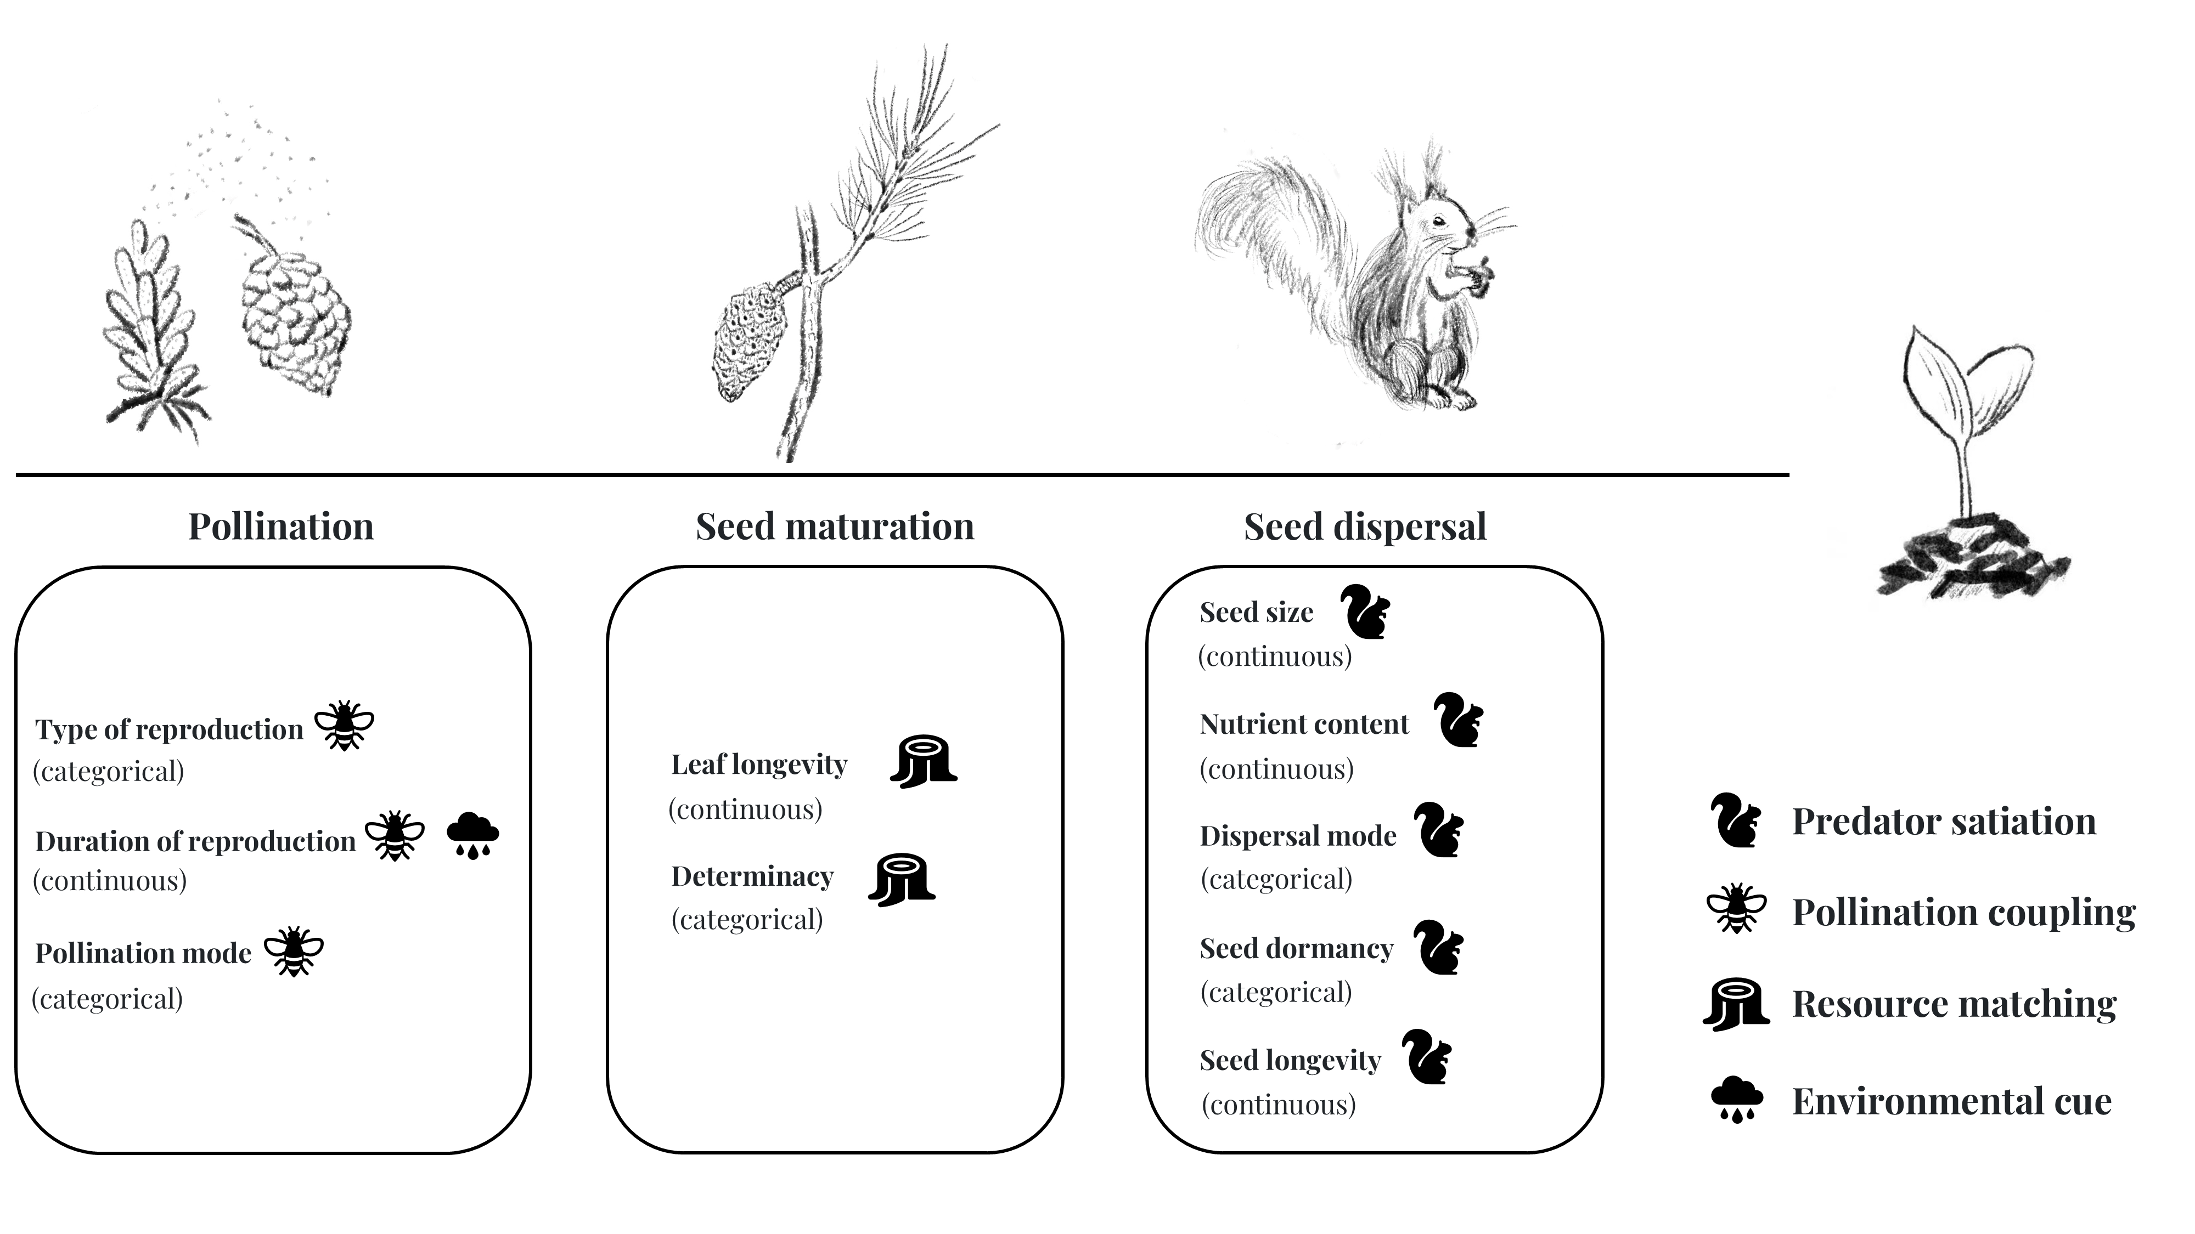

Slide 8
Response variables:
Binary: Whether a species masts or not (0/1)
Continuous: Frequency of mast (e.g., mean or CV of masting over time)
Predictors
Reproductive traits: mixture of categorical (e.g., pollination mode), and continuous (e.g., seed size).
Climate category: categorical (wet, moist, dry).
Potential interactions: between traits and climate.

Slide 9
For observation i
yi​∼Bernoulli(pi​)
logit(p_{i}​)=α₀ + α_{soil} + β_{1,soil[i]}​⋅x_{1,i​}+β_{2,soil[i]}​⋅x_{2,i​}+β_{3,soil[i]}​⋅x_{3,i​}

Slide 10
How to best model correlated traits?
What’s the best way to model variation in trait effects across climates?
Should you include interaction terms or hierarchical slopes?
Best way to handle different levels of uncertainty or missing data across studies?

