Slide 1
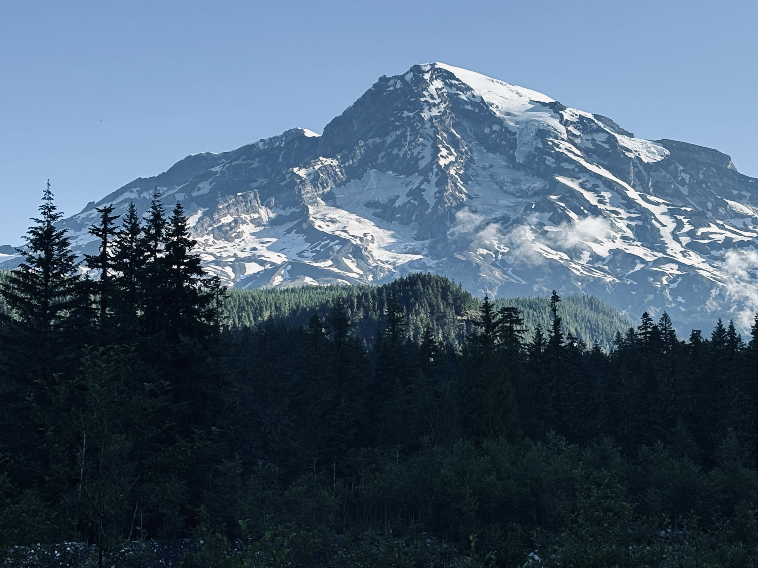

The fine balance Exploring the Interplay of Reproductive Strategies and Growth Dynamics in Trees
Faculty of Forestry, University of British Columbia
2nd Doctoral Committee Meeting
Xiaomao (Mao) Wang
Supervisor: Elizabeth Wolkovich

