Slide 2
Method
Shuffle trial ID (across conditions)
Shuffle spike timing between 0 to 1100ms (within trial)
Shuffle firing rate across trials, maintaining timing
Trial 1: 2 3 3 3 4 = 15
Trial 2: 0 0 30 0 0 = 30
Trial 3: 0 0 0 0 0 = 0
Trial 1: 4 6 6 6 8
Trial 2: 0 0 15 0 0
Trial 3: (10) NaN NaN

Slide 3
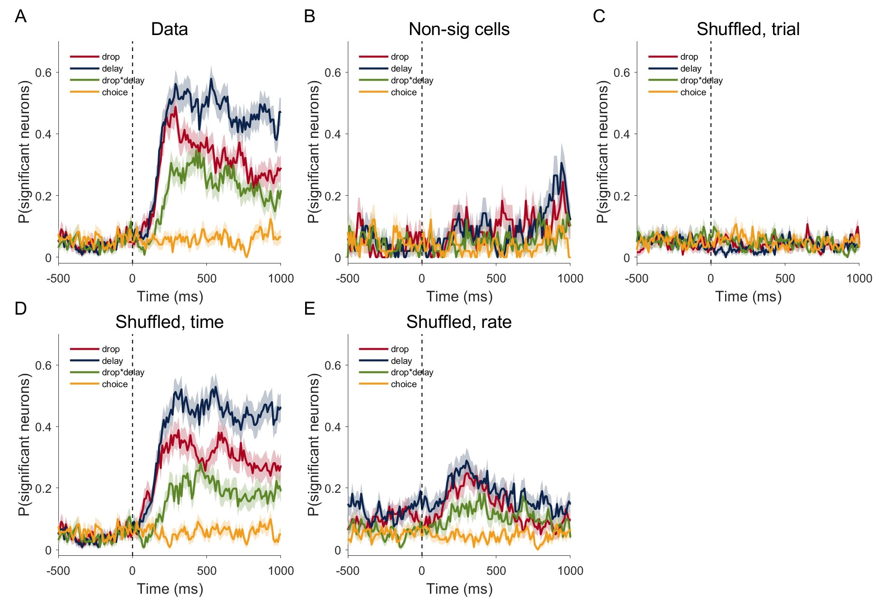

Slide 4
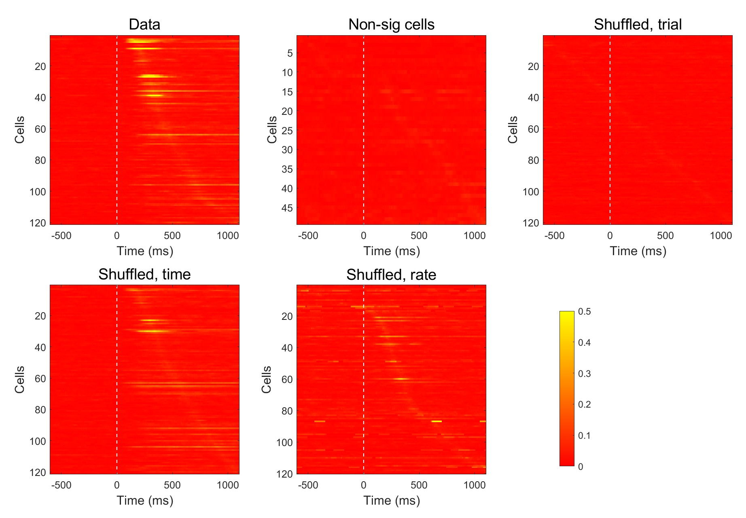

Slide 5
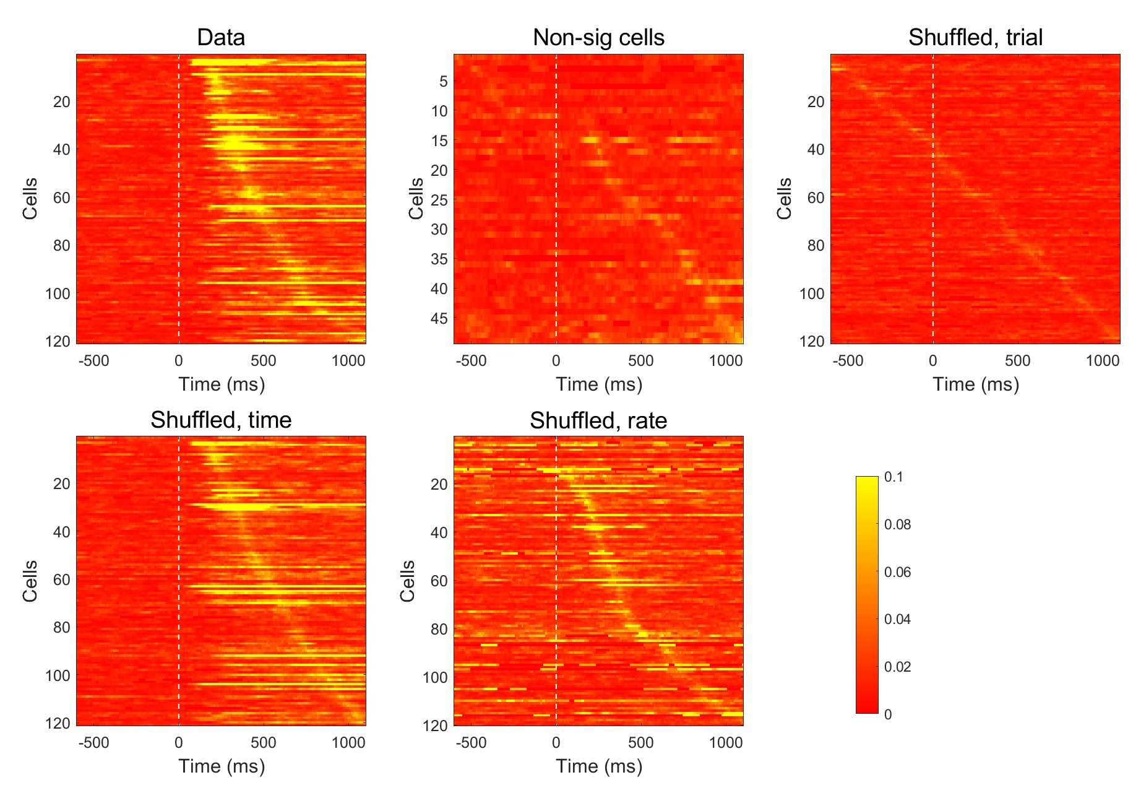

Slide 6
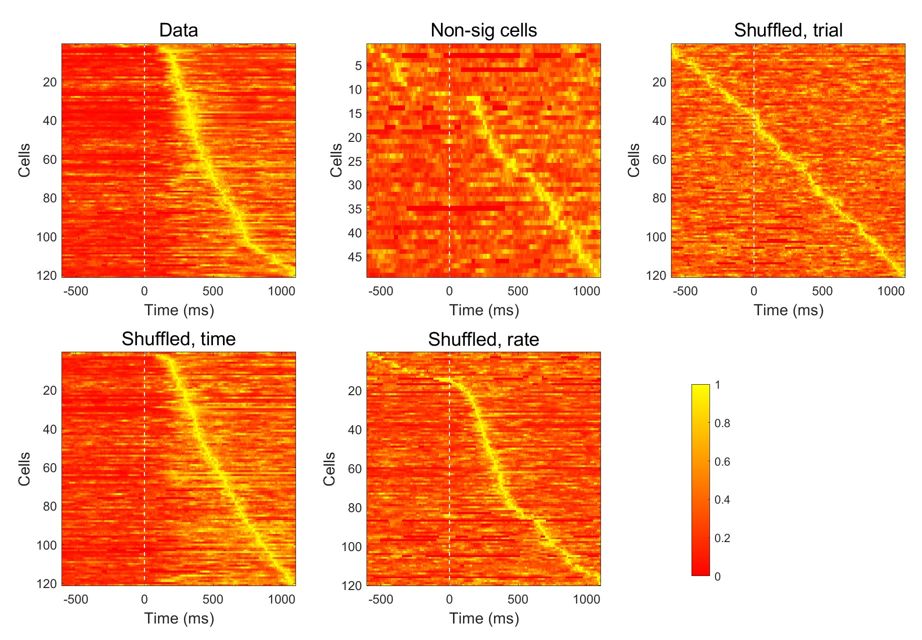

Slide 7
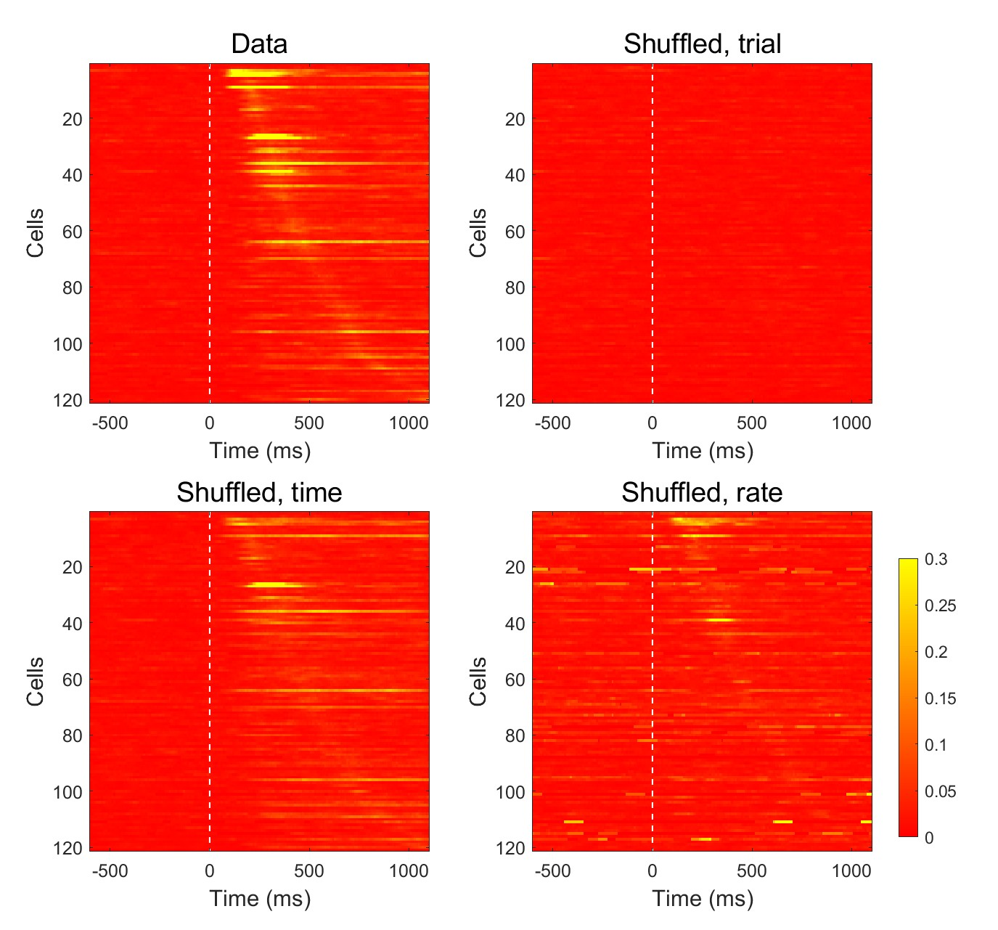

Slide 9
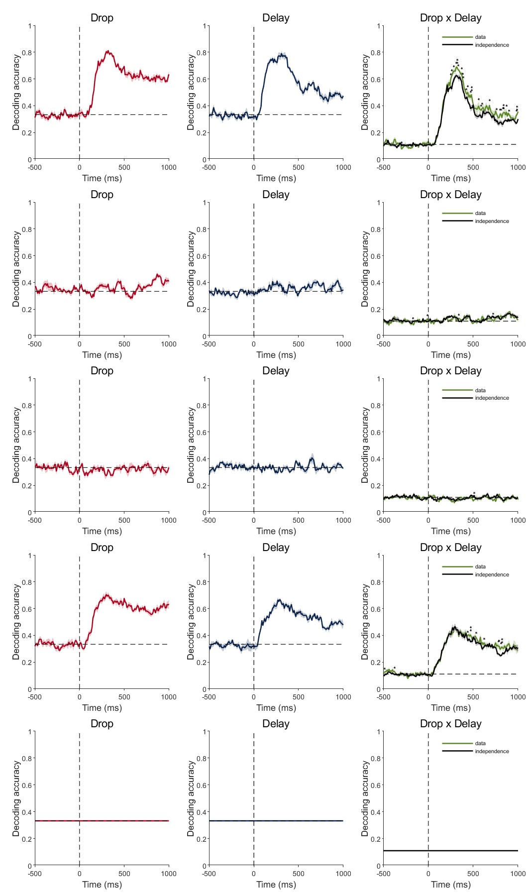
Notes:
Shuffle trial within condition…

